Slide 1
Introduction
CSE 473: Introduction to Artificial Intelligence
Megan Hazen (mh75@cs)
cs.uw.edu/473
acknowledgements
Welcome!
What are you excited about this quarter?

Slide 2

Overview
Introductions
What is Artificial Intelligence?
What is CSE 473?
Course Logistics
Week 1 Preview
Illustrations by Ketrina Yim

Slide 3

About Me
Megan Hazen
Associate Teaching Professor
Teaching: Intro to AI & data science classes; capstone and project courses
Computing interests: Search & machine learning; Data science; AI ethics and policy; 25 years experience in intelligent systems
Free time activities: biking; backpacking; Girl Scouts
Office hours: Friday 1:00-2:15 PM (CSE 462)

Slide 4
Teaching Assistants
Jack Curry
Krisha Khandelwal
Hannah Lee
William Ong
Entong Su
Rongwu Danny Xu
Yunchu Zhang
Get to know your TAs
Visit the staff page.
Visit office hours.
Chat on Ed.

Slide 5


Teaching Assistants
Rongwu Xu
Krish Jain

Slide 6
Getting to Know You
First, introduce yourself to your neighbor and talk about:
  Why you’re taking CSE 473
  Your experiences with and attitudes towards AI
Then, fill out the course welcome questions
  Handout with each lecture – there are no wrong answers

Slide 7
What is Artificial Intelligence?

Slide 8
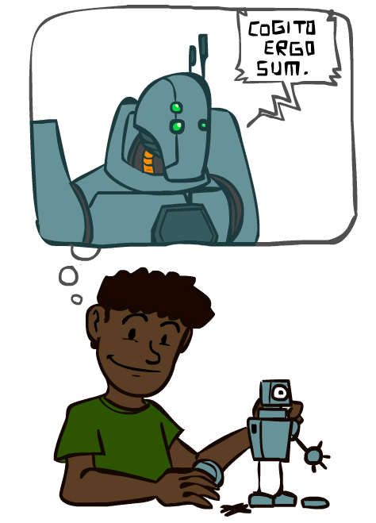
Conceptions of Intelligence
What does it mean for X to be intelligent?
  Philosophy (what constitutes knowledge?)
  Neuroscience, Biology (how do brains process information?)
  Economics (do intelligent agents act rationally?)
  Psychology, Sociology (how do agents learn and interact?)
  Linguistics (how do agents communicate?)
  Mathematics, Computer Science (how to represent information?)
So how should we define artificial intelligence?

Slide 9
Defining “Artificial Intelligence”
In relation to human intelligence:
  “how to make machines…solve kinds of problems now reserved for humans” (McCarthy et al. 1955)
  Machines that can “think humanly” and/or “act humanly” (Russell and Norvig)
  “AI tasks are often considered ‘intelligent’ because we can imagine humans doing them well; non-AI tasks are usually ones that (most) humans are terrible at.” (UW CSE)
A working definition:
A class of computer systems that demonstrate the ability to achieve specified objectives through independent action.

Slide 10
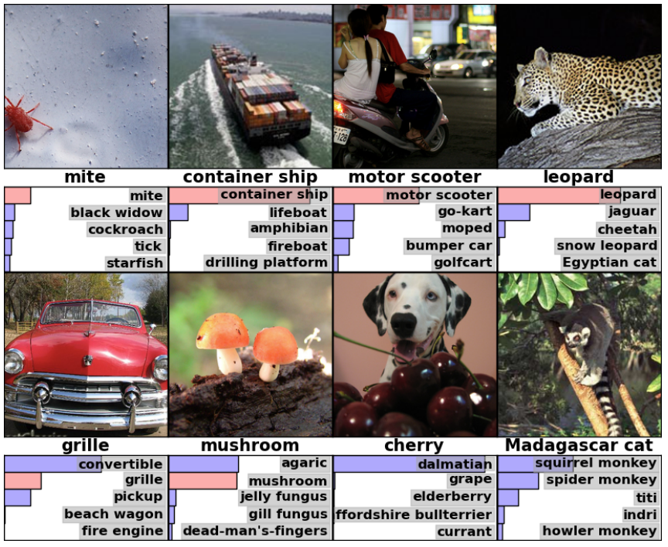
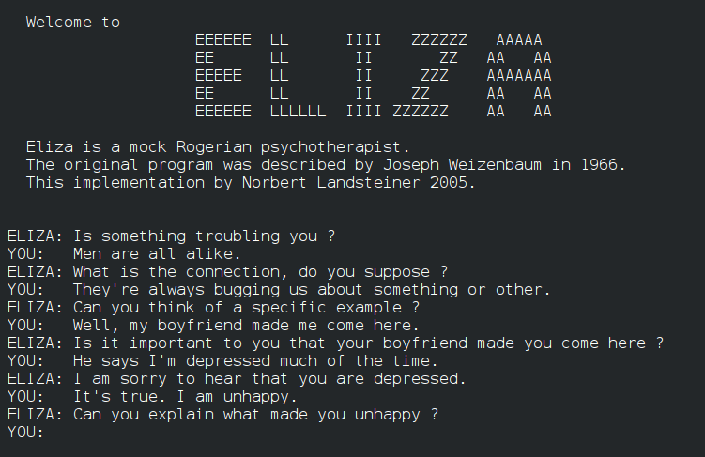
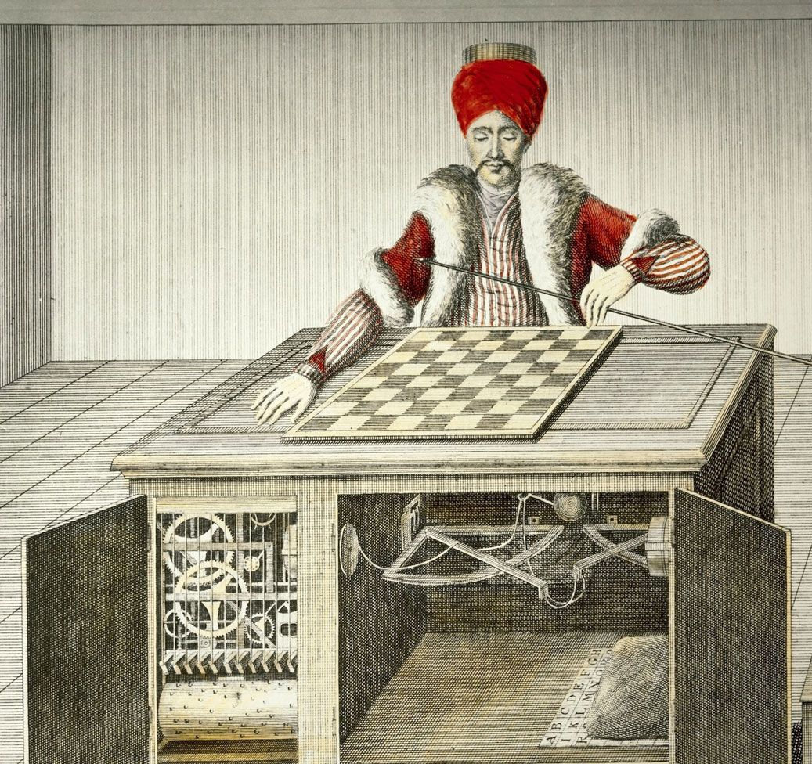
Artificial Intelligence?
AlexNet Image Classification (2012)
ELIZA Chatbot (1966)
“Mechanical Turk” Chess Player (1770)
Notes:
Here are some historical examples of systems – were they intelligent? AlexNet ‘knows’ things, Eliza can respond like a human, Mechanical Turk could play a game (but also was human intelligence).

Slide 11
1956: The Birth of “Artificial Intelligence”
“An attempt will be made to find how to make machines use language, form abstractions and concepts, solve kinds of problems now reserved for humans, and improve themselves.
We think that a significant advance can be made if we work on it together for a summer.”
McCarthy, Minksy, Rochester, and Shannon
Dartmouth Workshop Proposal (1955)
Notes:
1956: Concerted effort began towards artificial intelligence

Slide 12
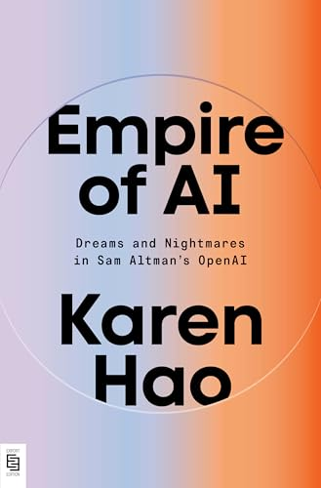
A Short History of Artificial Intelligence
1940s - 1950s: Beginnings
  1943: McCulloch and Pitts: Boolean circuit model of the brain (early neural networks)
  1950: Turing publishes “Computing Machinery and Intelligence” (Turing Test)
1956 - 1960s: Birth of “AI”, Early Days
  1950s: Early AI programs: chess, checkers, theorem proving
  1956: Dartmouth workshop on AI
1970s - 1980s: AI Winter, Knowledge-Based Approaches
  1960s: Research on perceptrons, machine translation plateaus
  1970s: Funding for AI research dries up, industry turns to knowledge-based systems
1990s - 2010s: Statistical Approaches
  1990s – : Focus on uncertainty, probabilistic approaches
2012 – Present: Big Data, Big Compute
  2010s: Research (e.g. “AlexNet”) shows GPUs can be used to make neural networks effective
  2017: Vaswani et al. publish “Attention Is All You Need” (transformer architecture)
  2022: OpenAI publishes ChatGPT
Recommended Reading:
Karen Hao, Empire of AI (Ch. 4)

Slide 13
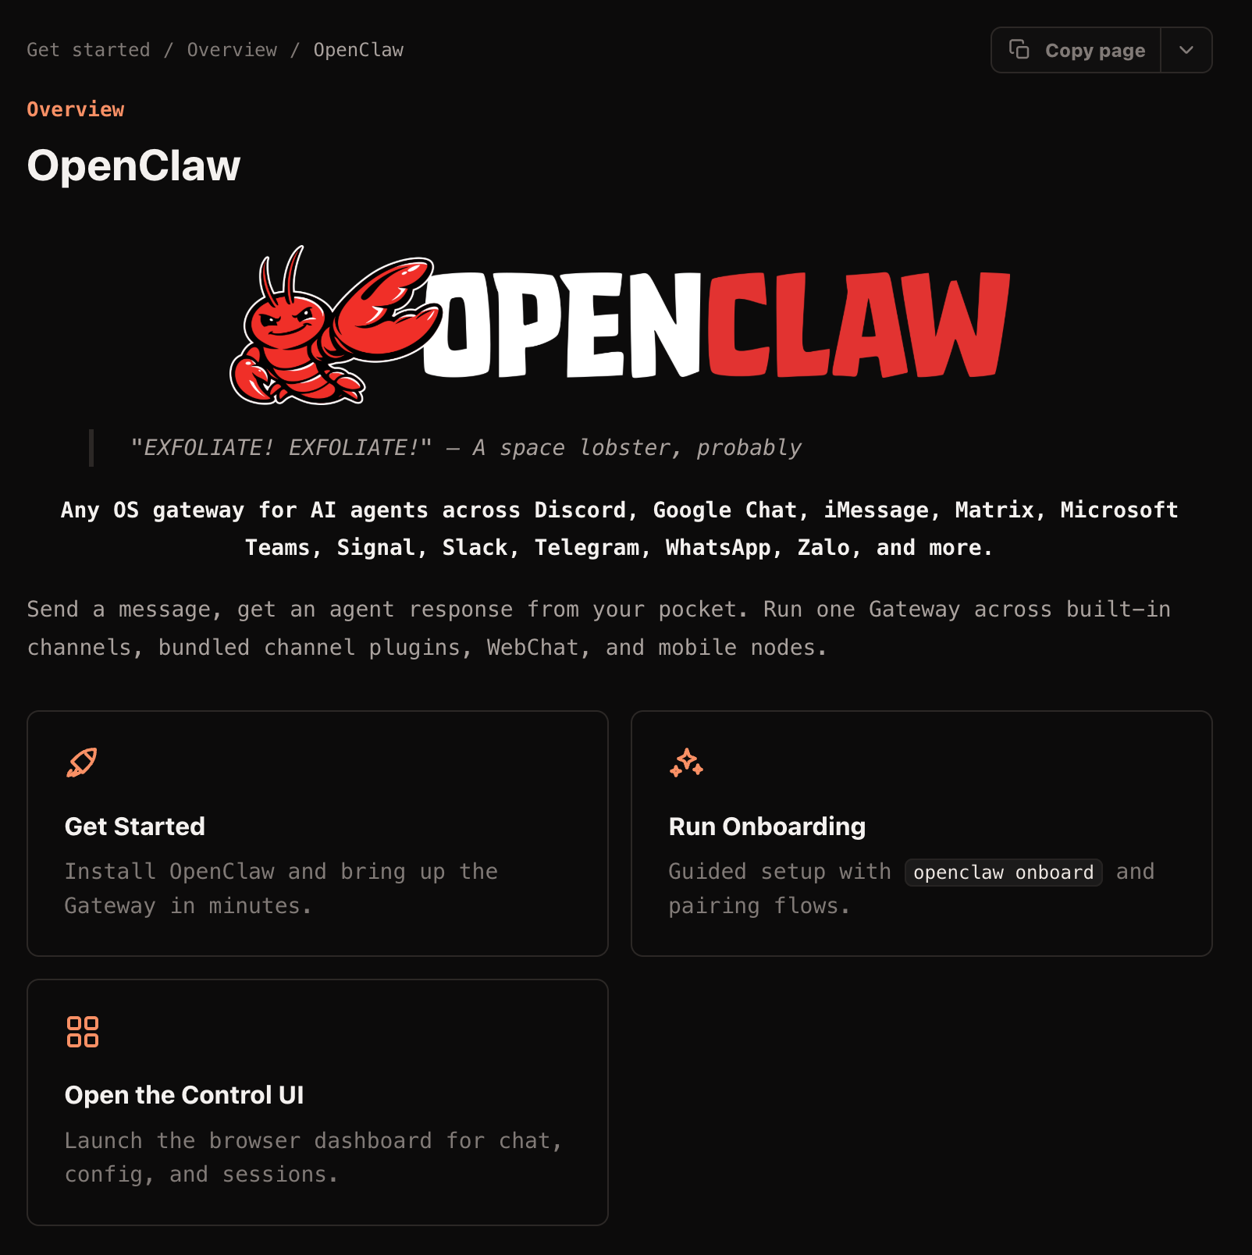
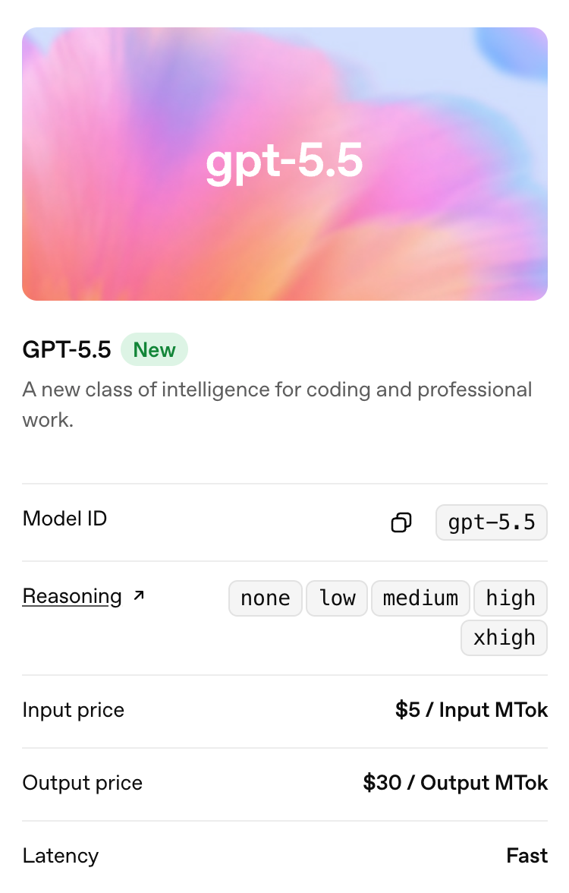
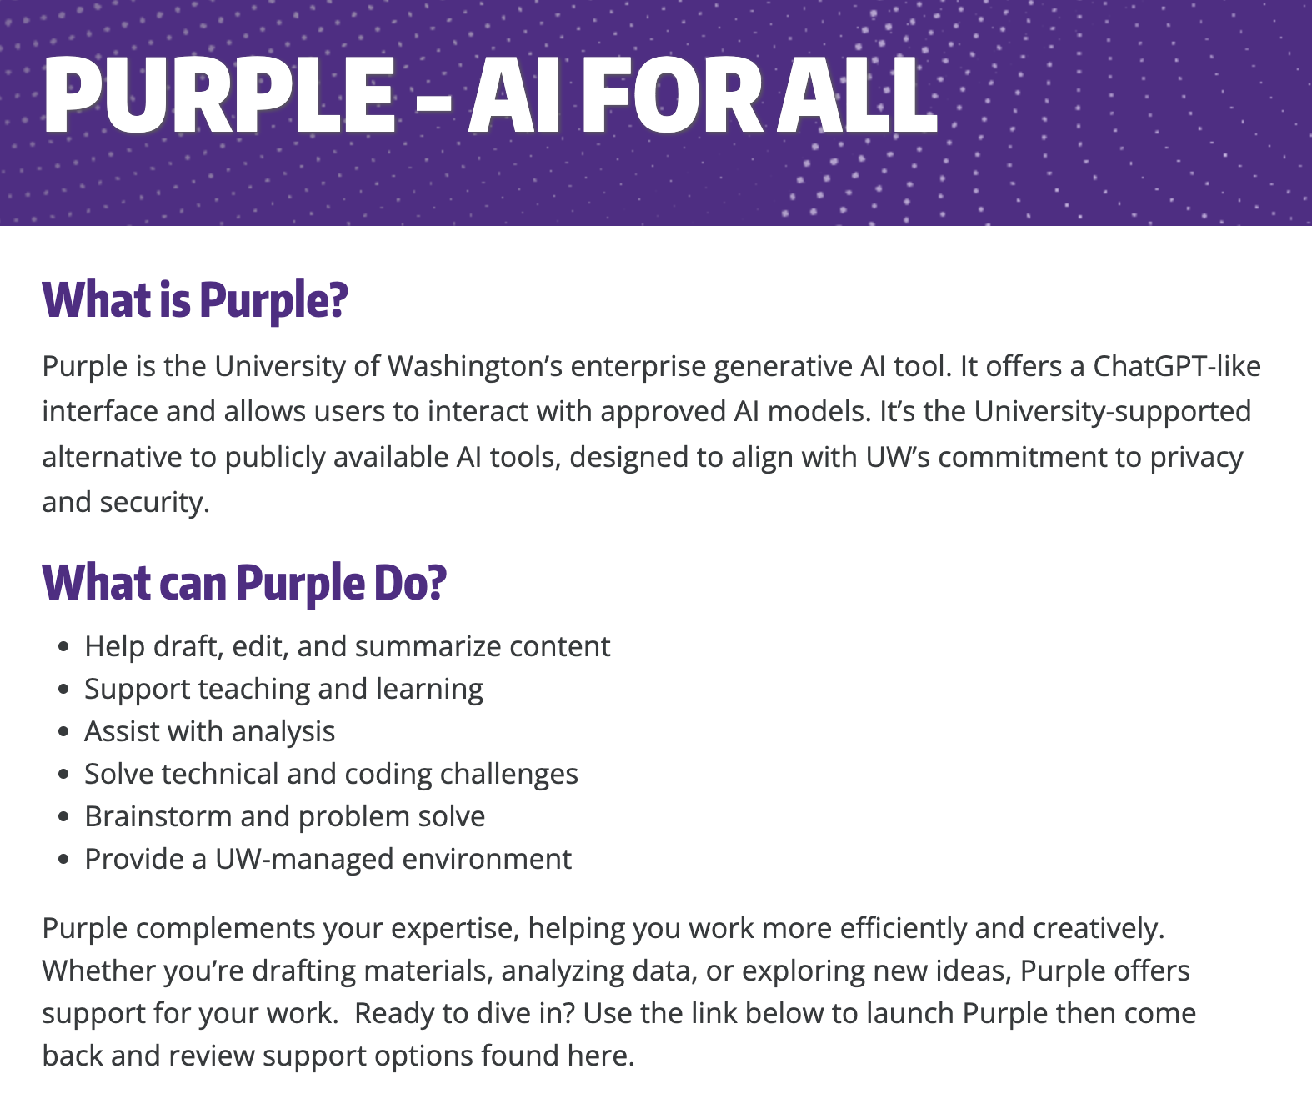
AI in 2026
OpenClaw (f.k.a. ClawdBot)
OpenAI GPT 5.5
UW Purple

Slide 14

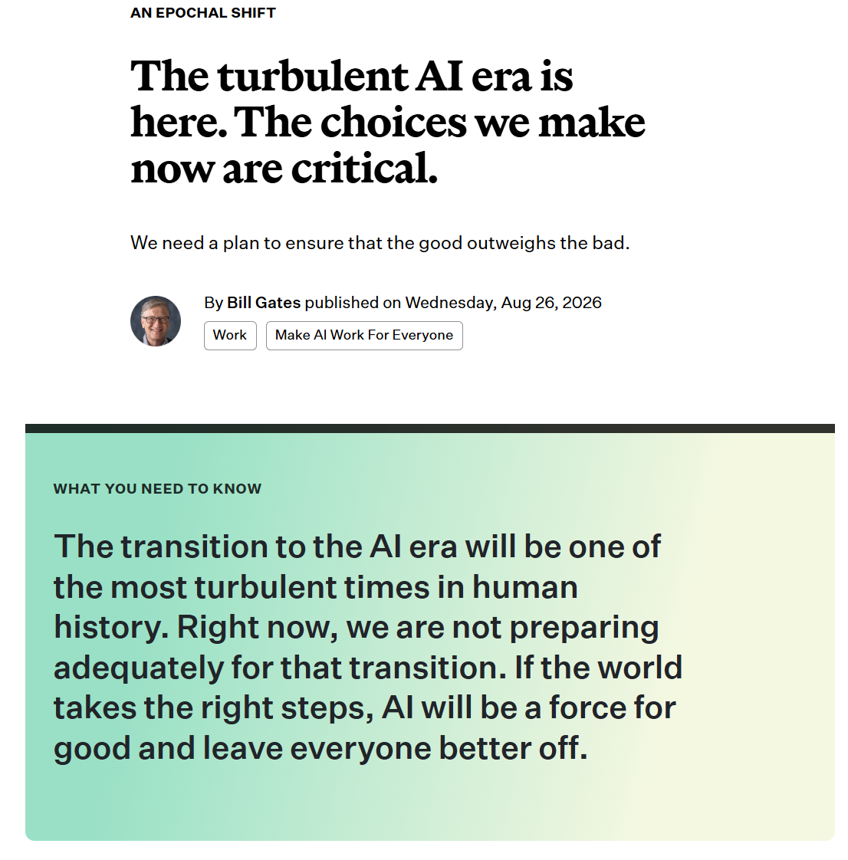
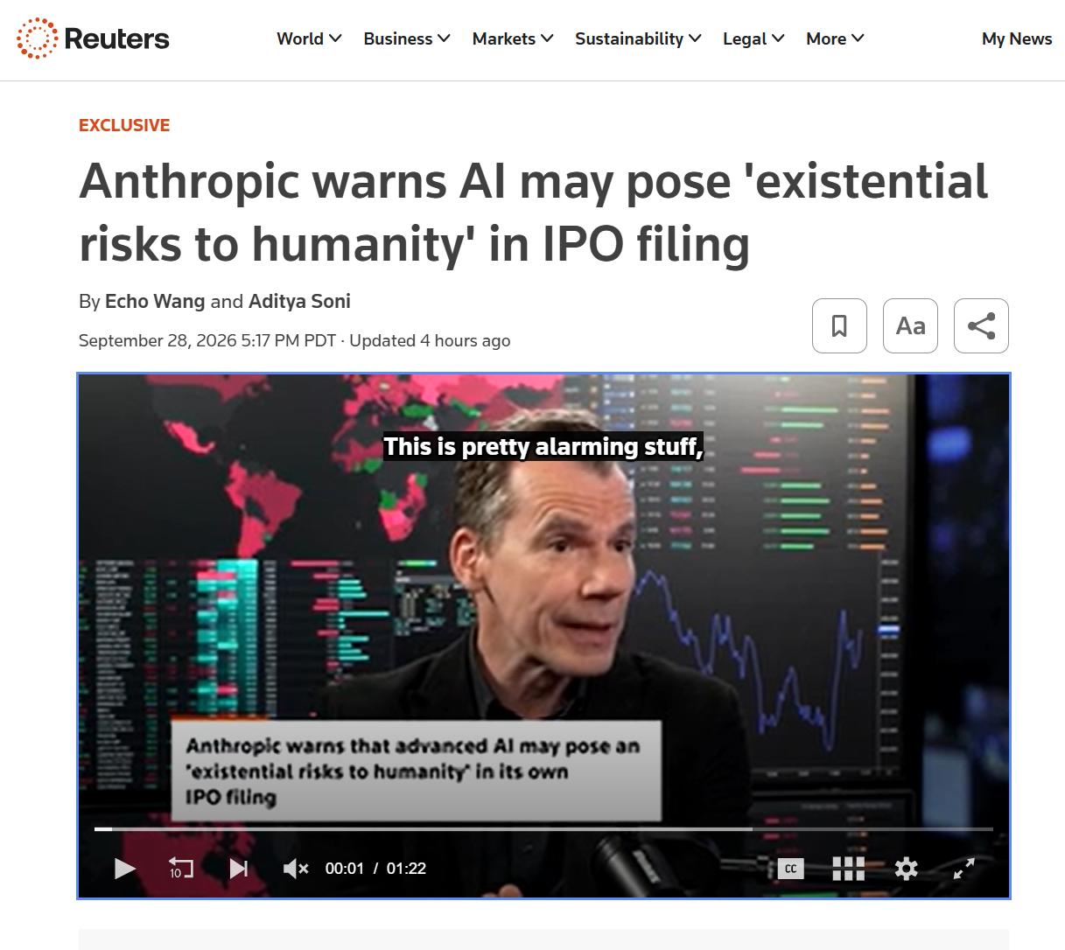
AI in 2026
Data Center Controversy (NYTimes)
Existential Threats (Reuters)
Jobs and societal impact

Slide 15
Questions (1)

Slide 16
CSE 473: Introduction to AI
Search
Reinforcement Learning
How to find an optimal solution?
How to learn from experience?
Modeling Uncertainty
Machine Learning
How to deal with uncertainty?
How to find patterns in data?
Notes:
Big areas in AI: Search – choose the state that best matches your goal (decision making), ML – learning something from data (knowledge), RL&Uncertainty (exploration and learning new things)

Slide 17
Why Take CSE 473?

Slide 18
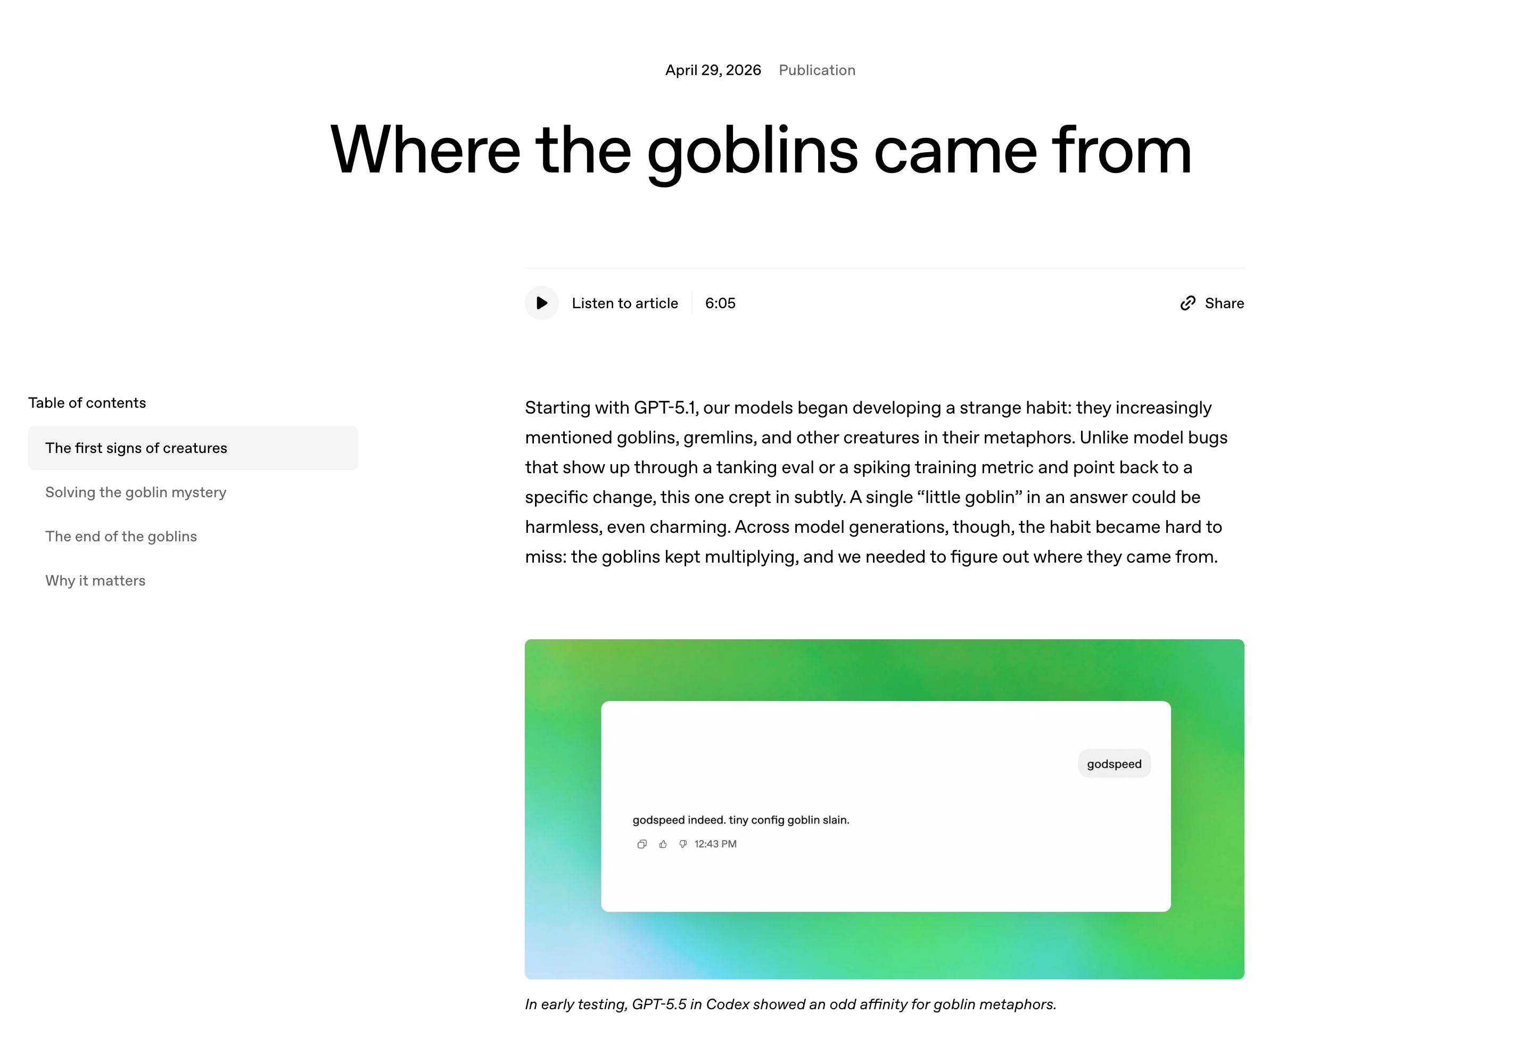
”Where the goblins come from” (OpenAI)

Slide 19
Questions (2)

Slide 20
Course Components
Lectures
Homeworks
Introduce concepts
Establish context
Provide examples
Check your understanding with practice problems
Assess your understanding of key concepts
Hosted on Gradescope
Due approximately two weeks after release
Projects
Assesments
Apply your knowledge
Specifications on course website, submissions through Gradescope
Mostly autograded
Assess your ability to apply fundamentals to new problems
Assessment 1: Friday, Oct 23
Test 2: Friday, Nov 13
Assessment 3: Tuesday, Dec 15

Slide 21
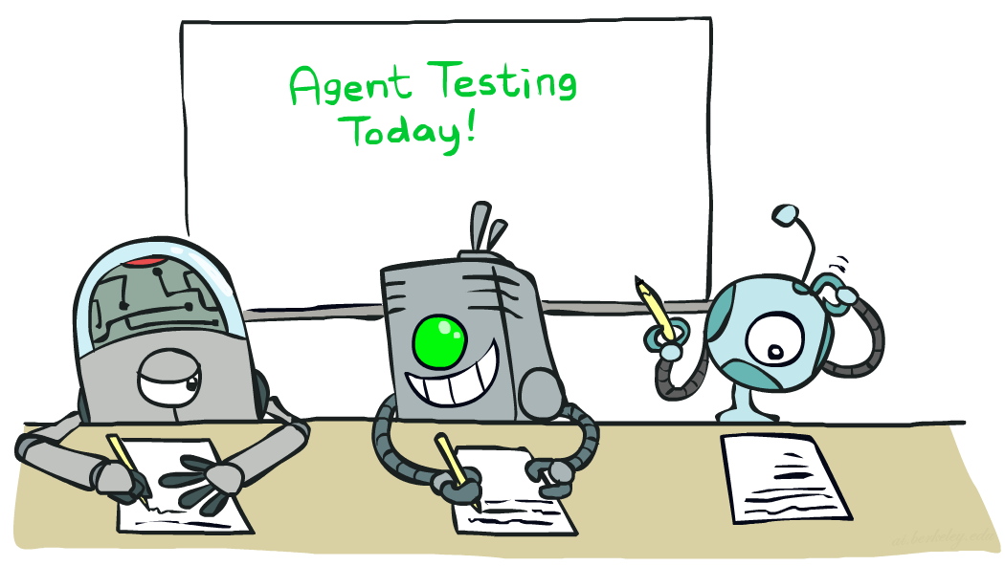
Course Policies
Read the syllabus! (cs.uw.edu/473/syllabus)
Course Infrastructure
  cs.uw.edu/473 for course information
  EdStem for communications and Q&A
  Gradescope for assignments
  Panopto (Canvas) for lecture recordings
Textbook
  Artificial Intelligence: A Modern Approach
Late Work
  Homeworks and projects may be submitted up to 2 days late without penalty
  Late penalty of 20% for each additional day
Grading
  ~35%: Homework Assignments
  ~30%: Projects (x4)
  ~35%: Assessments
  Up to 10%: Practice problems

Slide 22

Collaboration and AI Use
The goal of this course is to cultivate and assess your ability
to understand and apply core concepts in AI.
Collaboration
  Encouraged towards understanding course concepts
  All assignments must be completed individually — all work must be your own
  Sharing or accessing solutions (including code) is prohibited
AI Use
  Allen School policy AI as a Reference Tool
    AI may be used for research, explanations, and learning
    But AI may not be used to generate answers or code
* Any student work found by CSSC to be in violation of course policies will receive a score of 0 (0.0 for the course for repeated violations)
* All tools and sources for projects must be cited and accompanied by a short AI usage reflection.

Slide 23
Support and Accommodations
Every enrolled student deserves to have a great experience with this course.
Disability Accommodations
  Established via Disability Resources for Students (DRS)
  Email Megan (mh75@cs) to discuss accommodations
Religious Accommodations
  Requested within the first two weeks using the Religious Accommodations Request Form
General Support
  Having questions or getting stuck is expected! Use OH, Ed, and your peers as a first stop
  If you have extenuating circumstances, make a private Ed post or email Megan (mh75@cs)

Slide 24
Question (3)

Slide 25
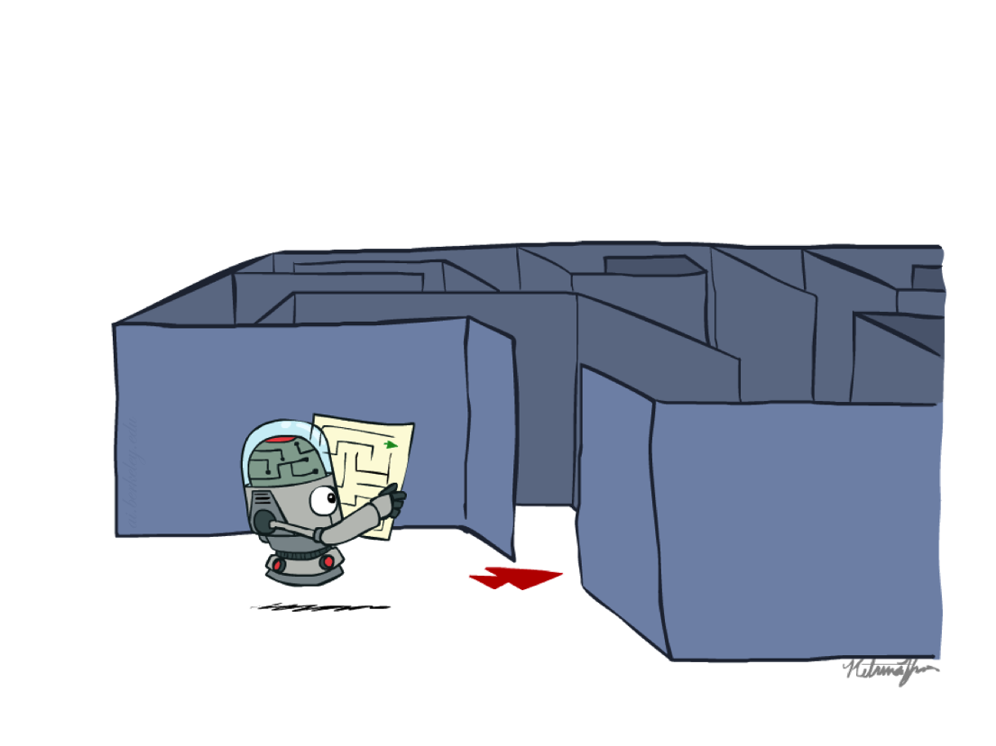
Preview: Search
How to find an optimal solution…
…efficiently?
…with imperfect information?

Slide 26
that’s it for today!
What is AI?
Why Take CSE 473?
Course Logistics
Agents and Environments
Search Problems
Search Algorithms
Fill out welcome survey!
Check Ed, Gradescope access
Project 0 (optional) released

