Slide 1
Radiomic and genomic approaches to survival stratification in adult-type diffuse glioma
Nicholas Nuechterlein
The University of Washington
Paul G. Allen School of Computer Science & Engineering
Notes:
:]

Slide 2
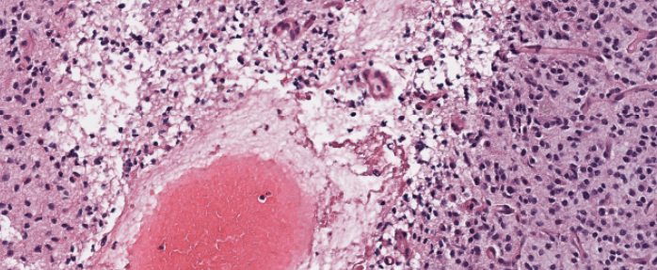
Adult-type diffuse glioma
Most common primary adult malignant brain tumor
Generally regarded as incurable
Survival ranges from 12-15 months (glioblastoma) to nearly 10 years (oligodendroglioma)
Notes:
So, what is adult-type diffuse glioma?
Adult-type diffuse glioma is the most common primary adult malignant brain tumor
It’s genrally regarded as incurable
And, based the type of adult-type diffuse glioma, survival ranges from 12-15 months for glioblastoma and around a decade for oligodendroglioma.

Slide 3
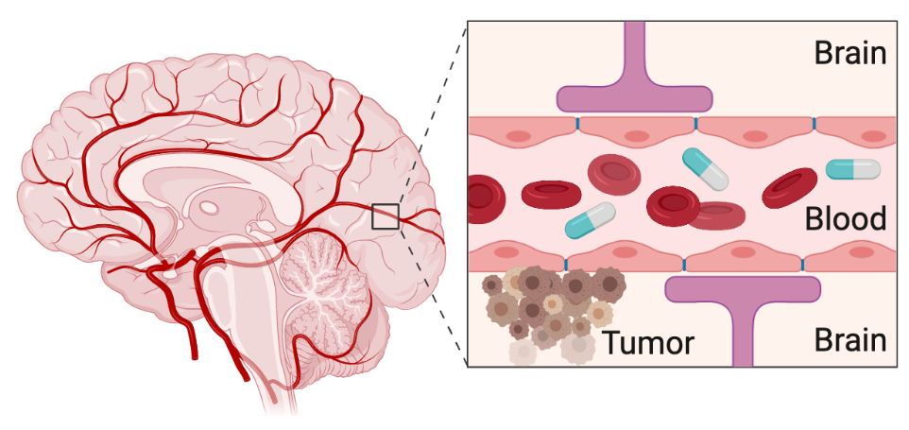
What makes adult-type diffuse glioma so difficult to treat?
Tumor molecular heterogeneity
Drug delivery
Clinical trial failure
Blood
brain
barrier
Even “effective” treatments do not work on all cells
Treatment resistant cells drive tumor recurrences
Drugs are ineffective if they cannot reach tumor cells
Unknown biomarkers can lead to:
Phase 2 success for ineffective therapies
Phase 3 failure for beneficial therapies
Notes:
**
Good intro, clear, but cut some here.
What makes adult-type diffuse glioma so lethal? So difficult to treat?
We are can bin these into three abstract catagories. The first is “tumor molecular heterogenatiy.” In this cartoon, we show the tumor
Read #3. Really two cases here.

Slide 4
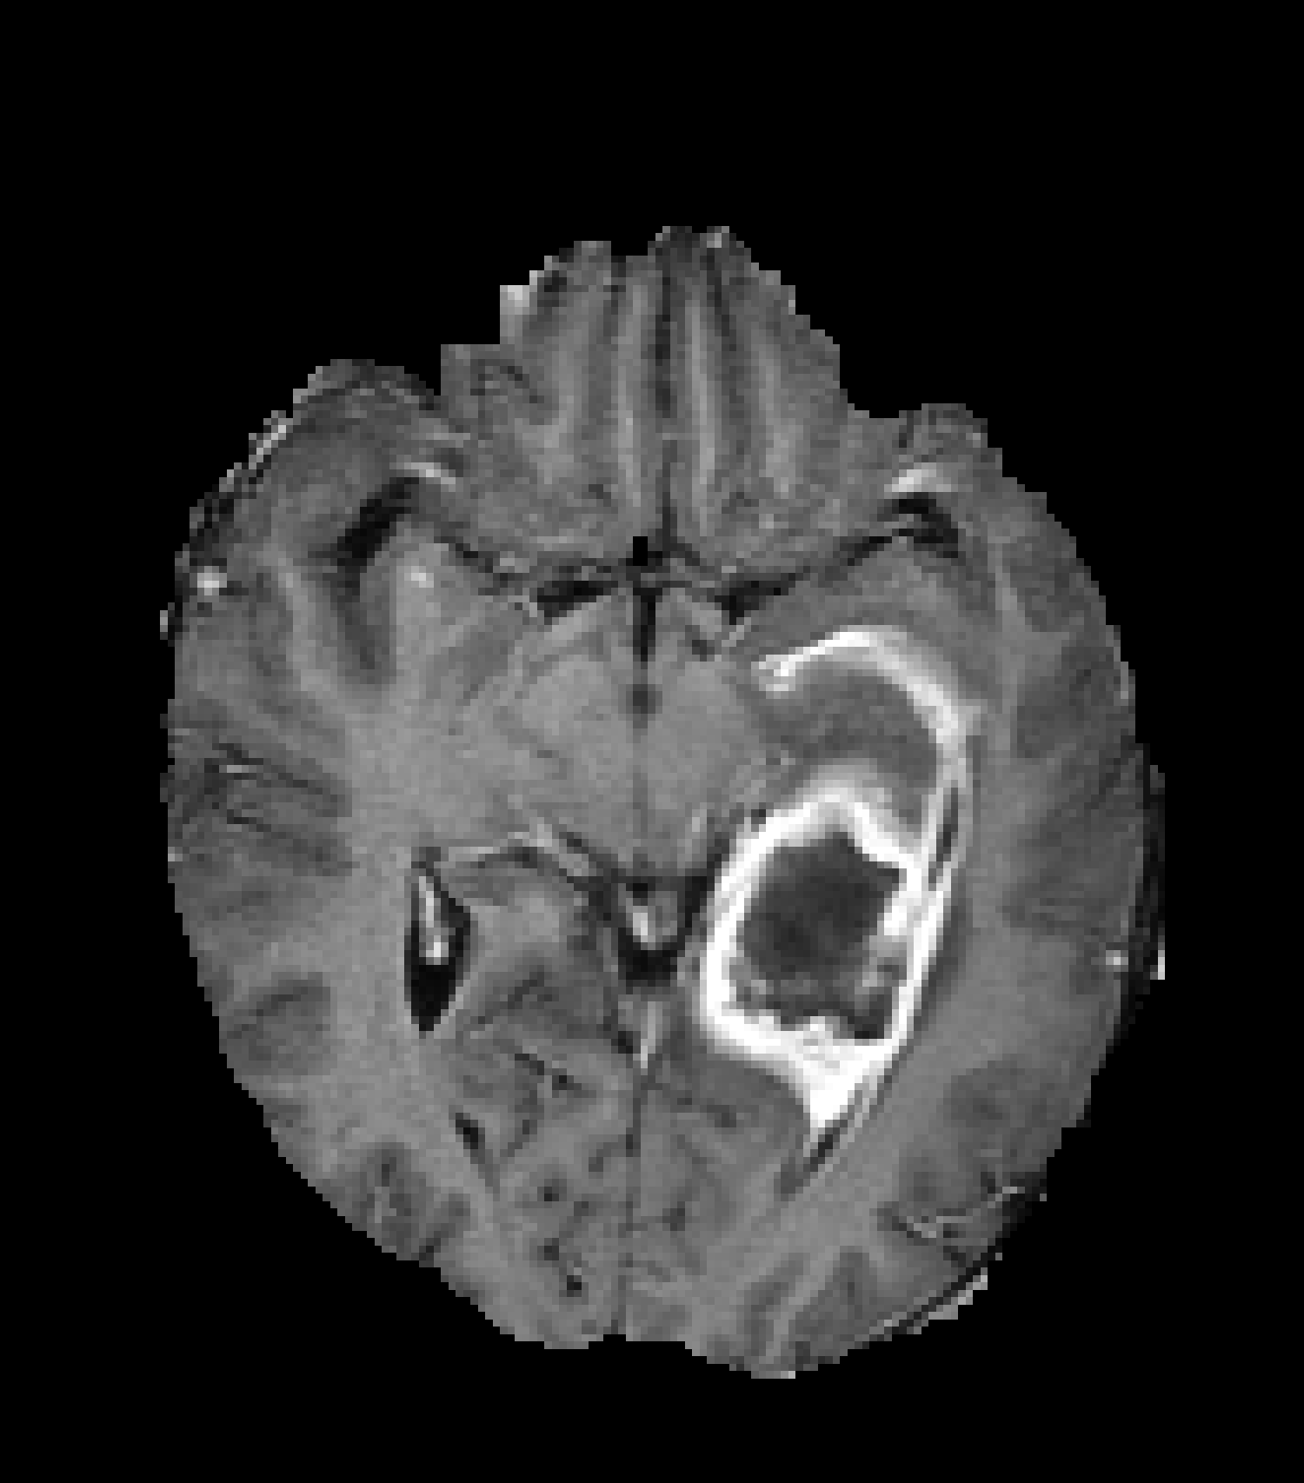
Survival stratification helps balance clinical trials
Notes:
** too much empty space here. Figures of biomarkers

Slide 5
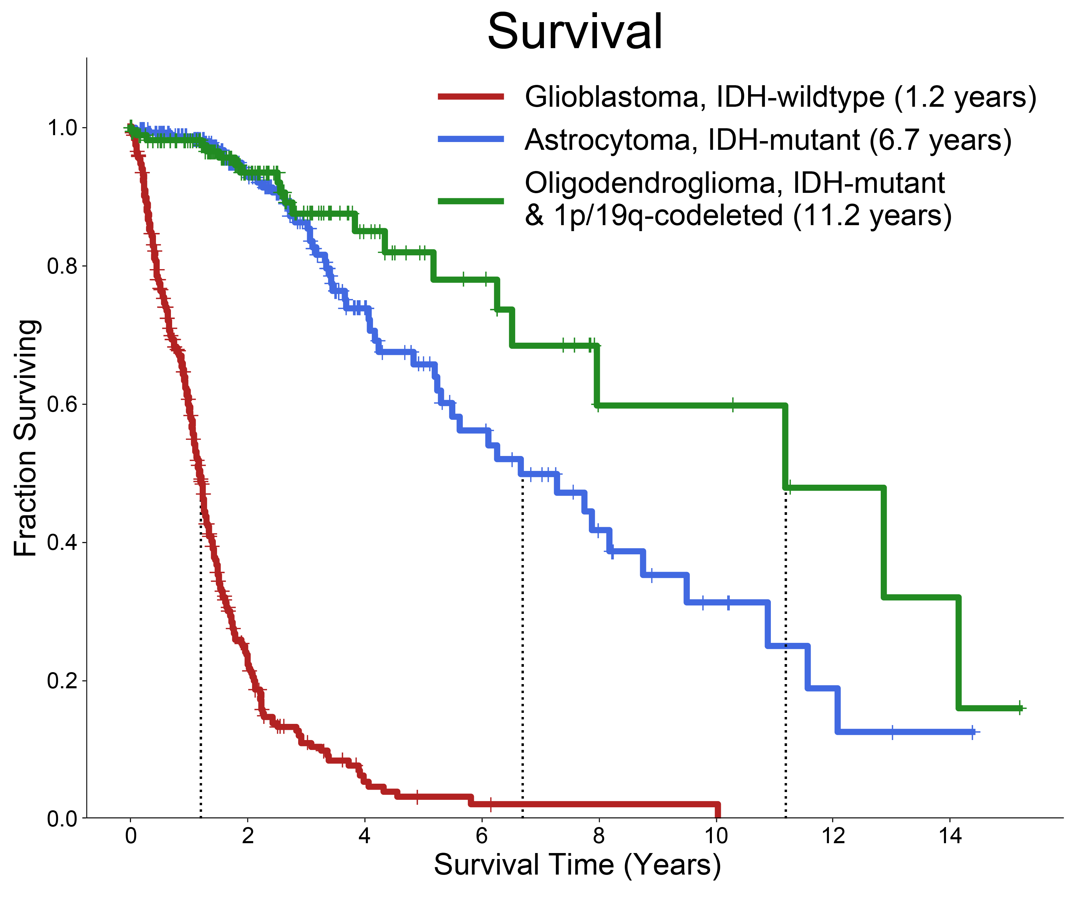
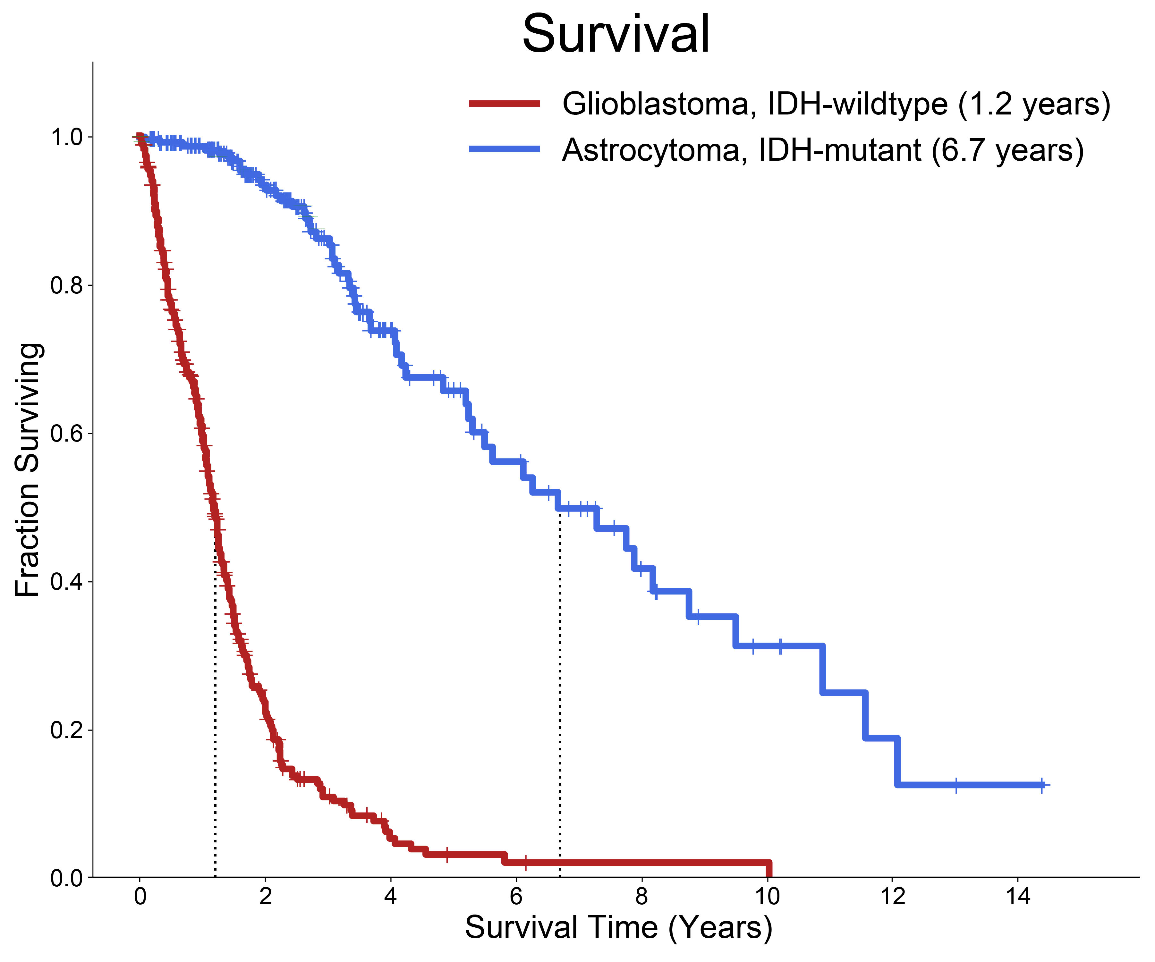
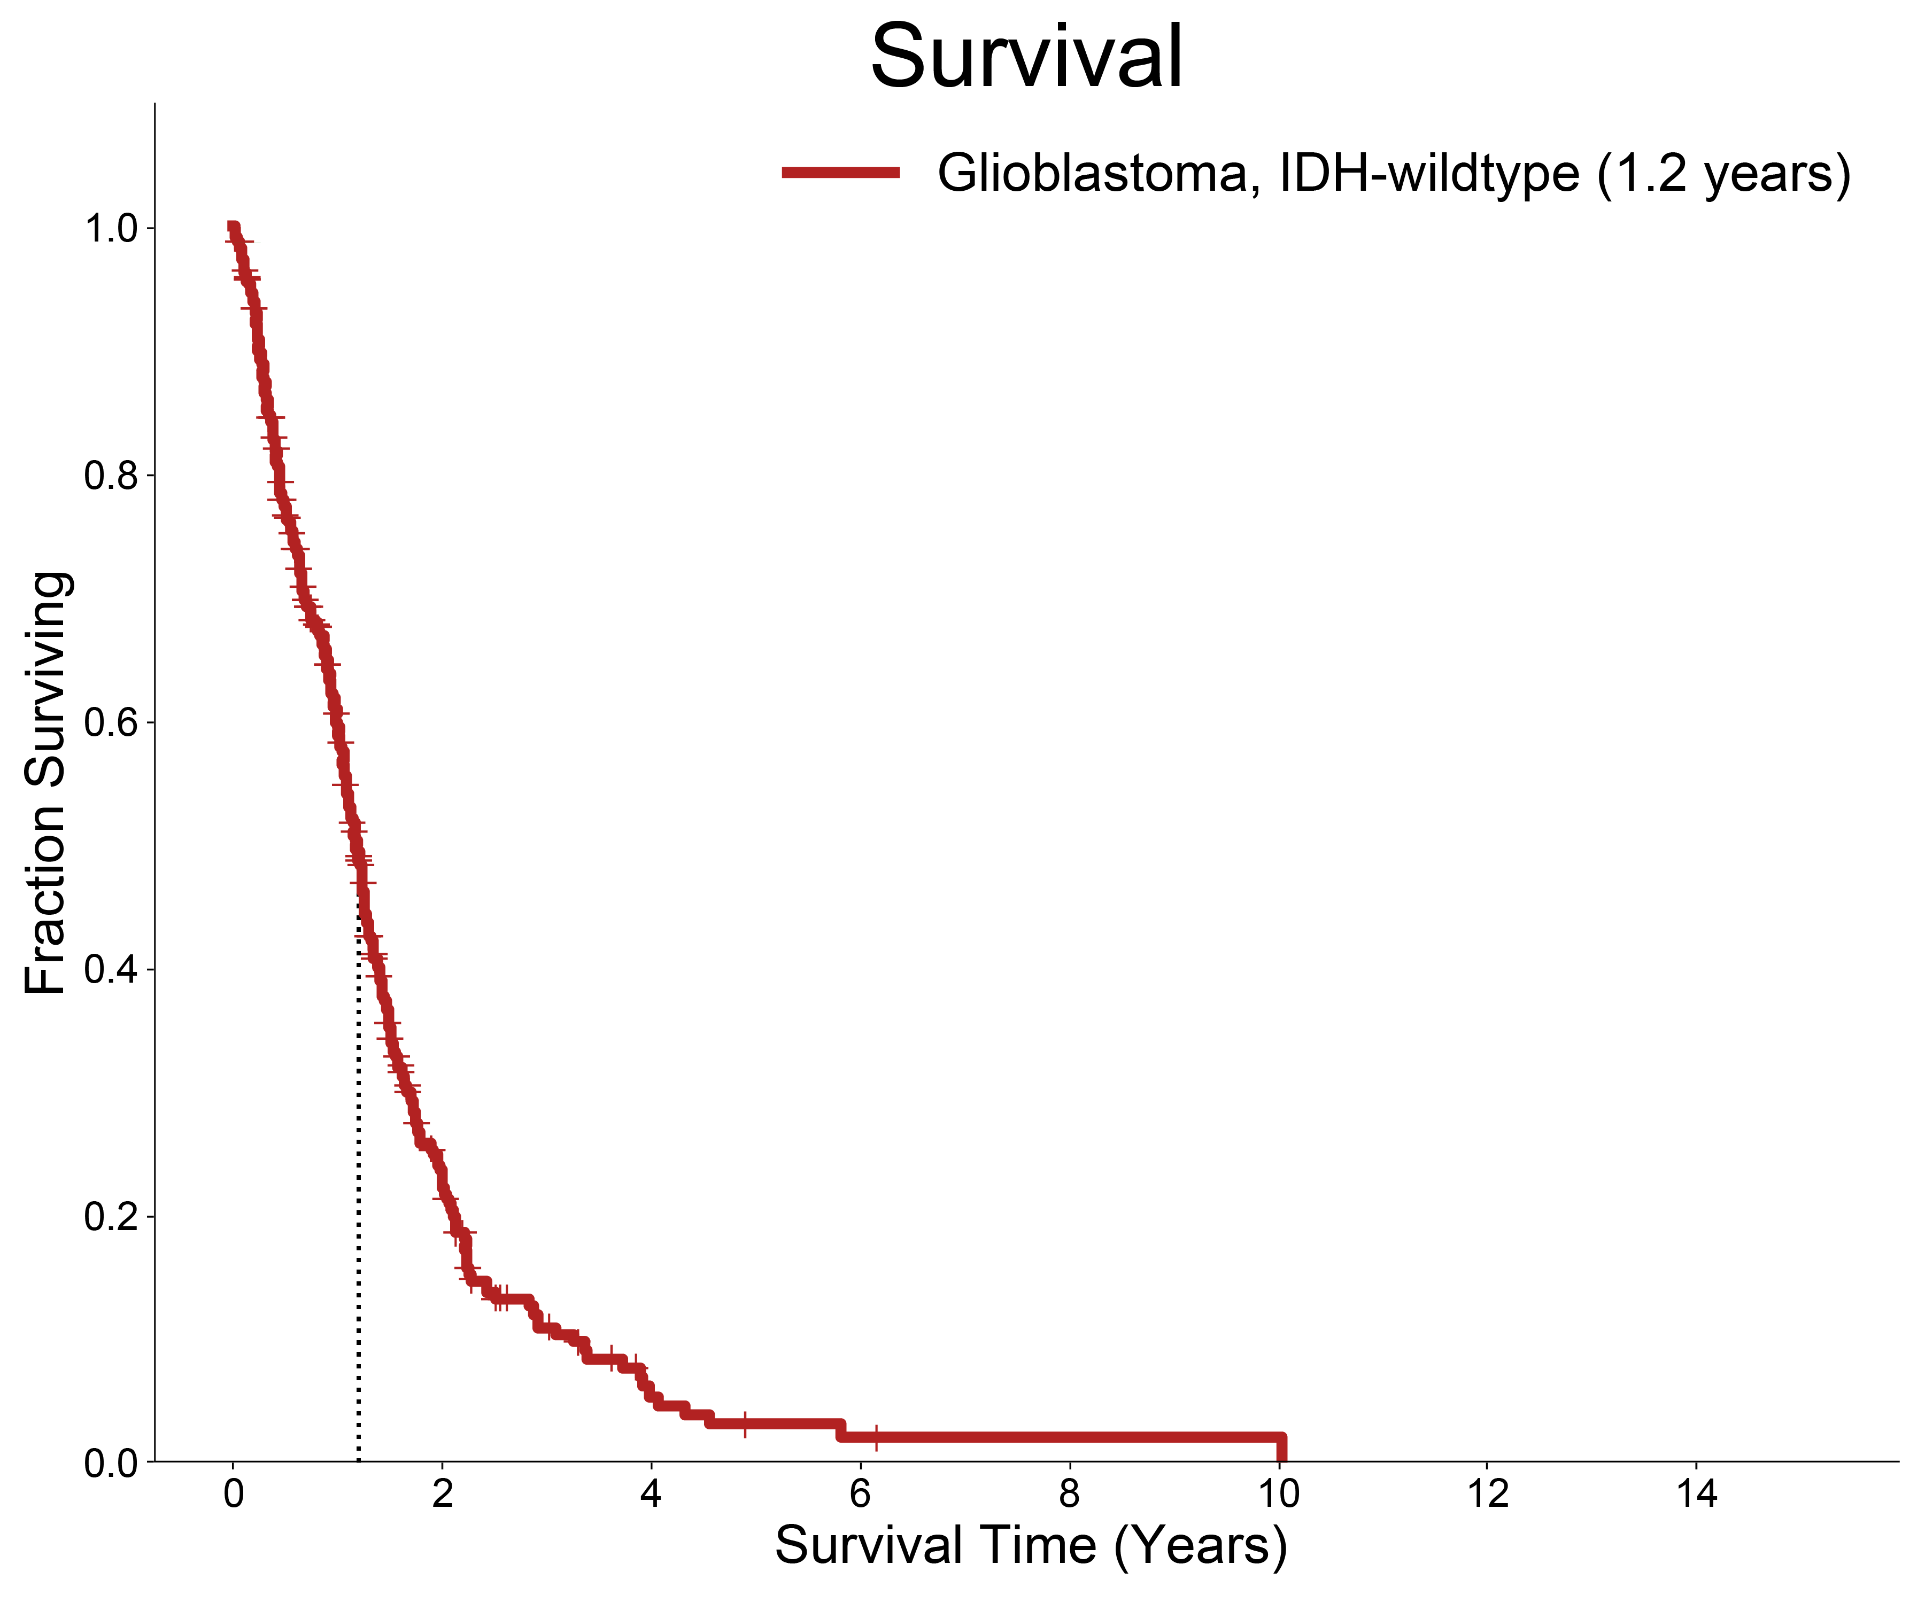
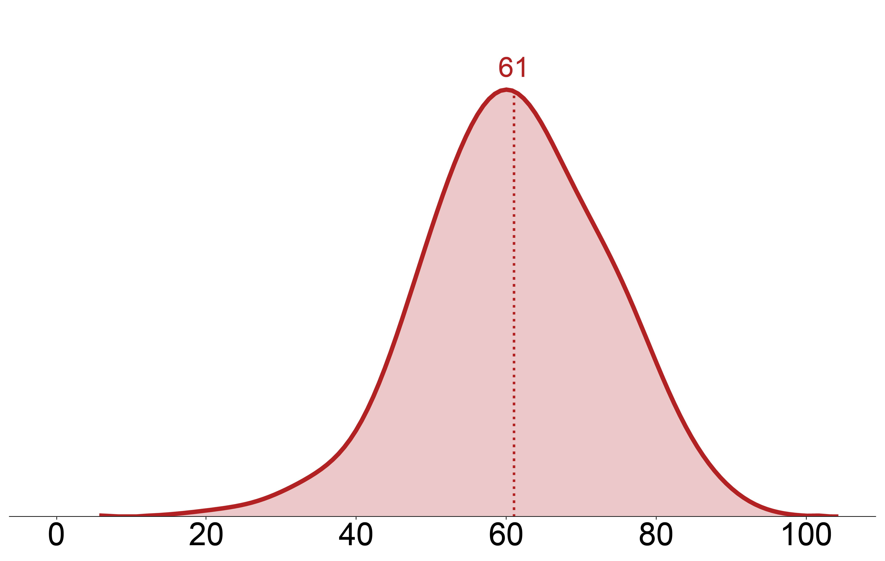
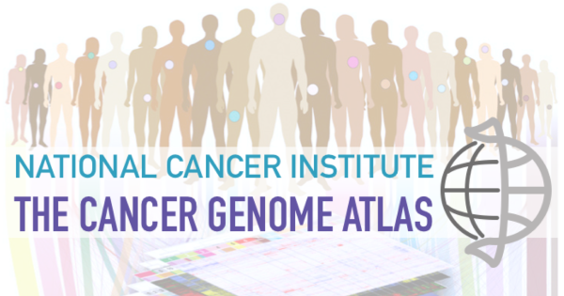
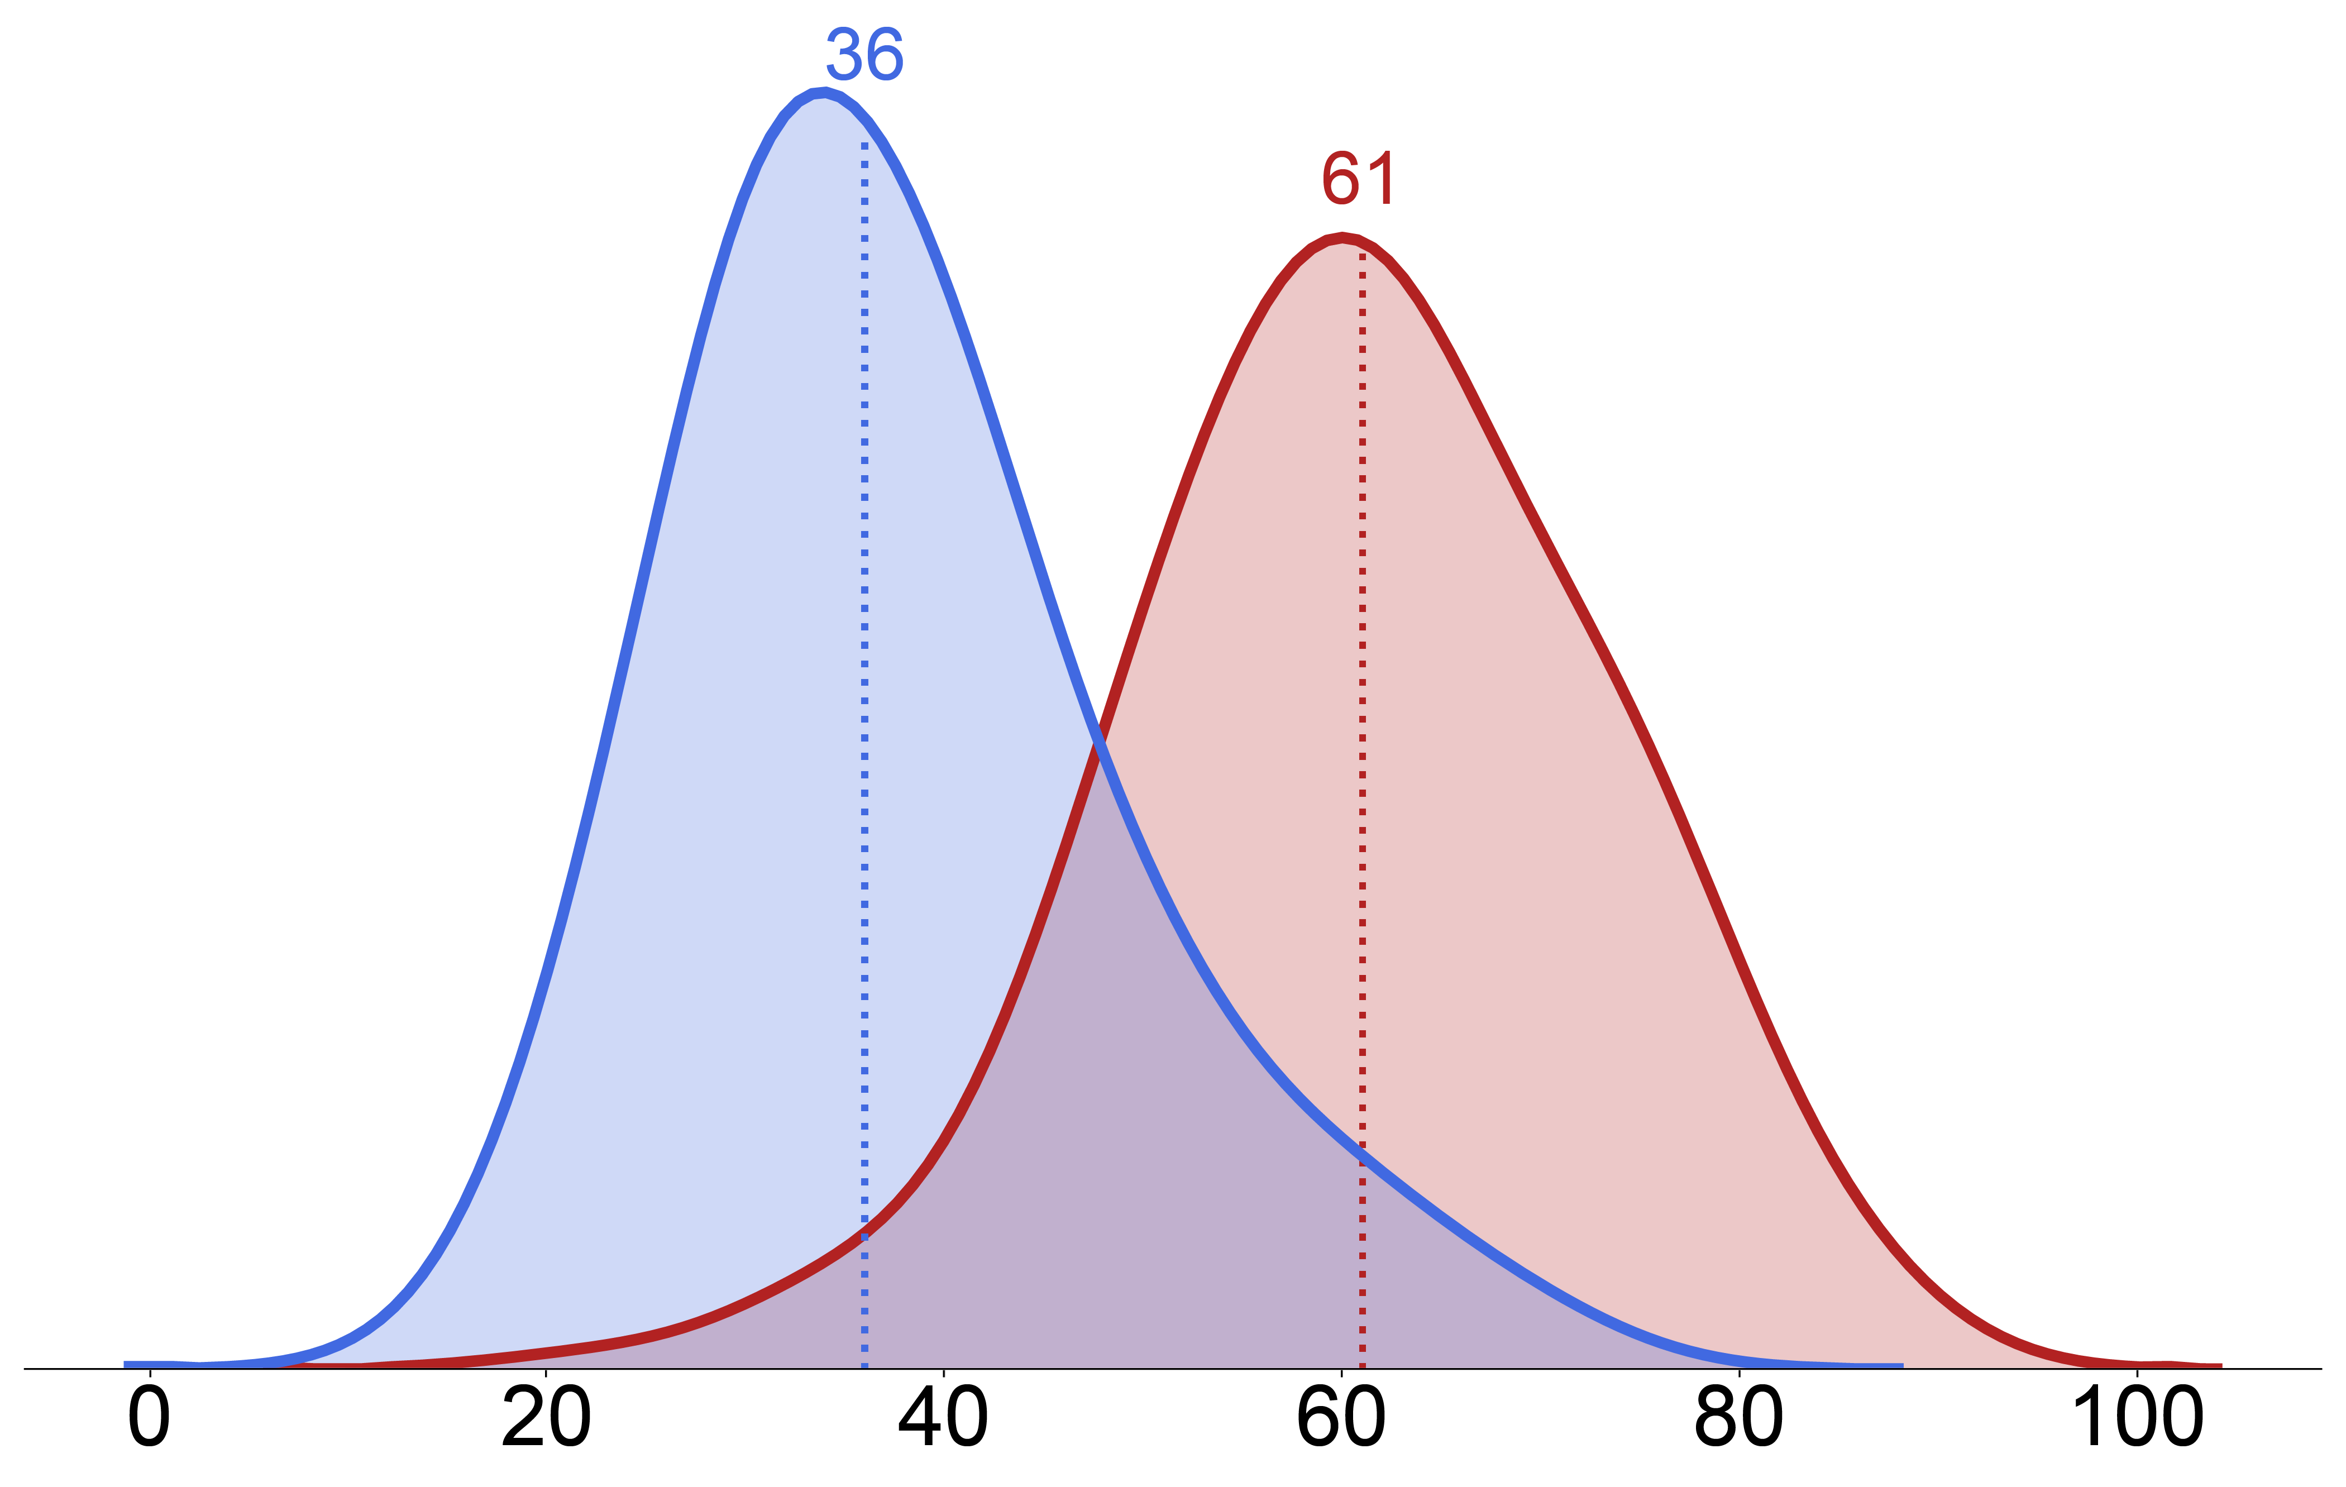
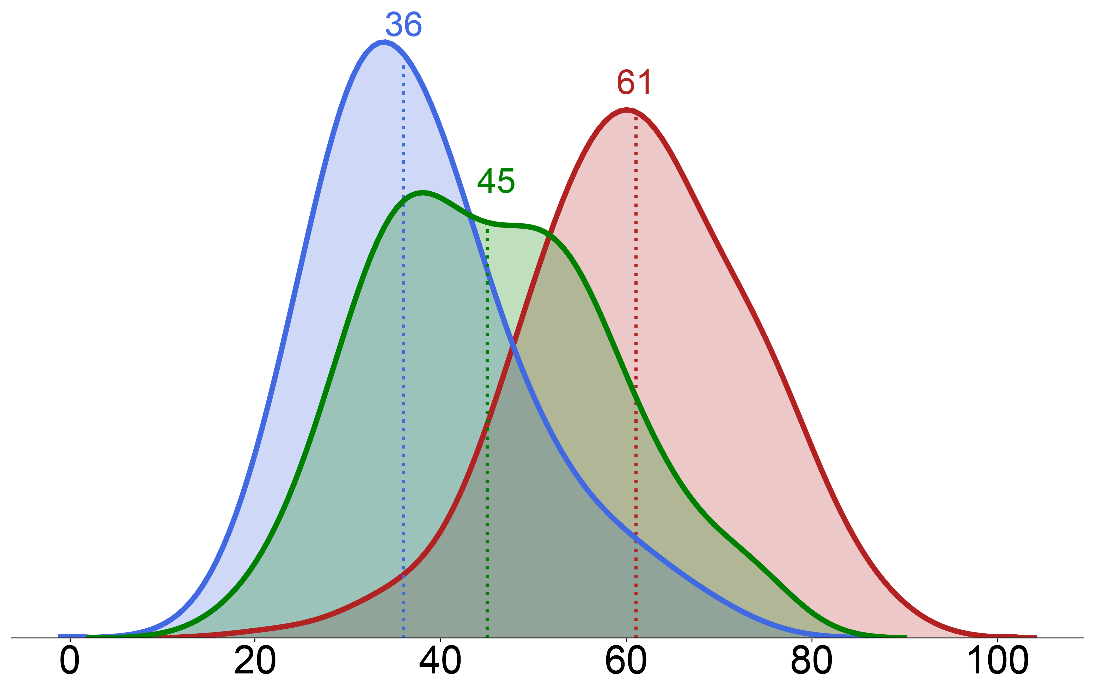
Types of adult-type diffuse glioma
Adult-Type Diffuse Glioma
IDH-mutation
Yes
No
Glioblastoma,
IDH-wildtype
p-arm
Oligodendroglioma,
IDH-mutant &
1p/19q-codeleted
1p/19q-codeletion
Glioblastoma,
IDH-wildtype
q-arm
Astrocytoma,
IDH-mutant
Chrom 1
Chrom 19
Yes
No
Oligodendroglioma,
IDH-mutant &
1p/19q-codeleted
Astrocytoma,
IDH-mutant
Age
Notes:
** explain what IDH is a little. Just a gene.

Slide 6
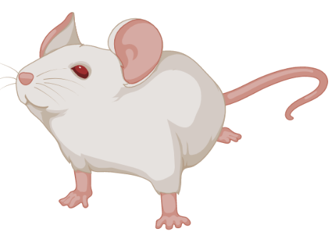
PhD trajectory
Glioblastoma, IDH-Wildtype
Astrocytoma, IDH-Mutant
Oligodendroglioma,
IDH-Mutant & 1p/19q-codel
Nuechterlein et al., MICCAI Workshop,
2018
Tumor segmentation tool
Classify tumors by type (IDH, 1p/19q)
From imaging data
From old genomic data
Find high-risk IDH-wildtype glioblastoma patients
From imaging data
From genomic data
(PDE10A)
Find low-risker patients in IDH-mutant tumors
Find gene (HOXD12) in
oligodendroglioma
Extend findings to all
IDH-mutant tumors
Imaging (MRI)
Nuechterlein et al., ICPR, 2021
Nuechterlein et al., AANP, 2021
Nuechterlein et al., Acta Neuro Com, 2021
Nuechterlein et al., SNO, 2020
Nuechterlein et al., Neuro-Onc Adv, 2021
Nuechterlein et al., In Preparation
Genomic
Nuechterlein et al., SNO, 2022
Nuechterlein et al., In Preparation
Postdoc work
Notes:
16
get rid of animation

Slide 7
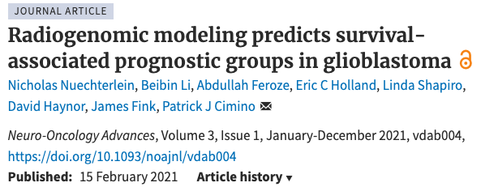
Radiogenomic modeling predicts survival-associated prognostic groups in glioblastoma
Project 1,
GBM MRI
Project 2,
SCNA -> IDH
Project 3,
Oligo HOXD12
Future work,
IDH-mut HOX
Neuro-oncology advances, 2021

Slide 8
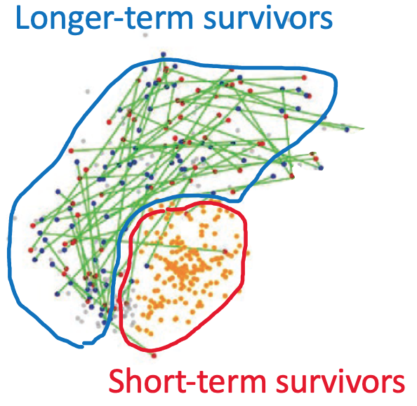
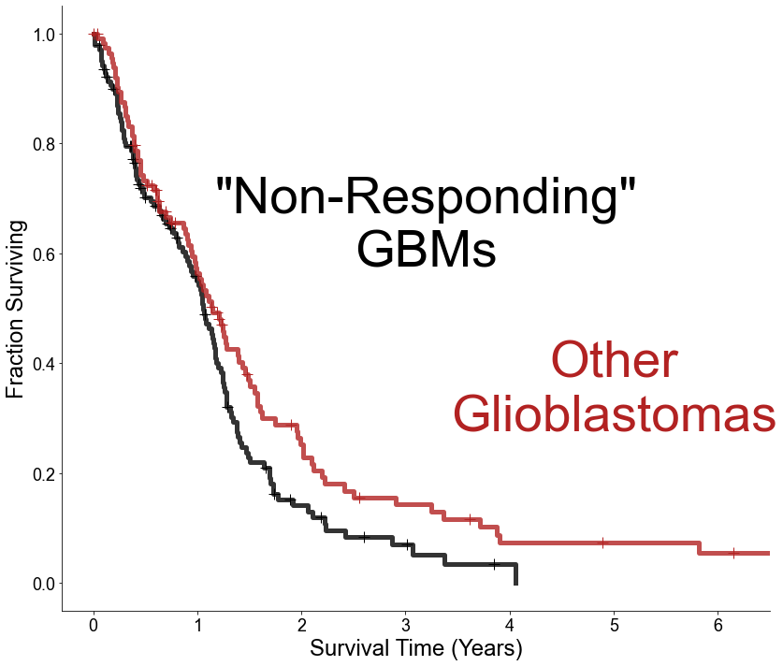
Problem motivation
Background
Motivation
Question
Approach
Binary classification $≈$
short-term survivors vs.
long-term survivors
Acquisition of MRI data is non-invasive and routinely collected
Is MRI data predictive of
GBM prognostic copy number signatures?
Radiomic analysis
Segment tumor
Patients with second resections survive longer
Patients with second resections are associated with a copy number signature
Extract
radiomic features
Feature selection
Upfront clinical trials are needed for highest-risk patients
Predict survival class
Cimino, et al. Neuro-oncology (2018)
Notes:
** clear, good.

Slide 9
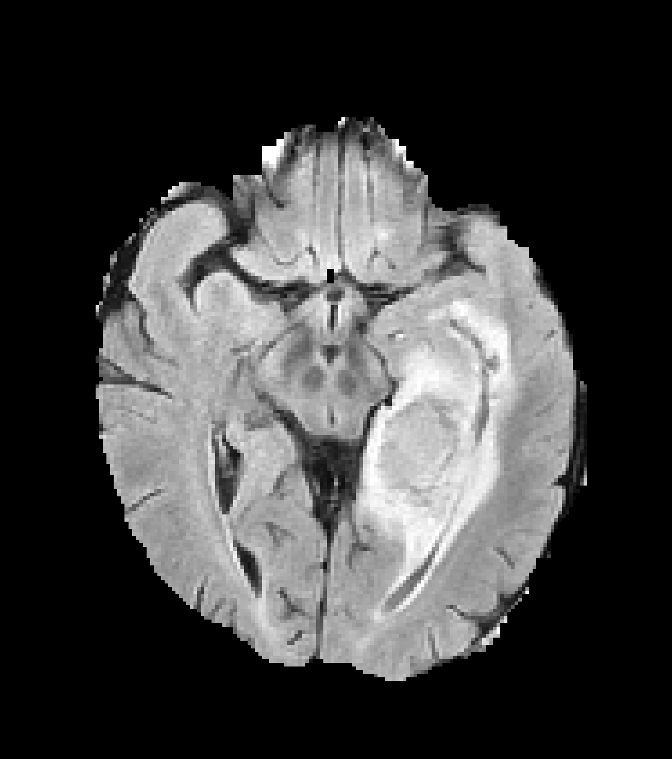
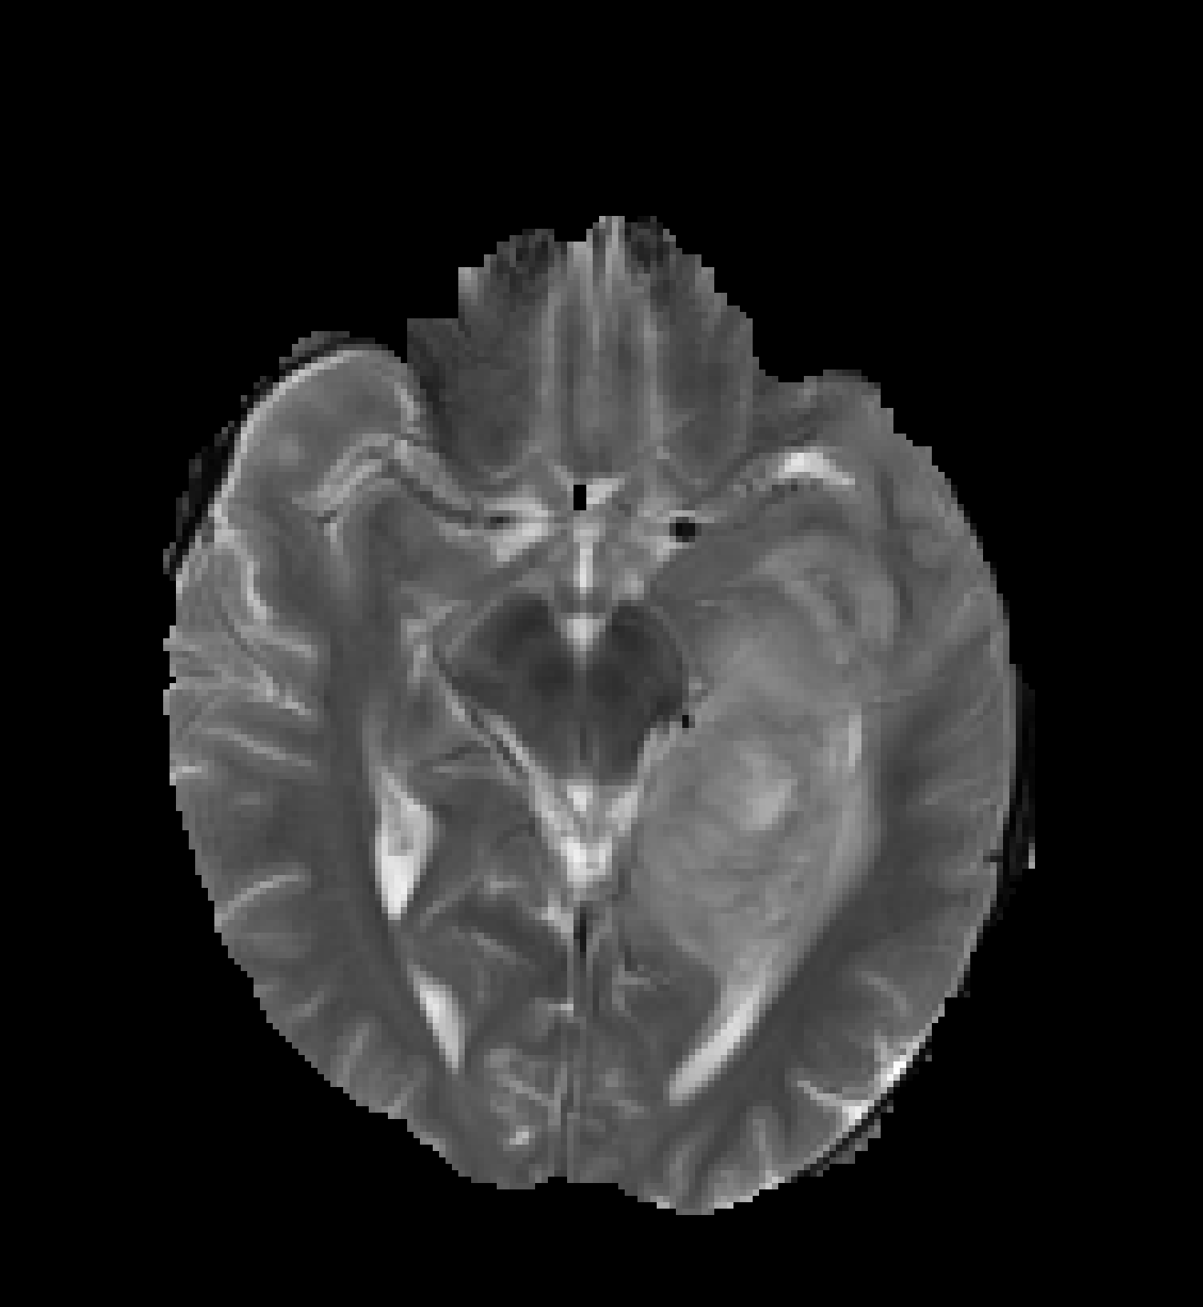
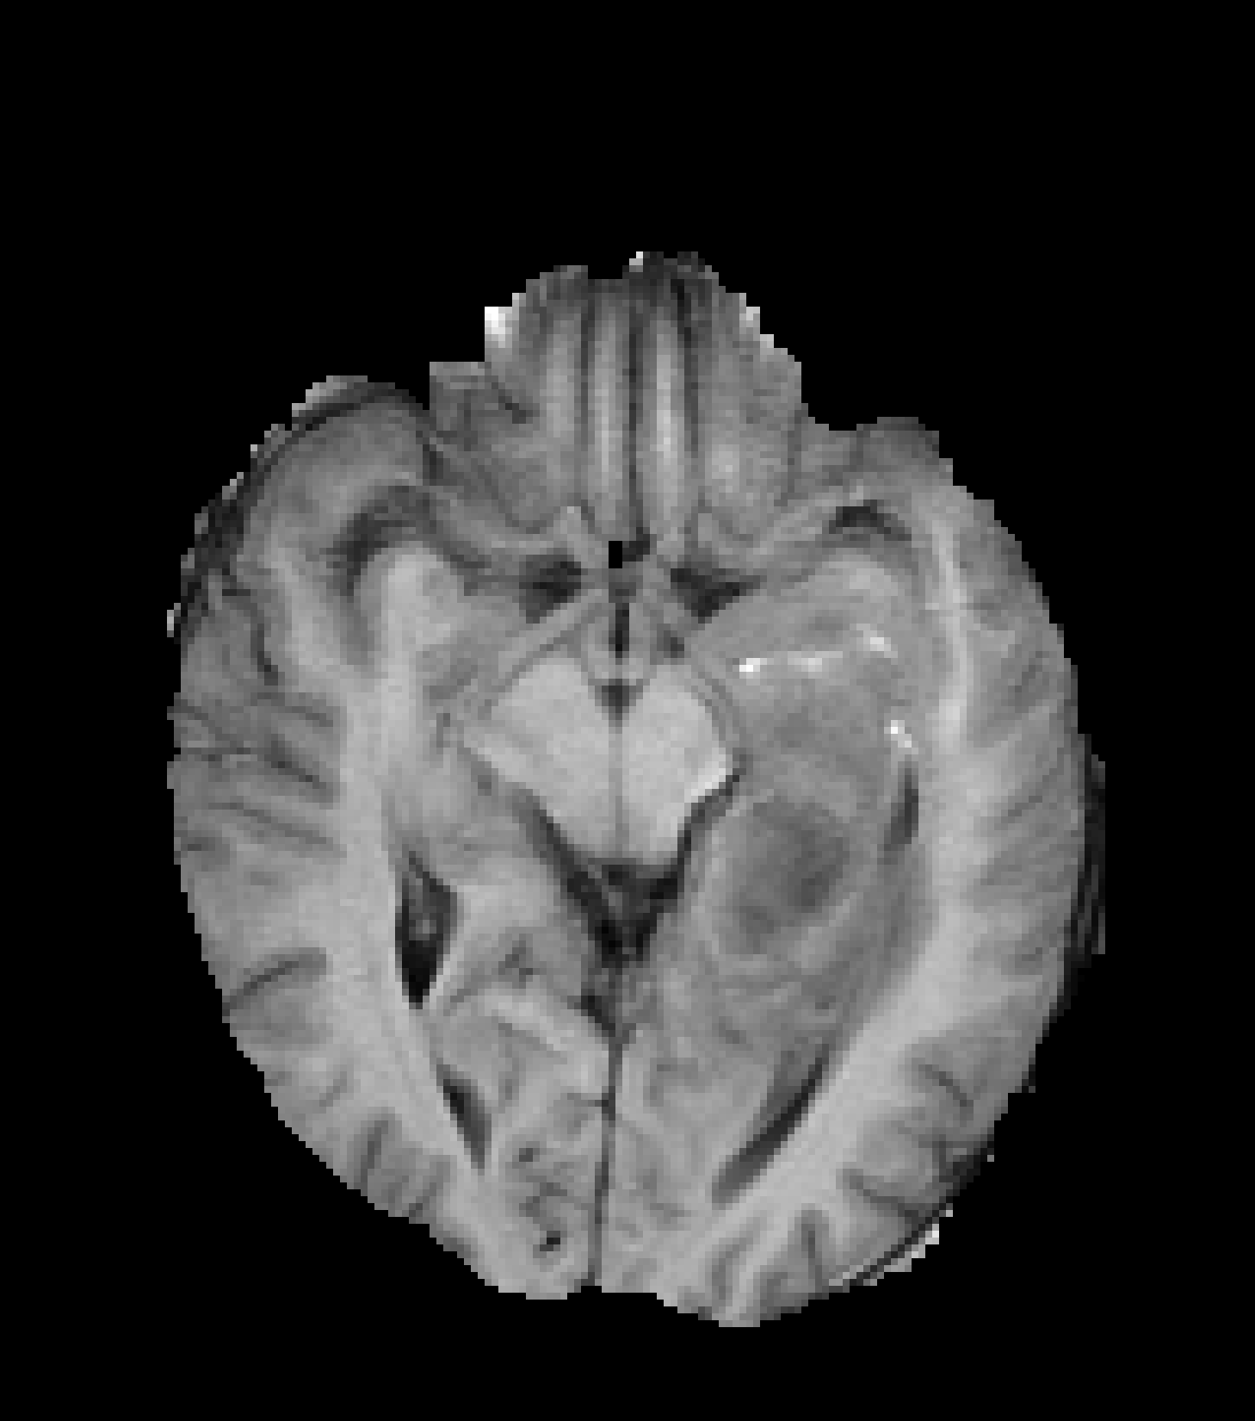
Magnetic resonance imaging (MRI)
Magnetic Resonance Imaging (MRI)
255 x 255 x 155 x 4 (> 40 M voxels)
Standard-of-care, fast, non-invasive, repeatable

Slide 10
Method
Radiomic Pipeline
Radiomic Feature
Notes:
** make images bigger

Slide 11
Feature selection
MRI
Feature extraction
Random 80% of training set
LASSO
Bag of features
Feature Selection
Select frequent features
Generate features from selected components
MRI sequence
tumor region
transformation
texture feature
PCA
Notes:
texture feature

Slide 12
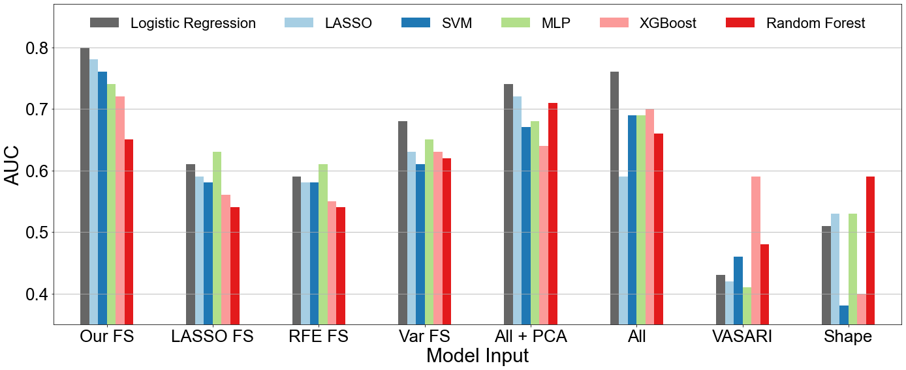
Results: comparisons to other feature selection methods
Notes:
** not clear that we are comparing our FS
We first observe that our method performs significantly better than models trained with other popular feature selection methods such as LASSO feature selection, recursive feature elimination, and variance thresholding. Our results also outperform models trained on the full feature set and PCA reduced versions of it. In particular, the worst performing features were the most interpretable: VASARI features, which are handcrafted features created by radiologists, and features describing the tumor's shape.
OF a suit of traditional machine learning models, simple logistic regression was most effective, reaching an AUC of 0.80.
On the bottom left is an illustration of an extracted feature: the 90th percentile image intensity value from a tumor region on the FLAIR MRI sequence filtered by an edge detector. (X) Such a combination of MRI sequence, tumor region, and image transformation define one of 380 VOIs which texture features are extracted from. (X) The bottom middle plot indicates that selected features disproportionately originate for this edge detector-transformed outer FLAIR region.
A visualization of results with this region highlighted indicates that the boundary of the tumor and normal brain may hold discriminative signal, but it is difficult to see.

Slide 13
Where should we look, and what should we look for?
Notes:
** make red edema outline bolder.
15 minutes on project 1 (w/ FG)
24 minutes (w/ FG)

Slide 14
Take aways
Novel feature selection method tailored for radiomic features
Promising results, but not ready for clinical adaptation
MRI has significant limitations
Genomic approaches
Surgical resection is always attempted
Biological validation (in vitro, in vivo)
Unavoidable noise
Complementary data modalities
Imaging features are too far “downstream”
Superior tumor characterization

Slide 15
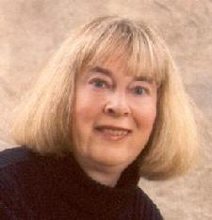
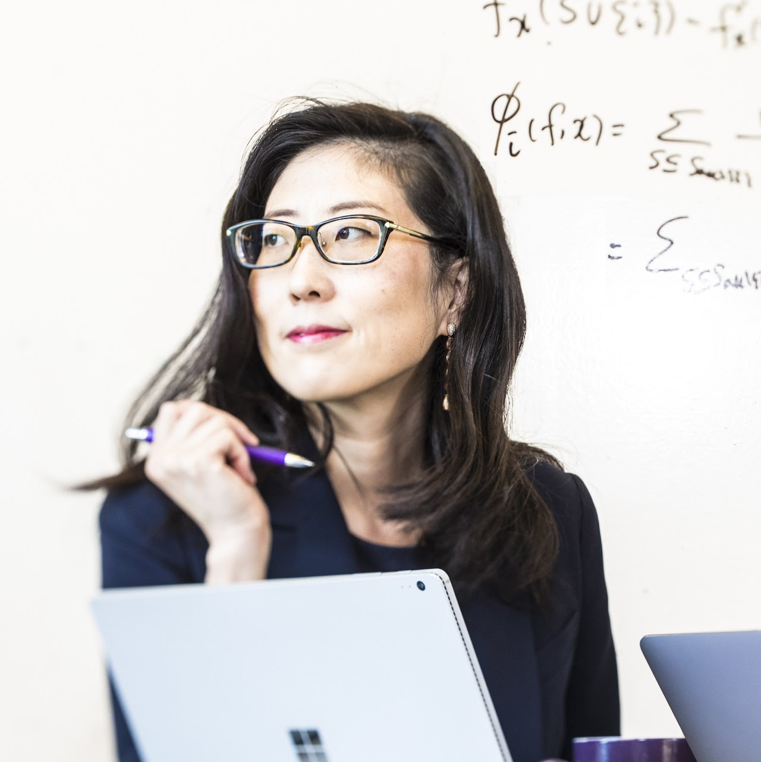
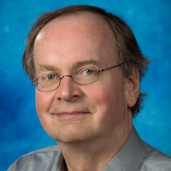
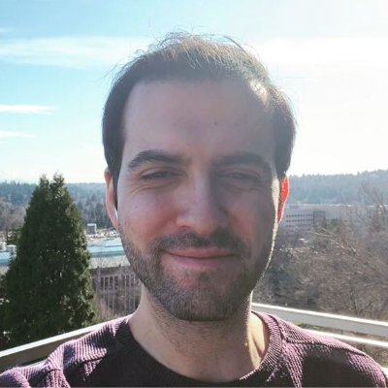
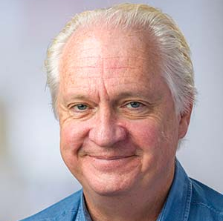
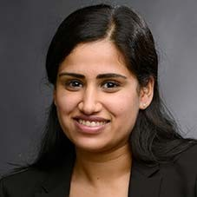
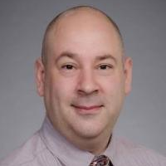
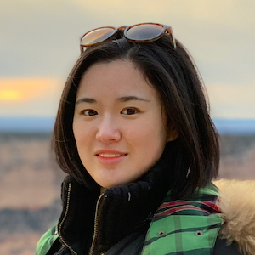
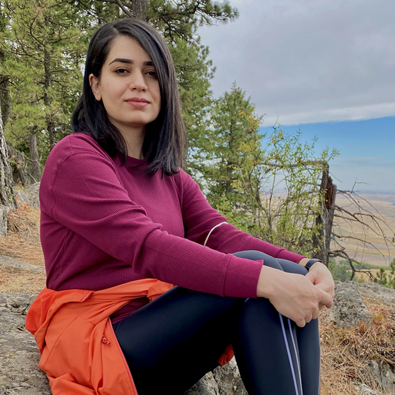
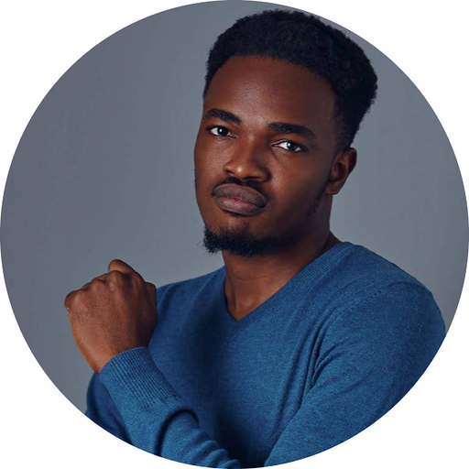
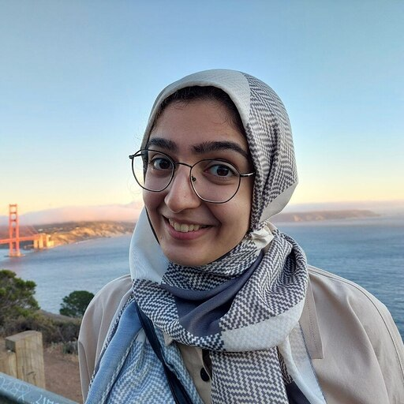
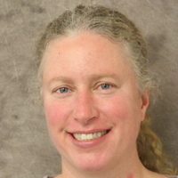
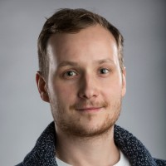
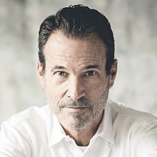
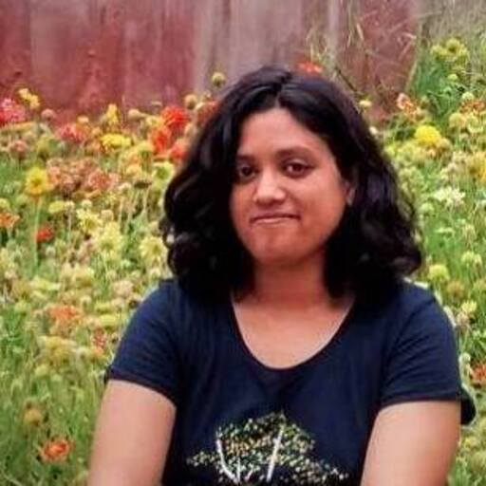
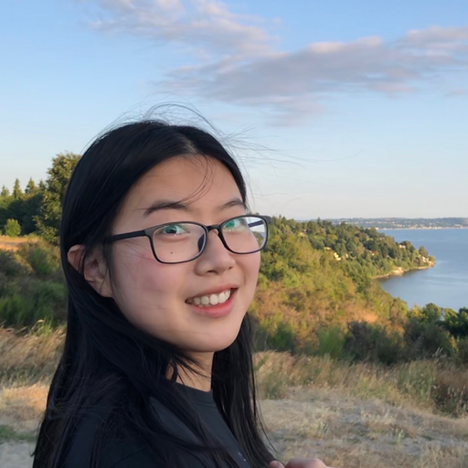
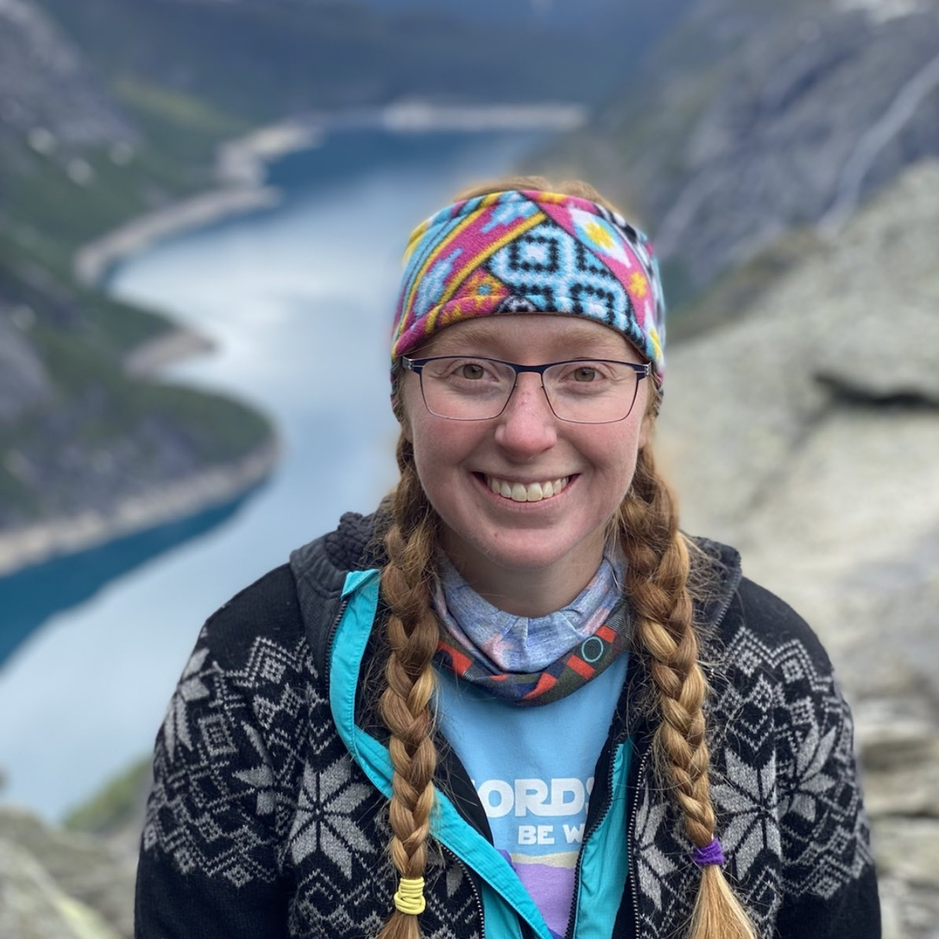
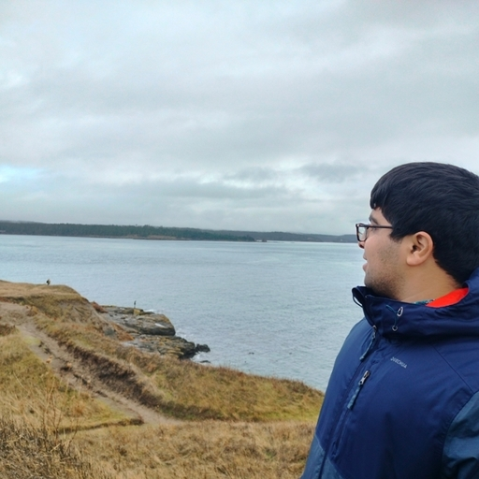
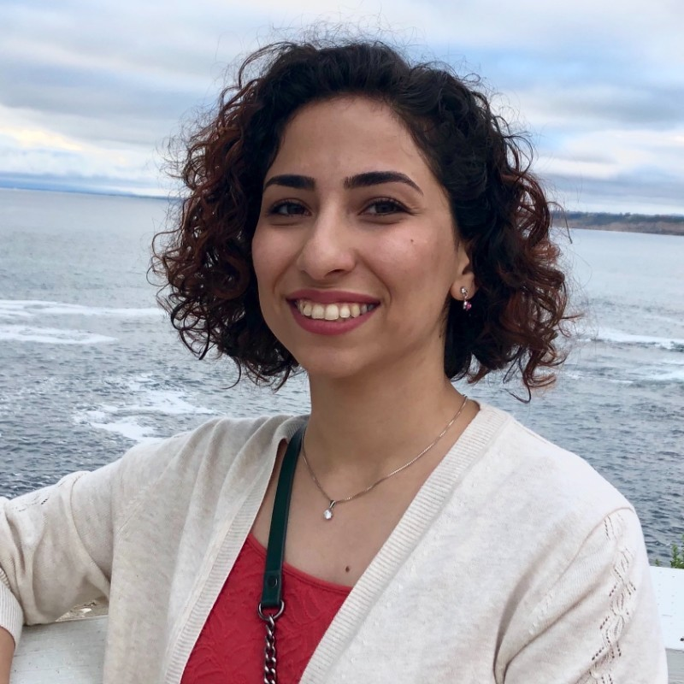
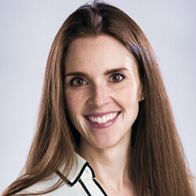
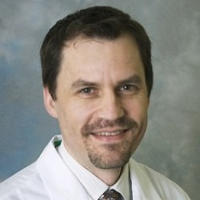
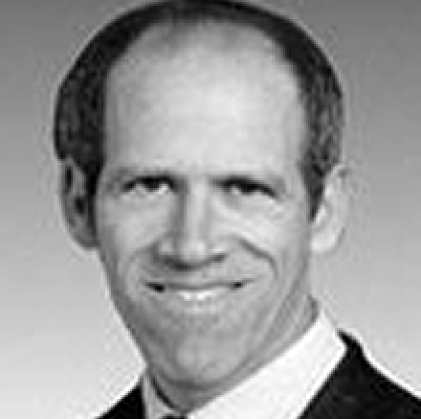
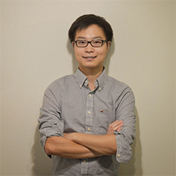
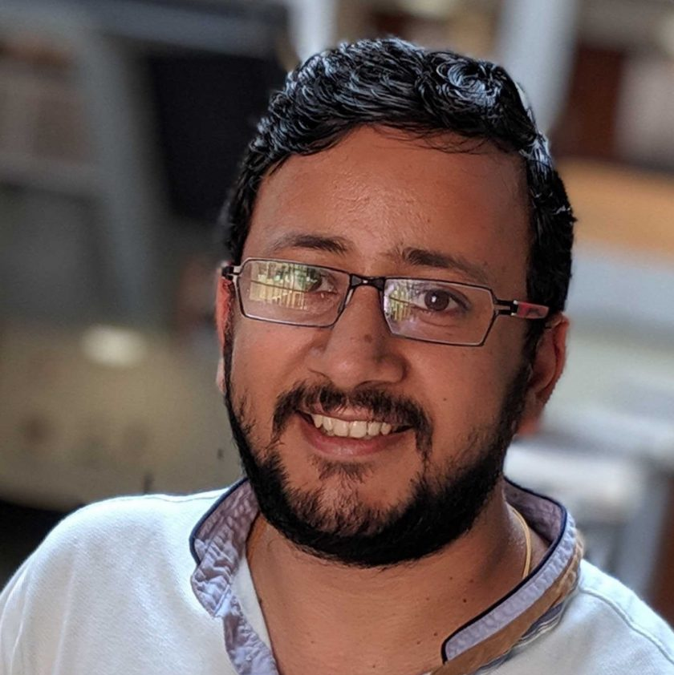
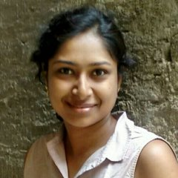
Acknowledgments
Linda Shapiro, PhD
Su-In Lee, PhD
John Kramlich, PhD
Saygin Seyfioğlu
Eric Holland, MD, PhD
Sonali Arora
PJ Cimino, MD, PhD
Mark Gilbert, MD
Wenjun Wu
Fateme Ghezloo
Wisdom Ikezogwo
Mahtab Bigverdi
Michelle Casad, PhD
Frank Szulzewsky, PhD
Denis Adair
Funding Sources
Kalyani Marathe
Kechun Liu
Erin Wilson
Fatwir Mohammed
Beibin Li, PhD
Sachin Mehta, PhD
Rashmi Mudduluru
Shima Nofallah, PhD
Siobhan Pattwell, PhD
James Fink, MD
David Haynor, MD, PhD

