Slide 1
Kernel Machines
A relatively new learning methodology (1992) derived from statistical learning theory.
Became famous when it gave accuracy comparable to neural nets in a handwriting recognition class.
Was introduced to computer vision researchers by Tomaso Poggio at MIT who started using it for face detection and got better results than neural nets.
Has become very popular and widely used with packages available.

Slide 2
Support Vector Machines (SVM)
Support vector machines are learning algorithms
that try to find a hyperplane that separates
the different classes of data the most.
They are a specific kind of kernel machines based on
two key ideas:
maximum margin hyperplanes
a kernel ‘trick’

Slide 3
The SVM Equation
y_{SVM}(x_{q}) = argmax Σ α_{i,c} K(x_{i},x_{q})
x_{q} is a query or unknown object
c indexes the classes
there are m support vectors x_{i} with weights α_{i,c}, i=1 to m for class c
K is the kernel function that compares x_{i} to x_{q}
c i=1,m

Slide 4
Maximal Margin (2 class problem)
In 2D space,
a hyperplane is
a line.
In 3D space,
it is a plane.
margin
hyperplane
Find the hyperplane with maximal margin for all
the points. This originates an optimization problem
which has a unique solution.

Slide 5
Support Vectors
The weights α_{i} associated with data points are zero, except for those points closest to the separator.
The points with nonzero weights are called the support vectors (because they hold up the separating plane).
Because there are many fewer support vectors than total data points, the number of parameters defining the optimal separator is small.

Slide 7
Kernels
A kernel is just a similarity function. It takes 2 inputs and decides how similar they are.
Kernels offer an alternative to standard feature vectors. Instead of using a bunch of features, you define a single kernel to decide the similarity between two objects.

Slide 8
Kernels and SVMs
Under some conditions, every kernel function can be expressed as a dot product in a (possibly infinite dimensional) feature space (Mercer’s theorem)
SVM machine learning can be expressed in terms of dot products.
So SVM machines can use kernels instead of feature vectors.

Slide 9
The Kernel Trick
The SVM algorithm implicitly maps the original
data to a feature space of possibly infinite dimension
in which data (which is not separable in the
original space) becomes separable in the feature space.
Original space R^{k}
Feature space R^{n}
1
0
1
1
0
0
1
0
0
1
0
Kernel
trick
0
1
0
0
0
1
1

Slide 10
Kernel Functions
The kernel function is designed by the developer of the SVM.
It is applied to pairs of input data to evaluate dot products in some corresponding feature space.
Kernels can be all sorts of functions including polynomials and exponentials.

Slide 11
Kernel Function used in our 3D Computer Vision Work
k(A,B) = exp(-θ²_{AB}/σ²)
A and B are shape descriptors (big vectors).
θ is the angle between these vectors.
σ² is the “width” of the kernel.

Slide 12
What does SVM learning solve?
The SVM is looking for the best separating plane in its alternate space.
It solves a quadratic programming optimization problem
argmax Σα_{j}-1/2 Σα_{j} α_{k} y_{j} y_{k} (x_{j}•x_{k})
subject to α_{j} > 0 and Σα_{j}y_{j} = 0.
The equation for the separator for these optimal α_{j} is
h(x) = sign(Σα_{j} y_{j} (x•x_{j}) – b)
α j j,k
j

Slide 13
Time taken to build model: 0.15 seconds
Correctly Classified Instances 319 83.5079 %
Incorrectly Classified Instances 63 16.4921 %
Kappa statistic 0.6685
Mean absolute error 0.1649
Root mean squared error 0.4061
Relative absolute error 33.0372 %
Root relative squared error 81.1136 %
Total Number of Instances 382
TP Rate FP Rate Precision Recall F-Measure ROC Area Class
0.722 0.056 0.925 0.722 0.811 0.833 cal
0.944 0.278 0.78 0.944 0.854 0.833 dor
W Avg. 0.835 0.17 0.851 0.835 0.833 0.833
=== Confusion Matrix ===
a b <-- classified as
135 52 | a = cal
11 184 | b = dor

Slide 15
Unsupervised Learning
Find patterns in the data.
Group the data into clusters.
Many clustering algorithms.
K means clustering
EM clustering
Graph-Theoretic Clustering
Clustering by Graph Cuts
etc

Slide 16
Clustering by K-means Algorithm
Form K-means clusters from a set of n-dimensional feature vectors
1. Set ic (iteration count) to 1
2. Choose randomly a set of K means m₁(1), …, m_{K}(1).
3. For each vector x_{i}, compute D(x_{i},m_{k}(ic)), k=1,…K
and assign x_{i} to the cluster C_{j} with nearest mean.
4. Increment ic by 1, update the means to get m₁(ic),…,m_{K}(ic).
5. Repeat steps 3 and 4 until C_{k}(ic) = C_{k}(ic+1) for all k.

Slide 17
K-Means Classifier (shown on RGB color data)
original data
one RGB per pixel
color clusters

Slide 18
K-Means → EM The clusters are usually Gaussian distributions.
Boot Step:
Initialize K clusters: C₁, …, C_{K}
Iteration Step:
Estimate the cluster of each datum
Re-estimate the cluster parameters
(μ_{j,} Σ_{j}) and P(C_{j}) for each cluster j.
Expectation
Maximization
For each cluster j
The resultant set of clusters is called a mixture model;
if the distributions are Gaussian, it’s a Gaussian mixture.

Slide 19
EM Algorithm Summary
Boot Step:
Initialize K clusters: C₁, …, C_{K}
Iteration Step:
Expectation Step
Maximization Step
(μ_{j,} Σ_{j}) and p(C_{j}) for each cluster j.

Slide 20
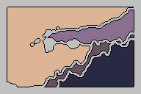
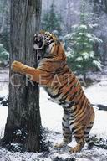
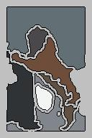
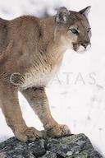
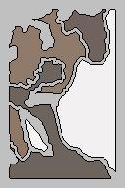
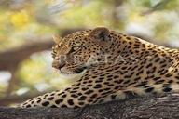
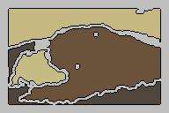
EM Clustering using color and texture information at each pixel (from Blobworld)

Slide 21
EM for Classification of Images in Terms of their Color Regions
Initial Model for “trees”
Final Model for “trees”
EM
Initial Model for “sky”
Final Model for “sky”

Slide 22
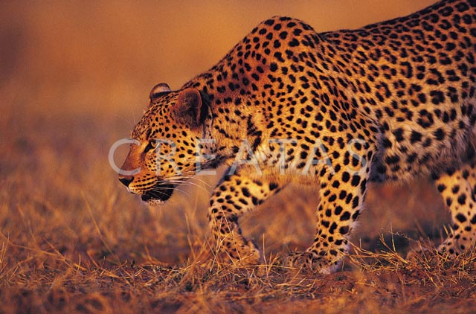
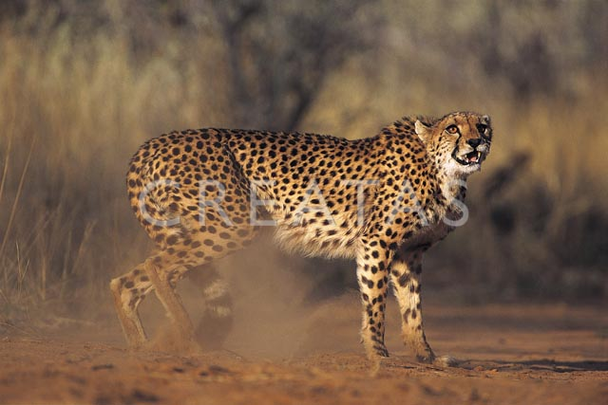
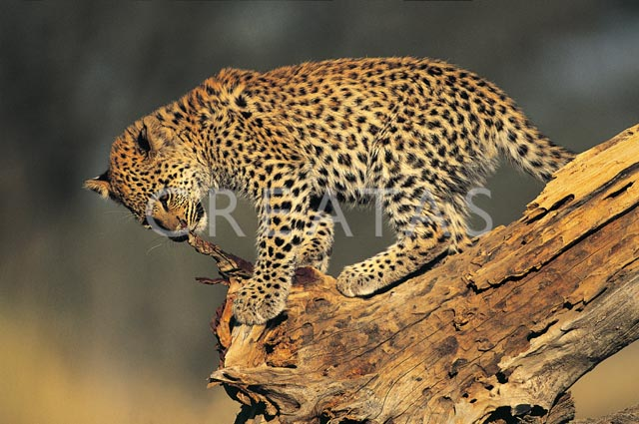
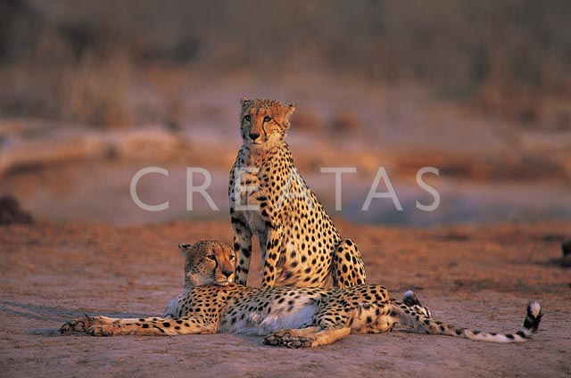
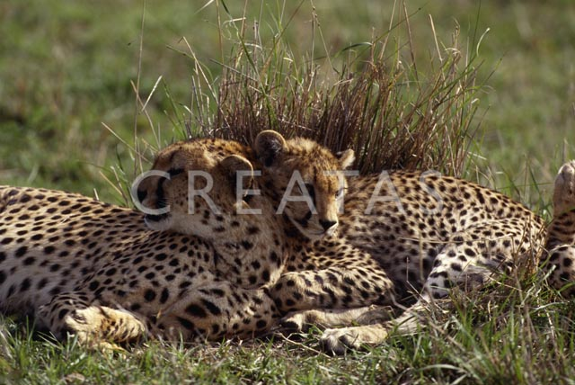
Sample Results
cheetah

Slide 23
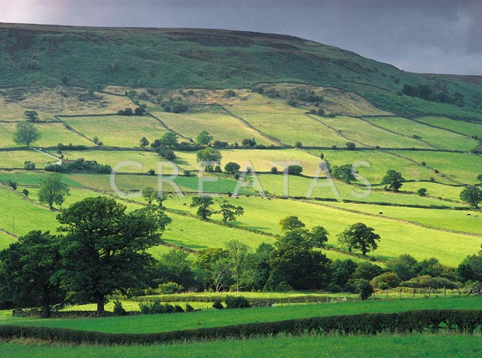
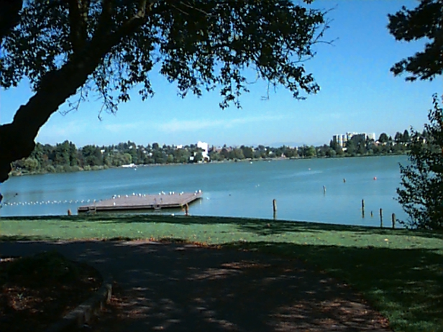
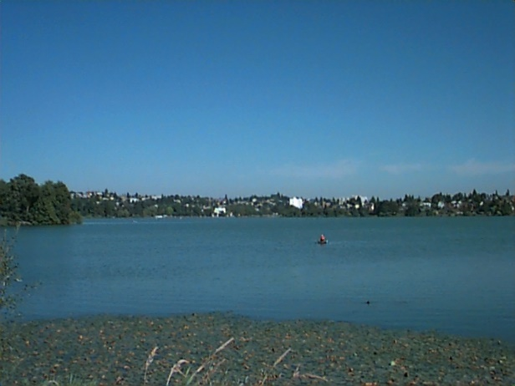
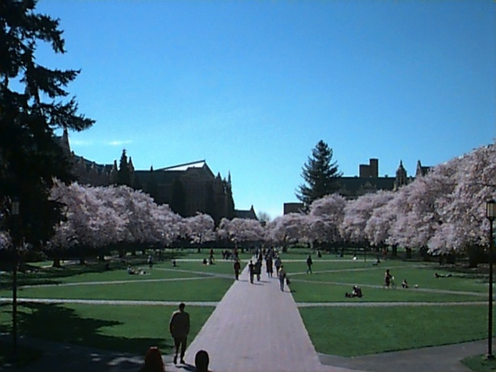
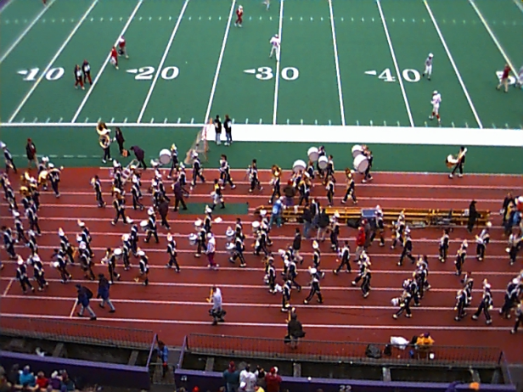
Sample Results (Cont.)
grass

Slide 24
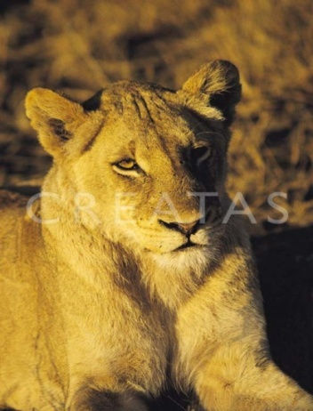
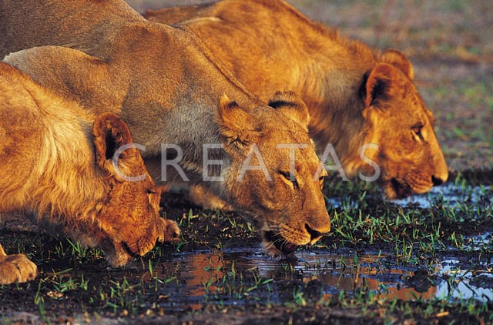
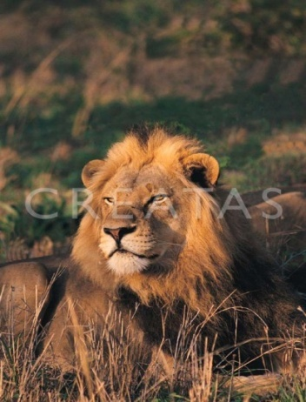
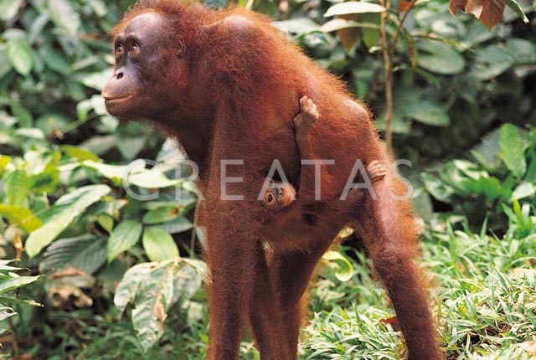
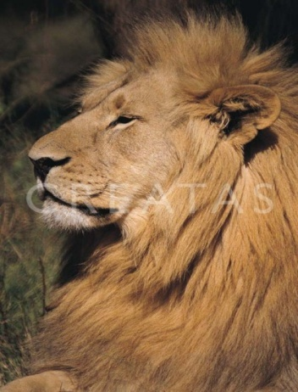
Sample Results (Cont.)
lion

Slide 25
Haar Random Forest Features Combined with a Spatial Matching Kernel for Stoneﬂy Species Identiﬁcation
Natalia Larios*
Bilge Soran*
Linda Shapiro*
Gonzalo Martinez-Munoz^
Jeffrey Lin+
Tom Dietterich+
*University of Washington
+Oregon State University
^Universidad Autónoma de Madrid

Slide 26
Goal: to identify the species of insect specimens rapidly and accurately

Slide 27
Overview of our Classification Method
Training Image Set
Positive and Negative
Testing
Patch extraction
Test Image Patches
Forest Learning
Image Patches
HRF Feature Extraction
HRF
Test Image Features
HRF Feature Extraction
SVM
Classification
Training Vectors
SVM Learning
Prediction

Slide 28
RESULTS: Stonefly Identification: Classification Error [%]
Task | SET | CIELAB color | CIELAB+G
Cal vs Dor | 6.26 | 10.16 | 4.60
Hes vs Iso | 3.74 | 9.05 | 3.55
Pte vs Swe | 2.71 | 8.75 | 2.80
Dor vs Hes | 2.25 | 8.09 | 2.20
Mos vs Pte | 2.06 | 7.95 | 1.92
Yor vs Zap | 1.52 | 6.89 | 1.60
Zap vs Cal | 1.52 | 7.02 | 1.76
Swe vs Yor | 1.44 | 6.85 | 1.50
Iso vs Mos | 1.29 | 6.90 | 1.30
Average | 2.53 | 7.96 | 2.25
96.4% accuracy

