Slide 1
Baroque Chess
The "Paul G. Allen School Rules" for Baroque Chess
Khushi Khandelwal,
CSE 473 teaching staff member,
April, 2023.

Slide 2
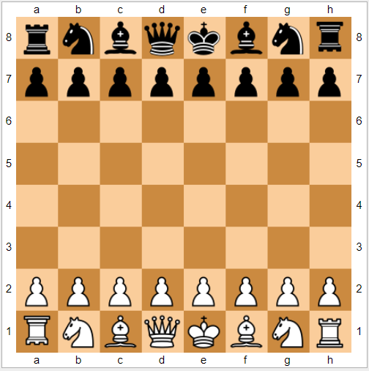
Introduction
Baroque Chess is played on a standard 8 X 8 Chessboard.
It is played by two players, one having white pieces and the other having black pieces.
White plays the first move and then Black and so on.
The objective of the game is to capture the opposing King.

Slide 3
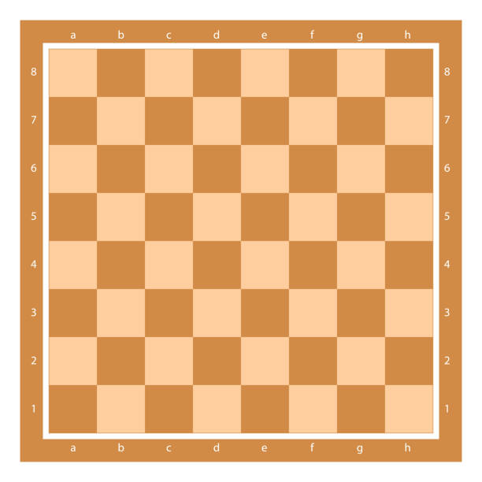
KING (King)
RULES FOR MOVEMENT
The King moves like a standard chess King, one square at a time in any direction.
Two Kings can be adjacent to each other (under some situations), unlike in standard chess.
RULES FOR CAPTURE
The King captures like a standard chess King unless it is adjacent to the opponent's Freezer.

Slide 4
PINCER (Pawn)
RULES FOR MOVEMENT
A Pincer moves like a Rook in standard chess.
It can move any number of squares vertically or horizontally and cannot jump over any piece.
RULES FOR CAPTURE
A Pincer captures an opposing piece horizontally or vertically between the arrival square and a friendly (same color) piece. The opponent's piece must be sandwiched between the pincer and the same color piece. There must be no gap.
It is sometimes possible for a Pincer to capture up to 3 enemy pieces in one move.
A Pincer cannot capture diagonally.

Slide 5
WITHDRAWER (Queen)
RULES FOR MOVEMENT
The Withdrawer moves like a standard chess Queen, in any direction when the squares are empty.
It cannot jump over its own or the opponent's pieces.
RULES FOR CAPTURE
The Withdrawer captures by moving away from the opponent’s adjacent piece in the opposite direction.

Slide 6
COORDINATOR (Rook)
RULES FOR MOVEMENT
The Coordinator moves like a standard chess Queen, in any direction when the squares are empty.
It cannot jump over its own or the opponent's piece.
RULES FOR CAPTURE
The Coordinator can capture more than 1 piece at a time.
It captures an opponent’s piece that is on either of the two squares found at the intersection of its own file and the King’s rank, or the King’s file and its own rank after it has moved.

Slide 7
FREEZER (Inverted Rook)
RULES FOR MOVEMENT
The Freezer (a.k.a. the Immobilizer) moves like a standard chess Queen, in any direction when the squares are empty.
It cannot jump over own or opponent's pieces.
RULES FOR CAPTURE
The Freezer does not capture any piece but immobilizes all opponent’s pieces which are at any of the immediately neighboring squares.

Slide 8
LEAPER (Knight)
RULES FOR MOVEMENT
The Leaper moves like a standard chess Queen, in any direction when the squares are empty.
It can jump ONLY over opponent's piece and not over the same color piece.
RULES FOR CAPTURE
The Leaper captures by jumping over the opponent’s piece in a straight line and can capture only ONE piece in one move. The Leaper lands in the square beyond the piece being captured. Thus, that square must be empty before the move. The Leaper may move multiple steps to reach the enemy piece before it jumps over it, but these steps and the jump must all be in the same straight line.

Slide 9
IMITATOR (Bishop)
RULES FOR MOVEMENT
The Imitator moves like a standard chess Queen, in any direction when the squares are empty.
It can jump only on the occasion when it is capturing an opponent Leaper by imitating the Leaper’s movement to capture.
RULES FOR CAPTURE
It can capture any piece by moving as a piece of the type captured would have moved to capture.
The Imitator can capture more than one piece at one time provided that each piece captured is captured in its own manner of capturing.
It can immobilize the enemy Freezer by being adjacent to it.
It cannot capture the opponent's Imitators.

Slide 10
Thank you.

