Slide 1
VSGD-Net:
Virtual Staining Guided Melanocyte Detection on Histopathological Images
Kechun Liu
Contact: kechun@cs.washington.edu
March 2022

Slide 2
Outline
Introduction
Dataset
Methodology
Results and Discussions
  Main Results
  Ablation Study

Slide 3
Outline
Introduction
Dataset
Methodology
Results and Discussions
  Main Results
  Ablation Study

Slide 4
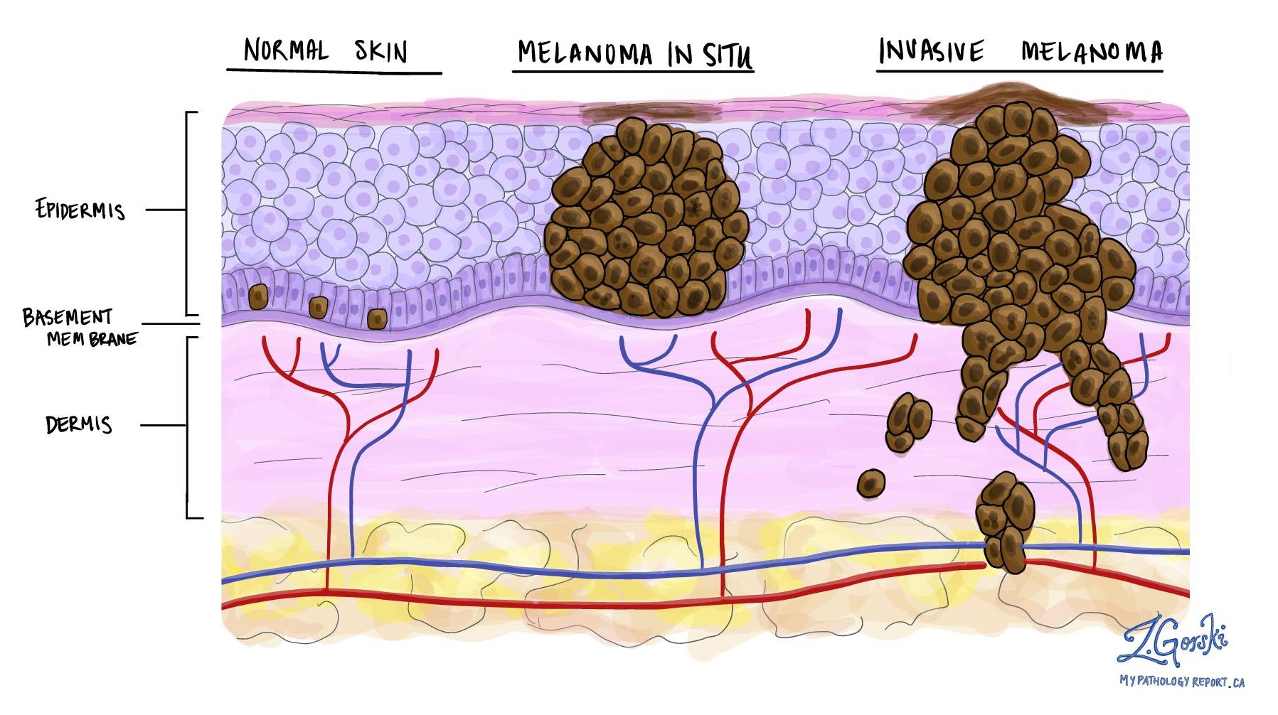
What is melanoma?
Melanoma is the most serious type of skin cancer and is potentially fatal.
Melanoma develops when melanocytes start to grow out of control.
Melanocyte:
melanin-producing cell

Slide 5
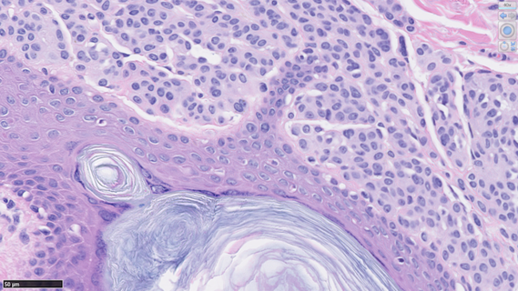
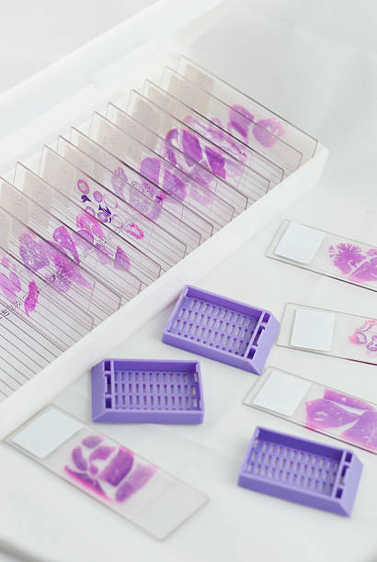

How do pathologists diagnose melanoma?
Architectural growth patterns of melanocytes?
Hematoxylin and Eosin (H&E) stained skin biopsies
Notes:
H&E stain
Growth patterns of melanocytes
Visual similarity of melanocytes to other cells under H&E staining

Slide 6
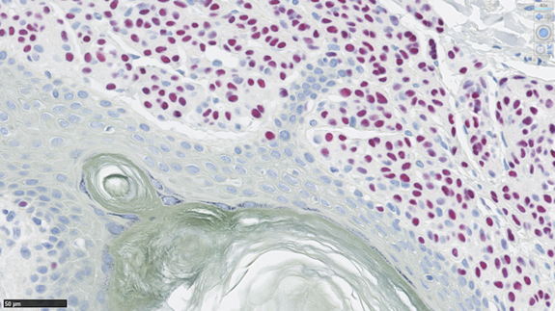
Supplemental Immunostaining
Sox10 staining can highlight melanocytes, but it’s not a routine procedure due to its high cost.
(a) H&E Staining
(b) Sox10 Staining – melanocytes are red
(c) Crop from Sox10
Notes:
Sox10 immunostaining

Slide 7

Study Goal
Can we automatically detect melanocytes on H&E images?
Address the limitations:
  -- Visual similarity of melanocytes to other cells in H&E images
  -- High cost of Sox10 staining
Reduce the burden on pathologists
Aid in melanoma diagnosis in the future

Slide 8
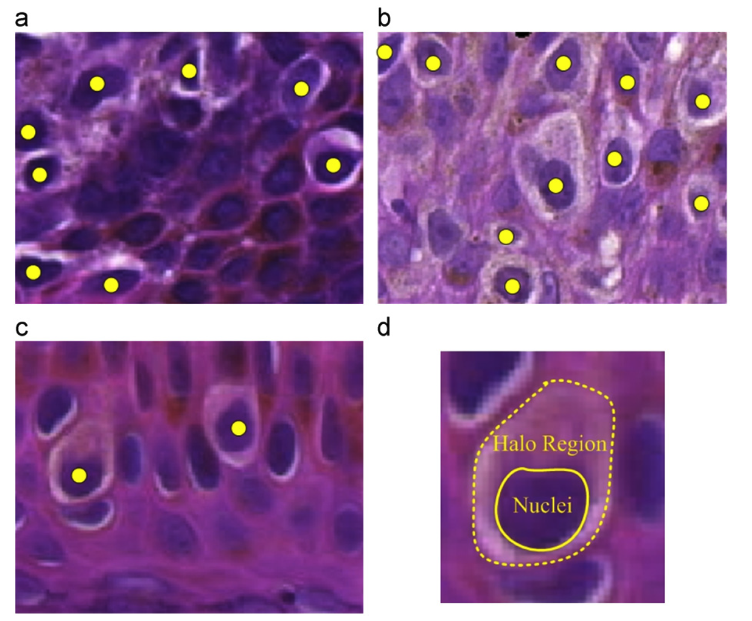
Related Work
Melanocyte detection
  Radial Line Scanning [1] based on the “halo region” assumption.
  Halo-regions are not the gold standard of melanocyte detection.
Nuclei detection with CNN
  U-Net [2], Mask R-CNN [3], Hover-Net (deep CNN) [4], StarDist (a shape-guided CNN) [5], CHR-Net (a high resolution network) [6], etc.
  Fail to incorporate information from Sox10.
Tissues detection on images synthesized by GAN [7]
  Fail to explore intermediate features from the image synthesis process.
Notes:
Previous work related to nuclei detection on histopathological images

Slide 9
Study Goal
To automatically detect melanocytes on H&E stained images and leverage the information from the two stainings (H&E and Sox10), we propose VSGD-Net (Virtual Staining Guided Detection Network).
Address the limitations:
  -- Visual similarity of melanocytes to other cells in H&E images
  -- High cost of Sox10 staining
Reduce the burden on pathologists
Aid in melanoma diagnosis in the future

Slide 10
Outline
Introduction
Dataset
Methodology
Results and Discussions
  Main Results
  Ablation Study

Slide 11
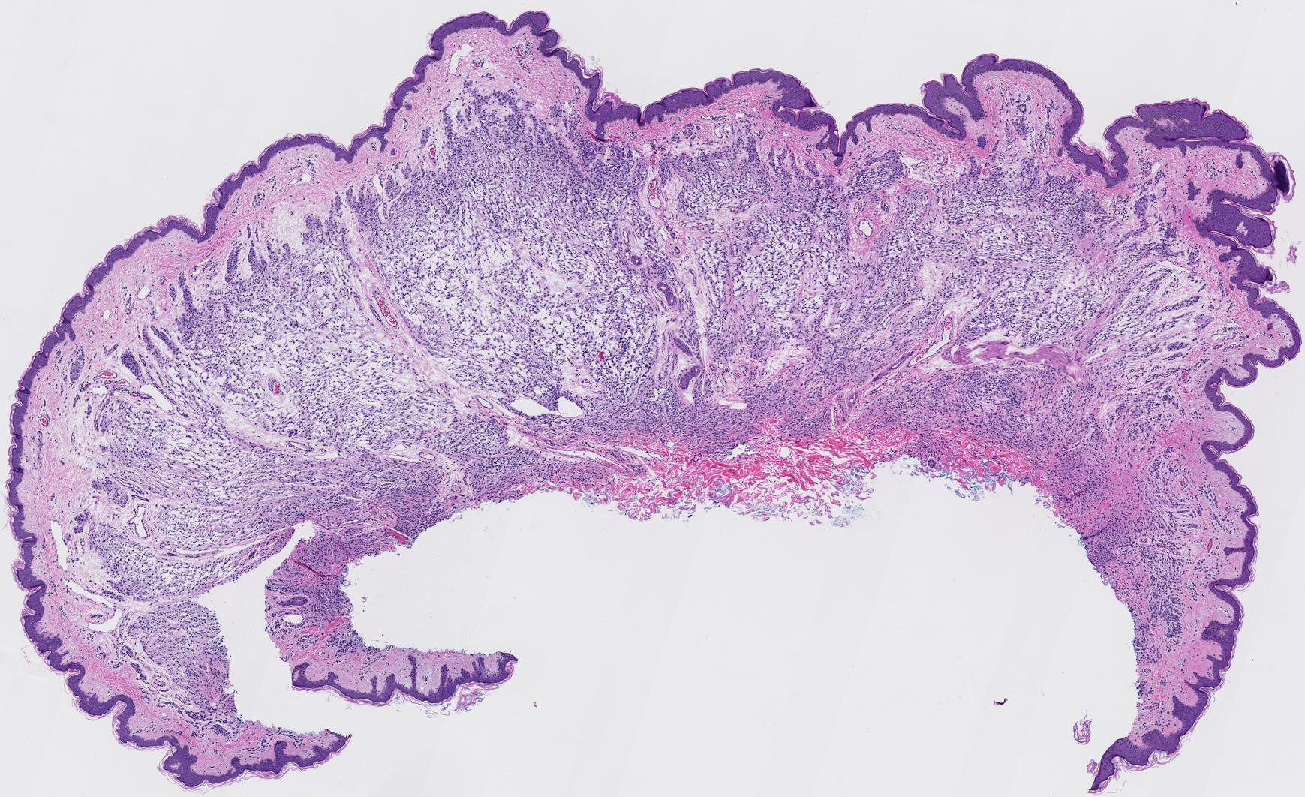
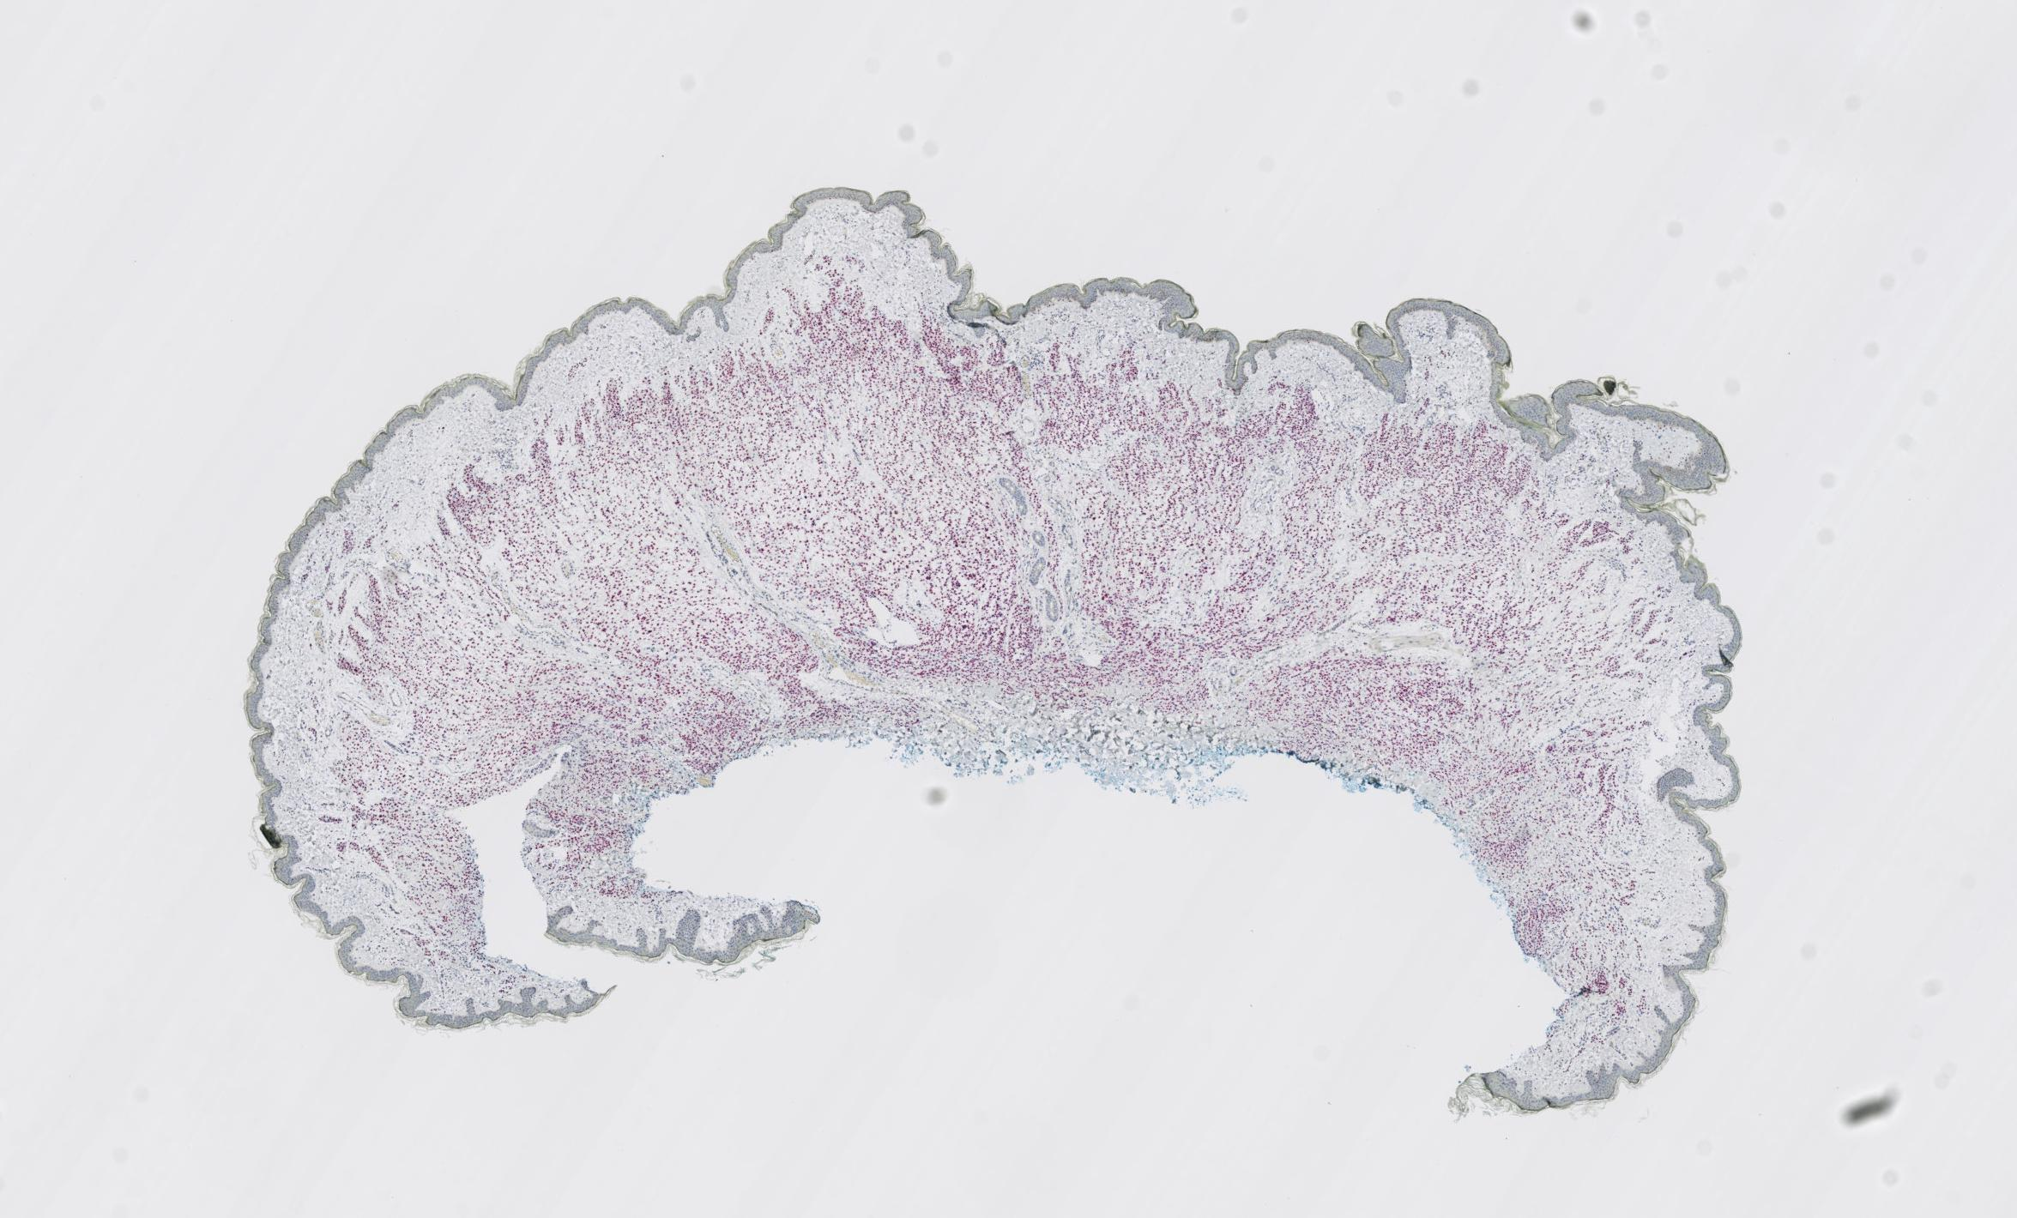
Dataset
Our dataset consists of skin tissues of 15 cases from a private dermatopathology lab, including 3 cases for each MPATH diagnostic category¹ [8].
We stain each glass slide with H&E first, then de-stain and re-stain the same glass slide in Sox10.
Each skin tissue is cut into multiple (4-6) thin slices for microscopic examination, resulting in 75 slices at 20x magnification.
¹ Class 1-5: Benign mildly atypical nevi, Moderate dysplastic nevi, Melanoma in situ, Invasive melanoma T1a, and Invasive melanoma T1b.

Slide 12
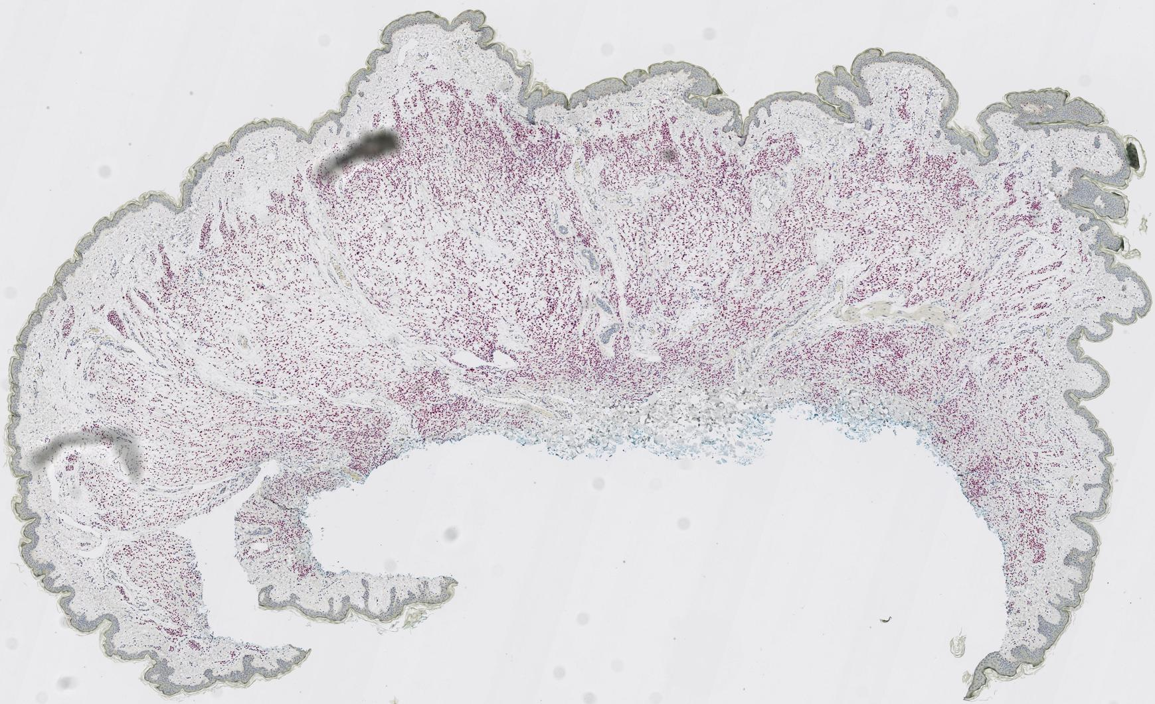
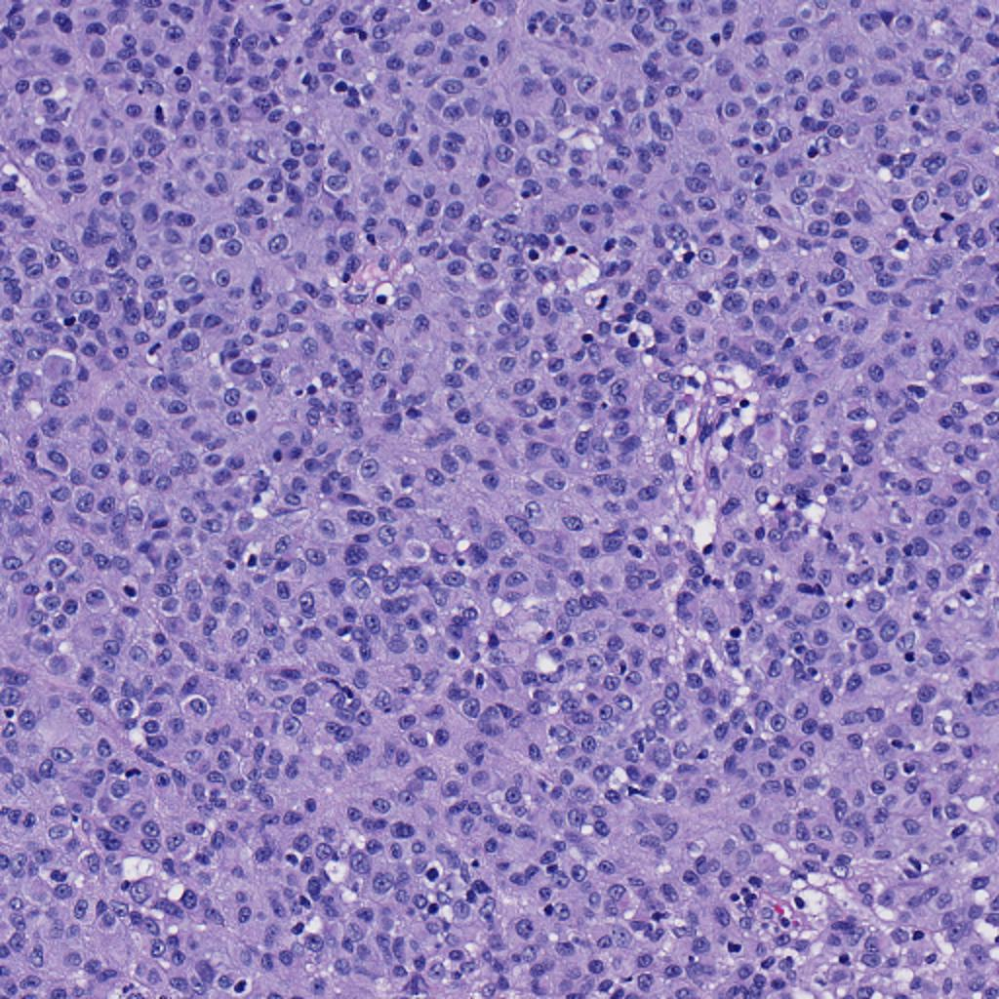
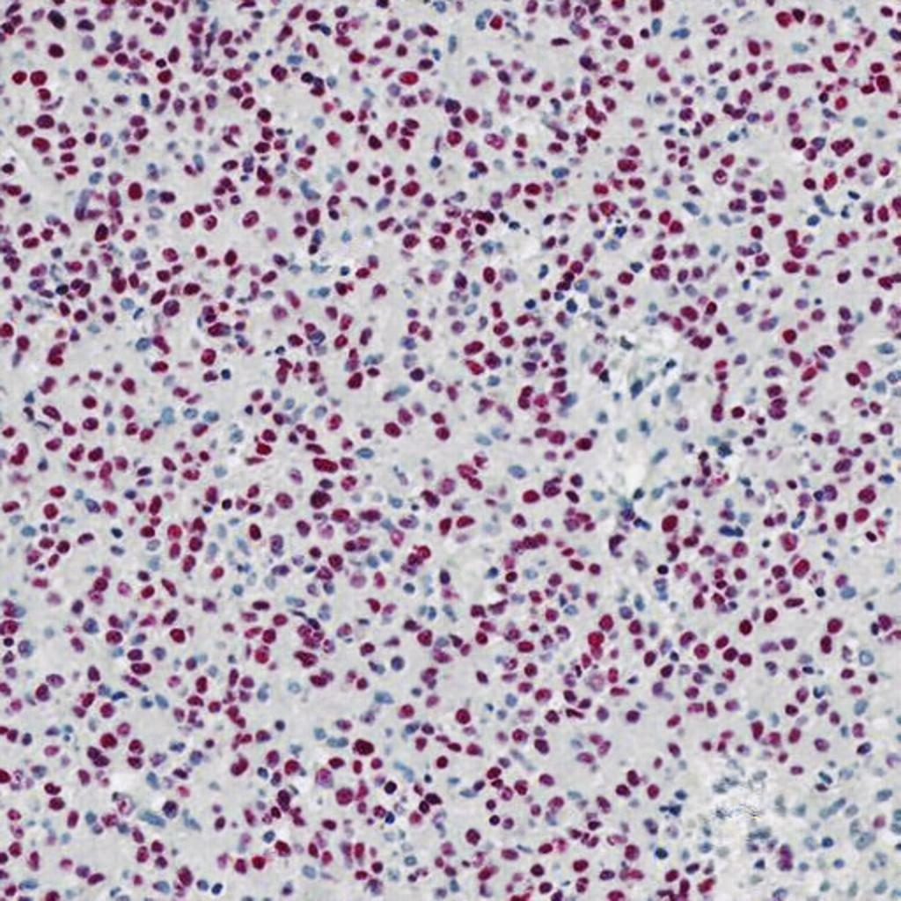
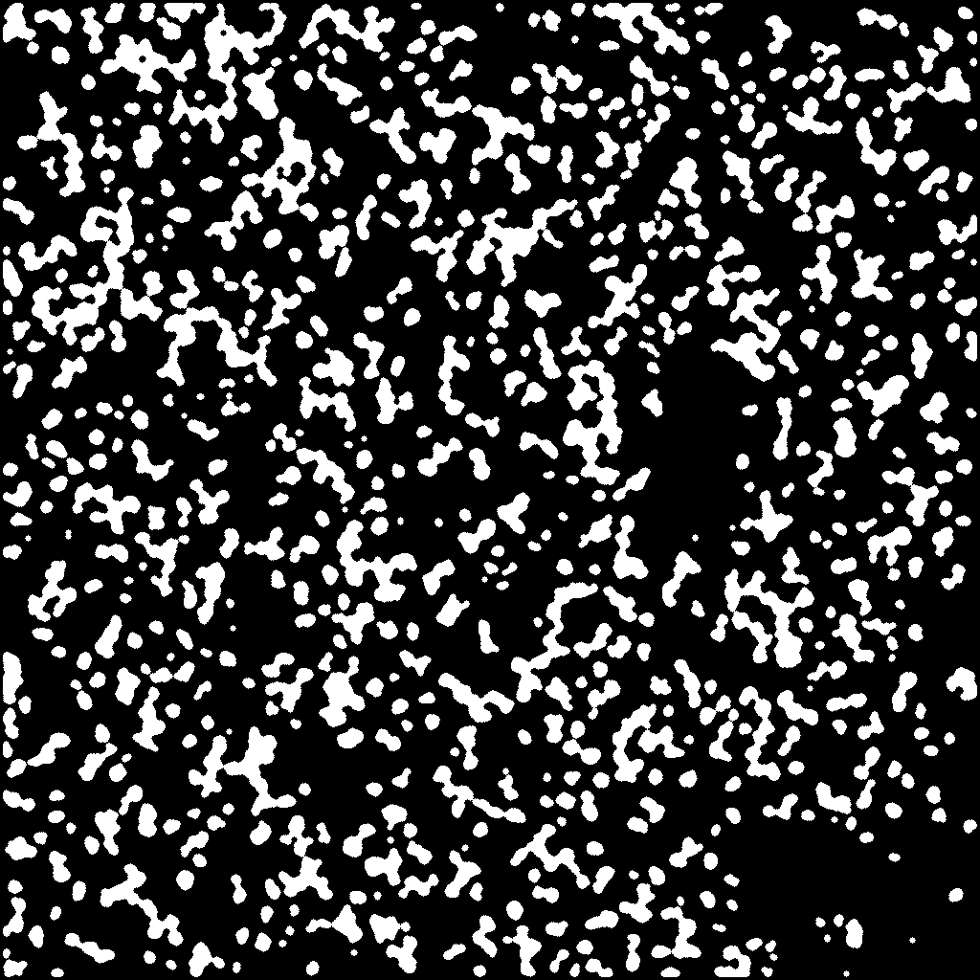
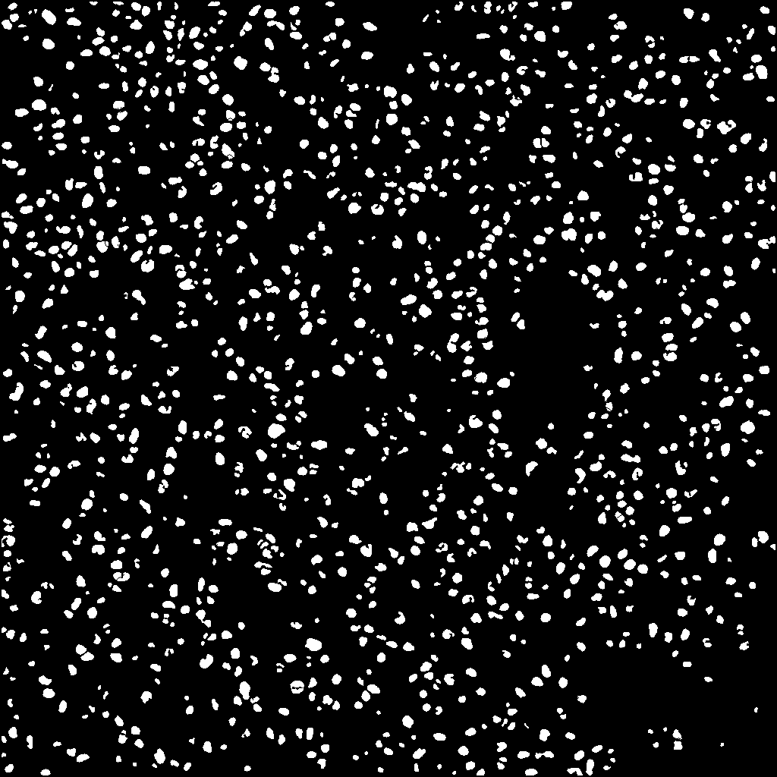
Dataset - Preprocessing
1
(a) Raw H&E stained image
(b) Raw Sox10 stained image
(c) Registered Sox10 stained image
2
3
(d) H&E patch
(e) Sox10 patch
(f) Rough mask
(g) Refined mask
Preprocessing steps: First, we register raw Sox10 images (b) into aligned Sox10 images (c) using template H&E images (a) with the Histokat software [9]. Then, we apply a Random Forest classifier to classify pixels into melanocyte or non-melanocyte. At last, the pretrained NuSeT [10] separates touching nuclei and refine the masks.

Slide 13
Dataset
To fit images into memory as well as keep adequate information, we crop the registered paired images into 256x256 patches with 10x magnification and exclude the background patches, leaving 25,314 patches to use.
Sub-dataset | From ? cases | # Patches
Train | 10 cases | 14,630
Validation |  | 1,032
Test | 5 cases | 9,652

Slide 14
Outline
Introduction
Dataset
Methodology
Results and Discussions
  Main Results
  Ablation Study

Slide 15
VSGD-Net
U-Net [2] with ResNet50
Inspired by Mask R-CNN [3]
Multi-scale discriminator
Notes:
Model structure
Generator: Unet with ResNet50 as backbone
Discriminator: multi-scale
Detection: feature pyramid, region proposal network, downstream heads

Slide 16
VSGD-Net
Features input to the detection branch?
  We assume decoder layers have higher correlation with the Sox10 than encoder layers.
  The ablation study validates this design.

Slide 17
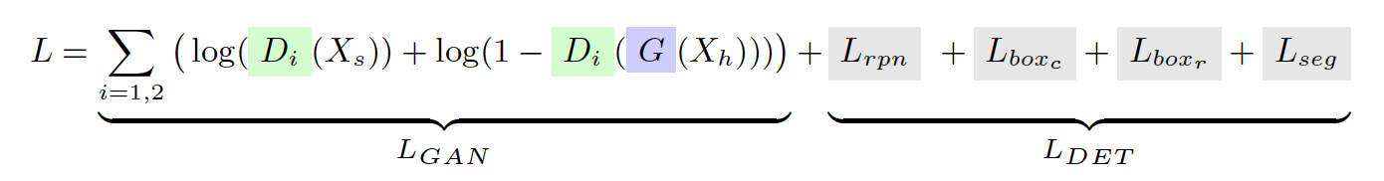
VSGD-Net
Notes:
GAN loss

Slide 18
Outline
Introduction
Dataset
Methodology
Results and Discussions
  Main Results
  Ablation Study

Slide 19

Evaluation Metrics
Precision = TP / (TP + FP)
Recall = TP / (TP + FN)
F1-score = $2×\frac{\text{(}\text{Precision} × \text{Recall}\text{)}}{\text{Precision}\text{ + }\text{Recall}}$
Jaccard Index = TP / (TP + FN + FP)

Slide 20
Baseline Methods
Radial Line Scanning [1]: detects melanocytes through the halo regions
Mask R-CNN [3]
U-Net [2]
StarDist [5]: guided by nuclei shape
HoverNet [4]: leverages the distance maps from pixels to nuclear center
CHR-Net [6]: leverages high-resolution feature extractors
Nuclei Classification: train ESPNetv2 [11] to classify predicted nuclei patches into melanocytes or non-melanocytes.

Slide 21
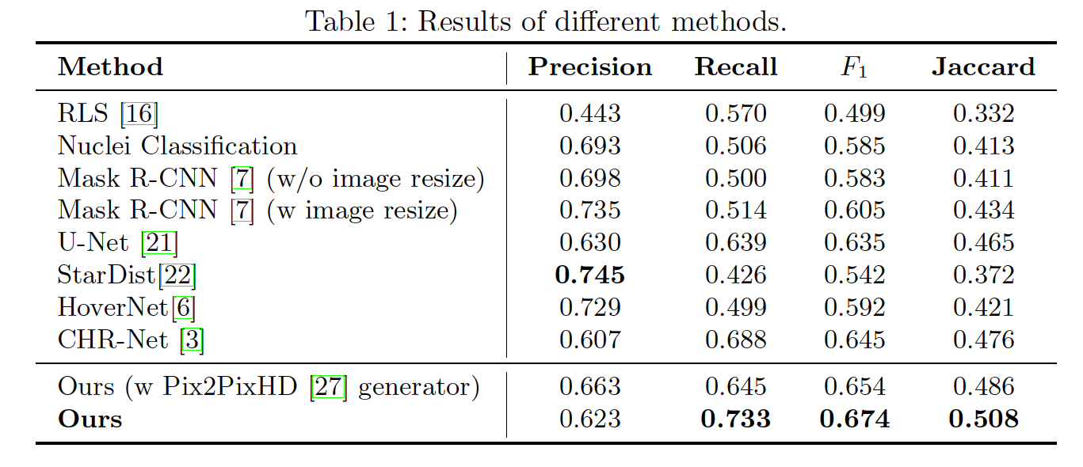
Main Results
Lack generalizability
High precision
but
Low recall
Fails due to the similarity between melanocytes and other cells
Benefit from skip connections
Fewer Conv layers &
no skip connection

Slide 22
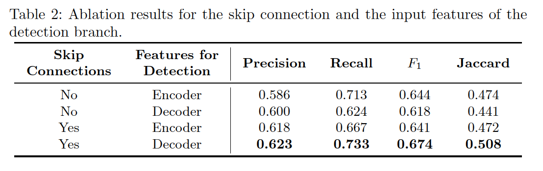
Ablation Study
Decoder layers have higher correlation with the Sox10 than encoder layers.

Slide 23
Limitations
Pseudo ground-truth labels
  It’s not feasible to manually label melanocytes for training.
Generator structure
  Synthesis features can be improved by SOTA GAN models.

Slide 24
Future Work
Build a computer-aided system (CAD) to analyze the growth patterns of melanocytes and expand it to a diagnosis framework.
Apple VSGD-Net to more multi-modality medical imaging fields, such as CT-MRI [12], PET-MRI [13], etc.

Slide 25
Conclusion
We present a novel virtual staining guided detection network, VSGD-Net.
During inference, the model can produce promising results from only the routine H&E staining.
We anticipate that the proposed method can adapt to a broad category of diseases.

Slide 26

Acknowledgement
Advisor:
Dr. Linda Shapiro
PI:
Dr. Joann Elmore
Pathologists:
Dr. Stevan Knezevich
Dr. Caitlin May
Dr. Oliver Chang
Collaborators:
Beibin Li
Wenjun Wu

Slide 27
References
Lu, C., Mahmood, M., Jha, N., Mandal, M.: Detection of melanocytes in skin histopathological images using radial line scanning. Pattern Recognition 46(2), 509–518 (Feb 2013)
Ronneberger, O., Fischer, P., Brox, T.: U-Net: Convolutional Networks for Biomedical Image Segmentation. arXiv:1505.04597 [cs] (May 2015), arXiv: 1505.04597
He, K., Gkioxari, G., Doll ar, P., Girshick, R.: Mask R-CNN. arXiv:1703.06870 [cs] (Mar 2017)
Graham, S., Vu, Q.D., Raza, S.E.A., Azam, A., Tsang, Y.W., Kwak, J.T., Rajpoot, N.: Hover-net: Simultaneous segmentation and classification of nuclei in multitissue histology images. Medical Image Analysis 58, 101563 (2019)
Schmidt, U., Weigert, M., Broaddus, C., Myers, G.: Cell detection with starconvex polygons. In: International Conference on Medical Image Computing and Computer-Assisted Intervention. pp. 265–273. Springer (2018)
Gao, Z., Shi, J., Zhang, X., Li, Y., Zhang, H., Wu, J., Wang, C., Meng, D., Li, C.: Nuclei Grading of Clear Cell Renal Cell Carcinoma in Histopathological Image by Composite High-Resolution Network. In: de Bruijne, M., Cattin, P.C., Cotin, S., Padoy, N., Speidel, S., Zheng, Y., Essert, C. (eds.) Medical Image Computing and Computer Assisted Intervention – MICCAI 2021
Zhao, J., Li, D., Kassam, Z., Howey, J., Chong, J., Chen, B., Li, S.: Tripartite-GAN: Synthesizing liver contrast-enhanced MRI to improve tumor detection. Medical Image Analysis 63, 101667 (Jul 2020)
Piepkorn, M.W., Barnhill, R.L., Elder, D.E., Knezevich, S.R., Carney, P.A., Reisch, L.M., Elmore, J.G.: The mpath-dx reporting schema for melanocytic proliferations and melanoma. Journal of the American Academy of Dermatology 70(1) (2014)

Slide 28
References
Lotz, J., Weiss, N., van der Laak, J., StefanHeldmann: High-resolution Image Registration of Consecutive and Re-stained Sections in Histopathology. arXiv:2106.13150 [cs, eess] (Jun 2021)
Yang, L., Ghosh, R.P., Franklin, J.M., Chen, S., You, C., Narayan, R.R., Melcher, M.L., Liphardt, J.T.: NuSeT: A deep learning tool for reliably separating and analyzing crowded cells. PLOS Computational Biology 16(9), e1008193 (Sep 2020), publisher: Public Library of Science
Mehta, S., Rastegari, M., Shapiro, L., Hajishirzi, H.: ESPNetv2: A Light-Weight, Power Efficient, and General Purpose Convolutional Neural Network. In: 2019 IEEE/CVF Conference on Computer Vision and Pattern Recognition (CVPR). pp. 9182–9192. IEEE, Long Beach, CA, USA (Jun 2019)
Jin, C.B., Kim, H., Liu, M., Jung, W., Joo, S., Park, E., Ahn, Y.S., Han, I.H., Lee, J.I., Cui, X.: Deep ct to mr synthesis using paired and unpaired data. Sensors 19(10), 2361 (2019)
Knoll, F., Holler, M., Koesters, T., Otazo, R., Bredies, K., Sodickson, D.K.: Joint mr-pet reconstruction using a multi-channel image regularizer. IEEE transactions on medical imaging 36(1), 1–16 (2016)

Slide 29
Thank you for your attention.

