Slide 1
HW 1: Warmup Missionaries and Cannibals
Solve the Missionary-Cannibal Problem (with 3 missionaries and 3 cannibals) with a RECURSIVE DEPTH-FIRST SEARCH as follows:
You MUST use a recursive depth first search
No ancestor repeated states in a path
Keep counts of illegal states (cannibals eat missionaries), repeated states, total states searched
Use Python
Comment on each method and important code sections
Print all paths from start to goal
Print the final 3 counts.
Due Jan 12 11:59pm. Late date Jan 14 11:59pm
Your work must be YOUR OWN.

Slide 2
Informed (Heuristic) Search
Idea: be smart
about what paths
to try.

Slide 3
Blind Search vs. Informed Search
What’s the difference?
How do we formally specify this?
A node is selected for expansion based on an evaluation function that estimates cost to goal.

Slide 4
General Tree Search Paradigm
function tree-search(root-node)
fringe ← successors(root-node)
while ( notempty(fringe) )
{node ← remove-first(fringe)
state ← state(node)
if goal-test(state) return solution(node)
fringe ← insert-all(successors(node),fringe) }
return failure
end tree-search
root-node
successors list
How do we order the successor list?

Slide 5
Best-First Search
Use an evaluation function f(n) for node n.
Always choose the node from fringe that has the lowest f value.
3
5
1
4
6

Slide 6
Heuristics
What is a heuristic?
What are some examples of heuristics we use?
We’ll call the heuristic function h(n).

Slide 7
Greedy Best-First Search
f(n) = h(n)
What does that mean?
What is it ignoring?

Slide 8
Romanian Route Finding
Problem
Initial State: Arad
Goal State: Bucharest
c(s,a,s´) is the length of the road from s to s´
Heuristic function: h(s) = the straight line distance from s to Bucharest

Slide 9
Original Road Map of Romania
What’s the real shortest path from Arad to Bucharest?
What’s the distance on that path?

Slide 10
Greedy Search in Romania
140
99
211
Distance = 450

Slide 11
Greedy Best-First Search
Is greedy search optimal?
Is it complete?
No, can get into infinite loops in tree search.
Graph search is complete for finite spaces.
What is its worst-case complexity for a tree search with branching factor b and maximum depth m?
time
space
O(b^{m})
O(b^{m})

Slide 12
Greedy Best-First Search
When would we use greedy best-first search or greedy approaches in general?

Slide 13
A* Search
Hart, Nilsson & Rafael 1968
Best-first search with f(n) = g(n) + h(n)
where g(n) = sum of edge costs from start to n
and h(n) = estimate of lowest cost path n-->goal
If h(n) is admissible then search will find optimal solution.
{
Never overestimates the true
cost of any solution which
can be reached from a node.
Space bound since the queue must be maintained.

Slide 14
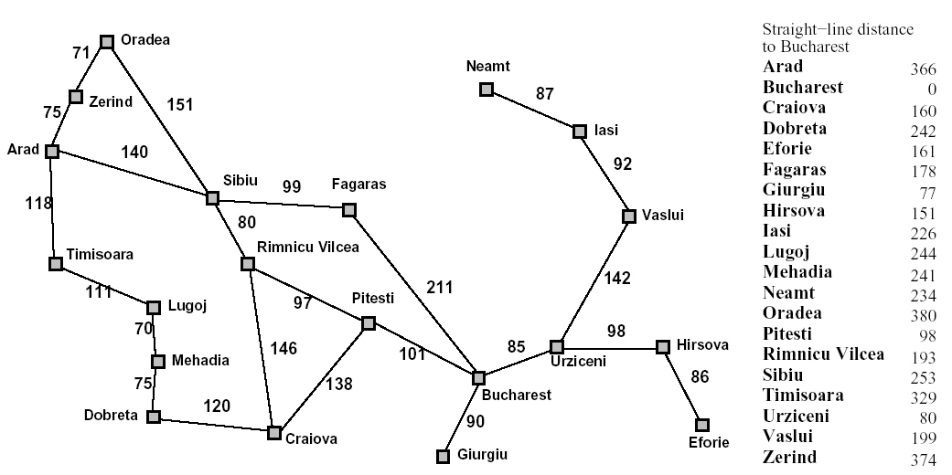
Back to Romania
start
end

Slide 15
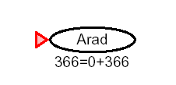
A* for Romanian Shortest Path

Slide 16
f(n) = g(n) + h(n)

Slide 20
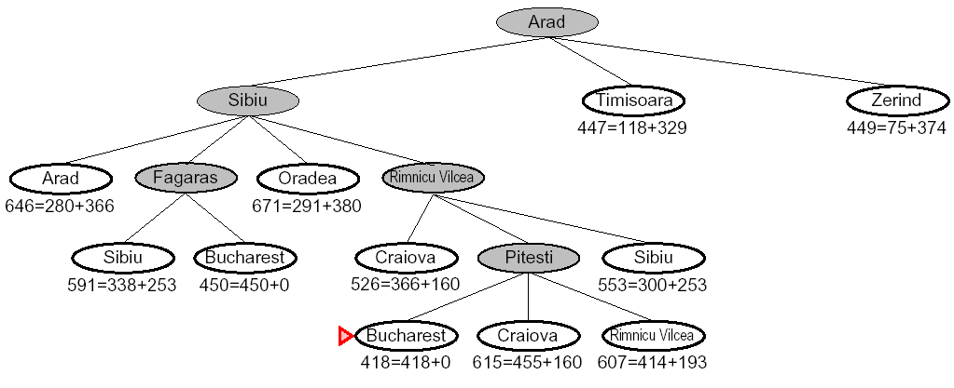

Slide 21
8 Puzzle Example
f(n) = g(n) + h(n)
What is the usual g(n)?
two well-known h(n)’s
h1 = the number of misplaced tiles
h2 = the sum of the distances of the tiles from their goal positions, using city block distance, which is the sum of the horizontal and vertical distances (Manhattan Distance)

Slide 22
8 Puzzle Using Number of Misplaced Tiles
2 3
4
7 6 5
g=0
h=4
f=4
8 3
6 4
7 5
goal
2 8 3
4
7 6 5
2 8 3
1 6 4
7 5
2 8 3
1 6 4
7 5

Slide 23
2 8 3
1 4
7 6 5
Exercise:
What are its children and their
f, g, h?

Slide 24
Optimality of A* with Admissibility (h never overestimates the cost to the goal)
Suppose a suboptimal goal G2 has been generated and
is in the queue. Let n be an unexpanded node on the
shortest path to an optimal goal G1.
f(n) = g(n) + h(n)
< g(G1) Why?
< g(G2) G2 is suboptimal
= f(G2) f(G2) = g(G2)
So f(n) < f(G2) and A* will never select
G2 for expansion.
n
G1
G2

Slide 25
Optimality of A* with Consistency (stronger condition)
h(n) is consistent if
for every node n
for every successor n´ due to legal action a
h(n) <= c(n,a,n´) + h(n´)
Every consistent heuristic is also admissible.
n
h(n)
c(n,a,n´)
h(n´)
n´
G

Slide 26
Algorithms for A*
Since Nillsson defined A* search, many different authors have suggested algorithms.
Using Tree-Search, the optimality argument holds, but you search too many states.
Using Graph-Search, it can break down, because an optimal path to a repeated state can be discarded if it is not the first one found.
One way to solve the problem is that whenever you come to a repeated node, discard the longer path to it.

Slide 27
The Rich/Knight Implementation
a node consists of
state
g, h, f values
list of successors
pointer to parent
OPEN is the list of nodes that have been generated and had h applied, but not expanded and can be implemented as a priority queue.
CLOSED is the list of nodes that have already been expanded.

Slide 28
Rich/Knight
/* Initialization */
OPEN <- start node
Initialize the start node
g:
h:
f:
CLOSED <- empty list

Slide 29
Rich/Knight
2) repeat until goal (or time limit or space limit)
if OPEN is empty, fail
BESTNODE <- node on OPEN with lowest f
if BESTNODE is a goal, exit and succeed
remove BESTNODE from OPEN and add it to CLOSED
generate successors of BESTNODE

Slide 30
Rich/Knight
for each successor s do
1. set its parent field
2. compute g(s)
3. if there is a node OLD on OPEN with the same state info as s
{ add OLD to successors(BESTNODE)
if g(s) < g(OLD), update OLD and
throw out s }

Slide 31
Rich/Knight/Tanimoto
4. if (s is not on OPEN and there is a node OLD on CLOSED with the same state
info as s
{ add OLD to successors(BESTNODE)
if g(s) < g(OLD), update OLD,
remove it from CLOSED
and put it on OPEN, throw out s
}

Slide 32
Rich/Knight
5. If s was not on OPEN or CLOSED
{ add s to OPEN
add s to successors(BESTNODE)
calculate g(s), h(s), f(s) }
end of repeat loop

