Slide 1
Homework: CNN

Slide 2
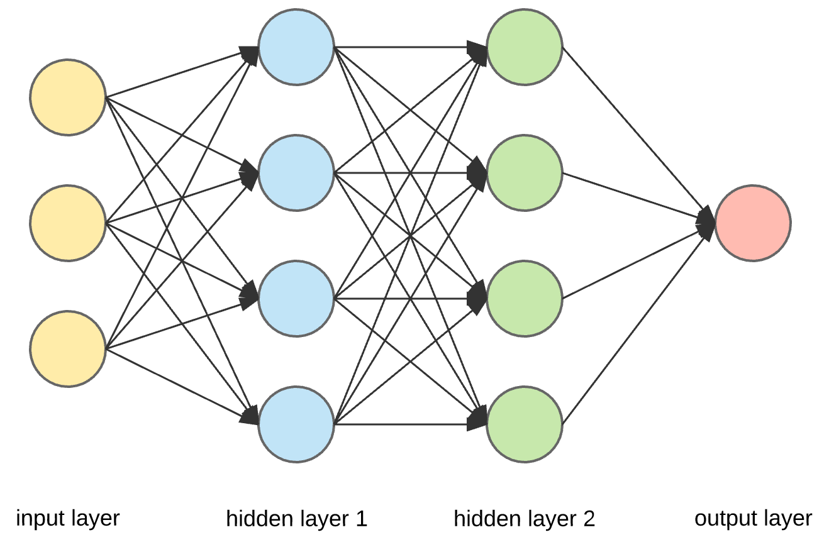
Neural Network (Q1)

Slide 3
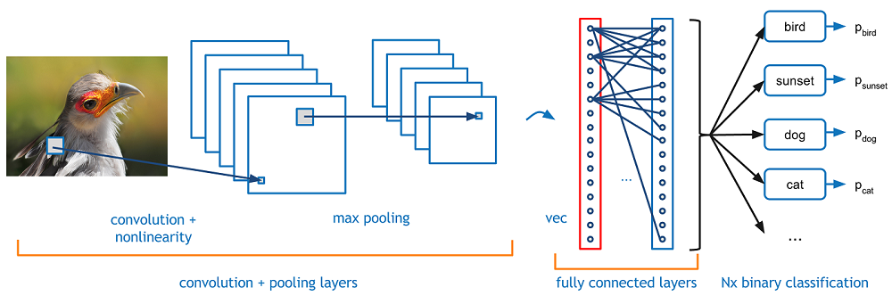
Convolutional Neural Network (Q2)
Conv
Pool
FC
Cross Entropy

Slide 4
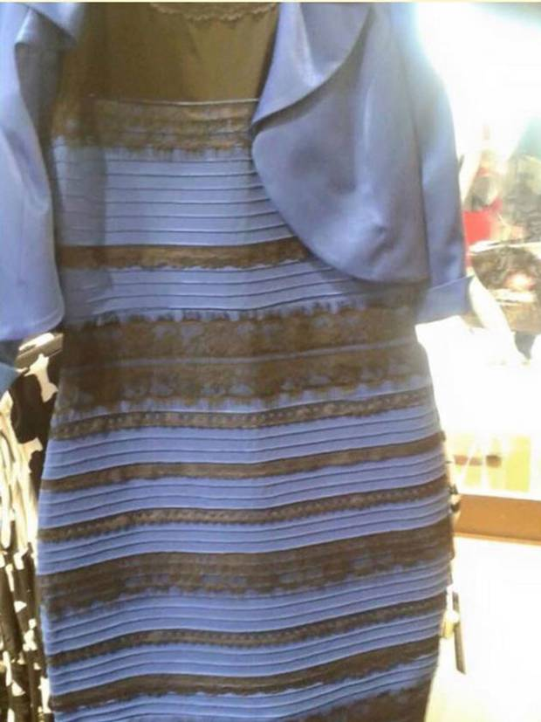
Yellow or Blue?

Slide 5
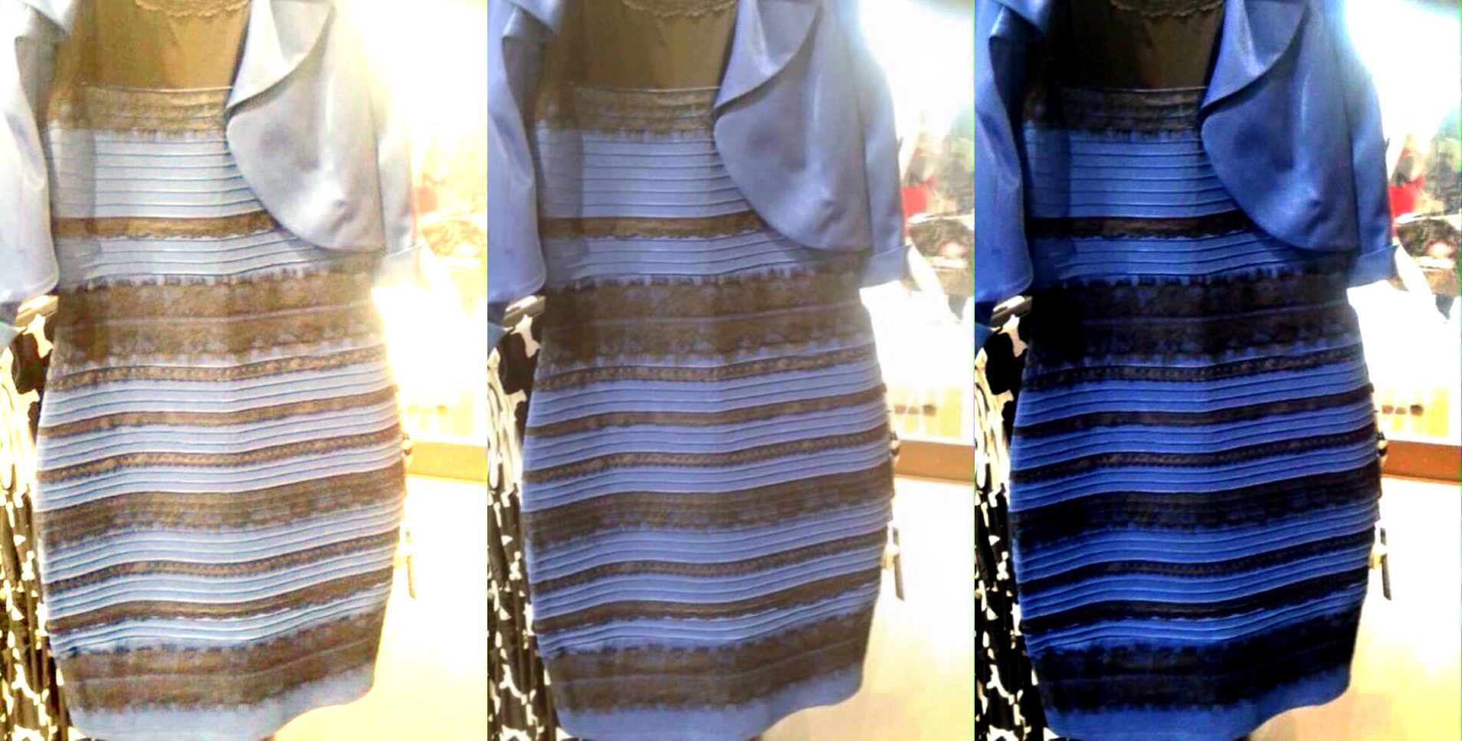
Color Normalization (Q3)

Slide 6
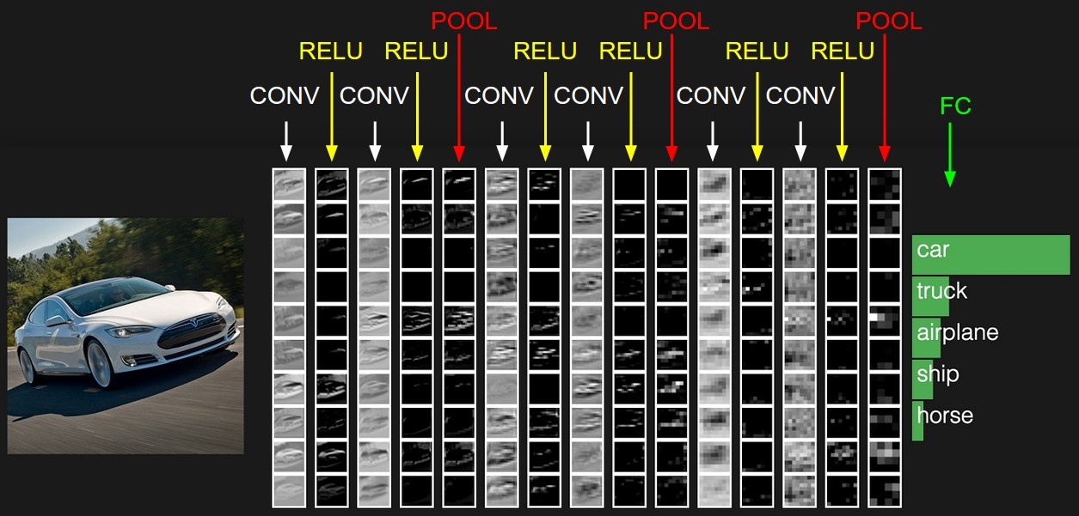
Deep Convolutional Neural Network (Q4)

Slide 7
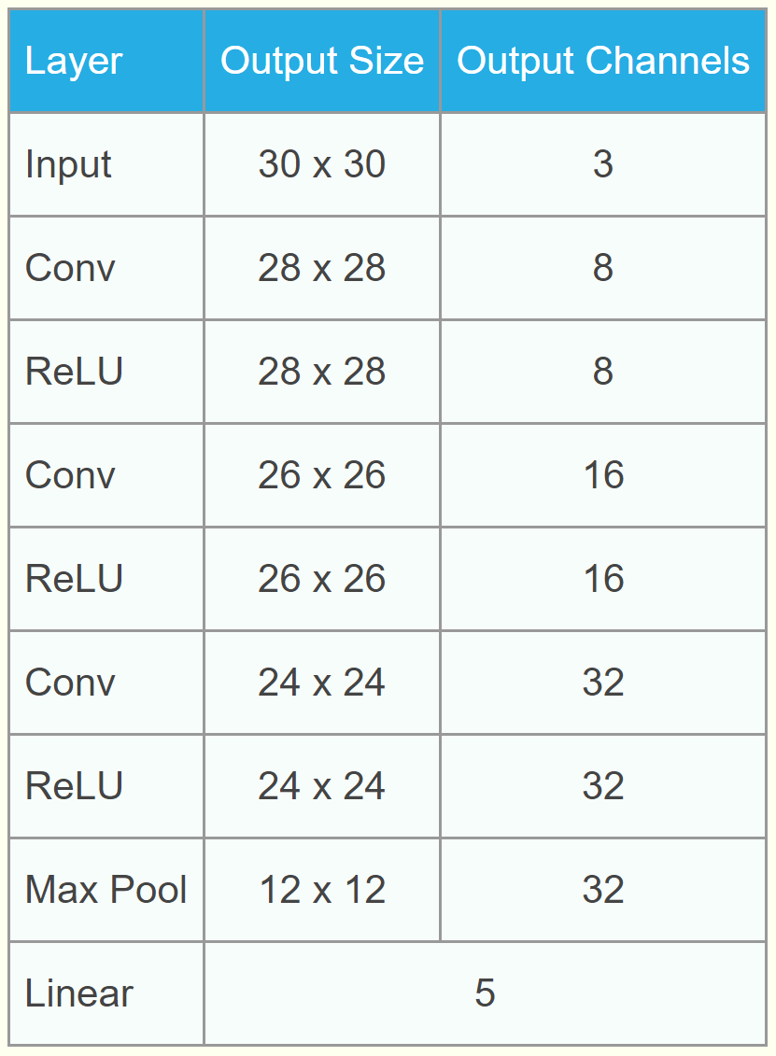
Make the Design More Flexible
Input:
[8, 16, 32, "pool"]

Slide 8
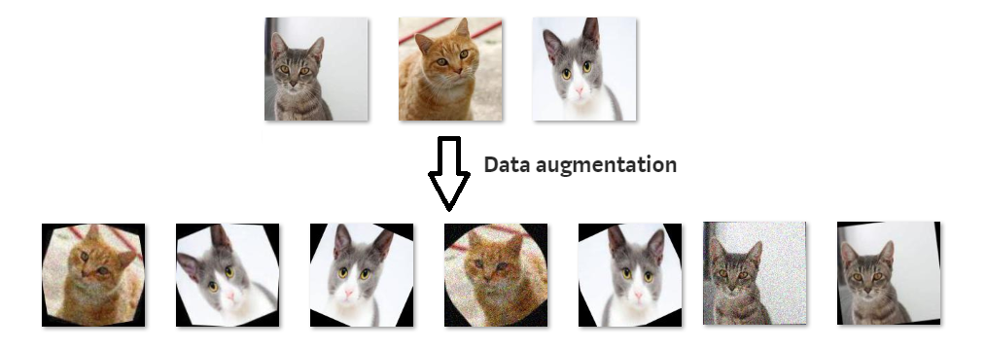
Data Augmentation (Q5)
Random Affine Transformation

Slide 9
Low-Resource
Neural Adaptation
Beibin Li
beibin@uw.edu
Feb/2021

Slide 10
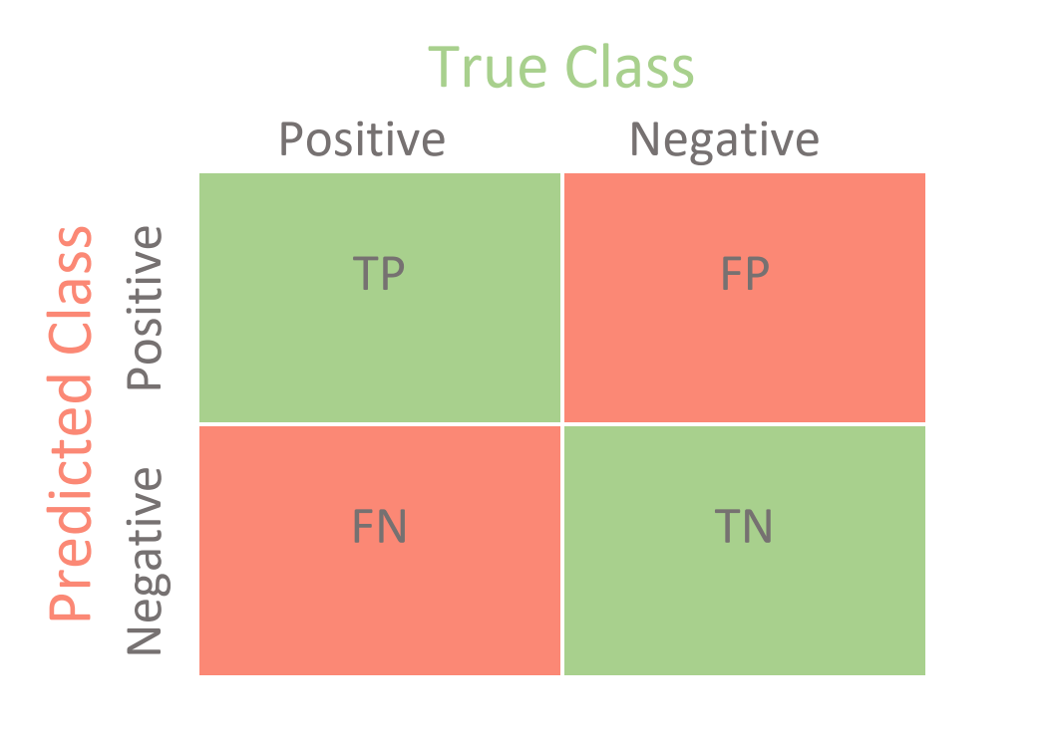
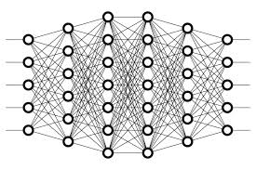
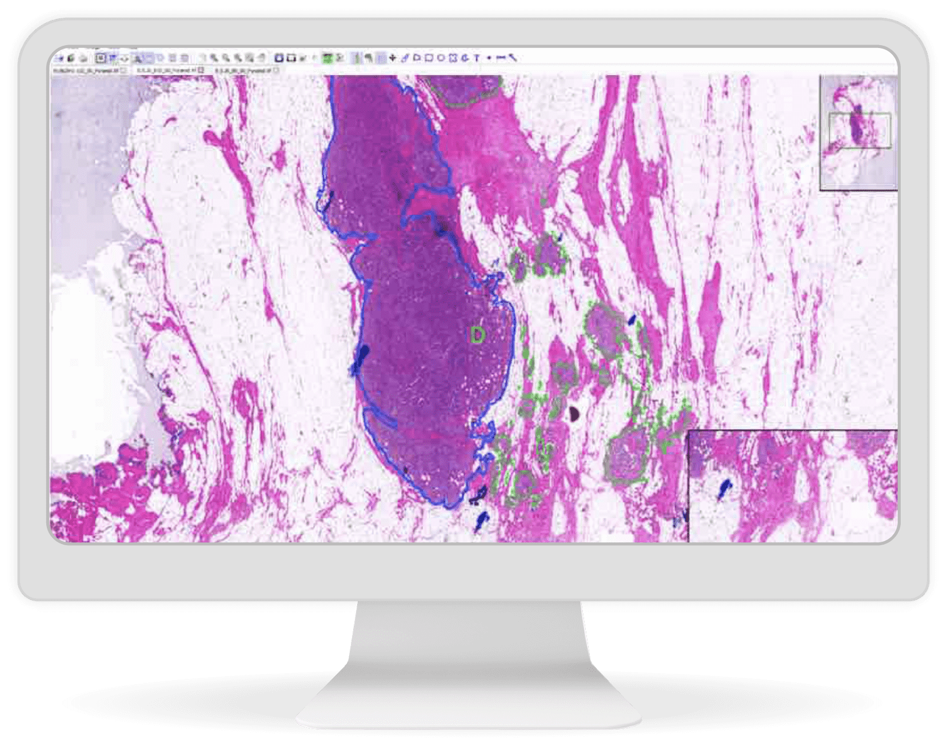
Traditional Machine Learning
Define the Problem
Collect Data
Train Model
Evaluate
Deploy
Breast Cancer

Slide 11
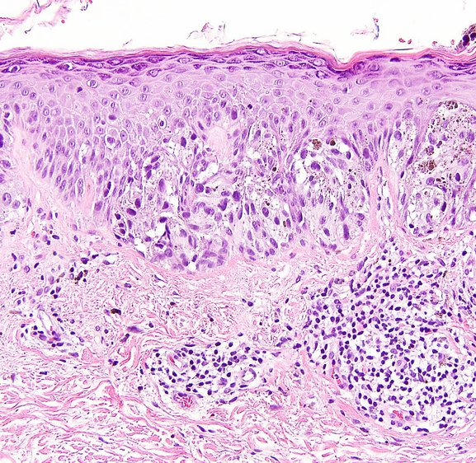
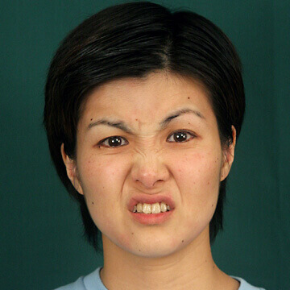
Challenges and Opportunities
During Training
Melanoma
Breast Cancer
During Deployment
Adults’ Expression
Children’s Expression

Slide 12
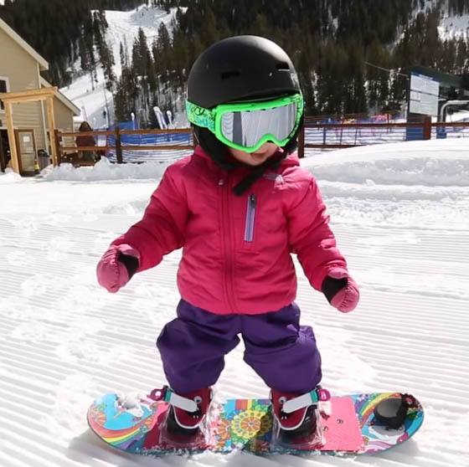
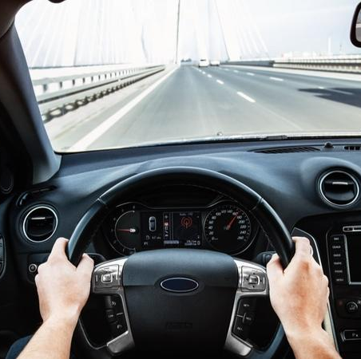
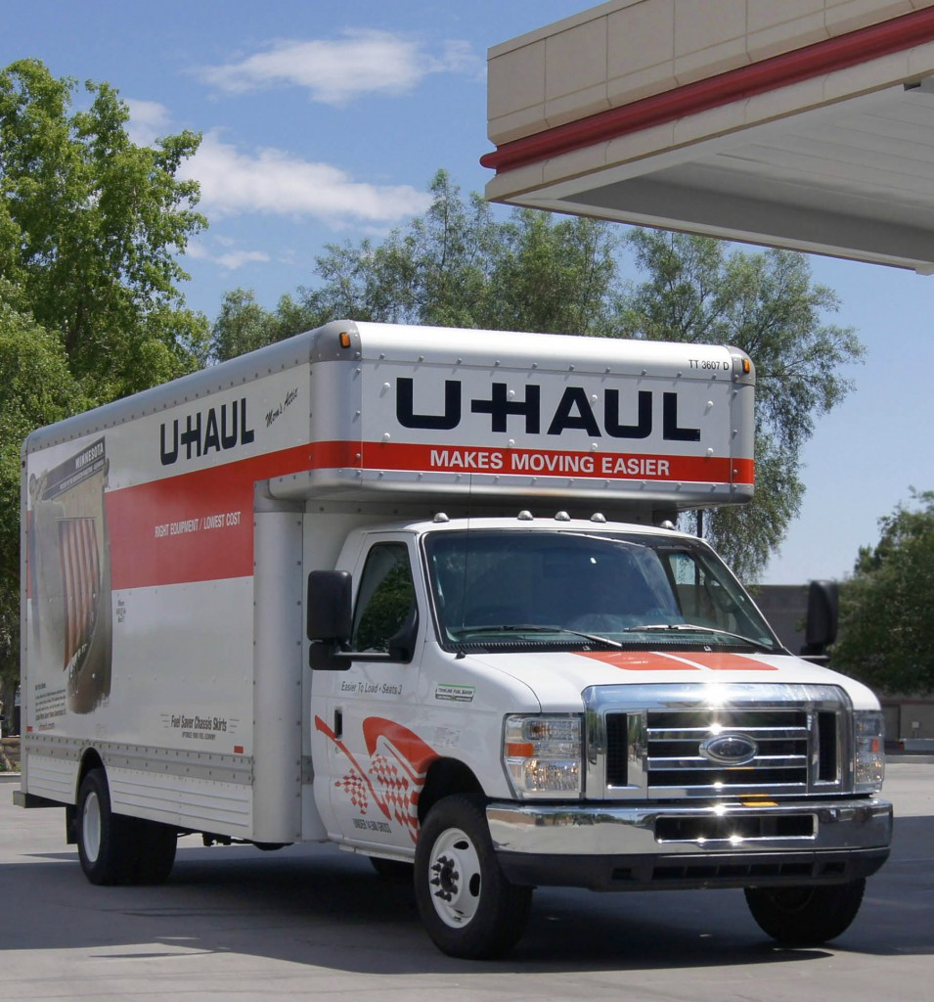
Adaptation in Humans: Fast and Good
During Learning
Skate
Snowboard
During Using
Drive car
Drive U-Haul Truck

Slide 13
How about Machines?
Can we do better and improve machine’s adaptation?

Slide 14
Learning
Inference
Adaptation
Utilize Prior Knowledge
Practice Different Tasks
Learn from Failure
Recognize Novel Samples
Estimate Confidence
Adjust Behavior

Slide 15
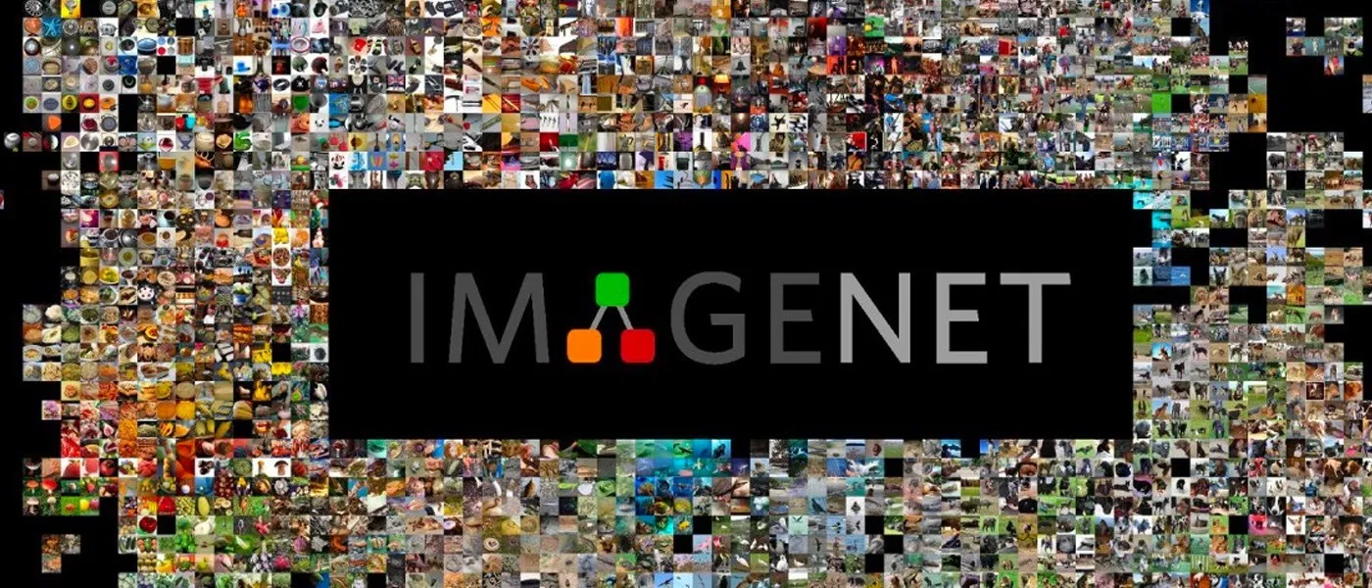
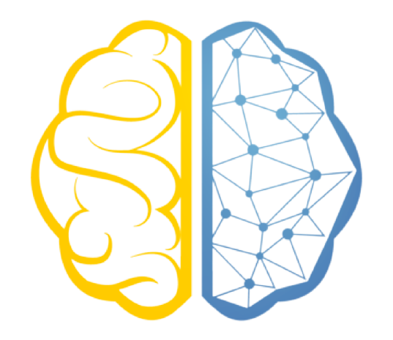
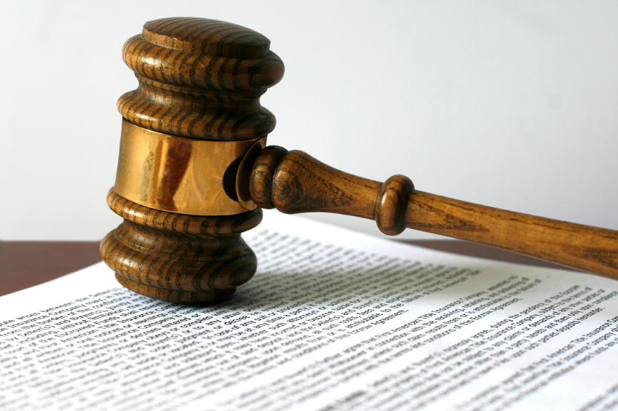
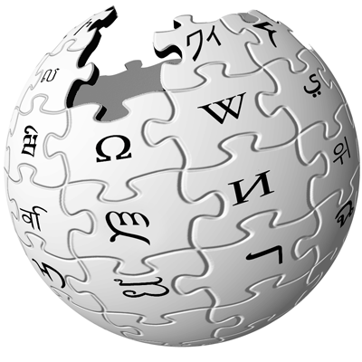
Adapting Knowledge
Big Data
Small Datasets
14+ Million Images
Medical Imaging
Foundation
Models
(Large, Powerful)
(Centralized, Federated)
WikiText-103: 100+ Million Tokens
Private Documents

Slide 16
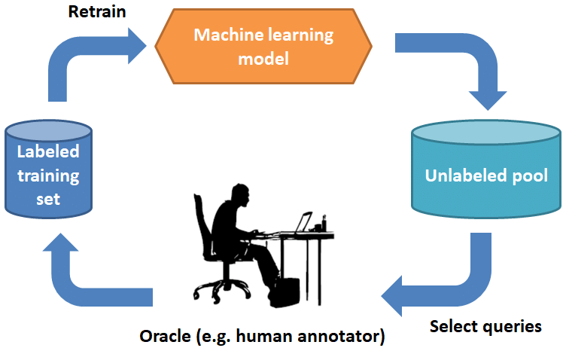
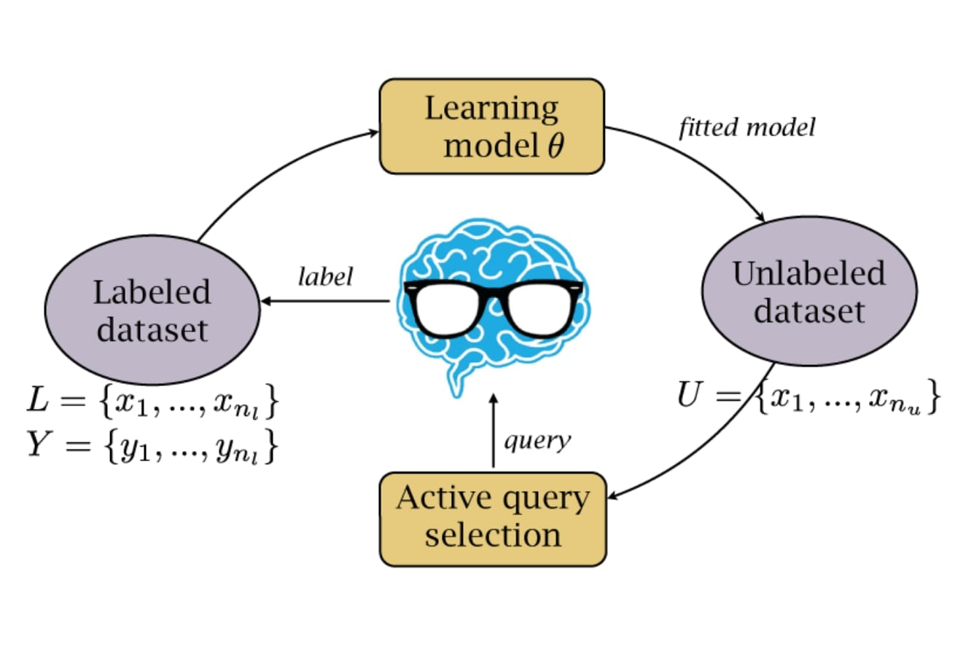
Adapting Shifts

Slide 17
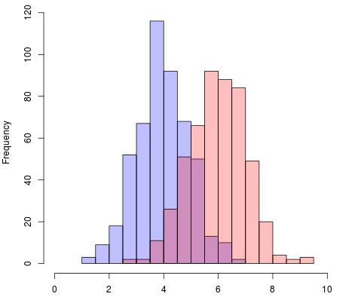
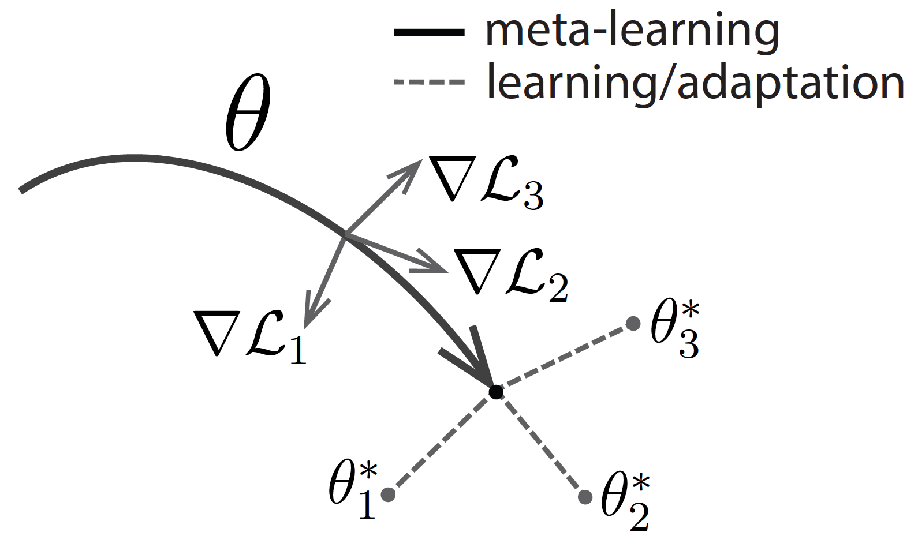
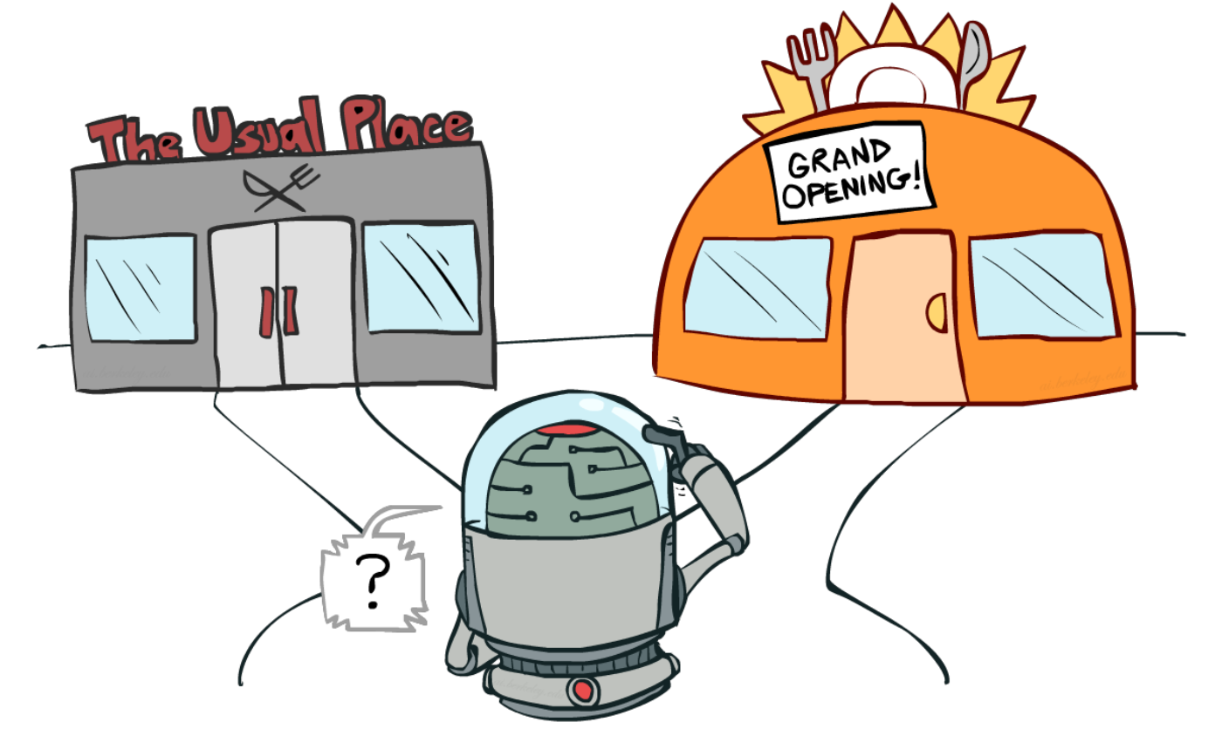
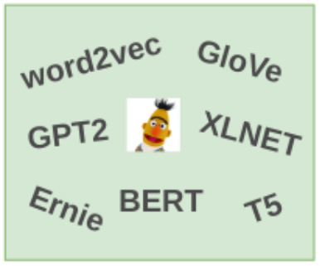
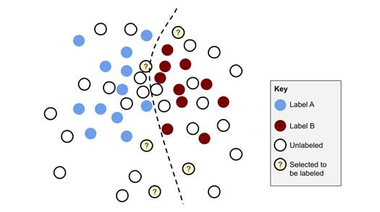
Prior Studies
Stats Analysis
Domain Adaptation
Meta Learning
Self-Supervision
Active Learning
Exploration v.s. Exploitation

Slide 18
They are Powerful,
But…

Slide 19
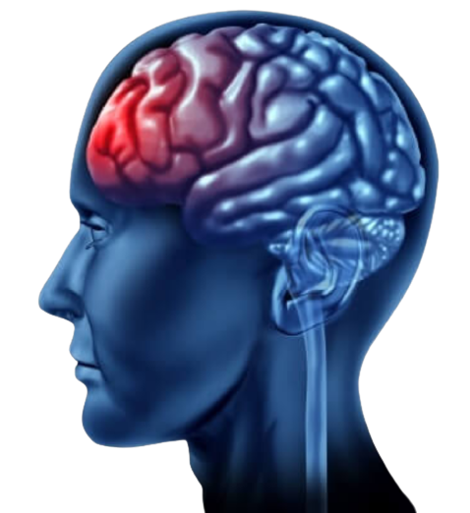
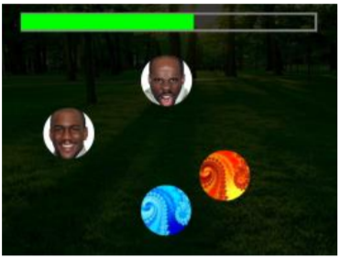
Unified Framework
in Human Brain!
Prefrontal Cortex
Executive Functioning Skills
Shifting
Inhibitory
Short-Term Memory
Confidence in Problem-Solving
Language Generation
Social Influences on Executive Functioning in Autism: Design of a Mobile Gaming Platform.
Li, B., et al. In Proceedings of the SIGCHI Conference on Human Factors in Computing Systems (p. 443) (ACM SIGCHI 2018).
Memory Deficit in Patients with Temporal Lobe Epilepsy: Evidence from Eye Tracking Technology Zhu, G., et al. Frontiers in Neuroscience 2021

Slide 20
Translate DL for Real World
Bringing state-of-the-art adaptation techniques into real-world applications for private entities (e.g., due to HIPAA, privacy, labeling cost, etc.).

Slide 21
Motivation
We need a Unified framework for these various ML tasks
Build in-house private foundation models for low-resource data

Slide 22
Method
An unified pipeline to adapt shifting in low-resource learning

Slide 23
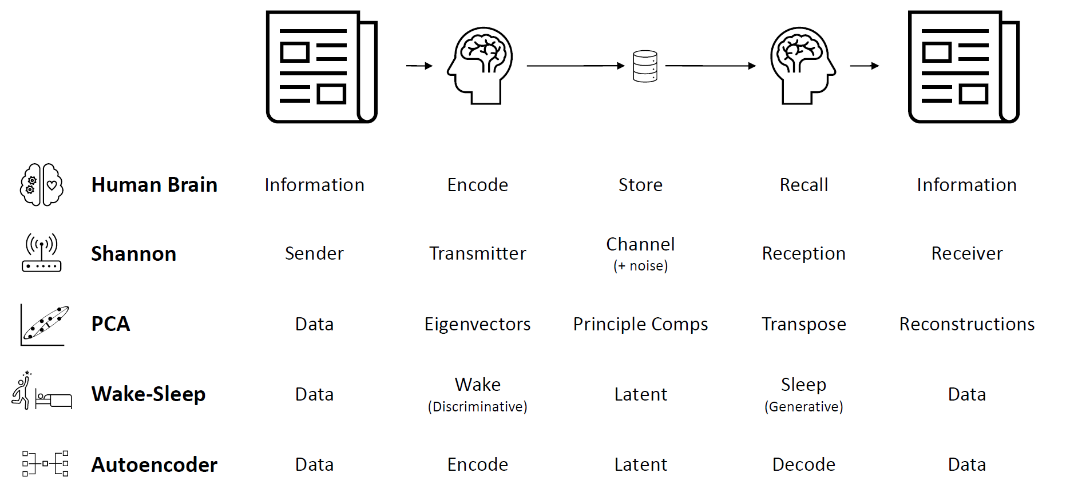

Slide 24
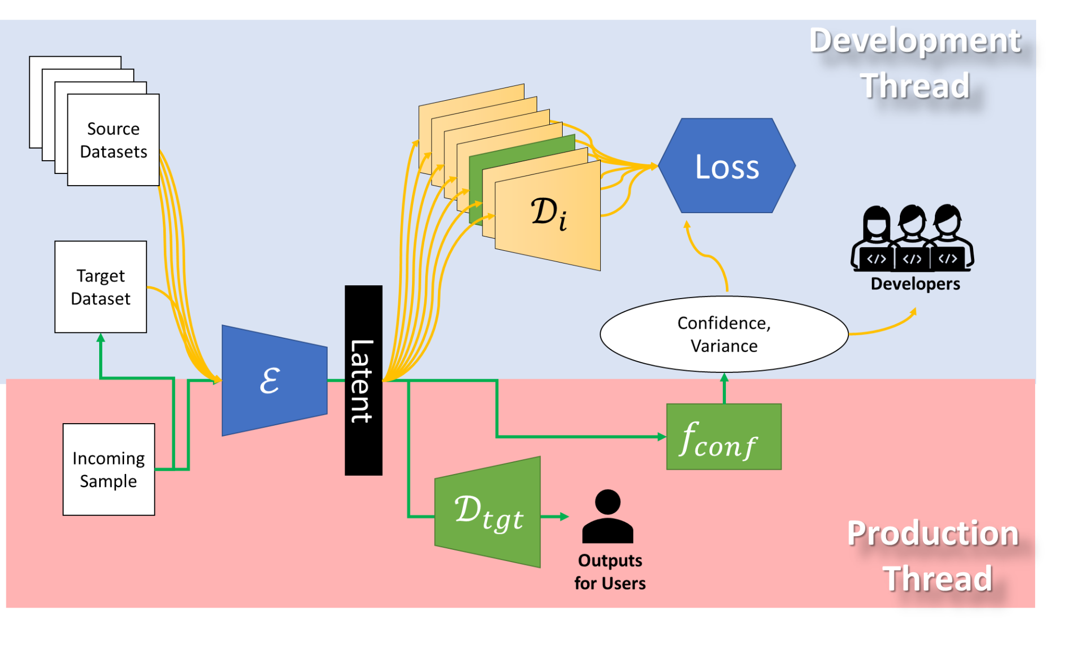

Slide 25
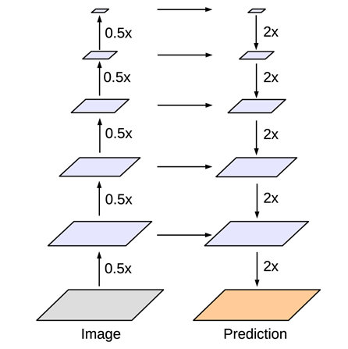
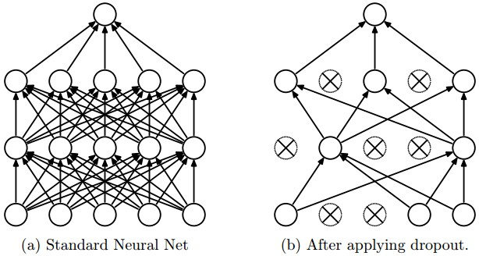
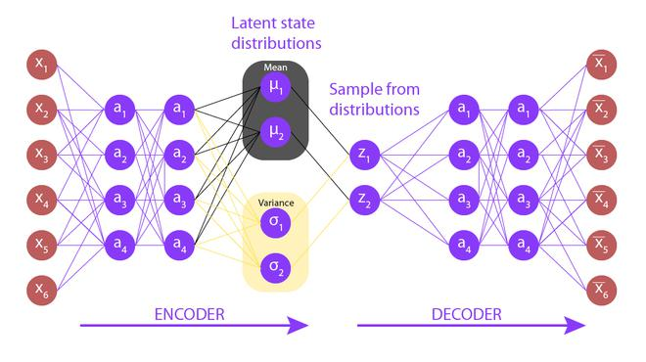
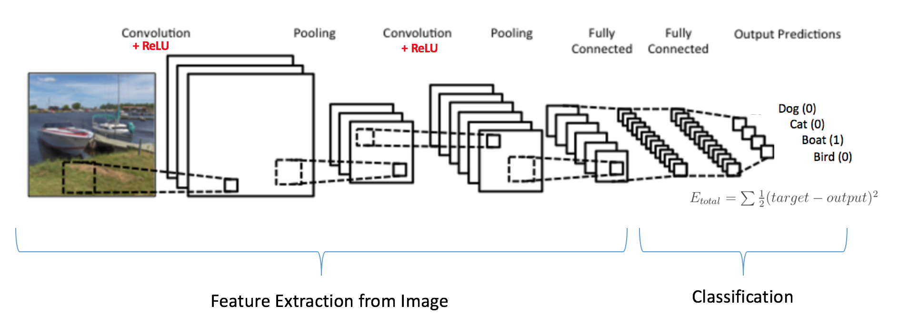
Encoder
Residual Option
Variational Bayes Option
Dropout Mechanism

Slide 26
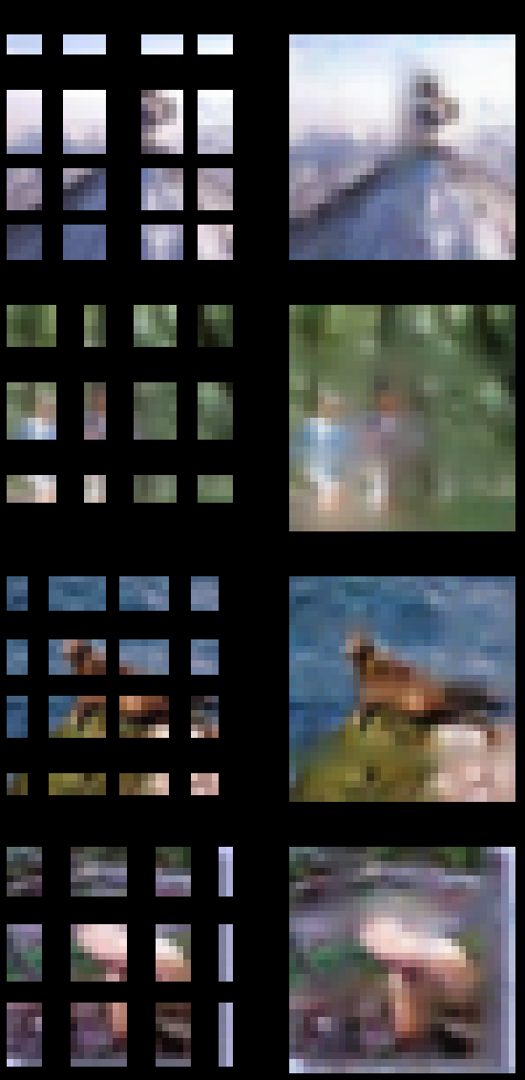
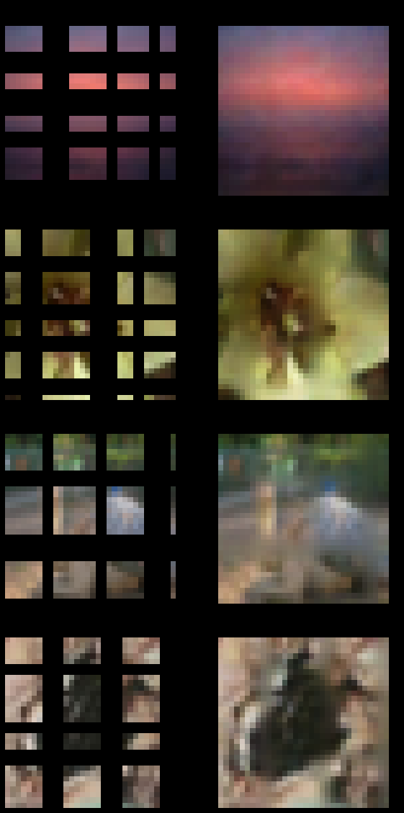
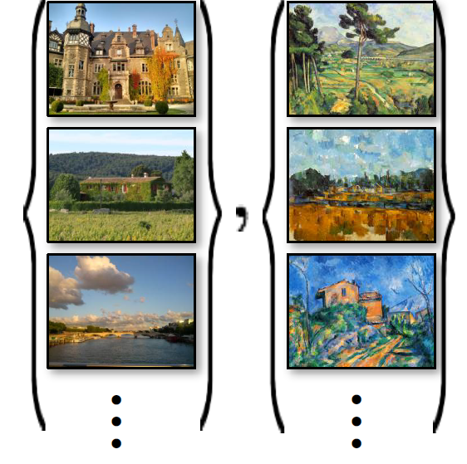
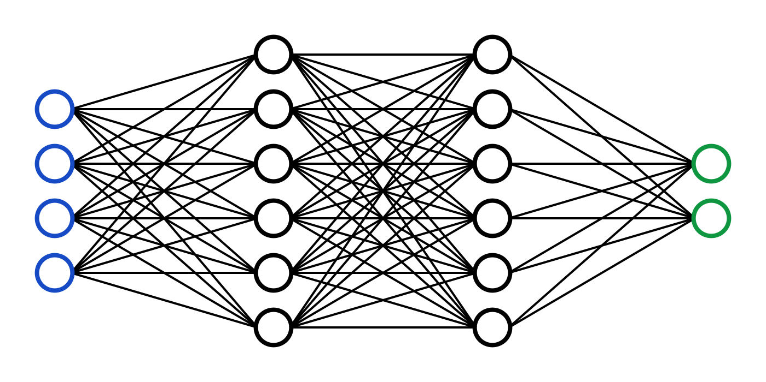
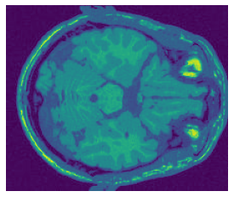
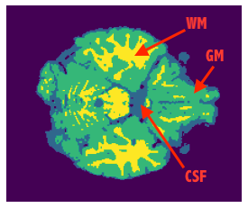
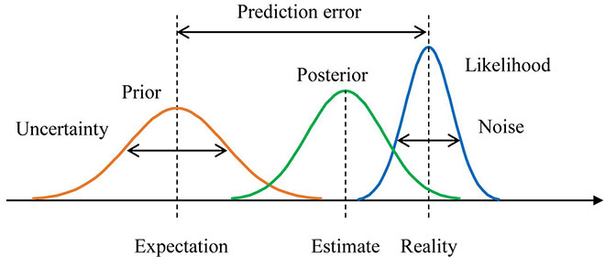
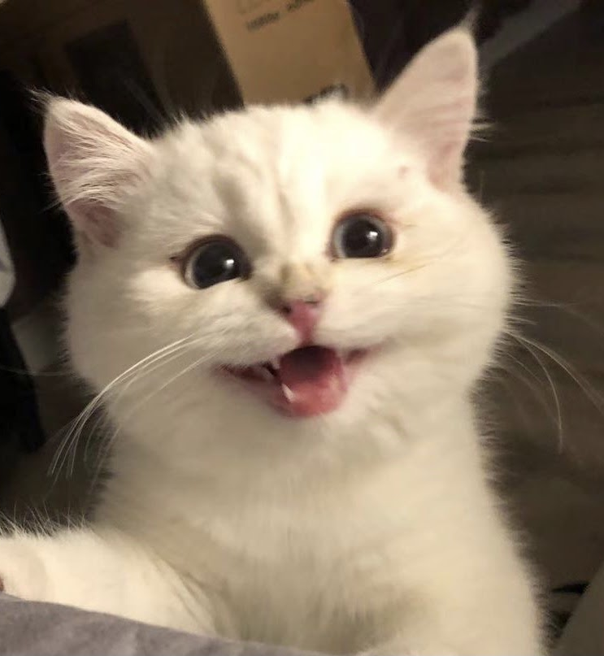
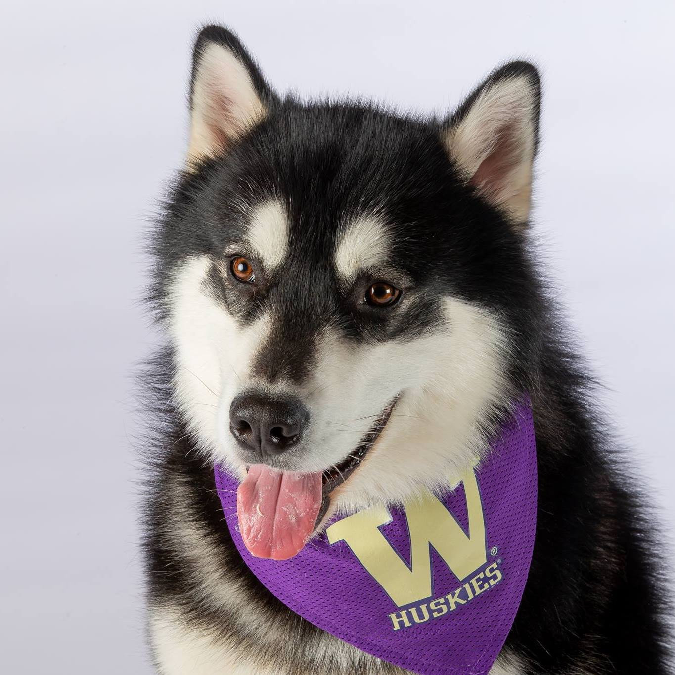
Decoders and Tasks
Classify, Regress
Reconst, Recover
Generate
Segment, Detect
Contrastive
f(Confidence Esti.)

Slide 27
Medical Imaging

Slide 28
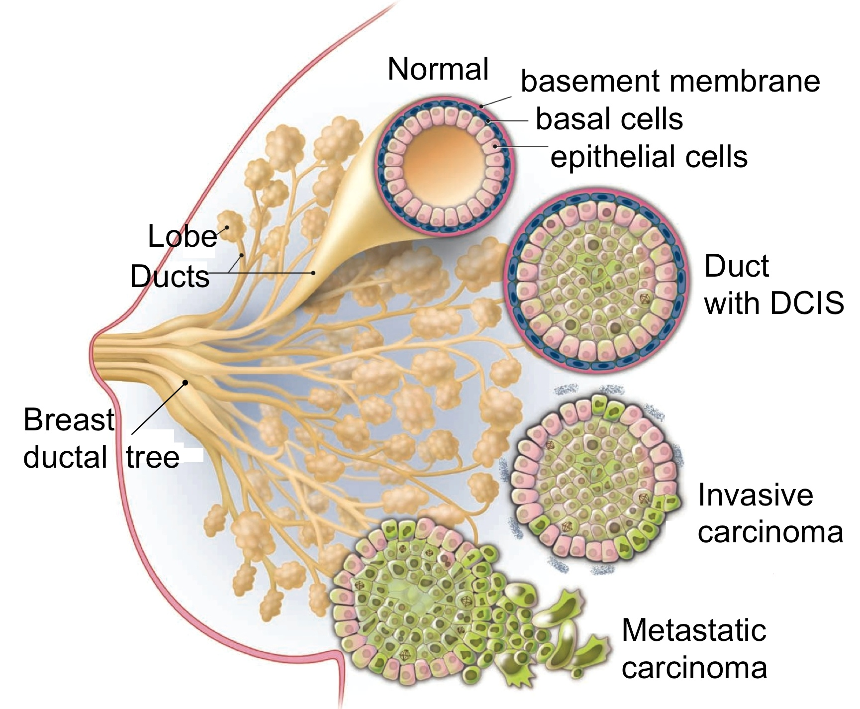
Ducts: for Breast Cancer Diagnosis
Important Region for Diagnosis
Interpretable Intermediate Results
Only 240 Images (Biopsies) in the Dataset
No Duct Label
Classifying Breast Histopathology Images with a Ductal Instance-Oriented Pipeline
Li, B.; Mercan, E.; Mehta, S.; Knezevich, S.; Arnold, C.; Weaver, D.; Elmore, J.; Shapiro, L.
In 2020 25th International Conference on Pattern Recognition. IEEE.

Slide 29
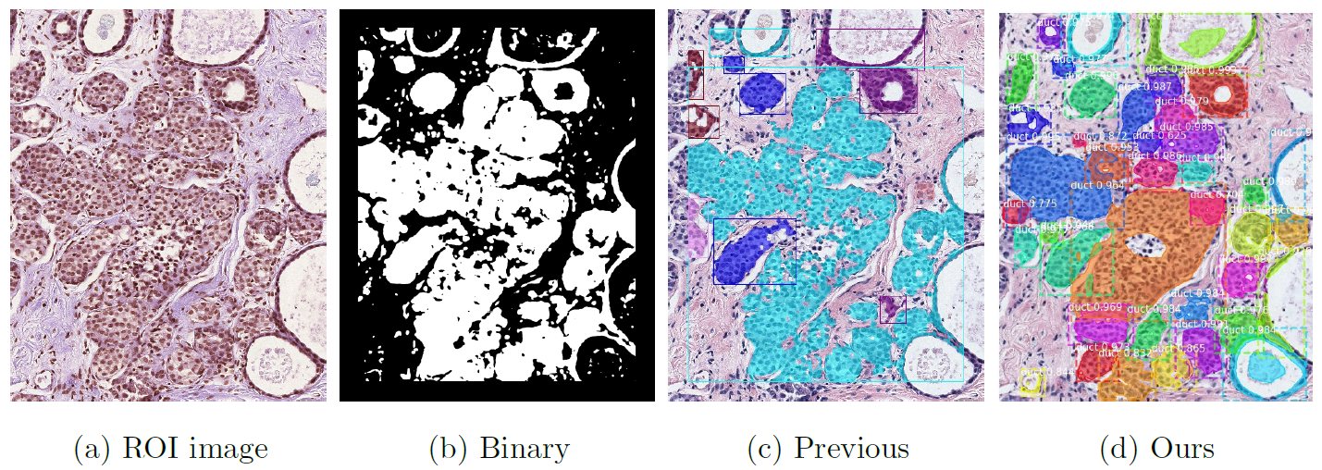
Ductal Instance Identification

Slide 30
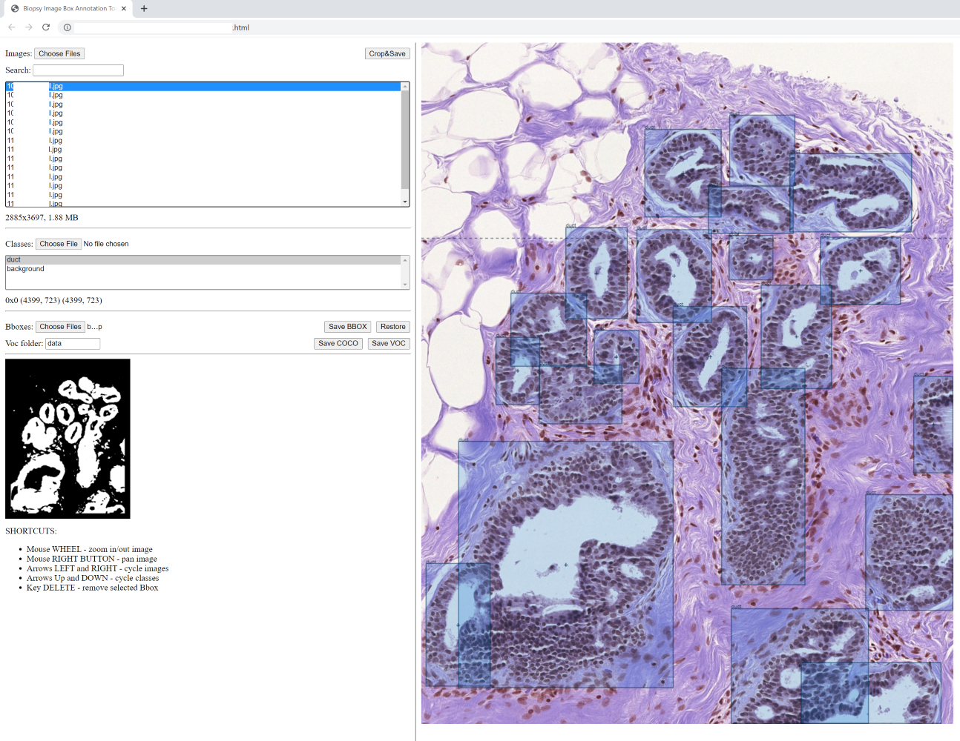
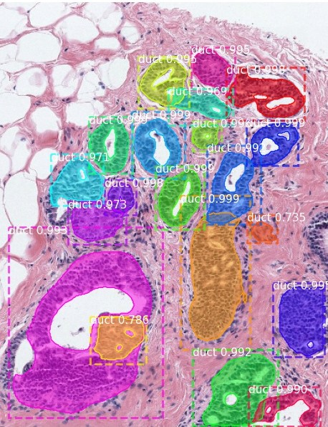
Weakly Supervised Annotation
Human-AI Collaboration
Weakly Supervised Labeling
Combines
Machine’s Semantic Prediction
Human Box Annotation
Instance Segmentation Labels
Silver Standard

Slide 31
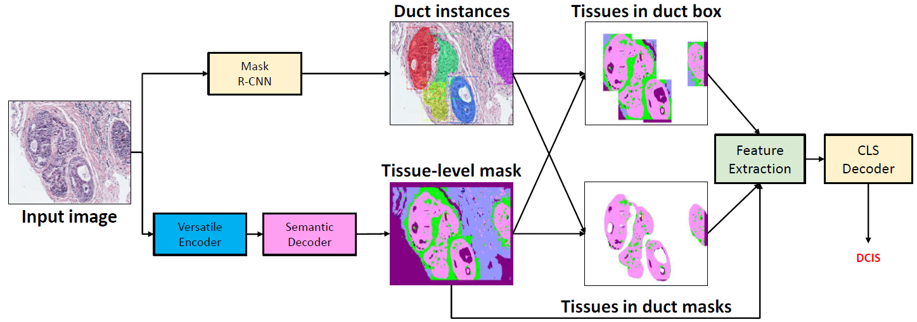
Diagnostic Performance

Slide 32
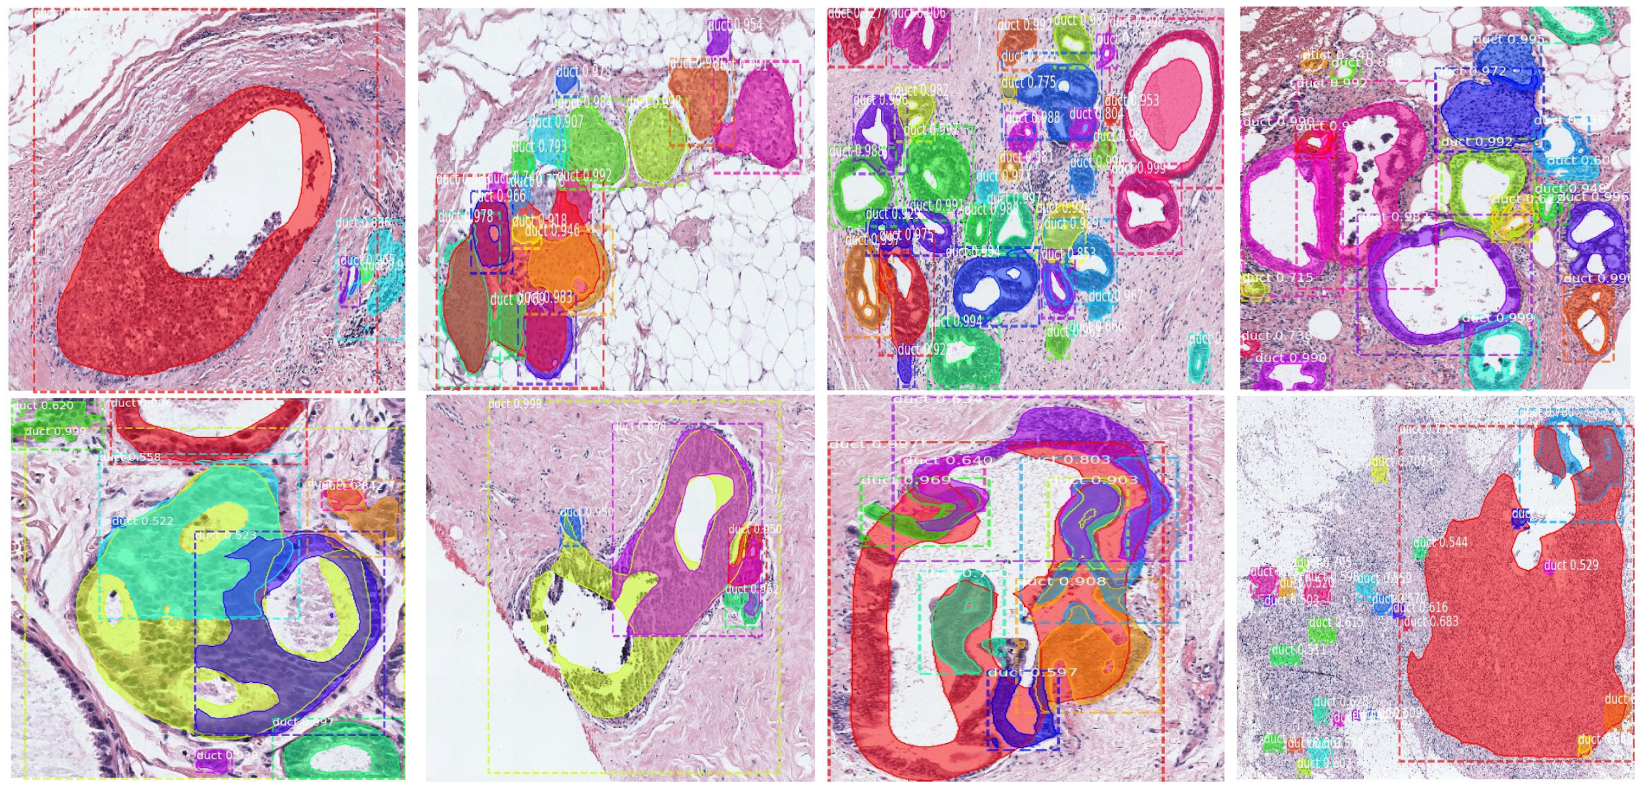
Instance Segmentation Results
Good
Imperfect

Slide 33
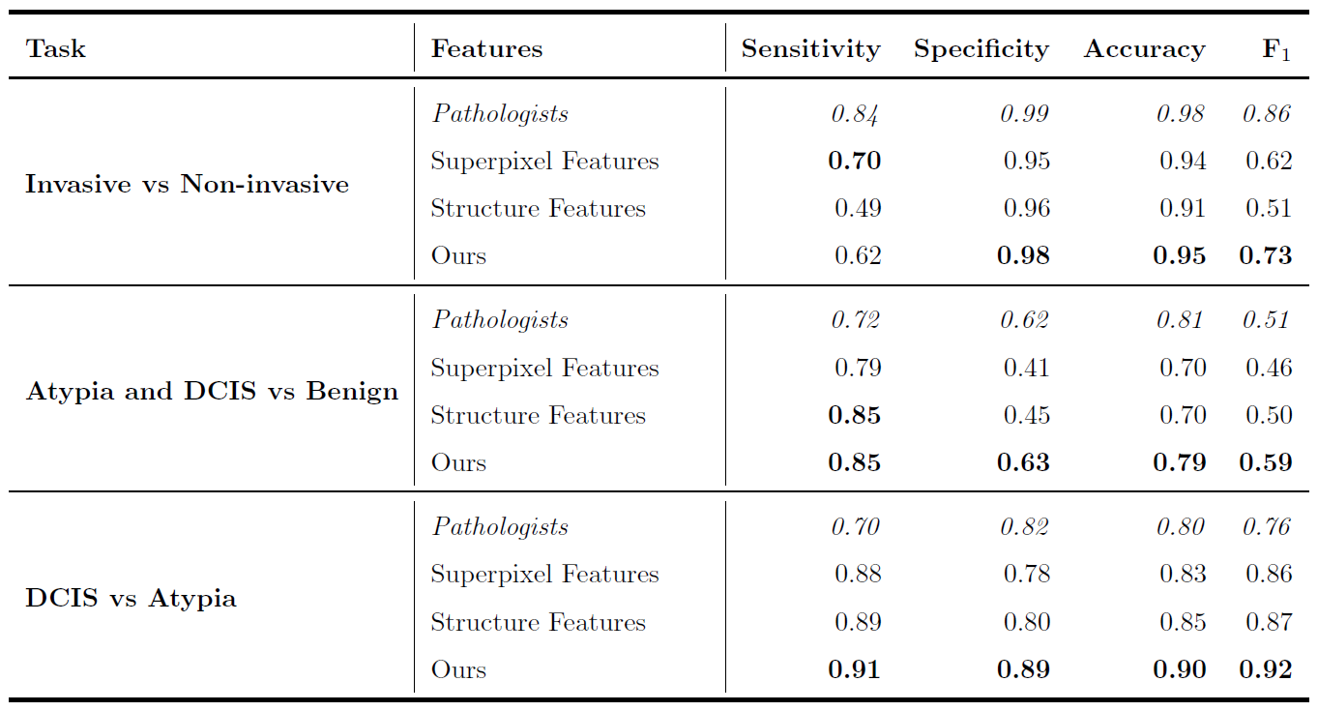
Diagnostic Results

Slide 34
Ablation Experiments
Malignant Epithelium (BE) and Necrosis (NC) co-occurs
Benign Epithelium (BE) near Boundary (BD)
Necrosis (NC) near Boundary (BD)

Slide 35
Behavior Analysis

Slide 36
Data Collection
From iPad Air 2 or iPad 5th Generation
88 participants
49 children with ASD
39 typically developing (TD) peers
Disclaimer: During our experiments, informed consent was obtained from parents of all children, and all study procedures were designed in accordance with the World Medical Association Declaration of Helsinki - Ethical Principles for Medical Research Involving Human Subjects as well as in compliance with HIPAA to preserve privacy. The Institutional Review Boards approved these studies of Yale University, Seattle Children’s Research Institute, and the University of Washington.

Slide 37
Multi-Task Learning in Affective Computing
A Facial Affect Analysis System for Autism Spectrum Disorder
Li, B.; Mehta, S.; Aneja, D.; Foster, C.; Ventola, P.; Shic, F.; Shapiro, L.
In Proceedings of the IEEE International Conference on Image Processing (ICIP 2019)

Slide 38
Results
Benitez-Quiroz, Carlos Fabian, Yan Wang, and Aleix M. Martinez. "Recognition of Action Units in the Wild with Deep Nets and a New Global-Local Loss." ICCV. 2017.
Benitez-Quiroz, C. Fabian, et al. "EmotioNet Challenge: Recognition of facial expressions of emotion in the wild." arXiv preprint arXiv:1703.01210 (2017).
Mollahosseini, Ali, Behzad Hasani, and Mohammad H. Mahoor. "AffectNet: A Database for Facial Expression, Valence, and Arousal Computing in the Wild." IEEE Transactions on Affective Computing (2017).

Slide 39
Gaze Estimation (Face to Gaze)

Slide 40
Severity of Data Shift (Post-Hoc)
GazeCapture

Slide 41
Adaptation (Calibration) Performance

Slide 42
Scanpath Analysis
Learning Oculomotor Behaviors from Scanpath Data. Li, B.; Nuechterlein, N.; Barney, E.; Foster, C.; Kim, M.; Mahony, M.; Atyabi, A.; Feng, L.; Wang, Q.; Ventola, P.; Shapiro, L.; Shic, F. In 2021 ACM International Conference In Multi-modal Interaction (ICMI).

Slide 43
Application Group Classification

Slide 44
Query Optimization in DBMS

Slide 45
Cardinality Estimation
SELECT p.Name AS ProductName,
NonDiscountSales = (OrderQty * UnitPrice),
Discounts = ((OrderQty * UnitPrice) * UnitPriceDiscount)
FROM Production.Product AS p
JOIN Sales.SalesOrderDetail AS sod
ON p.ProductID = sod.ProductID
ORDER BY ProductName DESC;
Cardinality Estimation: Is Machine Learning a Silver Bullet? Li, B.; Lu, Y.; Wang, C.; Kandula, S.. The 3rd International Workshop on Applied AI for Database Systems and Applications (AIDB).
Q-error Bounds of Random Uniform Sampling for Cardinality Estimation. Li, B.; Lu, Y.; Wang, C.; Kandula, S..
Warper: Efficiently Adapting Learned Cardinality Estimators to Data and Workload Drifts. Li, B.; Lu, Y.; Wang, C.; Kandula, S..

Slide 46
Data Shift After Deployment

Slide 48
Discussion

Slide 49
Future Work
Apply and Test on More Modalities (NLP, DNA, …)
More Theoretical Analyses
Multi-Encoder
Improve User Interface for AutoML
Federated Learning, Decentralized Learning
Diversity, Equality, Fairness, and Bias

Slide 50
Next ...
Ours
Big Data
Small Data
Improve

Slide 51
Thanks!

