Slide 1
Constraint Satisfaction Problems
Must be
Hot&Sour
Soup
No
Peanuts
Chicken
Dish
Appetizer
Total Cost
< $30
Pork Dish
No
Peanuts
Vegetable
Not Both
Spicy
Seafood
Rice
Not
Chow Mein
Constraint Network
Notes:
Unary, binary and N-ry constraints.

Slide 2
Formal Definition of CSP
A constraint satisfaction problem (CSP) is a triple (V, D, C) where
V is a set of variables X₁, ... , X_{n}.
D is the union of a set of domain sets D₁,...,D_{n}, where D_{i} is the domain of possible values for variable X_{i}.
C is a set of constraints on the values of the variables, which can be pairwise (simplest and most common) or k at a time.

Slide 3
CSPs vs. Standard Search Problems
Standard search problem:
state is a "black box“ – any data structure that supports successor function, heuristic function, and goal test
CSP:
state is defined by variables X_{i} with values from domain D_{i}
goal test is a set of constraints specifying allowable combinations of values for subsets of variables
Simple example of a formal representation language
Allows useful general-purpose algorithms with more power than standard search algorithms

Slide 4
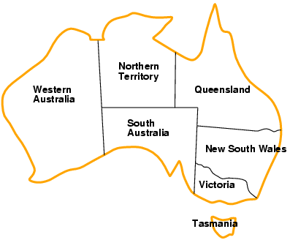
Example: Map-Coloring
memorize
the names
Variables WA, NT, Q, NSW, V, SA, T
Domains D_{i} = {red,green,blue}
Constraints: adjacent regions must have different colors
e.g., WA ≠ NT, or (WA,NT) in {(red,green),(red,blue),(green,red), (green,blue),(blue,red),(blue,green)}

Slide 5
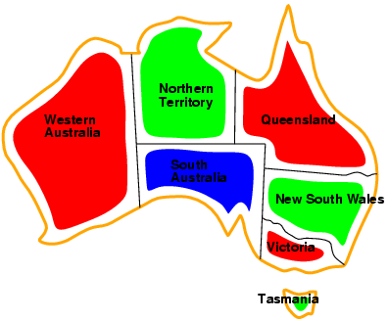
Example: Map-Coloring
Solutions are complete and consistent assignments, e.g., WA = red, NT = green,Q = red,NSW = green,V = red,SA = blue,T = green

Slide 6
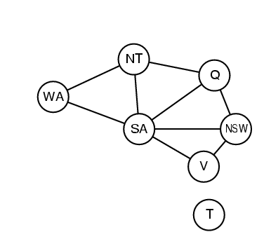
Constraint graph
Binary CSP: each constraint relates two variables
Constraint graph: nodes are variables, arcs are constraints

Slide 7
Varieties of constraints
Unary constraints involve a single variable,
e.g., SA ≠ green
Binary constraints involve pairs of variables,
e.g., value(SA) ≠ value(WA)
More formally, R1 <> R2 -> value(R1) <> value(R2)
Higher-order constraints involve 3 or more variables,
e.g., cryptarithmetic column constraints

Slide 8
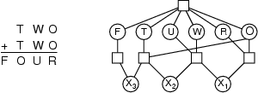
Example: Cryptarithmetic
Variables:
{F, T, U, W, R, O, X_{1,} X_{2,} X₃}
Domains: {0,1,2,3,4,5,6,7,8,9}
Constraints: Alldiff (F,T,U,W,R,O)
O + O = R + 10 · X₁
X₁ + W + W = U + 10 · X₂
X₂ + T + T = O + 10 · X₃
X₃ = F, T ≠ 0, F ≠ 0
X₃ =F= 1
X₁ = 0
X₁ = 1
R < 10, 2O = R+10 X₁
R is even?

Slide 9
Example: Latin Squares Puzzle
X₁₁ X₁₂ X₁₃ X₁₄
X₂₁ X₂₂ X₂₃ X₂₄
X₃₁ X₃₂ X₃₃ X₃₄
X₄₁ X₄₂ X₄₃ X₄₄
red RT RS RC RO
green GT GS GC GO
blue BT BS BC BO
yellow YT YS YC YO
Variables Values
Constraints: In each row, each column, each major diagonal, there must
be no two markers of the same color or same shape.
How can we formalize this?
V: {X_{il} | i=1to 4 and l=1to 4}
D: {(C,S) | C ε {R,G,B,Y} and S ε {T,S,C,O}}
C: val(X_{il}) <> val(X_{in}) if l <> n (same row)
val(X_{il)} <> val(X_{nl}) if i <> n (same col)
val(X_{ii}) <> val(X_{ll}) if i <> l (one diag)
i+l=n+m=5 -> val(X_{il}) <> val(X_{nm}), il <> nm

Slide 10
Real-world CSPs
Assignment problems
e.g., who teaches what class
Timetabling problems
e.g., which class is offered when and where?
Transportation scheduling
Factory scheduling
Notice that many real-world problems involve real-valued variables

Slide 11
The Consistent Labeling Problem
Let P = (V,D,C) be a constraint satisfaction problem.
An assignment is a partial function f : V -> D that assigns
a value (from the appropriate domain) to each variable
A consistent assignment or consistent labeling is an
assignment f that satisfies all the constraints.
A complete consistent labeling is a consistent labeling
in which every variable has a value.

Slide 12
Standard Search Formulation
state: (partial) assignment
initial state: the empty assignment { }
successor function: assign a value to an unassigned variable that does not conflict with current assignment
→ fail if no legal assignments
goal test: the current assignment is complete
(and is a consistent labeling)
This is the same for all CSPs regardless of application.
Every solution appears at depth n with n variables → we can use depth-first search.
Path is irrelevant, so we can also use complete-state formulation.

Slide 13
What Kinds of Algorithms are used for CSP?
Backtracking Tree Search
Tree Search with Forward Checking
Tree Search with Discrete Relaxation (arc consistency,
k-consistency)
Many other variants
Local Search using Complete State Formulation

Slide 14
Backtracking Tree Search
Variable assignments are commutative}, i.e.,
[ WA = red then NT = green ] same as [ NT = green then WA = red ]
Only need to consider assignments to a single variable at each node.
Depth-first search for CSPs with single-variable assignments is called backtracking search.
Backtracking search is the basic uninformed algorithm for CSPs.
Can solve n-queens for n ≈ 25.

Slide 15
Subgraph Isomorphisms
Given 2 graphs G1 = (V,E) and G2 = (W,F).
Is there a copy of G1 in G2?
V is just itself, the vertices of G1
D = W
f: V -> W
C: (v1,v2) ε E => (f(v1),f(v2)) ε F

Slide 16
Example
adjacency relation
Is there a copy of the snowman on the left in the
picture on the right?

Slide 17
Graph Matching Example
Find a subgraph isomorphism from R to S.
R
Note: there’s an edge from
1 to 2 in R, but no edge
from a to b in S
1
2
4
Note: must
be 1:1
(1,a) (1,b) (1,c) (1,d) (1,e)
3
“snowman”
(2,a) (2,b) (2,c) (2,d) (2,e)
X X X
S
e
(3,a) (3,b) (3,c) (3,d) (3,e) (3,a) (3,b) (3,c) (3,d) (3,e)
X X X X X X X X X
a
c
(4,a) (4,b) (4,c) (4,d) (4,e)
X X X X
b
d
“snowman with hat and arms”

Slide 18
Backtracking Search
1.
2.
3.
One variable at each tree level
Try all values for that variable (depth first)
Check for consistency, backup if not consistent

Slide 19
Backtracking Example

Slide 20
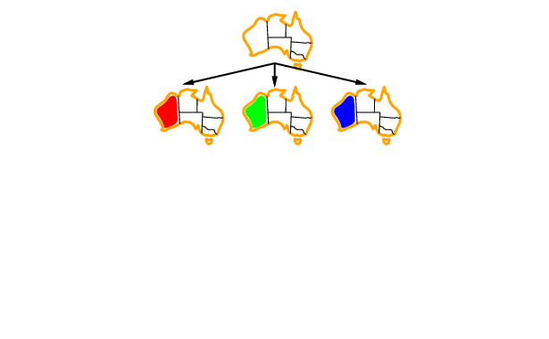
Backtracking Example

Slide 21
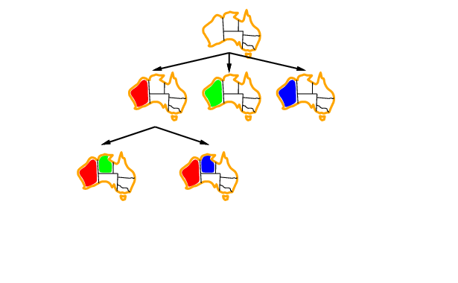
Backtracking Example

Slide 22
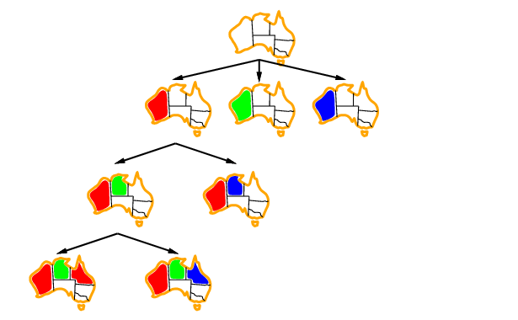
Backtracking Example

Slide 23
Improving Backtracking Efficiency
General-purpose methods can give huge gains in speed:
Which variable should be assigned next?
In what order should its values be tried?
Can we detect inevitable failure early?

Slide 24
Most Constrained Variable
Most constrained variable:
choose the variable with the fewest legal values
a.k.a. minimum remaining values (MRV) heuristic

Slide 25
Most Constraining Variable
Tie-breaker among most constrained variables
Most constraining variable:
choose the variable with the most constraints on remaining variables

Slide 26
Least Constraining Value
Given a variable, choose the least constraining value:
the one that rules out the fewest values in the remaining variables
Combining these heuristics makes 1000 queens feasible

Slide 27
Forward Checking
(Haralick and Elliott, 1980)
Variables: U = {u1, u2, … , un}
Values: V = {v1, v2, … , vm}
Constraint Relation: R = {(ui,v,uj,v’) | ui having value
v is compatible with uj having label v’}
ui,v
uj,v’
If (ui,v,uj,v’) is not in R, they are incompatible,
meaning if ui has value v, uj cannot have value v’.

Slide 28
Forward Checking
Forward checking is based on the idea that
once variable ui is assigned a value v,
then certain future variable-value pairs (uj,v’)
become impossible.
ui,v
uj,v’
uj,v’
Instead of finding this out at many places on the tree,
we can rule it out in advance.

Slide 29
Data Structure for Forward Checking
Future error table (FTAB)
One per level of the tree (ie. a stack of tables)
v1 v2 . . . vm
u1
u2
:
un
What does it mean if a
whole row becomes 0?
At some level in the tree,
for future (unassigned) variables u
FTAB(u,v) = 1 if it is still possible to assign v to u
0 otherwise

Slide 30
Graph Matching Example
a b c d e
1 1 1 1 1 1
2 1 1 1 1 1
3 1 1 1 1 1
4 1 1 1 1 1
a b c d e
2 0 0 1 0 1
3 0 1 1 1 1
4 0 1 1 1 1
R
1
2
3
4
(1,a) (1,b) (1,c) (1,d) (1,e)
a b c d e
3 0 0 0 0 0
4
a b c d e
3 0 1 0 0 0
4 0 0 0 1 0
(2,c) (2,e)
S
X
e
(3,b)
a
c
(4,d)
b
d

Slide 31
Book’s Forward Checking Example
Idea:
Keep track of remaining legal values for unassigned variables
Terminate search when any variable has no legal values

Slide 32
Forward Checking
Idea:
Keep track of remaining legal values for unassigned variables
Terminate search when any variable has no legal values

Slide 33
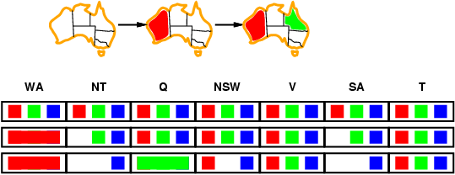
Forward Checking
Idea:
Keep track of remaining legal values for unassigned variables
Terminate search when any variable has no legal values

Slide 34
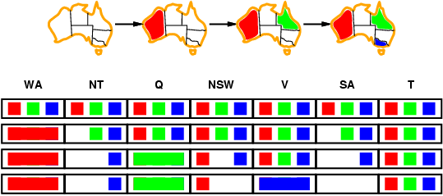
Forward Checking
Idea:
Keep track of remaining legal values for unassigned variables
Terminate search when any variable has no legal values

Slide 35
Constraint Propagation
Forward checking propagates information from assigned to unassigned variables, but doesn't provide early detection for all failures:
NT and SA cannot both be blue!
Constraint propagation repeatedly enforces constraints locally

Slide 36
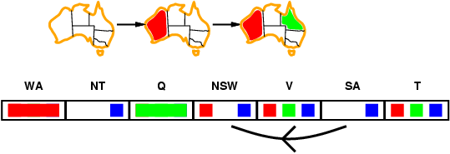
Arc Consistency
Simplest form of propagation makes each arc consistent
X →Y is consistent iff
for every value x of X there is some allowed value y of Y

Slide 37
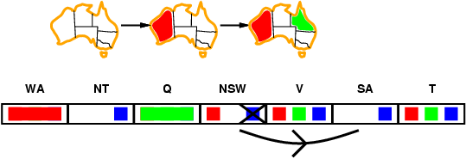
Arc Consistency
Simplest form of propagation makes each arc consistent
X →Y is consistent iff
for every value x of X there is some allowed value y of Y

Slide 38
Putting It All Together
backtracking tree search
with forward checking
add arc-consistency
For each pair of future variables (ui,uj) that
constrain one another
Check each possible remaining value v of ui
Is there a compatible value w of uj?
If not, remove v from possible values for ui
(set FTAB(ui,v) to 0)

Slide 39
Comparison of Methods
Backtracking tree search is a blind search.
Forward checking checks constraints between the
current variable and all future ones.
Arc consistency then checks constraints between
all pairs of future (unassigned) variables.
What is the complexity of a backtracking tree search?
How do forward checking and arc consistency affect that?

Slide 40
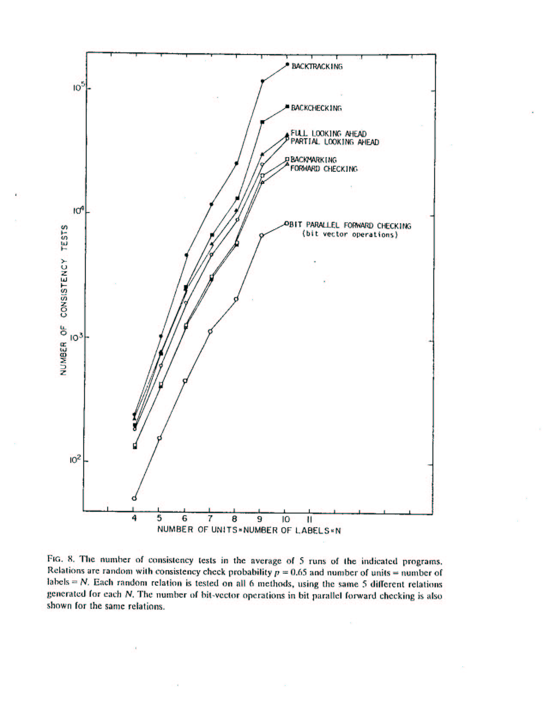

Slide 41
Inexact Matching
All of this expects things to be perfect.
But that’s not the case.
Real data is “noisy”.
Especially in computer vision or in speech recognition.
What’s the simplest thing we can do?
Allow some error.

Slide 42
Inexact Matching
An object model can be made up of its parts and their relationships (like the snowman).
Not all the parts show up every time.
Not all the relationships are detected correctly.

Slide 43
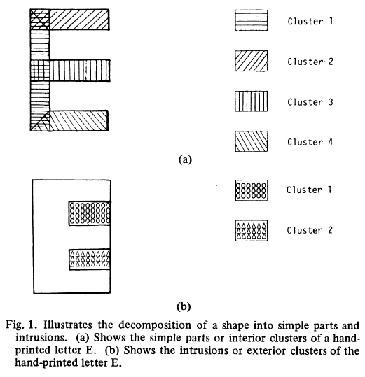
Example: Characters

Slide 44
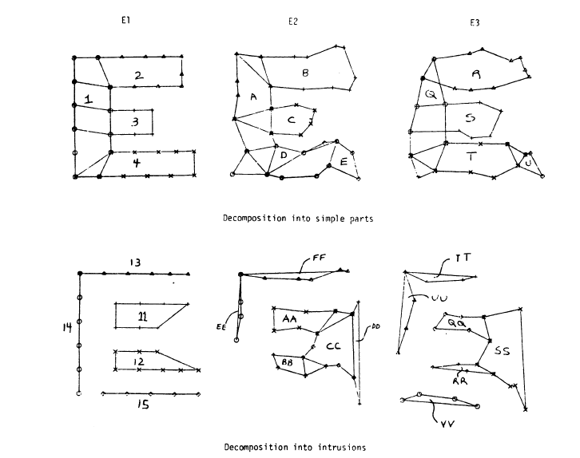
Samples

Slide 45
Subgraph Isomorphism Extension
Given 2 graphs G1 = (V,E) and G2 = (W,F).
Is there a copy of G1 in G2?
V is just itself, the vertices of G1
D = W
f: V -> W
C: (v1,v2) ε E => (f(v1),f(v2)) ε F
Inexact: ∑ weight((v1,v2)) < a threshold
(v1,v2) ε E and (f(v1),f(v2)) ε F

Slide 46
Algorithms
Can we still do backtracking tree search?
YES. Just keep going down a path as long as the error does not exceed the threshold.
Can we still do forward checking?
YES. I published the algorithm myself. It still keeps the FTAB, but now the FTAB keeps track of the error so far.

Slide 47
One Step Further
Relational distance allows us to just find the BEST match between two graphs instead of restricting it to a specific error threshold.
Given two graphs (or higher-dimensional relational descriptions of objects), what is the least error mapping f from one to the other?
The error of that mapping is the relational distance between the two graphs.

Slide 48
Relational Distance
A relational description is a data structure that may be used
to describe two dimensional shape models, three-dimensional
object models, regions on an image, and so on.
Definition A relational description DP is a sequence of
relations DX = {R1,…, RI}.
Let DA = {R1,…, RI} be a relational description with part
set A and DB = {S1,…, SI} be a relational description
with part set B .
Let f be any one-one, onto mapping from A to B.

Slide 49
The structural error of f for the ith pair of corresponding relation
(Ri and Si ) in DA and DB is given by
| f(Ri) – Si| + |f⁻¹(Si) – Ri |
The structural error indicates how many tuples in Ri are not
mapped by f to tuples in Si and how many tuples in Si are not mapped by f⁻¹ to tuples in Ri.
The total error of f with respect to DA and DB is the sum of the
structural errors for each pair of corresponding relations.
The relational distance is the minimal total error obtained for
any one-one, onto mapping f from A to B, and that mapping
is called the best mapping.

Slide 50
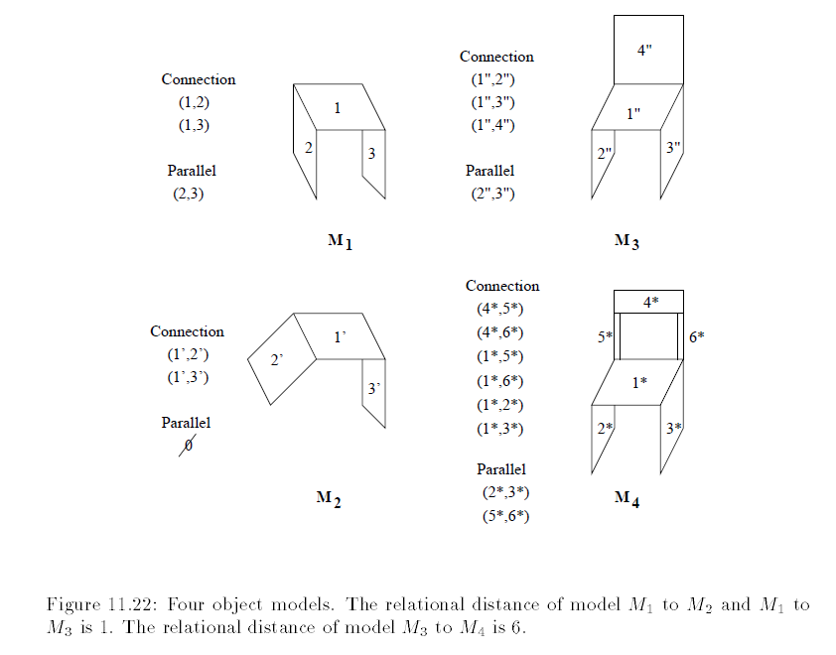

Slide 51
Summary
CSPs are a special kind of problem:
states defined by values of a fixed set of variables
goal test defined by constraints on variable values
Backtracking = depth-first search with one variable assigned per node
Variable ordering and value selection heuristics help significantly
Forward checking prevents assignments that guarantee later failure
Constraint propagation (e.g., arc consistency) does additional work to constrain values and detect inconsistencies
Searches are still worst case exponential, but pruning keeps the time down.

