Slide 1
More on HW 2 (due Jan 22)
Again, it must be in Python.
For the A* algorithm, you will need an Open* list and a Closed list.
States should have
the coordinates of the point
the g-value cost of the path from init to here
the h-value estimate of cost to goal
the parent state
(optional) list of successors
*Note: Python will have a fit if you call it Open.

Slide 2
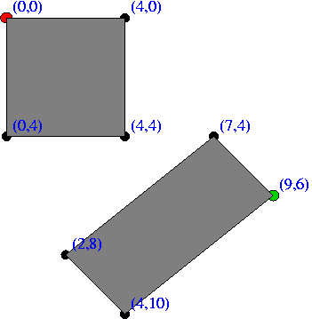
Input format Example
0 0
9 6
2
0 0 4 0 4 4 0 4
7 4 9 6 4 10 2 8
Start Point
Goal Point
How many Rectangles.
Rectangle coordinates are
given clockwise.

Slide 3
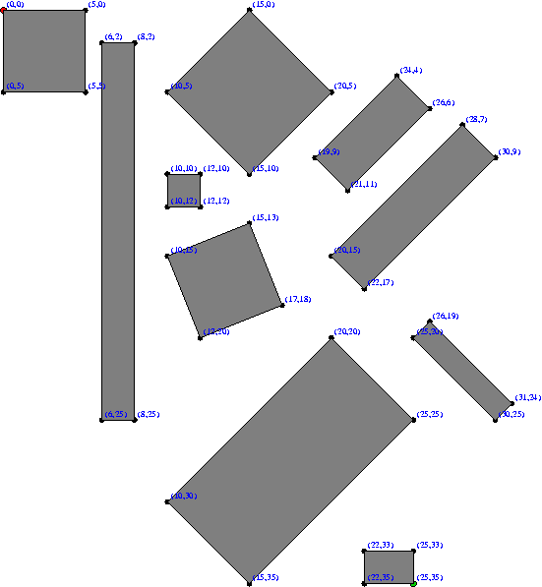
More Difficult Example
Has 4 known solutions
with approximately the
same cost.
You will just find 1
least cost solution
and print the whole
path with states and
cumulative costs.

Slide 4
In Addition
You must design your own custom data set and run your program on it, too. You will turn in a picture of your data set, similar to the pictures we give you of ours.
Turn in commented source code, input and output from all 3 data sets, and your picture.

Slide 5
Beyond Classical Search
Chapter 3 covered problems that considered the whole search space and produced a sequence of actions leading to a goal.
Chapter 4 covers techniques (some developed outside of AI) that don’t try to cover the whole space and only the goal state, not the steps, are important.
The techniques of Chapter 4 tend to use much less memory and are not guaranteed to find an optimal solution.

Slide 6
More Search Methods
Local Search
Hill Climbing
Simulated Annealing
Beam Search
Genetic Search
Local Search in Continuous Spaces
Searching with Nondeterministic Actions
Online Search (agent is executing actions)

Slide 7
Local Search Algorithms and Optimization Problems
Complete state formulation
For example, for the 8 queens problem, all 8 queens are on the board and need to be moved around to get to a goal state
Equivalent to optimization problems often found in science and engineering
Start somewhere and try to get to the solution from there
Local search around the current state to decide where to go next

Slide 8
Pose Estimation Example
Given a geometric model of a 3D object and a 2D image of the object.
Determine the position and orientation of the object wrt the camera that snapped the image.
image 3D object
State (x, y, z, θx, θy, θz)

Slide 9
Gradient
What is the gradient of a function?
In 1D. Function f(x). Gradient f΄(x), the derivative.
In 2D. Function f(x,y). Gradient ( x, y)
e.g. f(x) = x². f΄(x) = ?

Slide 10
Hill Climbing
“Gradient ascent”
solution
Note: solutions shown
here as max not min.
Often used for numerical optimization problems.
How does it work?
In continuous space, the gradient tells you the
direction in which to move uphill.

Slide 11
Numeric Example
-1 0 1
Normal distribution with 0 mean and 1 SD
f(x) = c e ^ (-1/2)x²
f΄(x) = -x c e ^ (-1/2)x²
f΄(1) comes out negative, ie. move backward
f΄(-1) comes out positive, ie. move forward.

Slide 12
AI Hill Climbing
Steepest-Ascent Hill Climbing
current ← start node
loop do
neighbor ← a highest-valued successor of current
if neighbor.Value <= current.Value then return current.State
current ← neighbor
end loop
At each step, the current node is replaced by
the best (highest-valued) neighbor.
This is sometimes called greedy local search.

Slide 13
Hill Climbing Search
current
6
4
10
3
2
8
What if current had a value of 12?

Slide 14
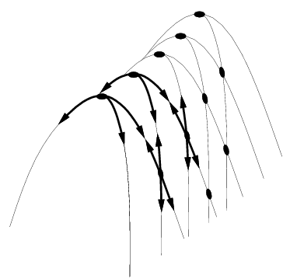
Hill Climbing Problems
Local maxima
Plateaus
Diagonal ridges
What is it sensitive to?
Does it have any advantages?

Slide 15
Solving the Problems
Allow backtracking (What happens to complexity?)
Stochastic hill climbing: choose at random from uphill moves, using steepness for a probability
Random restarts: “If at first you don’t succeed, try, try again.”
Several moves in each of several directions, then test
Jump to a different part of the search space

Slide 16
Simulated Annealing
Variant of hill climbing (so up is good)
Tries to explore enough of the search space early on, so that the final solution is less sensitive to the start state
May make some downhill moves before finding a good way to move uphill.

Slide 17
Simulated Annealing
Comes from the physical process of annealing in which substances are raised to high energy levels (melted) and then cooled to solid state.
The probability of moving to a higher energy state, instead of lower is
p = e^(-ΔE/kT)
where ΔE is the positive change in energy level, T is the temperature, and k is Bolzmann’s constant.
heat cool

Slide 18
Simulated Annealing
At the beginning, the temperature is high.
As the temperature becomes lower
kT becomes lower
ΔE/kT gets bigger
(-ΔE/kT) gets smaller
e^(-ΔE/kT) gets smaller
As the process continues, the probability of a downhill move gets smaller and smaller.

Slide 19
For Simulated Annealing
ΔE represents the change in the value of the objective function.
Since the physical relationships no longer apply, drop k. So p = e^(-ΔE/T)
We need an annealing schedule, which is a sequence of values of T: T₀, T₁, T₂, ...

Slide 20
Simulated Annealing Algorithm
current ← start node;
for each T on the schedule /* need a schedule */
next ← randomly selected successor of current
evaluate next; if it’s a goal, return it
ΔE ← next.Value – current.Value /* already negated */
if ΔE > 0
then current ← next /* better than current */
else current ← next with probability e^(ΔE/T)
How would you do this probabilistic selection?

Slide 21
Probabilistic Selection
Select next with probability p
Generate a random number
If it’s <= p, select next
p
0 1
random
number

Slide 22
Simulated Annealing Properties
At a fixed “temperature” T, state occupation probability reaches the Boltzman distribution
If T is decreased slowly enough (very slowly), the procedure will reach the best state.
Slowly enough has proven too slow for some researchers who have developed alternate schedules.
p(x) = αe^(E(x)/kT)

Slide 23
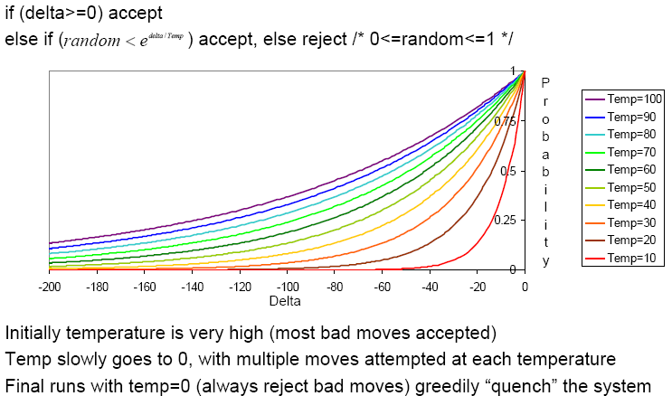
Simulated Annealing Schedules
Acceptance criterion and cooling schedule

Slide 24
Simulated Annealing Applications
Basic Problems
Traveling salesman
Graph partitioning
Matching problems
Graph coloring
Scheduling
Engineering
VLSI design
Placement
Routing
Array logic minimization
Layout
Facilities layout
Image processing
Code design in information theory

Slide 25
Local Beam Search
Keeps more previous states in memory
Simulated annealing just kept one previous state in memory.
This search keeps k states in memory.
- randomly generate k initial states
- if any state is a goal, terminate
- else, generate all successors and select best k
- repeat

Slide 26
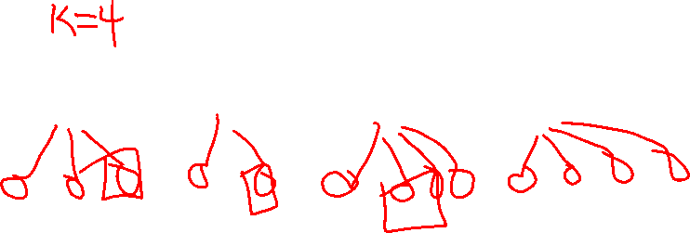
Local Beam Search

Slide 27
Coming next: Genetic Algorithms, which are
motivated by human genetics. How do you
search a very large search space in a fitness
oriented way?

