Slide 1
Object detection, deep learning, and R-CNNs
Partly from Ross Girshick
Microsoft Research
Now at Facebook

Slide 2
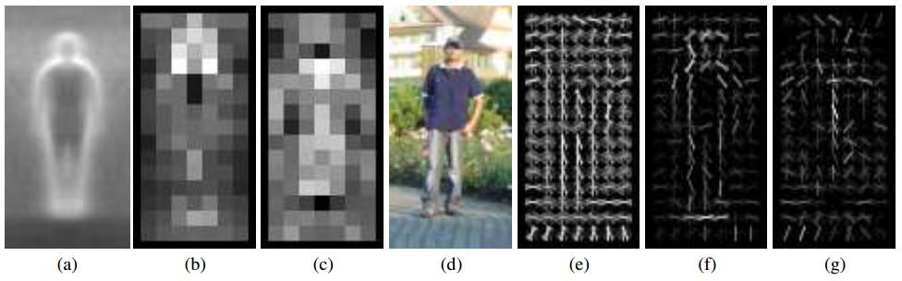
Pedestrians
Histograms of Oriented Gradients for Human Detection, Dalal and Triggs, CVPR 2005
AP ~77%
More sophisticated methods: AP ~90%
(a) average gradient image over training examples
(b) each “pixel” shows max positive SVM weight in the block centered on that pixel
(c) same as (b) for negative SVM weights
(d) test image
(e) its R-HOG descriptor
(f) R-HOG descriptor weighted by positive SVM weights
(g) R-HOG descriptor weighted by negative SVM weights

Slide 3
Overview of HOG Method
1. Compute gradients in the region to be described
2. Put them in bins according to orientation
3. Group the cells into large blocks
4. Normalize each block
5. Train classifiers to decide if these are parts of a human

Slide 4
Details
Gradients
[-1 0 1] and [-1 0 1]^{T} were good enough filters.
Cell Histograms
Each pixel within the cell casts a weighted vote for an
orientation-based histogram channel based on the values
found in the gradient computation. (9 channels worked)
Blocks
Group the cells together into larger blocks, either R-HOG
blocks (rectangular) or C-HOG blocks (circular).

Slide 5
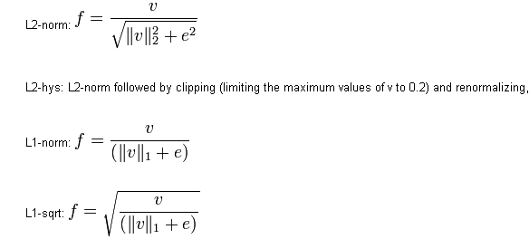
More Details
Block Normalization
They tried 4 different kinds of normalization.
Let υ be the block to be normalized and e be a small constant.

Slide 6
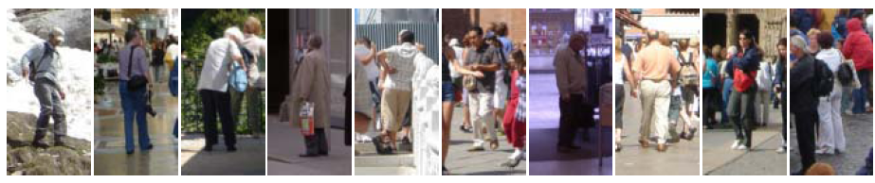
Example: Dalal-Triggs pedestrian detector
Extract fixed-sized (64x128 pixel) window at each position and scale
Compute HOG (histogram of gradient) features within each window
Score the window with a linear SVM classifier
Perform non-maxima suppression to remove overlapping detections with lower scores
Navneet Dalal and Bill Triggs, Histograms of Oriented Gradients for Human Detection, CVPR05

Slide 7
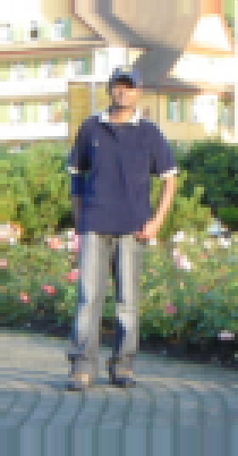
Slides by Pete Barnum
Navneet Dalal and Bill Triggs, Histograms of Oriented Gradients for Human Detection, CVPR05

Slide 8
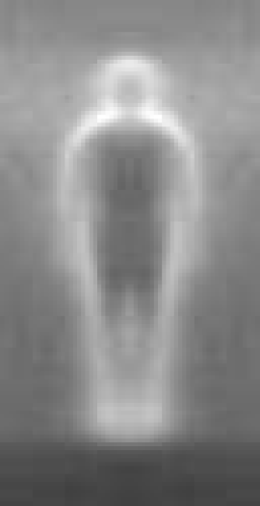

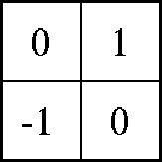

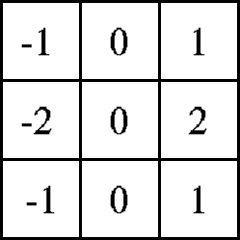

Outperforms
centered
diagonal
uncentered
cubic-corrected
Sobel
Slides by Pete Barnum
Navneet Dalal and Bill Triggs, Histograms of Oriented Gradients for Human Detection, CVPR05

Slide 9

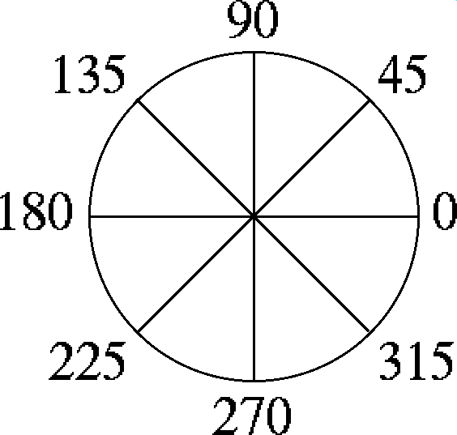
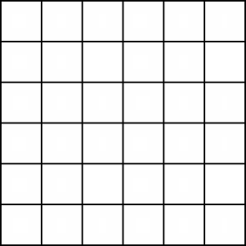
Histogram of gradient orientations
  Votes weighted by magnitude
  Bilinear interpolation between cells
Orientation: 9 bins (for unsigned angles)
Histograms in 8x8 pixel cells
Slides by Pete Barnum
Navneet Dalal and Bill Triggs, Histograms of Oriented Gradients for Human Detection, CVPR05

Slide 10
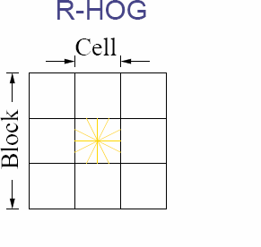
Normalize with respect to surrounding cells
Slides by Pete Barnum
Navneet Dalal and Bill Triggs, Histograms of Oriented Gradients for Human Detection, CVPR05

Slide 11
# orientations
# features = 15 x 7 x 9 x 4 = 3780
X=
# cells
# normalizations by neighboring cells
Slides by Pete Barnum
Navneet Dalal and Bill Triggs, Histograms of Oriented Gradients for Human Detection, CVPR05

Slide 12
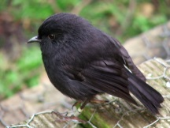
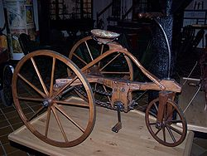
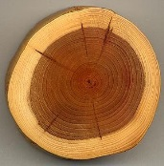
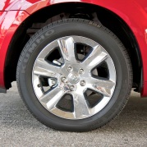
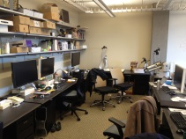
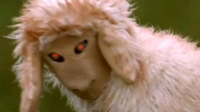
Training set

Slide 13
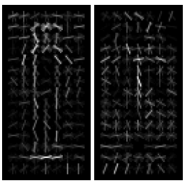
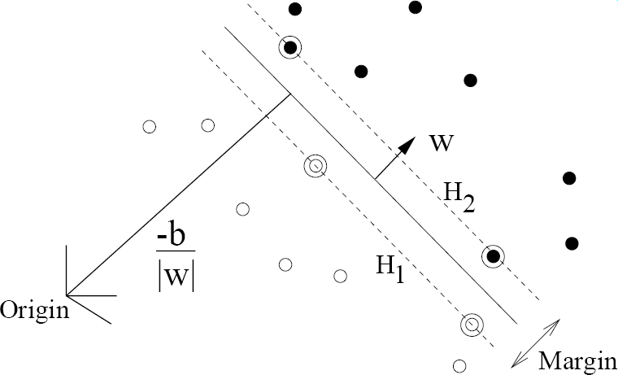
pos w
neg w
Slides by Pete Barnum
Navneet Dalal and Bill Triggs, Histograms of Oriented Gradients for Human Detection, CVPR05

Slide 14
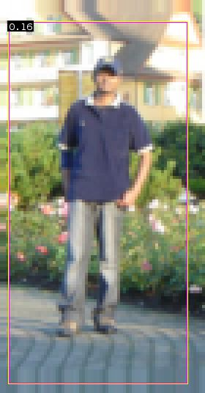


pedestrian
Slides by Pete Barnum
Navneet Dalal and Bill Triggs, Histograms of Oriented Gradients for Human Detection, CVPR05

Slide 15
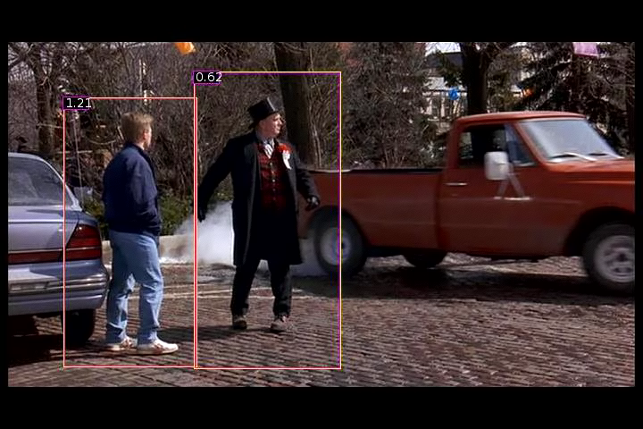
Detection examples

Slide 16


Slide 17

Each window is separately classified

Slide 19
Deformable Parts Model
Takes the idea a little further
Instead of one rigid HOG model, we have multiple HOG models in a spatial arrangement
One root part to find first and multiple other parts in a tree structure.

Slide 20
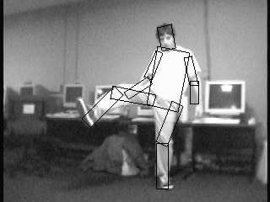

The Idea
Articulated parts model
  Object is configuration of parts
  Each part is detectable
Images from Felzenszwalb

Slide 21
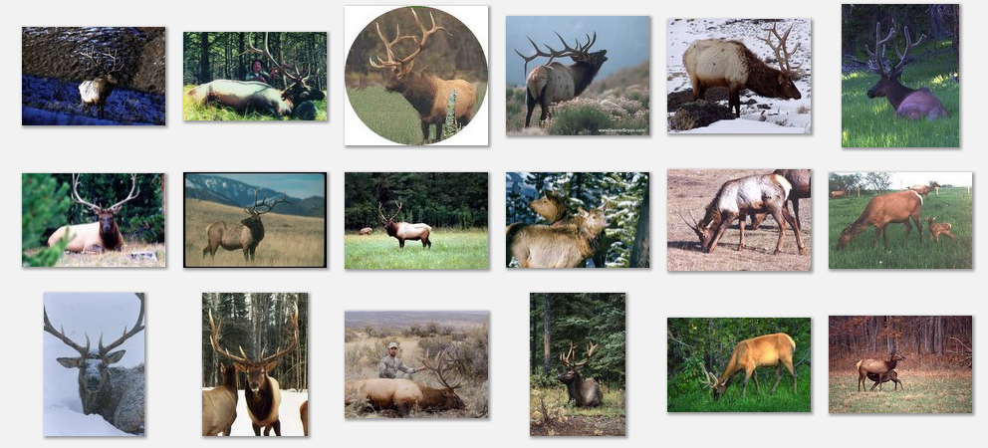
Deformable objects
Images from Caltech-256
Slide Credit: Duan Tran

Slide 22
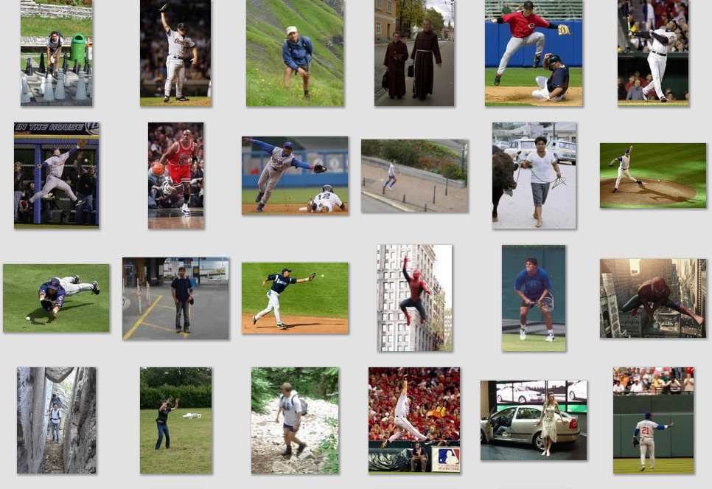
Deformable objects
Images from D. Ramanan’s dataset
Slide Credit: Duan Tran

Slide 23
How to model spatial relations?
Tree-shaped model

Slide 24
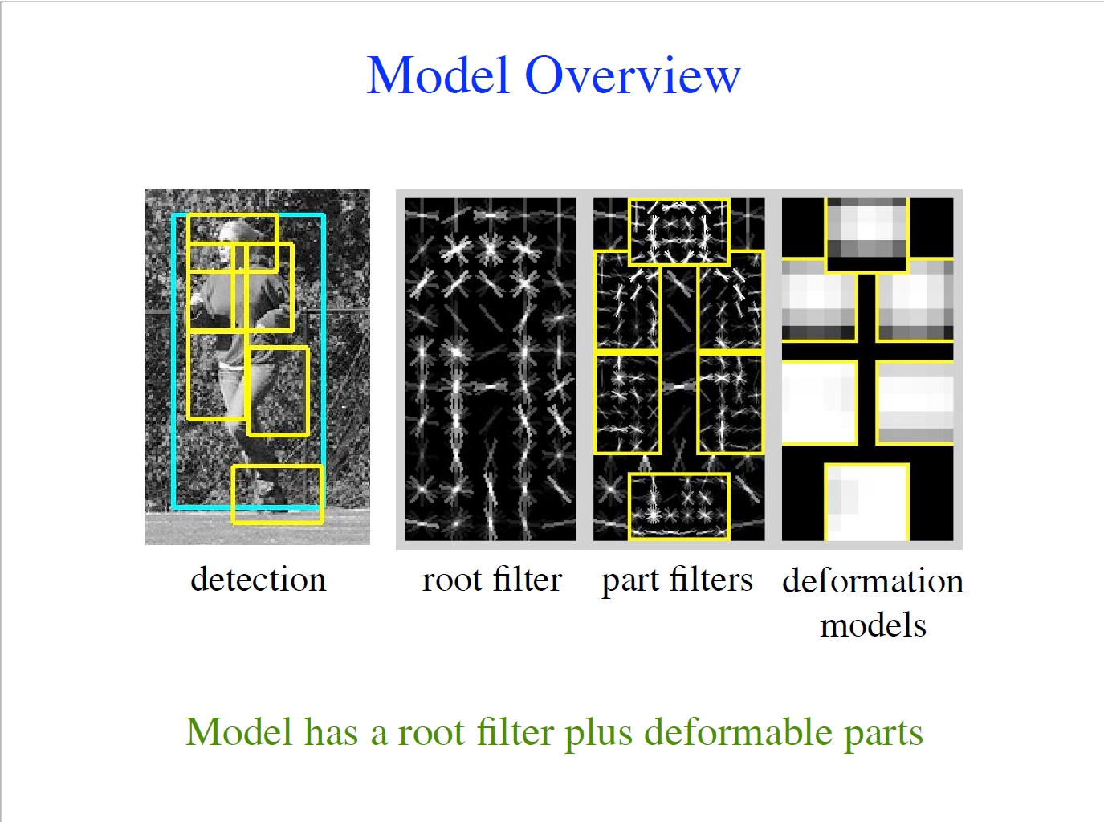

Slide 25

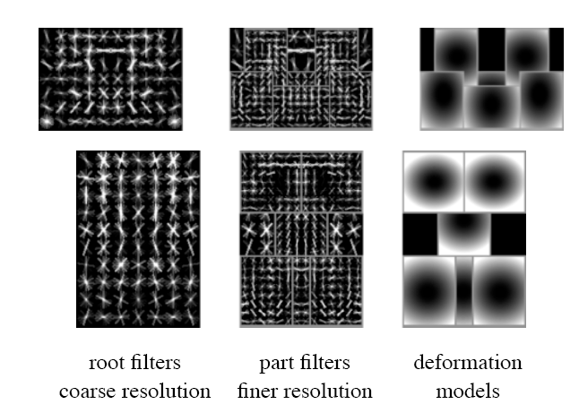
Hybrid template/parts model
Detections
Template Visualization
Felzenszwalb et al. 2008

Slide 26
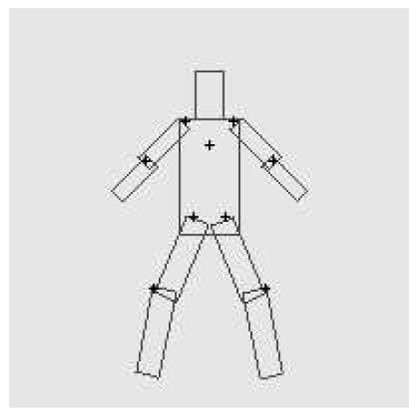
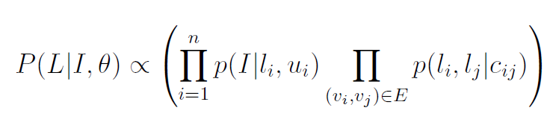
Pictorial Structures Model
Appearance likelihood
Geometry likelihood

Slide 27
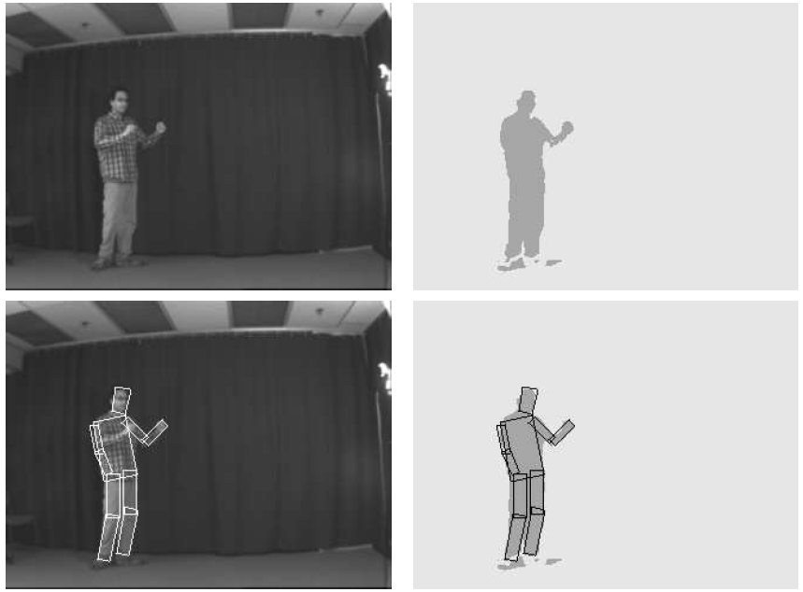
Results for person matching

Slide 28
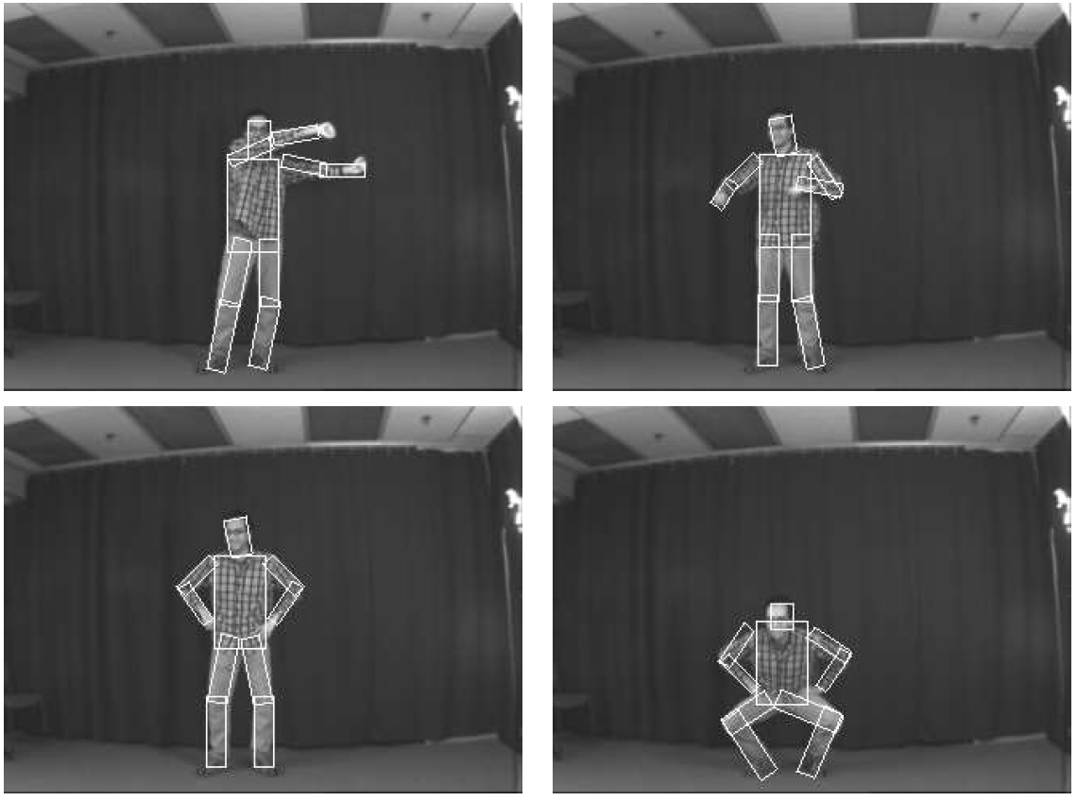
Results for person matching

Slide 29
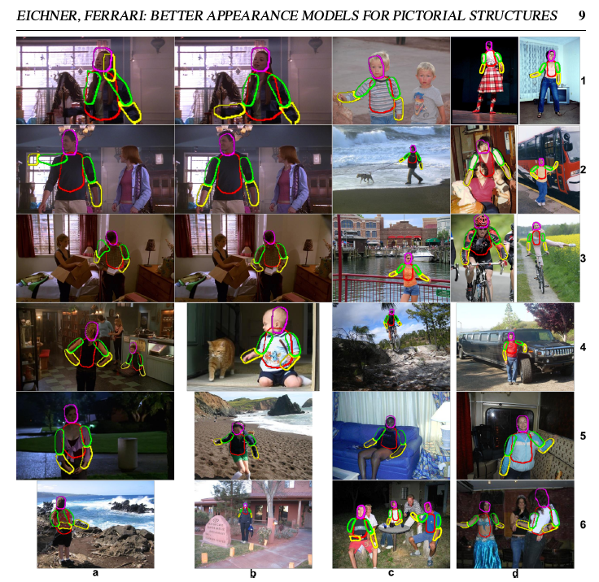
BMVC 2009

Slide 30
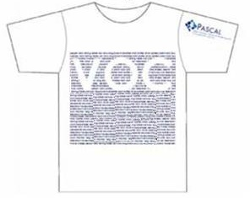
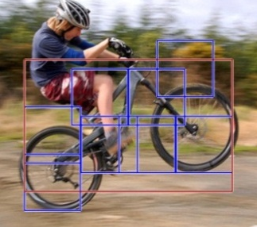
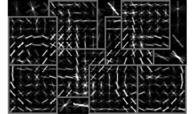
2012 State-of-the-art Detector:
Deformable Parts Model (DPM)
Lifetime
Achievement
Strong low-level features based on HOG
Efficient matching algorithms for deformable part-based models (pictorial structures)
Discriminative learning with latent variables (latent SVM)
Felzenszwalb et al., 2008, 2010, 2011, 2012
Notes:
For the local window detector implementation, we used the publicly available implementation of the DPM detector. This is the best performing sliding window implementation and has consistently performed well in the VOC challenge receiving the lifetime achievement award.

Slide 31
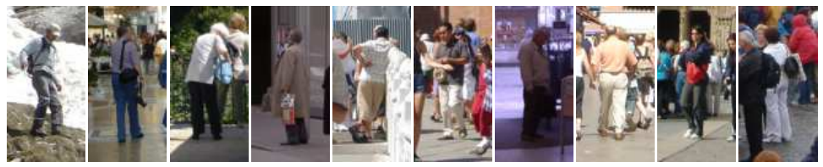
Why did gradient-based models work?
Average gradient image

Slide 32
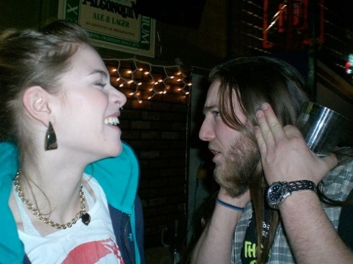
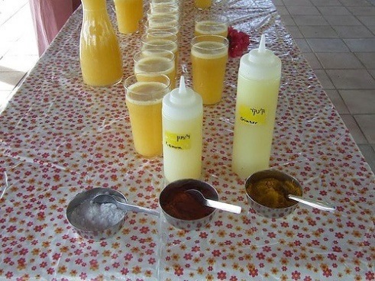
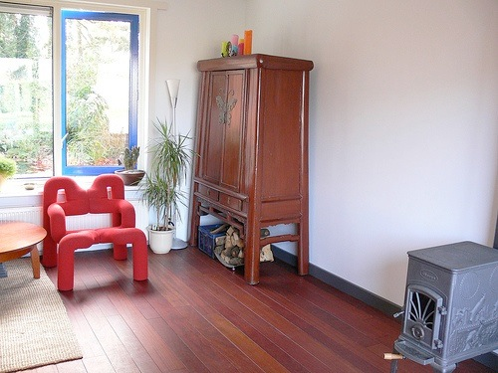
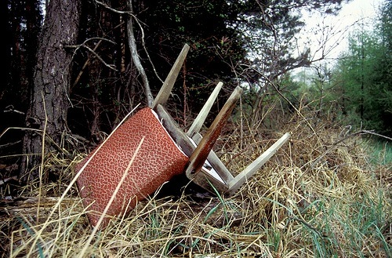
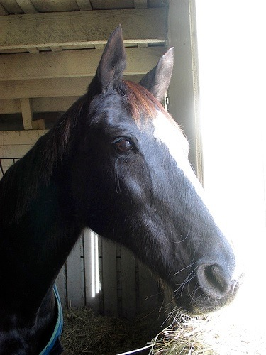
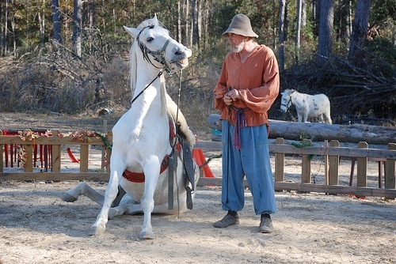
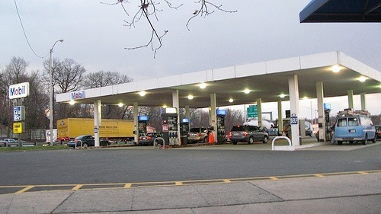
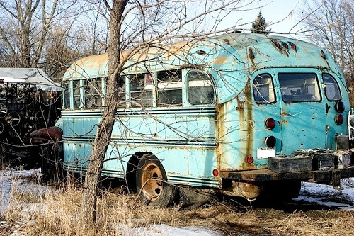
Generic categories
Can we detect people, chairs, horses, cars, dogs, buses, bottles, sheep …?
PASCAL Visual Object Categories (VOC) dataset

Slide 33
Generic categories
Why doesn’t this work (as well)?
Can we detect people, chairs, horses, cars, dogs, buses, bottles, sheep …?
PASCAL Visual Object Categories (VOC) dataset

Slide 34
PASCAL VOC detection history
41%
41%
37%
DPM++,
MKL,
Selective
Search
Selective
Search,
DPM++,
MKL
28%
DPM++
23%
DPM,
MKL
17%
DPM,
HOG+
BOW
DPM

Slide 35
Part-based models & multiple features (MKL)
41%
41%
37%
rapid performance improvements
DPM++,
MKL,
Selective
Search
Selective
Search,
DPM++,
MKL
28%
DPM++
23%
DPM,
MKL
17%
DPM,
HOG+
BOW
DPM

Slide 36
Kitchen-sink approaches
increasing complexity & plateau
41%
41%
37%
DPM++,
MKL,
Selective
Search
Selective
Search,
DPM++,
MKL
28%
DPM++
23%
DPM,
MKL
17%
DPM,
HOG+
BOW
DPM

Slide 37
Region-based Convolutional Networks (R-CNNs)
62%
53%
R-CNN v2
R-CNN v1
41%
41%
37%
DPM++,
MKL,
Selective
Search
Selective
Search,
DPM++,
MKL
28%
DPM++
23%
DPM,
MKL
17%
DPM,
HOG+
BOW
DPM
[R-CNN. Girshick et al. CVPR 2014]

Slide 38
Region-based Convolutional Networks (R-CNNs)
~1 year
~5 years
[R-CNN. Girshick et al. CVPR 2014]

Slide 39
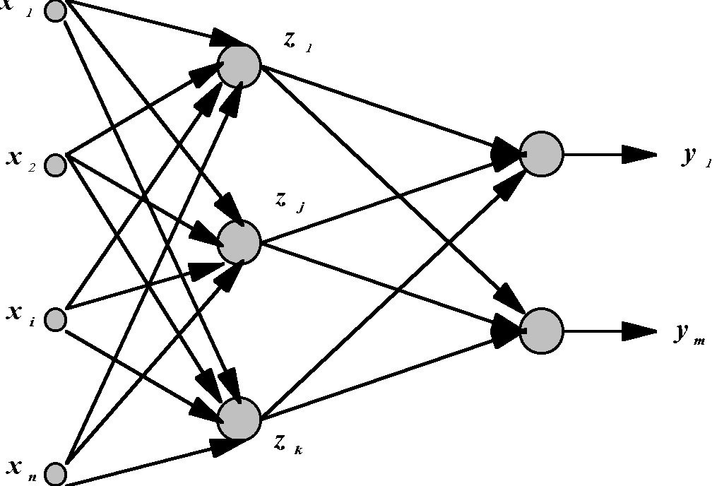
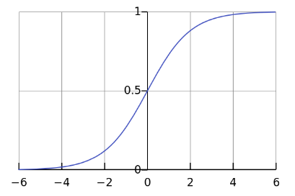
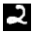



Standard Neural Networks
“Fully connected”
$$x={\left(x_{1},…,x_{784}\right)}^{T}$$
$$z_{j}={g(w}_{j }^{T}x)$$
$$g\left(t\right)=\frac{1}{1+e^{−t}}$$

Slide 40
From NNs to Convolutional NNs
Local connectivity
Shared (“tied”) weights
Multiple feature maps
Pooling

Slide 41
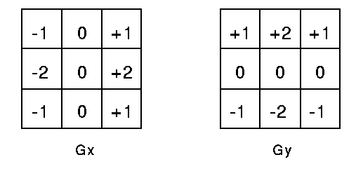
Just-in-Time Information
What is a convolution?
In signal processing, a correlation is an operation that multiplies a small mask times a small piece of the image. These are examples of such masks.
The strict definition of convolution flips the mask.
But in computer vision, we call everything convolution.

Slide 42
Convolutional NNs
Local connectivity
compare
Each green unit is only connected to (3)
neighboring blue units

Slide 43



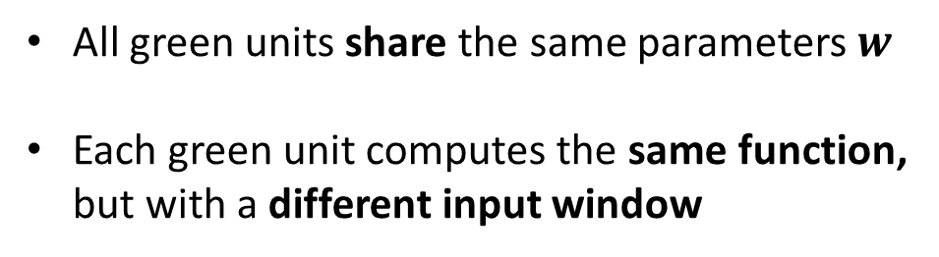



Convolutional NNs
Shared (“tied”) weights
$$w_{1}$$
$$w_{2}$$
$$w_{3}$$
All green units share the same parameters $w$
Each green unit computes the same function,
but with a different input window
$$w_{1}$$
$$w_{2}$$
$$w_{3}$$

Slide 44

Convolutional NNs
Convolution with 1-D filter: $[w_{3},w_{2},w_{1}]$
$$w_{1}$$
$$w_{2}$$
$$w_{3}$$
All green units share the same parameters $w$
Each green unit computes the same function,
but with a different input window

Slide 45



Convolutional NNs
Convolution with 1-D filter: $[w_{3},w_{2},w_{1}]$
$$w_{1}$$
$$w_{2}$$
All green units share the same parameters $w$
Each green unit computes the same function,
but with a different input window
$$w_{3}$$

Slide 46



Convolutional NNs
Convolution with 1-D filter: $[w_{3},w_{2},w_{1}]$
All green units share the same parameters $w$
Each green unit computes the same function,
but with a different input window
$$w_{1}$$
$$w_{2}$$
$$w_{3}$$

Slide 47



Convolutional NNs
Convolution with 1-D filter: $[w_{3},w_{2},w_{1}]$
All green units share the same parameters $w$
Each green unit computes the same function,
but with a different input window
$$w_{1}$$
$$w_{2}$$
$$w_{3}$$

Slide 48



Convolutional NNs
Convolution with 1-D filter: $[w_{3},w_{2},w_{1}]$
All green units share the same parameters $w$
Each green unit computes the same function,
but with a different input window
$$w_{1}$$
$$w_{2}$$
$$w_{3}$$

Slide 49



Convolutional NNs
Multiple feature maps
$${w′}_{1}$$
$${w′}_{2}$$
All orange units compute the same function
but with a different input windows
Orange and green units compute
different functions
$${w′}_{3}$$
$$w_{1}$$
Feature map 2
(array of orange
units)
$$w_{2}$$
$$w_{3}$$
Feature map 1
(array of green
units)

Slide 50
Convolutional NNs
Pooling (max, average)
1
4
Pooling area: 2 units
Pooling stride: 2 units
Subsamples feature maps
4
0
3
3

Slide 51
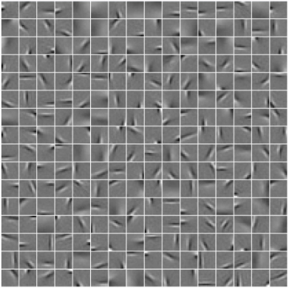
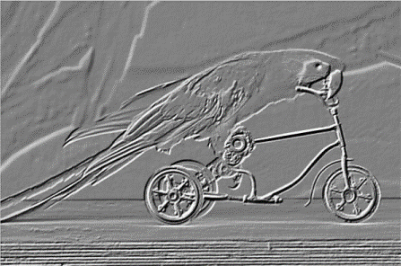

2D input
Pooling
Convolution
Image

Slide 52
The key to SVMs
It’s all about the features
HOG features
SVM weights
(+) (-)
Histograms of Oriented Gradients for Human Detection, Dalal and Triggs, CVPR 2005

Slide 53
Core idea of “deep learning”
Input: the “raw” signal (image, waveform, …)
Features: hierarchy of features is learned from the raw input

Slide 54
If SVMs killed neural nets, how did they come back (in computer vision)?

Slide 55



What’s new since the 1980s?
More layers
  LeNet-3 and LeNet-5 had 3 and 5 learnable layers
  Current models have 8 – 20+
“ReLU” non-linearities (Rectified Linear Unit)
  $g\left(x\right)=\max\left(0, x\right)$
  Gradient doesn’t vanish
“Dropout” regularization
Fast GPU implementations
More data
$$g(x)$$
$$x$$

Slide 56

What else? Object Proposals
Sliding window based object detection
Object proposals
  Fast execution
  High recall with low # of candidate boxes
Iterate over window size, aspect ratio, and location

Slide 57

The number of contours wholly enclosed by a bounding box is indicative of
the likelihood of the box containing an object.

Slide 58

Ross’s Own System: Region CNNs

Slide 59

Competitive Results

Slide 60
Top Regions for Six Object Classes

