Slide 1
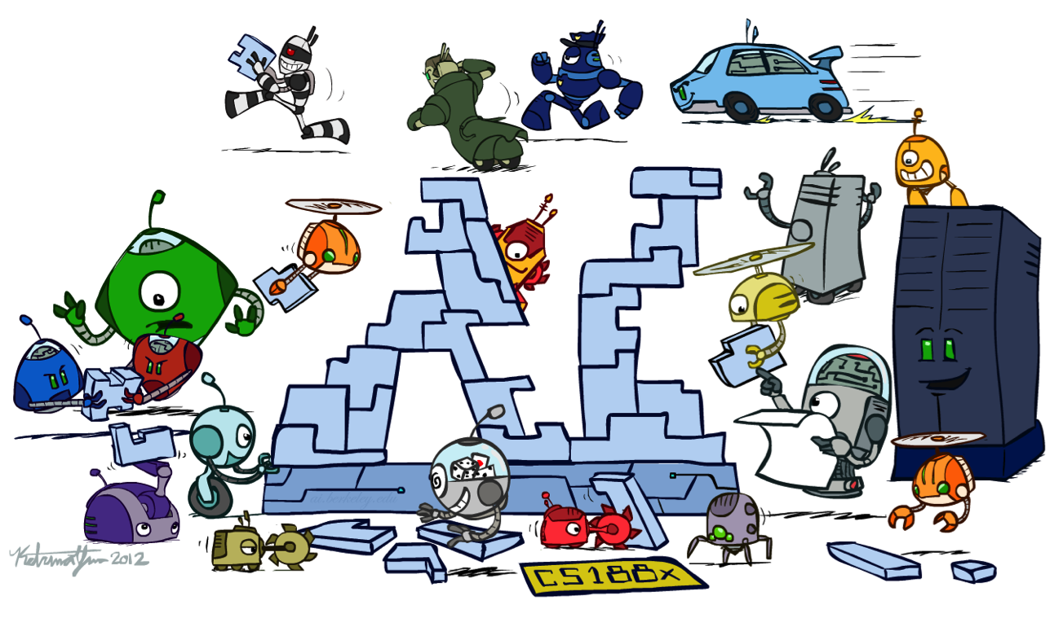
CS 473: Artificial Intelligence
Conclusion
Dieter Fox – University of Washington
[Many of these slides were created by Dan Klein and Pieter Abbeel for CS188 Intro to AI at UC Berkeley. All CS188 materials are available at http://ai.berkeley.edu.]
Notes:
Please retain proper attribution, including the reference to ai.berkeley.edu. Thanks!

Slide 2
Exam Topics
Search
Problem spaces
BFS, DFS, UCS, A* (tree and graph), local search
Completeness and Optimality
Heuristics: admissibility and consistency; pattern DBs
CSPs
Constraint graphs, backtracking search
Forward checking, AC3 constraint propagation, ordering heuristics
Games
Minimax, Alpha-beta pruning,
Expectimax
Evaluation Functions
MDPs
Bellman equations
Value iteration, policy iteration
Reinforcement Learning
Exploration vs Exploitation
Model-based vs. model-free
Q-learning
Linear value function approx.
Inverse optimal control
Hidden Markov Models
DBNs
Forward algorithm
Particle Filters
Bayesian Networks
Basic definition, independence (d-sep)
Variable elimination
Learning
BN parameters with complete data
Search through space of BN structures
Expectation maximization

Slide 3
What is intelligence?
(bounded) Rationality
Agent has a performance measure to optimize
Given its state of knowledge
Choose optimal action
With limited computational resources
Human-like intelligence/behavior

Slide 4
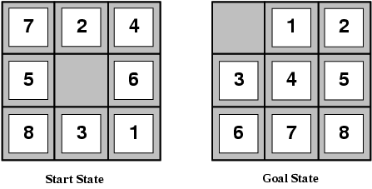
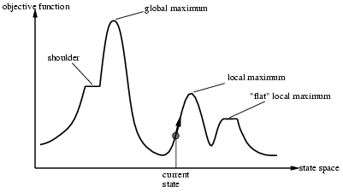
Search in Discrete State Spaces
Every discrete problem can be cast as a search problem.
states, actions, transitions, cost, goal-test
Types
uninformed systematic: often slow
DFS, BFS, uniform-cost, iterative deepening
Heuristic-guided: better
Greedy best first, A*
relaxation leads to heuristics
Local: fast, fewer guarantees; often local optimal
Hill climbing and variations
Simulated Annealing: global optimal

Slide 5
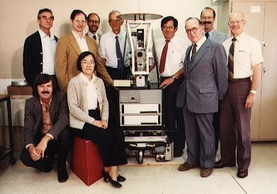
Which Algorithm?
A*, Manhattan Heuristic

Slide 6
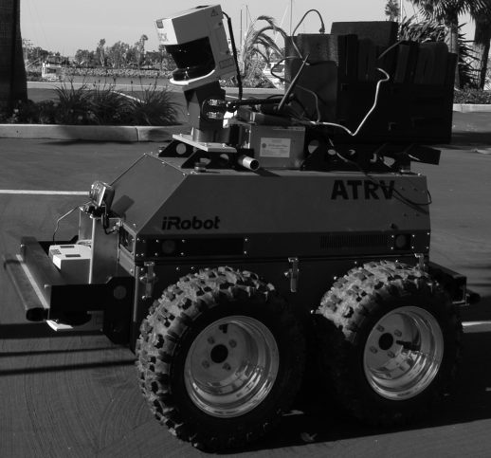
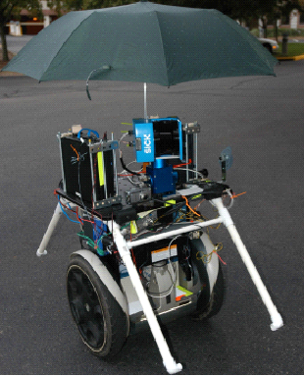
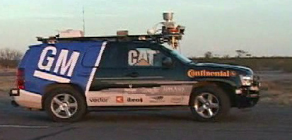
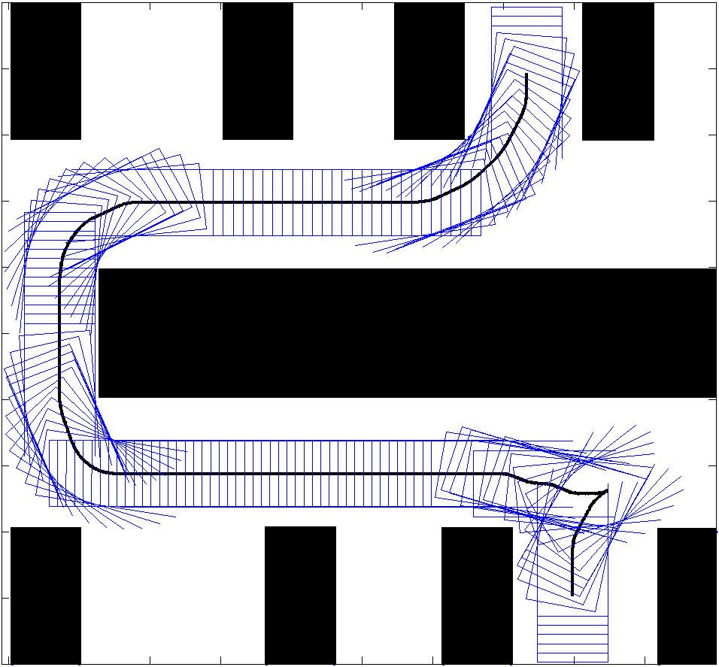
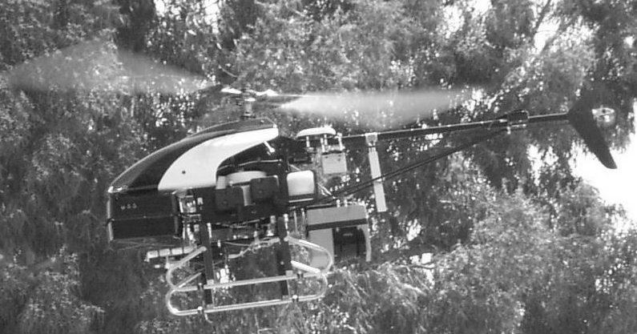
Motion/Path Planning
Examples (of what is usually referred to as path planning):

Slide 7
Example
Urban Challenge Race, CMU team, planning with Anytime D*

Slide 8
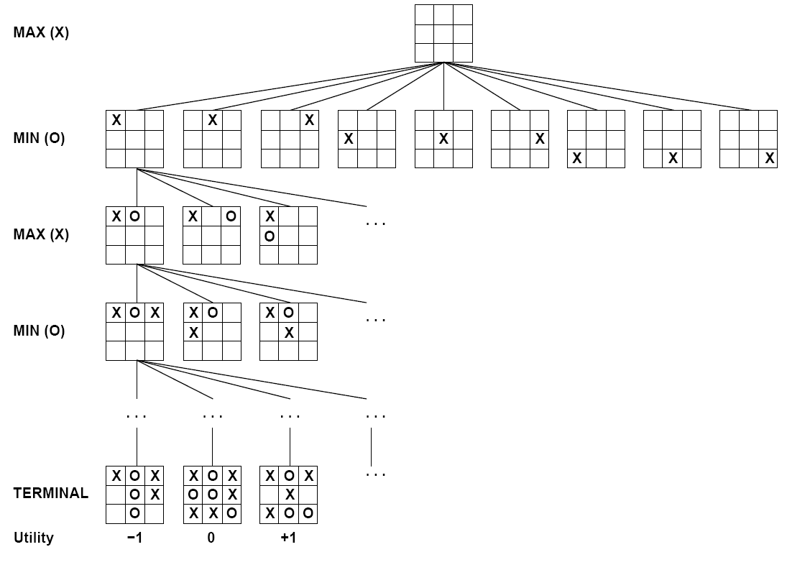
Adversarial Search

Slide 9
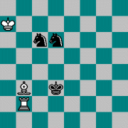
Adversarial Search
AND/OR search space (max, min)
minimax objective function
minimax algorithm (~dfs)
alpha-beta pruning
Utility function for partial search
Learning utility functions by playing with itself
Openings/Endgame databases

Slide 10
Knowledge Representation and Reasoning
Representing: what agent knows
Reasoning: what agent can infer
Propositional logic
Constraint networks
HMMs
Bayesian networks
…
Search
Dynamic programming
Preprocessing to simplify

Slide 11
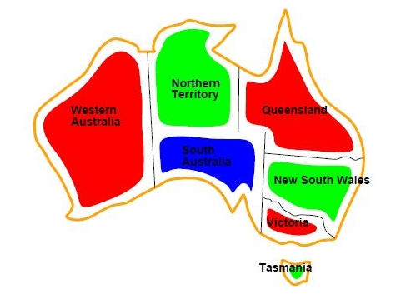
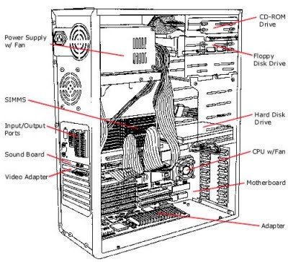
Search+KR&R Example: CSP
Representation
Variables, Domains, Constraints
Reasoning:
Arc Consistency (k-Consistency)
Solving
Backtracking search: partial var assignments
Heuristics: min remaining values, min conflicts
Local search: complete var assignments

Slide 12
KR&R: Markov Decision Process
Representation
states, actions, probabilistic outcomes, rewards
Reasoning: V*(s)
Expectimax
Value Iteration: dynamic programming
Reinforcement Learning:
Exploration / exploitation
Learn model or learn Q-function?
max
2
a₁
s₁
V₁= 6.5
s₀
5
a₂
4.5
0.9
s₂
a₃
0.1
s₃

Slide 13
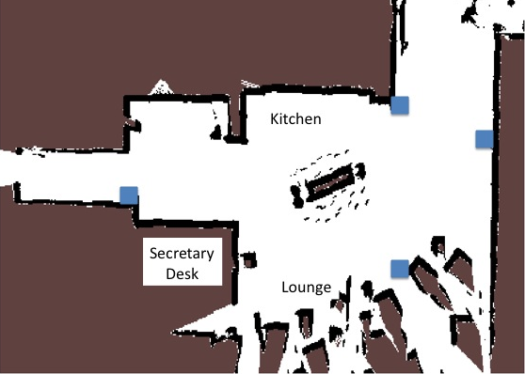
IOC: Pedestrian Trajectory Prediction

Slide 14
Pedestrian Trajectory Prediction

Slide 15
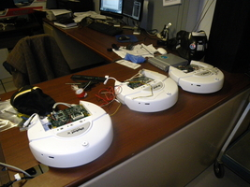
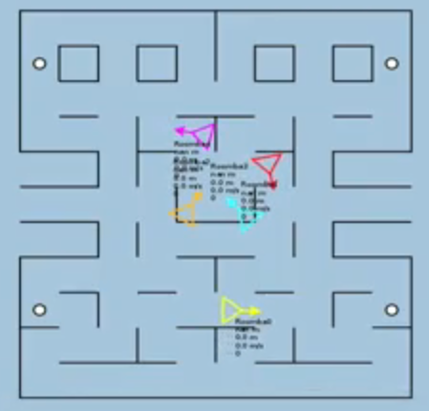
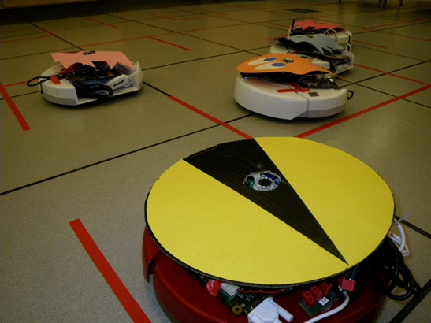
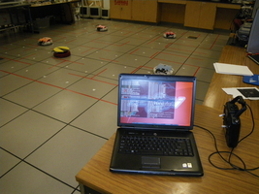
Pacman: Beyond Simulation?
Students at Colorado University: http://pacman.elstonj.com
Notes:
Roomba .flv

Slide 16
Pacman: Beyond Simulation!
[VIDEO: Roomba Pacman.mp4]

Slide 17
KR&R: Probability
Representation: Bayesian Networks
encode probability distributions compactly
by exploiting conditional independences
Reasoning
Exact inference: var elimination
Approx inference: sampling based methods
rejection sampling, likelihood weighting, MCMC/Gibbs
Earthquake
Burglary
Alarm
JohnCalls
MaryCalls

Slide 18
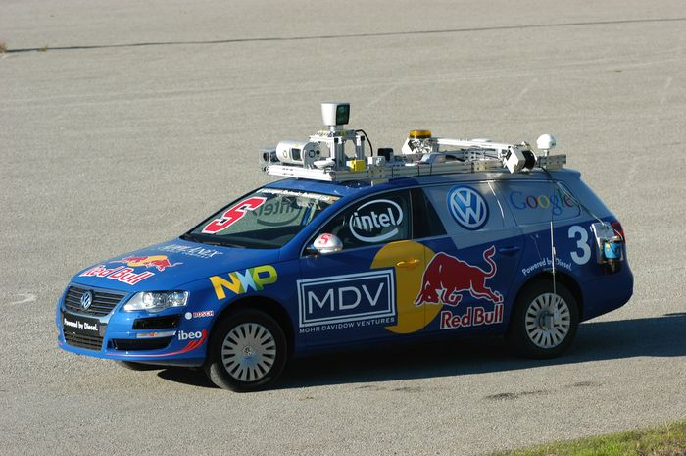
KR&R: Hidden Markov Models
Representation
Sequence model
One hidden state, one observation
Reasoning/Search
most likely state sequence: Viterbi algorithm
marginal prob of one state: forward-backward

Slide 19
Learning Bayes Networks
Learning Structure of Bayesian Networks
Search through space of BN structures
Learning Parameters for a Bayesian Network
Fully observable variables
Maximum Likelihood (ML), MAP & Bayesian estimation
Example: Naïve Bayes for text classification
Hidden variables
Expectation Maximization (EM)

Slide 20
Where to Go Next?

Slide 21
That’s It!
Help out with some course evaluations
See you on Monday and then have a great summer!

