Slide 1
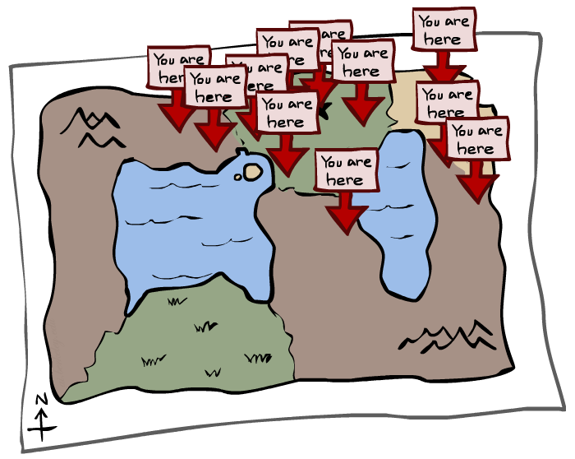
CSE 473: Artificial Intelligence
Particle Filters
Dieter Fox --- University of Washington
[Most slides were created by Dan Klein and Pieter Abbeel for CS188 Intro to AI at UC Berkeley. All CS188 materials are available at http://ai.berkeley.edu.]
Notes:
Please retain proper attribution, including the reference to ai.berkeley.edu. Thanks!

Slide 2
Particle Filtering
Filtering: approximate solution
Sometimes |X| is too big to use exact inference
  |X| may be too big to even store B(X)
  E.g. X is continuous
  |X|² may be too big to do updates
Solution: approximate inference
  Track samples of X, not all values
  Samples are called particles
  Time per step is linear in the number of samples
  But: number needed may be large
  In memory: list of particles, not states
This is how robot localization works in practice
0.0
0.1
0.0
0.0
0.0
0.2
0.0
0.2
0.5

Slide 3
Representation: Particles
Our representation of P(X) is now a list of N particles (samples)
  Generally, N << |X|
  Storing map from X to counts would defeat the point
P(x) approximated by number of particles with value x
  So, many x may have P(x) = 0!
  More particles, more accuracy
For now, all particles have a weight of 1
Particles:
(3,3)
(2,3)
(3,3)
(3,2)
(3,3)
(3,2)
(1,2)
(3,3)
(3,3)
(2,3)

Slide 4

Particle Filtering: Elapse Time
Each particle is moved by sampling its next position from the transition model
  This is like prior sampling – samples’ frequencies reflect the transition probabilities
  Here, most samples move clockwise, but some move in another direction or stay in place
This captures the passage of time
  If enough samples, close to exact values before and after (consistent)
Particles:
(3,3)
(2,3)
(3,3)
(3,2)
(3,3)
(3,2)
(1,2)
(3,3)
(3,3)
(2,3)
Particles:
(3,2)
(2,3)
(3,2)
(3,1)
(3,3)
(3,2)
(1,3)
(2,3)
(3,2)
(2,2)

Slide 5


Particle Filtering: Observe
Particles:
(3,2)
(2,3)
(3,2)
(3,1)
(3,3)
(3,2)
(1,3)
(2,3)
(3,2)
(2,2)
Slightly trickier:
  Don’t sample observation, fix it
  Similar to likelihood weighting, downweight samples based on the evidence
  As before, the probabilities don’t sum to one, since all have been downweighted (in fact they now sum to (N times) an approximation of P(e))
Particles:
(3,2) w=.9
(2,3) w=.2
(3,2) w=.9
(3,1) w=.4
(3,3) w=.4
(3,2) w=.9
(1,3) w=.1
(2,3) w=.2
(3,2) w=.9
(2,2) w=.4

Slide 6
Particle Filtering: Resample
Rather than tracking weighted samples, we resample
N times, we choose from our weighted sample distribution (i.e. draw with replacement)
This is equivalent to renormalizing the distribution
Now the update is complete for this time step, continue with the next one
Particles:
(3,2) w=.9
(2,3) w=.2
(3,2) w=.9
(3,1) w=.4
(3,3) w=.4
(3,2) w=.9
(1,3) w=.1
(2,3) w=.2
(3,2) w=.9
(2,2) w=.4
(New) Particles:
(3,2)
(2,2)
(3,2)
(2,3)
(3,3)
(3,2)
(1,3)
(2,3)
(3,2)
(3,2)

Slide 7
Recap: Particle Filtering
Particles: track samples of states rather than an explicit distribution
Elapse
Weight
Resample
Particles:
(3,3)
(2,3)
(3,3)
(3,2)
(3,3)
(3,2)
(1,2)
(3,3)
(3,3)
(2,3)
Particles:
(3,2)
(2,3)
(3,2)
(3,1)
(3,3)
(3,2)
(1,3)
(2,3)
(3,2)
(2,2)
Particles:
(3,2) w=.9
(2,3) w=.2
(3,2) w=.9
(3,1) w=.4
(3,3) w=.4
(3,2) w=.9
(1,3) w=.1
(2,3) w=.2
(3,2) w=.9
(2,2) w=.4
(New) Particles:
(3,2)
(2,2)
(3,2)
(2,3)
(3,3)
(3,2)
(1,3)
(2,3)
(3,2)
(3,2)
[Demos: ghostbusters particle filtering (L15D3,4,5)]

Slide 8
Particle Filters in Robotics

Slide 9
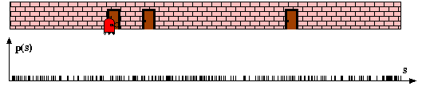
Particle Filters

Slide 10
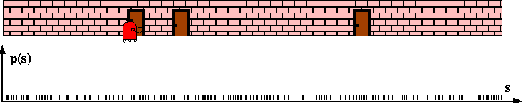
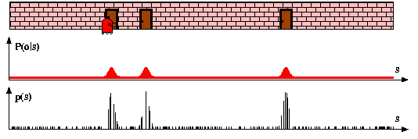
Sensor Information: Importance Sampling

Slide 11
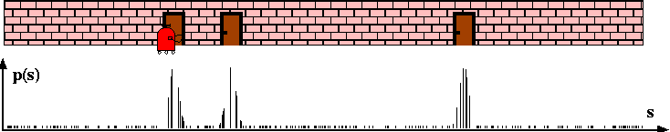
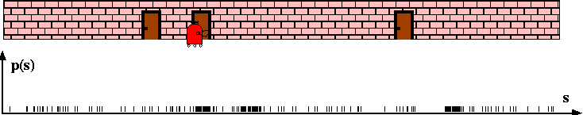
Robot Motion

Slide 12
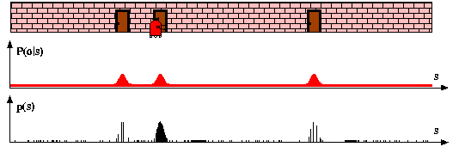
Sensor Information: Importance Sampling

Slide 13
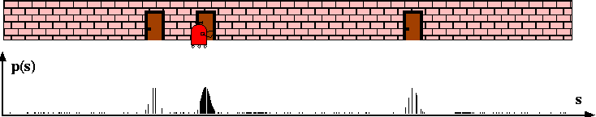
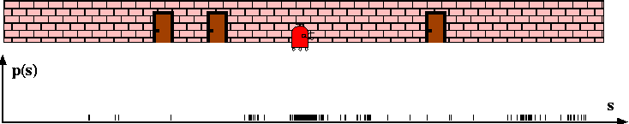
Robot Motion

Slide 14
Particle Filter Algorithm
draw x^{i}_{t−1} from Bel(x_{t−1})
draw x^{i}_{t} from p(x_{t} | x^{i}_{t−1},u_{t−1})
Importance factor for x^{i}_{t}:

Slide 15
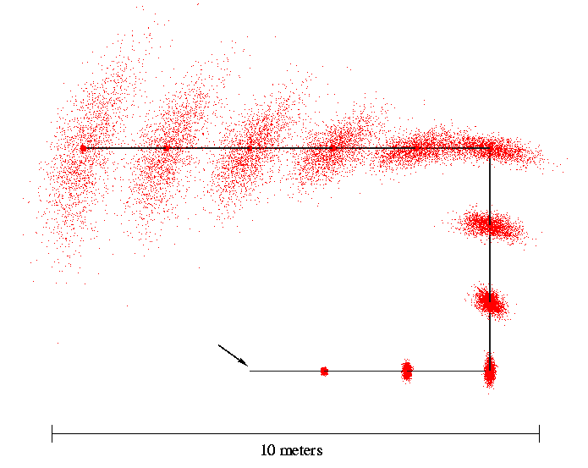
Sampled Motion Model
Start

Slide 16
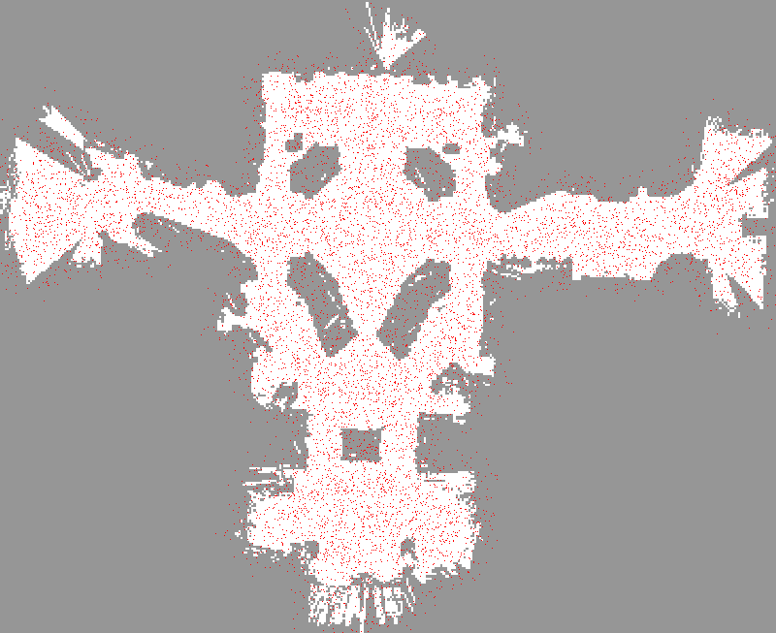

Slide 17
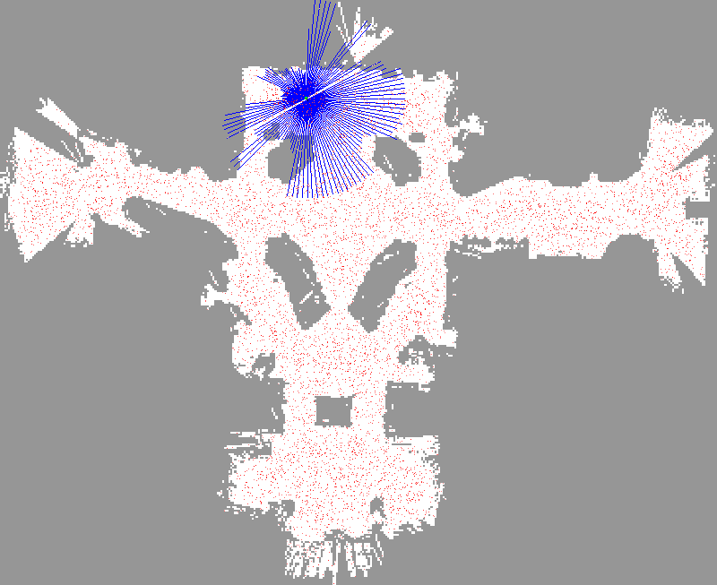

Slide 18
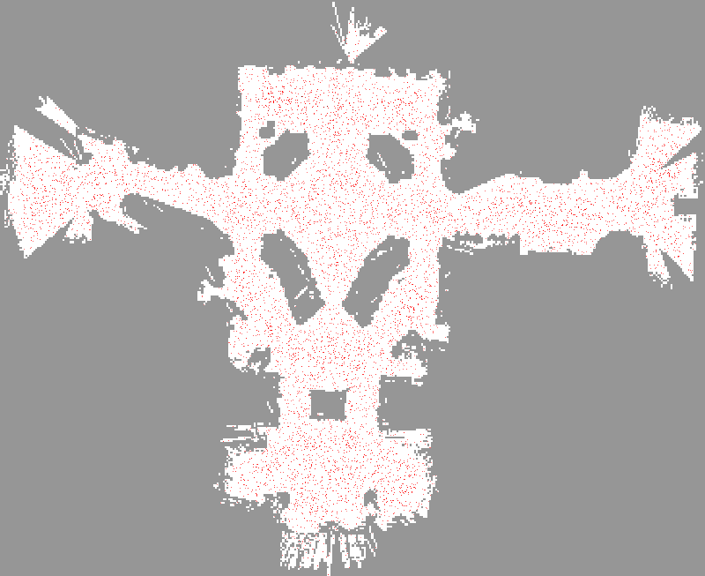

Slide 19
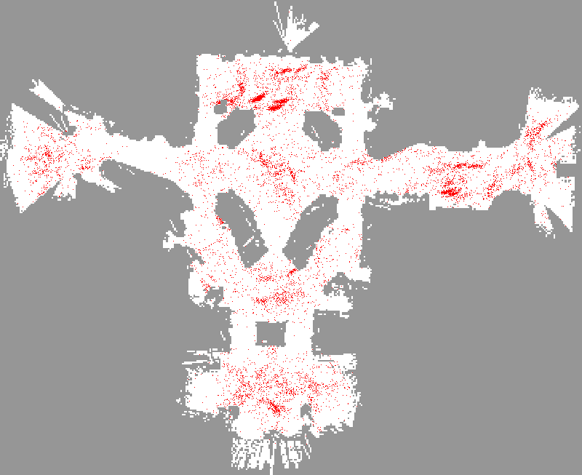

Slide 20
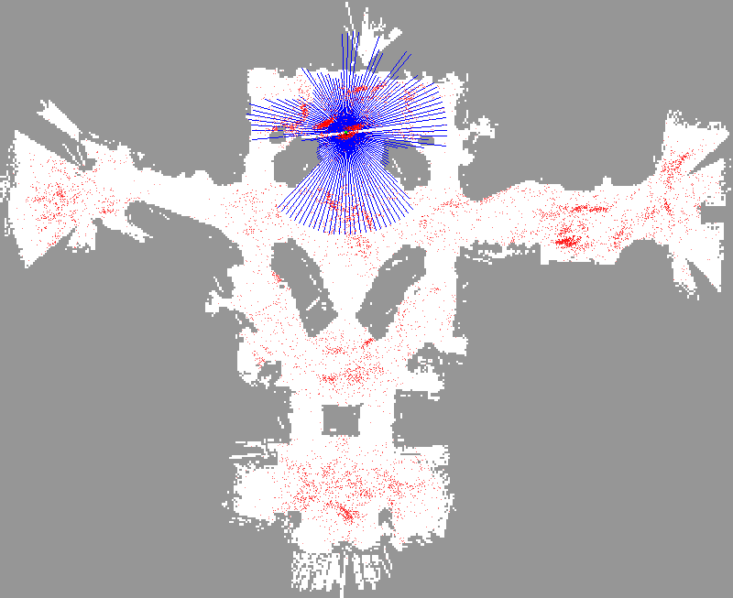

Slide 21
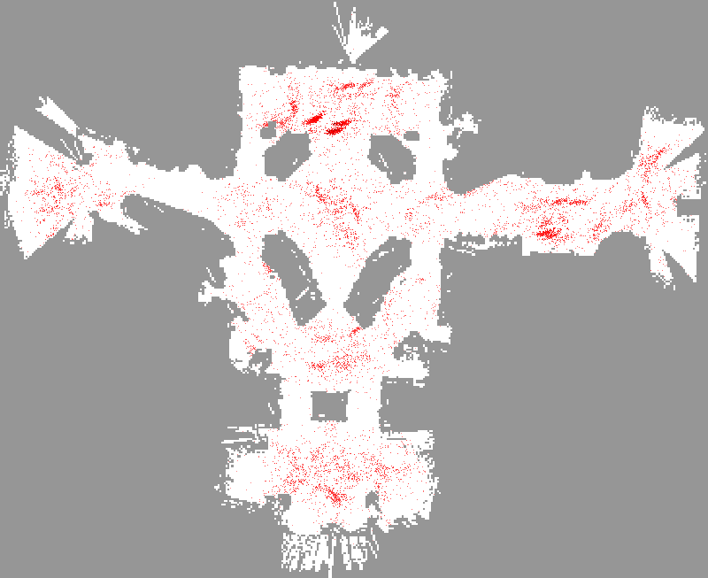

Slide 22
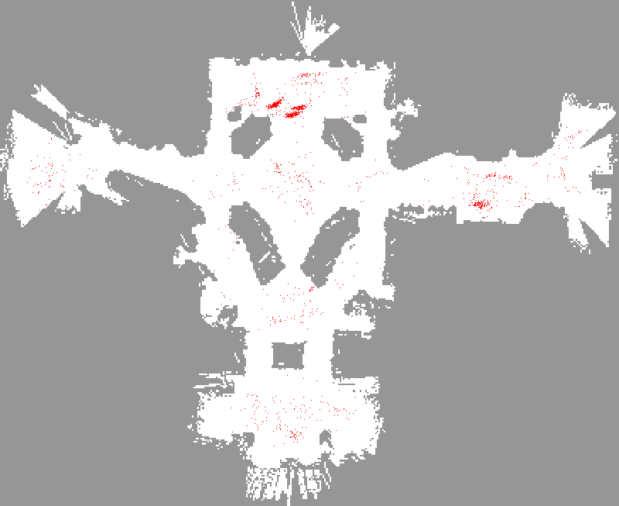

Slide 23
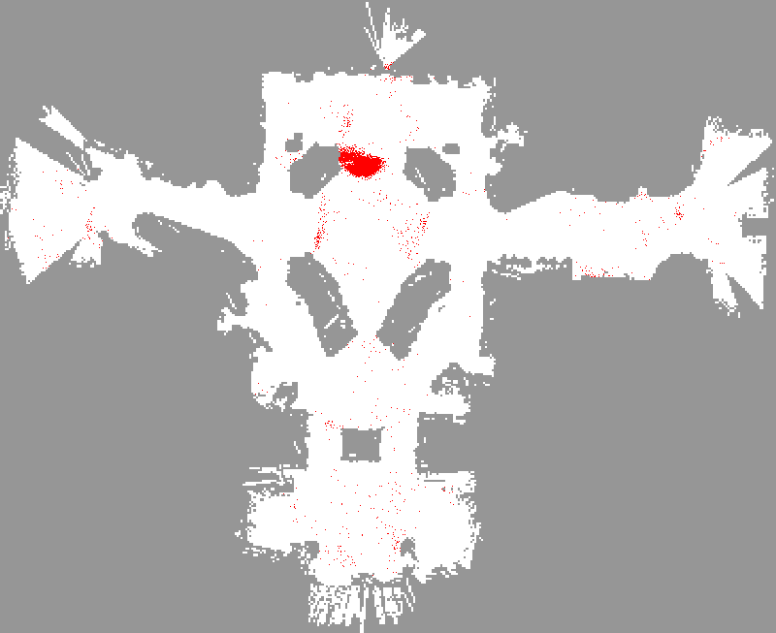

Slide 24
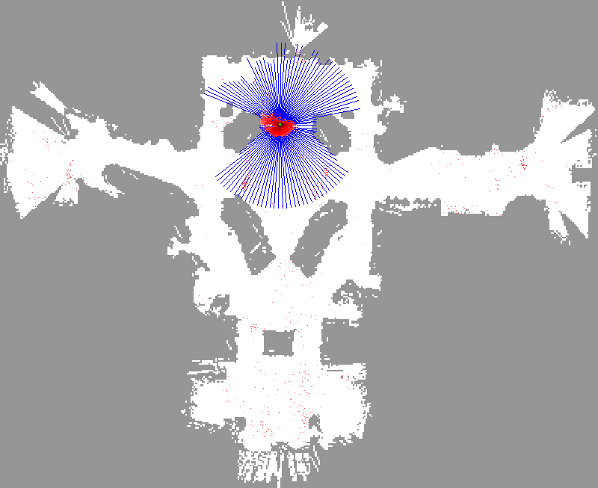

Slide 25


Slide 26
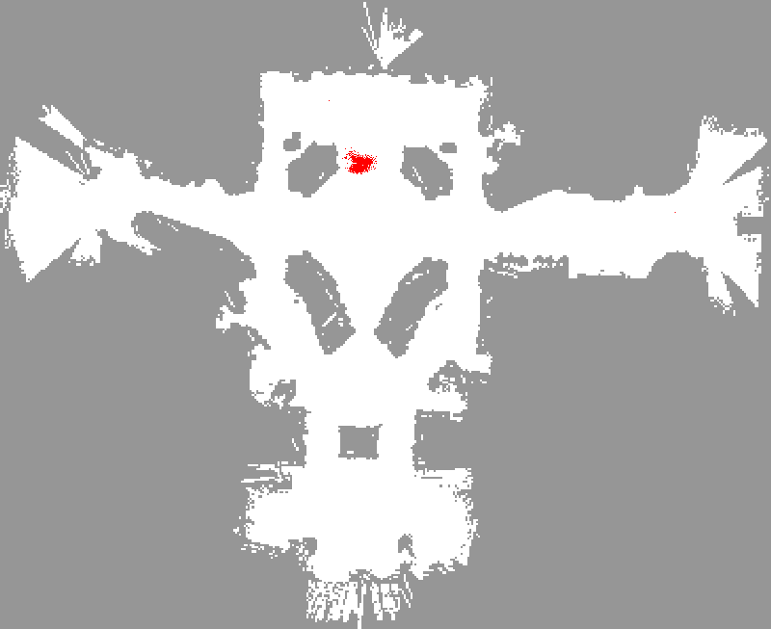

Slide 27
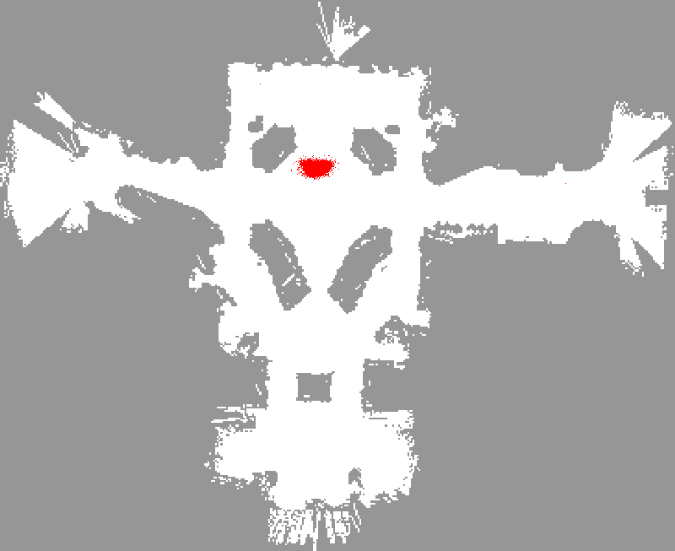

Slide 28
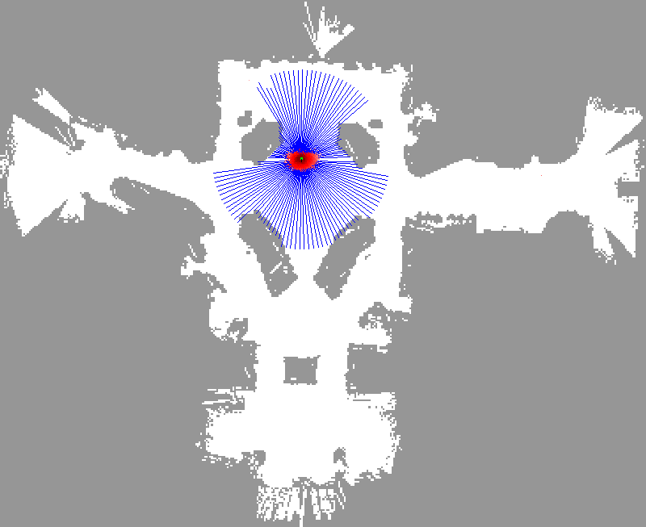

Slide 29
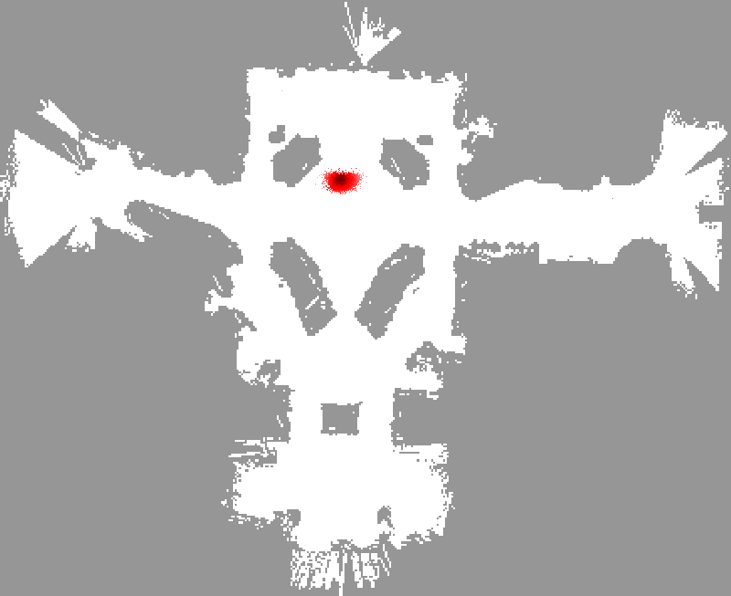

Slide 30
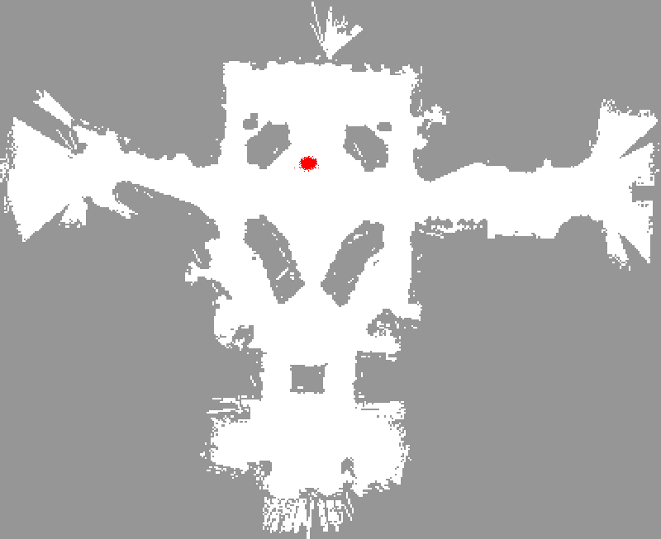

Slide 31


Slide 32
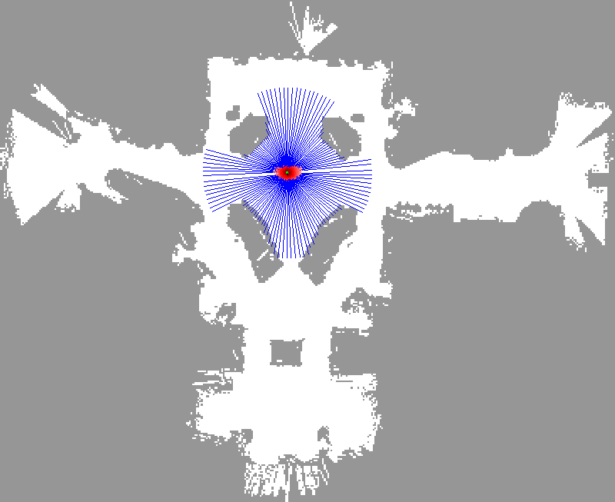

Slide 33
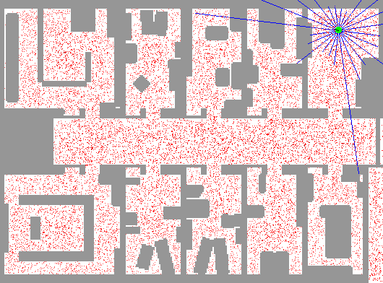
Particle Filter Localization (Sonar)
[Video: global-floor.gif]

Slide 34
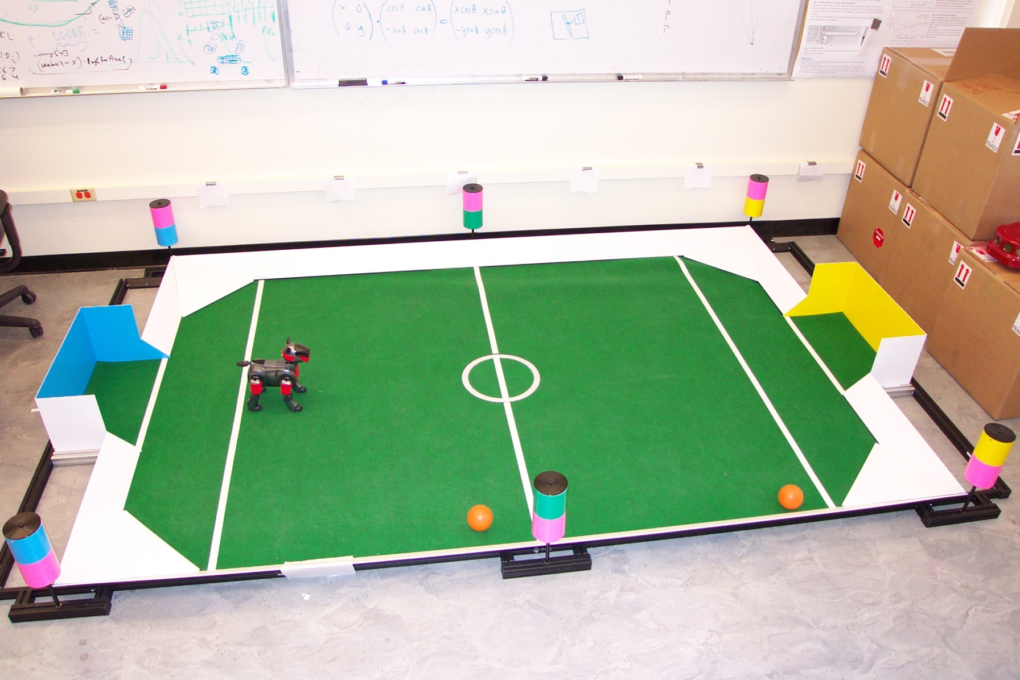
Aibo Sensor Model

Slide 35
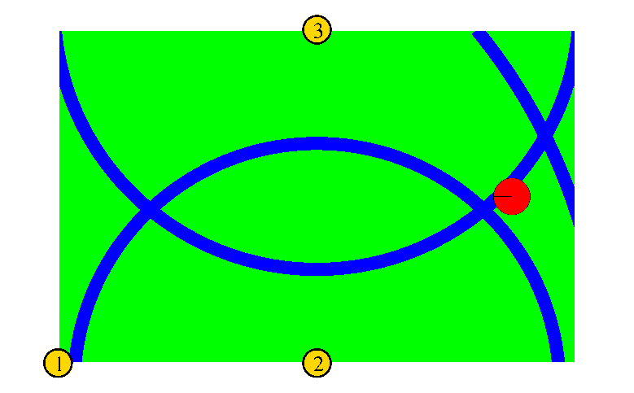
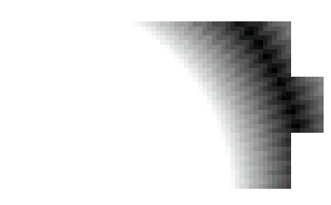
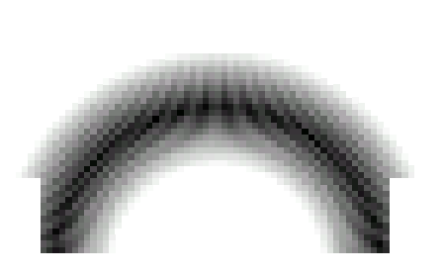
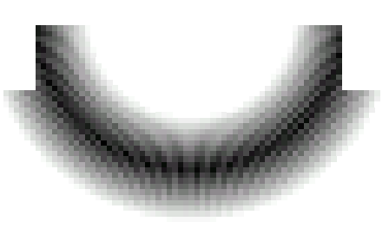
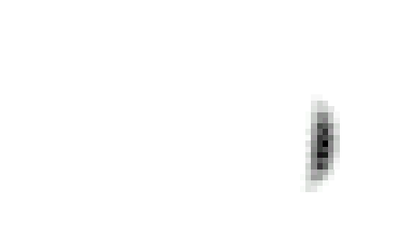
Distributions for P(z|x)

Slide 36
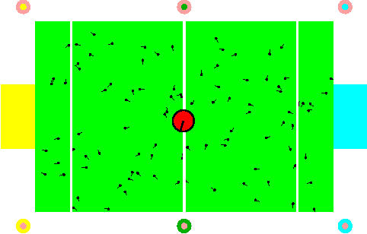
Localization for AIBO robots

Slide 37
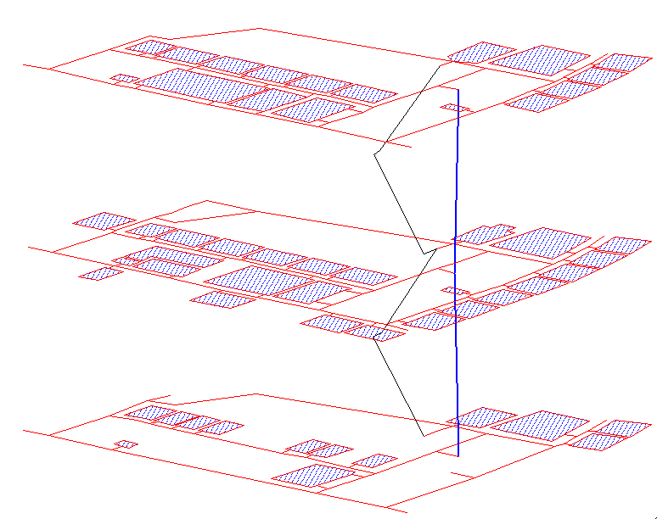
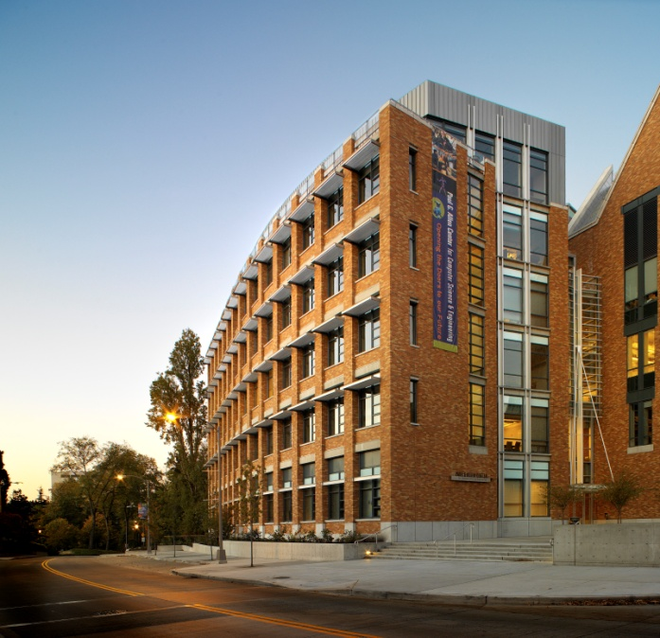
WiFi-Based People Tracking

Slide 38
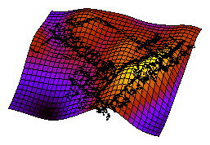
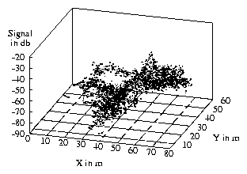
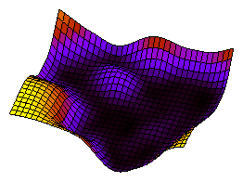
WiFi Sensor Model
Mean
Variance

Slide 39
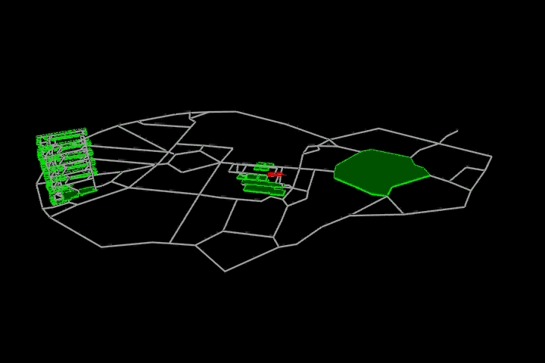
Tracking Example

Slide 40
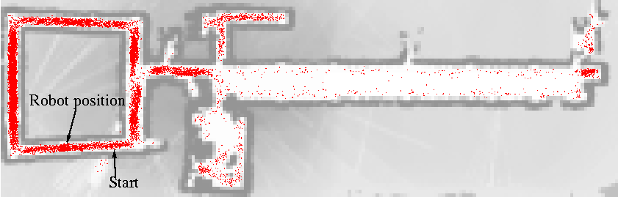
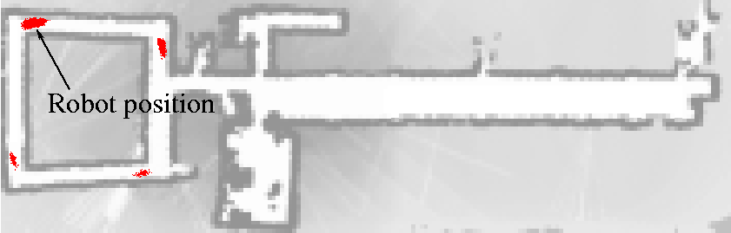
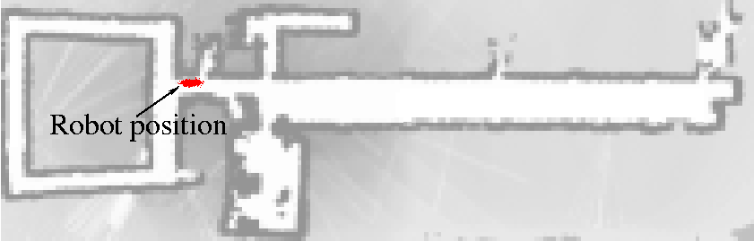
Adaptive Sampling

Slide 41
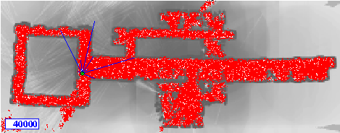
KLD-Sampling Sonar
Adapt number of particles on the fly based
on statistical approximation measure

Slide 42
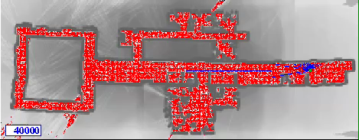
KLD-Sampling Laser

Slide 43
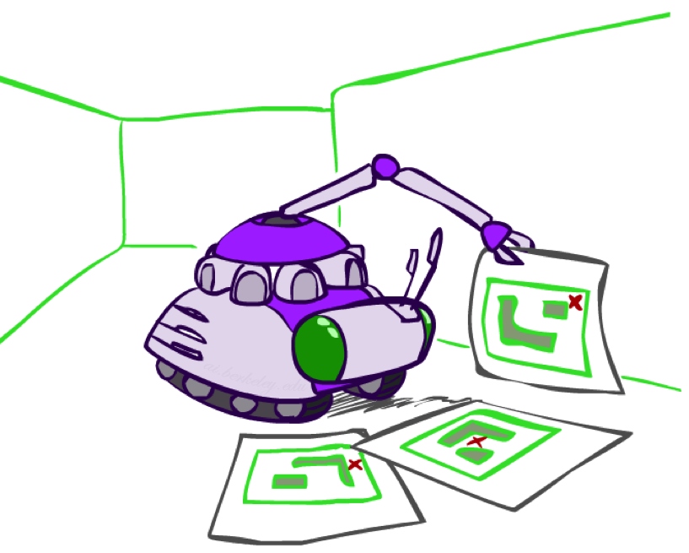
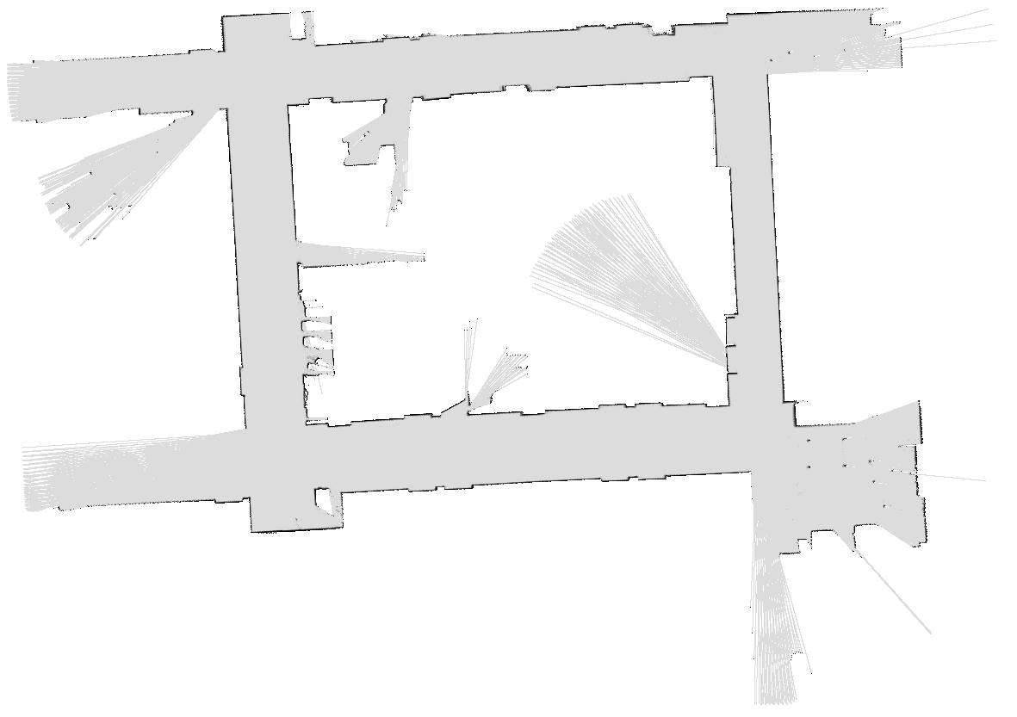
Robot Mapping
SLAM: Simultaneous Localization And Mapping
  We do not know the map or our location
  State consists of position AND map!
  Main techniques: Kalman filtering (Gaussian HMMs) and particle methods
DP-SLAM, Ron Parr
[Demo: PARTICLES-SLAM-mapping1-new.avi]

Slide 44
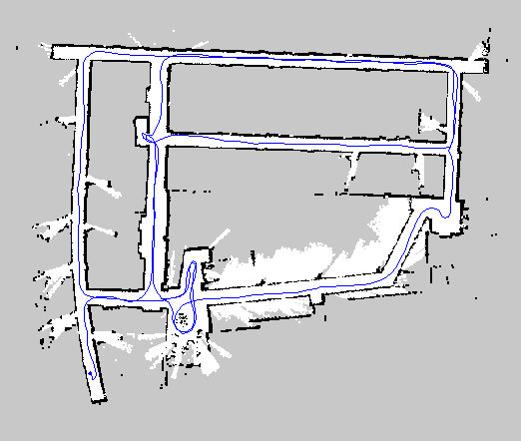
Mapping with a Laser Scanner
Notes:
What we believe, and what I hope to convince you today, is that Kinect and gaming is only the tip of the iceburg for visual perception using RGB-D cameras.
Here is a video of the raw data tfrom one of our cameras. The camera returns two video streams, a regular video, in RGB color, and a depth video, telling us how far away the scene is at every pixel, here on the right panel, coded by color, black are pixels with missing depth. The color video and the depth video are fully registered and synchronized, and that’s why we call these cameras RGB-D cameras. RGB-D cameras today can easily do 640x480 resolution at 30Hz. There are a few competing technologies underneath, this one uses active stereo, which projects an infrared pattern into the scene, and use the stereo principle, that is, two camera views, to measure depth. It may not seem much, or not so obvious why we need the active projection. But if you compare to some examples to the right, results from a popular traditional stereo camera, without infrared projection, , you can easily see the difference. Traditional stereo cameras rely heavily on a good lighting condition and scene texture, and the depth estimates tend to be unreliable and sparse, with lots of missing depth values. In comparison, RGB-D cameras return reliable dense depth, robust to lighting and material. Kinect uses these cameras to do controller-free gaming, which, we believe, is only the tip of the iceberg. We believe RGB-D cameras are truly revolutionary and we can enable a variety of applications combining color and depth.

Slide 45
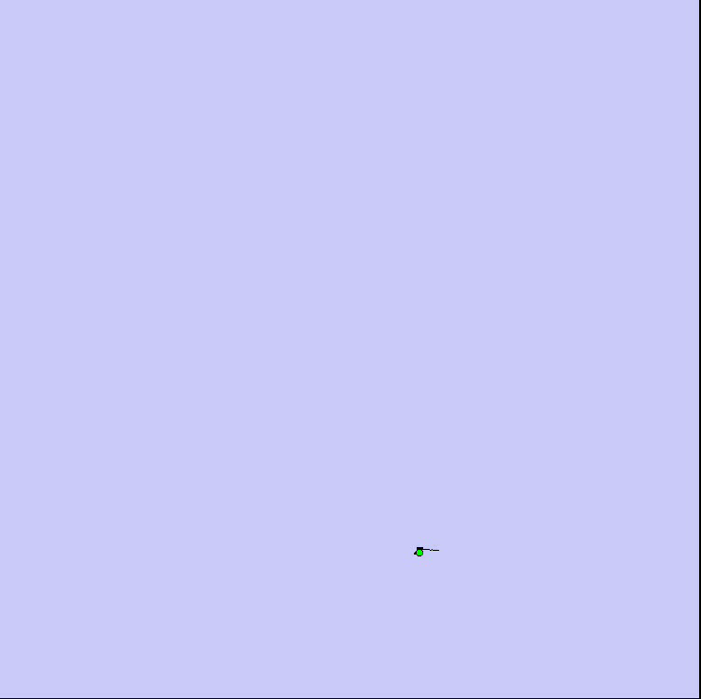
Rao-Blackwellized Mapping with Scan-Matching
Map: Intel Research Lab Seattle

Slide 46
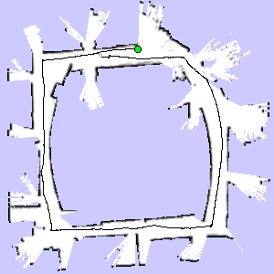
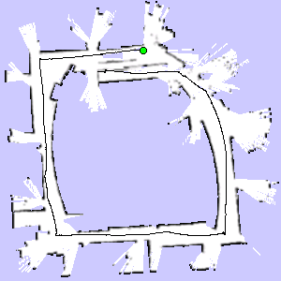


Loop Closure Example
3 particles
map of particle 1
map of particle 3
map of particle 2

Slide 47

Rao-Blackwellized Mapping with Scan-Matching
Map: Intel Research Lab Seattle

Slide 48

Rao-Blackwellized Mapping with Scan-Matching
Map: Intel Research Lab Seattle

Slide 49

Example (Intel Lab)
15 particles
four times faster than real-time
P4, 2.8GHz
5cm resolution during scan matching
1cm resolution in final map
Work by Grisetti et al.

Slide 50

Outdoor Campus Map
30 particles
250x250m²
1.75 km (odometry)
20cm resolution during scan matching
30cm resolution in final map
30 particles
250x250m²
1.088 miles (odometry)
20cm resolution during scan matching
30cm resolution in final map
Work by Grisetti et al.

