Slide 1

CSE 473: Artificial Intelligence
Hidden Markov Models
Dieter Fox --- University of Washington
[Most slides were created by Dan Klein and Pieter Abbeel for CS188 Intro to AI at UC Berkeley. All CS188 materials are available at http://ai.berkeley.edu.]
Notes:
Please retain proper attribution, including the reference to ai.berkeley.edu. Thanks!
Note: pretty short lecture, good one to present mini-contest results or anything else not exactly lecture.

Slide 2
Hidden Markov Models
Markov chains not so useful for most agents
  Eventually you don’t know anything anymore
  Need observations to update your beliefs
Hidden Markov models (HMMs)
  Underlying Markov chain over states S
  You observe outputs (effects) at each time step
  As a Bayes’ net:
X₁
X₂
X₃
X₄
X_{N}
X₅
E₁
E₂
E₃
E₄
E_{N}
E₅

Slide 3
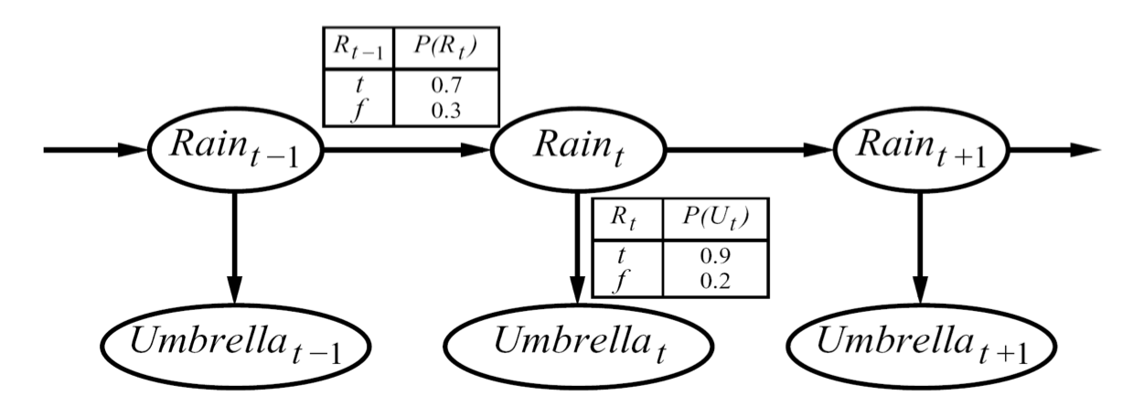



Example
An HMM is defined by:
  Initial distribution:
  Transitions:
  Emissions:

Slide 4



Hidden Markov Models
X₁
X₂
X₃
X₄
X_{N}
X₅
E₁
E₂
E₃
E₄
E_{N}
E₅
Defines a joint probability distribution:

Slide 5
Ghostbusters HMM
P(X₁) = uniform
P(X’|X) = ghosts usually move clockwise, but sometimes move in a random direction or stay put
P(E|X) = same sensor model as before:
red means close, green means far away.
1/9
1/9
1/9
1/9
1/9
1/9
1/9
1/9
1/9
P(X₁)
X₁
X₂
X₃
X₄
1/6
1/6
1/2
0
1/6
0
Etc…
E₁
E₁
E₃
E₄
0
0
0
P(X’|X=<1,2>)
P(red | 3) | P(orange | 3) | P(yellow | 3) | P(green | 3)
0.05 | 0.15 | 0.5 | 0.3
P(E|X)
E₅
Etc… (must specify for other distances)

Slide 6
HMM Computations
Given
  parameters
  evidence E_{1:n} =e_{1:n}
Inference problems include:
  Filtering, find P(X_{t}|e_{1:t}) for all t
  Smoothing, find P(X_{t}|e_{1:n}) for all t
  Most probable explanation, find
      x*_{1:n} = argmaxx_{1:n} P(x_{1:n}|e_{1:n})

Slide 7
Real HMM Examples
Speech recognition HMMs:
  Observations are acoustic signals (continuous valued)
  States are specific positions in specific words (so, tens of thousands)
X₁
X₂
X₃
X₄
E₁
E₁
E₃
E₄

Slide 8
Real HMM Examples
Machine translation HMMs:
  Observations are words (tens of thousands)
  States are translation options
X₁
X₂
X₃
X₄
E₁
E₁
E₃
E₄

Slide 9
Real HMM Examples
Robot tracking:
  Observations are range readings (continuous)
  States are positions on a map (continuous)
X₁
X₂
X₃
X₄
E₁
E₁
E₃
E₄

Slide 10
Conditional Independence
HMMs have two important independence properties:
  Markov hidden process, future depends on past via the present
?
?
X₁
X₂
X₃
X₄
E₁
E₁
E₃
E₄

Slide 11
Conditional Independence
HMMs have two important independence properties:
  Markov hidden process, future depends on past via the present
  Current observation independent of all else given current state
?
X₁
X₂
X₃
X₄
E₁
E₁
E₃
E₄
?

Slide 12
Conditional Independence
HMMs have two important independence properties:
  Markov hidden process, future depends on past via the present
  Current observation independent of all else given current state
Quiz: does this mean that observations are independent given no evidence?
  [No, correlated by the hidden state]
X₁
X₂
X₃
X₄
E₁
E₁
E₃
E₄
?
?

Slide 13
Filtering / Monitoring
Filtering, or monitoring, is the task of tracking the distribution B(X) (the belief state) over time
We start with B(X) in an initial setting, usually uniform
As time passes, or we get observations, we update B(X)
The Kalman filter (one method – Real valued values)
  invented in the 60’s as a method of trajectory estimation for the Apollo program

Slide 14
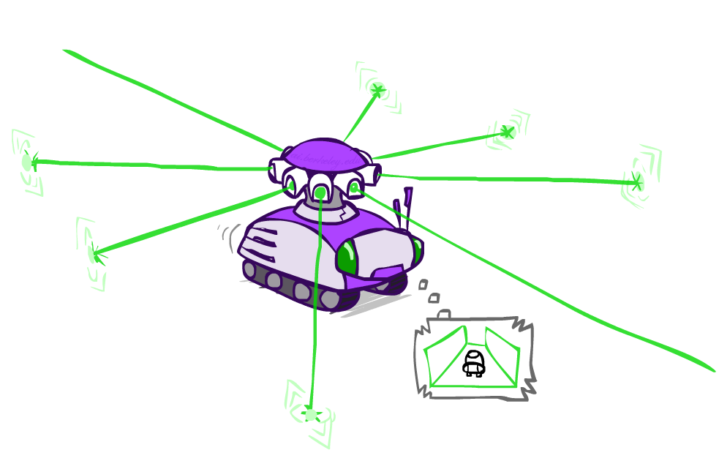
Example: Robot Localization
Example from Michael Pfeiffer
Prob
0
1
t=0
Sensor model: can read in which directions there is a wall, never more than 1 mistake
Motion model: may not execute action with small prob.

Slide 15
Example: Robot Localization
Prob
0
1
t=1
Lighter grey: was possible to get the reading, but less likely b/c required 1 mistake

Slide 16
Example: Robot Localization
Prob
0
1
t=2

Slide 17
Example: Robot Localization
Prob
0
1
t=3

Slide 18
Example: Robot Localization
Prob
0
1
t=4

Slide 19
Example: Robot Localization
Prob
0
1
t=5

Slide 20


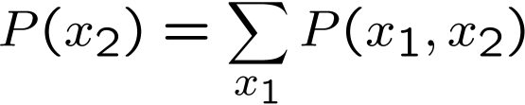

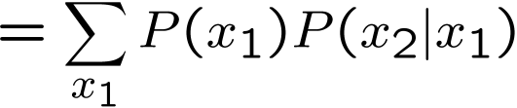

Inference Recap: Simple Cases
X₁
X₁
X₂
E₁

Slide 21
Online Belief Updates
Every time step, we start with current P(X | evidence)
We update for time:
We update for evidence:
The forward algorithm does both at once (and doesn’t normalize)
Problem: space is |X| and time is |X|² per time step
X₁
X₂
X₂
E₂

Slide 22

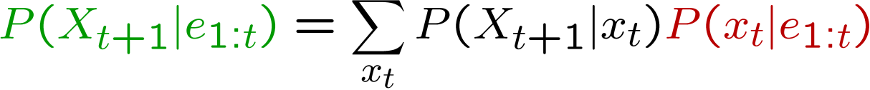
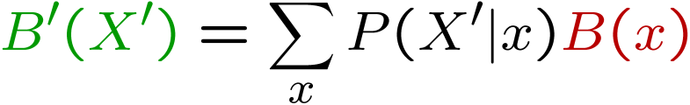
Passage of Time
Assume we have current belief P(X | evidence to date)
Then, after one time step passes:
Or, compactly:
Basic idea: beliefs get “pushed” through the transitions
  With the “B” notation, we have to be careful about what time step t the belief is about, and what evidence it includes
X₁
X₂

Slide 23
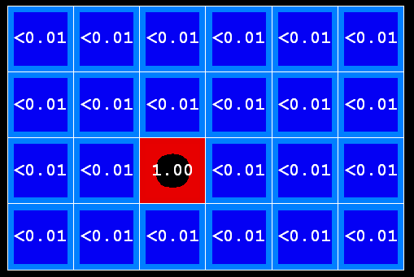

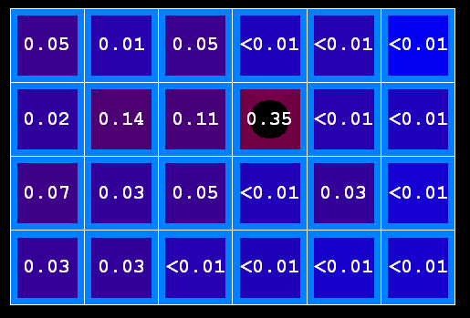
Example: Passage of Time
As time passes, uncertainty “accumulates”
T = 1
T = 2
T = 5
Transition model: ghosts usually go clockwise

Slide 24

Observation
Assume we have current belief P(X | previous evidence):
Then:
Or:
Basic idea: beliefs reweighted by likelihood of evidence
Unlike passage of time, we have to renormalize
X₁
E₁

Slide 25
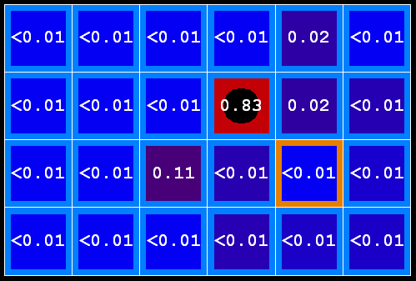

Example: Observation
As we get observations, beliefs get reweighted, uncertainty “decreases”
Before observation
After observation

Slide 26
Example: Run the Filter
An HMM is defined by:
  Initial distribution:
  Transitions:
  Emissions:

Slide 27
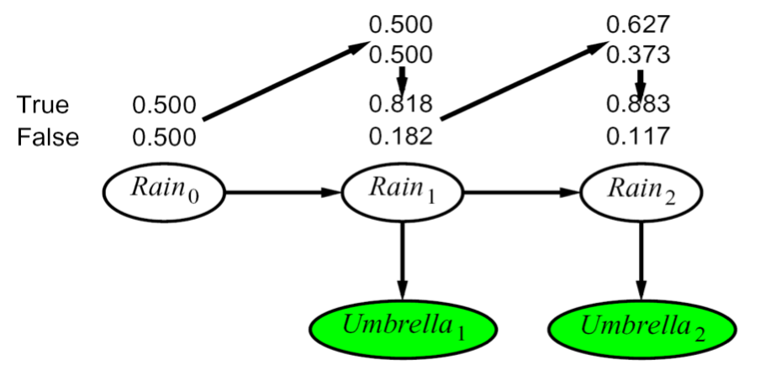
Example HMM

Slide 28
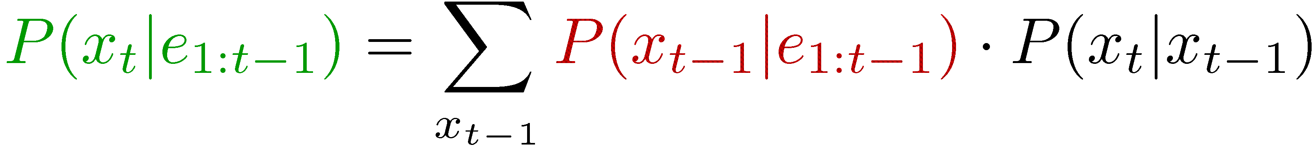
Summary: Filtering
Filtering is the inference process of finding a distribution over X_{T} given e₁ through e_{T} : P( X_{T} | e_{1:t} )
We first compute P( X₁ | e₁ ):
For each t from 2 to T, we have P( X_{t-1} | e_{1:t-1} )
Elapse time: compute P( X_{t} | e_{1:t-1} )
Observe: compute P(X_{t} | e_{1:t-1} , e_{t}) = P( X_{t} | e_{1:t} )

Slide 29
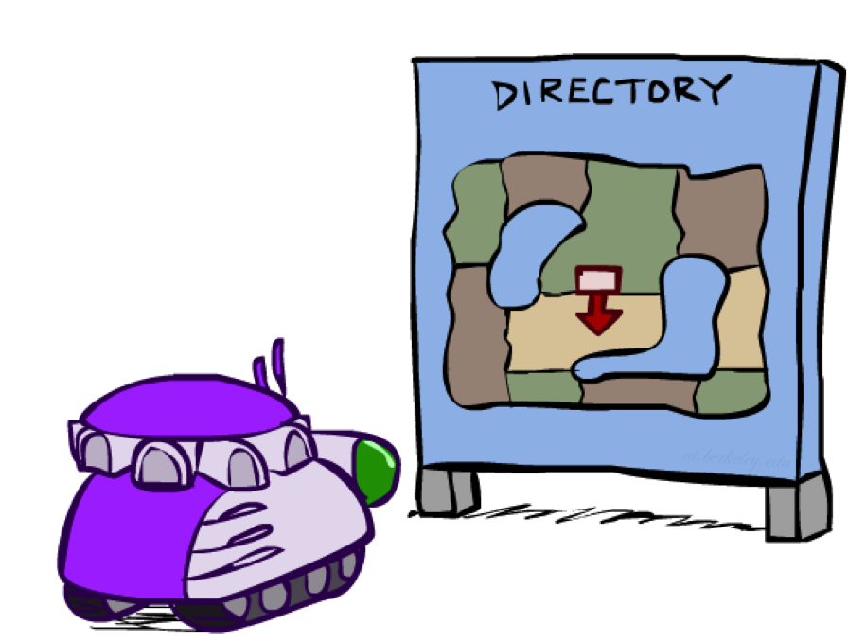
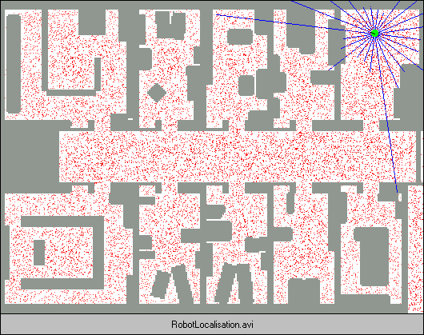
Robot Localization
In robot localization:
  We know the map, but not the robot’s position
  Observations may be vectors of range finder readings
  State space and readings are typically continuous (works basically like a very fine grid) and so we cannot store B(X)
  Particle filtering is a main technique

Slide 30
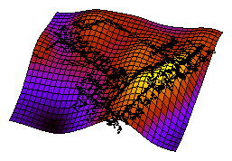
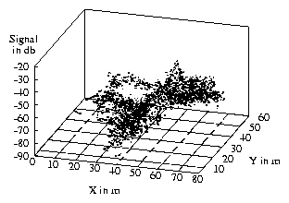
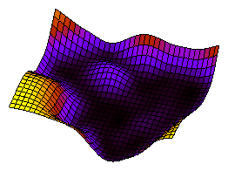
GP-Based WiFi Sensor Model
Mean
Variance

Slide 31
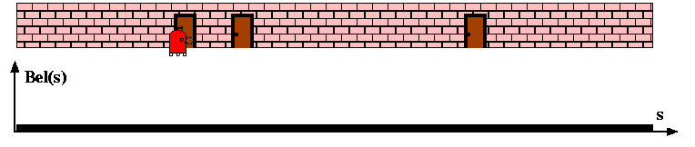
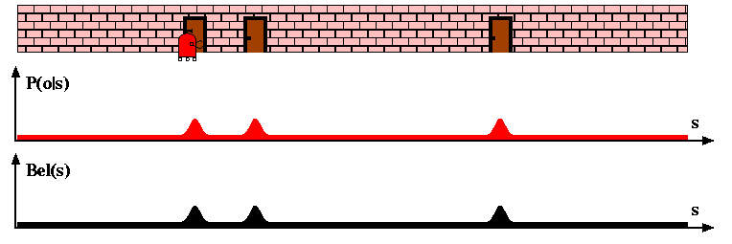
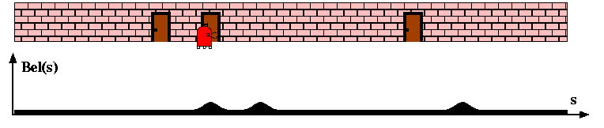
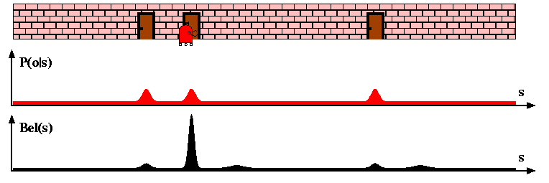
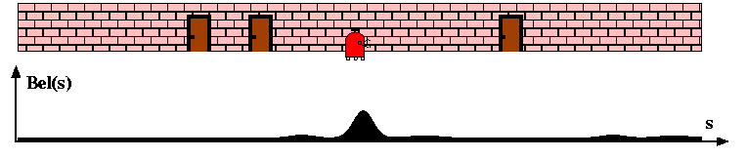
Bayes Filter for Robot Localization

Slide 32
Representations for Bayesian Robot Localization
Kalman filters (late-80s)
Gaussians, unimodal
approximately linear models
position tracking
Discrete approaches (’95)
Topological representation (’95)
  uncertainty handling (POMDPs)
  occas. global localization, recovery
Grid-based, metric representation (’96)
  global localization, recovery
Robotics
AI
Particle filters (’99)
sample-based representation
global localization, recovery
Multi-hypothesis (’00)
multiple Kalman filters
global localization, recovery

Slide 33
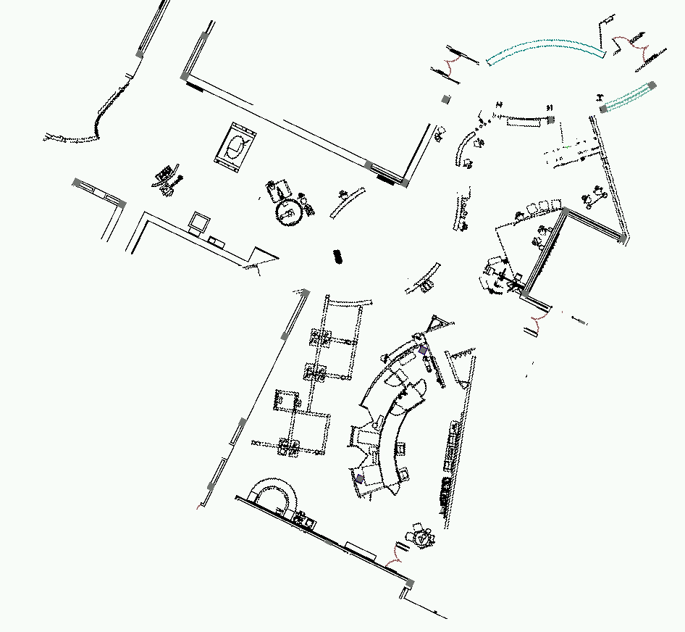
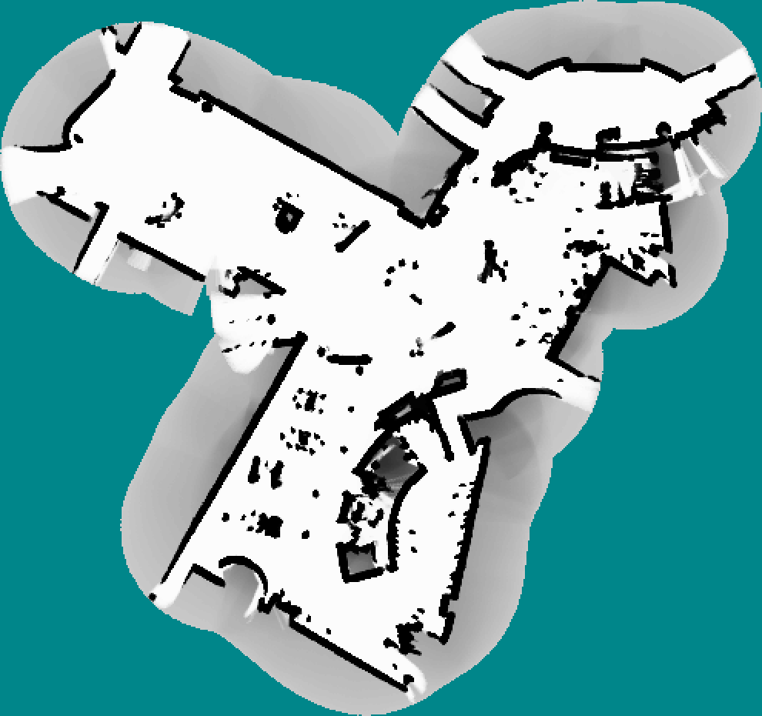
Occupancy Map
CAD map
occupancy grid map

Slide 34
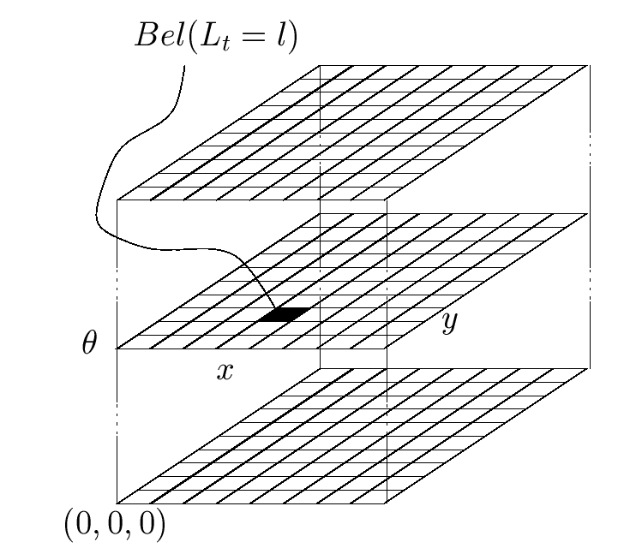
Piecewise Constant Representation

Slide 35
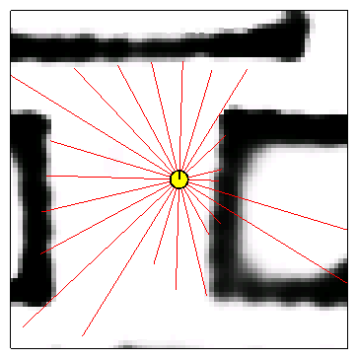
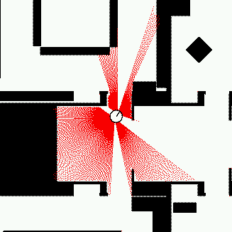
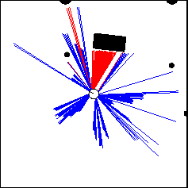
Proximity Sensors

Slide 36
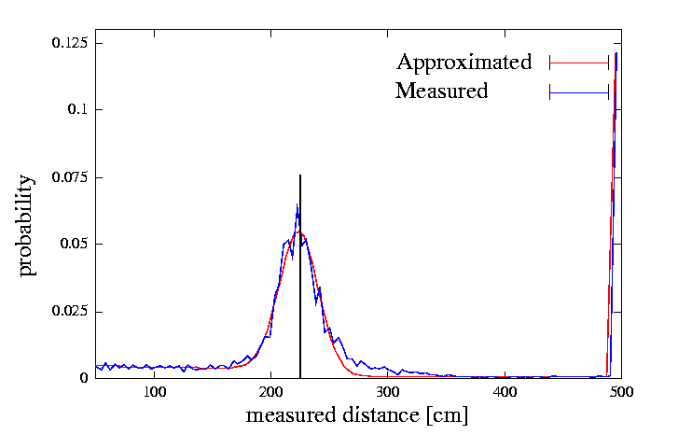
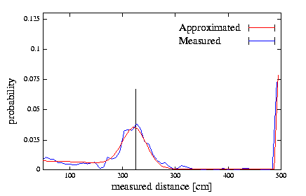
Proximity Sensor Model
Laser sensor
Sonar sensor

Slide 37
Beam-based Sensor Model
Scan z consists of K measurements.
Individual measurements are independent given the robot position.

Slide 38
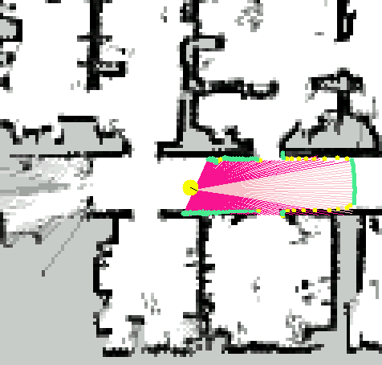

Example
z
P(z|x,m)

Slide 39
Probabilistic Kinematics
Robot moves from to .
Odometry information .

Slide 40

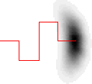
Probabilistic Kinematics
Odometry information is inherently noisy.
p(x|u,x’)
x’
x’
u
u

Slide 41
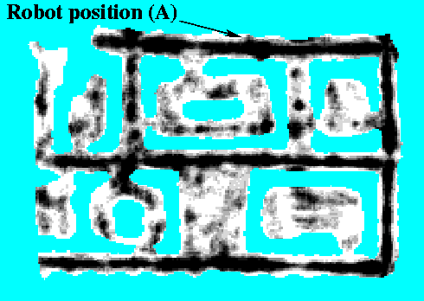
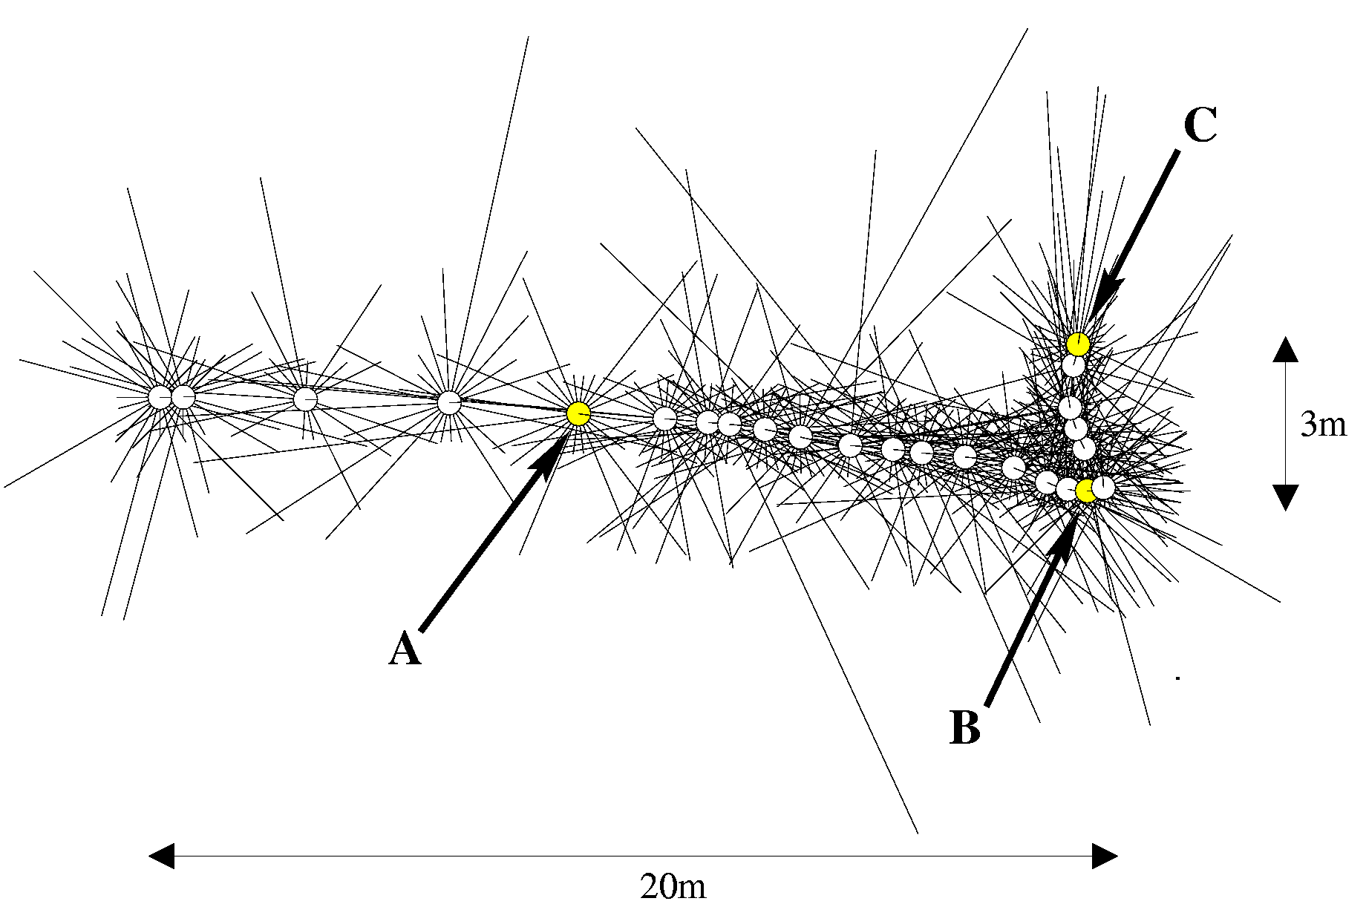
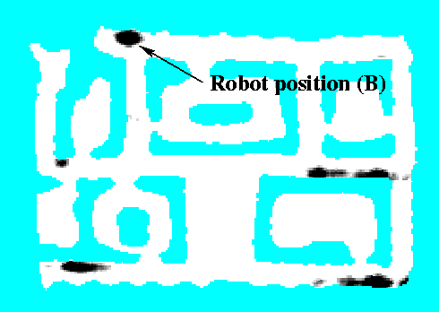
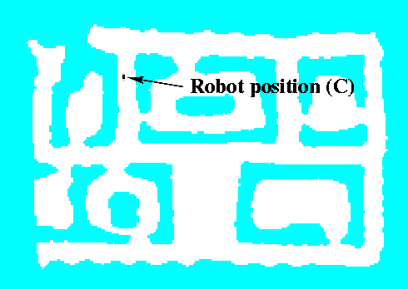
Sonars and Occupancy Grid Map

Slide 42
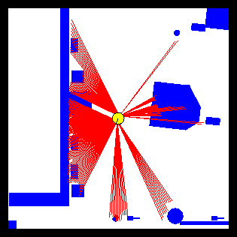
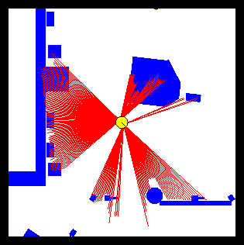
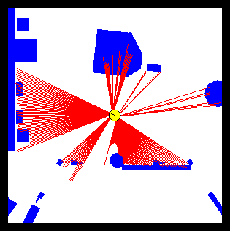
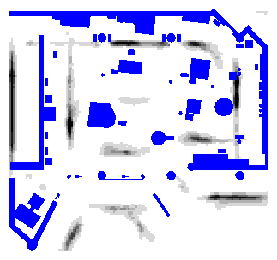
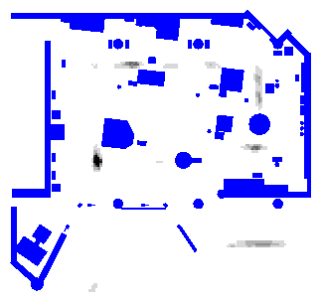
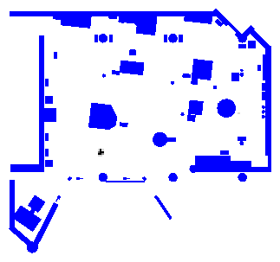
Laser-based Localization

Slide 43

Museum Tourguide Minerva

Slide 44
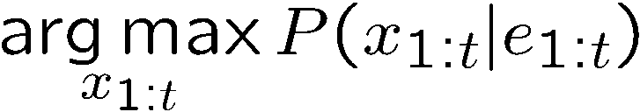
Best Explanation Queries
E₅
X₁
X₂
X₃
X₄
X₅
E₁
E₁
E₃
E₄
Query: most likely seq:

Slide 45





State Path Trellis
State trellis: graph of states and transitions over time
Each arc represents some transition
Each arc has weight
Each path is a sequence of states
The product of weights on a path is the seq’s probability
Can think of the Forward (and now Viterbi) algorithms as computing sums of all paths (best paths) in this graph
sun
sun
sun
sun
rain
rain
rain
rain

Slide 46
Viterbi Algorithm
sun
sun
sun
sun
rain
rain
rain
rain
22

Slide 47
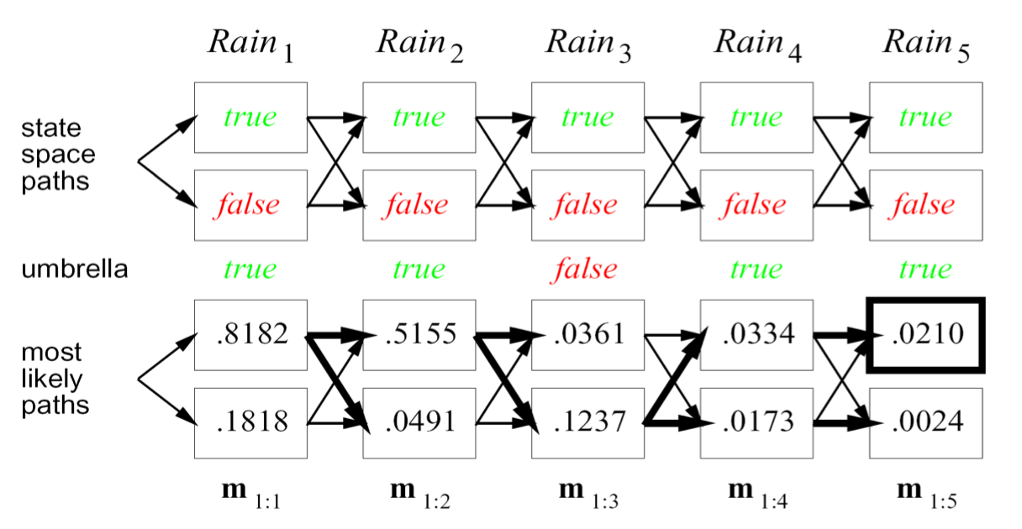
Example
23

Slide 48


Recap: Reasoning Over Time
Stationary Markov models
0.3
0.7
rain
sun
X₁
X₂
X₃
X₄
0.7
0.3
Hidden Markov models
X | E | P
rain | umbrella | 0.9
rain | no umbrella | 0.1
sun | umbrella | 0.2
sun | no umbrella | 0.8
X₁
X₂
X₃
X₄
X₅
E₁
E₂
E₃
E₄
E₅

