Slide 1
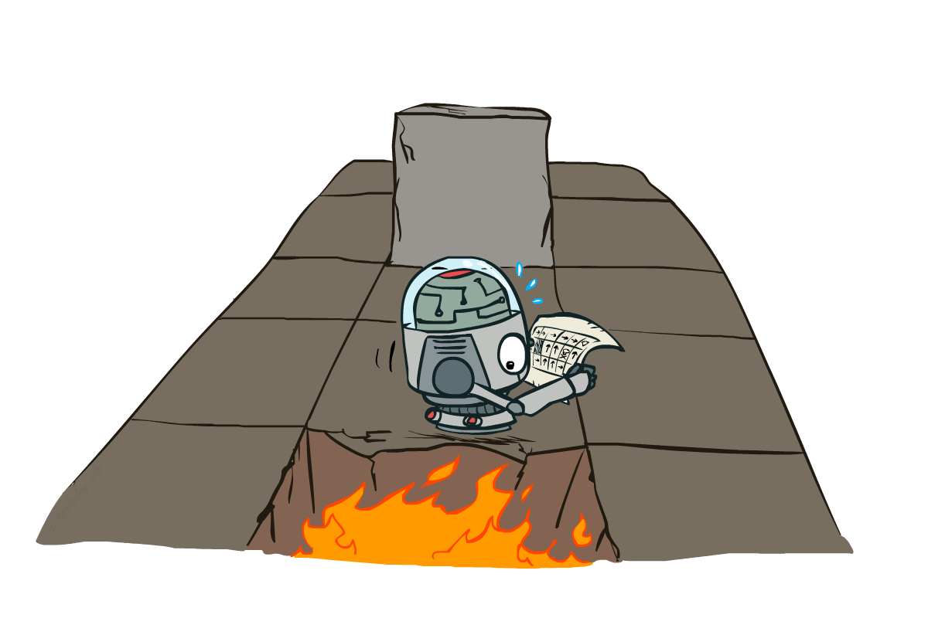
CSE 473: Introduction to Artificial Intelligence
Markov Decision Processes II
Based on slides by: Dan Klein and Pieter Abbeel --- University of California, Berkeley
[These slides were created by Dan Klein and Pieter Abbeel for CS188 Intro to AI at UC Berkeley. All CS188 materials are available at http://ai.berkeley.edu.]
Notes:
Please retain proper attribution, including the reference to ai.berkeley.edu. Thanks!

Slide 2
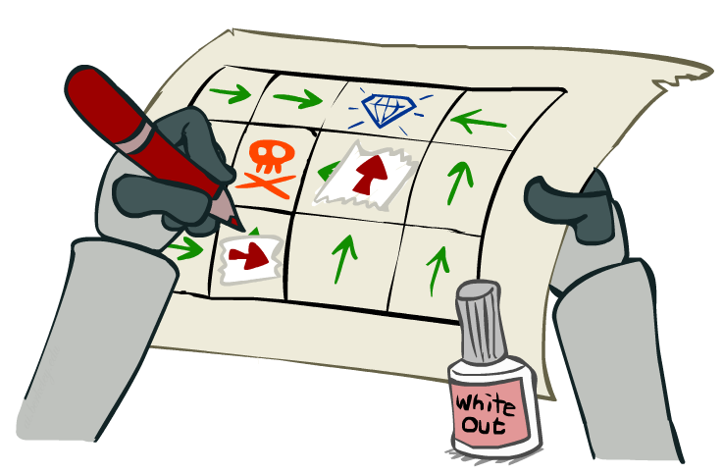
Solving MDPs
Value Iteration
Policy Iteration
Reinforcement Learning

Slide 3
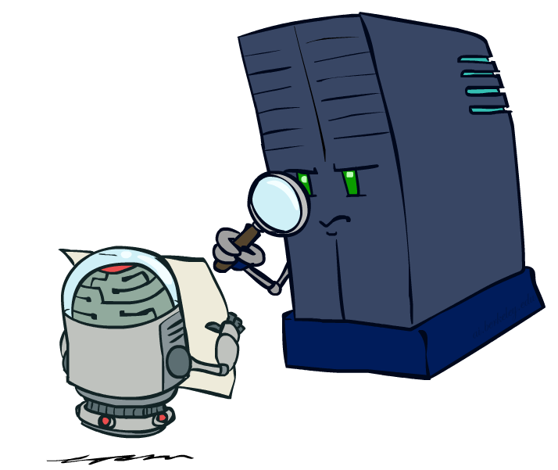
Policy Evaluation

Slide 4
Fixed Policies
Do the optimal action
Do what π says to do
s
s
a
π (s)
s, a
s, π(s)
s,a,s’
s, π(s),s’
s’
s’
Expectimax trees max over all actions to compute the optimal values
If we fixed some policy π (s), then the tree would be simpler – only one action per state
… though the tree’s value would depend on which policy we fixed

Slide 5
Utilities for a Fixed Policy
Another basic operation: compute the utility of a state s under a fixed (generally non-optimal) policy
Define the utility of a state s, under a fixed policy π:
V^{π} (s) = expected total discounted rewards starting in s and following π
Recursive relation (one-step look-ahead / Bellman equation):
s
π (s)
s, π(s)
s, π(s),s’
s’

Slide 6
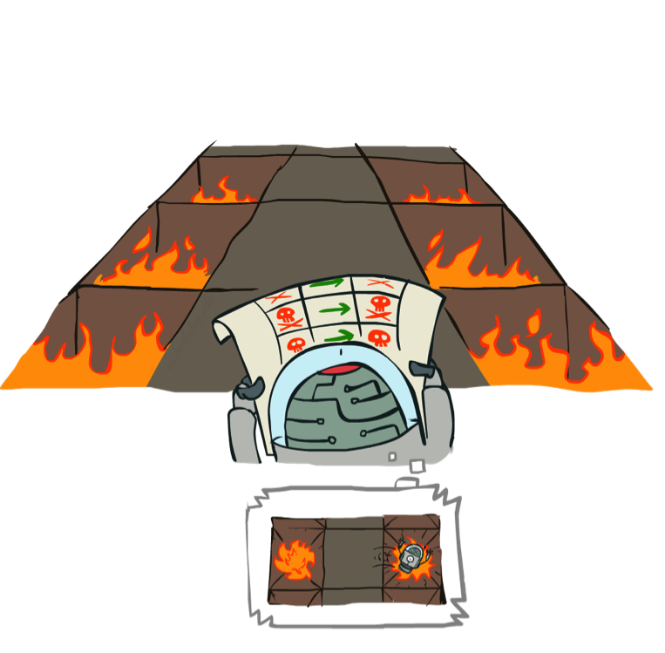
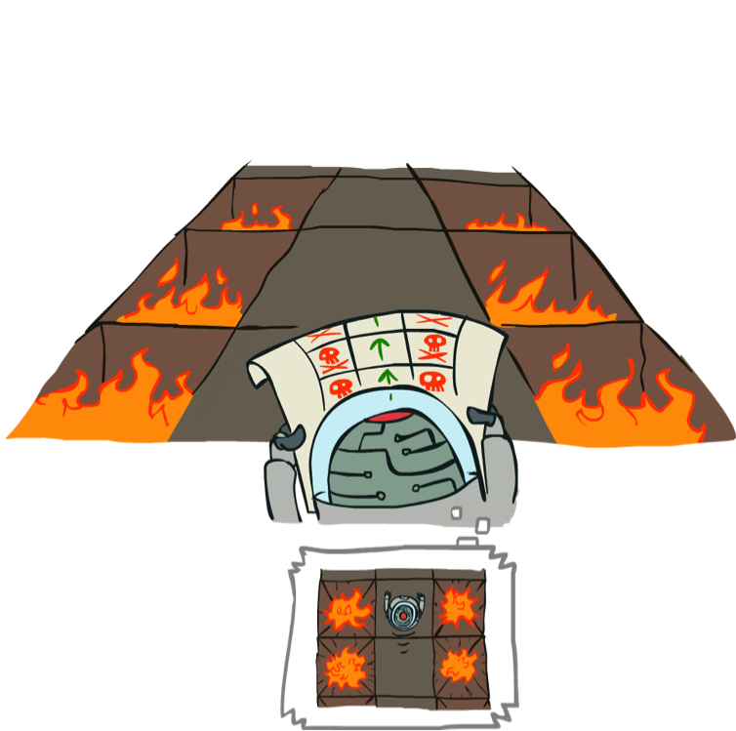
Example: Policy Evaluation
Always Go Right
Always Go Forward

Slide 7
Example: Policy Evaluation
Always Go Right
Always Go Forward

Slide 8
Policy Evaluation
s
How do we calculate the V’s for a fixed policy π?
Idea 1: Turn recursive Bellman equations into updates
(like value iteration)
Efficiency: O(S²) per iteration
Idea 2: Without the maxes, the Bellman equations are just a linear system
Solve with Matlab (or your favorite linear system solver)
π (s)
s, π(s)
s, π(s),s’
s’

Slide 9
Policy Iteration
Alternative approach for optimal values:
Step 1: Policy evaluation: calculate utilities for some fixed policy (not optimal utilities!) until convergence
Step 2: Policy improvement: update policy using one-step look-ahead with resulting converged (but not optimal!) utilities as future values
Repeat steps until policy converges
This is policy iteration
It’s still optimal! Can converge (much) faster under some conditions

Slide 10
Comparison
Both value iteration and policy iteration compute the same thing (all optimal values)
In value iteration:
Every iteration updates both the values and (implicitly) the policy
We don’t track the policy, but taking the max over actions implicitly recomputes it
In policy iteration:
We do several passes that update utilities with fixed policy (each pass is fast because we consider only one action, not all of them)
After the policy is evaluated, a new policy is chosen (slow like a value iteration pass)
The new policy will be better (or we’re done)
Both are dynamic programs for solving MDPs

Slide 11
Summary: MDP Algorithms
So you want to….
Compute optimal values: use value iteration or policy iteration
Compute values for a particular policy: use policy evaluation
Turn your values into a policy: use policy extraction (one-step lookahead)
These all look the same!
They basically are – they are all variations of Bellman updates
They all use one-step lookahead expectimax fragments
They differ only in whether we plug in a fixed policy or max over actions

Slide 12
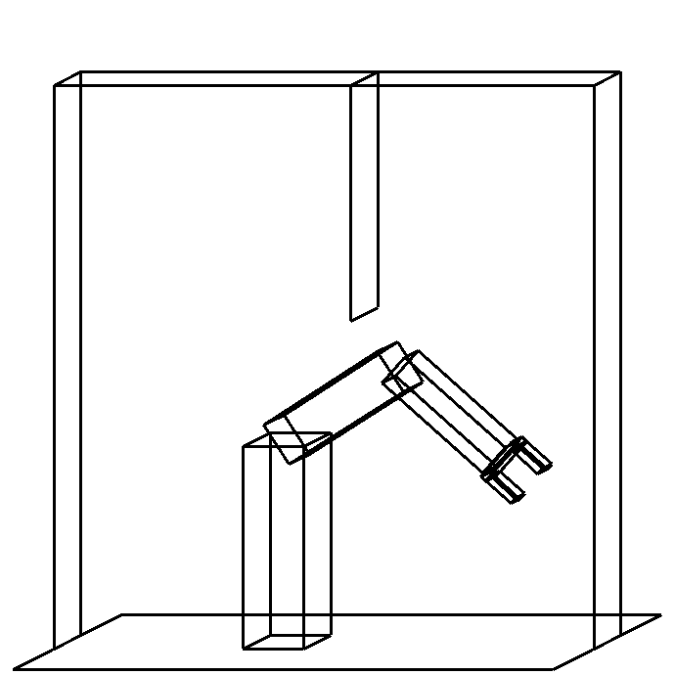
Manipulator Control
Arm with two joints (workspace) Configuration space

Slide 13
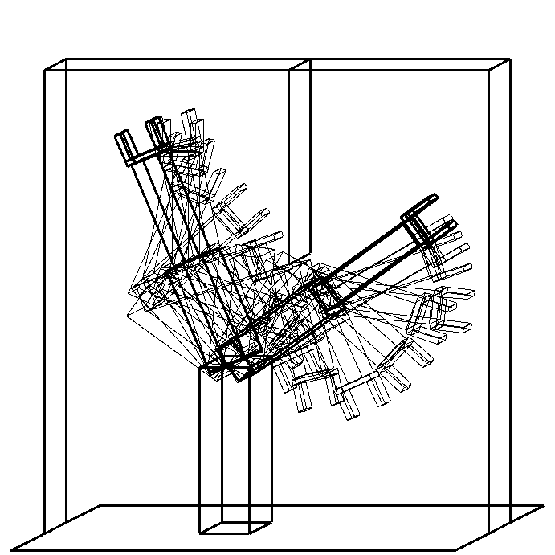
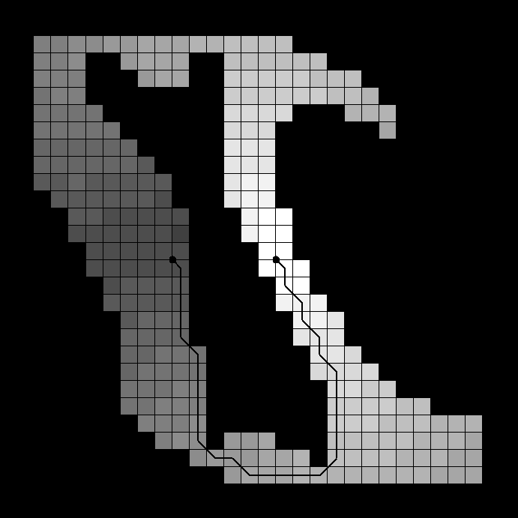
Manipulator Control Path
Arm with two joints (workspace) Configuration space

Slide 14
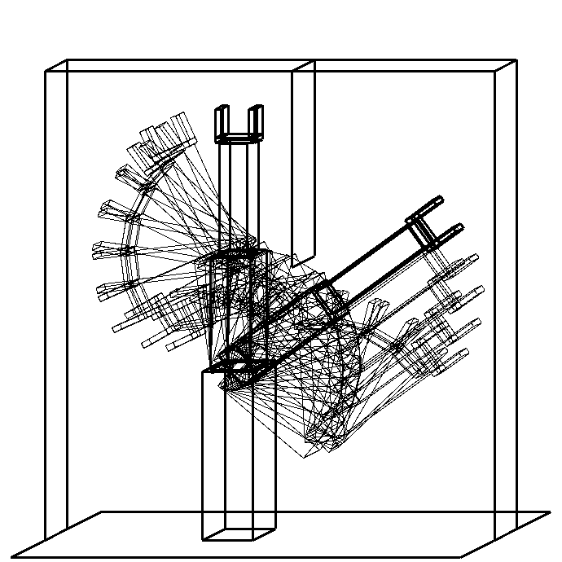
Manipulator Control Path
Arm with two joints (workspace) Configuration space

Slide 15
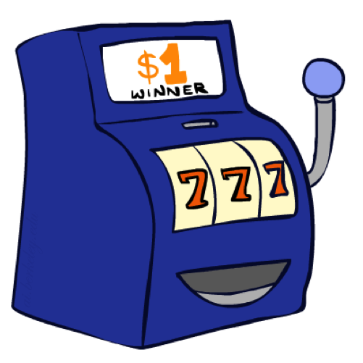
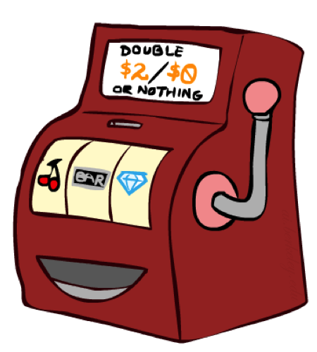
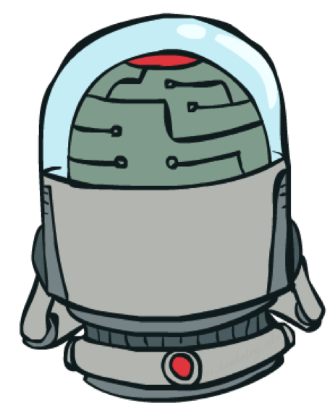
Double Bandits

Slide 16
Double-Bandit MDP
Actions: Blue, Red
States: Win, Lose
No discount
100 time steps
Both states have the same value
0.25 $0
0.75
$2
W
L
0.25
$0
$1
1.0
$1
1.0
0.75 $2

Slide 17
Offline Planning
Solving MDPs is offline planning
You determine all quantities through computation
You need to know the details of the MDP
You do not actually play the game!
No discount
100 time steps
Both states have the same value
0.25 $0
Value
0.75
$2
W
0.25
$0
Play Red
150
L
$1
1.0
$1
1.0
0.75 $2
Play Blue
100

Slide 18
Let’s Play!
$2
$2
$0
$2
$2
$2
$2
$0
$0
$0

Slide 19
Online Planning
Rules changed! Red’s win chance is different.
?? $0
??
$2
W
L
??
$0
$1
1.0
$1
1.0
?? $2

Slide 20
Let’s Play!
$0
$0
$0
$2
$0
$2
$0
$0
$0
$0

Slide 21
What Just Happened?
That wasn’t planning, it was learning!
Specifically, reinforcement learning
There was an MDP, but you couldn’t solve it with just computation
You needed to actually act to figure it out
Important ideas in reinforcement learning that came up
Exploration: you have to try unknown actions to get information
Exploitation: eventually, you have to use what you know
Regret: even if you learn intelligently, you make mistakes
Sampling: because of chance, you have to try things repeatedly
Difficulty: learning can be much harder than solving a known MDP

Slide 22
Next Time: Reinforcement Learning!

