Slide 1

CSE 473: Artificial Intelligence
Markov Decision Processes
Dieter Fox
University of Washington
[Slides originally created by Dan Klein & Pieter Abbeel for CS188 Intro to AI at UC Berkeley. All CS188 materials are available at http://ai.berkeley.edu.]
Notes:
Please retain proper attribution, including the reference to ai.berkeley.edu. Thanks!

Slide 2

Non-Deterministic Search

Slide 3





Example: Grid World
A maze-like problem
  The agent lives in a grid
  Walls block the agent’s path
Noisy movement: actions do not always go as planned
  80% of the time, the action North takes the agent North
  (if there is no wall there)
  10% of the time, North takes the agent West; 10% East
  If there is a wall in the direction the agent would have been taken, the agent stays put
The agent receives rewards each time step
  Small “living” reward each step (can be negative)
  Big rewards come at the end (good or bad)
Goal: maximize sum of rewards
Notes:
[cut demo of moving around in grid world program]

Slide 4



Grid World Actions
Deterministic Grid World
Stochastic Grid World

Slide 5
Markov Decision Processes
An MDP is defined by:
  A set of states s in S
  A set of actions a in A
  A transition function T(s, a, s’)
    Probability that a from s leads to s’, i.e., P(s’| s, a)
    Also called the model or the dynamics
T(s₁₁, E, …
…
T(s₃₁, N, s₁₁) = 0
…
T is a Big Table!
X 4 x 11 = 484 entries
For now, we give this as input to the agent
T(s₃₁, N, s₃₂) = 0.8
T(s₃₁, N, s₂₁) = 0.1
T(s₃₁, N, s₄₁) = 0.1
…
Notes:
In search problems: did not talk about actions, but about successor functions --- now the information inside the successor function is unpacked into actions, transitions and reward
Write out S, A, example entry in T, entry in R
Reward function different from the book : R(s,a,s’)
In book simpler for equations, but not useful for the projects.
Need to modify expectimax a tiny little bit to account for rewards along the way, but that’s something you should be able to do, and so you can already solve MDP’s (not in most efficient way)

Slide 6
Markov Decision Processes
An MDP is defined by:
  A set of states s in S
  A set of actions a in A
  A transition function T(s, a, s’)
    Probability that a from s leads to s’, i.e., P(s’| s, a)
    Also called the model or the dynamics
  A reward function R(s, a, s’)
…
R(s₃₂, N, s₃₃) = -0.01
Cost of breathing
R is also a Big Table!
For now, we also give this to the agent
…
R(s₃₂, N, s₄₂) = -1.01
…
R(s₃₃, E, s₄₃) = 0.99
Notes:
In search problems: did not talk about actions, but about successor functions --- now the information inside the successor function is unpacked into actions, transitions and reward
Write out S, A, example entry in T, entry in R
Reward function different from the book : R(s,a,s’)
In book simpler for equations, but not useful for the projects.
Need to modify expectimax a tiny little bit to account for rewards along the way, but that’s something you should be able to do, and so you can already solve MDP’s (not in most efficient way)

Slide 7
Markov Decision Processes
An MDP is defined by:
  A set of states s in S
  A set of actions a in A
  A transition function T(s, a, s’)
    Probability that a from s leads to s’, i.e., P(s’| s, a)
    Also called the model or the dynamics
  A reward function R(s, a, s’)
    Sometimes just R(s) or R(s’)
…
R(s₃₃) = -0.01
R(s₄₂) = -1.01
R(s₄₃) = 0.99
Notes:
In search problems: did not talk about actions, but about successor functions --- now the information inside the successor function is unpacked into actions, transitions and reward
Write out S, A, example entry in T, entry in R
Reward function different from the book : R(s,a,s’)
In book simpler for equations, but not useful for the projects.
Need to modify expectimax a tiny little bit to account for rewards along the way, but that’s something you should be able to do, and so you can already solve MDP’s (not in most efficient way)

Slide 8
Markov Decision Processes
An MDP is defined by:
  A set of states s in S
  A set of actions a in A
  A transition function T(s, a, s’)
    Probability that a from s leads to s’, i.e., P(s’| s, a)
    Also called the model or the dynamics
  A reward function R(s, a, s’)
    Sometimes just R(s) or R(s’)
  A start state
  Maybe a terminal state
MDPs are non-deterministic search problems
  One way to solve them is with expectimax search
  We’ll have a new tool soon
Notes:
In search problems: did not talk about actions, but about successor functions --- now the information inside the successor function is unpacked into actions, transitions and reward
Write out S, A, example entry in T, entry in R
Reward function different from the book : R(s,a,s’)
In book simpler for equations, but not useful for the projects.
Need to modify expectimax a tiny little bit to account for rewards along the way, but that’s something you should be able to do, and so you can already solve MDP’s (not in most efficient way)

Slide 9


What is Markov about MDPs?
“Markov” generally means that given the present state, the future and the past are independent
For Markov decision processes, “Markov” means action outcomes depend only on the current state
This is just like search, where the successor function could only depend on the current state (not the history)
Andrey Markov (1856-1922)
Notes:
Like search: successor function only depended on current state
Can make this happen by stuffing more into the state;
Very similar to search problems: when solving a maze with food pellets, we stored which food pellets were eaten

Slide 10

Policies
In deterministic single-agent search problems, we wanted an optimal plan, or sequence of actions, from start to a goal
For MDPs, we want an optimal policy π*: S → A
  A policy π gives an action for each state
  An optimal policy is one that maximizes expected utility if followed
  An explicit policy defines a reflex agent
Expectimax didn’t compute entire policies
  It computed the action for a single state only
Optimal policy when R(s, a, s’) = -0.03 for all non-terminals s
Notes:
Dan has a DEMO for this.

Slide 11
Optimal Policies
R(s) = -0.01
R(s) = -0.03
Cost of breathing
R(s) = -0.4
R(s) = -2.0
Notes:
R(s) = the “living reward”

Slide 12
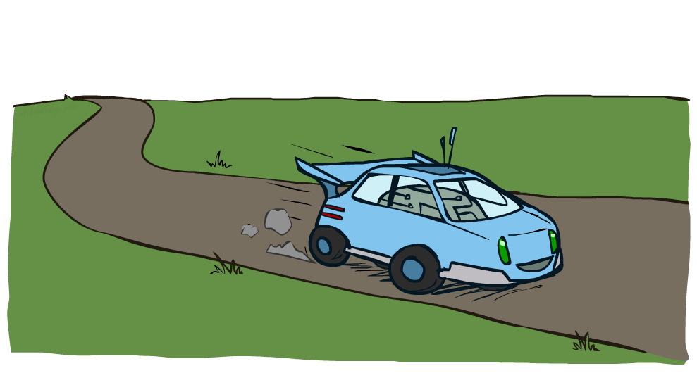
Example: Racing

Slide 13



Example: Racing
A robot car wants to travel far, quickly
Three states: Cool, Warm, Overheated
Two actions: Slow, Fast
Going faster gets double reward
0.5
+1
1.0
Fast
Slow
-10
+1
0.5
Warm
Slow
Fast
0.5
+2
Cool
0.5
Overheated
+1
1.0
+2

Slide 14




Racing Search Tree

Slide 15


MDP Search Trees
Each MDP state projects an expectimax-like search tree
s
s is a state
a
(s, a) is a q-state
s, a
(s,a,s’) called a transition
T(s,a,s’) = P(s’|s,a)
R(s,a,s’)
s,a,s’
s’
Notes:
In MDP chance node represents uncertainty about what might happen based on (s,a) [as opposed to being a random adversary]
Q-state (s,a) is when you were in a state and took an action

Slide 16

Utilities of Sequences

Slide 17
Utilities of Sequences
What preferences should an agent have over reward sequences?
More or less?
Now or later?
[1, 2, 2]
or
[2, 3, 4]
[0, 0, 1]
or
[1, 0, 0]

Slide 18




Discounting
It’s reasonable to maximize the sum of rewards
It’s also reasonable to prefer rewards now to rewards later
One solution: values of rewards decay exponentially
Worth Now
Worth Next Step
Worth In Two Steps

Slide 19

Discounting
How to discount?
  Each time we descend a level, we multiply in the discount once
Why discount?
  Sooner rewards probably do have higher utility than later rewards
  Also helps our algorithms converge
Example: discount of 0.5
  U([1,2,3]) = 1*1 + 0.5*2 + 0.25*3
  U([1,2,3]) < U([3,2,1])
Notes:
Rewards in the future (deeper in the tree) matter less
Interesting: running expectimax, if having to truncate the search, then not losing much; e.g., less then \gamma^d / (1-\gamma)

Slide 20

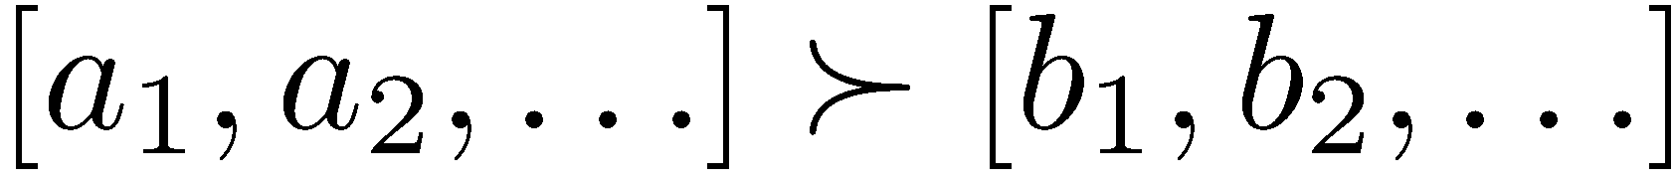
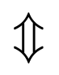
Stationary Preferences
Theorem: if we assume stationary preferences:
Then: there are only two ways to define utilities
  Additive utility:
  Discounted utility:

Slide 21


Quiz: Discounting
Given:
  Actions: East, West, and Exit (only available in exit states a, e)
  Transitions: deterministic
Quiz 1: For γ = 1, what is the optimal policy?
Quiz 2: For γ = 0.1, what is the optimal policy?
Quiz 3: For which γ are West and East equally good when in state d?
Notes:
Quiz 3: \gamma = 1 / sqrt(10)

Slide 22

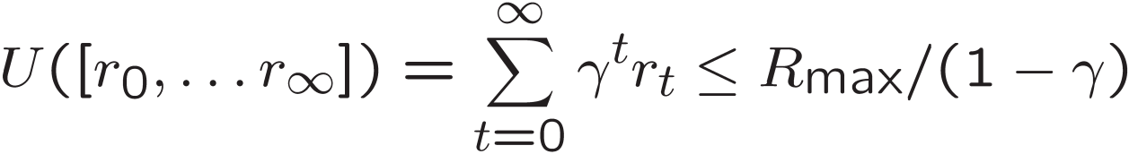
Infinite Utilities?!
Problem: What if the game lasts forever? Do we get infinite rewards?
Solutions:
  Finite horizon: (similar to depth-limited search)
    Terminate episodes after a fixed T steps (e.g. life)
    Gives nonstationary policies (γ depends on time left)
  Discounting: use 0 < γ < 1
    Smaller γ means smaller “horizon” – shorter term focus
  Absorbing state: guarantee that for every policy, a terminal state will eventually be reached (like “overheated” for racing)

Slide 23
Recap: Defining MDPs
Markov decision processes:
  Set of states S
  Start state s₀
  Set of actions A
  Transitions P(s’|s,a) (or T(s,a,s’))
  Rewards R(s,a,s’) (and discount γ)
MDP quantities so far:
  Policy = Choice of action for each state
  Utility = sum of (discounted) rewards
s
a
s, a
s,a,s’
s’

Slide 24

Solving MDPs
Value Iteration
Policy Iteration
Reinforcement Learning

Slide 25
Optimal Quantities
The value (utility) of a state s:
  V*(s) = expected utility starting in s and acting optimally
The value (utility) of a q-state (s,a):
  Q*(s,a) = expected utility starting out having taken action a from state s and (thereafter) acting optimally
The optimal policy:
  π*(s) = optimal action from state s
s
s is a state
a
(s, a) is a q-state
s, a
s,a,s’
(s,a,s’) is a
transition
s’
Notes:
[Note: this demo doesn’t show anything in action, just pops up V and Q values.]

Slide 26


Values of States
Fundamental operation: compute the (expectimax) value of a state
  Expected utility under optimal action
  Average sum of (discounted) rewards
  This is just what expectimax computed!
Recursive definition of value:
s
a
s, a
s,a,s’
s’

Slide 27

Snapshot of Demo – Gridworld V Values
Noise = 0.2
Discount = 0.9
Living reward = 0
Notes:
This demo doesn’t show anything in action, it just shows the V and Q values.

Slide 28

Snapshot of Demo – Gridworld Q Values
Noise = 0.2
Discount = 0.9
Living reward = 0
Notes:
This demo doesn’t show anything in action, it just shows the V and Q values.

Slide 29
Racing Search Tree

Slide 30




Racing Search Tree
We’re doing way too much work with expectimax!
Problem: States are repeated
  Idea: Only compute needed quantities once
Problem: Tree goes on forever
  Idea: Do a depth-limited computation, but with increasing depths until change is small
  Note: deep parts of the tree eventually don’t matter if γ < 1

Slide 31





Time-Limited Values
Key idea: time-limited values
Define V_{k}(s) to be the optimal value of s if the game ends in k more time steps
  Equivalently, it’s what a depth-k expectimax would give from s
Notes:
This demo generates the time-limited values for gridworld as snapshotted onto the next slides.

Slide 32





Computing Time-Limited Values

Slide 33

Value Iteration

Slide 34

The Bellman Equations
How to be optimal:
Step 1: Take correct first action
Step 2: Keep being optimal

Slide 35

The Bellman Equations
Definition of “optimal utility” via expectimax recurrence gives a simple one-step lookahead relationship amongst optimal utility values
These are the Bellman equations, and they characterize optimal values in a way we’ll use over and over
s
a
s, a
s,a,s’
s’
Notes:
Let’s start by equations that characterize these quantities through mutual recursions. [step through this by writing on slide, one step at a time]
Recursive characterization of V* in terms of V*; not necessarily helpful; but it is a characterization.
Note: this is a set of equations that needs to be satisfied; but it could have multiple solutions (it does not, but at this stage of our knowledge it could).

Slide 36
Value Iteration
Bellman equations characterize the optimal values:
Value iteration computes them:
Value iteration is just a fixed point solution method
  … though the V_{k} vectors are also interpretable as time-limited values
V(s)
a
s, a
s,a,s’
V(s’)
Notes:
Discuss computational complexity: S * A * S times number of iterations
Note: updates not in place [if in place, it means something else and not even clear what it means]

Slide 37
Value Iteration Algorithm
Start with V₀(s) = 0:
Given vector of V_{k}(s) values, do one ply of expectimax from each state:
Repeat until convergence
Complexity of each iteration: O(S²A)
  Number of iterations: poly(|S|, |A|, 1/(1-γ))
Theorem: will converge to unique optimal values
V_{k+1}(s)
a
s, a
s,a,s’
V_{k}(s’)
Notes:
Discuss computational complexity: S * A * S times number of iterations
Note: updates not in place [if in place, it means something else and not even clear what it means]

Slide 38

k=0
Noise = 0.2
Discount = 0.9
Living reward = 0
Notes:
Assuming zero living reward

Slide 39

k=1
Noise = 0.2
Discount = 0.9
Living reward = 0
Notes:
Assuming zero living reward

Slide 40

k=2
Noise = 0.2
Discount = 0.9
Living reward = 0
Notes:
Assuming zero living reward

Slide 41

k=3
Noise = 0.2
Discount = 0.9
Living reward = 0
Notes:
Assuming zero living reward

Slide 42

k=4
Noise = 0.2
Discount = 0.9
Living reward = 0
Notes:
Assuming zero living reward

Slide 43

k=5
Noise = 0.2
Discount = 0.9
Living reward = 0
Notes:
Assuming zero living reward

Slide 44

k=6
Noise = 0.2
Discount = 0.9
Living reward = 0
Notes:
Assuming zero living reward

Slide 45

k=7
Noise = 0.2
Discount = 0.9
Living reward = 0
Notes:
Assuming zero living reward

Slide 46

k=8
Noise = 0.2
Discount = 0.9
Living reward = 0
Notes:
Assuming zero living reward

Slide 47

k=9
Noise = 0.2
Discount = 0.9
Living reward = 0
Notes:
Assuming zero living reward

Slide 48

k=10
Noise = 0.2
Discount = 0.9
Living reward = 0
Notes:
Assuming zero living reward

Slide 49

k=11
Noise = 0.2
Discount = 0.9
Living reward = 0
Notes:
Assuming zero living reward

Slide 50

k=12
Noise = 0.2
Discount = 0.9
Living reward = 0
Notes:
Assuming zero living reward

Slide 51

k=100
Noise = 0.2
Discount = 0.9
Living reward = 0
Notes:
Assuming zero living reward

Slide 52


Convergence*
How do we know the V_{k} vectors will converge?
Case 1: If the tree has maximum depth M, then V_{M} holds the actual untruncated values
Case 2: If the discount is less than 1
  Sketch: For any state V_{k} and V_{k+1} can be viewed as depth k+1 expectimax results in nearly identical search trees
  The max difference happens if big reward at k+1 level
  That last layer is at best all R_{MAX}
  But everything is discounted by γ^{k} that far out
  So V_{k} and V_{k+1} are at most γ^{k} max|R| different
  So as k increases, the values converge
Notes:
Theorem: will converge to unique optimal values
Basic idea: approximations get refined towards optimal values
Policy may converge long before values do

Slide 53
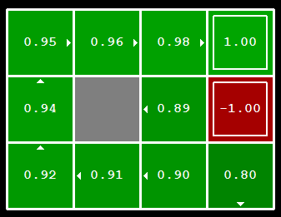


Computing Actions from Values
Let’s imagine we have the optimal values V*(s)
How should we act?
  It’s not obvious!
We need to do a mini-expectimax (one step)
This is called policy extraction, since it gets the policy implied by the values

Slide 54
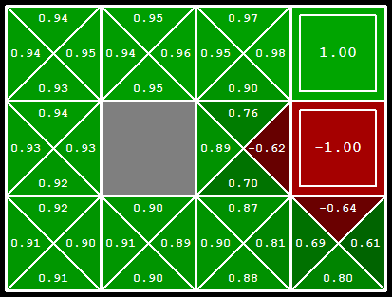
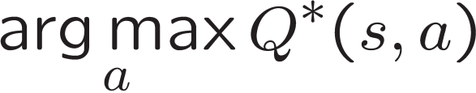
Computing Actions from Q-Values
Let’s imagine we have the optimal q-values:
How should we act?
  Completely trivial to decide!
Important lesson: actions are easier to select from q-values than values!

Slide 55
Problems with Value Iteration
Value iteration repeats the Bellman updates:
Problem 1: It’s slow – O(S²A) per iteration
Problem 2: The “max” at each state rarely changes
Problem 3: The policy often converges long before the values
s
a
s, a
s,a,s’
s’
Notes:
Demo steps through value iteration; snapshots of values shown on next slides.

Slide 56
VI → Asynchronous VI
Is it essential to back up all states in each iteration?
  No!
States may be backed up
  many times or not at all
  in any order
As long as no state gets starved…
  convergence properties still hold!!

Slide 57
k=1
Noise = 0.2
Discount = 0.9
Living reward = 0
Notes:
Assuming zero living reward

Slide 58
k=2
Noise = 0.2
Discount = 0.9
Living reward = 0
Notes:
Assuming zero living reward

Slide 59
k=3
Noise = 0.2
Discount = 0.9
Living reward = 0
Notes:
Assuming zero living reward

Slide 60
Asynch VI: Prioritized Sweeping
Why backup a state if values of successors same?
Prefer backing a state
  whose successors had most change
Priority Queue of (state, expected change in value)
Backup in the order of priority
After backing a state update priority queue
  for all predecessors

Slide 61
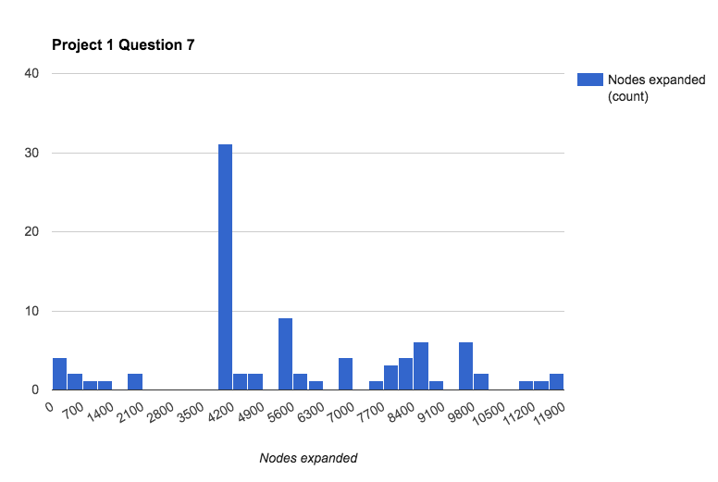
Pacman
Q7 of Project 1 had a 4-way tie for first place: 255 nodes
Joshua Bean
Matthew Gaylor
Wuyi Zhang
Zezhi Zheng

