Slide 1
CSE 473: Artificial Intelligence
Constraint Satisfaction
Dieter Fox
Based on slides adapted Luke Zettlemoyer, Dan Klein, Stuart Russell or Andrew Moore

Slide 2
What is Search For?
Models of the world: single agent, deterministic actions, fully observed state, discrete state space
Planning: sequences of actions
  The path to the goal is the important thing
  Paths have various costs, depths
  Heuristics to guide, fringe to keep backups
Identification: assignments to variables
  The goal itself is important, not the path
  All paths at the same depth (for some formulations)
  CSPs are specialized for identification problems

Slide 3
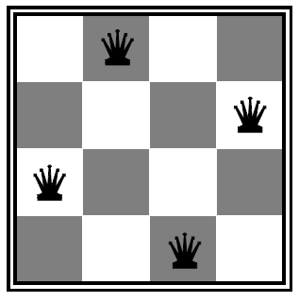
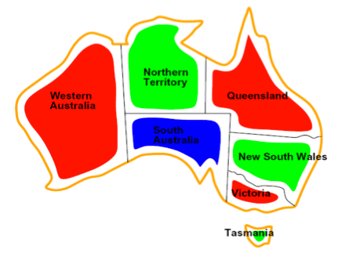
Constraint Satisfaction Problems
Standard search problems:
  State is a “black box”: arbitrary data structure
  Goal test: any function over states
  Successor function can be anything
  Constraint satisfaction problems (CSPs):
    A special subset of search problems
    State is defined by variables X_{i} with values from a domain D (sometimes D depends on i)
    Goal test is a set of constraints specifying allowable combinations of values for subsets of variables
  Simple example of a formal representation language
  Allows useful general-purpose algorithms with more power than standard search algorithms

Slide 4
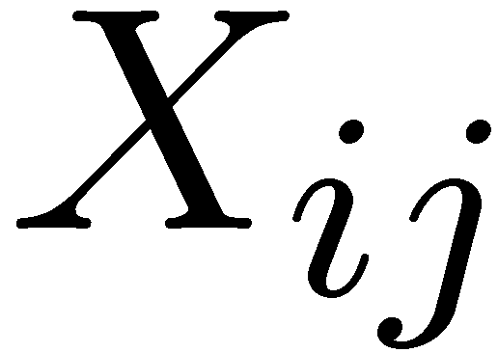

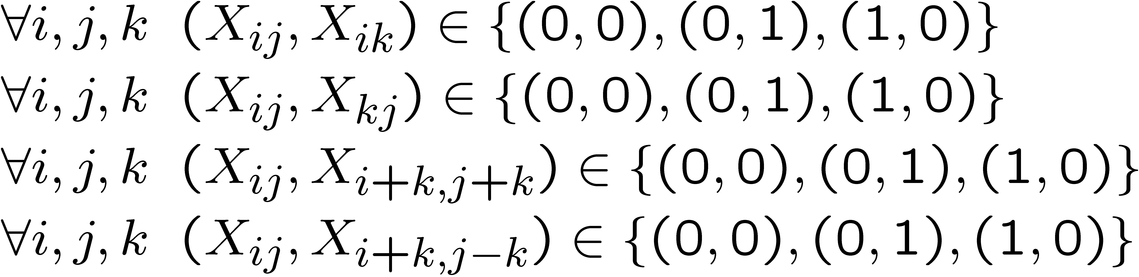
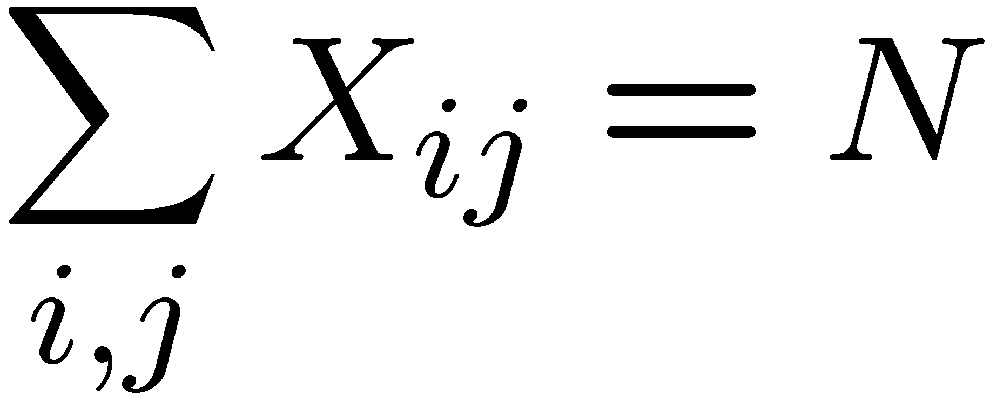
Example: N-Queens
Formulation 1:
  Variables:
  Domains:
  Constraints
  Note: need to make sure that constraints refer to different squares

Slide 5

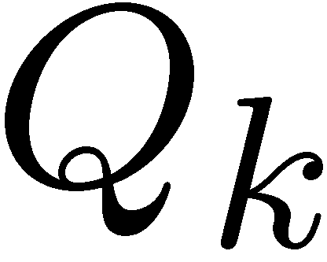


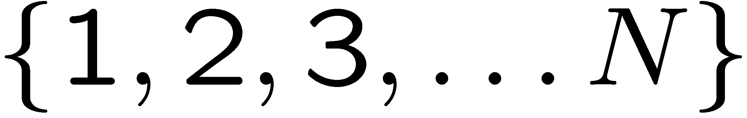


Example: N-Queens
Formulation 2:
  Variables:
  Domains:
  Constraints:
Implicit:
-or-
Explicit:

Slide 6
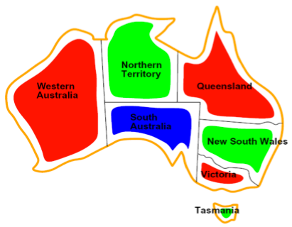
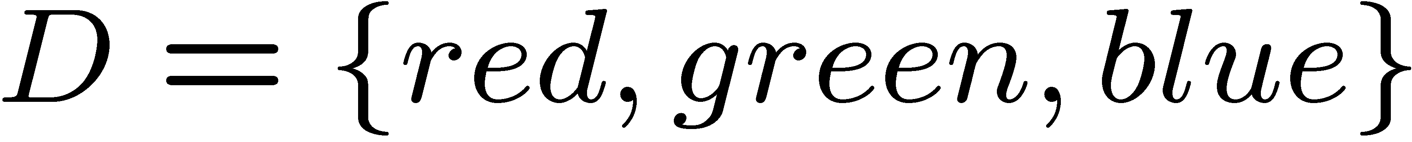

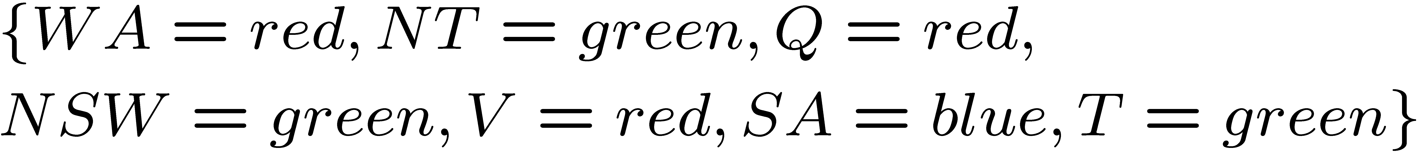
Example: Map-Coloring
Variables:
Domain:
Constraints: adjacent regions must have different colors
Solutions are assignments satisfying all constraints, e.g.:

Slide 7
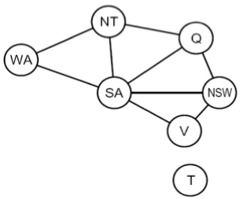
Constraint Graphs
Binary CSP: each constraint relates (at most) two variables
Binary constraint graph: nodes are variables, arcs show constraints
General-purpose CSP algorithms use the graph structure to speed up search. E.g., Tasmania is an independent subproblem!

Slide 8
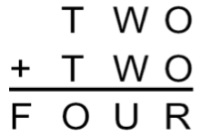
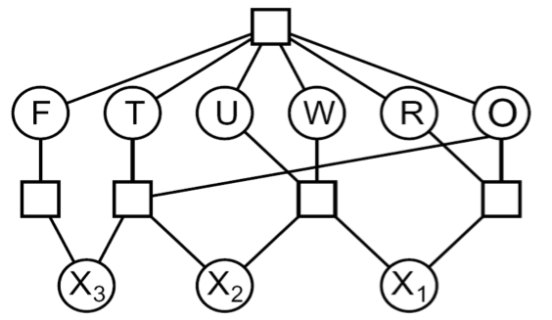

Example: Cryptarithmetic
Variables (circles):
Domains:
Constraints (boxes):
Notes:
0=7, R=4, W=6, U=2, T=8, F=1; 867 + 867 = 1734

Slide 9
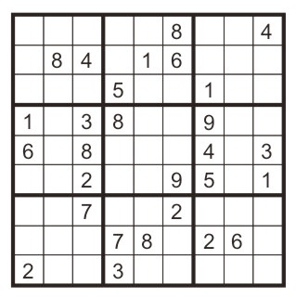
Example: Sudoku
Variables:
Domains:
Constraints:
Each (open) square
{1,2,…,9}
9-way alldiff for each column
9-way alldiff for each row
9-way alldiff for each region

Slide 10
Varieties of CSPs
Discrete Variables
  Finite domains
    Size d means O(d^{n}) complete assignments
    E.g., Boolean CSPs, including Boolean satisfiability (NP-complete)
  Infinite domains (integers, strings, etc.)
    E.g., job scheduling, variables are start/end times for each job
    Linear constraints solvable, nonlinear undecidable
Continuous variables
  E.g., start/end times for Hubble Telescope observations
  Linear constraints solvable in polynomial time by LP methods

Slide 11
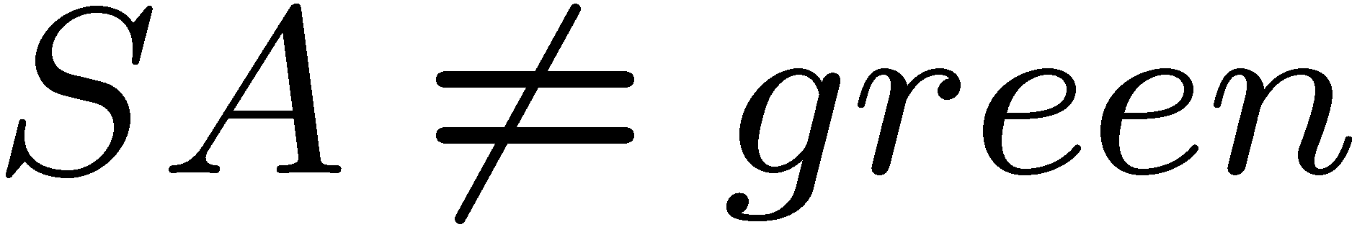
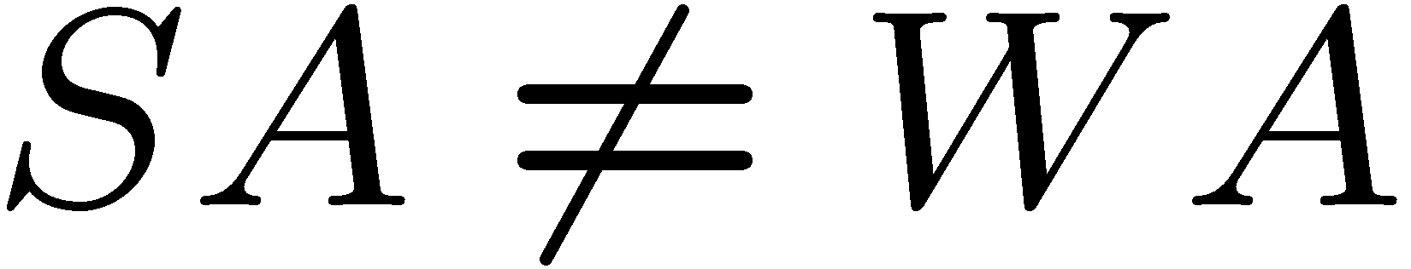
Varieties of Constraints
Varieties of Constraints
  Unary constraints involve a single variable (equiv. to shrinking domains):
  Binary constraints involve pairs of variables:
  Higher-order constraints involve 3 or more variables:
  e.g., cryptarithmetic column constraints
Preferences (soft constraints):
  E.g., red is better than green
  Often representable by a cost for each variable assignment
  Gives constrained optimization problems
  (We’ll ignore these until we get to Bayes’ nets)

Slide 12
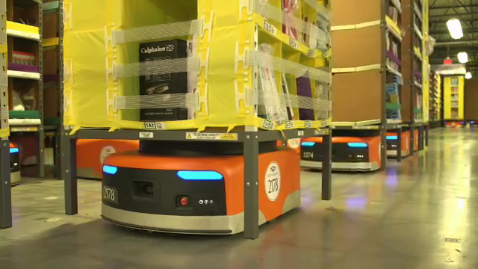
Real-World CSPs
Assignment problems: e.g., who teaches what class
Timetabling problems: e.g., which class is offered when and where?
Hardware configuration
Transportation scheduling
Factory scheduling
Floorplanning
Fault diagnosis
… lots more!
Many real-world problems involve real-valued variables…

Slide 13
Standard Search Formulation
Standard search formulation of CSPs (incremental)
Let's start with a straightforward, dumb approach, then fix it
  States are defined by the values assigned so far
    Initial state: the empty assignment, {}
    Successor function: assign a value to an unassigned variable
    Goal test: the current assignment is complete and satisfies all constraints

Slide 14
Search Methods
What does BFS do?
What does DFS do?

Slide 15
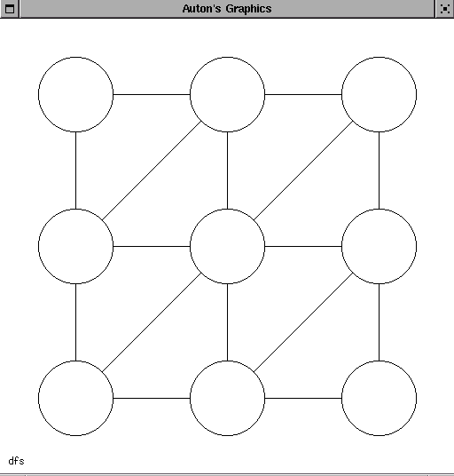
DFS, and BFS would be much worse!

Slide 16
Backtracking Search
  Idea 1: Only consider a single variable at each point
    Variable assignments are commutative, so fix ordering
    I.e., [WA = red then NT = green] same as [NT = green then WA = red]
    Only need to consider assignments to a single variable at each step
    How many leaves are there?
Idea 2: Only allow legal assignments at each point
  I.e. consider only values which do not conflict previous assignments
  Might have to do some computation to figure out whether a value is ok
  “Incremental goal test”
Depth-first search for CSPs with these two improvements is called backtracking search
Backtracking search is the basic uninformed algorithm for CSPs
Can solve n-queens for n ≈ 25

Slide 17
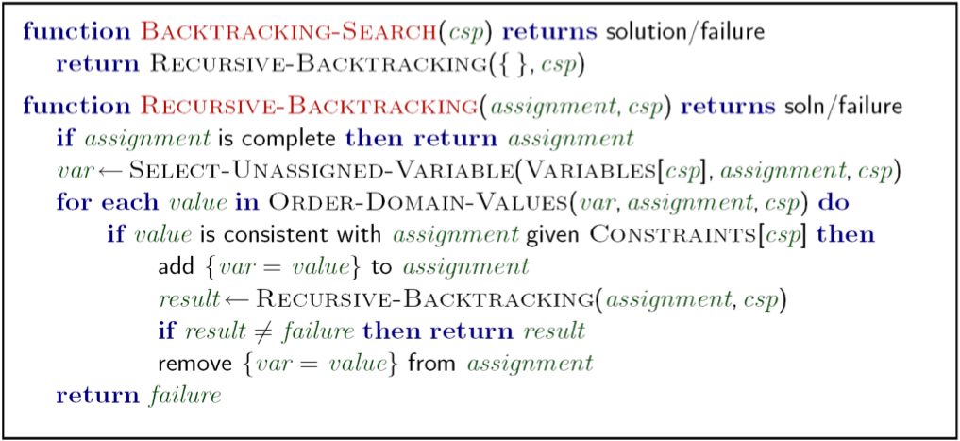
Backtracking Search
What are the choice points?

Slide 18
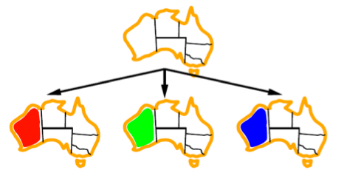
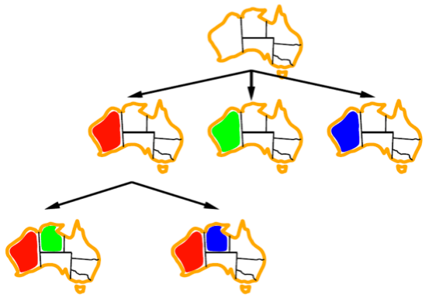

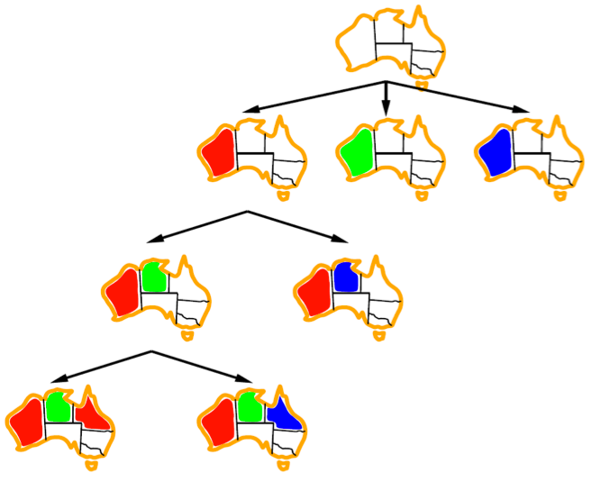
Backtracking Example

Slide 19
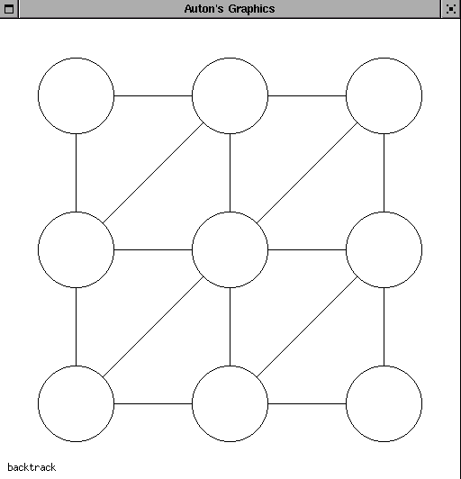
Backtracking

Slide 20
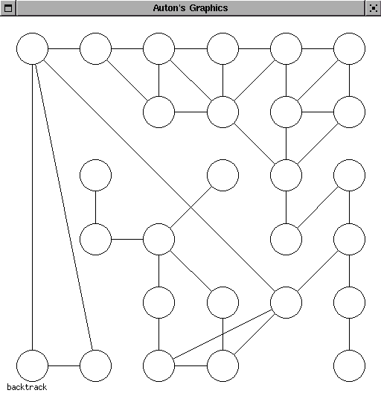
Are we done?

Slide 21
Improving Backtracking
General-purpose ideas give huge gains in speed
  Ordering:
    Which variable should be assigned next?
    In what order should its values be tried?
  Filtering: Can we detect inevitable failure early?
  Structure: Can we exploit the problem structure?

Slide 22

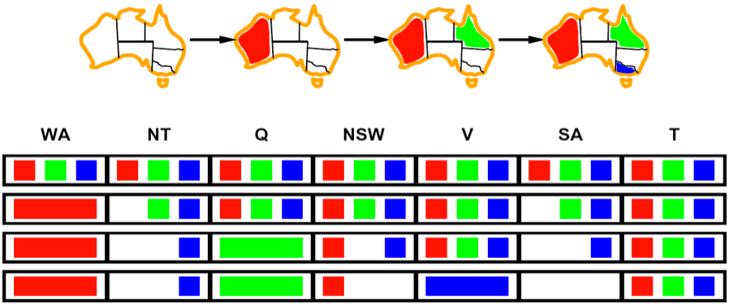
Forward Checking
NT
Q
WA
SA
NSW
V
Idea: Keep track of remaining legal values for unassigned variables (using immediate constraints)
Idea: Terminate when any variable has no legal values

Slide 23
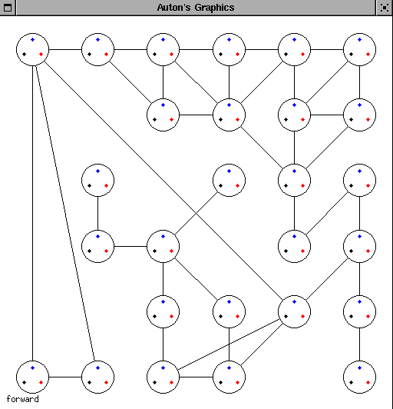
Forward Checking

Slide 24
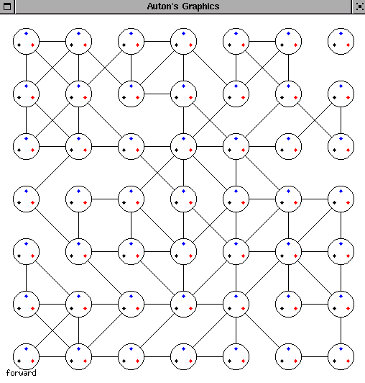
Are We Done?

Slide 25
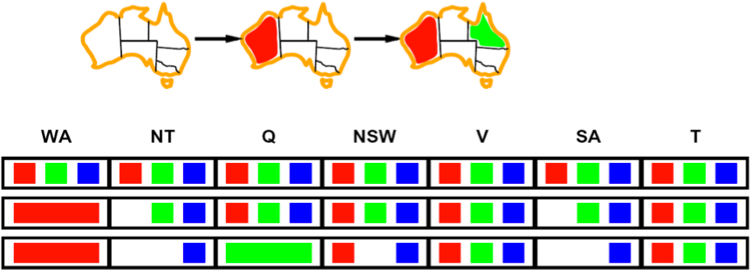
Constraint Propagation
NT
Q
WA
SA
NSW
V
Forward checking propagates information from assigned to adjacent unassigned variables, but doesn't detect more distant failures:
  NT and SA cannot both be blue!
  Why didn’t we detect this yet?
  Constraint propagation repeatedly enforces constraints (locally)

Slide 26
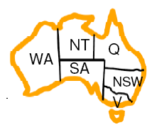
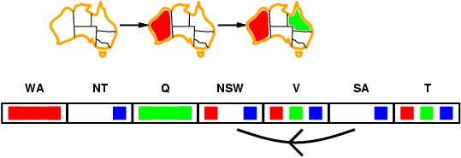
Arc consistency
Simplest form of propagation makes each pair of variables consistent:
  X →Y is consistent iff for every value of X there is some allowed value of Y
Consistent!

Slide 27
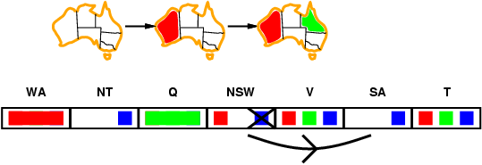
Arc consistency
Simplest form of propagation makes each pair of variables consistent:
  X →Y is consistent iff for every value of X there is some allowed value of Y

Slide 28
Arc consistency
Simplest form of propagation makes each pair of variables consistent:
  X →Y is consistent iff for every value of X there is some allowed value of Y
  When checking X →Y, throw out any values of X for which there isn’t an allowed value of Y
If X loses a value, all pairs Z → X need to be rechecked

Slide 29
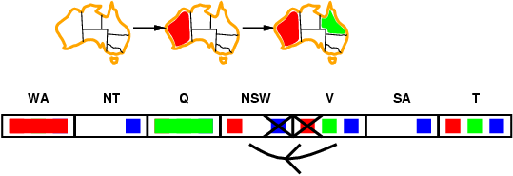
Arc consistency
Simplest form of propagation makes each pair of variables consistent:
  X →Y is consistent iff for every value of X there is some allowed value of Y
  When checking X →Y, throw out any values of X for which there isn’t an allowed value of Y
If X loses a value, all pairs Z → X need to be rechecked

Slide 30
Arc consistency
Simplest form of propagation makes each pair of variables consistent:
  X →Y is consistent iff for every value of X there is some allowed value of Y
  When checking X →Y, throw out any values of X for which there isn’t an allowed value of Y
If X loses a value, all pairs Z → X need to be rechecked

Slide 31
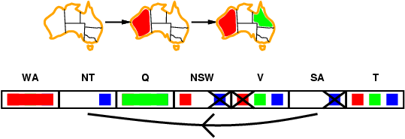
Arc consistency
Simplest form of propagation makes each pair of variables consistent:
  X →Y is consistent iff for every value of X there is some allowed value of Y
  When checking X →Y, throw out any values of X for which there isn’t an allowed value of Y
Arc consistency detects failure earlier than forward checking
Can be run before or after each assignment

Slide 32
Arc consistency
Simplest form of propagation makes each pair of variables consistent:
  X →Y is consistent iff for every value of X there is some allowed value of Y
  When checking X →Y, throw out any values of X for which there isn’t an allowed value of Y

Slide 33
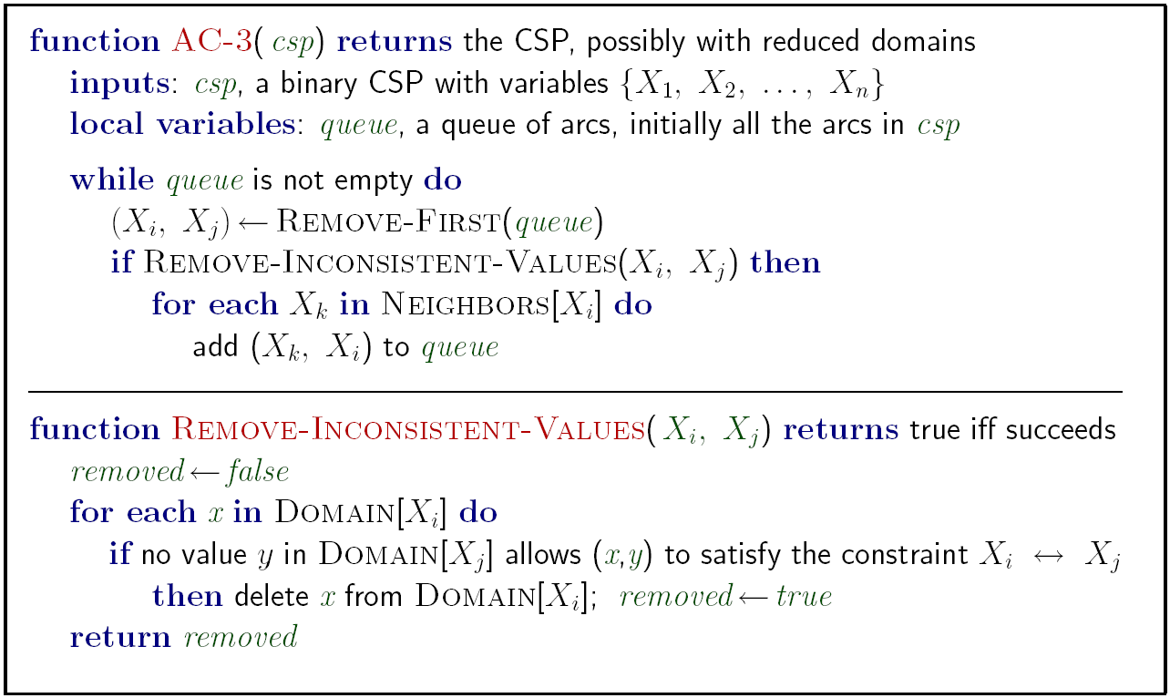
Arc Consistency
Runtime: O(n²d³), can be reduced to O(n²d²)
… but detecting all possible future problems is NP-hard

Slide 34
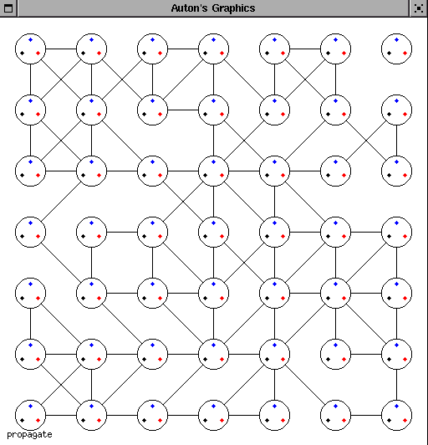
Constraint
Propagation

Slide 35
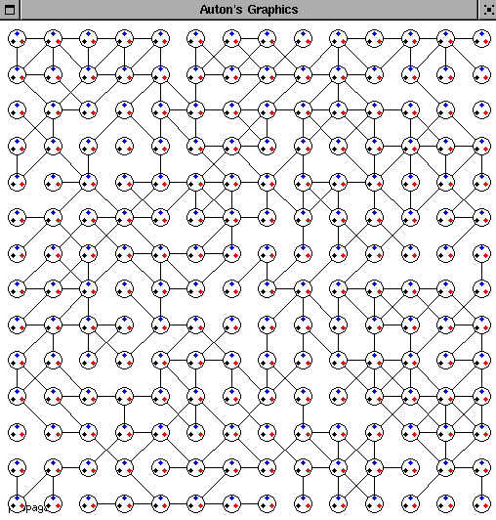
Are We Done?

Slide 36
Limitations of Arc Consistency
After running arc consistency:
  Can have one solution left
  Can have multiple solutions left
  Can have no solutions left (and not know it)
What went wrong here?

Slide 37
K-Consistency*
Increasing degrees of consistency
  1-Consistency (Node Consistency): Each single node’s domain has a value which meets that node’s unary constraints
  2-Consistency (Arc Consistency): For each pair of nodes, any consistent assignment to one can be extended to the other
  K-Consistency: For each k nodes, any consistent assignment to k-1 can be extended to the k^{th} node.
Higher k more expensive to compute
(You need to know the k=2 algorithm)

Slide 38

Ordering: Minimum Remaining Values
Minimum remaining values (MRV):
  Choose the variable with the fewest legal values
Why min rather than max?
Also called “most constrained variable”
“Fail-fast” ordering

Slide 39

Ordering: Degree Heuristic
Tie-breaker among MRV variables
Degree heuristic:
  Choose the variable participating in the most constraints on remaining variables
Why most rather than fewest constraints?

Slide 40
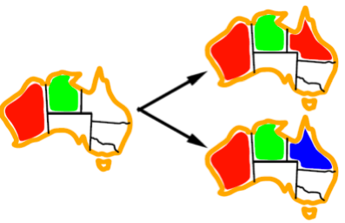
Ordering: Least Constraining Value
Given a choice of variable:
  Choose the least constraining value
  The one that rules out the fewest values in the remaining variables
  Note that it may take some computation to determine this!
Why least rather than most?
Combining these heuristics makes 1000 queens feasible

Slide 41
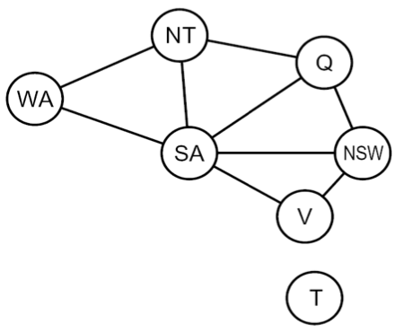
Problem Structure
Tasmania and mainland are independent subproblems
Identifiable as connected components of constraint graph
Suppose each subproblem has c variables out of n total
Worst-case solution cost is O((n/c)(d^{c})), linear in n
  E.g., n = 80, d = 2, c =20
  2⁸⁰ = 4 billion years at 10 million nodes/sec
  (4)(2²⁰) = 0.4 seconds at 10 million nodes/sec

Slide 42
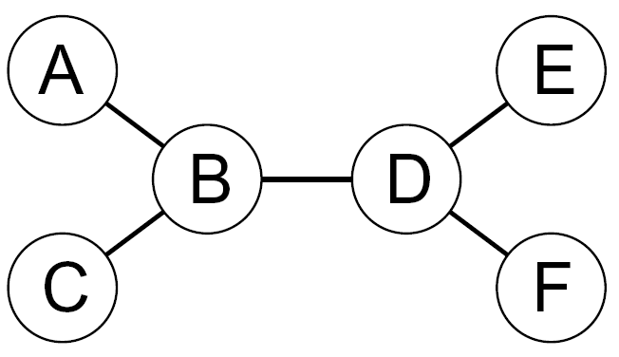
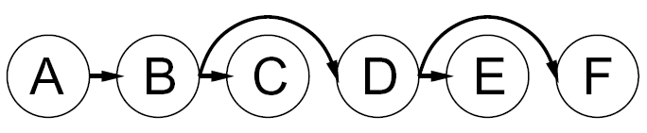
Tree-Structured CSPs
Choose a variable as root, order variables from root to leaves such that every node's parent precedes it in the ordering

Slide 43
Tree-Structured CSPs
Algorithm for tree-structured CSPs:
  Order: Choose a root variable, order variables so that parents precede children
  Remove backward:
  For i = n : 2, apply RemoveInconsistent(Parent(X_{i}),X_{i})
  Assign forward:
  For i = 1 : n, assign X_{i} consistently with Parent(X_{i})
Runtime: O(n d²) (why?)

Slide 44
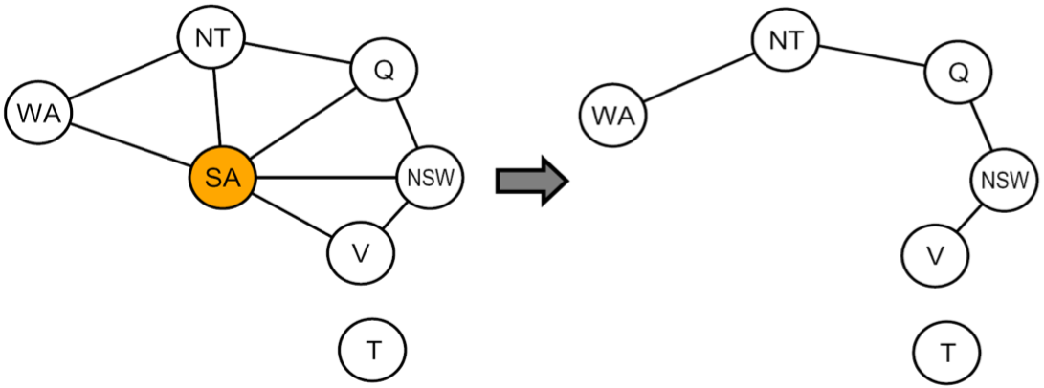
Nearly Tree-Structured CSPs
Conditioning: instantiate a variable, prune its neighbors' domains
Cutset conditioning: instantiate (in all ways) a set of variables such that the remaining constraint graph is a tree
Cutset size c gives runtime O( (d^{c}) (n-c) d² ), very fast for small c

Slide 45
Cutset Conditioning
Choose a cutset
SA
Instantiate the cutset (all possible ways)
SA
SA
SA
Compute residual CSP for each assignment
Solve the residual CSPs (tree structured)

Slide 46
Iterative Algorithms for CSPs
Greedy and local methods typically work with “complete” states, i.e., all variables assigned
To apply to CSPs:
  Allow states with unsatisfied constraints
  Operators reassign variable values
Variable selection: randomly select any conflicted variable
Value selection by min-conflicts heuristic:
  Choose value that violates the fewest constraints
  I.e., hill climb with h(n) = total number of violated constraints

Slide 47
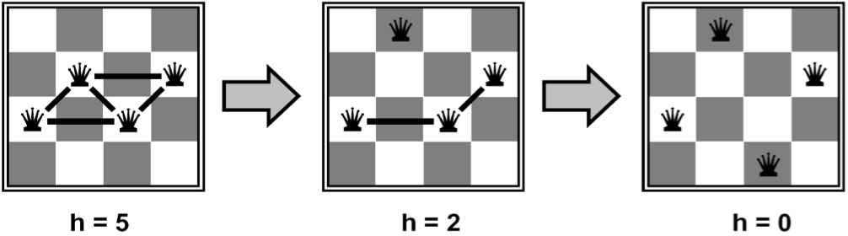
Example: 4-Queens
States: 4 queens in 4 columns (4⁴ = 256 states)
Operators: move queen in column
Goal test: no attacks
Evaluation: h(n) = number of attacks

Slide 48
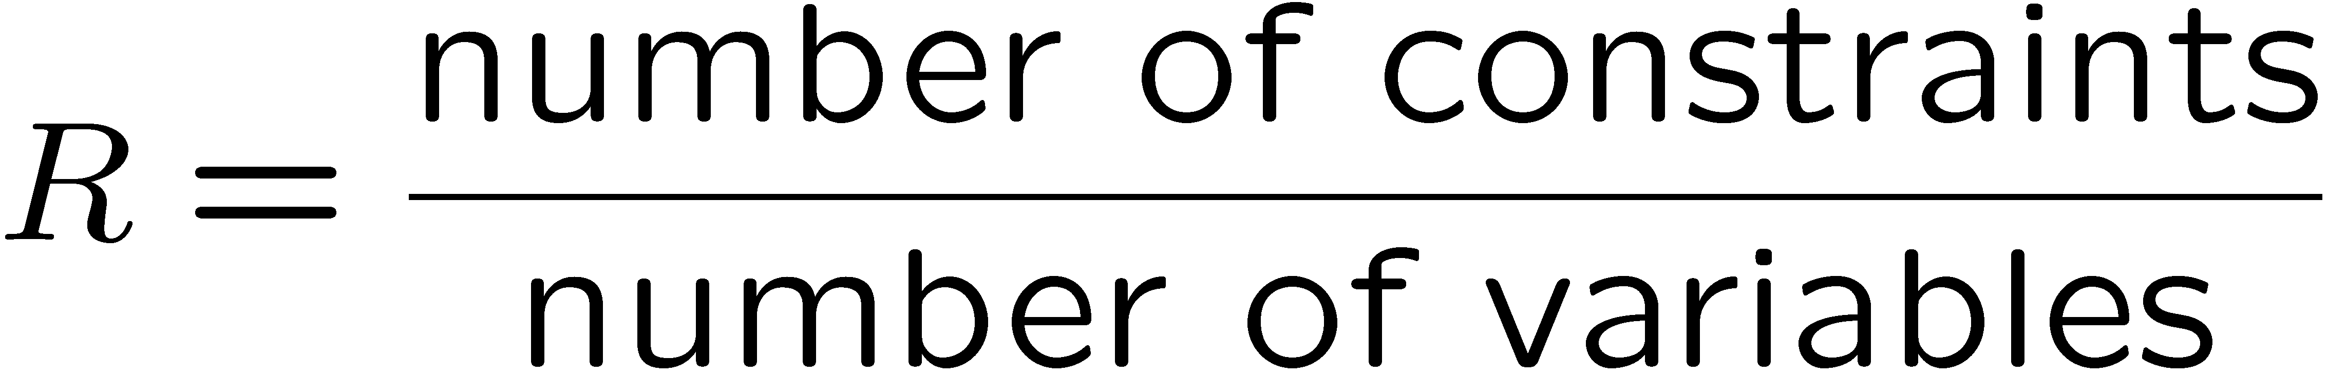
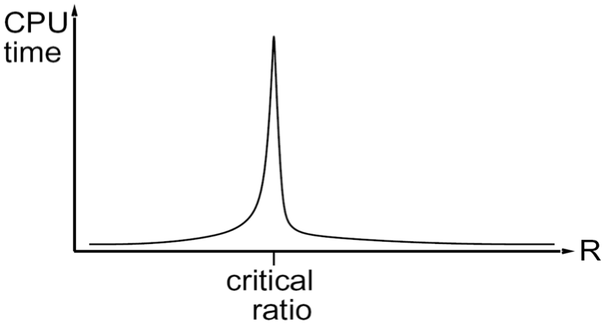
Performance of Min-Conflicts
Given random initial state, can solve n-queens in almost constant time for arbitrary n with high probability (e.g., n = 10,000,000)
The same appears to be true for any randomly-generated CSP except in a narrow range of the ratio
Notes:
3-Sat 4.2

Slide 49
Summary
CSPs are a special kind of search problem:
  States defined by values of a fixed set of variables
  Goal test defined by constraints on variable values
Backtracking = depth-first search with one legal variable assigned per node
Variable ordering and value selection heuristics help significantly
Forward checking prevents assignments that guarantee later failure
Constraint propagation (e.g., arc consistency) does additional work to constrain values and detect inconsistencies
The constraint graph representation allows analysis of problem structure
Tree-structured CSPs can be solved in linear time
Iterative min-conflicts is usually effective in practice

Slide 50

Local Search

Slide 51
Local Search
Tree search keeps unexplored alternatives on the fringe (ensures completeness)
Local search: improve a single option until you can’t make it better (no fringe!)
New successor function: local changes
Generally much faster and more memory efficient (but incomplete and suboptimal)

Slide 52
Hill Climbing
Simple, general idea:
  Start wherever
  Repeat: move to the best neighboring state
  If no neighbors better than current, quit
What’s bad about this approach?
  Complete?
  Optimal?
What’s good about it?

Slide 53
Hill Climbing Diagram

Slide 54
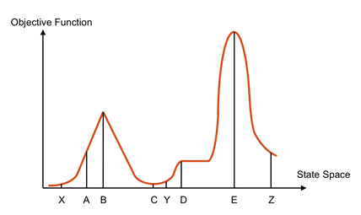
Hill Climbing
Starting from X, where do you end up ?
Starting from Y, where do you end up ?
Starting from Z, where do you end up ?

Slide 55
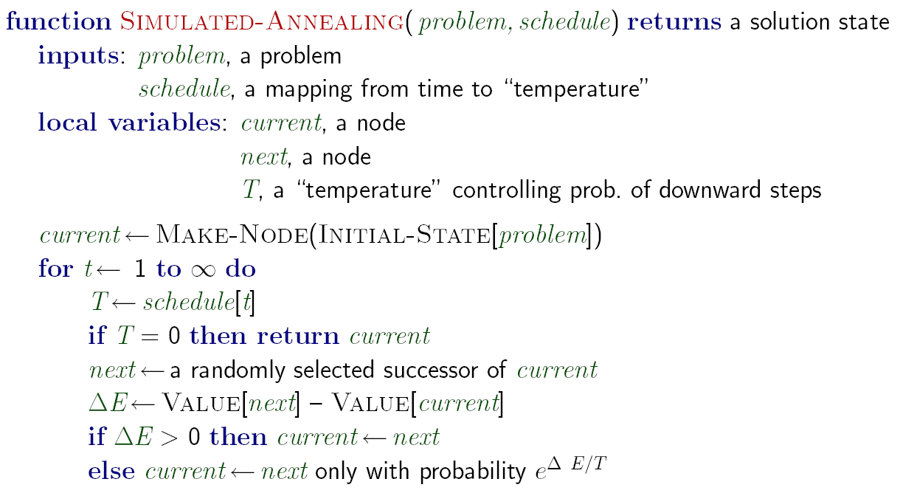
Simulated Annealing
Idea: Escape local maxima by allowing downhill moves
  But make them rarer as time goes on

Slide 56
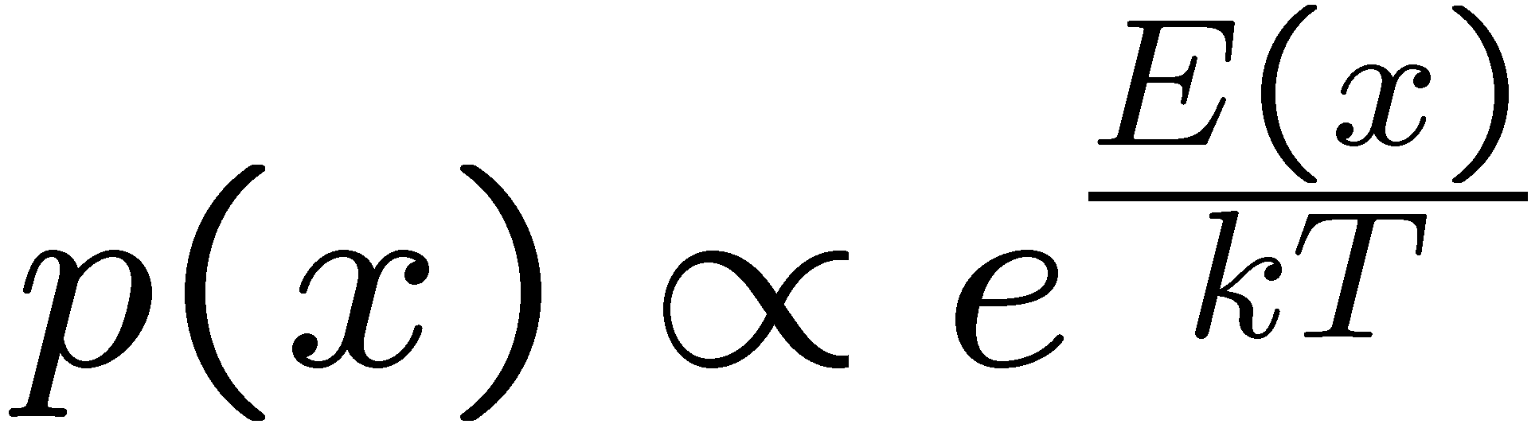
Simulated Annealing
Theoretical guarantee:
  Stationary distribution:
  If T decreased slowly enough,
  will converge to optimal state!
Is this an interesting guarantee?
Sounds like magic, but reality is reality:
  The more downhill steps you need to escape a local optimum, the less likely you are to ever make them all in a row
  People think hard about ridge operators which let you jump around the space in better ways

Slide 57

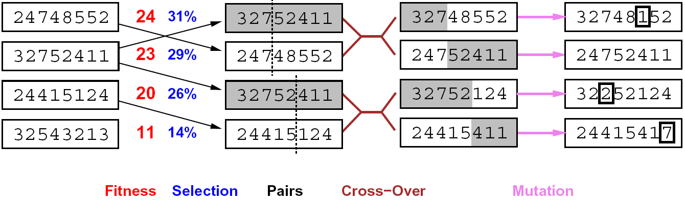
Genetic Algorithms
Genetic algorithms use a natural selection metaphor
  Keep best N hypotheses at each step (selection) based on a fitness function
  Also have pairwise crossover operators, with optional mutation to give variety
Possibly the most misunderstood, misapplied (and even maligned) technique around

Slide 58
Example: N-Queens
Why does crossover make sense here?
When wouldn’t it make sense?
What would mutation be?
What would a good fitness function be?

Slide 59

GA’s for Locomotion

Slide 60

GA’s for Locomotion

