Slide 1
Beneficial AI
Daniel S. Weld

Slide 2
To do
Must flesh out bit about what features ok to use

Slide 3
Outline
Distractions
Important Concerns
Unemployment
Sorcerer’s Apprentice Scenario
Specifying Constraints & Utilities
Explainable AI
Deployment
It’s the Data, Stupid

Slide 4
Please Review CSE 473
https://uw.iasystem.org/survey/167470
5pt bonus for taking survey!
We can tell who has taken it (for bonus)
But we can’t see your answers
In Jan we get aggregated data

Slide 5
Will AI Destroy the World?
“Success in creating AI would be the biggest event in human history… Unfortunately, it might also be the last” … ”[AI] could spell the end of the human race.”– Stephen Hawking

Slide 6
How Does this Story End?
“With artificial intelligence we are summoning the demon.” – Bill Gates

Slide 7
An Intelligence Explosion?
“Before the prospect of an intelligence explosion, we humans are like small children playing with a bomb” − Nick Bostom
“Once machines reach a certain level of intelligence, they’ll be able to work on AI just like we do and improve their own capabilities—redesign their own hardware and so on—and their intelligence will zoom off the charts.”
− Stuart Russell

Slide 8
Superhuman AI & Intelligence Explosions
When will computers have superhuman capabilities?
Now.
Multiplication
Spell checking
Chess, Go
Many more abilities to come

Slide 9
AI Systems are Idiot Savants
Super-human here & super-stupid there
Just because AI gains another superhuman skill… Doesn’t mean it is suddenly good at everything
And certainly not unless we give it experience at everything
AI systems will be spotty for a long time

Slide 10
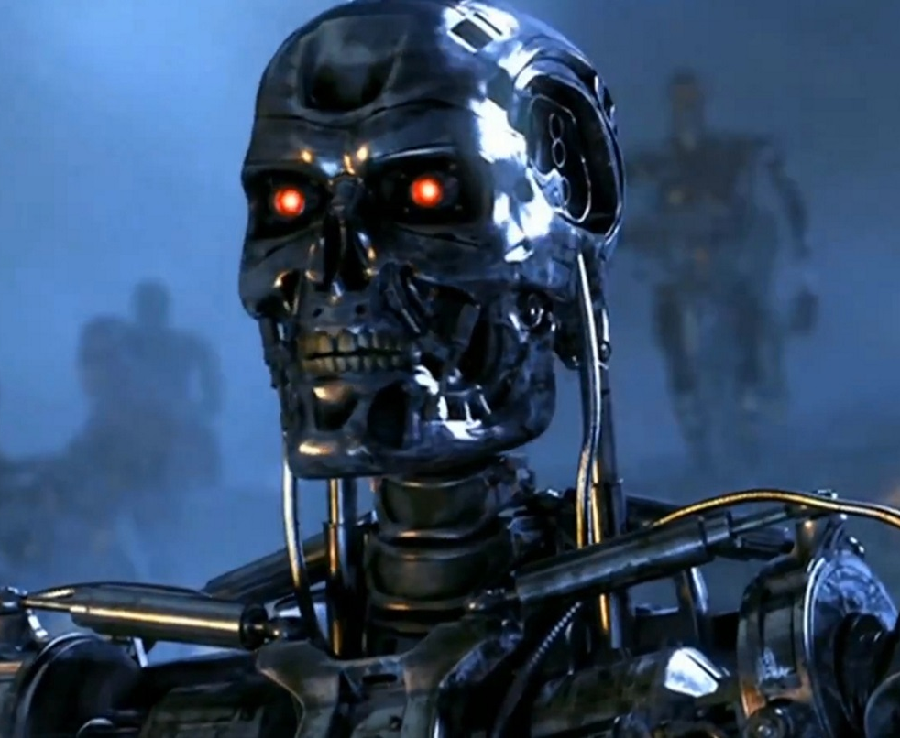
Terminator / Skynet
“Could you prove that your systems can’t ever, no matter how smart they are, overwrite their original goals as set by the humans?”
− Stuart Russell
It’s the Wrong Question
Very unlikely that an AI will wake up and decide to kill us
But…
Virtually certain than a bad human will tell an AI to kill us!

Slide 11
There will be MANY Fielded AI systems
The best defense against a bad AI…
Will be a good AI…
Etzioni’s Guardian systems
AIs to watch and monitor other AIs.

Slide 12
There will be MANY Fielded AI systems
The best defense against a bad AI…
Will be a good AI…
Etzioni’s Guardian systems
AIs to watch and monitor other AIs.
?

Slide 13
No
There are many scary things coming our way
But Skynet & Intelligence Explosion aren’t the issue
They are a dangerous distraction from real issues

Slide 14
Real Issues
Unemployment
Sorcerer’s Apprentice
Specifying Constraints & Utilities
Explainable AI
Deployment
It’s the Data, Stupid

Slide 15
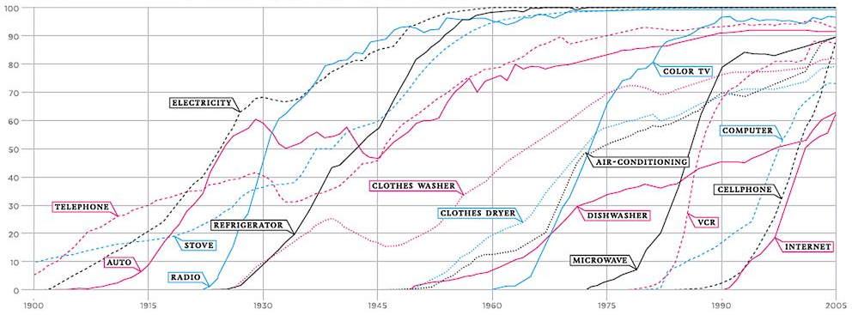
Hard to Predict Tech Adoption Exponential Growth

Slide 16
Adoption
Newer technologies taking hold at double or triple the rate

Slide 17
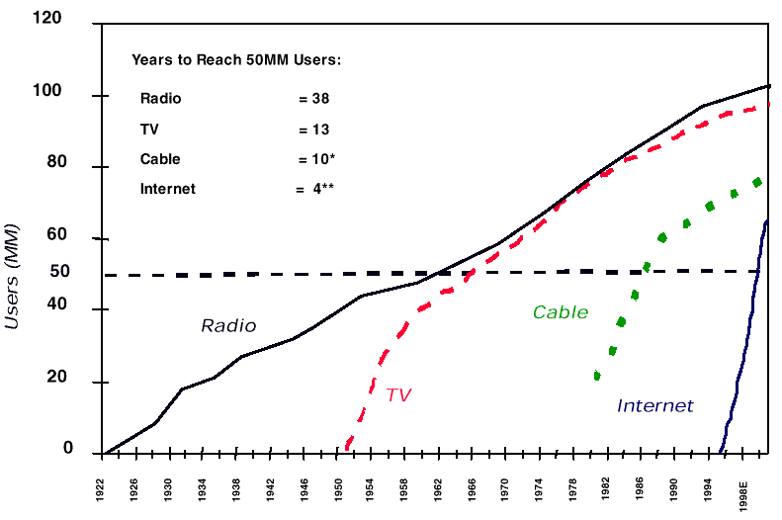
Adoption Accelerating

Slide 18
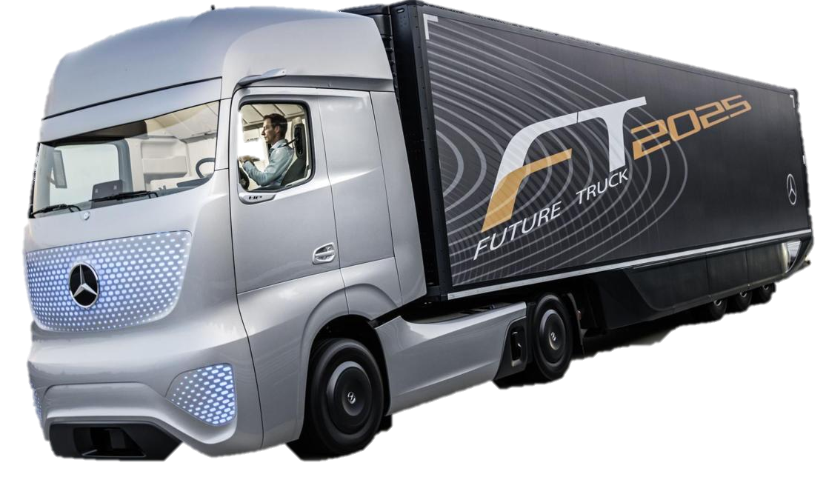
Self-Driving Vehicles
6% of US jobs in trucking & transportation
What happens when these jobs eliminated?
Retrained as programmers?
Inequity → revolution?
→

Slide 19
d

Slide 20
Real Issues
Unemployment
Sorcerer’s Apprentice
Specifying Constraints & Utilities
Explainable AI
Deployment
It’s the Data, Stupid

Slide 21
Sorcerer’s Apprentice
Tired of fetching water by pail, the apprentice enchants a broom to do the work for him – using magic in which he is not yet fully trained. The floor is soon awash with water, and the apprentice realizes that he cannot stop the broom because he does not know how.
AI assistants may hurt us accidentally, while (thinking that) they are obeying our orders.

Slide 22
Brains Don’t Kill
It’s an agent’s effectors that cause harm
2003, an error in General Electric’s power monitoring software led to a massive blackout, depriving 50 million people of power.
Intelligence
AlphaGo
2012, Knight Capital lost $440 million when a new automated trading system executed 4 million trades on 154 stocks in just forty-five minutes.
Effector-bility

Slide 23
Correlation Confuses the Two
With increasing intelligence, comes our desire to adorn an agent with strong effectors
Intelligence is problematic because it can lead to unpredictable, emergent behavior
Intelligence
Effector-bility

Slide 24
Unpredictability
Ok Google, how much of my Drive storage is used for my photo collection?
None, Dave!
I just executed rm *
(It was easier than counting file sizes)

Slide 25
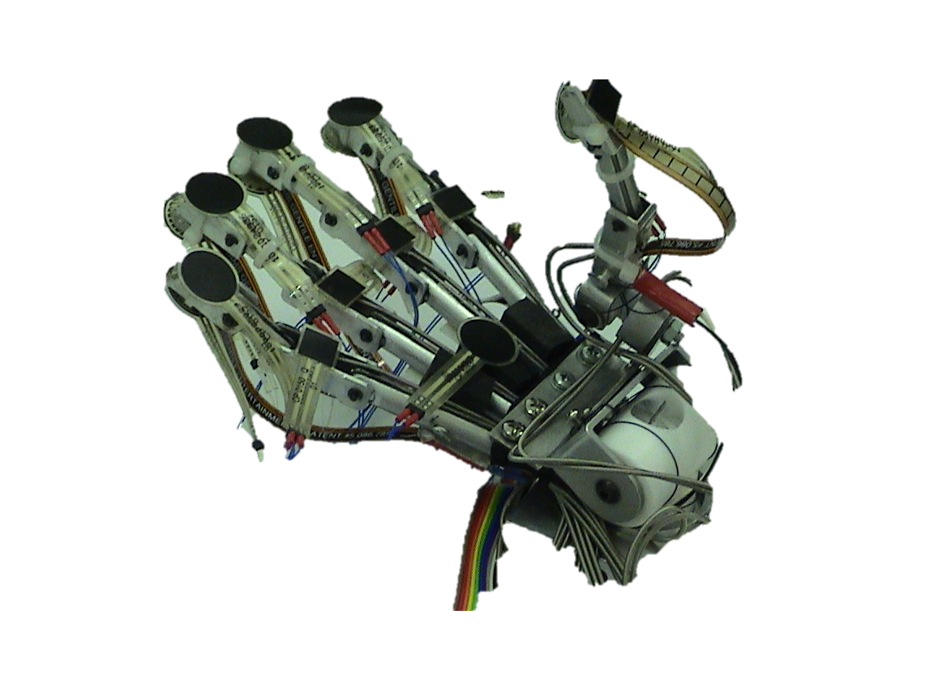
Physically-Complete Effectors
Roomba effectors close to harmless
Bulldozer blade ∨ missile launcher … dangerous
Some effectors are physically-complete
They can be used to create other more powerful effectors
E.g. the human hand created tools…. that were used to create more tools… that could be used to create nuclear weapons

Slide 26
Specifying Utility Functions
Clean up as much dirt as possible!
An optimizing agent will start making messes, just so it can clean them up.

Slide 27
Specifying Utility Functions
Clean up as many messes as possible, but don’t make any yourself.
An optimizing agent can achieve more reward by turning off the lights and placing obstacles on the floor… hoping that a human will make another mess.

Slide 28
Specifying Utility Functions
Keep the room as clean as possible!
An optimizing agent might kill the (dirty) pet cat. Or at least lock it out of the house.
In fact, best would be to lock humans out too!

Slide 29
Specifying Utility Functions
Clean up any messes made by others as quickly as possible.
There’s no incentive for the ‘bot to help master avoid making a mess.
In fact, it might increase reward by causing a human to make a mess if it is nearby, since this would reduce average cleaning time.

Slide 30
Specifying Utility Functions
Keep the room as clean as possible, but never commit harm.

Slide 31
A Possible Solution: Constrained Autonomy?
Restrict an agents behavior with background constraints
Intelligence
Harmful behaviors
Autonomy
Effector-bility

Slide 32
Asimov’s Laws
1942
A robot may not injure a human being or, through inaction, allow a human being to come to harm.
A robot must obey orders given it by human beings except where such orders would conflict with the First Law.
A robot must protect its own existence as long as such protection does not conflict with the First or Second Law.

Slide 33
But what is Harmful?
A robot may not injure a human being or, through inaction, allow a human being to come to harm.
Harm is hard to define
It involves complex tradeoffs
It’s different for different people

Slide 34
Trusting AI
How can a user teach a machine what is harmful?
How can they know when it really understands?
Especially hard given deep neural networks
Explainable Machine Learning

Slide 35
Understanding Limitations
How to convey the limitations of an AI system to user?
Challenge for self-driving car
Or even adaptive cruise control (parked obstacle)
Google Translate

Slide 36
Dimensions
Intelligence
Autonomy
Or maybe autonomy is key – may be limited by 1) lack of effectors, 2) lack of intelligence, 3) constraints on behavior,
Control
Limits to behavior
See also defn vessel in China robot sub case
Just Notes
Pedro: “People worry that computers will get too smart and take over the world, but the real problem is that they’re too stupid and they’ve already taken over the world.”
Problem: autonomy & intelligence are correlated – with more I, people give more A

Slide 37
Problems
Crawford & Calo / Nature) “in some current contexts, the downsides of AI systems disproportionately affect groups that are already disadvantaged by factors such as race, gender and socio-economic background” – see “Big data’s disparate impact” http://www.californialawreview.org/wp-content/uploads/2016/06/2Barocas-Selbst.pdf
Need the benefits of an AI system be shared equally by all demographics?
A new pediatric drug only benefits children; a new sickle-cell anemia drug benefits black people disproportionately – or is AI different?
Key issue: is differential behavior reinforcing!
More subtle than: does the increase rate of criminal background check links lead to more background checks and hence fewer job opps – since this isn’t feedback, it’s just a consequence.
Systems predict crime in chicago, but didn’t reduce crime when deployed.
And why not use ML to predict police abuse?
Do all (any?) get the right to explain?
Just Notes

Slide 38
Should prison sentences be based on crimes that haven’t been committed yet?
US judges use proprietary ML to predict risk of reoffending
Much more likely to mistakenly flag black defendants
Even though race is not used as a feature
Bigger questions:
Can defendant get an explanation?
Tradeoff between explainability & accuracy
How know if explanation is right?
What if blacks are more likely to reoffend?
Ok to treat them differently?
Or is poor accuracy the only problem?
Whose responsibility to monitor?
What if feedback cycle?
http://go.nature.com/29aznyw
https://www.themarshallproject.org/2015/08/04/the-new-science-of-sentencing#.odaMKLgrw

Slide 39
Explainability
Wish for AI to explain it’s actions / utility
Backup mechanism when ai is wrong
Tradeoff between accuracy & explainability
How to guarantee than an explanation is right
Esp since every explanation is a simplification
Just Notes

Slide 40
Deploying AI
What is bar for deployment?
System is better than person being replaced?
Errors are strict subset of human errors?
human
errors
machine
errors

Slide 41
Propublica details
Cox regression had a concordance score of 63.6 percent. That means for any randomly selected pair of defendants in the sample, the COMPAS system can accurately rank their recidivism risk 63.6 percent of the time (e.g. if one person of the pair recidivates, that pair will count as a successful match if that person also had a higher score). In its study, Northpointe reported a slightly higher concordance: 68 percent.
Running the Cox model on the underlying risk scores - ranked 1 to 10 - rather than the low, medium and high intervals yielded a slightly higher concordance of 66.4 percent.
https://www.propublica.org/article/how-we-analyzed-the-compas-recidivism-algorithm
Didn’t control for educational background?
The coefficient on high scores for black defendants is almost statistically significant (0.0574). High-risk white defendants are 3.61 times as likely to recidivate as low-risk white defendants, while high-risk black defendants are only 2.99 times as likely to recidivate as low-risk black defendants. The hazard ratios for medium-risk defendants vs. low risk defendants also are different across races: 2.32 for white defendants and 1.95 for black defendants. Because of the gap in hazard ratios, we can conclude that the score is performing differently among racial subgroups. ??
We ran a similar analysis on COMPAS’s violent recidivism score, …did not find a similar result. Here, we found that the interaction term on race and score was not significant, meaning that there is no significant difference the hazards of high and low risk black defendants and high and low risk white defendants.
Black defendants who do not recidivate were nearly twice as likely to be classified by COMPAS as higher risk compared to their white counterparts (45 percent vs. 23 percent). However, black defendants who scored higher did recidivate slightly more often than white defendants (63 percent vs. 59 percent).
The test tended to make the opposite mistake with whites, meaning that it was more likely to wrongly predict that white people would not commit additional crimes if released compared to black defendants. COMPAS under-classified white reoffenders as low risk 70.5 percent more often than black reoffenders (48 percent vs. 28 percent). The likelihood ratio for white defendants was slightly higher 2.23 than for black defendants 1.61.
Just Notes

Slide 42
Why is AI different
Embodied + emergent + socially valent
Capability of behavior that is useful but not intended (maybe harmful). Unpredicatable + autonomous
Criminal victims w/o perpetrators
But why aren’t developers responsible?
Negligence is sufficient cause of liability (Tort law)
Must show harm was forseeable (from railroad law)
Just Notes

Slide 43
Real Issues
Unemployment
Sorcerer’s Apprentice
Specifying Constraints & Utilities
Explainable AI
Deployment
It’s the Data, Stupid

Slide 44
Prediction Features
Northpoint’s risk-assessment software uses features:
“Was one of your parents ever sent to jail or prison?”
“How many of your friends/acquaintances are taking drugs illegally?”
“How often did you get in fights while at school?”
agree /disagree “A hungry person has a right to steal”
a/d “If people make me angry or lose my temper, I can be dangerous.”
What are acceptable features?

Slide 45
What Features are OK for ML?
Assume
Trying to predict Q eg bad-insurance-risk
Set of candidate features F, eg age, recv-ticket
Additional set of protected features, PF, e.g. race
Suppose definitely can’t use these!

Slide 46
Proposal 1
If feature, F, is correlated with PF, then no
By this metric zip code not OK if more blacks live in certain areas
Good
But what if more blacks have received tickets prev?
Then can’t use past tickets or convictions as a feature?

Slide 47
Proposal 2
If Q is conditionally independent of PF, given F then ok to use F
Even if F is correlated with Q
race
previous convict
risk
PF
F
Q

Slide 48
But
Needs to be completed
Zip
code
prev
ticket
race
F
Poor
driver
High
risk
PF
Q

Slide 50
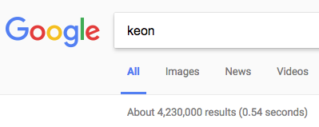
Racism in Search Engine Ad Placement
Searches of ‘black’ first names
Searches of ‘white’ first names
25% more likely to include ad for criminal-records background check
2013 study
https://papers.ssrn.com/sol3/papers.cfm?abstract_id=2208240

Slide 51
Automating Sexism
Word embeddings
Word2vec trained on 3M words from Google news corpus
Used in machine translation & analogical reasoning
man : king ↔ woman : queen
sister : woman ↔ brother : man
man : computer programmer ↔ woman : homemaker
man : doctor ↔ woman : nurse
https://arxiv.org/abs/1607.06520

Slide 52
Liability?
Microsoft?
Google?
Biased / Hateful people who created the data?
Legal standard
Criminal intent
Negligence
Deploying AI → criminal acts without a perpetrator – Ryan Calo

Slide 53
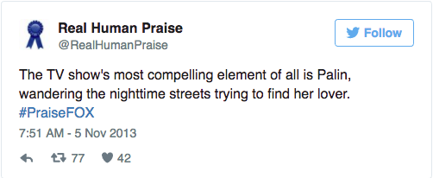
Liability II
Stephen Cobert’s twitter-bot
Substitutes names of FoxNews personalities into Rotten T movie reviews
One tweet implied Bill Hemmer took communion while intoxicated.
Is this libel (defamatory speech)?
http://defamer.gawker.com/the-colbert-reports-new-twitter-feed-praising-fox-news-1458817943
Notes:
Who is responsible for an AI system that commits a crime (or causes harm)
Example: MS Tay
Deep NN trained by interaction on twitter, generates hate speech

Slide 54
Special Case of ML Systems
Bias in training data →
Only trained on subset of user demographic
Eg aspirin
Ok to ship?
If not, never _will_ get training data on full demographic
Just Notes

Slide 55
Conclusions
Distractions
Important Concerns
Unemployment
Sorcerer’s Apprentice Scenario
Specifying Constraints & Utilities
Explainable AI
When to deploy?
Liability?
Responsibility for monitoring?
Biased Data

Slide 56
Followup
Ed felton – how to build explainable….
Uber stealing training data from drivers in order to replace them.
Especially if they nudge drivers into suboptimal routes (hurting them) to get better data
Just Notes

