Slide 1
CSE 473: Artificial Intelligence
Bayesian Networks - Learning
Dan Weld
Slides adapted from Jack Breese, Dan Klein, Daphne Koller, Stuart Russell, Andrew Moore & Luke Zettlemoyer
1

Slide 2
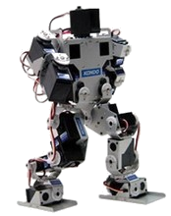
Static vs. Dynamic
Environment
Fully
vs.
Partially
Observable
Deterministic
vs.
Stochastic
What action next?
Perfect
vs.
Noisy
Instantaneous
vs.
Durative
Percepts
Actions

Slide 3
AI Topics
Search
  Problem Spaces
  BFS, DFS, UCS, A* (tree and graph)
  Completeness and Optimality
  Heuristics: admissibility and consistency
CSPs
  Constraint graphs, backtracking search
  Forward checking, AC3 constraint propagation, ordering heuristics
Games
  Minimax, Alpha-beta pruning, Expectimax, Evaluation Functions
MDPs
  Bellman equations
  Value iteration & policy iteration
  RTDP, LAO* & UCT
  POMDPs
Reinforcement Learning
  Exploration vs. Exploitation
  Model-based vs. model-free
  Q-learning
  Linear value function approx.
Hidden Markov Models
  Markov chains
  Forward algorithm
  Particle Filter
Bayesian Networks
  Basic definition, independence (d-sep)
  Variable elimination
  Gibbs sampling
Learning
  BN parameters with data complete &
  incomplete (Expectation Maximization)
  Search thru space of BN structures

Slide 4
Search thru a
Problem Space / State Space
Ex. Proving a trig identity, e.g. sin²(x) = ½ - ½ cos(2x)
Input:
  Set of states
  Operators [and costs]
  Start state
  Goal state [test]
Output:
  Path: start ⇒ a state satisfying goal test
  [May require shortest path]
  [Sometimes just need state passing test]
Notes:
State Space Search is basically a GRAPH SEARCH PROBLEM
STATES are whatever you like!
OPERATORS are a compact DESCRIPTION of possible STATE TRANSITIONS – the EDGES of the GRAPH
May have different COSTS or all be UNIT cost
OUTPUT may be specified either as ANY PATH (REACHABILITY), or a SHORTEST PATH

Slide 5
Today
Bonus Topic – Hybrid Bayes Nets
Learning
  Parameter Learning & Priors
  Expectation Maximization
  Structure Learning

Slide 6
Bayes Nets
Pr(E=t) Pr(E=f)
0.01 0.99
Earthquake
Burglary
Pr(A|E,B)
e,b 0.9 (0.1)
e,b 0.2 (0.8)
e,b 0.85 (0.15)
e,b 0.01 (0.99)
Radio
Alarm
Nbr1Calls
Nbr2Calls
© Daniel S. Weld
6

Slide 7
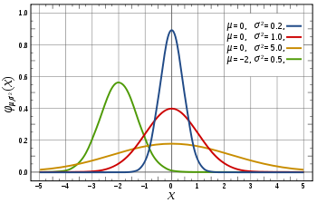
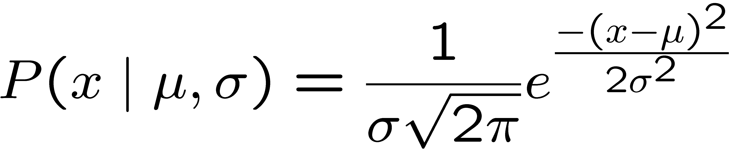
Continuous Variables
Pr(E=t) Pr(E=f)
0.01 0.99
Earthquake
So far: assuming variables have discrete values
Could also allow continuous values, E ∈ R,
How specify probabilities? (explicit CPT would be infinitely large)
© Daniel S. Weld

Slide 8
Continuous Variables
Pr(E=t) Pr(E=f)
0.01 0.99
Earthquake
So far: assuming variables have discrete values
Could also allow continuous values, E ∈ R,
And specify probabilities using a continuous distribution, such as a Gaussian
© Daniel S. Weld

Slide 9
Continuous Variables
Pr(E=x)
mean: μ = 6
Earthquake
variance: σ = 2
So far: assuming variables have discrete values
Could also allow continuous values, E ∈ R,
And specify probabilities using a continuous distribution, such as a Gaussian
© Daniel S. Weld

Slide 10
Continuous Variables
Pr(A=t) Pr(A=f)
0.01 0.99
Aliens
Pr(E|A)
a μ = 6
σ = 2
a μ = 1
σ = 3
Earthquake
© Daniel S. Weld

Slide 11

Learning
?

Slide 12
What is Machine Learning ?

Slide 13
Machine Learning
Study of algorithms that
improve their performance
at some task
with experience
Machine
Learning
Data
Understanding

Slide 14
Exponential Growth in Data
Machine
Learning
Data
Understanding

Slide 15
Supremacy of Machine Learning
Machine learning is preferred approach to
  Speech recognition, Natural language processing
  Web search – result ranking
  Computer vision
  Medical outcomes analysis
  Robot control
  Computational biology
  Sensor networks
  …
This trend is accelerating
  Improved machine learning algorithms
  Improved data capture, networking, faster computers
  Software too complex to write by hand
  New sensors / IO devices
  Demand for self-customization to user, environment

Slide 16
Space of ML Problems
Type of Supervision
(eg, Experience, Feedback)
 | Labeled Examples | Reward | Nothing
Discrete Function | Classification |  | Clustering
Continuous Function | Regression
Policy | Apprenticeship Learning | Reinforcement Learning
What is Being Learned?

Slide 17
Supremacy of Machine Learning
Machine learning is preferred approach to
  Speech recognition, Natural language processing
  Web search – result ranking
  Computer vision
  Medical outcomes analysis
  Robot control
  Computational biology
  Sensor networks
  …
This trend is accelerating
  Improved machine learning algorithms
  Improved data capture, networking, faster computers
  Software too complex to write by hand
  New sensors / IO devices
  Demand for self-customization to user, environment

Slide 18
What is Machine Learning ?
Machine
Learning
Data
Understanding

Slide 19
Machine Learning
Study of algorithms that
improve their performance
at some task
with experience
Ability to accumulate reward
Executing actions
Executing actions
?? Reinforcement Learning ??

Slide 20
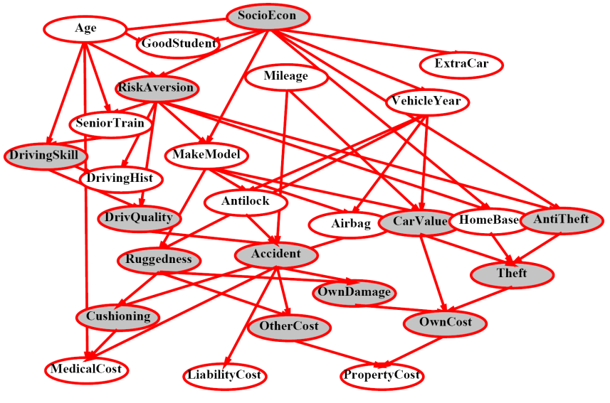
Machine Learning
Study of algorithms that
improve their performance
at some task
with experience
Prediction accuracy
Answering probabilistic queries
Seeing labeled data

Slide 21
Learning Bayes Networks
Learning Parameters for a Bayesian Network
  Fully observable variables
    Maximum Likelihood (ML), MAP & Bayesian estimation
    Example: Naïve Bayes for text classification
  Hidden variables
    Expectation Maximization (EM)
Learning Structure of Bayesian Networks

Slide 22
The Origin of Bayes Nets
Pr(B=t) Pr(B=f)
0.05 0.95
Earthquake
Burglary
Pr(A|E,B)
e,b 0.9 (0.1)
e,b 0.2 (0.8)
e,b 0.85 (0.15)
e,b 0.01 (0.99)
Radio
Alarm
Nbr1Calls
Nbr2Calls
© Daniel S. Weld
22

Slide 23
Learning Bayes Nets
Suppose …
  Know structure & get complete observations of every var
  Know structure & get observations only of some vars
    Others are hidden (learn with EM)
  Don’t even know structure!

Slide 24
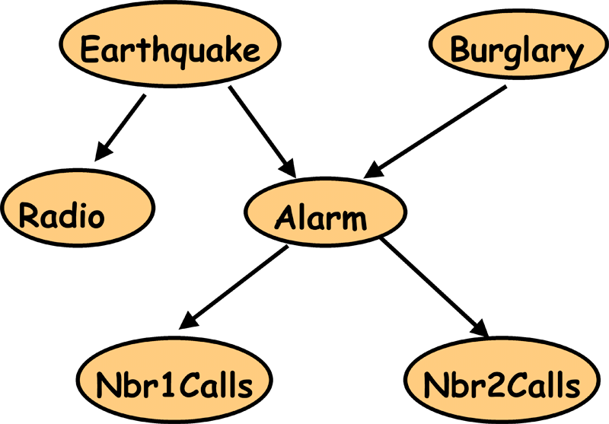
Parameter Estimation and Bayesian Networks
E | B | R | A | J | M
T | F | T | T | F | T
F | F | F | F | F | T
F | T | F | T | T | T
F | F | F | T | T | T
F | T | F | F | F | F
...
We have:
- Bayes Net structure and observations
- We need: Bayes Net parameters

Slide 25
Parameter Estimation and Bayesian Networks
E | B | R | A | J | M
T | F | T | T | F | T
F | F | F | F | F | T
F | T | F | T | T | T
F | F | F | T | T | T
F | T | F | F | F | F
...
P(B) = ?
P(¬B) = 1- P(B)
= 0.4
= 0.6

Slide 26
Parameter Estimation and Bayesian Networks
E | B | R | A | J | M
T | F | T | T | F | T
F | F | F | F | F | T
F | T | F | T | T | T
F | F | F | T | T | T
F | T | F | F | F | F
...
P(A|E,B) = ?
P(A|E,¬B) = ?
P(A|¬E,B) = ?
P(A|¬E,¬B) = 0.5

Slide 27
Parameter Estimation and Bayesian Networks
E | B | R | A | J | M
T | F | T | T | F | T
F | F | F | F | F | T
F | T | F | T | T | T
F | F | F | T | T | T
F | T | F | F | F | F
...
P(A|E,B) = ?
P(A|E,¬B) = 1.0 ?
P(A|¬E,B) = ?
P(A|¬E,¬B) = ?

Slide 28
Parameter Estimation and Bayesian Networks
E | B | R | A | J | M
T | F | T | T | F | T
F | F | F | F | F | T
F | T | F | T | T | T
F | F | F | T | T | T
F | T | F | F | F | F
...
P(A|E,B) = ?
P(A|E,¬B) = ?
P(A|¬E,B) = ?
P(A|¬E,¬B) = ?

Slide 29
Parameter Estimation and Bayesian Networks
Coin

Slide 30



Coin Flip
C₁
C₂
C₃
P(H|C₁) = 0.1
P(H|C₂) = 0.5
P(H|C₃) = 0.9
Which coin will I use?
P(C₁) = 1/3
P(C₂) = 1/3
P(C₃) = 1/3
Prior: Probability of a hypothesis
before we make any observations

Slide 31
Coin Flip
C₁
C₂
C₃
P(H|C₁) = 0.1
P(H|C₂) = 0.5
P(H|C₃) = 0.9
Which coin will I use?
P(C₁) = 1/3
P(C₂) = 1/3
P(C₃) = 1/3
Uniform Prior: All hypothesis are equally likely
before we make any observations

Slide 32

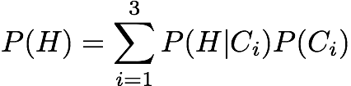
Experiment 1: Heads
Which coin did I use?
P(C₁|H) = ?
P(C₂|H) = ?
P(C₃|H) = ?
C₁
C₂
C₃
P(H|C₁)=0.1
P(H|C₂) = 0.5
P(H|C₃) = 0.9
P(C₁)=1/3
P(C₂) = 1/3
P(C₃) = 1/3

Slide 33
Experiment 1: Heads
Which coin did I use?
P(C₁|H) = 0.066
P(C₂|H) = 0.333
P(C₃|H) = 0.6
Posterior: Probability of a hypothesis given data
C₁
C₂
C₃
P(H|C₁) = 0.1
P(H|C₂) = 0.5
P(H|C₃) = 0.9
P(C₁) = 1/3
P(C₂) = 1/3
P(C₃) = 1/3

Slide 34
Terminology
Prior:
  Probability of a hypothesis before we see any data
Uniform Prior:
  A prior that makes all hypothesis equally likely
Posterior:
  Probability of a hypothesis after we saw some data
Likelihood:
  Probability of data given hypothesis

Slide 35
Using Prior Knowledge
Should we always use a Uniform Prior ?
Background knowledge:
  Heads => we have to buy Dan chocolate
  Dan likes chocolate…
  => Dan is more likely to use a coin biased in his favor
C₁
C₂
C₃
P(H|C₁) = 0.1
P(H|C₂) = 0.5
P(H|C₃) = 0.9

Slide 36
Using Background Knowledge
We can encode it in the prior:
P(C₁) = 0.05
P(C₂) = 0.25
P(C₃) = 0.70
C₁
C₂
C₃
P(H|C₁) = 0.1
P(H|C₂) = 0.5
P(H|C₃) = 0.9

Slide 37
Experiment 1: Heads
Which coin did I use?
P(C₁|H) = 0.006
P(C₂|H) = 0.165
P(C₃|H) = 0.829
Compare with ML posterior after Exp 1:
P(C₁|H) = 0.066
P(C₂|H) = 0.333
P(C₃|H) = 0.600
C₁
C₂
C₃
P(H|C₁) = 0.1
P(H|C₂) = 0.5
P(H|C₃) = 0.9
P(C₁) = 0.05
P(C₂) = 0.25
P(C₃) = 0.70

Slide 38
Probabilistic Estimation
 | Prior | Hypothesis
Maximum Likelihood Estimate (MLE)
Maximum A Posteriori Estimate (MAP)
Bayesian Estimate
Easy to compute
Uniform | The most likely
Any | The most likely
Any | Weighted combination
Still easy to compute
Incorporates prior knowledge
Minimizes error
Great when data is scarce
Potentially much harder to compute

Slide 39
Bayesian Learning
Data Likelihood
Prior
Use Bayes rule:
P(Y | X) = P(X |Y) P(Y)
P(X)
Posterior
Normalization
Or equivalently: P(Y | X) ∝ P(X | Y) P(Y)

Slide 40
Really? Only 3 Coins?
C₁
C₂
C₃
P(H|C₁) = 0.1
P(H|C₂) = 0.5
P(H|C₃) = 0.9
More Likely….
0.1 0.5 0.9

Slide 41
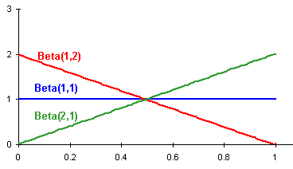
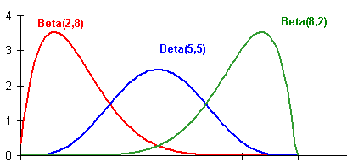
What Prior to Use?
Two common priors for continuous variables
  Binary variable Beta
    Posterior distribution is binomial
    Easy to compute posterior
    Easy to compute MAP estimate
      MAP E[Beta(a, b)] = a/(a+b)
  Discrete variable Dirichlet
    Posterior distribution is multinomial
    Easy to compute posterior

Slide 42
Parameter Estimation and Bayesian Networks
E | B | R | A | J | M
T | F | T | T | F | T
F | F | F | F | F | T
F | T | F | T | T | T
F | F | F | T | T | T
F | T | F | F | F | F
...
Prior
B
¬B
P(B|data) = ?
Beta(1,4)
“+ data” =
(3,7)
.3
.7
Prior P(B)= 1/(1+4) = 20% with equivalent sample size 5

Slide 43
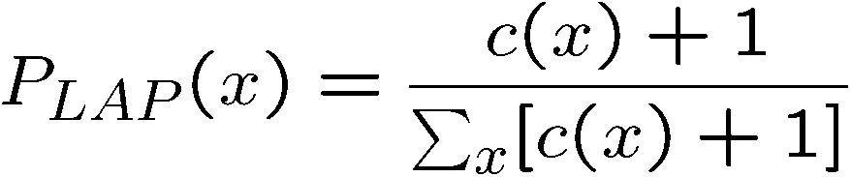
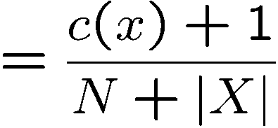
Estimation: Laplace Smoothing
Laplace’s estimate:
  pretend you saw every outcome
  once more than you actually did
  Another name for computing the MAP estimate with Dirichlet priors (Bayesian justification)
H
H
T
P_{LAP}(H) =
(2+1) / (3+2)
= 3/5

Slide 44

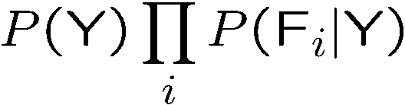
Application: Naïve Bayes
Y
Class
Value
…
F 1
F 2
F 3
F _{N}
Assume that features are conditionally independent given class variable
Works well in practice
But forces probabilities towards 0 and 1

Slide 45

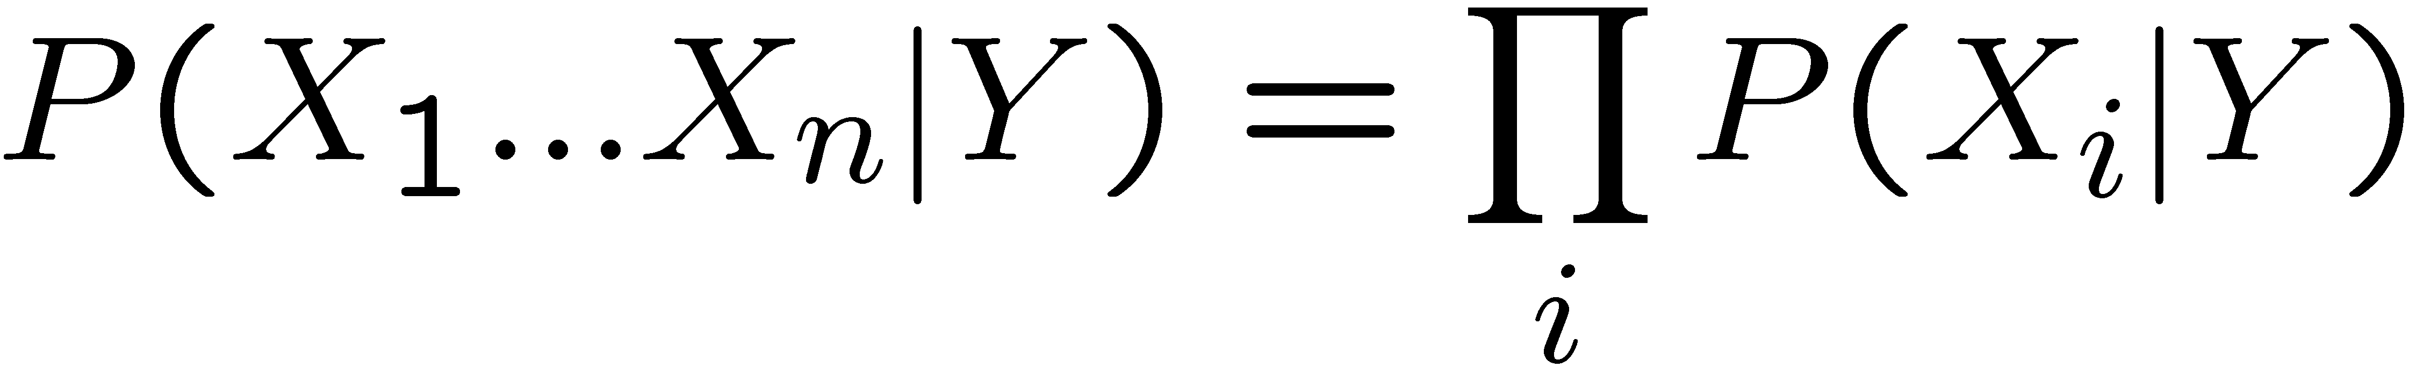
Naïve Bayes
Naïve Bayes assumption:
  Features are independent given class:
  More generally:
How many parameters now?
    Suppose X is composed of n binary features

Slide 46
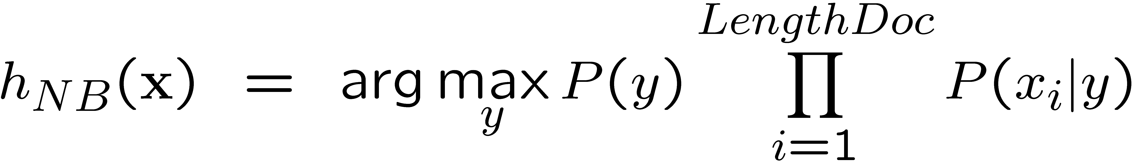
NB with Bag of Words for text classification
Learning phase:
  Prior P(Y)
    Count how many documents from each topic (prior)
  P(X_{i}|Y)
    For each of m topics, count how many times you saw word X_{i} in documents of this topic (+ k for prior)
    Divide by number of times you saw the word (+ k×m)
Test phase:
  For each document
    Use naïve Bayes decision rule

Slide 47
Probabilities: Important Detail!
P(spam | X₁ … X_{n}) = Π P(spam | X_{i})
i
Any more potential problems here?
We are multiplying lots of small numbers Danger of underflow!
  0.5⁵⁷ = 7 E -18
Solution? Use logs and add!
  p₁ * p₂ = e ^{log(p1)+log(p2)}
  Always keep in log form

Slide 48
How Learn Continuous CPTs?
48
Slide by Daniel S. Weld
Notes:
48

Slide 49
Maximum Likelihood
Mean of Single Gaussian
U_{mle} = argmin_{u} Σ_{i}(x_{i} – u)²
.01 .03 .05 .07 .09
Slide by Daniel S. Weld
49
Notes:
49

Slide 50
Maximum Likelihood
Mean of Single Gaussian
U_{mle} = argmin_{u} Σ_{i}(x_{i} – u)²
= Σ_{i} x_{i} / N
.01 .03 .05 .07 .09
50
Slide by Daniel S. Weld
Notes:
50

Slide 51
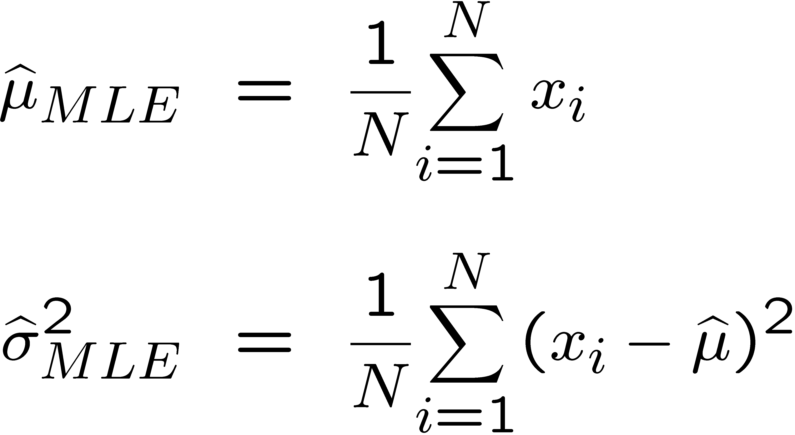
Learning with Continuous Variables
Pr(E=x)
Earthquake
mean: μ = ?
variance: σ = ?
© Daniel S. Weld

Slide 52
Output of Learning
Pr(B=t) Pr(B=f)
0.05 0.95
Pr(A|E,B)
e,b 0.9 (0.1)
e,b 0.2 (0.8)
e,b 0.85 (0.15)
e,b 0.01 (0.99)
E | B | R | A | J | M
T | F | T | T | F | T
F | F | F | F | F | T
F | T | F | T | T | T
F | F | F | T | T | T
F | T | F | F | F | F
...
Prior

Slide 53
Did Learning Work Well?
Pr(B=t) Pr(B=f)
0.05 0.95
Pr(A|E,B)
e,b 0.9 (0.1)
e,b 0.2 (0.8)
e,b 0.85 (0.15)
e,b 0.01 (0.99)
E | B | R | A | J | M
T | F | T | T | F | T
F | F | F | F | F | T
F | T | F | T | T | T
F | F | F | T | T | T
F | T | F | F | F | F
...
Can easily calculate
P(data) for learned parameters

Slide 54
Topics
Another Useful Bayes Net
  Hybrid Discrete / Continuous
Learning Parameters for a Bayesian Network
  Fully observable
  Hidden variables (EM algorithm)
Learning Structure of Bayesian Networks

Slide 55
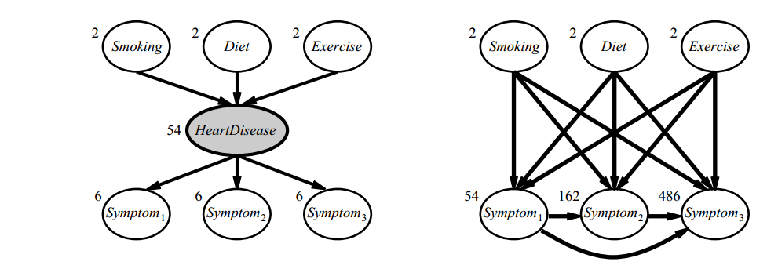
Why Learn Hidden Variables?

Slide 56
How Learn Hidden Variables?

Slide 57
Chicken & Egg Problem
If we knew whether patient had disease
  It would be easy to learn CPTs
  But we can’t observe states, so we don’t!
If we knew CPTs
  It would be easy to predict if patient had disease
  But we don’t, so we can’t!
Slide by Daniel S. Weld
57
Notes:
57

Slide 58
Face It…

Slide 59


Slide 60
Continuous Variables
Pr(A=t) Pr(A=f)
0.01 0.99
hidden
Aliens
Pr(E|A)
a μ = 6
σ = 2
a μ = 1
σ = 3
Earthquake
© Daniel S. Weld

Slide 61
Learning with Continuous Variables
Pr(E=x)
Earthquake
mean: μ = ?
variance: σ = ?
© Daniel S. Weld

Slide 62
Continuous Variables
Pr(A=t) Pr(A=f)
0.01 0.99
hidden
Aliens
Pr(E|A)
a μ = 6
σ = 2
a μ = 1
σ = 3
Earthquake
© Daniel S. Weld

Slide 63
Simplest Version
Mixture of two distributions
Know: form of distribution & variance,
σ = .5
Just need mean of each distribution
.01 .03 .05 .07 .09
63
Slide by Daniel S. Weld
Notes:
63

Slide 64
Input Looks Like
.01 .03 .05 .07 .09
64
Slide by Daniel S. Weld
Notes:
64

Slide 65
We Want to Predict
Naturally Caused
Aliens Caused
?
.01 .03 .05 .07 .09
65
Slide by Daniel S. Weld
Notes:
65

Slide 66
Chicken & Egg
Note that coloring instances would be easy
if we knew Gausians….
.01 .03 .05 .07 .09
66
Slide by Daniel S. Weld
Notes:
66

Slide 67
Chicken & Egg
And finding Gausian parameters would be easy
If we knew the coloring
.01 .03 .05 .07 .09
67
Slide by Daniel S. Weld
Notes:
67

Slide 68
Expectation Maximization (EM)
Pretend we do know the parameters
  Initialize randomly: set θ₁=?; θ₂=?
.01 .03 .05 .07 .09
68
Slide by Daniel S. Weld
Notes:
68

Slide 69
Expectation Maximization (EM)
Pretend we do know the parameters
  Initialize randomly
[E step] Compute probability of instance having each possible value of the hidden variable
.01 .03 .05 .07 .09
69
Slide by Daniel S. Weld
Notes:
69

Slide 70
Expectation Maximization (EM)
Pretend we do know the parameters
  Initialize randomly
[E step] Compute probability of instance having each possible value of the hidden variable
.01 .03 .05 .07 .09
70
Slide by Daniel S. Weld
Notes:
70

Slide 71
Expectation Maximization (EM)
Pretend we do know the parameters
  Initialize randomly
[E step] Compute probability of instance having each possible value of the hidden variable
[M step] Treating each instance as fractionally having both values compute the new parameter values
.01 .03 .05 .07 .09
71
Slide by Daniel S. Weld
Notes:
71

Slide 72
ML Mean of Single Gaussian
U_{ml} = argmin_{u} Σ_{i}(x_{i} – u)²
.01 .03 .05 .07 .09
72
Slide by Daniel S. Weld
Notes:
72

Slide 73
Expectation Maximization (EM)
[E step] Compute probability of instance having each possible value of the hidden variable
[M step] Treating each instance as fractionally having both values compute the new parameter values
.01 .03 .05 .07 .09
73
Slide by Daniel S. Weld
Notes:
73

Slide 74
Expectation Maximization (EM)
[E step] Compute probability of instance having each possible value of the hidden variable
.01 .03 .05 .07 .09
74
Slide by Daniel S. Weld
Notes:
74

Slide 75
Expectation Maximization (EM)
[E step] Compute probability of instance having each possible value of the hidden variable
[M step] Treating each instance as fractionally having both values compute the new parameter values
.01 .03 .05 .07 .09
75
Slide by Daniel S. Weld
Notes:
75

Slide 76
Expectation Maximization (EM)
[E step] Compute probability of instance having each possible value of the hidden variable
[M step] Treating each instance as fractionally having both values compute the new parameter values
.01 .03 .05 .07 .09
76
Slide by Daniel S. Weld
Notes:
76

Slide 77
Topics
Another Useful Bayes Net
  Hybrid Discrete / Continuous
Learning Parameters for a Bayesian Network
  Fully observable
    Maximum Likelihood (ML),
    Maximum A Posteriori (MAP)
  Hidden variables (EM algorithm)
Learning Structure of Bayesian Networks

Slide 78
What if we don’t know structure?

Slide 79
Learning The Structure of Bayesian Networks
Burglary
Earthqk
E | B | R | A | J | M
T | F | T | T | F | T
F | F | F | F | F | T
F | T | F | T | T | T
F | F | F | T | T | T
F | T | F | F | F | F
...
Alarm
John calls
Mary calls

Slide 80
Learning The Structure of Bayesian Networks
Burglary
Earthqk
E | B | R | A | J | M
T | F | T | T | F | T
F | F | F | F | F | T
F | T | F | T | T | T
F | F | F | T | T | T
F | T | F | F | F | F
...
Alarm
John calls
Mary calls

Slide 81
Learning The Structure of Bayesian Networks
Search thru the space…
  of possible network structures!
For each structure, learn parameters
  As just shown…
Pick the one that fits observed data best
  Calculate P(data)

Slide 82
A
B
C
D
E
A
A
B
C
B
C
D
E
D
E
Two problems:
  Fully connected will be most probable
  Exponential number of structures

Slide 83
Learning The Structure of Bayesian Networks
Search thru the space…
  of possible network structures!
For each structure, learn parameters
  As just shown…
Pick the one that fits observed data best
  Calculate P(data)
Two problems:
  Fully connected will be most probable
    Add penalty term (regularization) ∝ model complexity
  Exponential number of structures
    Local search

Slide 84
Overfitting
Can represent strictly more P distributions
Can represent NOISE in training data
Often preforms WORSE on test data

Slide 85
Augment Score Function
Bayesian Information Criterion (BIC)
  P(D | BN) – penalty
  Penalty = α complexity
  Penalty = α [½ (# parameters) Log (# data points)]
Instance of “regularization”
Solves problem of “overfitting”

Slide 86
Score Functions
Bayesian Information Criterion (BIC)
  P(D | BN) – penalty
  Penalty = ½ (# parameters) Log (# data points)
MAP score
  P(BN | D) = P(D | BN) P(BN)
  P(BN) must decay exponentially with # of parameters for this to work well

Slide 87
Hill-climbing Search
A
A
B
C
B
C
D
E
A
D
E
A
B
B
C
C
A
E
D
E
D
B
C
D
E

Slide 88





Tuning on Held-Out Data
Now we’ve got two kinds of unknowns
  Parameters: the probabilities P(Y|X), P(Y)
  Hyperparameters, like
    the amount of smoothing to do: k, or
    regularization penalty, α
Where to learn?
  Learn parameters from training data
  Must tune hyperparameters on different data
    Why?
  For each value of the hyperparameters, train and test on the held-out data
  Choose the best value and do a final test on the test data

Slide 89
Baselines
First step: get a baseline
  Baselines are very simple “straw man” procedures
  Help determine how hard the task is
  Help know what a “good” accuracy is
Weak baseline: most frequent label classifier
  Gives all test instances whatever label was most common in the training set
  E.g. for spam filtering, might label everything as ham
  Accuracy might be very high if the problem is skewed
  E.g. calling everything “spam” gets 86%, so a classifier that gets 90% isn’t very good…
For real research, usually use previous work as a (strong) baseline

