Slide 1
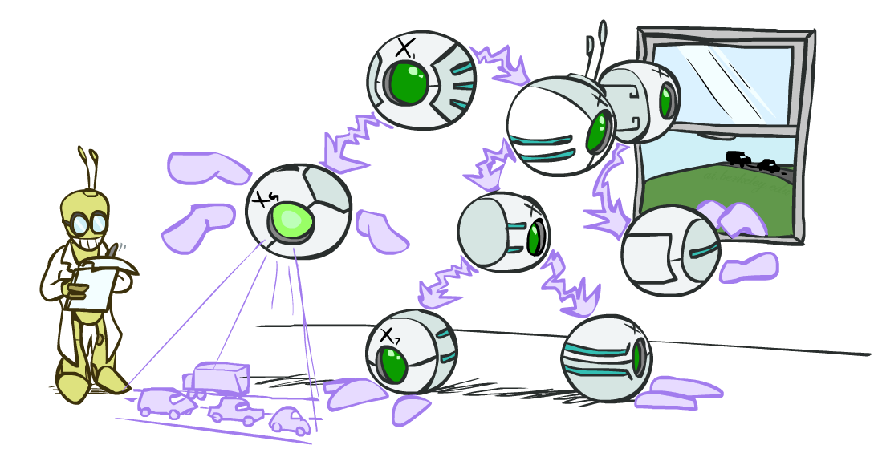
CSE 473: Artificial Intelligence
Bayes’ Nets: Inference
Dan Weld
[These slides were created by Dan Klein and Pieter Abbeel for CS188 Intro to AI at UC Berkeley. All CS188 materials are available at http://ai.berkeley.edu.]
Notes:
Please retain proper attribution, including the reference to ai.berkeley.edu. Thanks!

Slide 2
Time complexity
Dynamic programming
  Linear space and time complexity?
  Works well for polytrees (where there is at most one path between any two nodes)
  Doesn’t work for multiply connected networks (exponential space and time complexity on worst case)

Slide 3
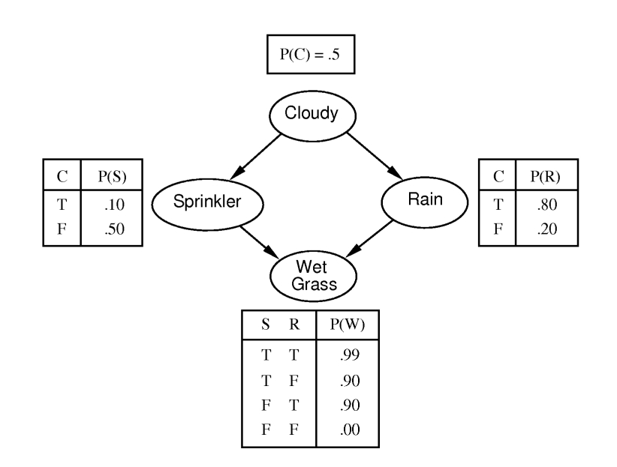
Inference in multiply connected networks
Clustering
Cutset conditioning
Stochastic methods
  Monte Carlo
  likelihood weighting
  Markov Chain Monte Carlo
    Will be skipped in this course

Slide 4
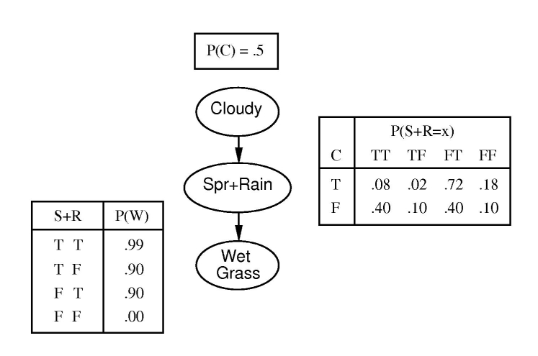
Clustering
Merge variables, replace their CPTs by their combined CPT

Slide 5
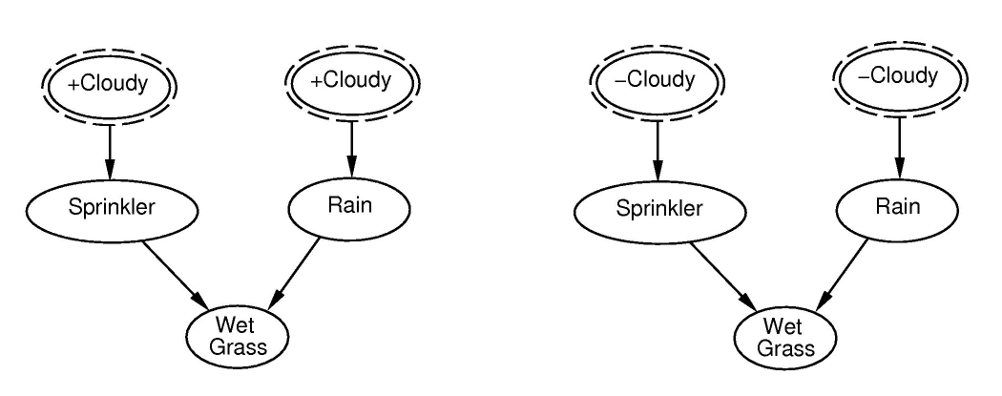
Cutset conditioning
cutting off cycles to obtain polytree.
Sum over all instantiations of cutset variables.

Slide 6
Cutset conditioning - example
P(W|S) = Σ_{RC} P(W|S,R,C) P(R,C|S)
= Σ_{RC} P(W|S,R) P(R,C|S)
P(R,C|S) = P(R,S|C) P(C) / P(S) = P(R|C) P(S|C) P(C) / P(S)
(Notice here that node C d-separates R and S)
P(C = +)
+ P(C = -)

Slide 7
Stochastic Inference
It’s expensive to work with the full joint distribution… whether as a table or as a Bayes Network
Is approximation good enough?
Monte Carlo

Slide 8
Monte Carlo
Use samples to approximate solution
  Simulated annealing used Monte Carlo theories to justify why random guesses and sometimes going uphill can lead to optimality
More samples = better approximation
  How many are needed?
  Where should you take the samples?

Slide 9
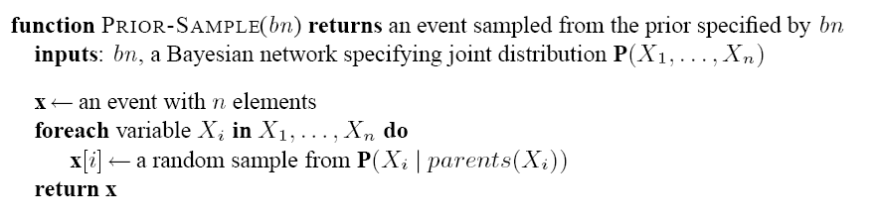
Prior sampling
Sampling algorithm that generates events from a Bayesian network

Slide 10
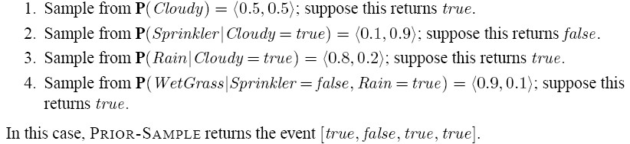
Prior sampling example
Sprinkler network

Slide 11
Approximating true distribution
With enough samples, perfect modeling is possible

Slide 12
Rejection sampling
Compute P(X | e)
  Use PriorSample (S_{PS}) and create N samples
  Denote Ne number of samples consistent with e (namely E = e)
  Denote Nex number of samples consistent with E = e) AND X = x
  P(X | e) can be computed from Nex / Ne

Slide 13
Example
  P(Rain | Sprinkler = true)
  Use Bayes Net to generate 100 samples
    Suppose 73 have Sprinkler=false
    Suppose 27 have Sprinkler=true
      8 have Rain=true
      19 have Rain=false
  P(Rain | Sprinkler=true) = <8/27; 19/27>

Slide 14
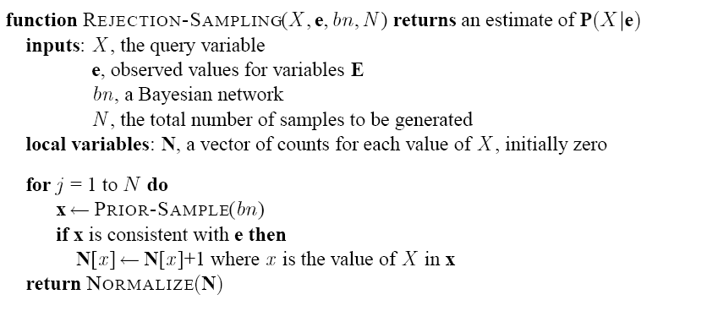
Rejection sampling

Slide 15
Problems with rejection sampling
  Standard deviation of the error in probability is proportional to 1/sqrt(n), where n is the number of samples consistent with evidence
  As problems become complex, number of samples consistent with evidence becomes small and it becomes harder to construct accurate estimates

Slide 16
Likelihood weighting
We only want to generate samples that are consistent with the evidence, e
  We’ll sample the Bayes Net, but we won’t let every random variable be sampled, some will be forced to produce a specific output

Slide 17
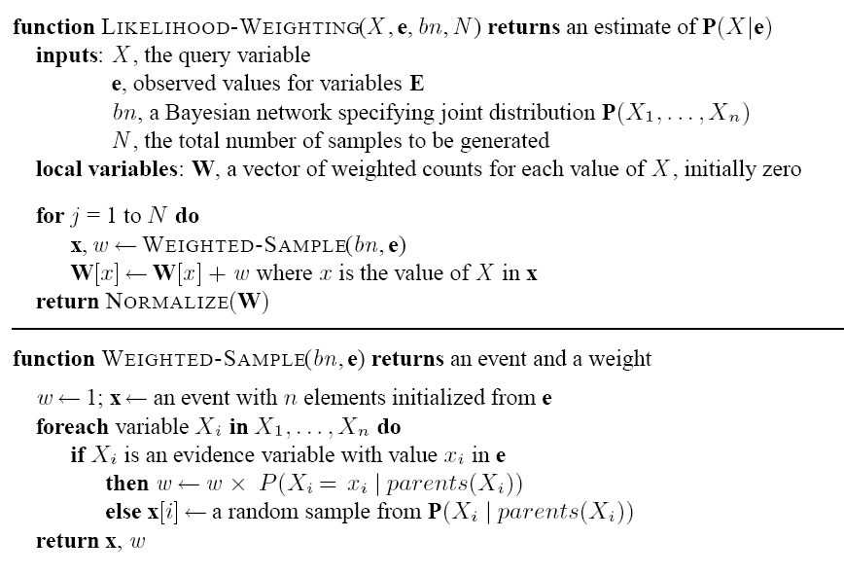
Likelihood Weighting algorithm

Slide 18
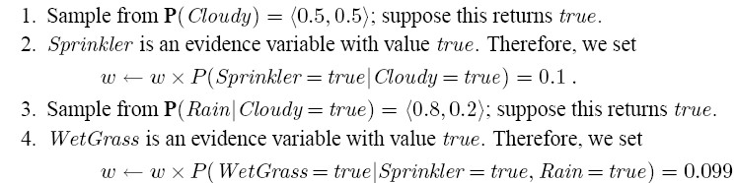
Likelihood Weighting Example
Estimate P (Rain| sprinkler, wetGrass)
  First, weight vector, w, set to 1.0

Slide 19
Example
Notice that weight is reduced according to how likely an evidence variable’s output is given its parents
  So final probability is a function of what comes from sampling the free variables while constraining the evidence variables

Slide 20
Comparing techniques
  In likelihood weighting, attention is paid to evidence variables before samples are collected
  In rejection sampling, evidence variables are considered after the sampling
  Likelihood weighting isn’t as accurate as the true posterior distribution, P(z | e) because the sampled variables ignore evidence among z’s non-ancestors

Slide 21
Likelihood weighting
  Uses all the samples
  As evidence variables increase, it becomes harder to keep the weighting constant high and estimate quality drops

Slide 22
Gibbs sampling
Start with an arbitrary state of the network, with Evidence variables set to their observed values
Randomly sample a value for a non evidence variable, conditioned on its: parents, children and childrens parents (Markov blanket)
Each state sampled contributes equally to the estimate of the query

Slide 23


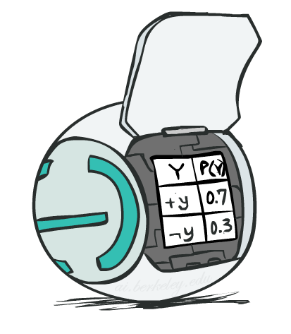
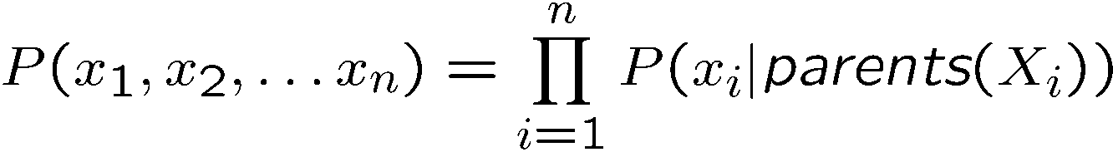
Bayes’ Net Representation
A directed, acyclic graph, one node per random variable
A conditional probability table (CPT) for each node
  A collection of distributions over X, one for each combination of parents’ values
Bayes’ nets implicitly encode joint distributions
  As a product of local conditional distributions
  To see what probability a BN gives to a full assignment, multiply all the relevant conditionals together:

Slide 24
Active / Inactive Paths
Question: Are X and Y conditionally independent given evidence variables {Z}?
  Yes, if X and Y “d-separated” by Z
Consider all (undirected) paths from X to Y…
If all paths are inactive → independence!
A path is active if every triple is active:
  Causal chain A → B → C where B is unobserved (either direction)
  Common cause A ← B → C where B is unobserved
  Common effect (aka v-structure)
  A → B ← C where B or one of its descendants is observed
All it takes to block a path is a single inactive segment
  But every path must be blocked
Active Triples
Inactive Triples

Slide 25


Example
Variables:
  R: Raining
  T: Traffic
  D: Roof drips
  S: I’m sad
Questions:
Active Triples
Inactive Triples
X
Y
X
Y
R
X
Y
X
Y
X
Y
X
Y
T
D
X
Y
S
No
Yes, Independent

Slide 26

Structure Implications
Given a Bayes net structure, can run d-separation algorithm to build a complete list of conditional independences that are necessarily true of the form
This list determines the set of probability distributions that can be represented

Slide 27

Computing All Independences
Y
X
Z
Y
X
Z
X
Z
Y
Y
X
Z

Slide 28
Topology Limits Distributions
Given some graph topology G, only certain joint distributions can be encoded
The graph structure guarantees certain (conditional) independences
(There might be more independence)
Adding arcs increases the set of distributions, but has several costs
Full conditioning can encode any distribution
Y
Y
X
Z
X
Z
Y
X
Z
Y
X
Z
Y
Y
Y
X
Z
X
Z
X
Z
Y
Y
Y
X
Z
X
Z
X
Z

Slide 29
Bayes Nets Representation Summary
Bayes nets compactly encode joint distributions
Guaranteed independencies of distributions can be deduced from BN graph structure
D-separation gives precise conditional independence guarantees from graph alone
A Bayes’ net’s joint distribution may have further (conditional) independence that is not detectable until you inspect its specific distribution

Slide 30

Bayes’ Nets
Representation
Conditional Independences
Probabilistic Inference
  Enumeration (exact, exponential complexity)
  Variable elimination (exact, worst-case
  exponential complexity, often better)
  Probabilistic inference is NP-complete
  Sampling (approximate)
Learning Bayes’ Nets from Data

Slide 31

Inference
Inference: calculating some useful quantity from a joint probability distribution
Examples:
  Posterior probability
  Most likely explanation:

Slide 32
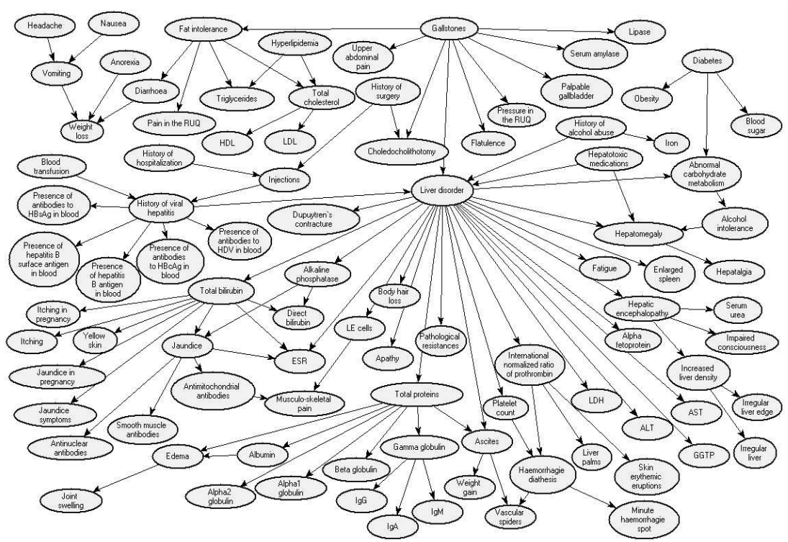
Liver Disorder
Onisko et al CBMI-99-27 (1999)

Slide 33
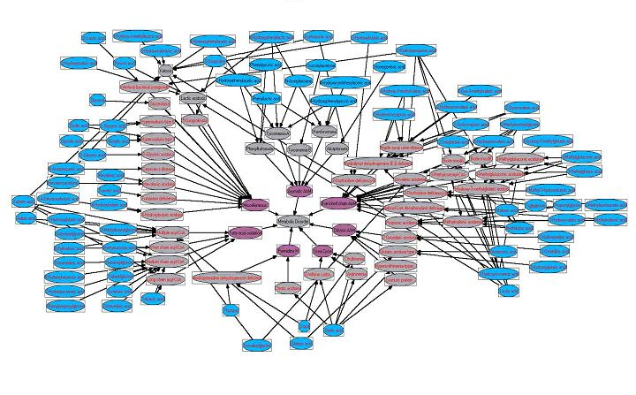
Test for Infant Metabolic Defects
Blue ovals represent chromatographic peaks, grey ovals represent 20 metabolic diseases
Notes:
Logical representation of a Bayesian network for classification of infant metabolic defects from gas chromatographic data.
Blue ovals represent chromatographic peaks, grey ovals represent metabolic diseases and magenta ovals represent biochemical class of disease.
The central grey oval indicates that there is/is not a metabolic defect present from peak data.
Data are classified by loading the chromatographic data into the blue ovals and observing the values in the grey and magenta ovals.
From http://www.udel.edu/chemo/Links/chemo_res.htm

Slide 34





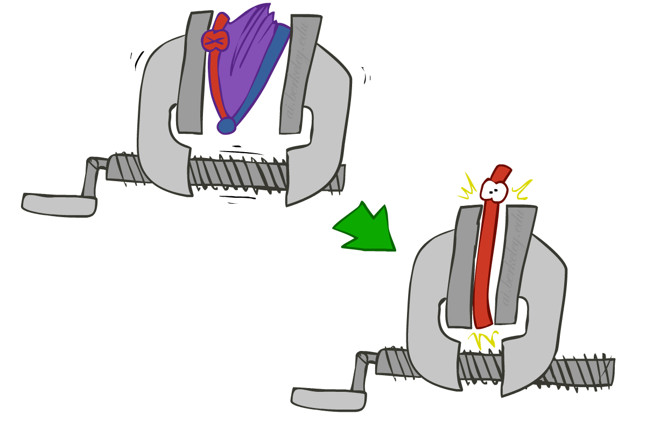
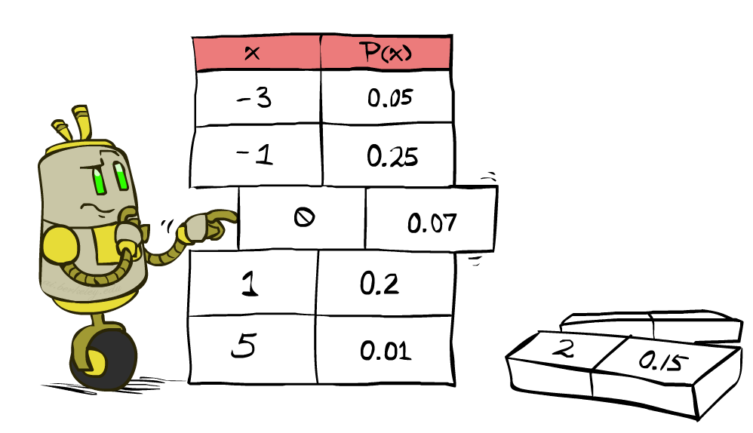


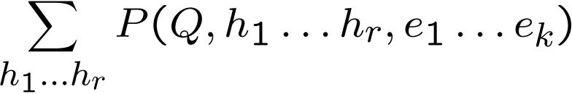
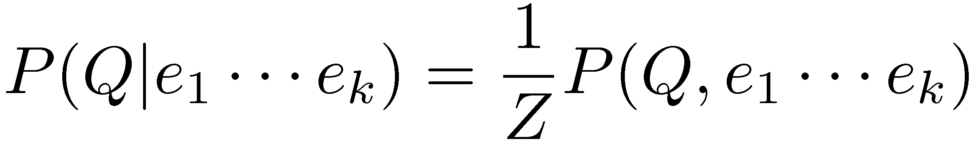
Inference by Enumeration
* Works fine with multiple query variables, too
General case:
  Evidence variables:
  Query* variable:
  Hidden variables:
We want:
All variables
Step 1: Select the entries consistent with the evidence
Step 2: Sum out H to get joint of Query and evidence
Step 3: Normalize

Slide 35
Inference by Enumeration in Bayes’ Net
Given unlimited time, inference in BNs is easy
Reminder of inference by enumeration by example:
B
E
A
J
M

Slide 36
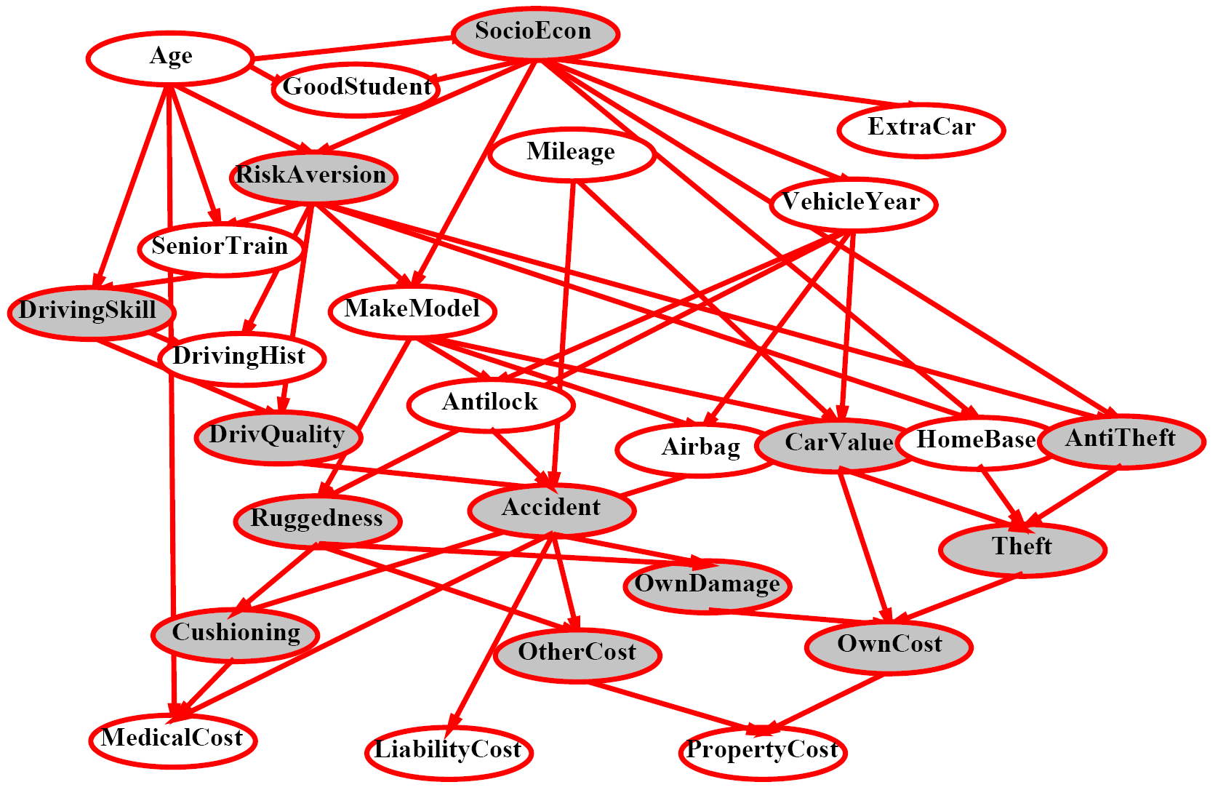
Inference by Enumeration?

Slide 37
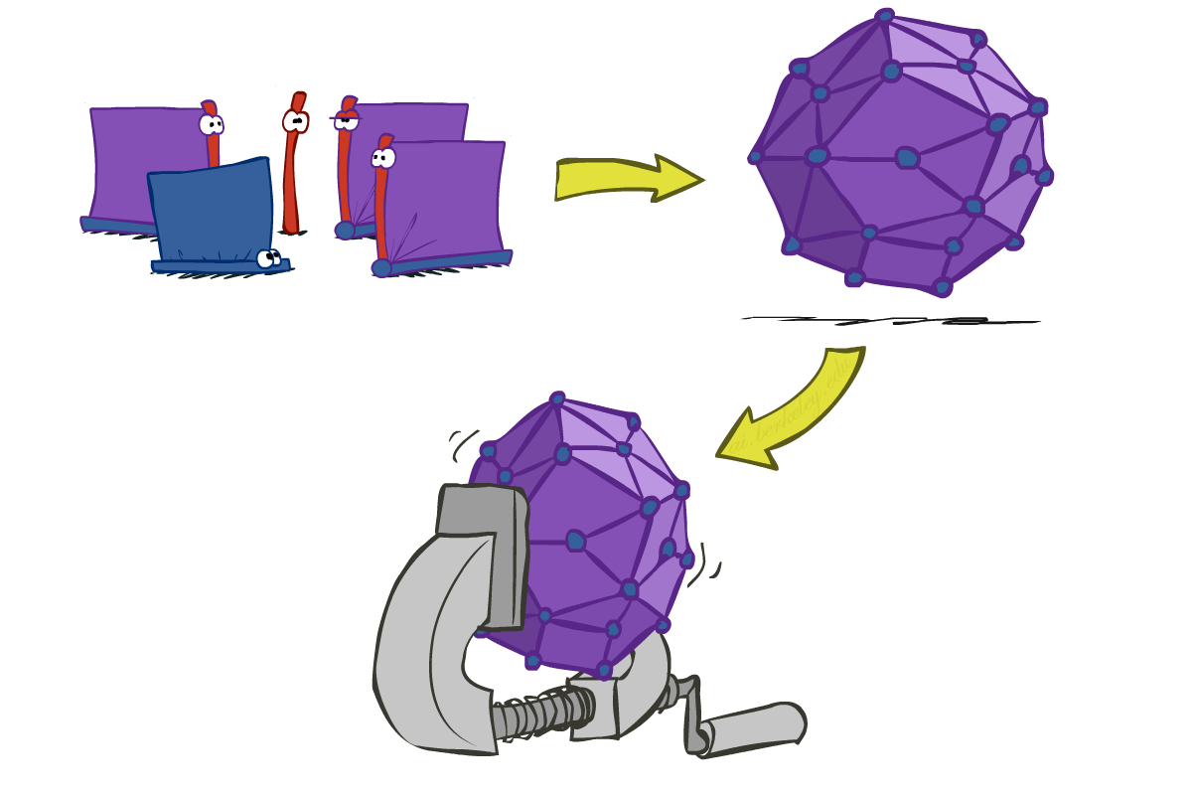
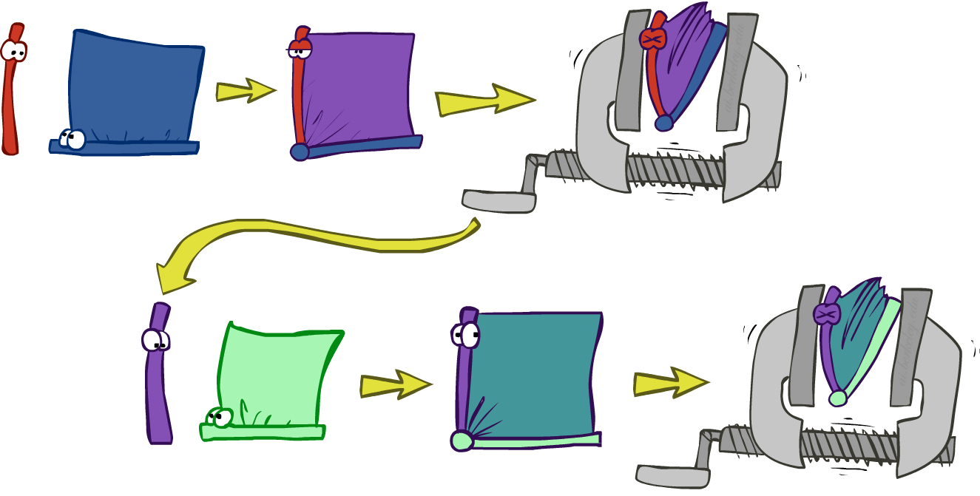
Inference by Enumeration vs. Variable Elimination
Why is inference by enumeration so slow?
  You join up the whole joint distribution before you sum out the hidden variables
Idea: interleave joining and marginalizing!
  Called “Variable Elimination”
  Still NP-hard, but usually much faster than inference by enumeration
  First we’ll need some new notation: factors

Slide 38
Traffic Domain
R
Inference by Enumeration
Variable Elimination
T
L
Join on r
Join on r
Join on t
Eliminate r
Eliminate r
Join on t
Eliminate t
Eliminate t

Slide 39
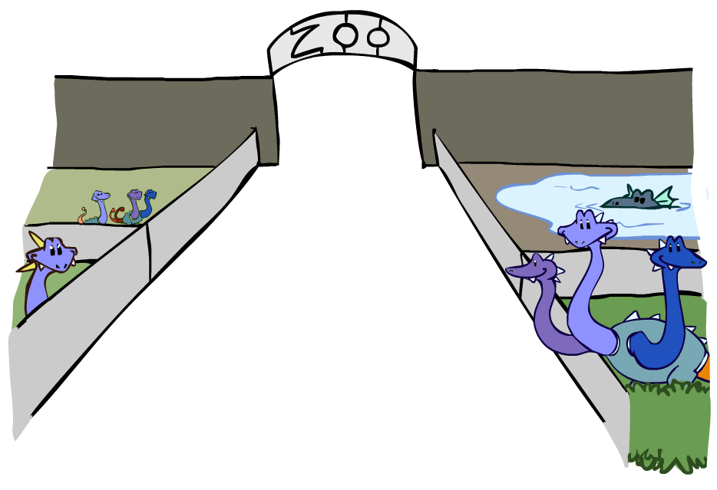
Factor Zoo

Slide 40



Factor Zoo I
Joint distribution: P(X,Y)
  Entries P(x,y) for all x, y
  Sums to 1
Selected joint: P(x,Y)
  A slice of the joint distribution
  Entries P(x,y) for fixed x, all y
  Sums to P(x)
Number of capitals = dimensionality of the table
T | W | P
hot | sun | 0.4
hot | rain | 0.1
cold | sun | 0.2
cold | rain | 0.3
T | W | P
cold | sun | 0.2
cold | rain | 0.3

Slide 41
Factor Zoo I
Two dimensions
sun
rain
T | W | P
hot | sun | 0.4
hot | rain | 0.1
cold | sun | 0.2
cold | rain | 0.3
hot
0.4
0.1
cold
0.2
0.3
One dimension
sun
rain
T | W | P
cold | sun | 0.2
cold | rain | 0.3
cold
0.2
0.3
Number of capitals = dimensionality of the table

Slide 42
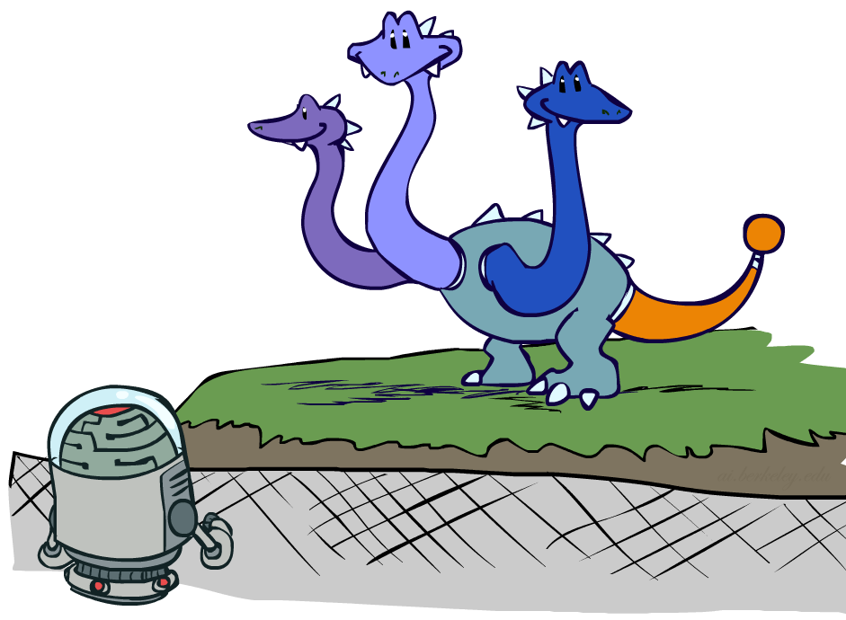

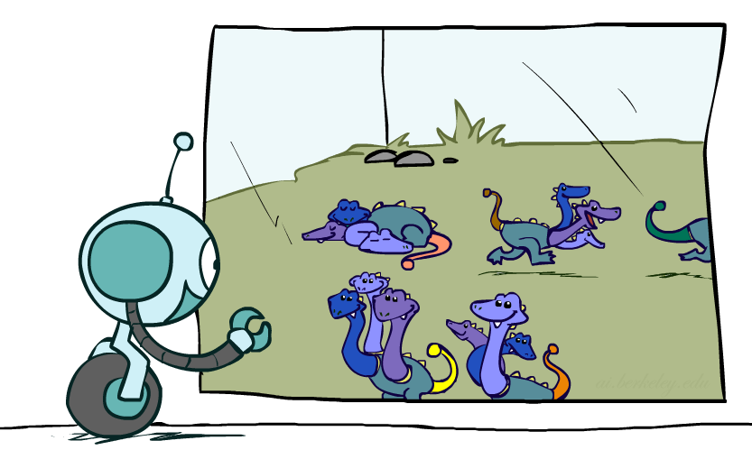



Factor Zoo II
Single conditional: P(Y | x)
  Entries P(y | x) for fixed x, all y
  Sums to 1
Family of conditionals:
P(X |Y)
  Multiple conditionals
  Entries P(x | y) for all x, y
  Sums to |Y|
T | W | P
cold | sun | 0.4
cold | rain | 0.6
T | W | P
hot | sun | 0.8
hot | rain | 0.2
cold | sun | 0.4
cold | rain | 0.6

Slide 43
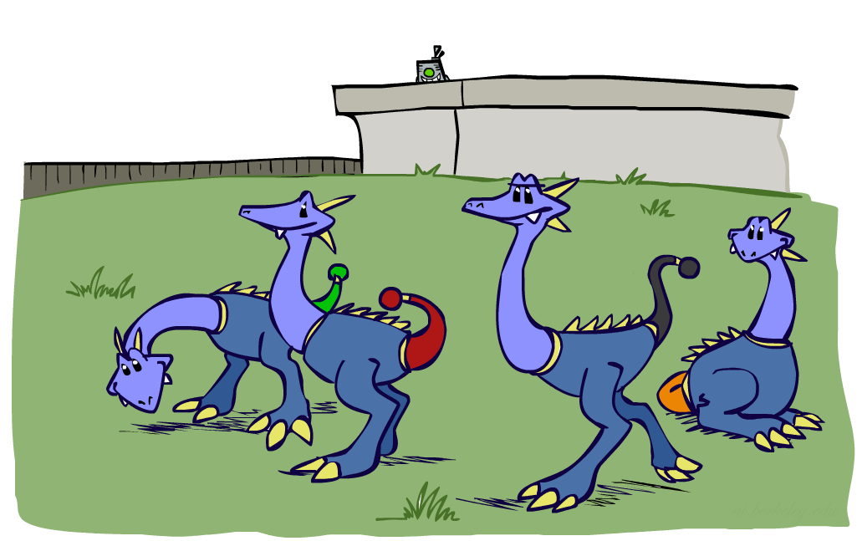



Factor Zoo III
Specified family: P( y | X )
  Entries P(y | x) for fixed y,
  but for all x
  Sums to … who knows!
T | W | P
hot | rain | 0.2
cold | rain | 0.6

Slide 44




Factor Zoo Summary
In general, when we write P(Y₁ … Y_{N} | X₁ … X_{M})
  It is a “factor,” a multi-dimensional array
  Its values are P(y₁ … y_{N} | x₁ … x_{M})
  Any assigned (=lower-case) X or Y is a dimension missing (selected) from the array

Slide 45



Example: Traffic Domain
Random Variables
  R: Raining
  T: Traffic
  L: Late for class!
+r | 0.1
-r | 0.9
R
T
+r | +t | 0.8
+r | -t | 0.2
-r | +t | 0.1
-r | -t | 0.9
L
+t | +l | 0.3
+t | -l | 0.7
-t | +l | 0.1
-t | -l | 0.9
Notes:
Seems like question is better P(+l) not P(L)
Hence sum_rt P®P(t|r)P(+l|t)

Slide 46

Variable Elimination (VE)

Slide 47







Inference by Enumeration: Procedural Outline
Track objects called factors
Initial factors are local CPTs (one per node)
Any known values are selected
  E.g. if we know , the initial factors are
Procedure: Join all factors, then eliminate all hidden variables
+r | 0.1
-r | 0.9
+r | +t | 0.8
+r | -t | 0.2
-r | +t | 0.1
-r | -t | 0.9
+t | +l | 0.3
+t | -l | 0.7
-t | +l | 0.1
-t | -l | 0.9
+r | 0.1
-r | 0.9
+r | +t | 0.8
+r | -t | 0.2
-r | +t | 0.1
-r | -t | 0.9
+t | +l | 0.3
-t | +l | 0.1

Slide 48





Operation 1: Join Factors
First basic operation: joining factors
Combining factors:
  Just like a database join
  Get all factors over the joining variable
  Build a new factor over the union of the variables involved
Example: Join on R
  Computation for each entry: pointwise products
R
+r | 0.1
-r | 0.9
+r | +t | 0.8
+r | -t | 0.2
-r | +t | 0.1
-r | -t | 0.9
+r | +t | 0.08
+r | -t | 0.02
-r | +t | 0.09
-r | -t | 0.81
R,T
T

Slide 49
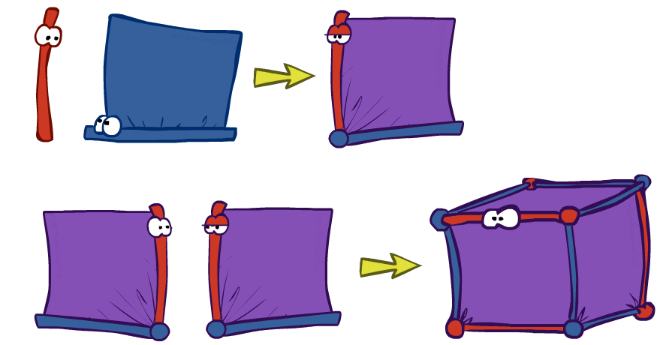
Example: Multiple Joins

Slide 50



Example: Multiple Joins
+r | 0.1
-r | 0.9
R
Join R
Join T
+r | +t | 0.08
+r | -t | 0.02
-r | +t | 0.09
-r | -t | 0.81
R, T, L
T
+r | +t | 0.8
+r | -t | 0.2
-r | +t | 0.1
-r | -t | 0.9
R, T
+r | +t | +l | 0.024
+r | +t | -l | 0.056
+r | -t | +l | 0.002
+r | -t | -l | 0.018
-r | +t | +l | 0.027
-r | +t | -l | 0.063
-r | -t | +l | 0.081
-r | -t | -l | 0.729
L
L
+t | +l | 0.3
+t | -l | 0.7
-t | +l | 0.1
-t | -l | 0.9
+t | +l | 0.3
+t | -l | 0.7
-t | +l | 0.1
-t | -l | 0.9

Slide 51
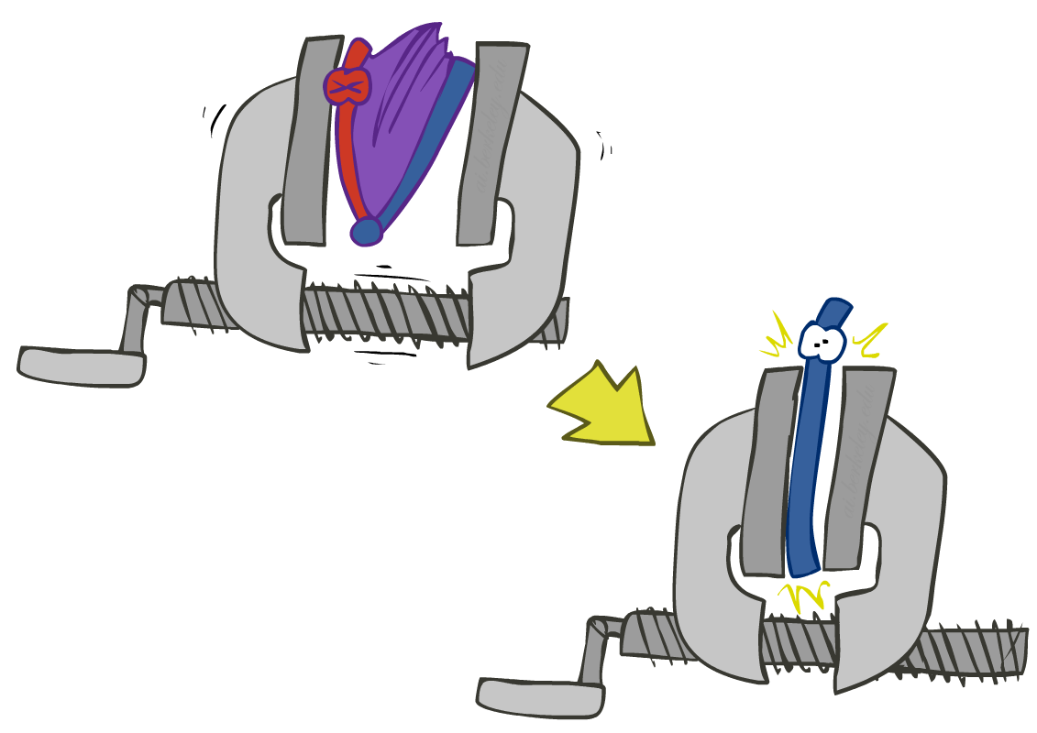


Operation 2: Eliminate
Second basic operation: marginalization
Take a factor and sum out a variable
  Shrinks a factor to a smaller one
  An aggregate/project operation
Example:
R, T
T
+r | +t | 0.08
+r | -t | 0.02
-r | +t | 0.09
-r | -t | 0.81
+t | 0.17
-t | 0.83

Slide 52



Multiple Elimination
R, T, L
T, L
L
+r | +t | +l | 0.024
+r | +t | -l | 0.056
+r | -t | +l | 0.002
+r | -t | -l | 0.018
-r | +t | +l | 0.027
-r | +t | -l | 0.063
-r | -t | +l | 0.081
-r | -t | -l | 0.729
Sum
out R
Sum
out T
+t | +l | 0.051
+t | -l | 0.119
-t | +l | 0.083
-t | -l | 0.747
+l | 0.134
-l | 0.886

Slide 53
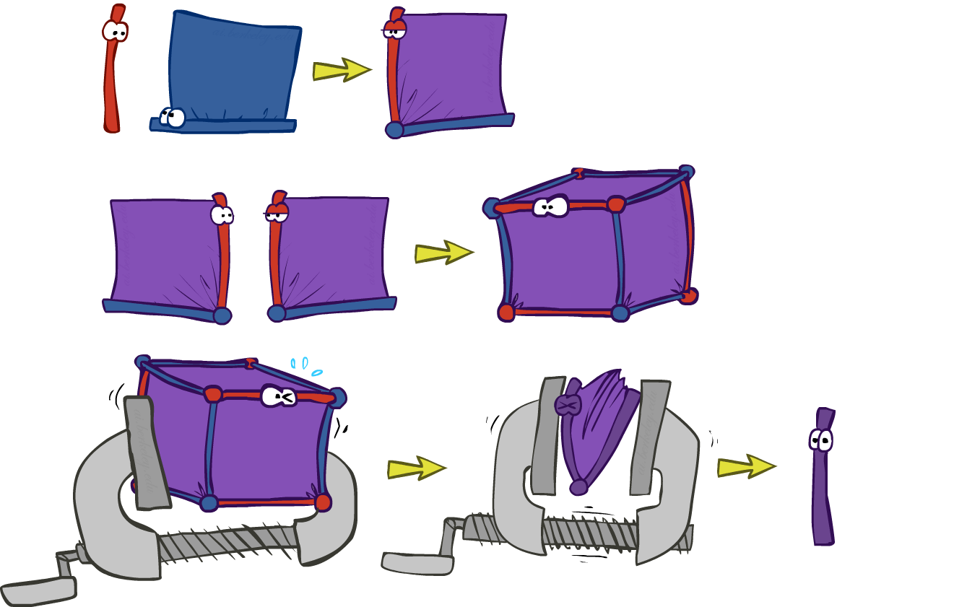
Thus Far: Multiple Join, Multiple Eliminate (= Inference by Enumeration)

Slide 54

Marginalizing Early (= Variable Elimination)

Slide 55
Traffic Domain
R
Inference by Enumeration
Variable Elimination
T
L
Join on r
Join on r
Join on t
Eliminate r
Eliminate r
Join on t
Eliminate t
Eliminate t

Slide 56


Marginalizing Early! (aka VE)
Join R
Sum out R
Join T
Sum out T
+r | +t | 0.08
+r | -t | 0.02
-r | +t | 0.09
-r | -t | 0.81
+r | 0.1
-r | 0.9
+t | 0.17
-t | 0.83
R
T
T, L
R, T
L
+r | +t | 0.8
+r | -t | 0.2
-r | +t | 0.1
-r | -t | 0.9
T
L
L
+t | +l | 0.051
+t | -l | 0.119
-t | +l | 0.083
-t | -l | 0.747
+l | 0.134
-l | 0.866
L
+t | +l | 0.3
+t | -l | 0.7
-t | +l | 0.1
-t | -l | 0.9
+t | +l | 0.3
+t | -l | 0.7
-t | +l | 0.1
-t | -l | 0.9
+t | +l | 0.3
+t | -l | 0.7
-t | +l | 0.1
-t | -l | 0.9
Notes:
No arrow between RT and L, since CPT for T only depends on L

Slide 57
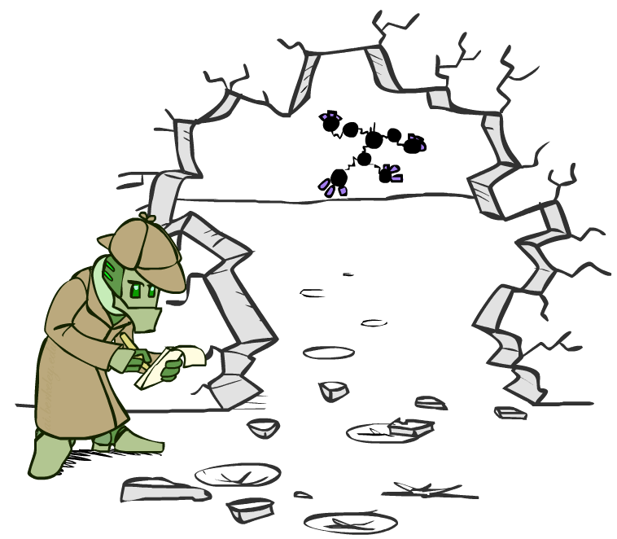



Evidence
If evidence, start with factors that select that evidence
  If there is no evidence, then use these initial factors:
  But if given some evidence, eg +r, then select for it…
  Computing , the initial factors become:
Next do joins & eliminate, removing all vars other than query + evidence
+r | 0.1
-r | 0.9
+r | +t | 0.8
+r | -t | 0.2
-r | +t | 0.1
-r | -t | 0.9
+t | +l | 0.3
+t | -l | 0.7
-t | +l | 0.1
-t | -l | 0.9
+r | 0.1
+r | +t | 0.8
+r | -t | 0.2
+t | +l | 0.3
+t | -l | 0.7
-t | +l | 0.1
-t | -l | 0.9

Slide 58

Evidence II
Result will be a selected joint of query and evidence
  E.g. for P(L | +r), we would end up with:
To get our answer, just normalize this!
That ’s it!
Normalize
+r | +l | 0.026
+r | -l | 0.074
+l | 0.26
-l | 0.74

Slide 59

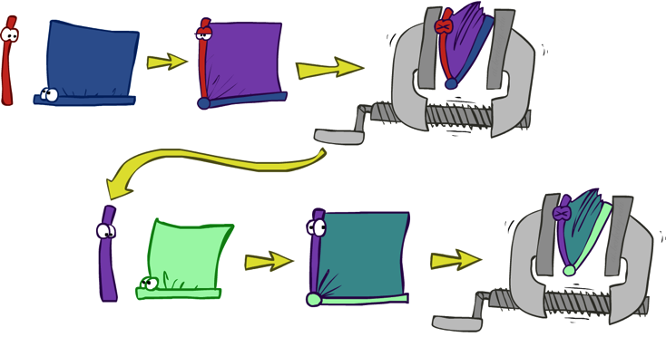


General Variable Elimination
Query:
Start with initial factors:
  Local CPTs (but instantiated by evidence)
While there are still hidden variables (not Q or evidence):
  Choose a hidden variable H
  Join all factors mentioning H
  Eliminate (sum out) H
Join all remaining factors and normalize

Slide 60
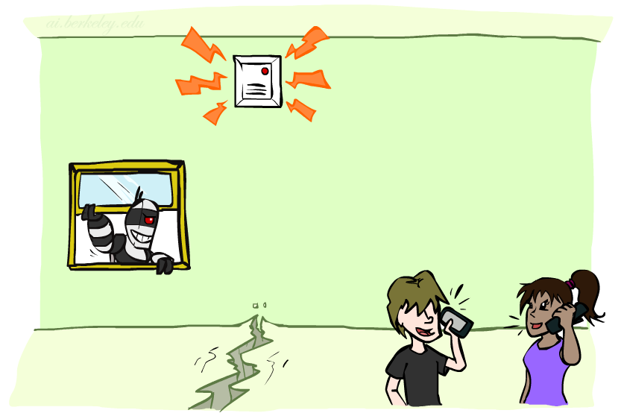
Example: Alarm Network
P(B | j, m) = ?
B | P(B)
+b | 0.001
-b | 0.999
B
E
E | P(E)
+e | 0.002
-e | 0.998
A
B | E | A | P(A|B,E)
+b | +e | +a | 0.95
+b | +e | -a | 0.05
+b | -e | +a | 0.94
+b | -e | -a | 0.06
-b | +e | +a | 0.29
-b | +e | -a | 0.71
-b | -e | +a | 0.001
-b | -e | -a | 0.999
J
M
A | J | P(J|A)
+a | +j | 0.9
+a | -j | 0.1
-a | +j | 0.05
-a | -j | 0.95
A | M | P(M|A)
+a | +m | 0.7
+a | -m | 0.3
-a | +m | 0.01
-a | -m | 0.99
Notes:
demo

Slide 61
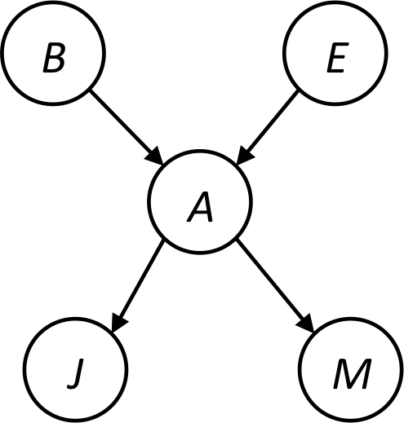









Example
Choose A

Slide 62




Example
Choose E
Finish with B
Normalize

Slide 63





Example 2: P(B|a)
Start / Select
Join on B
Normalize
B
a, B
B | P
+b | 0.1
¬b | 0.9
a
A | B | P
+a | +b | 0.08
+a | ¬b | 0.09
A | B | P
+a | +b | 8/17
+a | ¬b | 9/17
B | A | P
+b | +a | 0.8
b | ¬a | 0.2
¬b | +a | 0.1
¬b | ¬a | 0.9

Slide 64
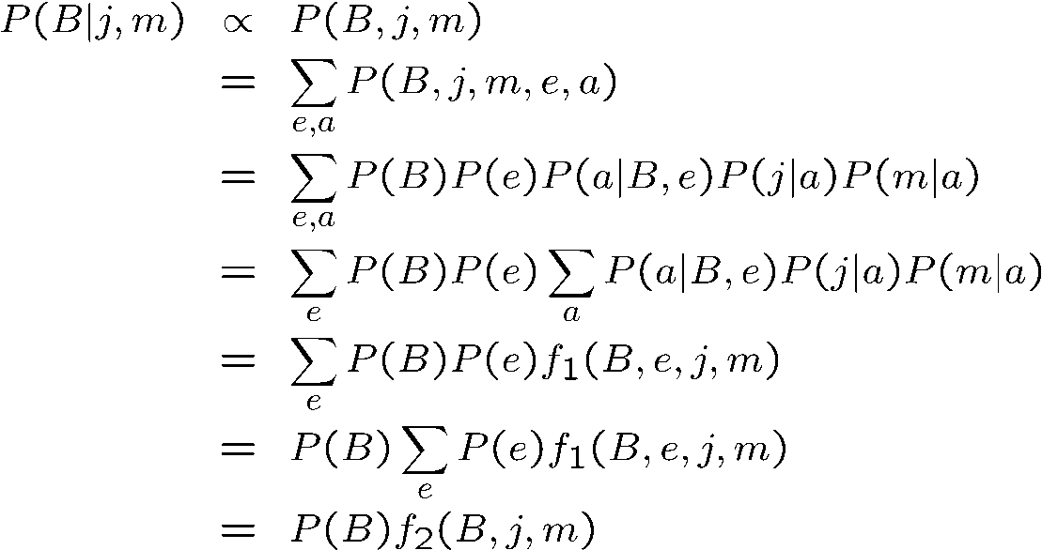
Same Example in Equations
marginal can be obtained from joint by summing out
use Bayes’ net joint distribution expression
use xy + xz= x*(y+z) do sum first
joining on a, and then summing out gives f₁
use xy + xz = x*(y+z) do sum first
joining on e, and then summing out gives f₂
Simple! Exploiting uwy + uwz + uxy + uxz + vwy + vwz + vxy +vxz = (u+v)(w+x)(y+z) to reduce computation

Slide 65
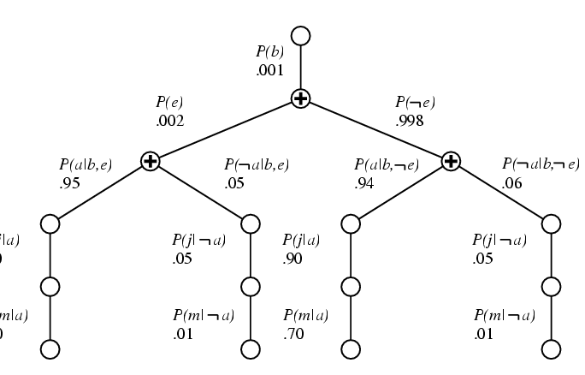

Variable Elimination
P(b|j,m) = αP(b) ΣP(e) ΣP(a|b,e)P(j|a)P(m,a)
e a
© UC Berkeley
Repeated computations ➔ Dynamic Programming

Slide 66
Choices during Variable Elimination
Query:
Start with initial factors:
  Local CPTs (but instantiated by evidence)
While there are still hidden variables (not Q or evidence):
  Choose a hidden variable H
  Join all factors mentioning H
  Eliminate (sum out) H
Join all remaining factors and normalize

Slide 67

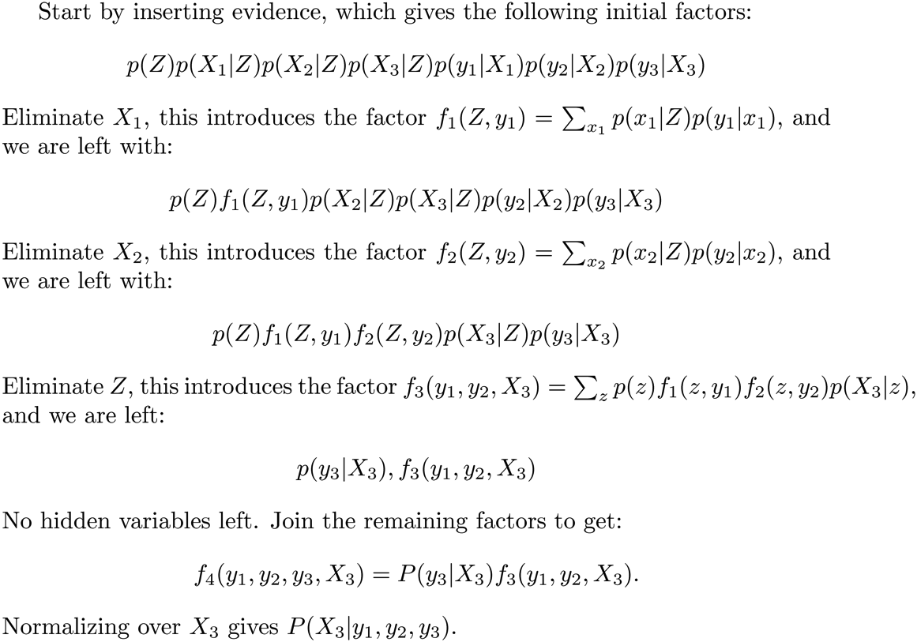






Another Variable Elimination Example
What variables could we eliminate?

Slide 68
Another Variable Elimination Example
What dimension are f₁, f₂ & f₃?
1
Notes:
In example above (assuming binary) all factors generated are of size 2 --- as they all only have one variable (Z, Z, and X₃ respectively).

Slide 69
Another Variable Elimination Example
Alternatively, suppose we start by eliminating Z:
P(X₁ | Z)
P(X₂ | Z)
f_{Z}(X₁, X₂, X₃)
What is the resulting factor?
What dimension is it?
3
P(X₃ | Z)
p(y₁ |X₁)
p(y₂ |X₂)
How many entries?
k³
p(y₃ |X₃)

Slide 70
Another Variable Elimination Example
Computational complexity depends on the largest factor generated by the process.
Size of factor = number of entries in table.

Slide 71




Variable Elimination Ordering
For the query P(X_{n}|y₁,…,y_{n}) work through the following two different orderings as done in previous slide: Z, X₁, …, X_{n-1} and X₁, …, X_{n-1}, Z. What is the size of the maximum factor generated for each of the orderings?
Answer: 2^{n+1} versus 2² (assuming binary)
In general: the ordering can greatly affect efficiency.
…
…

Slide 72
VE: Computational and Space Complexity
The computational and space complexity of variable elimination is determined by the largest factor
The elimination ordering can greatly affect the size of the largest factor.
  E.g., previous slide’s example 2^{n} vs. 2
Does there always exist an ordering that only results in small factors?
  No!

Slide 73















Worst Case Complexity?
CSP:
If we can answer P(z) equal to zero or not, we answered whether the 3-SAT problem has a solution.
Hence inference in Bayes’ nets is NP-hard. No known efficient probabilistic inference in general.
…
…

Slide 74
Polytrees
A polytree is a directed graph with no undirected cycles
  I.e. a tree (or forest) with multiple roots
For poly-trees you can always find an ordering that is efficient
  Try it!!
Cut-set conditioning for Bayes’ net inference
  Choose set of variables such that if removed only a polytree remains
  Exercise: Think about how the specifics would work out!
Not a poly tree!
Yes! poly tree!

Slide 75
A set of nodes, C, is a loop cutset, if removing C yields a polytree
Finding smallest loop cutset is NP hard
Figure from Jinbo Huang http://users.cecs.anu.edu.au/~jinbo/pr/lecture03.pdf
Notes:
Complexity O(n exp(k))O(exp(s)) = O(n exp(k + s)) where s = |loop cutset| and k = max number of parents of any node

Slide 76

Bayes’ Nets
Representation
Conditional Independences
Probabilistic Inference
  Enumeration (exact, exponential complexity)
  Variable elimination (exact, worst-case exponential complexity, often better)
  Inference is NP-complete
  Sampling (approximate)
Learning Bayes’ Nets from Data

Slide 77
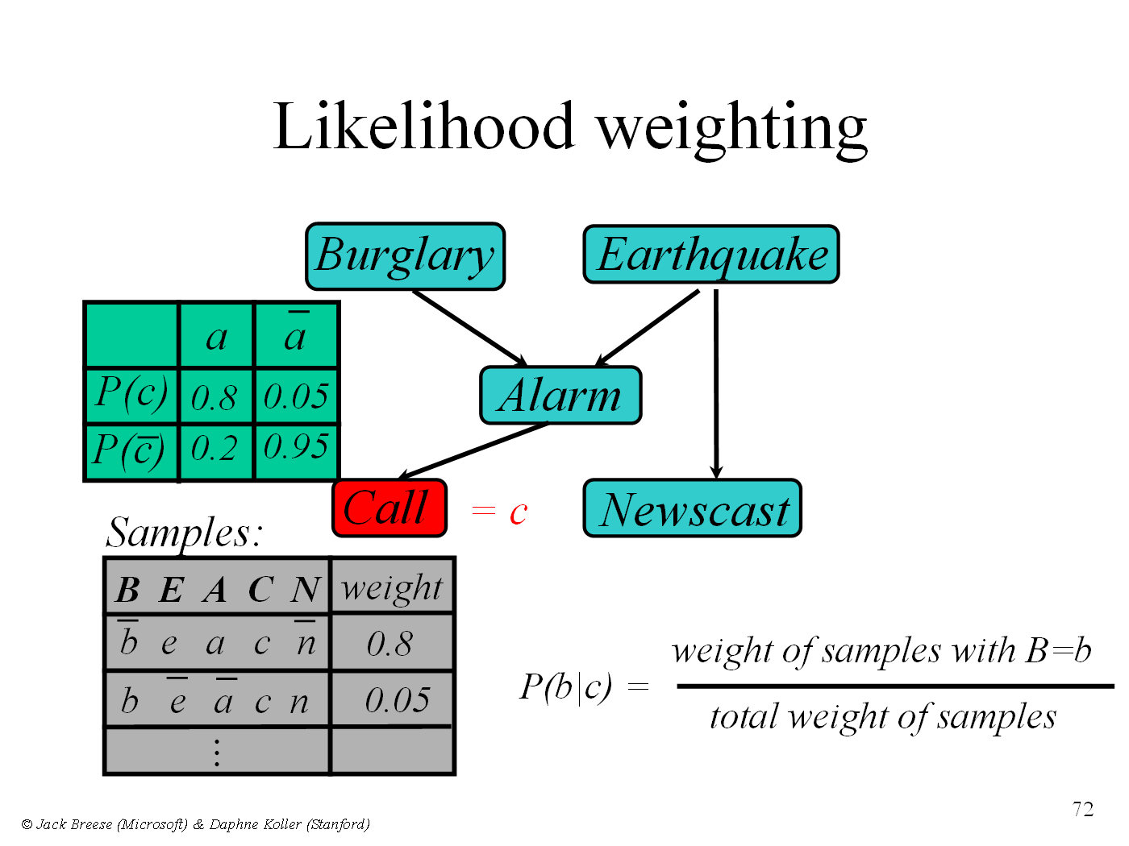
P(B|C)

Slide 78
Conditional Independence: Active / Inactive Paths
Question: Are X and Y conditionally independent given evidence variables {Z}?
  Yes, if X and Y “d-separated” by Z
  Consider all (undirected) paths from X to Y
  No active paths = independence!
A path is active if each triple in path is active:
  Causal chain A → B → C where B is unobserved (either direction)
  Common cause A ← B → C where B is unobserved
  Common effect (aka v-structure)
  A → B ← C where B or one of its descendants is observed
All it takes to block a path is a single inactive segment
If all paths are inactive == conditional independence
Active Triples
Inactive Triples
X
Y
X
Y
X
Y
X
Y
X
Y
X
Y
X
Y
Shaded means
Observed

Slide 79
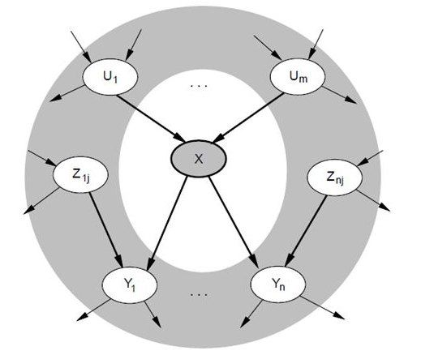
Markov Blanket
Markov Blanket (X) = Parents(X) ∪ Children(x) ∪Parents(Children(X))

Slide 80
MCMC with Gibbs Sampling
Fix the values of observed variables
Set the values of all non-observed variables randomly
Perform a random walk through the space of complete variable assignments. On each move:
  Pick a variable X
  Calculate Pr(X=true | Markov blanket)
  Set X to true with that probability
Repeat many times.
Frequency with which any variable X is true is it’s posterior probability.
Converges to true posterior when frequencies stop changing significantly
  stable distribution, mixing

Slide 81
Example
See https://www.youtube.com/watch?v=a_08GKWHFWo
  Starting at 4:30 they give an example (animation) for the case of a bivariate normal. The probability distribution is continuous, but it still illustrates the idea

