Slide 1

CSE 473: Artificial Intelligence
Bayes’ Nets: D-Separation
Daniel Weld
[Most slides were created by Dan Klein and Pieter Abbeel for CS188 Intro to AI at UC Berkeley. All CS188 materials are available at http://ai.berkeley.edu.]
Notes:
Please retain proper attribution, including the reference to ai.berkeley.edu. Thanks!

Slide 2


Bayes’ Nets: Big Picture
Two problems with using full joint distribution tables as our probabilistic models:
  Unless there are only a few variables, the joint is WAY too big to represent explicitly
  Hard to learn (estimate) anything empirically about more than a few variables at a time
Bayes’ nets: a technique for describing complex joint distributions (models) using simple, local distributions (conditional probabilities)
  More properly … aka probabilistic graphical model
  We describe how variables locally interact
  Local interactions chain together to give global, indirect interactions
  For about 10 min, we’ll be vague about how these interactions are specified

Slide 3
Example Bayes’ Net: Car

Slide 4
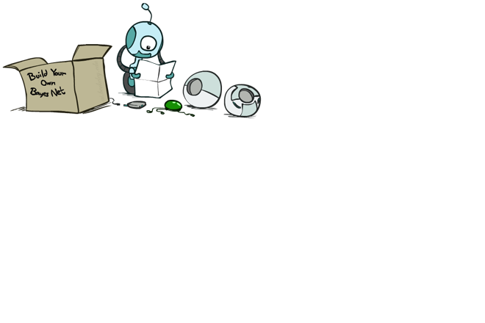
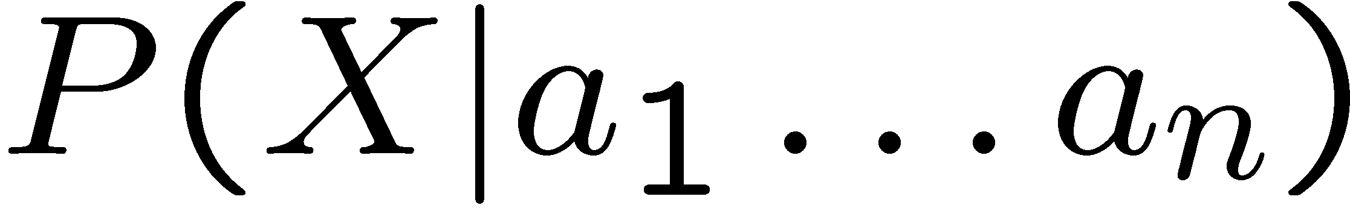
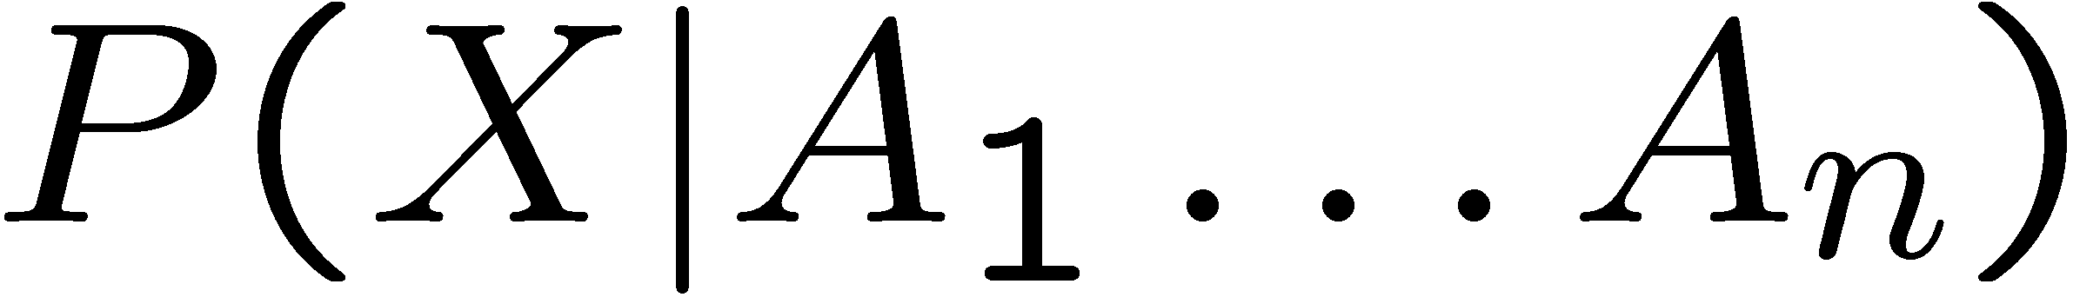
Bayes’ Net Semantics
A set of nodes, one per variable X
A directed, acyclic graph
A conditional distribution for each node
  A collection of distributions over X, one for each combination of parents’ values
  CPT: conditional probability table
  Description of a noisy “causal” process
P(A₁ ) …. P(A_{n} )
A₁
A_{n}
X
A Bayes net = Topology (graph) + Local Conditional Probabilities

Slide 5
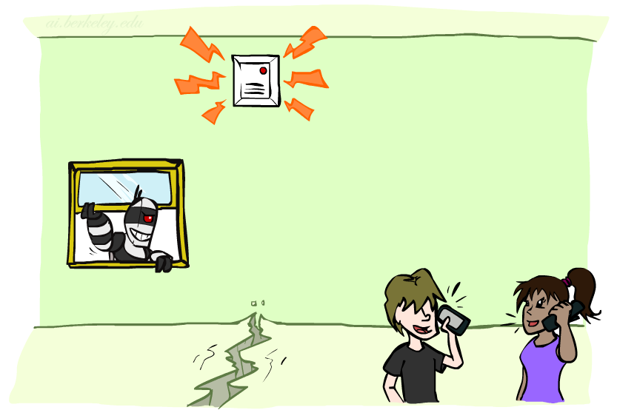
Example: Alarm Network
B | P(B)
+b | 0.001
-b | 0.999
E | P(E)
+e | 0.002
-e | 0.998
Burglary
Earthqk
Alarm
B | E | A | P(A|B,E)
+b | +e | +a | 0.95
+b | +e | -a | 0.05
+b | -e | +a | 0.94
+b | -e | -a | 0.06
-b | +e | +a | 0.29
-b | +e | -a | 0.71
-b | -e | +a | 0.001
-b | -e | -a | 0.999
John calls
Mary calls
A | J | P(J|A)
+a | +j | 0.9
+a | -j | 0.1
-a | +j | 0.05
-a | -j | 0.95
A | M | P(M|A)
+a | +m | 0.7
+a | -m | 0.3
-a | +m | 0.01
-a | -m | 0.99
Notes:
demo

Slide 6

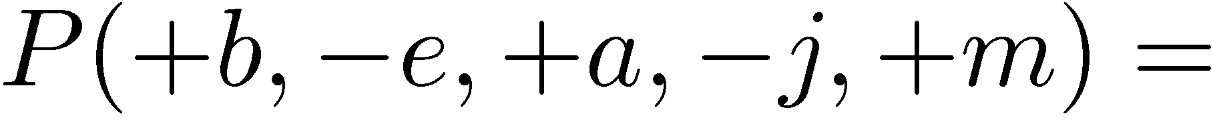
Example: Alarm Network
B | P(B)
+b | 0.001
-b | 0.999
B
E
E | P(E)
+e | 0.002
-e | 0.998
A
A | J | P(J|A)
+a | +j | 0.9
+a | -j | 0.1
-a | +j | 0.05
-a | -j | 0.95
A | M | P(M|A)
+a | +m | 0.7
+a | -m | 0.3
-a | +m | 0.01
-a | -m | 0.99
B | E | A | P(A|B,E)
+b | +e | +a | 0.95
+b | +e | -a | 0.05
+b | -e | +a | 0.94
+b | -e | -a | 0.06
-b | +e | +a | 0.29
-b | +e | -a | 0.71
-b | -e | +a | 0.001
-b | -e | -a | 0.999
J
M
Notes:
demo

Slide 7
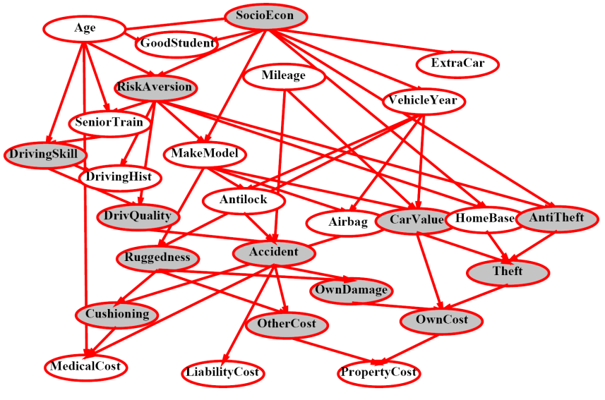
What’s Next with Bayes’ Nets
Questions we can ask:
  Definition: P(X = x)
  Representation: given a BN graph, what kinds of distributions can it encode?
  Modeling: what BN is most appropriate for a given domain?
  Inference: given a fixed BN, what is P(X | e)?
  Learning: Given data, what is best BN encoding?

Slide 8

Remember….
X, Y independent if and only if:
X and Y are conditionally independent given Z: if and only if:

Slide 9
Conditional Independence in a BN
Important question about a BN:
  Are two nodes independent given certain evidence?
  If yes, must prove using algebra (tedious in general)
  If no, can prove with a counter example (including CPTs)
  For example:
  Question 1: are X and Z necessarily independent?
    Answer: NO. Example: low pressure causes rain, which causes traffic.
    Information about X may change our belief in Z (via Y)
    Similarly, info about Z may change our belief in X
P(Y|X) = 1
P(Y|#X) = 1
P(Z|Y) = .5
P(Z|#Y) = .5
Note: one can change the CPTs so they are independent, but that’s not enough for proof
P(X) = .9
X
Y
Z

Slide 10
Conditional Independence in a BN
Important question about a BN:
  Are two nodes independent given certain evidence?
  If yes, can prove using algebra (tedious in general)
  If no, can prove with a counter example
  For example:
  Question 1: are X and Z necessarily independent?
    Answer: no.
  Question 2: are X and Z conditionally independent, given Y?
    Answer: yes, as we’ll see
X
Y
Z

Slide 11
Conditional Independence in a BN
B
E
Harder case:
  Question 3: are B and M conditionally independent, given J?
A
J
M

Slide 12
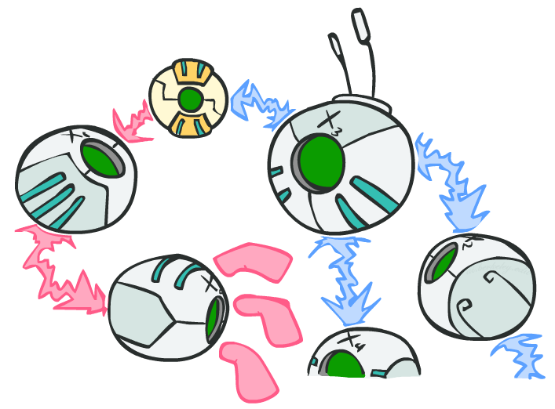
D-separation

Slide 13
D-separation: Outline
Study independence properties for subgraphs
  (connected triples)
Analyze complex cases in terms of triples along paths between vars
D-separation: a condition / algorithm for answering such queries

Slide 14
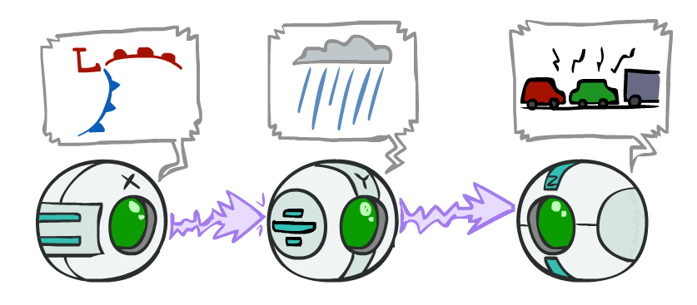
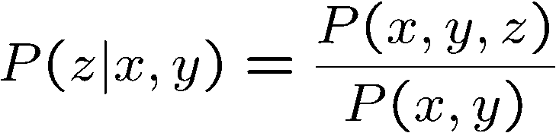
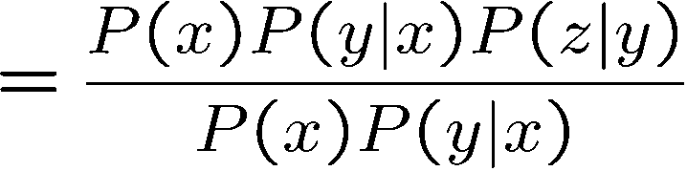

Causal Chains
This configuration is a “causal chain”
Guaranteed X independent of Z given Y?
  Evidence along the chain “blocks” the influence (makes “inactive”)
X: Low pressure Y: Rain Z: Traffic
Yes!

Slide 15
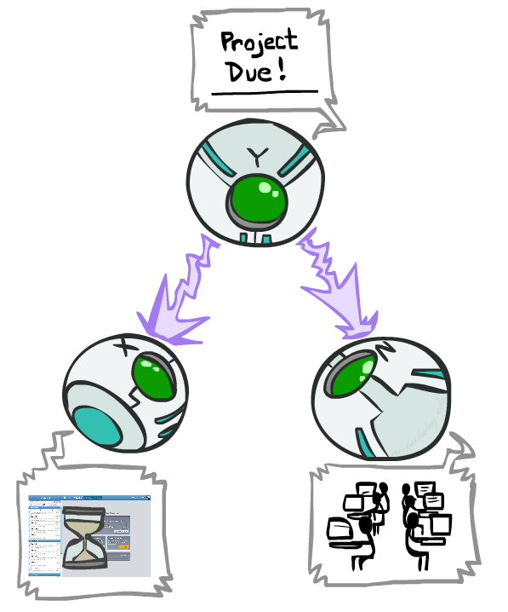
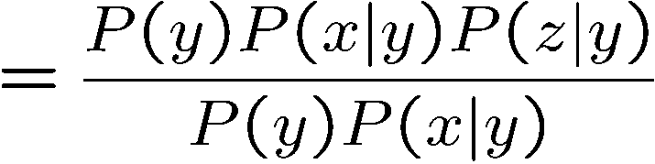
Common Cause
This configuration is a “common cause”
Guaranteed X and Z independent given Y?
  Observing the cause blocks influence between effects. (makes inactive)
Y: Project due
X: Forums busy
Z: Lab full
Yes!

Slide 16
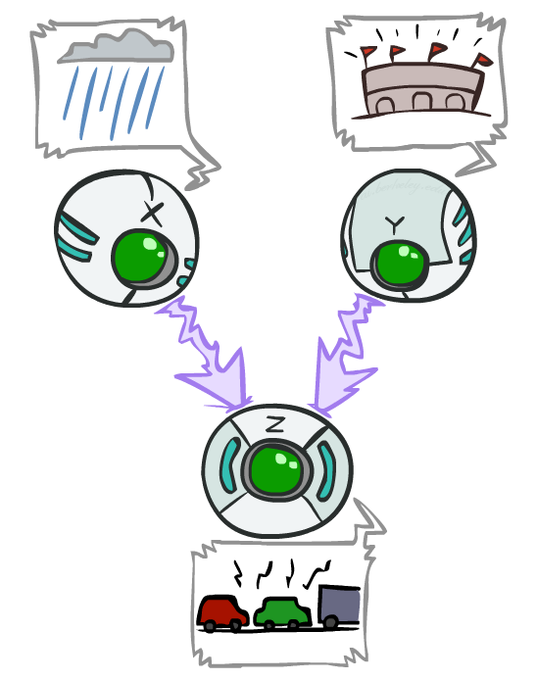
Common Effect
Last configuration: two causes of one effect (v-structures)
Are X and Y independent?
  Yes: the ballgame and the rain cause traffic, but they are not correlated
  Still need to prove they must be (try it!)
Are X and Y independent given Z?
  No: seeing traffic puts the rain and the ballgame in competition as explanation.
This is backwards from the other cases
  Observing an effect activates influence between possible causes. (makes active!)
X: Raining
Y: Ballgame
Z: Traffic

Slide 17
Common Effect
X | Y | Z | P
T | T | T | 0.076
T | T | F | 0.004
T | F | T | 0.576
T | F | F | 0.144
F | T | T | 0.162
F | T | F | 0.002
F | F | T | 0.090
F | F | F | 0.009
P(X) = 0.8
P(Y) = 0.1
X: Raining
Y: Ballgame
X | Y | P(Z)
T | T | 0.95
T | F | 0.8
F | T | 0.9
F | F | 0.5
Z: Traffic

Slide 18
Common Effect
X | Y | Z | P
T | T | T | 0.076
T | T | F | 0.004
T | F | T | 0.576
T | F | F | 0.144
F | T | T | 0.162
F | T | F | 0.002
F | F | T | 0.090
F | F | F | 0.009
P(X) = 0.8
P(Y) = 0.1
X: Raining
Y: Ballgame
X | Y | P(Z)
T | T | 0.95
T | F | 0.8
F | T | 0.9
F | F | 0.5
Z: Traffic

Slide 19
Common Effect
X | Y | Z | P
T | T | T | 0.076
T | T | F | 0.004
T | F | T | 0.576
T | F | F | 0.144
F | T | T | 0.018
F | T | F | 0.002
F | F | T | 0.090
F | F | F | 0.009
P(X) = 0.8
P(Y) = 0.1
X: Raining
Y: Ballgame
X | Y | P(Z)
T | T | 0.95
T | F | 0.8
F | T | 0.9
F | F | 0.5
P(X|Y) =
= 0.08 / 0.1
= 0.8
0.076+0.004
0.076+0.004+0.018+0.002
Z: Traffic

Slide 20
But Suppose Also Know Z=T
X | Y | Z | P
T | T | T | 0.076
T | T | F | 0.004
T | F | T | 0.576
T | F | F | 0.144
F | T | T | 0.018
F | T | F | 0.002
F | F | T | 0.090
F | F | F | 0.009
P(X) = 0.8
P(Y) = 0.1
X: Raining
Y: Ballgame
P(X|Z) = .076+.576
.076+.576+.018+.090
= 0.652/0.76
= 0.858
X | Y | P(Z)
T | T | 0.95
T | F | 0.8
F | T | 0.9
F | F | 0.5
P(X|Y,Z) =
= 0.8085
0.076
0.076+ 0.018
Z: Traffic

Slide 21
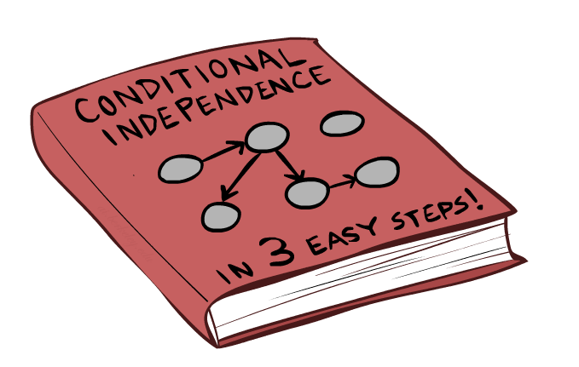
The General Case

Slide 22
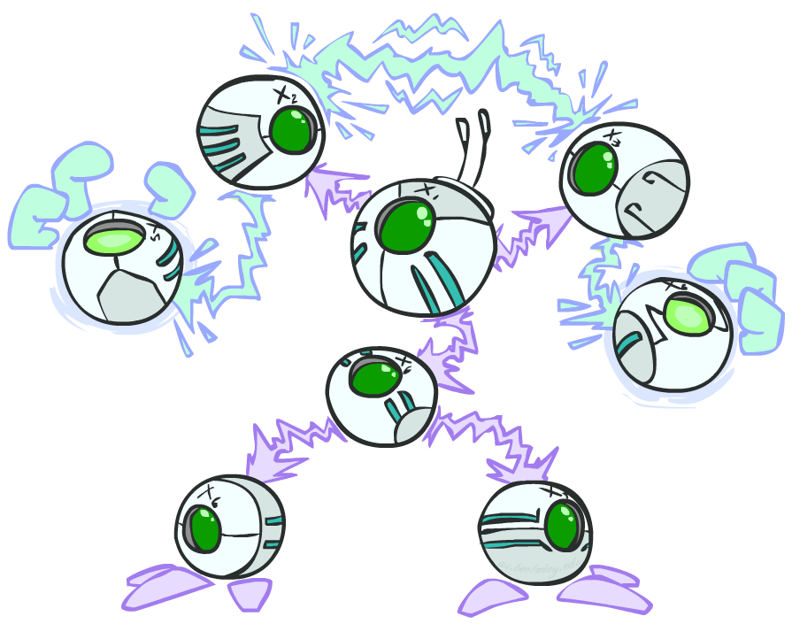
The General Case
General question: in a given BN, are two variables independent (given evidence)?
Solution: analyze the graph
Any complex example can be broken
into repetitions of the three canonical cases

Slide 23

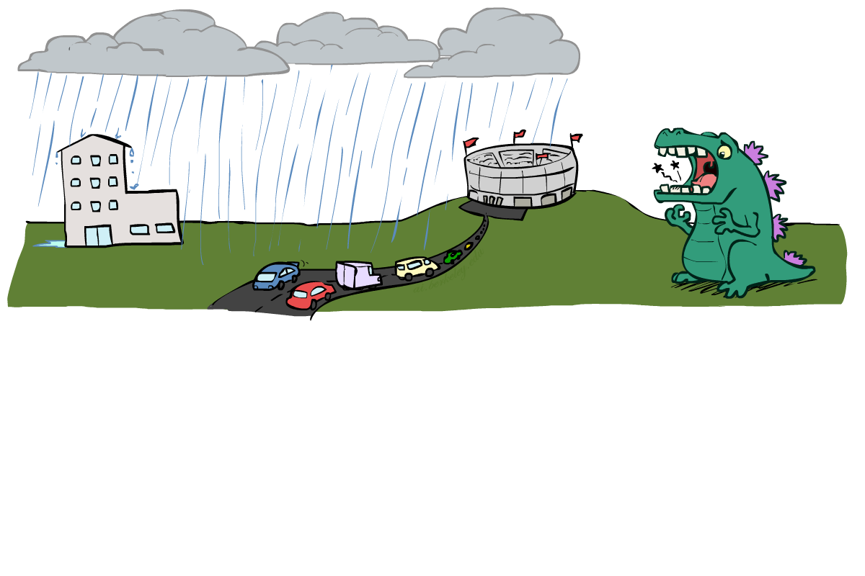
Reachability
L
Recipe: shade evidence nodes, look for paths in the resulting graph
Attempt 1: if two nodes are connected by an undirected path not blocked by a shaded node, they are conditionally independent
Almost works, but not quite
  Where does it break?
  Answer: the v-structure at T doesn’t count as a link in a path unless “active”
R
B
D
T

Slide 24
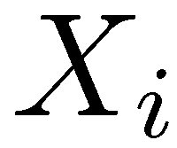
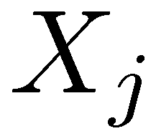

D-Separation
?
Query:
Check all (undirected!) paths between and
  If one or more paths is active, then independence not guaranteed
  Otherwise (i.e. if all paths are inactive),
  then “D-separated” = independence is guaranteed

Slide 25
Active / Inactive Paths
Question: Are X and Y conditionally independent given evidence variables {Z}?
  Yes, if X and Y “d-separated” by Z
  Consider all (undirected) paths from X to Y
  If no path is active → independence!
A path is active if every triple in path is active:
  Causal chain A → B → C where B is unobserved (either direction)
  Common cause A ← B → C where B is unobserved
  Common effect (aka v-structure)
  A → B ← C where B or one of its descendants is observed
All it takes to block a path is a single inactive segment
  (But all paths must be inactive)
Active Triples
Inactive Triples
X
Y
X
Y
X
Y
X
Y
X
Y
X
Y
X
Y
Shaded means observed
We only care about the middle

Slide 26

Example
Query:
Yes – Independent. T makes the path whole inactive
R
X
T
B
X
Y
Active
X
Y
Inactive

Slide 27

Example
Active Triples
Inactive Triples
X
Y
X
Y
Yes, Independent!
R
B
X
Y
X
Y
X
Y
X
Y
T
X
Y
T’
Notes:
T’: traffic report

Slide 28
Example
Active Triples
Inactive Triples
X
Y
X
Y
Yes, Independent!
R
B
X
Y
X
Y
No
X
Y
X
Y
T
X
Y
T’
Notes:
T’: traffic report

Slide 29
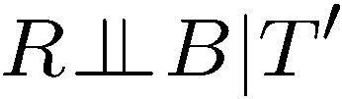
Example
Active Triples
Inactive Triples
X
Y
X
Y
Yes, Independent!
R
B
X
Y
X
Y
No
X
Y
X
Y
T
X
Y
No
T’
Notes:
T’: traffic report

Slide 30
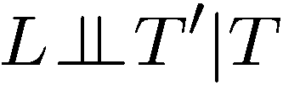
Example
Active Triples
Inactive Triples
L
Yes, Independent
X
Y
X
Y
X
Y
X
Y
R
B
X
Y
X
Y
X
Y
D
T
T’

Slide 31

Example
Active Triples
Inactive Triples
L
Yes, Independent
X
Y
X
Y
Yes, Independent
X
Y
X
Y
R
B
X
Y
X
Y
X
Y
D
T
T’

Slide 32

Example
Active Triples
Inactive Triples
L
Yes, Independent
X
Y
X
Y
Yes, Independent
X
Y
X
Y
R
B
No
X
Y
X
Y
X
Y
D
T
T’

Slide 33
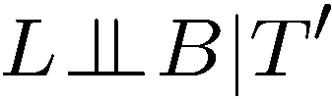
Example
Active Triples
Inactive Triples
L
Yes, Independent
X
Y
X
Y
Yes, Independent
X
Y
X
Y
R
B
No
X
Y
X
Y
X
Y
No
D
T
T’

Slide 34

Example
Active Triples
Inactive Triples
L
Yes, Independent
X
Y
X
Y
Yes, Independent
X
Y
X
Y
R
B
No
X
Y
X
Y
X
Y
No
D
T
Yes, Independent
T’

Slide 35
Example
Active Triples
Inactive Triples
L
Yes, Independent
X
Y
X
Y
Yes, Independent
X
Y
X
Y
R
B
No
X
Y
X
Y
X
Y
No
D
T
Yes, Independent
R T’ | L, B
No
T’

Slide 36

Example
Variables:
  R: Raining
  T: Traffic
  D: Roof drips
  S: I’m sad
Questions:
Active Triples
Inactive Triples
X
Y
X
Y
R
X
Y
X
Y
X
Y
X
Y
T
D
X
Y
S
No

Slide 37

Example
Variables:
  R: Raining
  T: Traffic
  D: Roof drips
  S: I’m sad
Questions:
Active Triples
Inactive Triples
X
Y
X
Y
R
X
Y
X
Y
X
Y
X
Y
T
D
X
Y
S
No
Yes, Independent

Slide 38

Example
Variables:
  R: Raining
  T: Traffic
  D: Roof drips
  S: I’m sad
Questions:
Active Triples
Inactive Triples
X
Y
X
Y
R
X
Y
X
Y
X
Y
X
Y
T
D
X
Y
S
No
Yes, Independent
No

Slide 39
Two Degenerate Cases
Unconnected → Always Independent
There are no paths between R and D, so definitely no active paths)
R
D

Slide 40
Two Degenerate Cases
Directly connected → Dependent (for some values of the CPT)
R
D

Slide 41

Structure Implications
Given a Bayes net structure, can run d-separation algorithm to build a complete list of conditional independences that are necessarily true of the form
This list determines the set of probability distributions that can be represented

Slide 42

Computing All Independences
Y
X
Z
Y
X
Z
X
Z
Y
Y
X
Z

Slide 43
Topology Limits Distributions
Given some graph topology G, only certain joint distributions can be encoded
The graph structure guarantees certain (conditional) independences
(There might be more independence)
Adding arcs increases the set of distributions, but has several costs
Full conditioning can encode any distribution
Y
Y
X
Z
X
Z
Y
X
Z
Y
X
Z
Y
Y
Y
X
Z
X
Z
X
Z
Y
Y
Y
X
Z
X
Z
X
Z

Slide 44
Bayes Nets Representation Summary
Bayes nets compactly encode joint distributions
Guaranteed independencies of distributions can be deduced from BN graph structure
D-separation gives precise conditional independence guarantees from graph alone
A Bayes’ net’s joint distribution may have further (conditional) independence that is not detectable until you inspect its specific distribution

Slide 45

Bayes’ Nets
Representation
Conditional Independences
Probabilistic Inference
  Enumeration (exact, exponential complexity)
  Variable elimination (exact, worst-case
  exponential complexity, often better)
  Probabilistic inference is NP-complete
  Sampling (approximate)
Learning Bayes’ Nets from Data

Slide 46

Inference
Inference: calculating some useful quantity from a joint probability distribution
Examples:
  Posterior probability
  Most likely explanation:

Slide 47
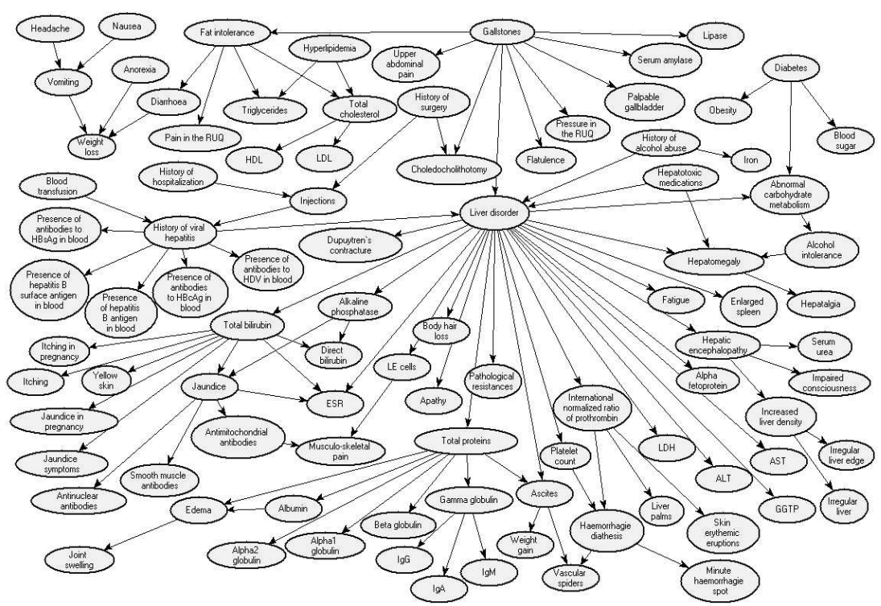
Liver Disorder
Onisko et al CBMI-99-27 (1999)

Slide 48





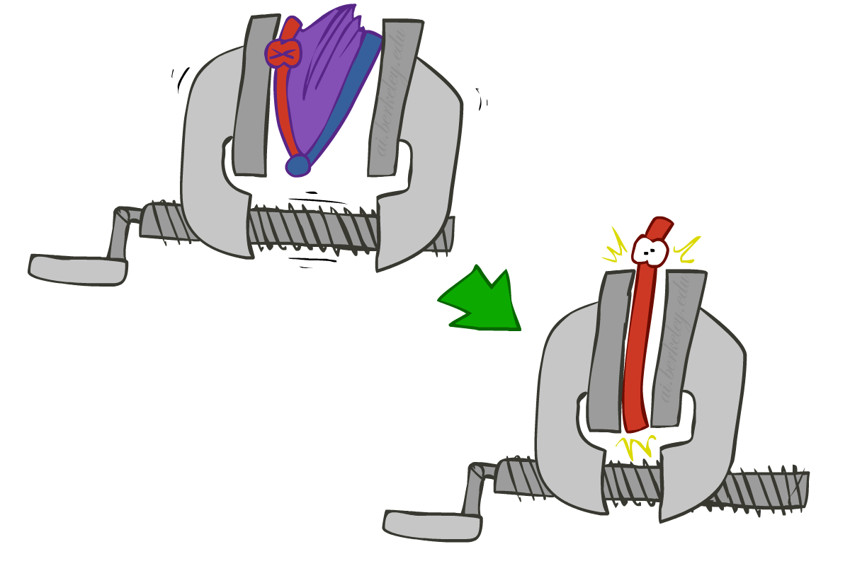
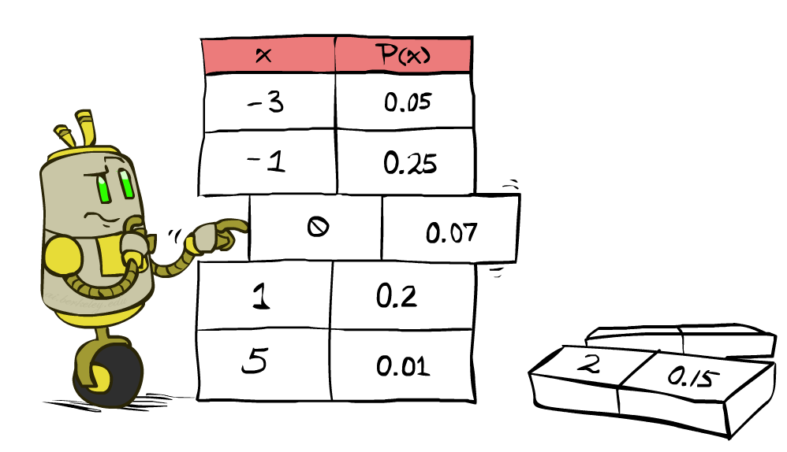


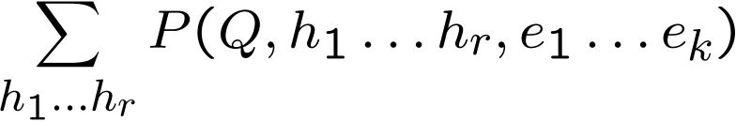
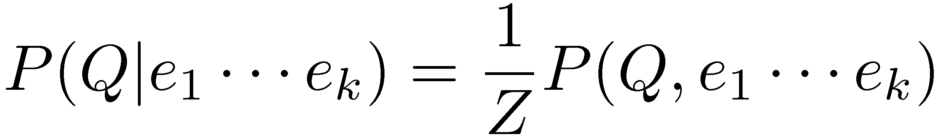
Inference by Enumeration
* Works fine with multiple query variables, too
General case:
  Evidence variables:
  Query* variable:
  Hidden variables:
We want:
All variables
Step 1: Select the entries consistent with the evidence
Step 2: Sum out H to get joint of Query and evidence
Step 3: Normalize

Slide 49
Inference by Enumeration in Bayes’ Net
Given unlimited time, inference in BNs is easy
Reminder of inference by enumeration by example:
B
E
A
J
M

Slide 50

Inference by Enumeration?

Slide 51
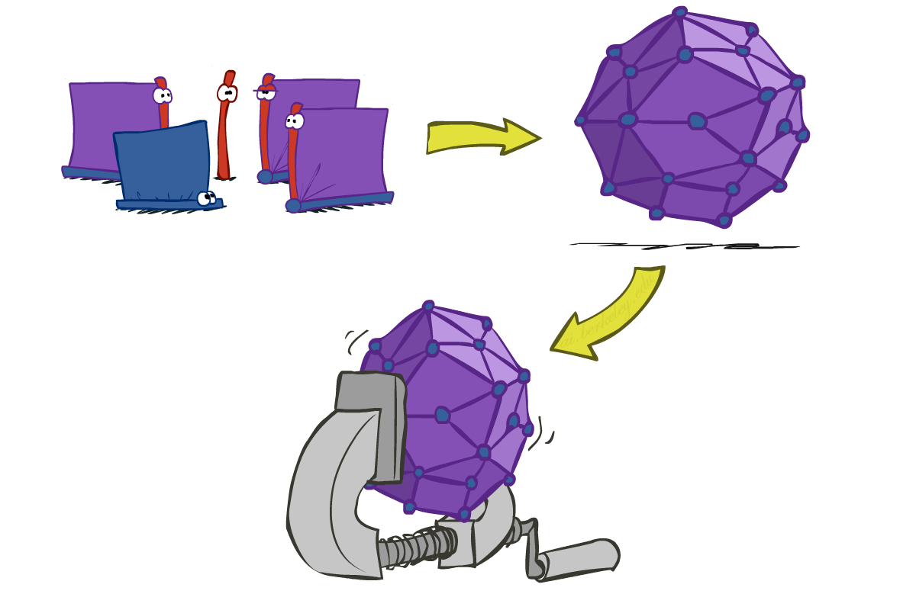
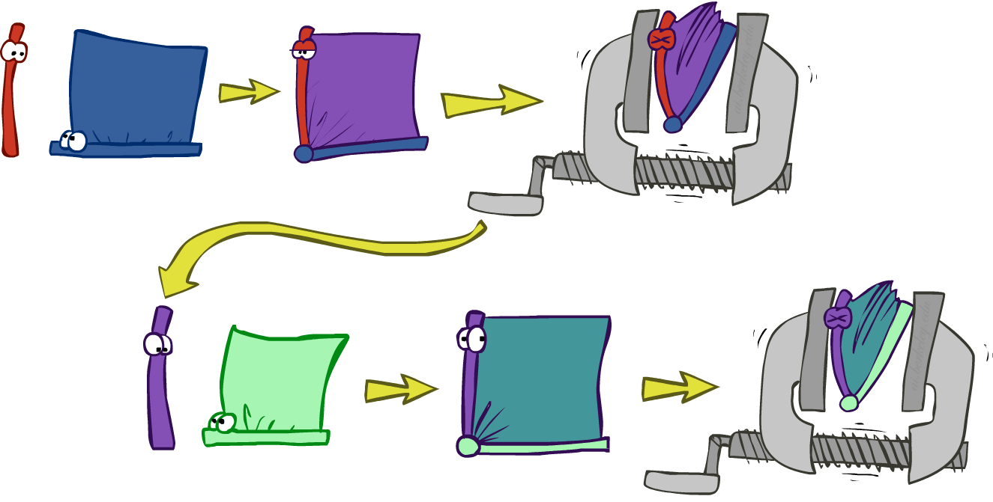
Inference by Enumeration vs. Variable Elimination
Why is inference by enumeration so slow?
  You join up the whole joint distribution before you sum out the hidden variables
Idea: interleave joining and marginalizing!
  Called “Variable Elimination”
  Still NP-hard, but usually much faster than inference by enumeration
  First we’ll need some new notation: factors

