Slide 1

CSE 473: Artificial Intelligence
Bayes’ Nets
Daniel Weld
[Most slides were created by Dan Klein and Pieter Abbeel for CS188 Intro to AI at UC Berkeley. All CS188 materials are available at http://ai.berkeley.edu.]
Notes:
Please retain proper attribution, including the reference to ai.berkeley.edu. Thanks!

Slide 2


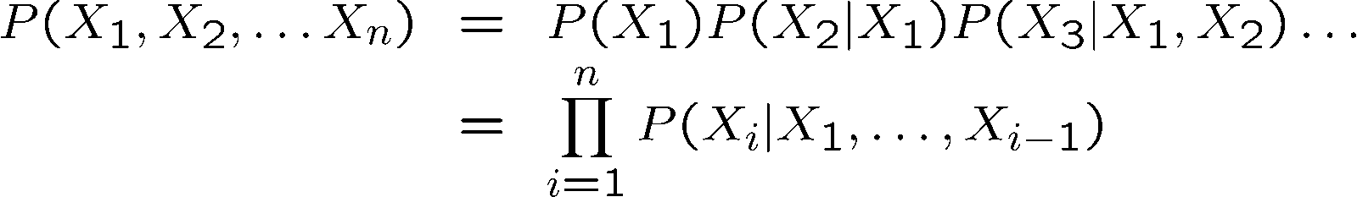
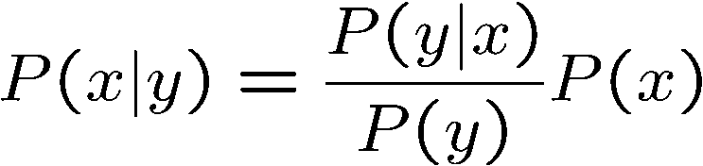

Probability Recap
Conditional probability
Product rule
Chain rule
Bayes rule
X, Y independent if and only if:
X and Y are conditionally independent given Z: if and only if:

Slide 3
Hidden Markov Models
Two random variable at each time step
  Hidden state, X_{i}
  Observation, E_{i}
Conditional Independences
Dynamics don’t change
  E.g., P(X₂ | X₁) = P(X₁₈ | X₁₇)
X₁
X₂
X₃
X₄
X_{N}
X₅
E₁
E₂
E₃
E₄
E_{N}
E₅

Slide 4
HMM Computations
Given
  Parameters
  Evidence E_{1:n} =e_{1:n}
Inference problems include:
  Filtering, find P(X_{t}|e_{1:t}) for all t
    Exact Inference
    Particle Filter
  Smoothing, find P(X_{t}|e_{1:n}) for all t
  Most probable explanation, find
      x*_{1:n} = argmaxx_{1:n} P(x_{1:n}|e_{1:n})

Slide 5
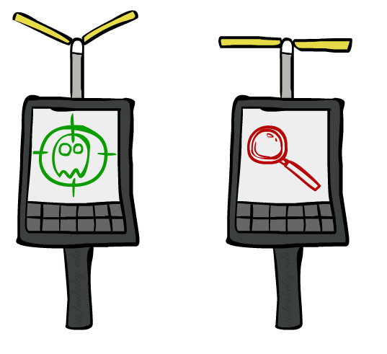



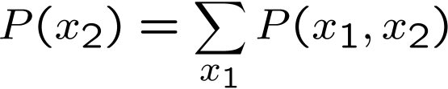

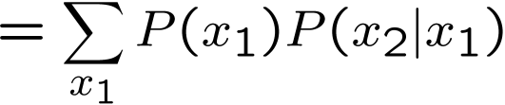

Exact Inference: Forward Algorithm
“Observation”
“Passage of Time”
X₁
X₁
X₂
E₁

Slide 6
Particle Filtering: Summary
Particles: track samples of states rather than an explicit distribution
Elapse
Weight
Resample
Particles:
(3,3)
(2,3)
(3,3)
(3,2)
(3,3)
(3,2)
(1,2)
(3,3)
(3,3)
(2,3)
Particles:
(3,2)
(2,3)
(3,2)
(3,1)
(3,3)
(3,2)
(1,3)
(2,3)
(3,2)
(2,2)
Particles:
(3,2) w=.9
(2,3) w=.2
(3,2) w=.9
(3,1) w=.4
(3,3) w=.4
(3,2) w=.9
(1,3) w=.1
(2,3) w=.2
(3,2) w=.9
(2,2) w=.4
(New) Particles:
(3,2)
(2,2)
(3,2)
(2,3)
(3,3)
(3,2)
(1,3)
(2,3)
(3,2)
(3,2)

Slide 7
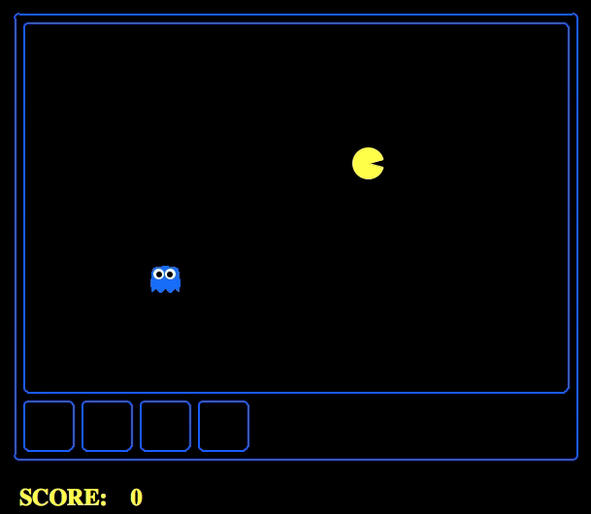
Which Algorithm?
Particle filter, uniform initial beliefs, 25 particles

Slide 8
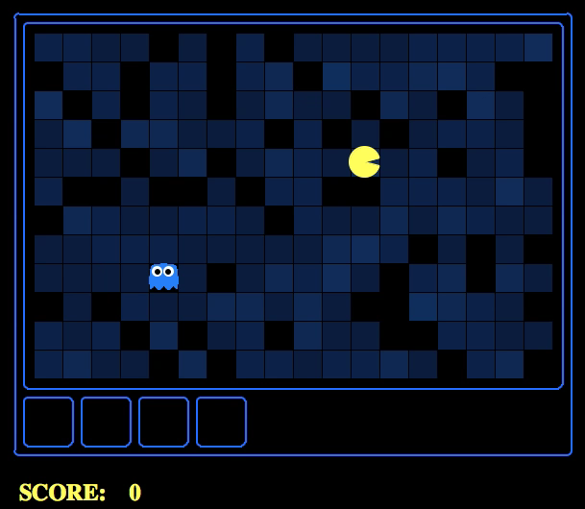
Which Algorithm?
Particle filter, uniform initial beliefs, 300 particles

Slide 9
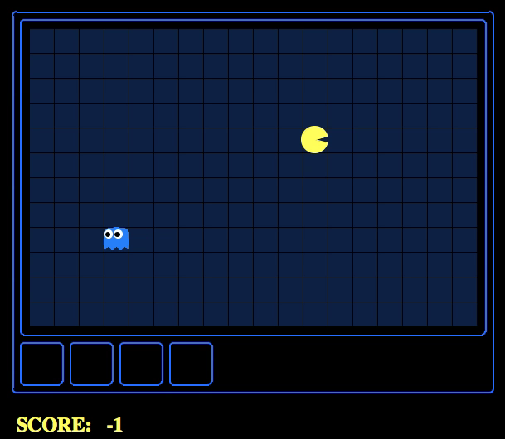
Which Algorithm?
Exact filter, uniform initial beliefs

Slide 10

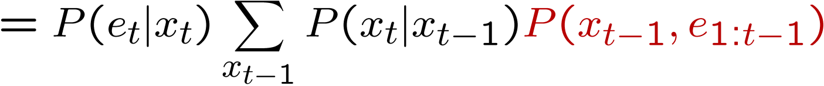
Complexity of the Forward Algorithm?
We are given evidence at each time and want to know
We use the single (time-passage+observation) updates:
If only need P(x|e) at the end, only normalize there
Complexity?
O(|X|²) time & O(X) space
But |X| is exponential in the number of state variables ☹
Notes:
TODO: explain propto and it’s X_t, not X

Slide 11
Why Does |X| Grow?
1 Ghost: k (eg 9) possible positions in maze
2 Ghosts: k² combinations
N Ghosts: k^{N} combinations

Slide 12

Don’t be Fooled
It may look cute…
https://fc08.deviantart.net/fs71/i/2010/258/4/4/baby_dragon__charles_by_imsorrybuti-d2yti11.png

Slide 13

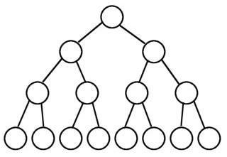
Joint Distribution for Snapshot of World
It gets big…
P
T
F
Q
T
F
T
F
R
T
F
T
F
T
F
T
F
http://img4.wikia.nocookie.net/__cb20090430175407/monster/images/9/92/Basilisk.jpg
0.1
0.05
0.2
0.07
0.03
0.05
0.1
0.3

Slide 14

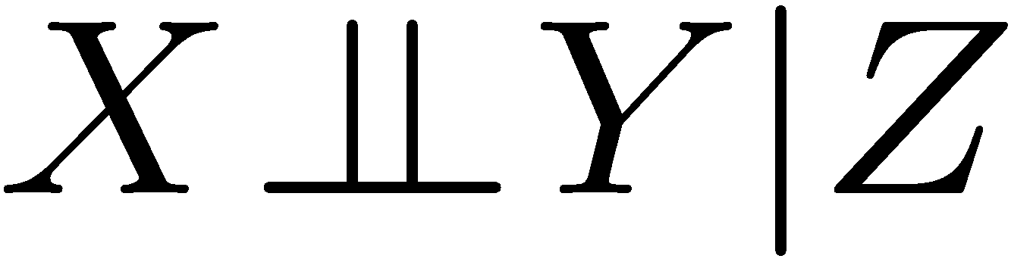
The Sword of Conditional Independence!
I am a BIG joint distribution!
Slay
the
Basilisk!
harrypotter.wikia.com/
Means:
Or, equivalently:

Slide 15
HMM Conditional Independence
HMMs have two important independence properties:
  Markov hidden process, future depends on past via the present
?
?
X₁
X₂
X₃
X₄
E₁
E₁
E₃
E₄

Slide 16
HMM Conditional Independence
HMMs have two important independence properties:
  Markov hidden process, future depends on past via the present
  Current observation independent of all else given current state
?
X₁
X₂
X₃
X₄
E₁
E₁
E₃
E₄
?

Slide 17
What about Conditional Independence in Snapshot
Can we do something here?
Factor X into product of (conditionally) independent random vars?
Maybe also factor E
X₃
E₃

Slide 18

Yes! with Bayes Nets
X₃

Slide 19
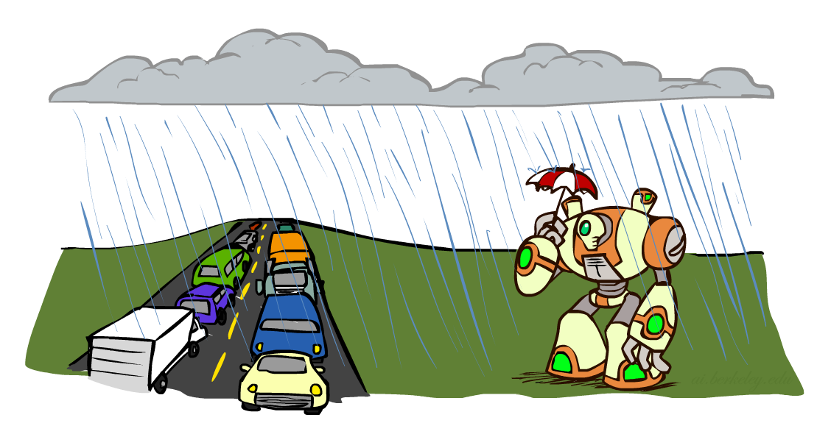
Conditional Independence
What about this domain:
  Traffic
  Umbrella
  Raining

Slide 20

Conditional Independence and the Chain Rule
Chain rule:
Trivial decomposition:
With assumption of conditional independence:
Bayes’nets / graphical models help us express conditional independence assumptions

Slide 21
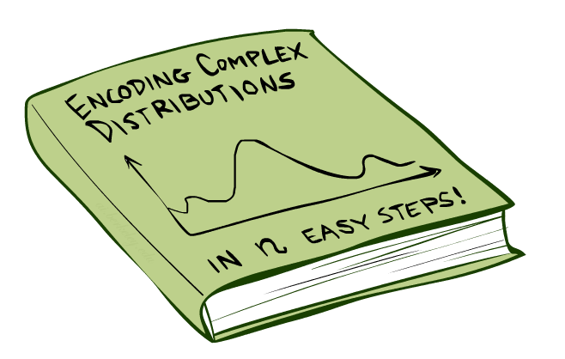
Bayes’Nets: Big Picture

Slide 22
Bayes’ Nets
Representation & Semantics
Conditional Independences
Probabilistic Inference
Learning Bayes’ Nets from Data

Slide 23
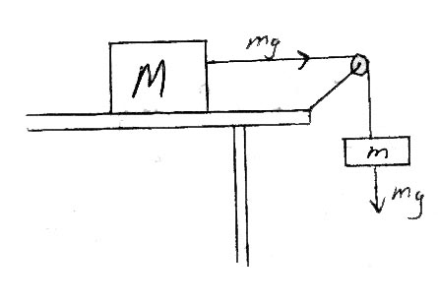
Bayes Nets = a Kind of Probabilistic Graphical Model
Models describe how (a portion of) the world works
Models are always simplifications
  May not account for every variable
  May not account for all interactions between variables
  “All models are wrong; but some are useful.”
  – George E. P. Box
What do we do with probabilistic models?
  We (or our agents) need to reason about unknown variables, given evidence
  Example: explanation (diagnostic reasoning)
  Example: prediction (causal reasoning)
  Example: value of information
Friction,
Air friction,
Mass of pulley,
Inelastic string, …
Notes:
George Box: All models are wrong; some of them are useful

Slide 24


Bayes’ Nets: Big Picture
Two problems with using full joint distribution tables as our probabilistic models:
  Unless there are only a few variables, the joint is WAY too big to represent explicitly
  Hard to learn (estimate) anything empirically about more than a few variables at a time
Bayes’ nets: a technique for describing complex joint distributions (models) using simple, local distributions (conditional probabilities)
  More properly … aka probabilistic graphical model
  We describe how variables locally interact
  Local interactions chain together to give global, indirect interactions
  For about 10 min, we’ll be vague about how these interactions are specified

Slide 25
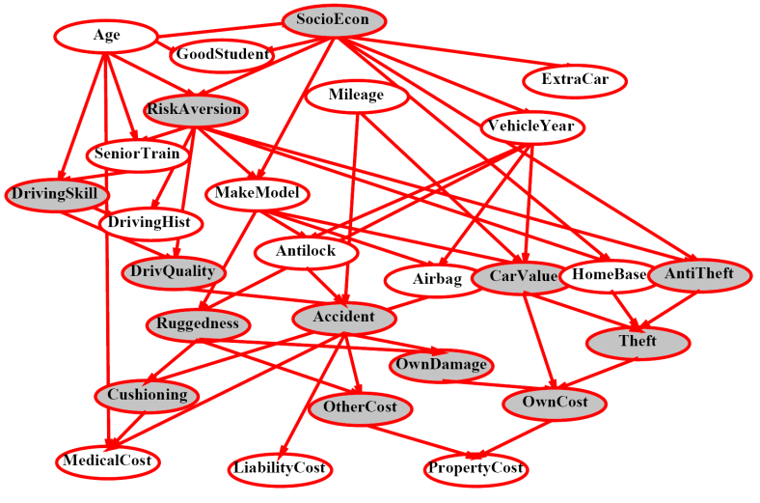
Example Bayes’ Net: Insurance

Slide 26
Example Bayes’ Net: Car

Slide 27
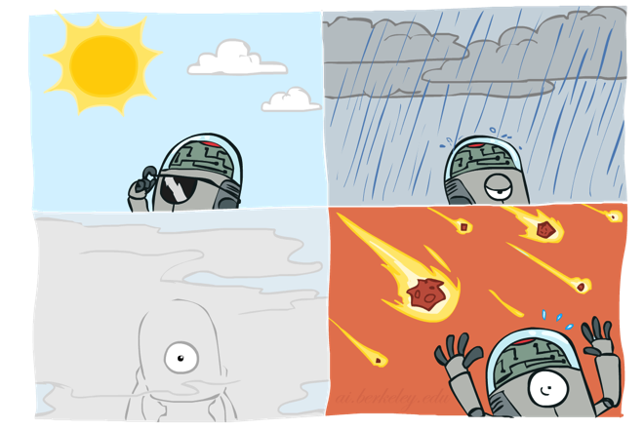
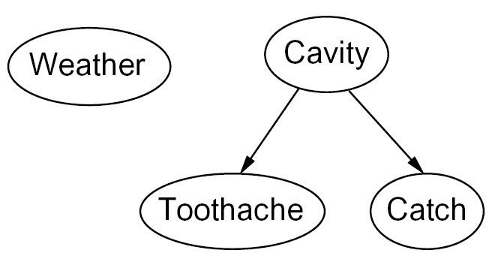

Graphical Model Notation
Nodes: random variables (with domains)
  Can be assigned (observed) or unassigned (unobserved)
Arcs: interactions
  Similar to CSP constraints
  Indicate “direct influence” between variables
  Formally: encode conditional independence (more later)
For now: imagine that arrows mean direct causation (they don’t really have to)

Slide 28
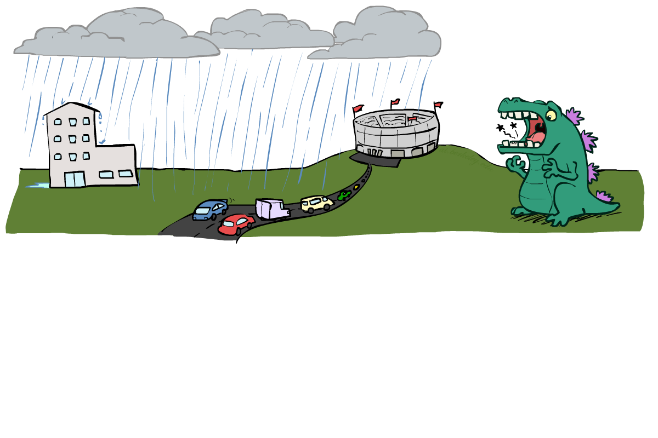
Example: Traffic II
Let’s build a causal graphical model!
Variables
  T: Traffic
  R: It rains
  L: Low pressure
  D: Roof drips
  B: Ballgame
  C: Cavity
L
B
R
C
D
T

Slide 29
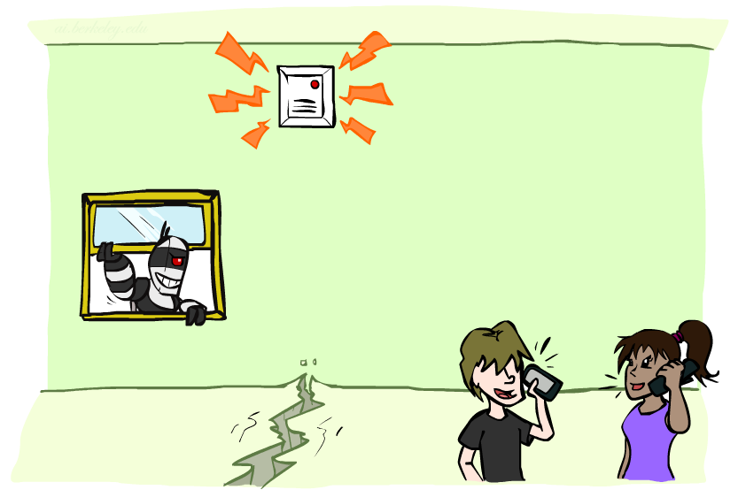
Example: Alarm Network
Variables
  B: Burglary
  A: Alarm goes off
  M: Mary calls
  J: John calls
  E: Earthquake!
B
E
A
M
J

Slide 30
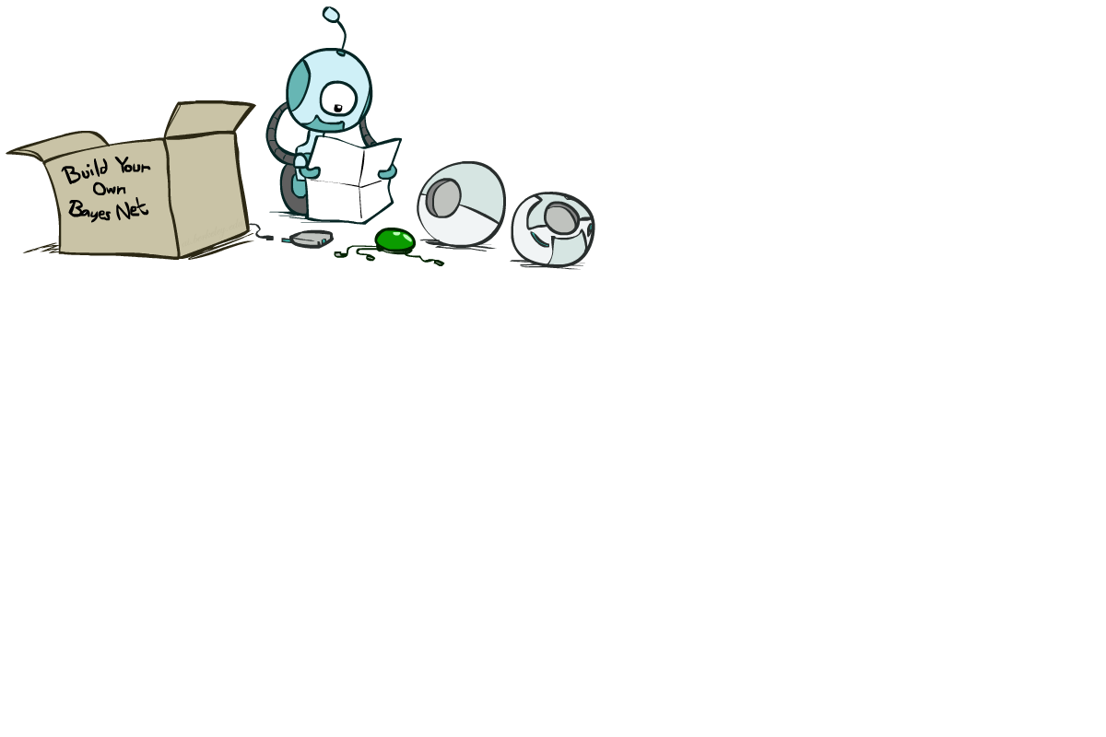
Bayes’ Net Semantics

Slide 31
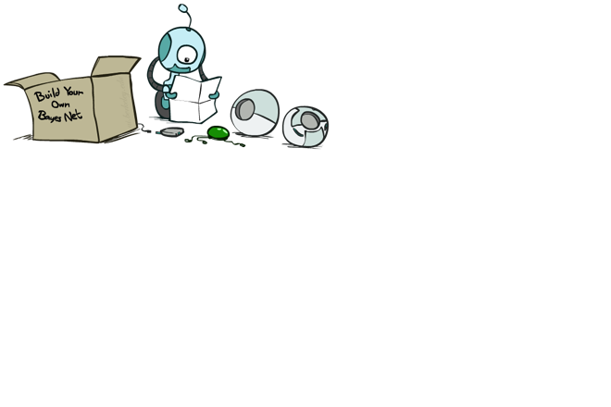
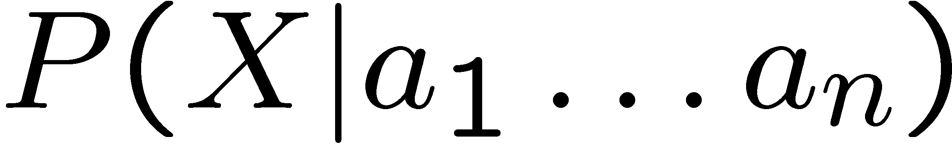
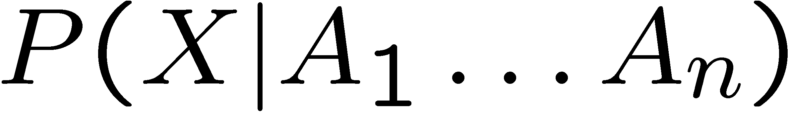
Bayes’ Net Semantics
A set of nodes, one per variable X
A directed, acyclic graph
A conditional distribution for each node
  A collection of distributions over X, one for each combination of parents’ values
  CPT: conditional probability table
  Description of a noisy “causal” process
P(A₁ ) …. P(A_{n} )
A₁
A_{n}
X
A Bayes net = Topology (graph) + Local Conditional Probabilities

Slide 32

Example: Alarm Network
B | P(B)
+b | 0.001
-b | 0.999
E | P(E)
+e | 0.002
-e | 0.998
Burglary
Earthqk
Alarm
B | E | A | P(A|B,E)
+b | +e | +a | 0.95
+b | +e | -a | 0.05
+b | -e | +a | 0.94
+b | -e | -a | 0.06
-b | +e | +a | 0.29
-b | +e | -a | 0.71
-b | -e | +a | 0.001
-b | -e | -a | 0.999
John calls
Mary calls
A | J | P(J|A)
+a | +j | 0.9
+a | -j | 0.1
-a | +j | 0.05
-a | -j | 0.95
A | M | P(M|A)
+a | +m | 0.7
+a | -m | 0.3
-a | +m | 0.01
-a | -m | 0.99
Notes:
demo

Slide 33
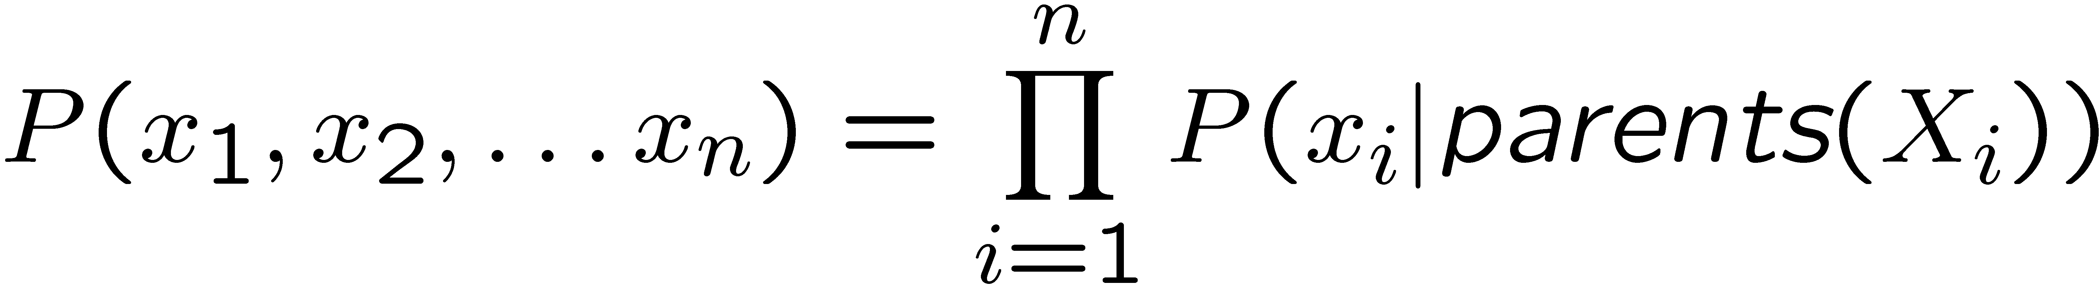
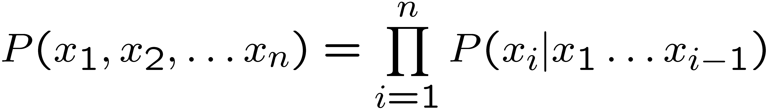
Joint Probabilities from BNs
Why are we guaranteed that setting
results in a proper joint distribution?
Chain rule (valid for all distributions):
Assume conditional independences:
→ Consequence:
Every BN represents a joint distribution, but
Not every distribution can be represented by a specific BN
  The topology enforces certain conditional independencies

Slide 34

Example: Coin Flips
X₁
X₂
X_{n}
h | 0.5
t | 0.5
h | 0.5
t | 0.5
h | 0.5
t | 0.5
Only distributions whose variables are absolutely independent can be represented by a Bayes’ net with no arcs.
Notes:
demo

Slide 35

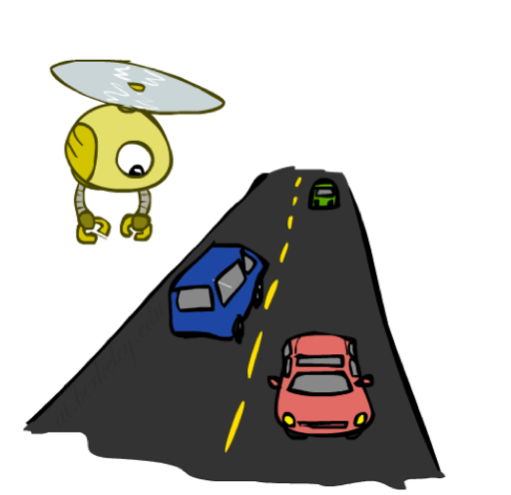

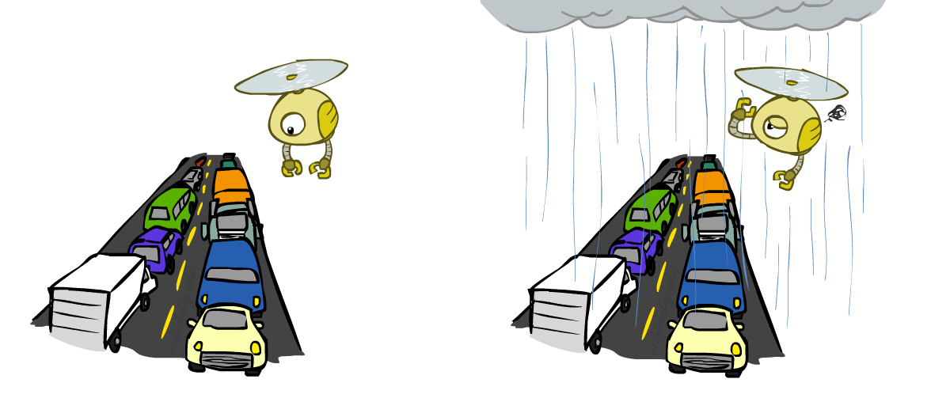
Example: Traffic
+r | 1/4
-r | 3/4
¼ * ¼ = 1/16
R
+r | +t | 3/4
 | -t | 1/4
T
-r | +t | 1/2
 | -t | 1/2
Notes:
demo

Slide 36

Probabilities in BNs
Bayes’ nets implicitly encode joint distributions
  As a product of local conditional distributions
  To see what probability a BN gives to a full assignment, multiply all the relevant conditionals together:
  Example:

Slide 37
Example: Alarm Network
B | P(B)
+b | 0.001
-b | 0.999
B
E
E | P(E)
+e | 0.002
-e | 0.998
A
A | J | P(J|A)
+a | +j | 0.9
+a | -j | 0.1
-a | +j | 0.05
-a | -j | 0.95
A | M | P(M|A)
+a | +m | 0.7
+a | -m | 0.3
-a | +m | 0.01
-a | -m | 0.99
B | E | A | P(A|B,E)
+b | +e | +a | 0.95
+b | +e | -a | 0.05
+b | -e | +a | 0.94
+b | -e | -a | 0.06
-b | +e | +a | 0.29
-b | +e | -a | 0.71
-b | -e | +a | 0.001
-b | -e | -a | 0.999
J
M
Notes:
demo

Slide 38
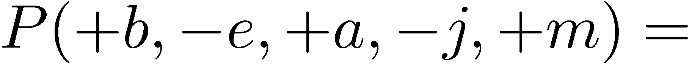
Example: Alarm Network
B | P(B)
+b | 0.001
-b | 0.999
B
E
E | P(E)
+e | 0.002
-e | 0.998
A
A | J | P(J|A)
+a | +j | 0.9
+a | -j | 0.1
-a | +j | 0.05
-a | -j | 0.95
A | M | P(M|A)
+a | +m | 0.7
+a | -m | 0.3
-a | +m | 0.01
-a | -m | 0.99
B | E | A | P(A|B,E)
+b | +e | +a | 0.95
+b | +e | -a | 0.05
+b | -e | +a | 0.94
+b | -e | -a | 0.06
-b | +e | +a | 0.29
-b | +e | -a | 0.71
-b | -e | +a | 0.001
-b | -e | -a | 0.999
J
M
Notes:
demo

Slide 39

Example: Alarm Network
B | P(B)
+b | 0.001
-b | 0.999
B
E
E | P(E)
+e | 0.002
-e | 0.998
A
A | J | P(J|A)
+a | +j | 0.9
+a | -j | 0.1
-a | +j | 0.05
-a | -j | 0.95
A | M | P(M|A)
+a | +m | 0.7
+a | -m | 0.3
-a | +m | 0.01
-a | -m | 0.99
B | E | A | P(A|B,E)
+b | +e | +a | 0.95
+b | +e | -a | 0.05
+b | -e | +a | 0.94
+b | -e | -a | 0.06
-b | +e | +a | 0.29
-b | +e | -a | 0.71
-b | -e | +a | 0.001
-b | -e | -a | 0.999
J
M
Notes:
demo

Slide 40
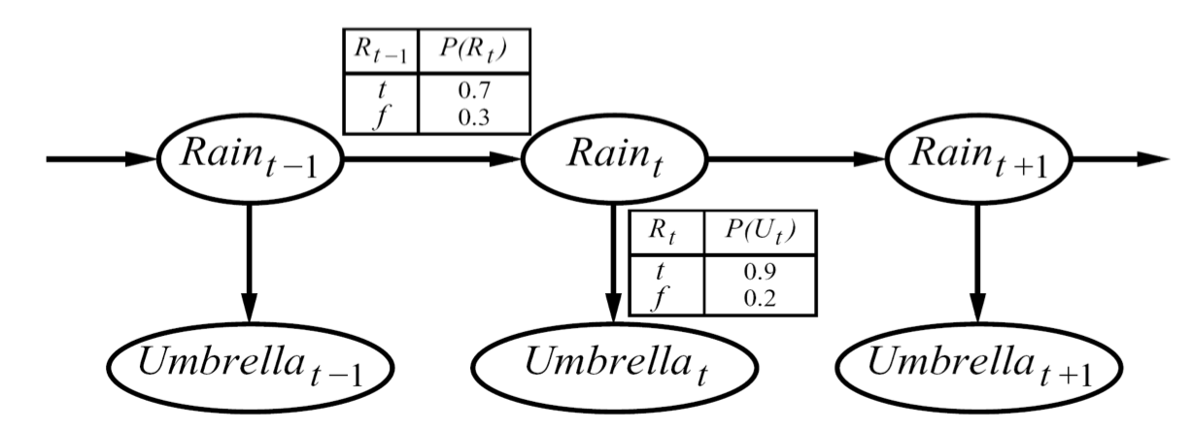
Example: Hidden Markov Models
X₁
X₂
X₃
X₄
X_{N}
X₅
E₁
E₂
E₃
E₄
E_{N}
E₅
…
P(R₀) = 0.4
R₀
R₁
R₂
U₀
U₁
U₂

Slide 41

What Causes Bad Traffic?
Causal direction
R
+r | 1/4
-r | 3/4
+r | +t | 3/16
+r | -t | 1/16
-r | +t | 6/16
-r | -t | 6/16
+r | +t | 3/4
 | -t | 1/4
T
-r | +t | 1/2
 | -t | 1/2

Slide 42
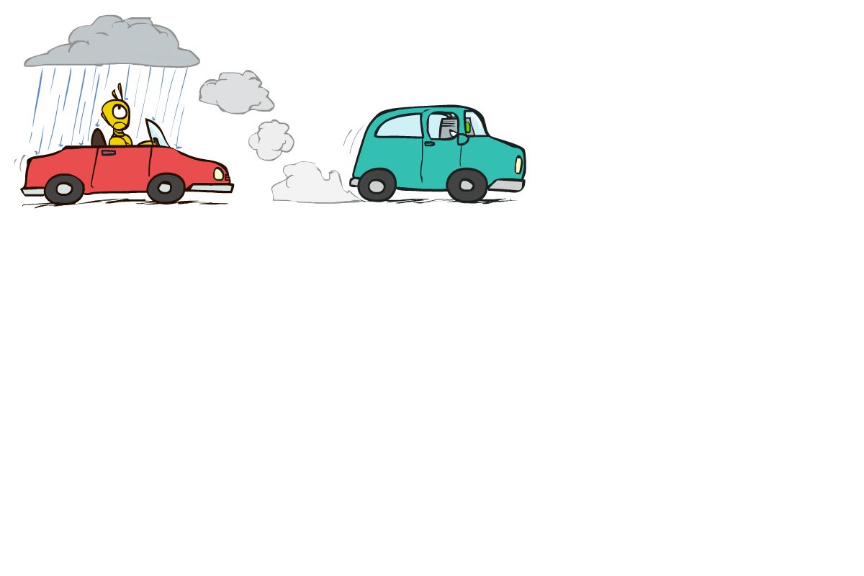

Example: Reverse Traffic
Reverse causality?
T
+t | 9/16
-t | 7/16
+r | +t | 3/16
+r | -t | 1/16
-r | +t | 6/16
-r | -t | 6/16
+t | +r | 1/3
 | -r | 2/3
R
-t | +r | 1/7
 | -r | 6/7

Slide 43
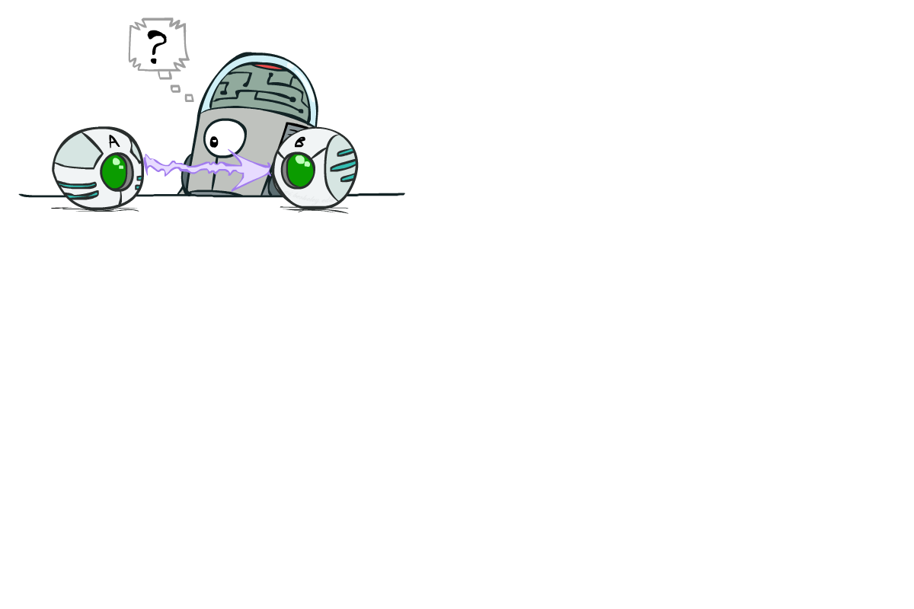
Causality?
When Bayes’ nets reflect the true causal patterns:
  Often simpler (nodes have fewer parents)
  Often easier to think about
  Often easier to elicit from experts
BNs need not actually be causal
  Sometimes no causal net exists over the domain (especially if variables are missing)
  E.g. consider the variables Traffic and Drips
  End up with arrows that reflect correlation, not causation
What do the arrows really mean?
  Topology may happen to encode causal structure
  Topology really encodes conditional independence

Slide 44

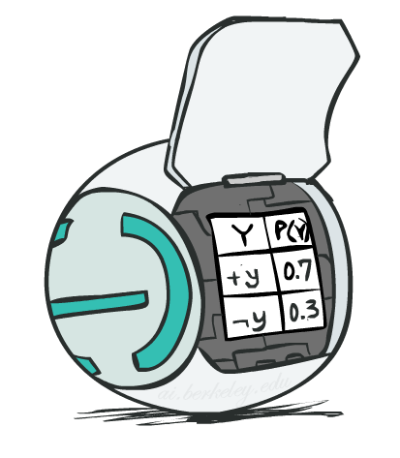
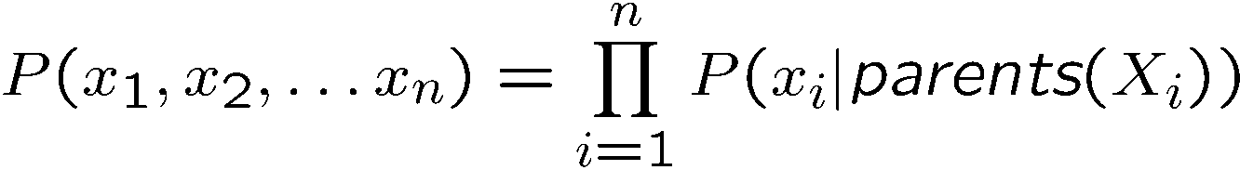
Summary: Bayes’ Net Semantics
A directed, acyclic graph, one node per random variable
A conditional probability table (CPT) for each node
  A collection of distributions over X, one for each combination of parents’ values
Bayes’ nets compactly encode joint distributions
  As a product of local conditional distributions
  To see what probability a BN gives to a full assignment, multiply all the relevant conditionals together:

Slide 45


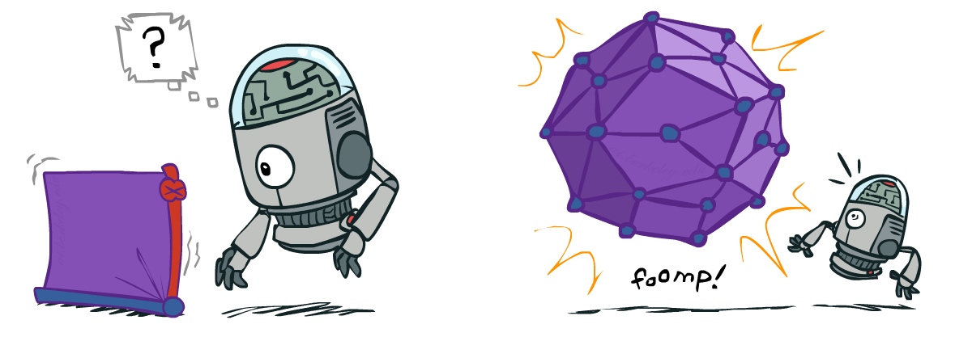
Size of a Bayes’ Net
How big is a joint distribution over N Boolean variables?
  2^{N}
How big is an N-node net if nodes have up to k parents?
  O(N * 2^{k})
Both give you the power to calculate
BNs: Huge space savings!
Also easier to elicit local CPTs
Also faster to answer queries (coming)

Slide 46
What’s Next with Bayes’ Nets
Questions we can ask:
  Definition: P(X = x)
  Inference: given a fixed BN, what is P(X | e)?
  Representation: given a BN graph, what kinds of distributions can it encode?
  Modeling: what BN is most appropriate for a given domain?
  Learning: Given data, what is best BN encoding?

Slide 47

Bayes’ Nets
Representation
  Special case: HMMs & DBNs
Conditional Independences
Probabilistic Inference
Learning Bayes’ Nets from Data

Slide 48
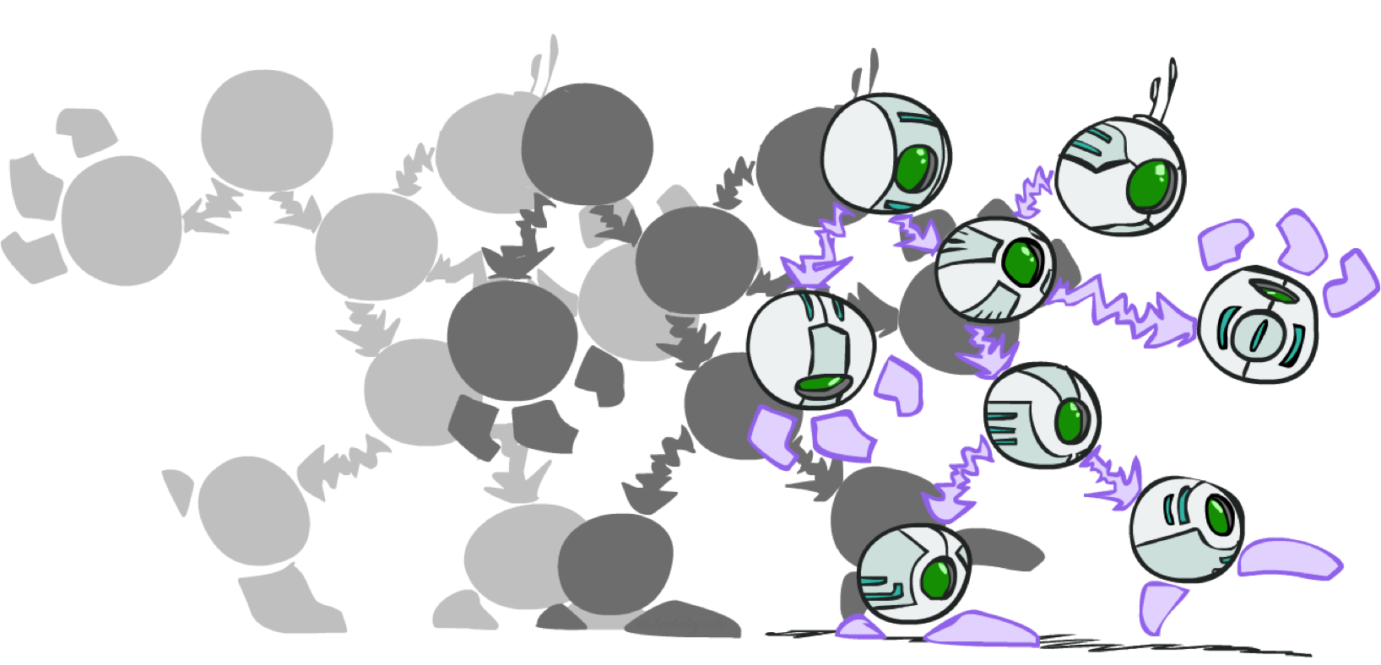
Dynamic Bayes Nets

Slide 49

Dynamic Bayes Nets (DBNs)
We want to track multiple variables over time, using multiple sources of evidence
Idea: Repeat a fixed Bayes net structure at each time
Variables from time t can condition on those from t-1
Dynamic Bayes nets are a generalization of HMMs
t = 1
t = 2
t = 3
G₁ª
G₂ª
G₃ª
G₁^{b}
G₂^{b}
G₃^{b}
E₁ª
E₁^{b}
E₂ª
E₂^{b}
E₃ª
E₃^{b}
Notes:
[Demo: pacman sonar ghost DBN model (L15D6)]

Slide 50
Exact Inference in DBNs
Variable elimination applies to dynamic Bayes nets
Procedure: “unroll” the network for T time steps, then eliminate variables until P(X_{T}|e_{1:T}) is computed
Online belief updates: Eliminate all variables from the previous time step; store factors for current time only
t =1
t =2
t =3
G₁ª
G₂ª
G₃ª
G₃^{b}
G₁^{b}
G₂^{b}
G₃^{b}
E₁ª
E₁^{b}
E₂ª
E₂^{b}
E₃ª
E₃^{b}

Slide 51
DBN Particle Filters
A particle is a complete sample for a time step
Initialize: Generate prior samples for the t=1 Bayes net
  Example particle: G₁ª = (3,3) G₁^{b} = (5,3)
Elapse time: Sample a successor for each particle
  Example successor: G₂ª = (2,3) G₂^{b} = (6,3)
Observe: Weight each entire sample by the likelihood of the evidence conditioned on the sample
  Likelihood: P(E₁ª |G₁ª ) * P(E₁^{b} |G₁^{b} )
Resample: Select prior samples (tuples of values) in proportion to their likelihood
Notes:
Dan has a demo here.

Slide 52
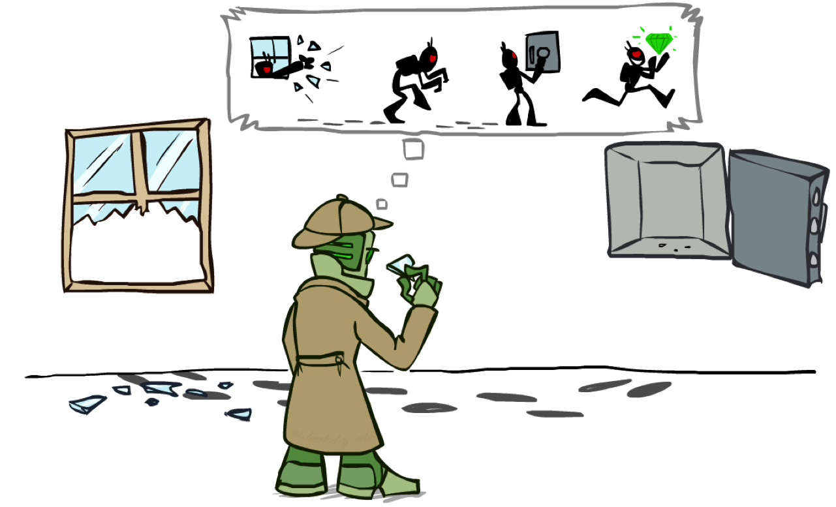
Most Likely Explanation

Slide 53
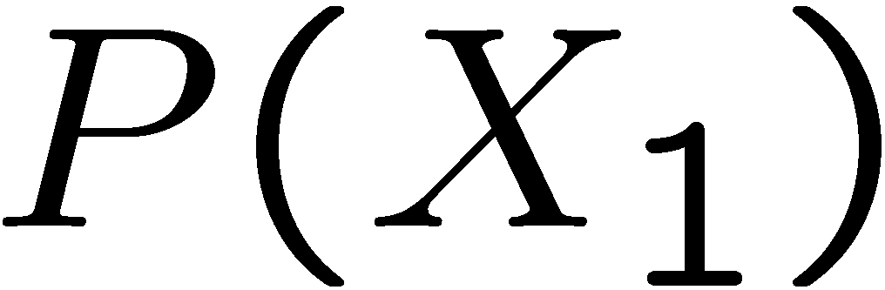
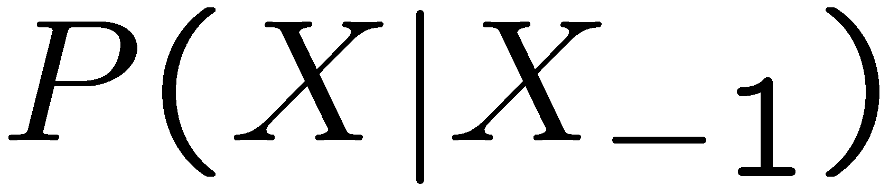
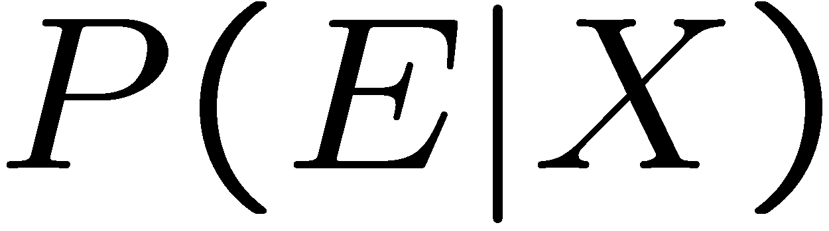
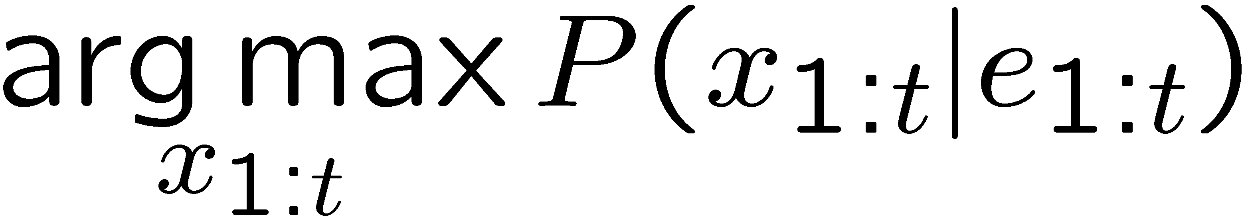
HMMs: MLE Queries
HMMs defined by
  States X
  Observations E
  Initial distribution:
  Transitions:
  Emissions:
New query: most likely explanation:
New method: the Viterbi algorithm
X₁
X₂
X₃
X₄
X₅
E₁
E₂
E₃
E₄
E₅

Slide 54
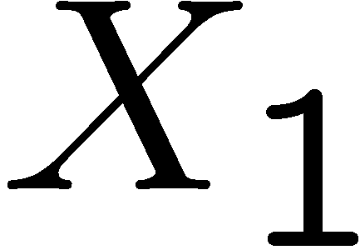
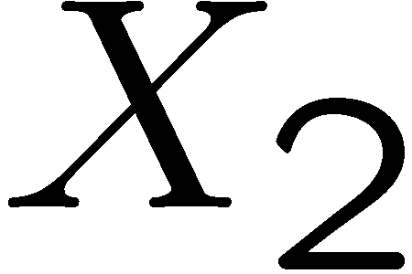

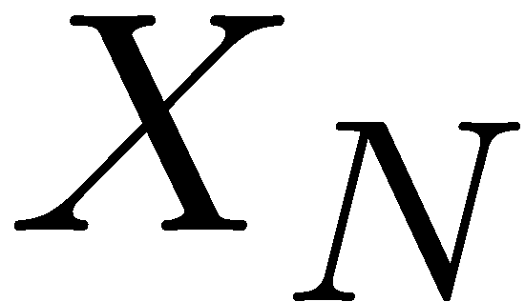

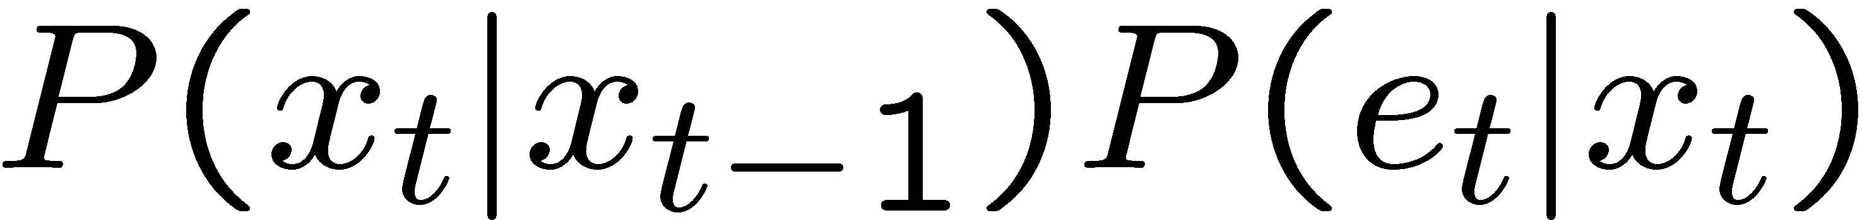
State Trellis
State trellis: graph of states and transitions over time
Each arc represents some transition
Each arc has weight
Each path is a sequence of states
The product of weights on a path is that sequence’s probability along with the evidence
Forward algorithm computes sums of paths, Viterbi computes best paths
sun
sun
sun
sun
rain
rain
rain
rain

Slide 55

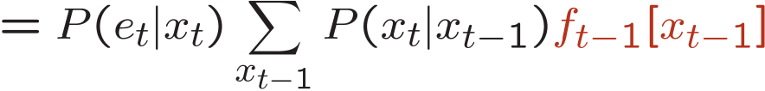
Forward / Viterbi Algorithms
sun
sun
sun
sun
rain
rain
rain
rain
Forward Algorithm (Sum)
Viterbi Algorithm (Max)

Slide 56

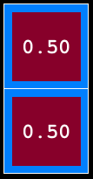
Ghostbusters Chain Rule
Each sensor depends only
on where the ghost is
That means, the two sensors are conditionally independent, given the ghost position
T: Top square is red
B: Bottom square is red
G: Ghost is in the top
Givens:
P( +g ) = 0.5
P( +t | +g ) = 0.8
P( +t | -g ) = 0.4
P( +b | +g ) = 0.4
P( +b | -g ) = 0.8
P(T,B,G) = P(G) P(T|G) P(B|G)
T | B | G | P(T,B,G)
+t | +b | +g | 0.16
+t | +b | -g | 0.16
+t | -b | +g | 0.24
+t | -b | -g | 0.04
-t | +b | +g | 0.04
-t | +b | -g | 0.24
-t | -b | +g | 0.06
-t | -b | -g | 0.06
Number of Parameters?

