Slide 1
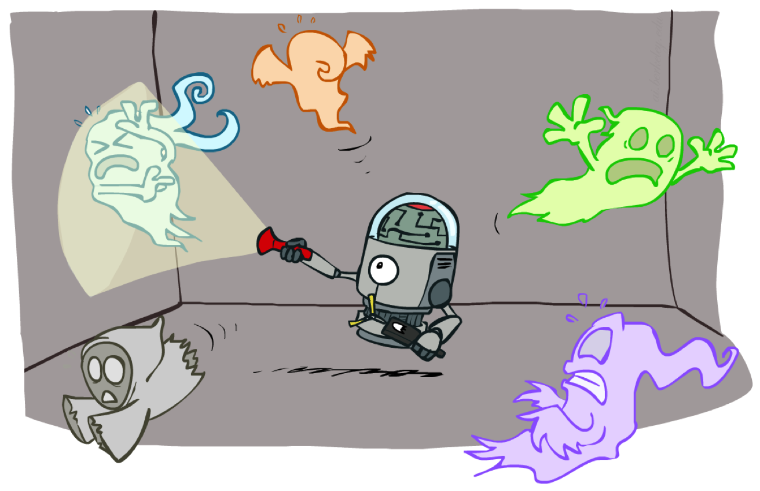
CSE 473: Artificial Intelligence
Hidden Markov Models
Daniel Weld
University of Washington
[Many of these slides were created by Dan Klein and Pieter Abbeel for CS188 Intro to AI at UC Berkeley. All CS188 materials are available at http://ai.berkeley.edu.]
Notes:
Please retain proper attribution, including the reference to ai.berkeley.edu. Thanks!

Slide 2
ToDo
Exact inference is still too complex?
  Way too complex - Reams of formulas and derivations – why? It’s easy?
  What happens with dead particles?
  Add mini-DBN with multiple ghosts before Pset due!

Slide 3



Hidden Markov Models
X₁
X₂
X₃
X₄
X_{N}
X₅
E₁
E₂
E₃
E₄
E_{N}
E₅
Defines a joint probability distribution:

Slide 4
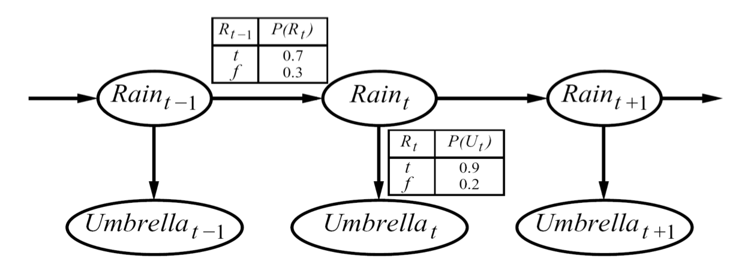



Hidden Markov Model: Example
P(R₁ )
R_{t-1}
P(R_{t} | R_{t-1} )
0.6
t
0.7
f
0.1
R_{t}
P(U_{t} | R_{t} )
t
0.9
f
0.2
An HMM is defined by:
  Initial distribution:
  Transitions:
  Emissions:

Slide 5
Conditional Independence
HMMs have two important independence properties:
  Future independent of past given the present
?
?
X₁
X₂
X₃
X₄
E₁
E₁
E₃
E₄

Slide 6
Conditional Independence
HMMs have two important independence properties:
  Future independent of past given the present
  Current observation independent of all else given current state
?
X₁
X₂
X₃
X₄
E₁
E₁
E₃
E₄
?

Slide 7
Conditional Independence
HMMs have two important independence properties:
  Markov hidden process, future depends on past via the present
  Current observation independent of all else given current state
Quiz: does this mean that observations are independent given no evidence?
  [No, correlated by the hidden state]
X₁
X₂
X₃
X₄
E₁
E₁
E₃
E₄
?
?

Slide 8
Ghostbusters HMM
P(X₁) = uniform
P(X’|X) = ghosts usually move clockwise, but sometimes move in a random direction or stay put
P(E|X) = same sensor model as before:
red means probably close, green means likely far away.
1/9
1/9
1/9
1/9
1/9
1/9
1/9
1/9
1/9
P(X₁)
X₁
X₂
X₃
X₄
1/6
1/6
1/2
0
1/6
0
Etc…
E₁
E₁
E₃
E₄
0
0
0
P(X’|X=<1,2>)
P(red | 3) | P(orange | 3) | P(yellow | 3) | P(green | 3)
0.05 | 0.15 | 0.5 | 0.3
P(E|X)
E₅
Etc… (must specify for other distances)

Slide 9
HMM Computations
Given
  parameters
  evidence E_{1:n} =e_{1:n}
Inference problems include:
  Filtering, find P(X_{t}|e_{1:t}) for some t
  Most probable explanation, for some t find
      x*_{1:t} = argmaxx_{1:t} P(x_{1:t}|e_{1:t})
  Smoothing, find P(X_{t}|e_{1:n}) for some t < n

Slide 10
Filtering (aka Monitoring)
The task of tracking the agent’s belief state, B(x), over time
  B(x) is a distribution over world states – repr agent knowledge
  We start with B(X) in an initial setting, usually uniform
  As time passes, or we get observations, we update B(X)
Many algorithms for this:
  Exact probabilistic inference
  Particle filter approximation
  Kalman filter (a method for handling continuous Real-valued random vars)
    invented in the 60’for Apollo Program – real-valued state, Gaussian noise

Slide 11
HMM Examples
Robot tracking:
  States (X) are positions on a map (continuous)
  Observations (E) are range readings (continuous)
X₁
X₂
X₃
X₄
E₁
E₁
E₃
E₄

Slide 12
Example: Robot Localization
Example from Michael Pfeiffer
Prob
0
1
T=1
Sensor model: never more than 1 mistake
Motion model: may not execute action with small prob.

Slide 13
Example: Robot Localization
Prob
0
1
t=1

Slide 14
Example: Robot Localization
Prob
0
1
t=2

Slide 15
Example: Robot Localization
Prob
0
1
t=3

Slide 16
Example: Robot Localization
Prob
0
1
t=4

Slide 17
Example: Robot Localization
Prob
0
1
t=5

Slide 18
Other Real HMM Examples
Speech recognition HMMs:
  States are specific positions in specific words (so, tens of thousands)
  Observations are acoustic signals (continuous valued)
X₁
X₂
X₃
X₄
E₁
E₁
E₃
E₄

Slide 19
Other Real HMM Examples
Machine translation HMMs:
  States are translation options
  Observations are words (tens of thousands)
X₁
X₂
X₃
X₄
E₁
E₁
E₃
E₄

Slide 20
Filtering (aka Monitoring)
Filtering, or monitoring, is the task of tracking the distribution B(X) (called “the belief state”) over time
We start with B₀(X) in an initial setting, usually uniform
We update B_{t}(X) computing B_{t+1}(X)
  As time passes, and using prob model of how ghosts move
  As we get observations using prob model of how noisy sensors work

Slide 21
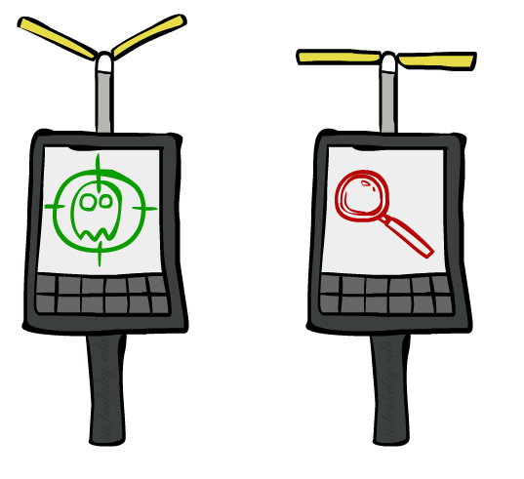



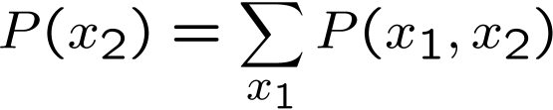

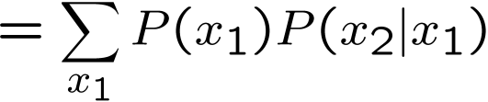

Filtering: Base Cases
“Observation”
“Passage of Time”
X₁
X₁
X₂
E₁

Slide 22

Forward Algorithm
t = 0
B(X_{t}) = initial distribution
Repeat forever
  B’(X_{t+1}) = Simulate passage of time from B(X_{t})
  Observe e_{t+1}
  B(X_{t+1}) = Update B’(X_{t+1}) based on probability of e_{t+1}

Slide 23
Passage of Time
Assume we have current belief P(X | evidence to date)
Then, after one time step passes:
Basic idea: beliefs get “pushed” through the transitions
  With the “B” notation, we have to be careful about what time step t the belief is about, and what evidence it includes
X₁
X₂
Or compactly:
Notes:
1 marginalizing x_t
2. Product rule
3. Conditional independence

Slide 24

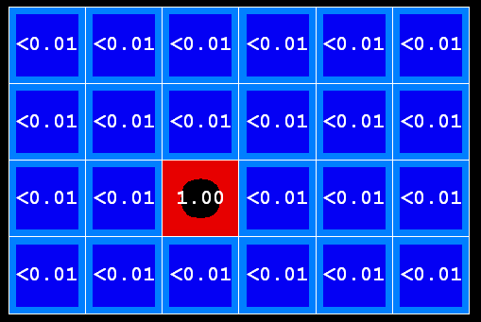

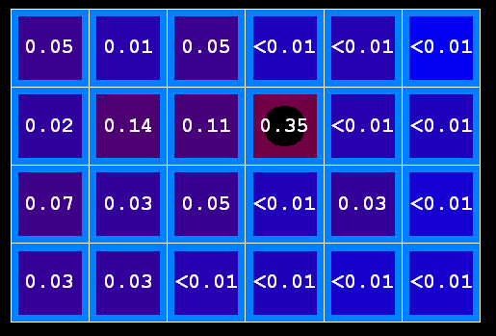
Example: Passage of Time
As time passes, uncertainty “accumulates”
(Transition model: ghosts usually go clockwise)
T = 1
T = 2
T = 5

Slide 25
Observation
X₁
Assume we have current belief P(X | previous evidence):
Then, after evidence comes in:
Or, compactly:
E₁
Defn cond prob
Defn cond prob
Independence
Basic idea: beliefs “reweighted” by likelihood of evidence
Unlike passage of time, we have to normalize
=
Notes:
Basic idea: beliefs “reweighted” by likelihood of evidence
Unlike passage of time, we have to renormalize

Slide 26
Observation
Old version
X₁
Assume we have current belief P(X | previous evidence):
Then, after evidence comes in:
Or, compactly:
E₁
Basic idea: beliefs “reweighted” by likelihood of evidence
Unlike passage of time, we have to renormalize
Notes:
Basic idea: beliefs “reweighted” by likelihood of evidence
Unlike passage of time, we have to renormalize

Slide 27

Normalization to Account for Evidence
  SELECT the joint probabilities matching the evidence
  NORMALIZE the selection
  (make it sum to one)
X | E | P
rain | U | 0.4
rain | - | 0.1
sun | U | 0.2
sun | - | 0.3
X | E | P
rain | U | 0.4
sun | U | 0.2
X | P
rain | 0.67
sun | 0.33
Since could have seen other evidence, we normalize by dividing by the probability of the evidence we did see (in this case dividing by 0.5)…

Slide 28



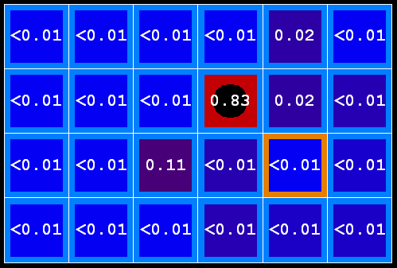
Example: Observation
As we get observations, beliefs get reweighted, uncertainty “decreases”
Before observation
After observation

Slide 29

Example: Weather HMM
B’(x₁=r) = P(x₁=r | x₀=r) * 0.5 + P(x₁=r | x₀=s) * 0.5
= 0.8*0.5 + 0.6*0.5
= 0.7
B(x₀=r) = 0.5
R_{t-1}
P(R_{t} | R_{t-1} )
Rain₀
Rain₁
Rain₂
t
0.8
f
0.6
P(R₁ )
0.5
Umbr₁ = T
Umbr₂ = T
R_{t}
P(U_{t} | R_{t} )
t
0.9
f
0.3

Slide 30

Example: Weather HMM
B’(x₁=r) = P(x₁=r | x₀=r) * 0.5 + P(x₁=r | x₀=s) * 0.5
= 0.8*0.5 + 0.6*0.5
= 0.7
B(x₁=r) ∝ 0.9 * 0.7 = 0.63
B(x₁=s) ∝ 0.3 * 0.3 = 0.09
Divide by 0.72 (=0.63+0.09) to normalize
B(x₀=r) = 0.5
B(x₁=r) =0.63/0.72 = 0.875
R_{t-1}
P(R_{t} | R_{t-1} )
Rain₀
Rain₁
Rain₂
t
0.8
f
0.6
P(R₁ )
0.5
Umbr₁ = T
Umbr₂ = T
R_{t}
P(U_{t} | R_{t} )
t
0.9
f
0.3

Slide 31
Example: Weather HMM
B’(x₂=r) = P(x₂=r | x₁=r)*0.875 + P(x₂=r | x₁=s)*0.125
= 0.8*0.875 + 0.6*0.125
= 0.775
B’(x₁=r) = 0.7
B(x₀=r) = 0.5
B(x₁=r) = 0.875
R_{t-1}
P(R_{t} | R_{t-1} )
Rain₀
Rain₁
Rain₂
t
0.8
f
0.6
P(R₁ )
0.5
Umbr₁ = T
Umbr₂ = T
R_{t}
P(U_{t} | R_{t} )
t
0.9
f
0.3

Slide 32
Example: Weather HMM
B’(x₂=r) = P(x₂=r | x₁=r)*0.875 + P(x₂=r | x₁=s)*0.125
= 0.8*0.875 + 0.6*0.125
= 0.775
B’(x₁=r) = 0.7
B(x₁=r) ∝ 0.9 * 0.775 = 0.6975
B(x₁=s) ∝ 0.3 * 0.225 = 0.0675
Divide by 0.765 to normalize
B(x₀=r) = 0.5
B(x₁=r) = 0.875
B(x₁=r) = 0.912
R_{t-1}
P(R_{t} | R_{t-1} )
Rain₀
Rain₁
Rain₂
t
0.8
f
0.6
P(R₁ )
0.5
Umbr₁ = T
Umbr₂ = T
R_{t}
P(U_{t} | R_{t} )
t
0.9
f
0.3

Slide 33
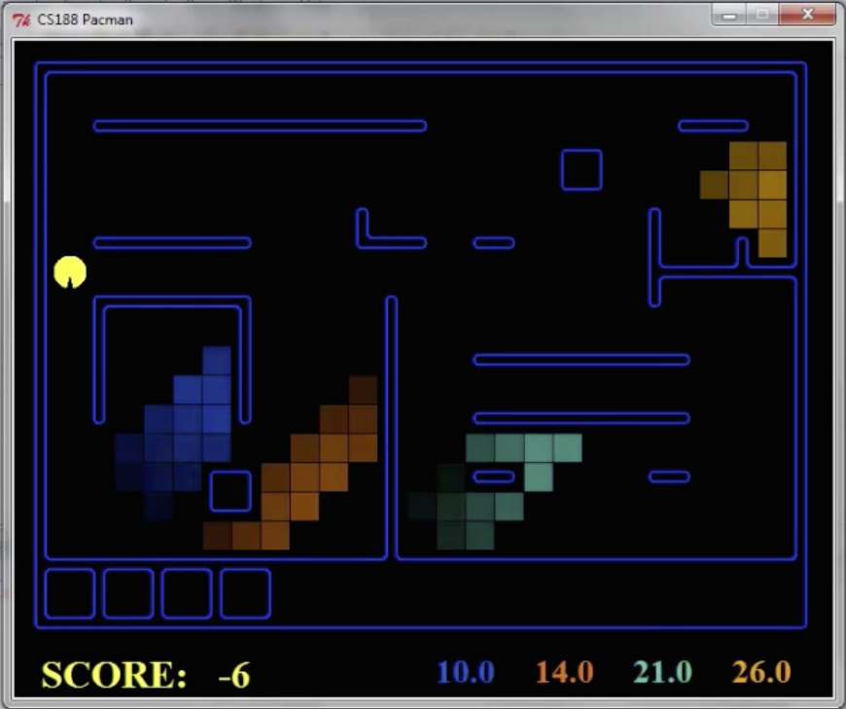
Pacman – Sonar (P4)
[Demo: Pacman – Sonar – No Beliefs(L14D1)]

Slide 34

Video of Demo Pacman – Sonar (with beliefs)
Notes:
Starts moving at 13 seconds in

Slide 35

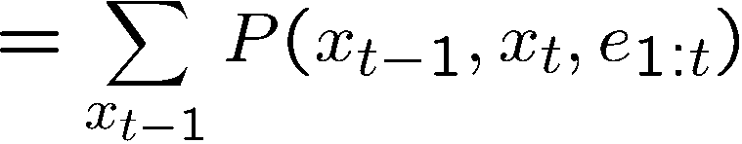
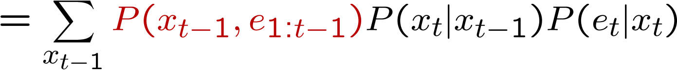
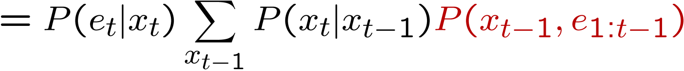
The Forward Algorithm
We are given evidence at each time and want to know
We use the single (time-passage+observation) updates:
Don’t show me!
We can normalize as we go if we want to have P(x|e) at each time step, or just once at the end…
Complexity of single time update?
O(|X|²) time & O(X) space
Notes:
TODO: explain propto and it’s X_t, not X

Slide 36
Summary: Online Belief Updates
Every time step, we start with current P(X | evidence)
1. We update for time:
2. We update for evidence:
The forward algorithm does both at once (and doesn’t normalize)
  Computational complexity?
X₁
X₂
X₂
E₂
O(X² +XE) time & O(X+E) space

Slide 37
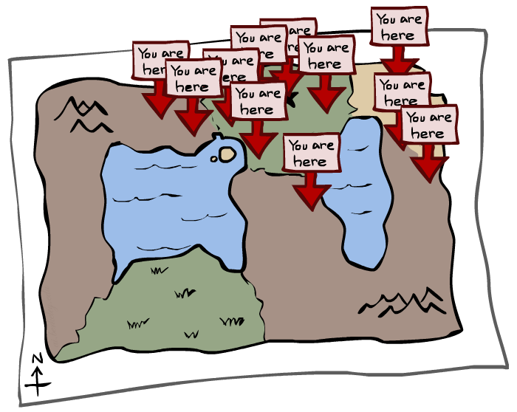
Particle Filtering

Slide 38
Particle Filtering Overview
Approximation technique to solve filtering problem
Represents P distribution with samples
Filtering still operates in two steps
    Elapse time
    Incorporate observations
      (But this part has two sub-steps: weight & resample)

Slide 39
Particle Filtering
Sometimes |X| is too big to use exact inference
  |X| may be too big to even store B(X)
  E.g. X is continuous
Solution: approximate inference
  Track samples of X, not exact distribution of values
  Samples are called particles
  Time per step is linear in the number of samples
  But: number needed may be large
  In memory: list of particles, not states
Particle is just new name for sample
This is how robot localization works in practice

Slide 40
Remember…
We’ll start by looking at this
An HMM is defined by:
  Initial distribution:
  Transitions:
  Emissions:

Slide 41
Here’s a Single Particle
It represents a hypothetical state where the robot is in (1,2)

Slide 42
Particles Approximate Distribution
Our representation of P(X) is now a list of N particles (samples)
  Generally, N << |X|
P(x)
Distribution
Particles: (3,3)
(2,3)
(3,3)
(3,2)
(3,3)
(3,2)
(1,2)
(3,3)
(3,3)
(2,3)
P(x=<3,3>) = 5/10 = 50%

Slide 43
Particle Filtering
A more compact view overlays the samples:
0.0
0.2
0.5
Encodes →
0.1
0.0
0.2
0.0
0.2
0.5

Slide 44
Another Example
In the weather HMM, suppose we decide to approximate the distributions with 5 particles. To initialize the filter, we draw 5 samples from B(x₀=r) = 0.5 and we might get the following set of particles:
P(x)
Distribution
Particles: S
R
R
S
S
Not such a good approximation, but that’s life.

Slide 45
Representation: Particles
Our representation of P(X) is now a list of N particles (samples)
  Generally, N << |X|
  Storing map from X to counts would defeat the purpose
P(x) approximated by (number of particles with value x) / N
  More particles, more accuracy
What is P((3,3))?
Particles: (3,3)
(2,3)
(3,3)
(3,2)
(3,3)
(3,2)
(1,2)
(3,3)
(3,3)
(2,3)
5/10 = 50%

Slide 46
Representation: Particles
Our representation of P(X) is now a list of N particles (samples)
  Generally, N << |X|
  Storing map from X to counts would defeat the purpose
P(x) approximated by (number of particles with value x) / N
    More particles, more accuracy
What is P((2,2))?
In fact, many x may have P(x) = 0!
Particles: (3,3)
(2,3)
(3,3)
(3,2)
(3,3)
(3,2)
(1,2)
(3,3)
(3,3)
(2,3)
0/10 = 0%

Slide 47
Particle Filtering Algorithm
Elapse Time
Observe
  2a. Downweight samples based on evidence
  2b. Resample

Slide 48

Particle Filtering: Elapse Time
For each particle, x, move x by sampling its next position from the transition model
  This is like prior sampling – samples’ frequencies reflect the transition probabilities
  Here, most samples move clockwise, but some move in another direction or stay in place
This captures the passage of time
  If enough samples, close to exact values before and after (consistent)
Particles:
(3,3)
(2,3)
(3,3)
(3,2)
(3,3)
(3,2)
(1,2)
(3,3)
(3,3)
(2,3)
Aka: sample(P(x_{t+1} | x_{t}))
Particles:
(3,2)
(2,3)
(3,2)
(3,1)
(3,3)
(3,2)
(1,3)
(2,3)
(3,2)
(2,2)

Slide 49


Particle Filtering: Observe
Slightly trickier:
  Don’t sample observation, fix it
    Similar to likelihood weighting,
  For each particle, x, down-weight x based on the evidence
  As before, the probabilities don’t sum to one, since all have been downweighted (in fact they now sum to (N times) an approximation of P(e))
Particles:
(3,2)
(2,3)
(3,2)
(3,1)
(3,3)
(3,2)
(1,3)
(2,3)
(3,2)
(2,2)
Size indicates sample weight!
Particles:
(3,2) w=.9
(2,3) w=.2
(3,2) w=.9
(3,1) w=.4
(3,3) w=.4
(3,2) w=.9
(1,3) w=.1
(2,3) w=.2
(3,2) w=.9
(2,2) w=.4

Slide 50
Particle Filtering Observe Part II: Resample
Particles:
(3,2) w=.9
(2,3) w=.2
(3,2) w=.9
(3,1) w=.4
(3,3) w=.4
(3,2) w=.9
(1,3) w=.1
(2,3) w=.2
(3,2) w=.9
(2,2) w=.4
Rather than tracking weighted samples, we resample
N times, we choose from our weighted sample distribution (i.e. draw with replacement)
∑w_{i} = 5.3
Draw random number in [0, 5.3]
(New) Particles:
(3,2)
(2,2)
(3,2)
(2,3)
(3,3)
(3,2)
(3,1)
(3,2)
(3,1)
(3,2)
(3,2)
(2,3)
(3,2)
(2,2)
w=.9
w=.2
w=.9
w=.4
This is equivalent to renormalizing the distribution
Now the update is complete for this time step, continue with the next one

Slide 51
Particle Collapse
What if weights of all particles go to zero?
What if converge to a single particle?

Slide 52
Rao-Blackwellization

Slide 53
Recap: Particle Filtering
Particles: track samples of states rather than an explicit distribution
Elapse
Weight
Resample
Particles:
(3,3)
(2,3)
(3,3)
(3,2)
(3,3)
(3,2)
(1,2)
(3,3)
(3,3)
(2,3)
Particles:
(3,2)
(2,3)
(3,2)
(3,1)
(3,3)
(3,2)
(1,3)
(2,3)
(3,2)
(2,2)
Particles:
(3,2) w=.9
(2,3) w=.2
(3,2) w=.9
(3,1) w=.4
(3,3) w=.4
(3,2) w=.9
(1,3) w=.1
(2,3) w=.2
(3,2) w=.9
(2,2) w=.4
(New) Particles:
(3,2)
(2,2)
(3,2)
(2,3)
(3,3)
(3,2)
(1,3)
(2,3)
(3,2)
(3,2)
[Demos: ghostbusters particle filtering (L15D3,4,5)]

Slide 54
Video of Demo – Moderate Number of Particles
Uniform initialization (!)
Circular dynamics
Notes:
UNIFORM initialization!
Activity at time 23

Slide 55
Video of Demo – One Particle
Uniform initialization (ha!)
Circular dynamics

Slide 56
Video of Demo – Huge Number of Particles
Actually looks uniform !
but look closely
Circular dynamics

Slide 57
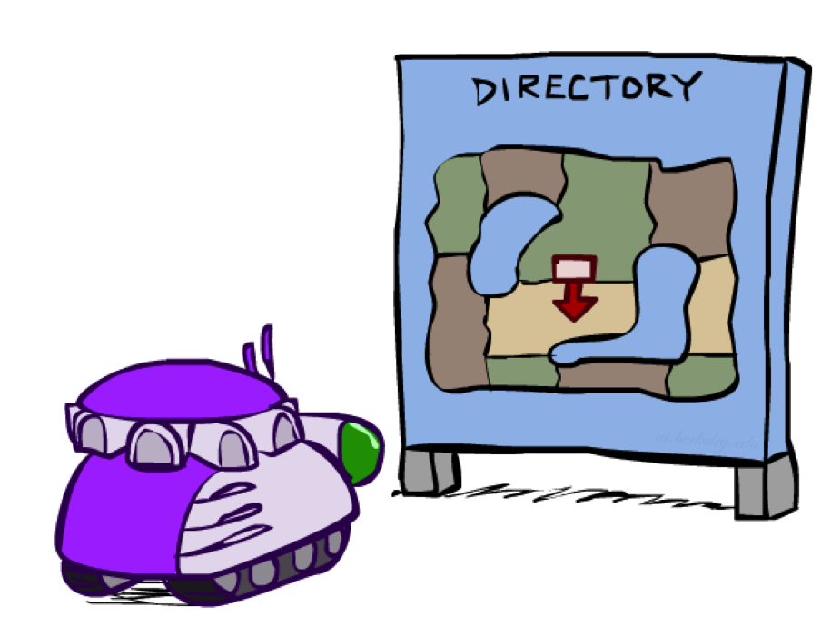
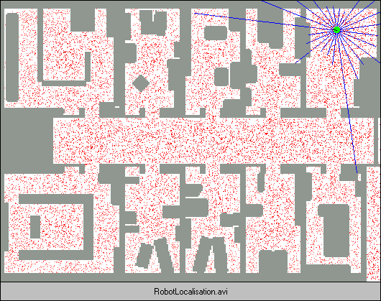
Robot Localization
In robot localization:
  We know the map, but not the robot’s position
  Observations may be vectors of range finder readings
  State space and readings are typically continuous (works basically like a very fine grid) and so we cannot store B(X)
  Particle filtering is a main technique

Slide 58

Particle Filter Localization (Sonar)
[Video: global-sonar-uw-annotated.avi]

Slide 59
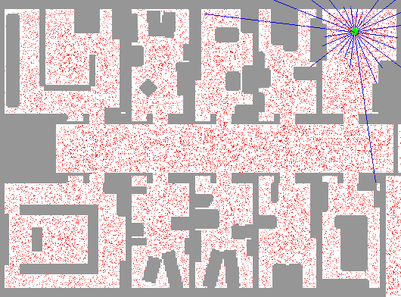
Particle Filter Localization (Laser)
[Video: global-floor.gif]

Slide 60

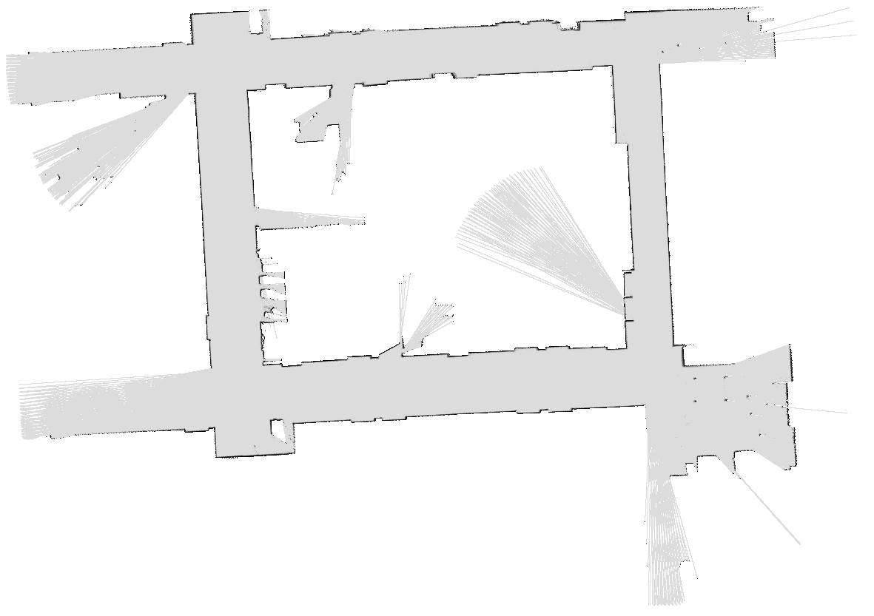
Robot Mapping
SLAM: Simultaneous Localization And Mapping
  We do not know the map or our location
  State consists of position AND map!
  Main techniques: Kalman filtering (Gaussian HMMs) and particle methods
DP-SLAM, Ron Parr
[Demo: PARTICLES-SLAM-mapping1-new.avi]

Slide 61

Particle Filter SLAM – Video 1
[Demo: PARTICLES-SLAM-mapping1-new.avi]

Slide 62

Particle Filter SLAM – Video 2
[Demo: PARTICLES-SLAM-fastslam.avi]

