Slide 1
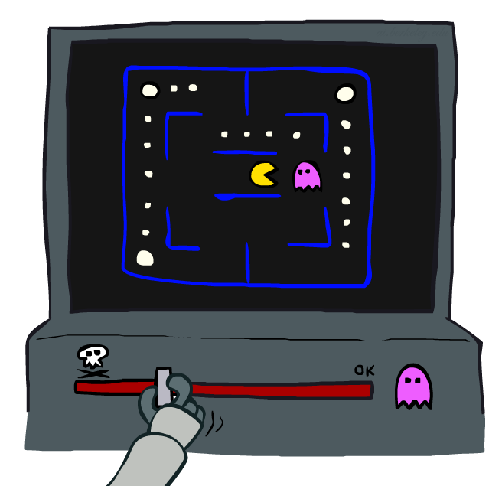
Approximate Q-Learning
Dan Weld / University of Washington
[Many slides taken from Dan Klein and Pieter Abbeel / CS188 Intro to AI at UC Berkeley – materials available at http://ai.berkeley.edu.]

Slide 2
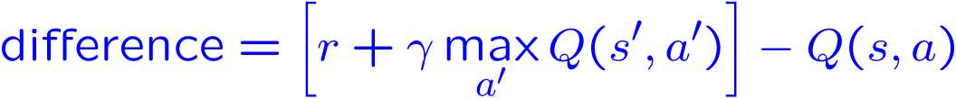
Q Learning
Forall s, a
  Initialize Q(s, a) = 0
Repeat Forever
  Where are you? s.
  Choose some action a
  Execute it in real world: (s, a, r, s’)
  Do update:
}
Equivalently
Notes:
Discuss computational complexity: S * A * S times number of iterations
Note: updates not in place [if in place, it means something else and not even clear what it means]

Slide 3
Q Learning
Forall s, a
  Initialize Q(s, a) = 0
Repeat Forever
  Where are you? s.
  Choose some action a
  Execute it in real world: (s, a, r, s’)
  Do update:
Notes:
Discuss computational complexity: S * A * S times number of iterations
Note: updates not in place [if in place, it means something else and not even clear what it means]

Slide 4

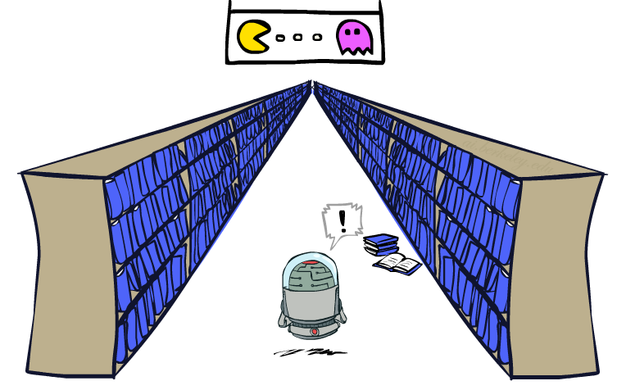
Generalizing Across States
Basic Q-Learning updates a table of all q-values
In realistic situations, we can’t possibly learn about every single state!
  Too many states to visit them all in training
  Too many states to hold the q-table in memory
Instead, we want to generalize:
  Learn about some small number of <s,a> from experience
  Generalize experience to new, similar situations
  Fundamental idea in machine learning, we’ll see it over and over again
[demo – RL pacman]

Slide 5




Example: Pacman
Let’s say we discover through experience that this state is bad:
In naïve q-learning, we know nothing about this state:

Slide 6
Example: Pacman
Let’s say we discover through experience that this state is bad:
Or even this one!

Slide 7
Q-learning, no features,
50 learning trials

Slide 8
Q-learning, no features,
1000 learning trials:

Slide 9
Feature-Based Representations
Soln: describe states w/ vector of features (aka “properties”)
  Features = functions from states to R (often 0/1) capturing important properties of the state
  Examples:
    Distance to closest ghost or dot
    Number of ghosts
    1 / (dist to dot)²
    Is Pacman in a tunnel? (0/1)
    …… etc.
    Is state the exact state on this slide?
  Can also describe a q-state (s, a) with features (e.g. action moves closer to food)

Slide 10
How to use features?
Using features we can represent V and/or Q as follows:
V(s) = g(f₁(s), f₂(s), …, f_{n}(s))
Q(s,a) = g(f₁(s,a), f₂(s,a), …, f_{n}(s,a))
What should we use for g?
(and f)?
Notes:
General form!

Slide 11
Linear Combination
Using a feature representation, we can write a q function (or value function) for any state using a few weights:
Advantage: our experience is summed up in a few powerful numbers
Disadvantage: states sharing features may actually have very different values!

Slide 12

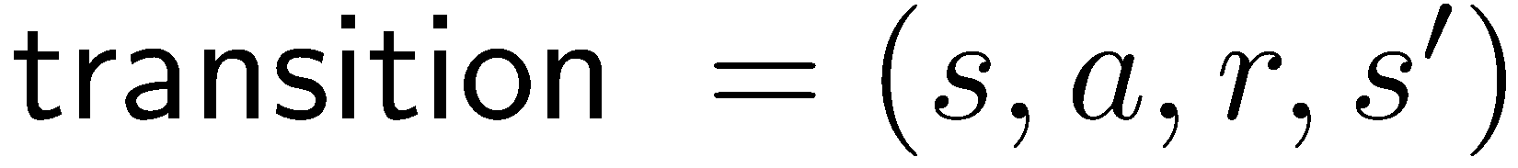
Approximate Q-Learning
Q-learning with linear Q-functions:
Intuitive interpretation:
  Adjust weights of active features
  E.g., if something unexpectedly bad happens, blame the features that were on: disprefer all states with that state’s features
Formal justification: in a few slides!
Exact Q’s
Approximate Q’s

Slide 13



Example: Pacman Features
$$Q\left(s,a\right)= w_{1}f_{DOT}\left(s, a\right)+w_{2}f_{GST}(s,a)$$
$$f_{DOT}\left(s,a\right)= \frac{1}{distance to closest food after taking a}$$
$$f_{DOT}\left(s,NORTH\right)=0.5$$
$$f_{GST}\left(s,a\right)=distance to closest ghost after taking a$$
$$f_{GST}\left(s,NORTH\right)= 1.0$$

Slide 14
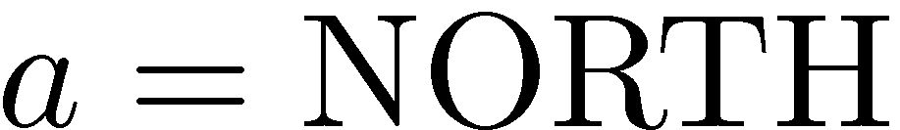
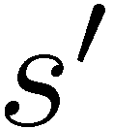



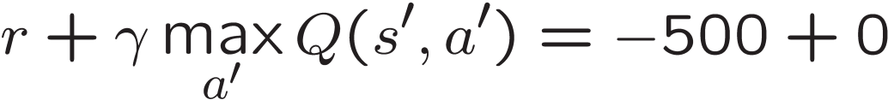
Example: Q-Pacman
α = 0.004
[Demo: approximate Q-learning pacman (L11D10)]
Notes:
Alpha = 1/250 = 0.004

Slide 15

Video of Demo Approximate Q-Learning -- Pacman

Slide 16
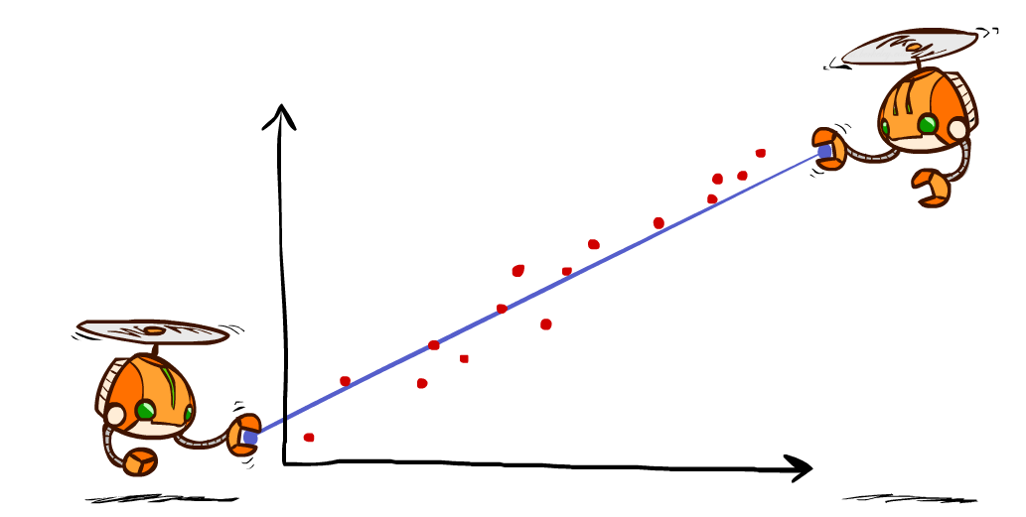
Sidebar: Q-Learning and Least Squares

Slide 17

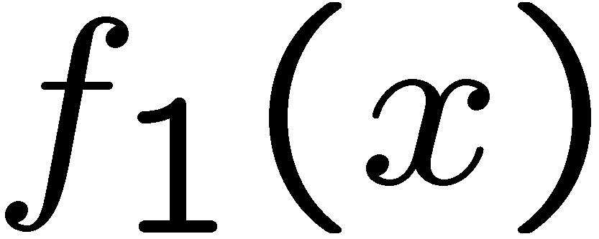
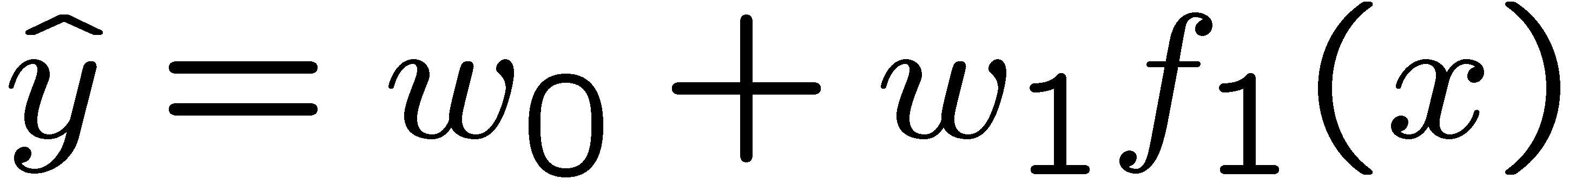
Linear Approximation: Regression
40
26
24
20
22
20
30
20
40
0
0
20
30
10
20
0
10
0
Prediction:
Prediction:
Notes:
Figure 1: scatter(1:20,10+(1:20)+2*randn(1,20),'k','filled'); a=axis; a(3)=0; axis(a);

Slide 18
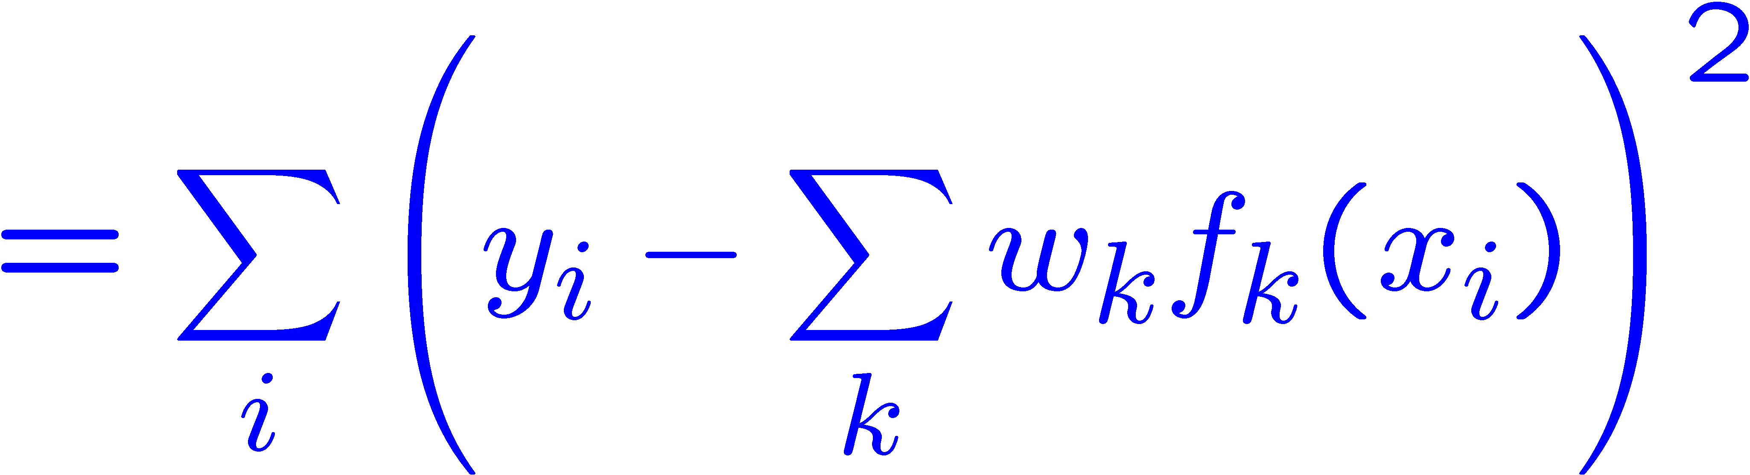
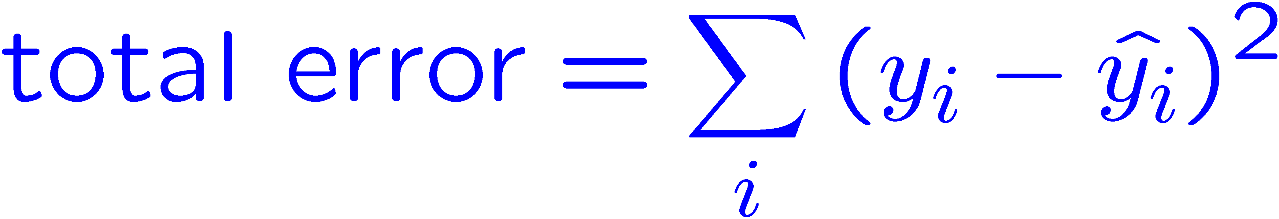



Optimization: Least Squares
Error or “residual”
Observation
Prediction
0
0
20
Notes:
Figure 1: scatter(1:20,10+(1:20)+2*randn(1,20),'k','filled'); a=axis; a(3)=0; axis(a);

Slide 19
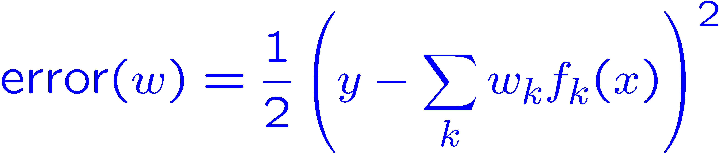
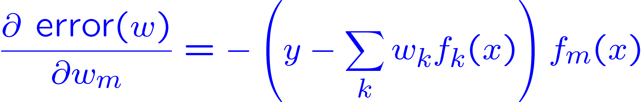
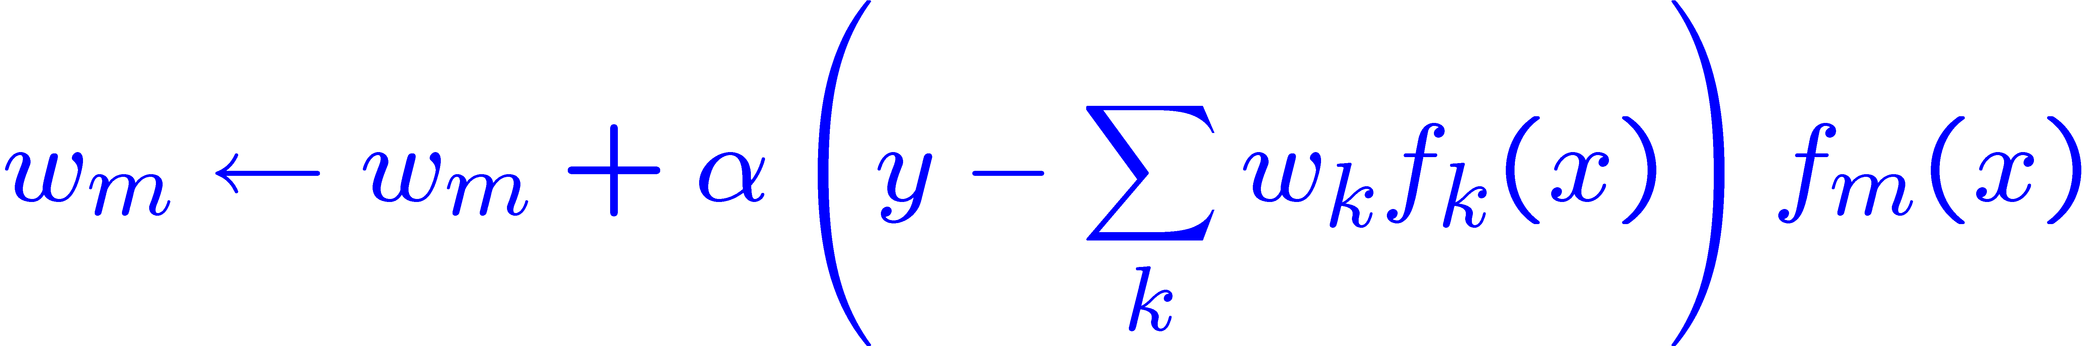
Minimizing Error
Imagine we had only one point x, with features f(x), target value y, and weights w:
Approximate q update explained:
“target”
“prediction”

Slide 20
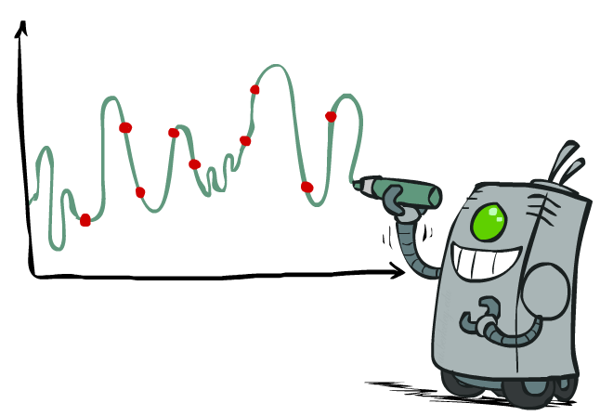
Overfitting: Why Limiting Capacity Can Help
30
25
20
Degree 15 polynomial
15
10
5
0
-5
-10
-15
0
2
4
6
8
10
12
14
16
18
20

Slide 21
Simple Problem
Given: Features of current state
Predict: Will Pacman die on the next step?

Slide 22
Just one feature. See a pattern?
Ghost one step away, pacman dies
Ghost one step away, pacman dies
Ghost one step away, pacman dies
Ghost one step away, pacman dies
Ghost one step away, pacman lives
Ghost more than one step away, pacman lives
Ghost more than one step away, pacman lives
Ghost more than one step away, pacman lives
Ghost more than one step away, pacman lives
Ghost more than one step away, pacman lives
Ghost more than one step away, pacman lives
Learn: Ghost one step away → pacman dies!

Slide 23
See a pattern?
Ghost one step away, pacman dies
Ghost one step away, pacman dies
Ghost one step away, pacman dies
Ghost one step away, pacman dies
Ghost one step away, pacman lives
Ghost more than one step away, pacman lives
Ghost more than one step away, pacman lives
Ghost more than one step away, pacman lives
Ghost more than one step away, pacman lives
Ghost more than one step away, pacman lives
Ghost more than one step away, pacman lives
Learn: Ghost one step away → pacman dies!

Slide 24
What if we add more features?
Ghost one step away, score 211, pacman dies
Ghost one step away, score 341, pacman dies
Ghost one step away, score 231, pacman dies
Ghost one step away, score 121, pacman dies
Ghost one step away, score 301, pacman lives
Ghost more than one step away, score 205, pacman lives
Ghost more than one step away, score 441, pacman lives
Ghost more than one step away, score 219, pacman lives
Ghost more than one step away, score 199, pacman lives
Ghost more than one step away, score 331, pacman lives
Ghost more than one step away, score 251, pacman lives
Learn: Ghost one step away AND score is NOT prime number → pacman dies!

Slide 25
There’s fitting, and there’s
30
25
20
Degree 1 polynomial
15
10
5
0
-5
-10
-15
0
2
4
6
8
10
12
14
16
18
20

Slide 26
There’s fitting, and there’s
30
25
20
Degree 2 polynomial
15
10
5
0
-5
-10
-15
0
2
4
6
8
10
12
14
16
18
20

Slide 27
Overfitting
30
25
20
Degree 15 polynomial
15
10
5
0
-5
-10
-15
0
2
4
6
8
10
12
14
16
18
20

Slide 28
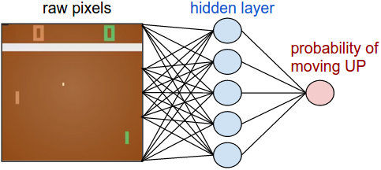
Approximating Q Function
Linear Approximation
Could also use Deep Neural Network
  https://www.nervanasys.com/demystifying-deep-reinforcement-learning/
Q(s,a)

Slide 29
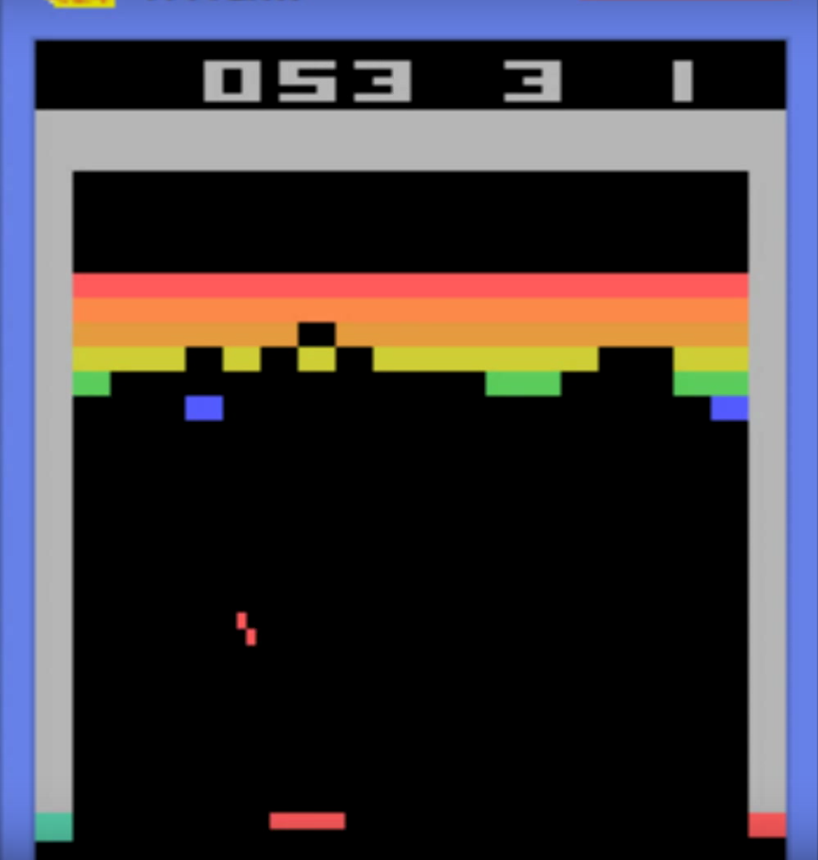
Deepmind Atari
https://www.youtube.com/watch?v=V1eYniJ0Rnk

Slide 30
DQN Results on Atari
Slide adapted from David Silver

Slide 31
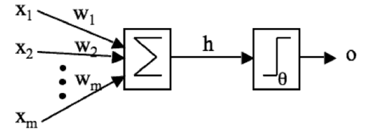
Approximating the Q Function
Linear Approximation
f₁(s,a)
Q
f₂(s,a)
f_{m}(s,a)
Neural Approximation (nonlinear)
f₁(s,a)
Q
f₂(s,a)
1
f_{m}(s,a)
h(z)
0
0

Slide 32
Deep Representations
Slide adapted from David Silver

Slide 33
Multi Layer Perceptron
Multiple Layers
Feed Forward
Connected Weights
1-of-N Output
[ Y₁ , Y₂ ]
k
output
w_{jk}
hidden
j
1
v_{ij}
0
i
input
0
[ X₁ , X₂ , X₃ ]

Slide 34
Training via Stochastic Gradient Descent
Loss = fancy ML word for “error”
Slide adapted from David Silver

Slide 35



Aka ... Backpropagation
Minimize error of
calculated output
Adjust weights
  Gradient Descent
Procedure
  Forward Phase
  Backpropagation
  of errors
For each sample,
multiple epochs
k
w_{jk}
j
v_{ij}
i

Slide 36
Weight Sharing
Slide adapted from David Silver

Slide 37
Recap: Approx Q-Learning
Slide adapted from David Silver

Slide 38
Deep Q-Networks (DQN) Experience Replay
Slide adapted from David Silver

Slide 39
DQN in Atari
Slide adapted from David Silver

Slide 40
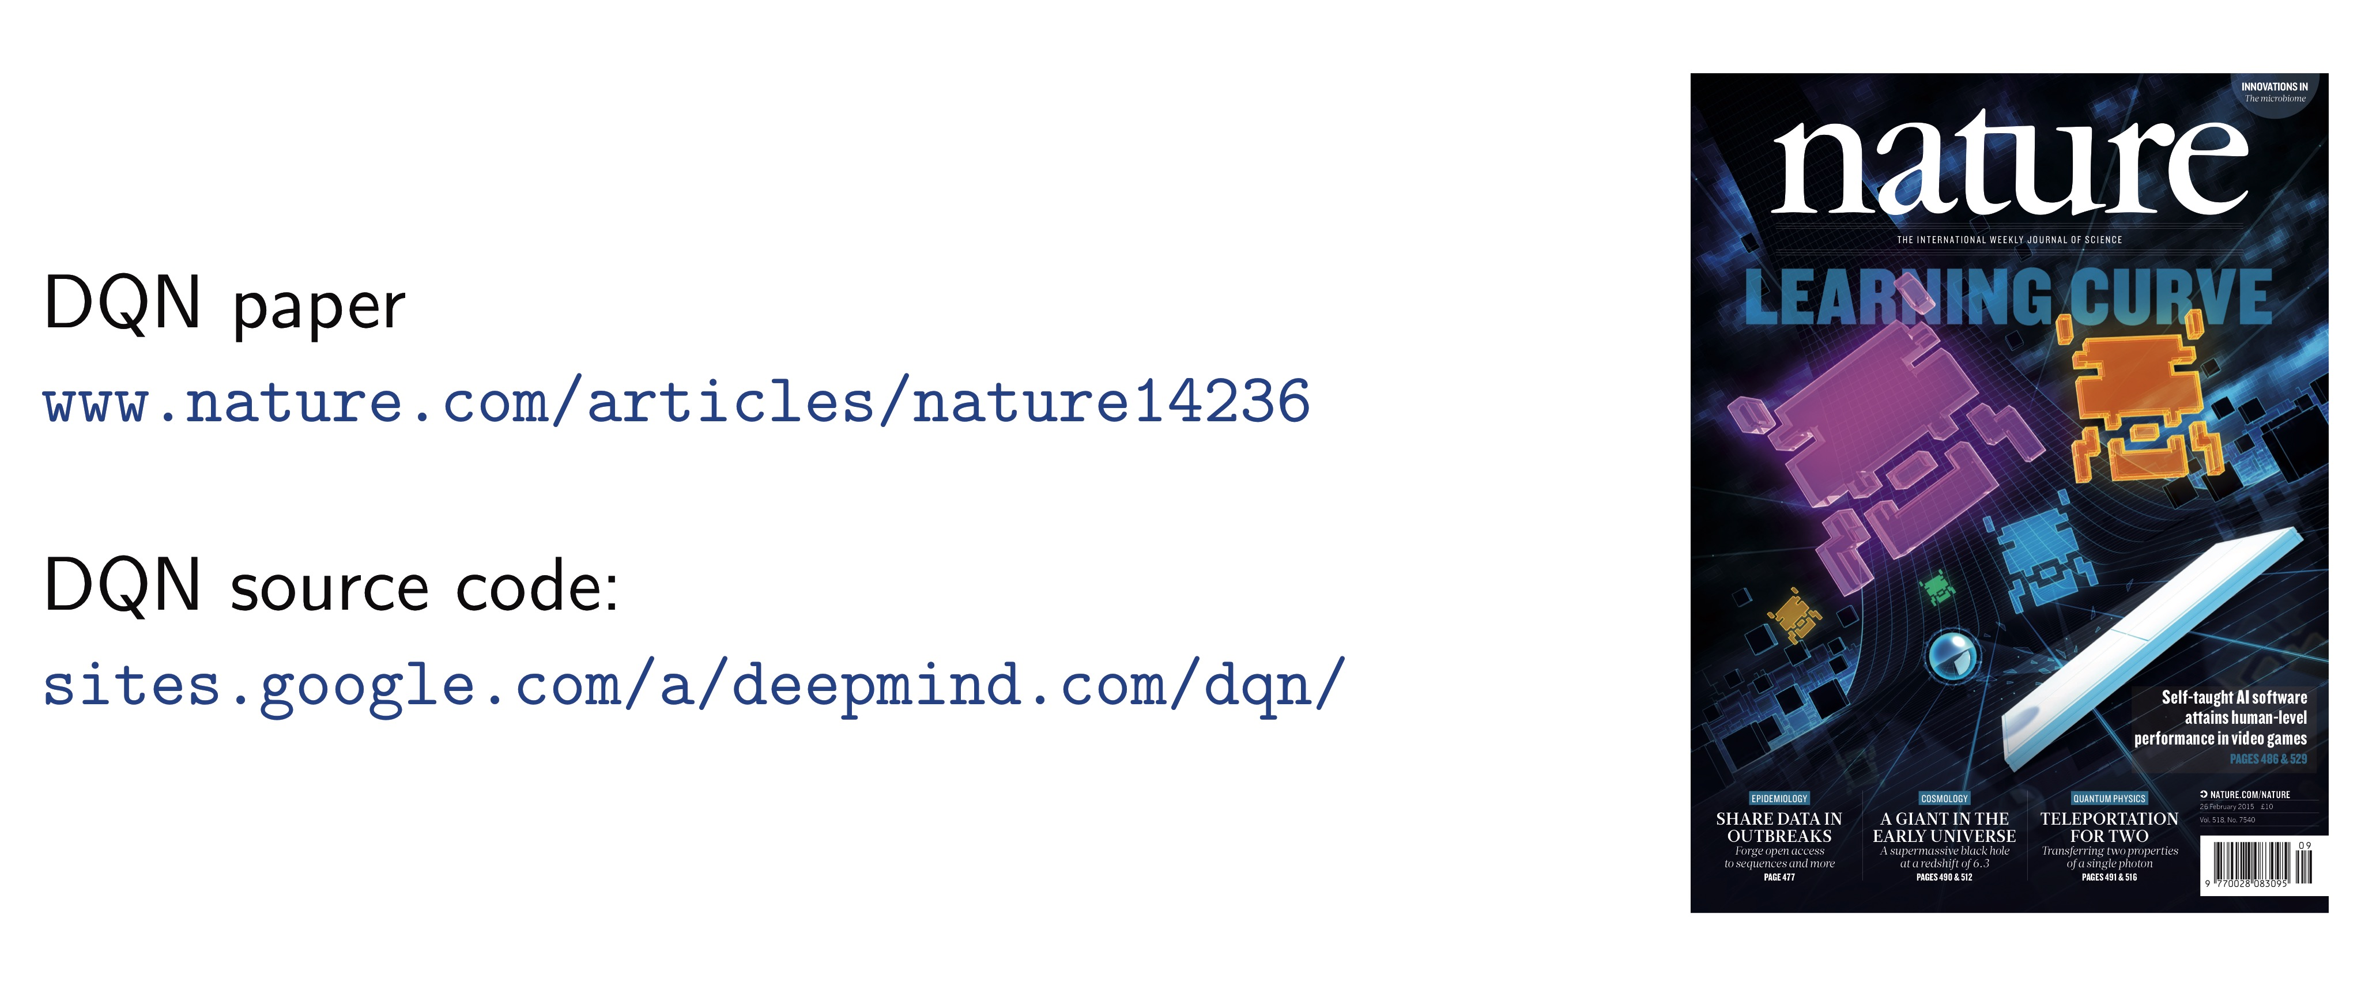
Deep Mind Resources
See also: http://icml.cc/2016/tutorials/deep_rl_tutorial.pdf

Slide 41
Playing Atari with Deep RL
Breakout:
https://www.youtube.com/watch?v=V1eYniJ0Rnk
More games (less interesting)
https://www.youtube.com/watch?v=iqXKQf2BOSE
Paper
https://arxiv.org/pdf/1312.5602.pdf)
Notes:
18 secs
122 sec for pong

Slide 42
What did you learn?
Deep RL obviates hand features
Approximate Q with nonlinear approx (NN)
  Convergence?
Use sequences (histories?) not individual actions
  Markov?
Challenge of sparse rewards

Slide 43
Why use Experience Replay?
Maximize utility of data
Avoid updates on correlated game states
  I.I.D. assumption
Avoid local maxima / divergence

Slide 44
Other Experiments?
Other types of Atari games?
  What characterized success / failure?
Fair comparison with human ‘experts’?
Effect of parameter values?
  Action every k frames, clipping rewards, …
Effect of experience replay?
Effect of NN architecture (# layers etc)
Does it work on go / chess?

Slide 45

Normal Programming now resuming…

Slide 46
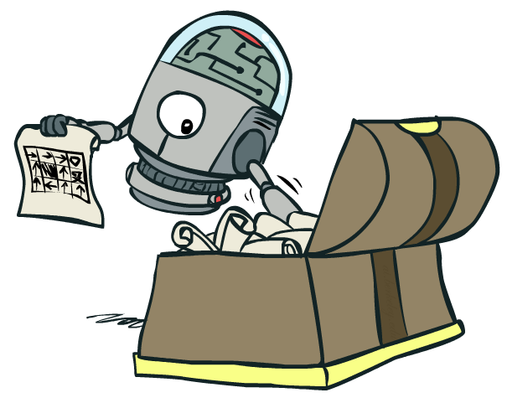
Policy Search

Slide 47
Policy Search
Problem: often the feature-based policies that work well (win games, maximize utilities) aren’t the ones that approximate V / Q best
  E.g. your value functions from project 2 were probably horrible estimates of future rewards, but they still produced good decisions
  Q-learning’s priority: get Q-values close (modeling)
  Action selection priority: get ordering of Q-values right (prediction)
  We’ll see this distinction between modeling and prediction again later in the course
Solution: learn policies that maximize rewards, not the values that predict them
Policy search: start with an ok solution (e.g. Q-learning) then fine-tune by hill climbing on feature weights

Slide 48
Policy Search
Simplest policy search:
  Start with an initial linear value function or Q-function
  Nudge each feature weight up and down and see if your policy is better than before
Problems:
  How do we tell the policy got better?
  Need to run many sample episodes!
  If there are a lot of features, this can be impractical
Better methods exploit lookahead structure, sample wisely, change multiple parameters…

Slide 49
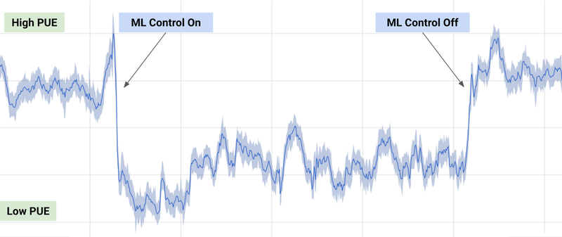
That’s all for Reinforcement Learning!
Data (experiences with environment)
Reinforcement Learning Agent
Policy (how to act in the future)
Very tough problem: How to perform any task well in an unknown, noisy environment!
Traditionally used mostly for robotics, but…
Google DeepMind – RL applied to data center power usage

Slide 50
That’s all for Reinforcement Learning!
Data (experiences with environment)
Reinforcement Learning Agent
Policy (how to act in the future)
Lots of open research areas:
  How to best balance exploration and exploitation?
  How to deal with cases where we don’t know a good state/feature representation?

Slide 51
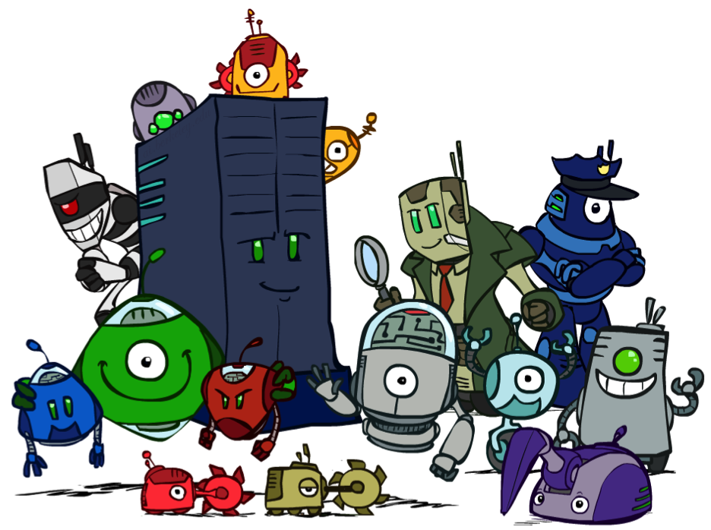
Conclusion
We’re done with Part I: Search and Planning!
We’ve seen how AI methods can solve problems in:
  Search
  Constraint Satisfaction Problems
  Games
  Markov Decision Problems
  Reinforcement Learning
Next up: Part II: Uncertainty and Learning!

