Slide 1
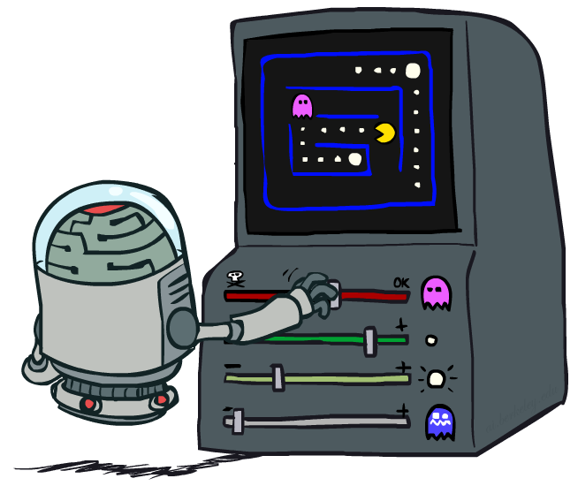
CSE 473: Artificial Intelligence
Reinforcement Learning
Dan Weld/ University of Washington
[Many slides taken from Dan Klein and Pieter Abbeel / CS188 Intro to AI at UC Berkeley – materials available at http://ai.berkeley.edu.]
Notes:
Please retain proper attribution and the reference to ai.berkeley.edu. Thanks!

Slide 2
todo
Bandit slides still poorly integrated
Exploration function slide is back to multi-state MDP in the middle of a bandit discussion
Lots of duplication – cut and simplify
Integrate thompson sampling
Make sure q-learning is always described using difference

Slide 3
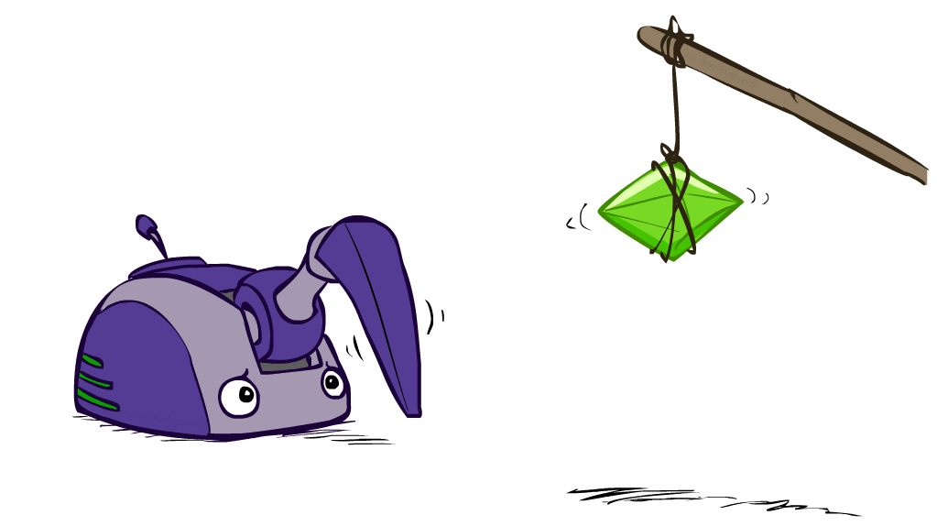
Reinforcement Learning

Slide 4
Reinforcement Learning
Agent
State: s
Reward: r
Actions: a
Environment
Basic idea:
  Receive feedback in the form of rewards
  Agent’s utility is defined by the reward function
  Must (learn to) act so as to maximize expected rewards
  All learning is based on observed samples of outcomes!
Notes:
Show robot-soccer learning to walk videos (UT Austin):
? Show snake robot:

Slide 5
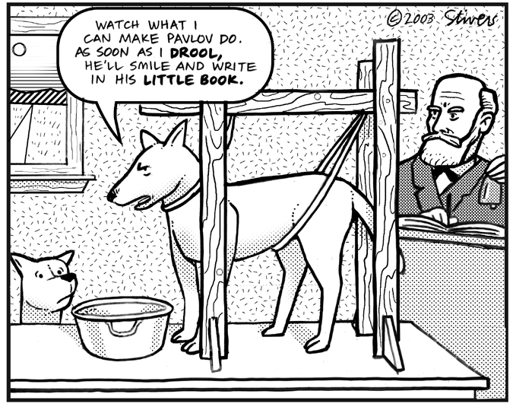
Example 2 – More Animal Learning

Slide 6
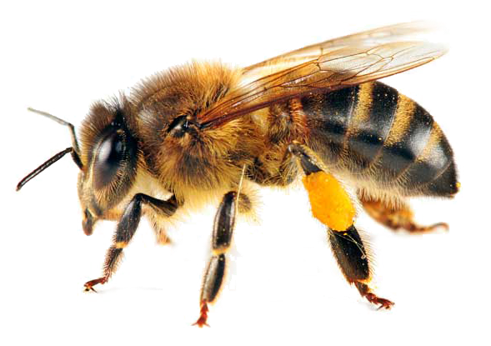
Example: Animal Learning
RL studied experimentally for more than 60 years in psychology
Example: foraging
  Rewards: food, pain, hunger, drugs, etc.
  Mechanisms and sophistication debated
  Bees learn near-optimal foraging plan in field of artificial flowers with controlled nectar supplies
  Bees have a direct neural connection from nectar intake measurement to motor planning area

Slide 7
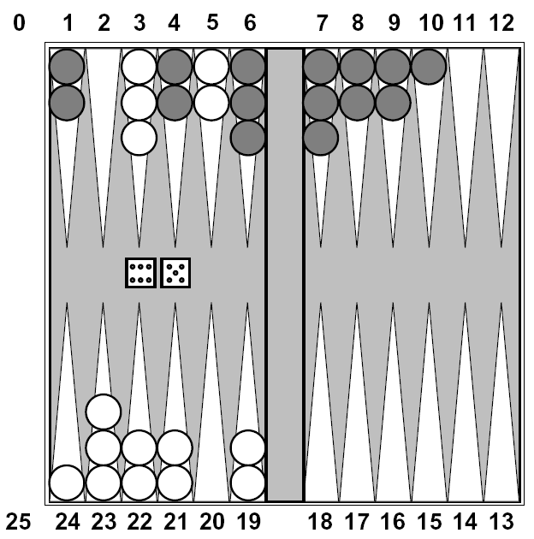
Example: Backgammon
Reward only for win / loss in terminal states, zero otherwise
TD-Gammon learns a function approximation to V(s) using a neural network
Combined with depth 3 search, one of the top 3 players in the world
You could imagine training Pacman this way…
… but it’s tricky! (It’s also PS 3)

Slide 8
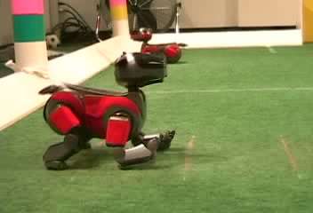
Example: Learning to Walk
Initial
[Kohl and Stone, ICRA 2004]
[Video: AIBO WALK – initial]

Slide 9
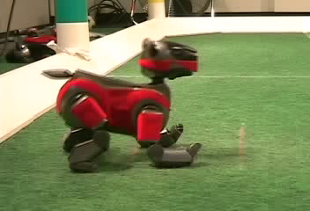
Example: Learning to Walk
Finished
[Kohl and Stone, ICRA 2004]
[Video: AIBO WALK – finished]

Slide 10
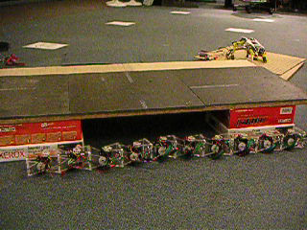
Example: Sidewinding
[Andrew Ng]
[Video: SNAKE – climbStep+sidewinding]

Slide 11

Video of Demo Crawler Bot
More demos at:
http://inst.eecs.berkeley.edu/~ee128/fa11/videos.html

Slide 12
“Few driving tasks are as intimidating as parallel parking….
https://www.youtube.com/watch?v=pB_iFY2jIdI

Slide 13
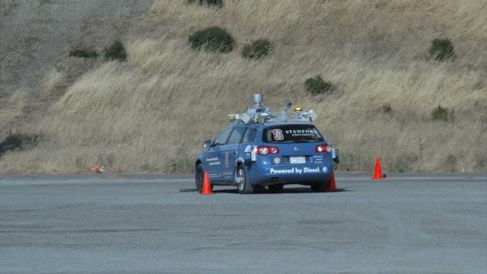
Parallel Parking
“Few driving tasks are as intimidating as parallel parking….
https://www.youtube.com/watch?v=pB_iFY2jIdI
Notes:
Zico Kolter - http://ai.stanford.edu/~kolter/icra10/mmlqr.mp4

Slide 14
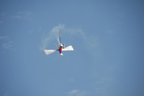
Other Applications
Go playing
Robotic control
  helicopter maneuvering, autonomous vehicles
  Mars rover - path planning, oversubscription planning
  elevator planning
Game playing - backgammon, tetris, checkers
Neuroscience
Computational Finance, Sequential Auctions
Assisting elderly in simple tasks
Spoken dialog management
Communication Networks – switching, routing, flow control
War planning, evacuation planning

Slide 15
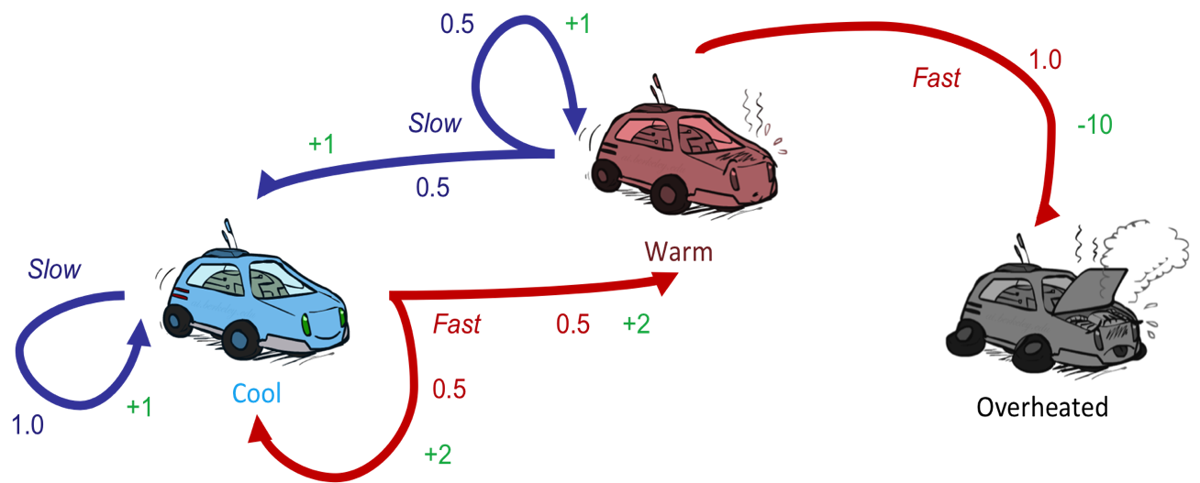
Reinforcement Learning
Still assume a Markov decision process (MDP):
  A set of states s ∈ S
  A set of actions (per state) A
  A model T(s,a,s’)
  A reward function R(s,a,s’) & discount γ
Still looking for a policy π(s)
New twist: don’t know T or R
  I.e. we don’t know which states are good or what the actions do
  Must actually try actions and states out to learn
?

Slide 16
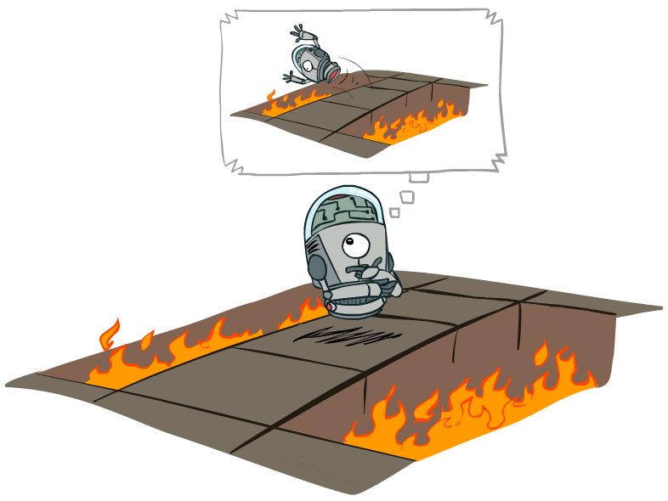
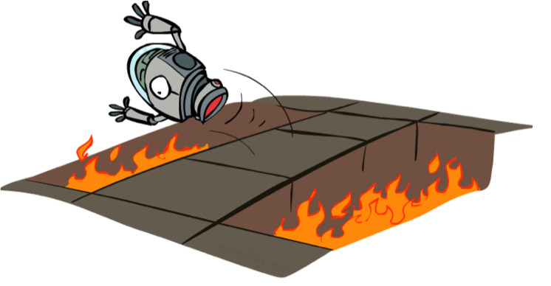
Offline (MDPs) vs. Online (RL)
Simulator
Offline Solution
(Planning)
Monte Carlo
Planning
Online Learning
(RL)

Slide 17
Three Key Ideas for RL
Model-based vs model-free learning
  What function is being learned?
Approximating the Value Function
  Smaller → easier to learn & better generalization
Exploration-exploitation tradeoff

Slide 18
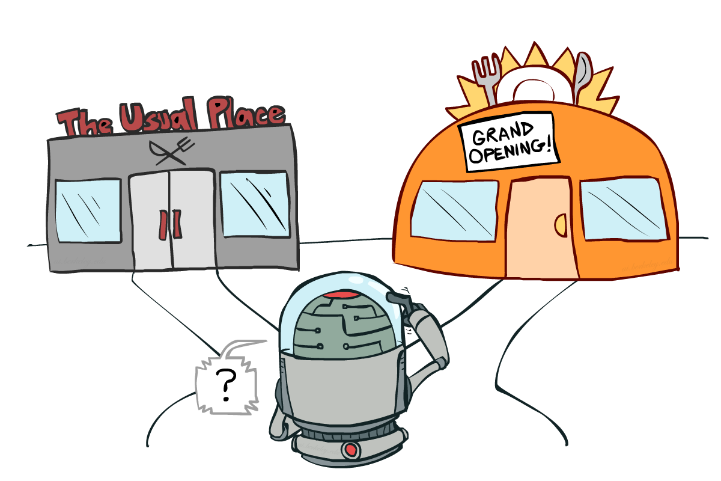
Exploration-Exploitation tradeoff
You have visited part of the state space and found a reward of 100
  is this the best you can hope for???
Exploitation: should I stick with what I know and find a good policy w.r.t. this knowledge?
  at risk of missing out on a better reward somewhere
Exploration: should I look for states w/ more reward?
  at risk of wasting time & getting some negative reward

Slide 19
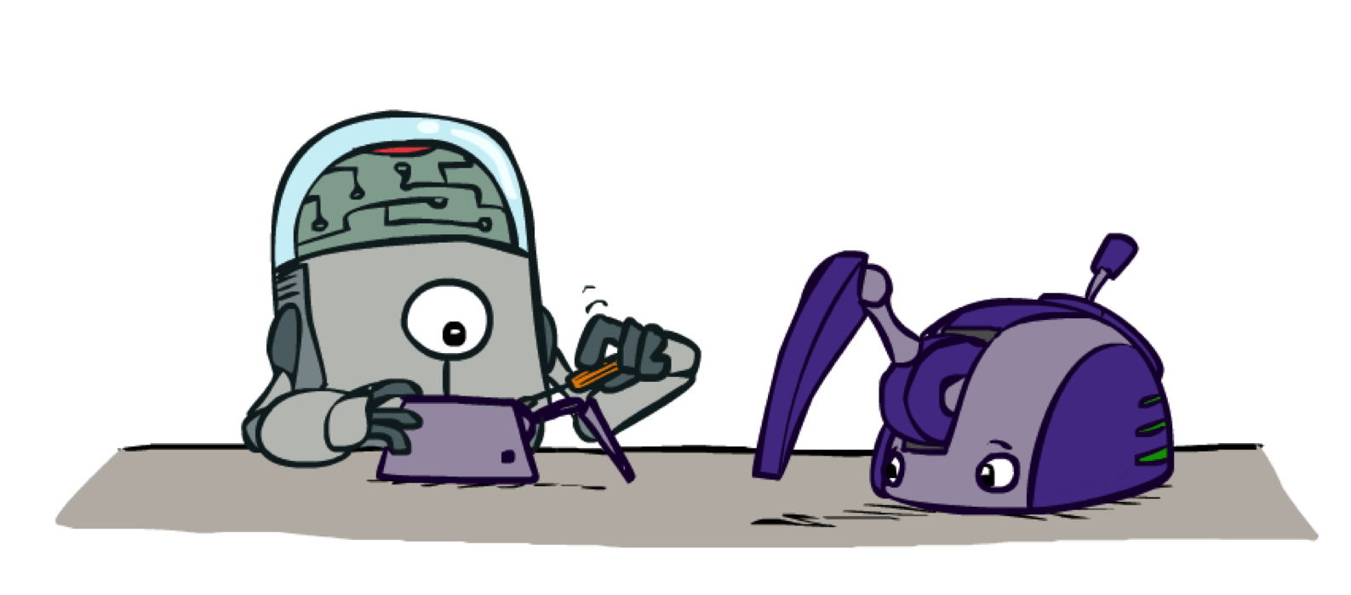
Model-Based Learning

Slide 20




Model-Based Learning
Model-Based Idea:
  Learn an approximate model based on experiences
  Solve for values as if the learned model were correct
Step 1: Learn empirical MDP model
  Count outcomes s’ for each s, a
  Normalize to give an estimate of
  Discover each when we experience (s, a, s’)
Step 2: Solve the learned MDP
  For example, use value iteration, as before

Slide 21
Example: Model-Based Learning
Random π
Observed Episodes (Training)
Learned Model
Episode 1
Episode 2
T(s,a,s’).
T(B, east, C) = 1.00
T(C, east, D) = 0.75
T(C, east, A) = 0.25
…
R(s,a,s’).
R(B, east, C) = -1
R(C, east, D) = -1
R(D, exit, x) = +10
…
 | A
B | C | D
 | E
B, east, C, -1
C, east, D, -1
D, exit, x, +10
B, east, C, -1
C, east, D, -1
D, exit, x, +10
Episode 3
Episode 4
E, north, C, -1
C, east, D, -1
D, exit, x, +10
E, north, C, -1
C, east, A, -1
A, exit, x, -10
Assume: γ = 1

Slide 22
Convergence
If policy explores “enough” – doesn’t starve any state
Then T & R converge
So, VI, PI, Lao* etc. will find optimal policy
  Using Bellman Equations
When can agent start exploiting??
  (We’ll answer this question later)

Slide 23
Two main reinforcement learning approaches
Model-based approaches:
  explore environment & learn model, T=P(s’|s,a) and R(s,a), (almost) everywhere
  use model to plan policy, MDP-style
  approach leads to strongest theoretical results
  often works well when state-space is manageable
Model-free approach:
  don’t learn a model; learn value function or policy directly
  weaker theoretical results
  often works better when state space is large

Slide 24
Two main reinforcement learning approaches
Model-based approaches:
  Learn T + R
  |S|²|A| + |S||A| parameters (40,400)
Model-free approach:
  Learn Q
  |S||A| parameters (400)
Suppose 100 states, 4 actions

Slide 25
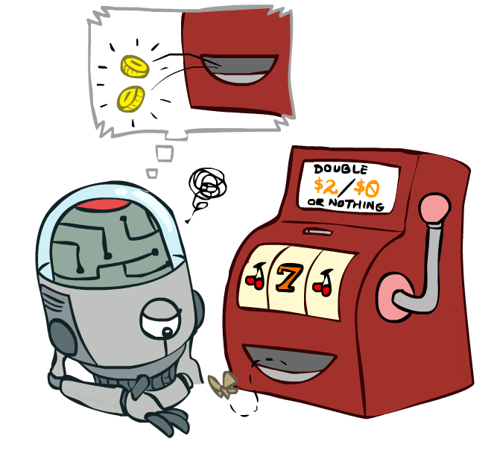
Model-Free Learning

Slide 26

Nothing is Free in Life!
What exactly is Free???
  No model of T
  No model of R
  (Instead, just model Q)

Slide 27
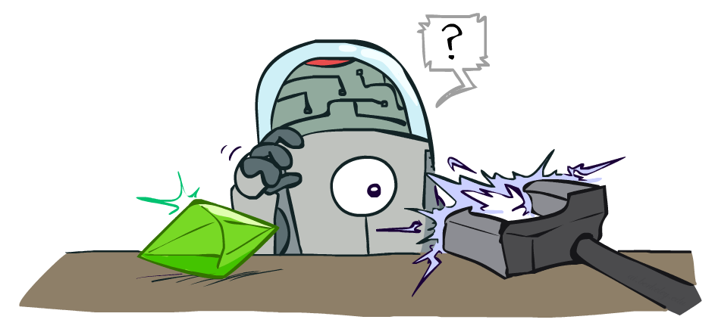
CSE 573: Artificial Intelligence
Reinforcement Learning
Dan Weld
University of Washington
[Most of these slides were created by Dan Klein and Pieter Abbeel for CS188 Intro to AI at UC Berkeley. All CS188 materials are available at http://ai.berkeley.edu.]
Notes:
Please retain proper attribution, including the reference to ai.berkeley.edu. Thanks!

Slide 28
Reminder: Q-Value Iteration
Forall s, a
  Initialize Q₀(s, a) = 0 no time steps left means an expected reward of zero
K = 0
Repeat do Bellman backups
  For every (s,a) pair:
  K += 1
Until convergence I.e., Q values don’t change much
Q_{k+1}(s,a)
a
s, a
s,a,s’
V_{k}(s’)=Max_{a’}Q_{k}(s’,a’)
This is easy….
We can sample this
Notes:
Discuss computational complexity: S * A * S times number of iterations
Note: updates not in place [if in place, it means something else and not even clear what it means]

Slide 29
Puzzle: Q-Learning
Forall s, a
  Initialize Q₀(s, a) = 0 no time steps left means an expected reward of zero
K = 0
Repeat do Bellman backups
  For every (s,a) pair:
  K += 1
Until convergence I.e., Q values don’t change much
Q_{k+1}(s,a)
a
s, a
s,a,s’
V_{k}(s’)=Max_{a’}Q_{k}(s’,a’)
Q: How can we compute without R, T ?!?
A: Compute averages using sampled outcomes
Notes:
Discuss computational complexity: S * A * S times number of iterations
Note: updates not in place [if in place, it means something else and not even clear what it means]

Slide 30
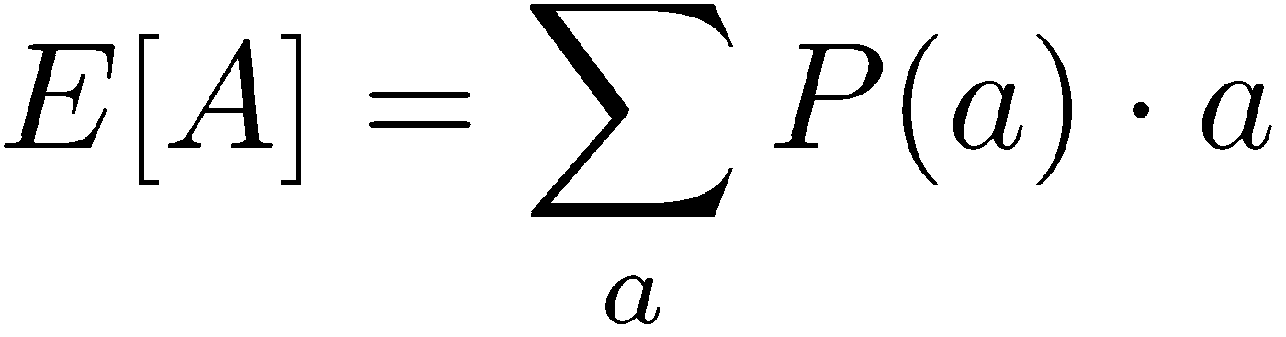
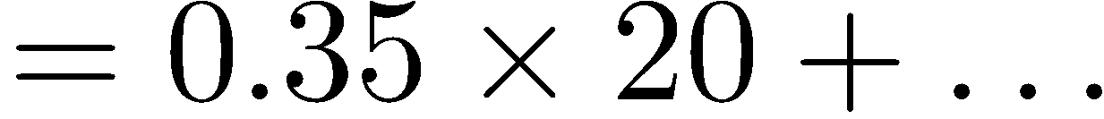
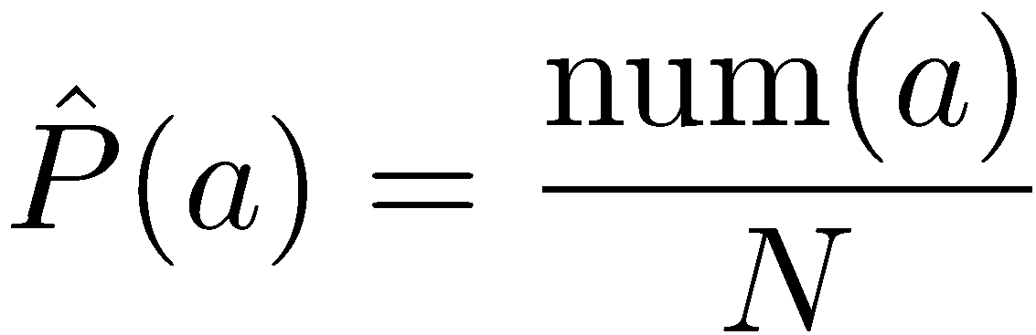
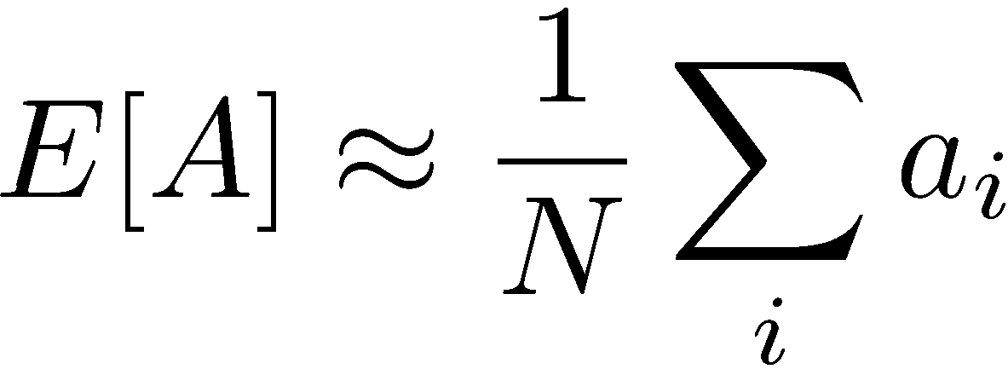
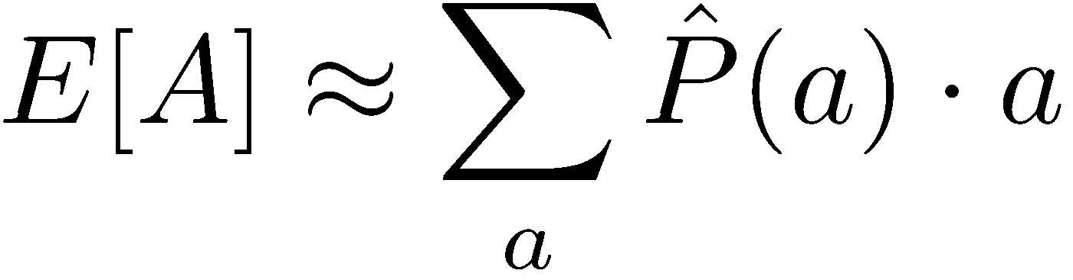
Simple Example: Expected Age
Goal: Compute expected age of CSE students
Known P(A)
Note: never know P(age=22)
Without P(A), instead collect samples [a₁, a₂, … a_{N}]
Unknown P(A): “Model Based”
Unknown P(A): “Model Free”
Why does this work? Because eventually you learn the right model.
Why does this work? Because samples appear with the right frequencies.

Slide 31
Anytime Model-Free Expected Age
Goal: Compute expected age of CSE students
Let A=0
Loop for i = 1 to ∞
a_{i} ← ask “what is your age?”
A ← (1-α)*A + α*a_{i}
Without P(A), instead collect samples [a₁, a₂, … a_{N}]
Unknown P(A): “Model Free”
Let A=0
Loop for i = 1 to ∞
a_{i} ← ask “what is your age?”
A ← (i-1)/i * A + (1/i) * a_{i}

Slide 32

Exponential Moving Average
Exponential moving average
  The running interpolation update:
  Makes recent samples more important:
  Forgets about the past (distant past values were wrong anyway)
Decreasing learning rate (alpha) can give converging averages
  E.g., 𝛼 = 1/i
Don’t show this - unnecessary

Slide 33
Sampling Q-Values
Big idea: learn from every experience!
  Follow exploration policy a ← π(s)
  Update Q(s,a) each time we experience a transition (s, a, s’, r)
  Likely outcomes s’ will contribute updates more often
Update towards running average:
s
π(s), r
s’
Get a sample of Q(s,a): sample = R(s,a,s’) + γ Max_{a’} Q(s’, a’)
Update to Q(s,a):
Q(s,a) ← (1-𝛼)Q(s,a) + (𝛼)sample
Same update:
Q(s,a) ← Q(s,a) + 𝛼(sample – Q(s,a))

Slide 34
Sampling Q-Values
Big idea: learn from every experience!
  Follow exploration policy a ← π(s)
  Update Q(s,a) each time we experience a transition (s, a, s’, r)
  Likely outcomes s’ will contribute updates more often
Update towards running average:
s
π(s), r
s’
Get a sample of Q(s,a): sample = R(s,a,s’) + γ Max_{a’} Q(s’, a’)
Update to Q(s,a):
Q(s,a) ← (1-𝛼)Q(s,a) + (𝛼)sample

Slide 35
Q Learning
Forall s, a
  Initialize Q(s, a) = 0
Repeat Forever
  Where are you? s.
  Choose some action a
  Execute it in real world: (s, a, r, s’)
  Do update:
Trial
Note parallel with RTDP from last class
Notes:
Discuss computational complexity: S * A * S times number of iterations
Note: updates not in place [if in place, it means something else and not even clear what it means]

Slide 36
Q Learning
Forall s, a
  Initialize Q(s, a) = 0
Repeat Forever
  Where are you? s.
  Choose some action a
  Execute it in real world: (s, a, r, s’)
  Do update:
Notes:
Discuss computational complexity: S * A * S times number of iterations
Note: updates not in place [if in place, it means something else and not even clear what it means]

Slide 37
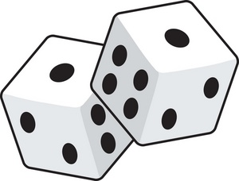
Example
Assume: γ = 1, α = 1/2
Observed Transition:
B, east, C, -2
A
0
0
0
0
B
0
C
0
D
0
0
0
0
0
0
8
0
0
0
E
0
0
0
0
In state B. What should you do?
Suppose (for now) we follow a random exploration policy
→ “Go east”

Slide 38
Example
Assume: γ = 1, α = 1/2
Observed Transition:
B, east, C, -2
A
0
A
0
0
0
0
0
0
0
B
0
C
0
D
0
B
0
C
0
D
0
0
0
0
0
0
8
0
?
0
0
0
8
0
0
0
0
0
0
E
0
E
0
0
0
0
0
0
0
-1
½
0
½
-2
0

Slide 39
Example
Assume: γ = 1, α = 1/2
Observed Transition:
B, east, C, -2
C, east, D, -2
A
0
A
0
A
0
0
0
0
0
0
0
0
0
0
B
0
C
0
D
0
B
0
C
0
D
0
B
0
C
0
D
0
0
0
0
0
0
8
0
-1
0
0
0
8
0
0
0
?
0
8
0
0
0
0
0
0
0
0
0
E
0
E
0
E
0
0
0
0
0
0
0
0
0
0
3
½
0
½
-2
8

Slide 40
Example
Assume: γ = 1, α = 1/2
Observed Transition:
B, east, C, -2
C, east, D, -2
A
0
A
0
A
0
0
0
0
0
0
0
0
0
0
B
0
C
0
D
0
B
0
C
0
D
0
B
0
C
0
D
0
0
0
0
0
0
8
0
-1
0
0
0
8
0
-1
0
3
0
8
0
0
0
0
0
0
0
0
0
E
0
E
0
E
0
0
0
0
0
0
0
0
0
0

Slide 41

Q-Learning Properties
Q-learning converges to optimal Q function (and hence learns optimal policy)
  even if you’re acting suboptimally!
  This is called off-policy learning
Caveats:
  You have to explore enough
  You have to eventually shrink the learning rate, α
  … but not decrease it too quickly
And… if you want to act optimally
  You have to switch from explore to exploit
[Demo: Q-learning – auto – cliff grid (L11D1)]

Slide 42
Video of Demo Q-Learning Auto Cliff Grid

Slide 43
Q Learning
Forall s, a
  Initialize Q(s, a) = 0
Repeat Forever
  Where are you? s.
  Choose some action a
  Execute it in real world: (s, a, r, s’)
  Do update:
Notes:
Discuss computational complexity: S * A * S times number of iterations
Note: updates not in place [if in place, it means something else and not even clear what it means]

Slide 44
Exploration vs. Exploitation

Slide 45
Questions
How to explore?
  a Exploration
  Uniform exploration
  Epsilon Greedy
    With (small) probability ε, act randomly
    With (large) probability 1-ε, act on current policy
  Exploration Functions (such as UCB)
  Thompson Sampling
When to exploit?
How to even think about this tradeoff?

Slide 46
Questions
How to explore?
  Random Exploration
  Uniform exploration
  Epsilon Greedy
    With (small) probability ε, act randomly
    With (large) probability 1-ε, act on current policy
  Exploration Functions (such as UCB)
  Thompson Sampling
When to exploit?
How to even think about this tradeoff?

Slide 47
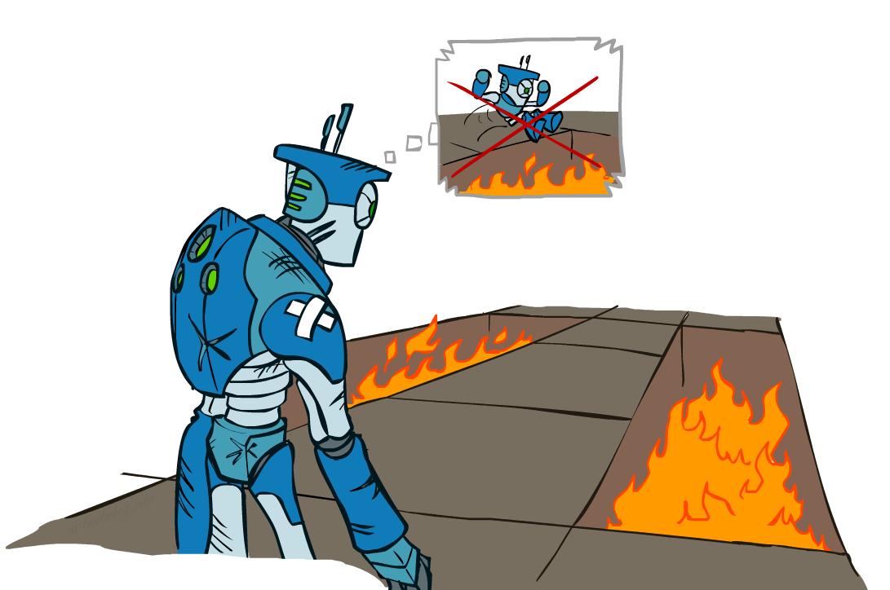
Regret
Even if you learn the optimal policy, you still make mistakes along the way!
Regret is a measure of your total mistake cost: the difference between your (expected) rewards, including youthful sub-optimality, and optimal (expected) rewards
Minimizing regret goes beyond learning to be optimal – it requires optimally learning to be optimal

Slide 48
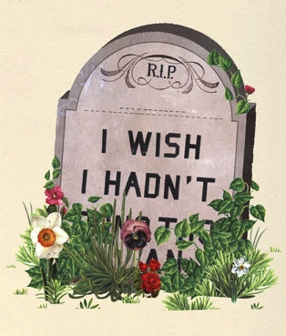
Two KINDS of Regret
Cumulative Regret:
  achieve near optimal cumulative lifetime reward
  (in expectation)
Simple Regret:
  quickly identify policy with high reward
  (in expectation)

Slide 49
Demos
Inverted Pendulum https://www.youtube.com/watch?v=Lt-KLtkDlh8
Stanford Helicopter https://www.youtube.com/watch?v=Idn10JBsA3Q

Slide 50
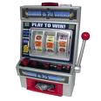
RL on Single State MDP
Suppose MDP has a single state and k actions
  Can sample rewards of actions using call to simulator
  Sampling action a is like pulling slot machine arm with random payoff function R(s,a)
s
a₁
a₂
a_{k}
…
R(s,a₁)
R(s,a₂)
…
R(s,a_{k})
Multi-Armed Bandit Problem
Slide adapted from Alan Fern (OSU)

Slide 51
Multi-Armed Bandits
Bandit algorithms are not just useful as components for RL & Monte-Carlo planning
Pure bandit problems arise in many applications
Applicable whenever:
  set of independent options with unknown utilities
  cost for sampling options or a limit on total samples
  Want to find the best option or maximize utility of samples
Slide adapted from Alan Fern (OSU)

Slide 52

Multi-Armed Bandits: Example 1
Clinical Trials
  Arms = possible treatments
  Arm Pulls = application of treatment to inidividual
  Rewards = outcome of treatment
  Objective = maximize cumulative reward = maximize benefit to trial population (or find best treatment quickly)
Slide adapted from Alan Fern (OSU)

Slide 53

Multi-Armed Bandits: Example 2
Online Advertising
  Arms = different ads/ad-types for a web page
  Arm Pulls = displaying an ad upon a page access
  Rewards = click through
  Objective = maximize cumulative reward = maximum clicks (or find best add quickly)

Slide 54
Multi-Armed Bandit: Possible Objectives
PAC Objective:
  find a near optimal arm w/ high probability
Cumulative Regret:
  achieve near optimal cumulative reward over lifetime of pulling (in expectation)
Simple Regret:
  quickly identify arm with high reward
  (in expectation)
s
a₁
a₂
a_{k}
…
R(s,a₁)
R(s,a₂)
…
R(s,a_{k})
Slide adapted from Alan Fern (OSU)

Slide 55
Cumulative Regret Objective
Problem: find arm-pulling strategy such that the expected total reward at time n is close to the best possible (one pull per time step)
  Optimal (in expectation) is to pull optimal arm n times
  UniformBandit is poor choice --- waste time on bad arms
  Must balance exploring machines to find good payoffs and exploiting current knowledge
s
a₁
a₂
a_{k}
…
Slide adapted from Alan Fern (OSU)

Slide 56
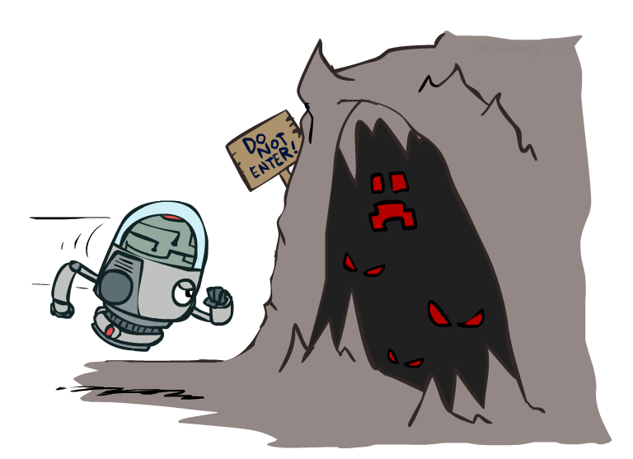

Exploration Functions
When to explore?
  Random actions: explore a fixed amount
  Better idea: explore areas whose badness is not
  (yet) established, eventually stop exploring
Exploration function
  Takes a value estimate u and a visit count n, and
  returns an optimistic utility, e.g.
  Note: this propagates the “bonus” back to states that lead to unknown states as well!
Regular Q-Update:
Modified Q-Update:

Slide 57
Cumulative Regret Objective
Strategy if one knew which arm was best
Slide adapted from Alan Fern (OSU)

Slide 58
UCB Algorithm for Minimizing Cumulative Regret
Auer, P., Cesa-Bianchi, N., & Fischer, P. (2002). Finite-time analysis of the multiarmed bandit problem. Machine learning, 47(2), 235-256.
Q(a) : average reward for trying action a (in our single state s) so far
n(a) : number of pulls of arm a so far
Action choice by UCB after n pulls:
Assumes rewards in [0,1] – normalized from R_{max}.
Slide adapted from Alan Fern (OSU)

Slide 59
UCB: Bounded Sub-Optimality
Value Term:
favors actions that looked
good historically
Exploration Term:
actions get an exploration
bonus that grows with ln(n)
Expected number of pulls of sub-optimal arm a is bounded by:
where is the sub-optimality of arm a
Doesn’t waste much time on sub-optimal arms, unlike uniform!
Slide adapted from Alan Fern (OSU)

Slide 60
UCB Performance Guarantee
[Auer, Cesa-Bianchi, & Fischer, 2002]
Slide adapted from Alan Fern (OSU)

Slide 61


Idea
The problem is uncertainty…
How to quantify uncertainty? Error bars
If arm has been sampled n times,
With probability at least 1- $δ$:
$$\left|\hat{μ}−μ\right|< \sqrt{\frac{log⁡(\frac{2}{δ})}{2n}}$$
Slide adapted from Travis Mandel (UW)

Slide 62
Given Error bars, how do we act?
Slide adapted from Travis Mandel (UW)

Slide 63
Given Error bars, how do we act?
Optimism under uncertainty!
Why? If bad, we will soon find out!
Slide adapted from Travis Mandel (UW)

Slide 64




One last wrinkle
How to set confidence $δ$
Decrease over time
If arm has been sampled n times,
With probability at least 1- $δ$:
$$\left|\hat{μ}−μ\right|< \sqrt{\frac{log⁡(\frac{2}{δ})}{2n}}$$
$δ$ =$\frac{2}{t}$
Slide adapted from Travis Mandel (UW)

Slide 65

Upper Confidence Bound (UCB)
1. Play each arm once
2. Play arm i that maximizes:
$${\hat{μ}}_{i}+\sqrt{\frac{2log⁡(t)}{n_{i}}}$$
3. Repeat Step 2 forever
Slide adapted from Travis Mandel (UW)

Slide 66


UCB Regret Bound
Problem –independent:
$$O(\sqrt{NTlogT})$$
Problem –dependent:
$$O\left(\frac{\log{T}}{\min_{i}{μ^{∗}−μ_{i}}}\right)$$
Can’t do much better!
Slide adapted from Travis Mandel (UW)

Slide 67

A little history…
William R. Thompson (1933): Was the first to examine MAB
problem, proposed a method for solving them
1940s-50s: MAB problem studied intentively during WWII,
Thompson ignored
1970’s-1980’s: “Optimal” solution (Gittins index) found but
is intractable and incomplete. Thompson ignored.
2001: UCB proposed, gains widespread use due to simplicity
and “optimal” bounds. Thompson still ignored.
2011: Empricial results show Thompson’s 1933 method beats
UCB, but little interest since no guarantees.
2013: Optimal bounds finally shown for Thompson Sampling
Slide adapted from Travis Mandel (UW)

Slide 68
Thompson’s method was fundamentally different!

Slide 69
Bayesian vs Frequentist
Bayesians: You have a prior, probabilities interpreted as beliefs, prefer probabilistic decisions
Frequentists: No prior, probabilities interpreted as facts about the world, prefer hard decisions (p<0.05)
UCB is a frequentist technique! What if we are Bayesian?

Slide 70


Bayesian review: Bayes’ Rule
$$p\left(θ \right|data)= \frac{p\left(data | θ\right)p(θ)}{p(data)}$$
Posterior
$$p\left(θ \right|data)∝p\left(data | θ\right)p(θ)$$
Prior
Likelihood

Slide 71
Bernoulli Case
What if distribution in the set {0,1}
instead of the range [0,1]?
Then we flip a coin with probability p → Bernoulli
Distribution!
To estimate p, we count up numbers of ones and zeros
Given observed ones and zeroes, how do we calculate
the distribution of possible values of p?

Slide 72
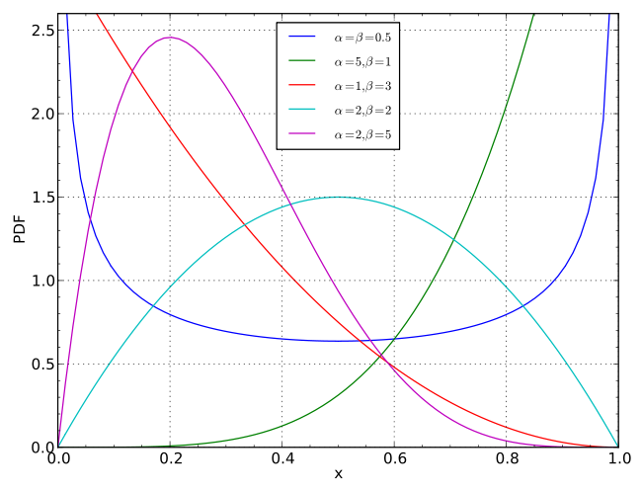
Beta-Bernoulli Case
Beta(a,b) → Given a 0’s and b 1’s, what is the
distribution over means?
Prior → pseudocounts
Likelihood → Observed counts
Posterior → pseudocounts + observed counts
Notes:
Image credit: Wikipedia.

Slide 73
How does this help us?
Thompson Sampling:
1. Specify prior (in Beta case often Beta(1,1))
2. Sample from each posterior distribution to get
estimated mean for each arm.
3. Pull arm with highest mean.
4. Repeat step 2 & 3 forever

Slide 74
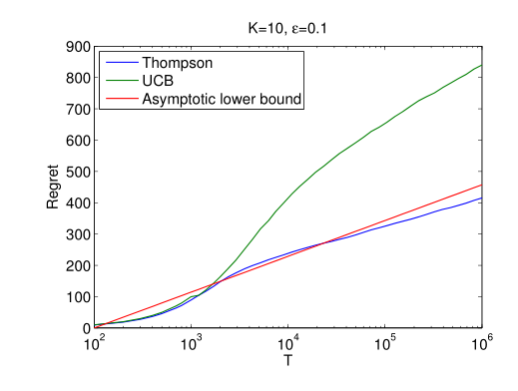
Thompson Empirical Results
And shown to have optimal regret bounds just like
(and in some cases a little better than) UCB!
Notes:
Image taken from {Chapelle & Li 2011).

Slide 75
Video of Demo Q-learning – Epsilon-Greedy – Crawler

Slide 76
Video of Demo Q-learning – Exploration Function – Crawler

Slide 77
What Else ….
UCB is great when we care about cumulative regret
But, sometimes all we care about is finding a good arm quickly
This is similar to the PAC objective, but:
  The PAC algorithms required precise knowledge of or control of # pulls
  We would like to be able to stop at any time and get a good result with some guarantees on expected performance
In these cases, “Simple regret” is better objective

Slide 78
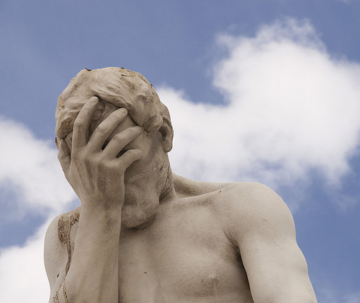
Two KINDS of Regret
Cumulative Regret:
  achieve near optimal cumulative lifetime reward
  (in expectation)
Simple Regret:
  quickly identify policy with high reward
  (in expectation)

Slide 79
Simple Regret Objective

Slide 80
Simple Regret Objective
What about UCB for simple regret?
Seems good, but we can do much better (at least in theory).
  Intuitively: UCB puts too much emphasis on pulling the best arm
  After an arm is looking good, maybe better to see if ∃a better arm

Slide 81
Incremental Uniform (or Round Robin)
Bubeck, S., Munos, R., & Stoltz, G. (2011). Pure exploration in finitely-armed and continuous-armed bandits. Theoretical Computer Science, 412(19), 1832-1852

Slide 82
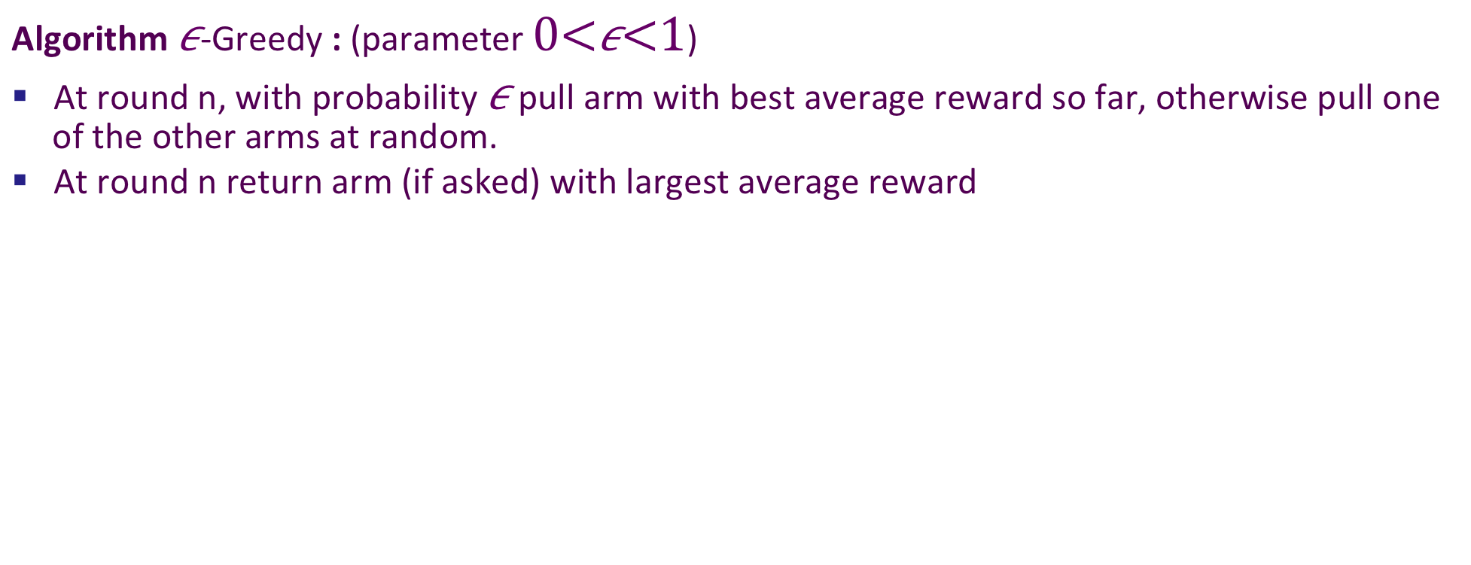
Can we do even better?
Tolpin, D. & Shimony, S, E. (2012). MCTS Based on Simple Regret. AAAI Conference on Artificial Intelligence.
Algorithm -Greedy : (parameter )
At round n, with probability pull arm with best average reward so far, otherwise pull one of the other arms at random.
At round n return arm (if asked) with largest average reward

Slide 83
Summary of Bandits in Theory
PAC Objective:
  UniformBandit is a simple PAC algorithm
  MedianElimination improves by a factor of log(k) and is optimal up to constant factors
Cumulative Regret:
  Uniform is very bad!
  UCB is optimal (up to constant factors)
Simple Regret:
  UCB shown to reduce regret at polynomial rate
  Uniform reduces at an exponential rate
  0.5-Greedy may have even better exponential rate

Slide 84
Theory vs. Practice
The established theoretical relationships among bandit algorithms have often been useful in predicting empirical relationships.
But not always ….

Slide 85
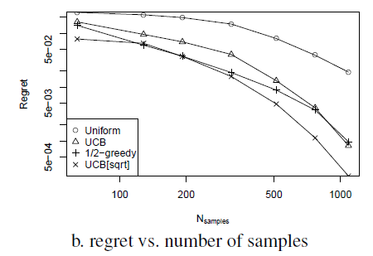
Theory vs. Practice
simple regret
Simple regret vs. number of samples
UCB maximizes Q_{a} + √ ((2 ln(n)) / n_{a})
UCB[sqrt] maximizes Q_{a} + √ ((2 √n) / n_{a})
Notes:
From MCTS Based on Simple Regret. AAAI-12
Exploration factor set to c=2

