Slide 1

CS 473: Artificial Intelligence
MDP Planning: Value Iteration and Policy Iteration
Travis Mandel (subbing for Dan Weld)
University of Washington
Slides by Dan Klein & Pieter Abbeel / UC Berkeley. (http://ai.berkeley.edu) and by Dan Weld, Mausam & Andrey Kolobov
Notes:
Please retain proper attribution, including the reference to ai.berkeley.edu. Thanks!

Slide 2
Reminder: Midterm Monday!!
Will cover everything from Search to Value Iteration
  One page (double-sided, 8.5 x 11) notes allowed

Slide 3
Reminder: MDP Planning
Given an MDP, find optimal policy π*: S→A that maximizes expected discounted reward
  Sometimes called “Solving” the MDP
Being so long-term complicates things
  Simplifies things if we know long-term value of state
Notes:
Given MDP, find policy that

Slide 4

MDP Planning
Value Iteration
  Prioritized Sweeping
Policy Iteration
Notes:
Given MDP, find policy that

Slide 5

Value Iteration

Slide 6
Value Iteration
Called a
“Bellman Backup”
Forall s, Initialize V₀(s) = 0 no time steps left means an expected reward of zero
Repeat do Bellman backups
  K += 1
Repeat until |V_{k+1}(s) – V_{k}(s) | < ε, forall s “convergence”
}
V_{k+1}(s)
Q_{k+1}(s, a) = Σ_{s’} T(s, a, s’) [ R(s, a, s’) + γ V_{k}(s’)]
V_{k+1}(s) = Max _{a} Q_{k+1} (s, a)
a
} do ∀s, a
s, a
s,a,s’
V_{k}(s’)
Successive approximation; dynamic programming
Notes:
Discuss computational complexity: S * A * S times number of iterations
Note: updates not in place [if in place, it means something else and not even clear what it means]

Slide 7

k=0
0
Noise = 0.2
Discount = 0.9
Living reward = 0
Notes:
Assuming zero living reward

Slide 8
k=1
If agent is in 4,3, it only has one legal action: get jewel. It gets a reward and the game is over.
If agent is in the pit, it has only one legal action, die. It gets a penalty and the game is over.
Agent does NOT get a reward for moving INTO 4,3.
Noise = 0.2
Discount = 0.9
Living reward = 0
Notes:
Assuming zero living reward

Slide 9

k=2
0.8 (0 + 0.9*1)
+ 0.1 (0 + 0.9*0)
+ 0.1 (0 + 0.9*0)
Noise = 0.2
Discount = 0.9
Living reward = 0
Notes:
Assuming zero living reward

Slide 10

k=3
Noise = 0.2
Discount = 0.9
Living reward = 0
Notes:
Assuming zero living reward

Slide 11

k=4
Noise = 0.2
Discount = 0.9
Living reward = 0
Notes:
Assuming zero living reward

Slide 12

k=5
Noise = 0.2
Discount = 0.9
Living reward = 0
Notes:
Assuming zero living reward

Slide 13

k=6
Noise = 0.2
Discount = 0.9
Living reward = 0
Notes:
Assuming zero living reward

Slide 14

k=7
Noise = 0.2
Discount = 0.9
Living reward = 0
Notes:
Assuming zero living reward

Slide 15

k=8
Noise = 0.2
Discount = 0.9
Living reward = 0
Notes:
Assuming zero living reward

Slide 16

k=9
Noise = 0.2
Discount = 0.9
Living reward = 0
Notes:
Assuming zero living reward

Slide 17

k=10
Noise = 0.2
Discount = 0.9
Living reward = 0
Notes:
Assuming zero living reward

Slide 18

k=11
Noise = 0.2
Discount = 0.9
Living reward = 0
Notes:
Assuming zero living reward

Slide 19

k=12
Noise = 0.2
Discount = 0.9
Living reward = 0
Notes:
Assuming zero living reward

Slide 20

k=100
Noise = 0.2
Discount = 0.9
Living reward = 0
Notes:
Assuming zero living reward

Slide 21
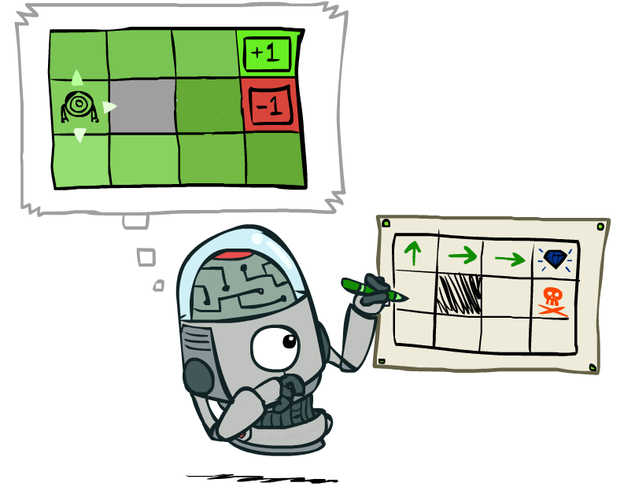
VI: Policy Extraction

Slide 22
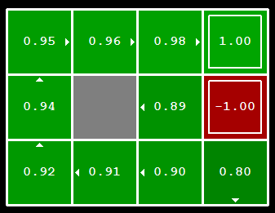


Computing Actions from Values
Let’s imagine we have the optimal values V*(s)
How should we act?
  In general, it’s not obvious!
We need to do a mini-expectimax (one step)
This is called policy extraction, since it gets the policy implied by the values

Slide 23
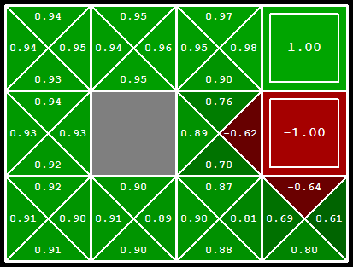
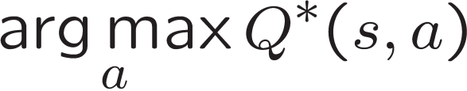
Computing Actions from Q-Values
Let’s imagine we have the optimal q-values:
How should we act?
  Completely trivial to decide!
Important lesson: actions are easier to select from q-values than values!

Slide 24


Convergence*
How do we know the V_{k} vectors will converge?
Case 1: If the tree has maximum depth M, then V_{M} holds the actual untruncated values
Case 2: If the discount is less than 1
  Sketch: For any state V_{k} and V_{k+1} can be viewed as depth k+1 expectimax results in nearly identical search trees
  The max difference happens if big reward at k+1 level
  That last layer is at best all R_{MAX}
  But everything is discounted by γ^{k} that far out
  So V_{k} and V_{k+1} are at most γ^{k} max|R| different
  So as k increases, the values converge
Notes:
Theorem: will converge to unique optimal values
Basic idea: approximations get refined towards optimal values
Policy may converge long before values do

Slide 25
Value Iteration - Recap
Forall s, Initialize V₀(s) = 0 no time steps left means an expected reward of zero
Repeat do Bellman backups
  K += 1
  Repeat for all states, s, and all actions, a:
Until |V_{k+1}(s) – V_{k}(s) | < ε, forall s “convergence”
Theorem: will converge to unique optimal values
V_{k+1}(s)
a
Q_{k+1}(s, a) = Σ_{s’} T(s, a, s’) [ R(s, a, s’) + γ V_{k}(s’)]
V_{k+1}(s) = Max _{a} Q_{k+1} (s, a)
s, a
s,a,s’
V_{k}(s’)
Notes:
Discuss computational complexity: S * A * S times number of iterations
Note: updates not in place [if in place, it means something else and not even clear what it means]

Slide 26
Value Iteration - Recap
Forall s, Initialize V₀(s) = 0 no time steps left means an expected reward of zero
Repeat do Bellman backups
  K += 1
  Repeat for all states, s, and all actions, a:
Until |V_{k+1}(s) – V_{k}(s) | < ε, forall s “convergence”
Complexity of each iteration?
V_{k+1}(s)
a
Q_{k+1}(s, a) = Σ_{s’} T(s, a, s’) [ R(s, a, s’) + γ V_{k}(s’)]
V_{k+1}(s) = Max _{a} Q_{k+1} (s, a)
s, a
s,a,s’
V_{k}(s’)
Notes:
Discuss computational complexity: S * A * S times number of iterations
Note: updates not in place [if in place, it means something else and not even clear what it means]

Slide 27
Value Iteration - Recap
Forall s, Initialize V₀(s) = 0 no time steps left means an expected reward of zero
Repeat do Bellman backups
  K += 1
  Repeat for all states, s, and all actions, a:
Until |V_{k+1}(s) – V_{k}(s) | < ε, forall s “convergence”
Complexity of each iteration: O(S²A)
  Number of iterations: poly(|S|, |A|, 1/(1-γ))
V_{k+1}(s)
a
Q_{k+1}(s, a) = Σ_{s’} T(s, a, s’) [ R(s, a, s’) + γ V_{k}(s’)]
V_{k+1}(s) = Max _{a} Q_{k+1} (s, a)
s, a
s,a,s’
V_{k}(s’)
Notes:
Discuss computational complexity: S * A * S times number of iterations
Note: updates not in place [if in place, it means something else and not even clear what it means]

Slide 28


Value Iteration as Successive Approximation
Bellman equations characterize the optimal values:
Value iteration computes them:
Value iteration is just a fixed-point solution method
  Computed using dynamic programming
  … though the V_{k} vectors are also interpretable as time-limited values
V(s)
a
s, a
s,a,s’
V(s’)
Q_{k+1}(s, a) = Σ_{s’} T(s, a, s’) [ R(s, a, s’) + γ V_{k}(s’)]
V_{k+1}(s) = Max _{a} Q_{k+1} (s, a)
Notes:
Discuss computational complexity: S * A * S times number of iterations
Note: updates not in place [if in place, it means something else and not even clear what it means]

Slide 29
Problems with Value Iteration
Value iteration repeats the Bellman updates:
Problem 1: It’s slow – O(S²A) per iteration
Problem 2: The “max” at each state rarely changes
Problem 3: The policy often converges long before the values
s
Q_{k+1}(s, a) = Σ_{s’} T(s, a, s’) [ R(s, a, s’) + γ V_{k}(s’)]
V_{k+1}(s) = Max _{a} Q_{k+1} (s, a)
a
s, a
s,a,s’
s’
[Demo: value iteration (L9D2)]
Notes:
Demo steps through value iteration; snapshots of values shown on next slides.

Slide 30
VI → Asynchronous VI
Is it essential to back up all states in each iteration?
  No!
States may be backed up
  many times or not at all
  in any order
As long as no state gets starved…
  convergence properties still hold!!

Slide 31
k=1
Noise = 0.2
Discount = 0.9
Living reward = 0
Notes:
Assuming zero living reward

Slide 32
k=2
Noise = 0.2
Discount = 0.9
Living reward = 0
Notes:
Assuming zero living reward

Slide 33
k=3
Noise = 0.2
Discount = 0.9
Living reward = 0
Notes:
Assuming zero living reward

Slide 34
k=8
Noise = 0.2
Discount = 0.9
Living reward = 0
Notes:
Assuming zero living reward

Slide 35
k=9
Noise = 0.2
Discount = 0.9
Living reward = 0
Notes:
Assuming zero living reward

Slide 36
k=10
Noise = 0.2
Discount = 0.9
Living reward = 0
Notes:
Assuming zero living reward

Slide 37
k=11
Noise = 0.2
Discount = 0.9
Living reward = 0
Notes:
Assuming zero living reward

Slide 38
k=12
Noise = 0.2
Discount = 0.9
Living reward = 0
Notes:
Assuming zero living reward

Slide 39
k=100
Noise = 0.2
Discount = 0.9
Living reward = 0
Notes:
Assuming zero living reward

Slide 40
Asynch VI: Prioritized Sweeping
Why backup a state if values of successors unchanged?
Prefer backing a state
  whose successors had most change
Priority Queue of (state, expected change in value)
Backup in the order of priority
After backing up state s’, update priority queue
  for all predecessors s (ie all states where an action can reach s’)
  Priority(s) ← T(s,a,s’) * |V^{k+1}(s’) - V^{k}(s’)|

Slide 41
Residual wrt Value Function V (Res^{V})
Residual at s with respect to V
  magnitude(¢V(s)) after one Bellman backup at s
Residual wrt respect to V
  max residual
  Res^{V} = max_{s} (Res^{V}(s))
Res^{V} <²
(²-consistency)

Slide 42
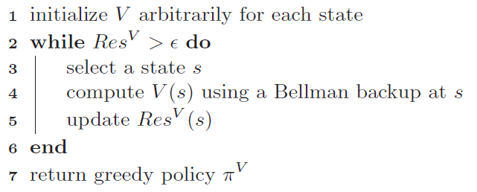
(General) Asynchronous VI

Slide 43
Prioritized Sweeping
Pros?
Cons?
Notes:
Pro: fewer backups!
Cons: n log(n) overhead of priority queue
Net: depends on domain structure. If branching factor is high, each backup may require updating many priorities

Slide 44

MDP Planning
Value Iteration
  Prioritized Sweeping
Policy Iteration

Slide 45
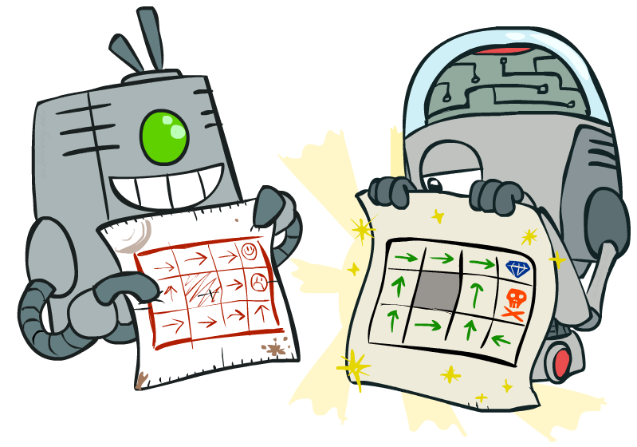
Policy Methods
Policy Iteration =
Policy Evaluation
Policy Improvement

Slide 46
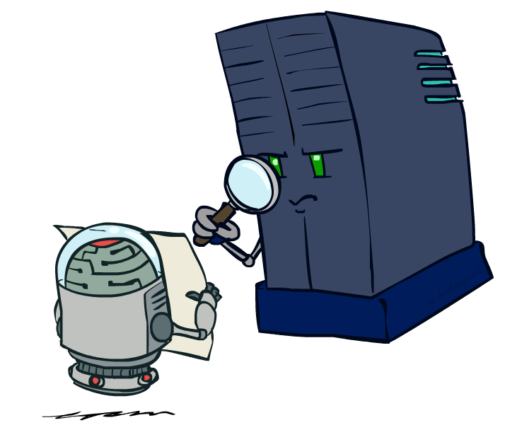
Part 1 - Policy Evaluation

Slide 47
Fixed Policies
Do the optimal action
Do what π says to do
s
s
a
π(s)
s, a
s, π(s)
s,a,s’
s, π(s),s’
s’
s’
Expectimax trees max over all actions to compute the optimal values
If we fixed some policy π(s), then the tree would be simpler – only one action per state
  … though the tree’s value would depend on which policy we fixed

Slide 48
Computing Utilities for a Fixed Policy
A new basic operation: compute the utility of a state s under a fixed (generally non-optimal) policy
Define the utility of a state s, under a fixed policy π:
  V^{π}(s) = expected total discounted rewards starting in s and following π
Recursive relation (variation of Bellman equation):
s
π(s)
s, π(s)
s, π(s),s’
s’

Slide 49
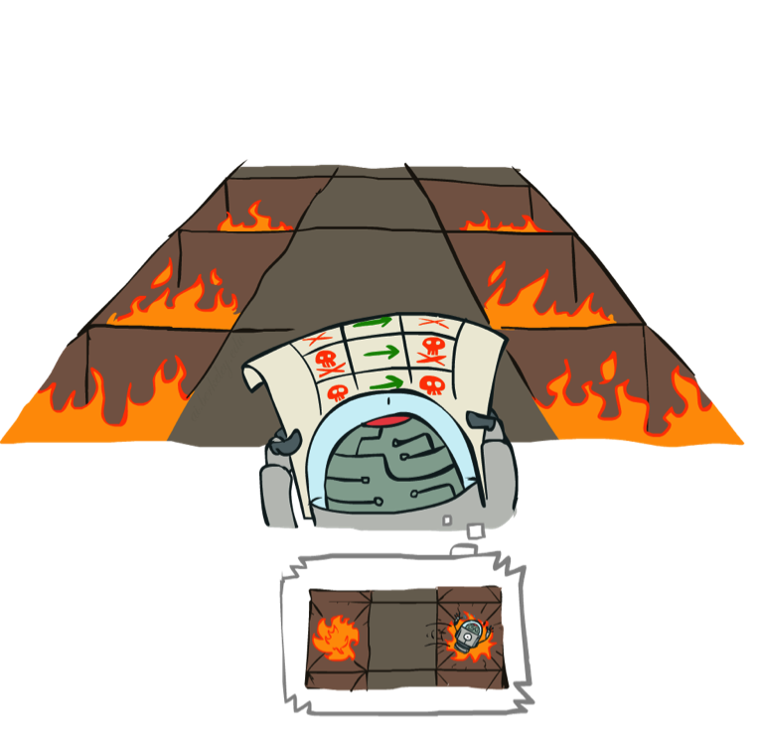
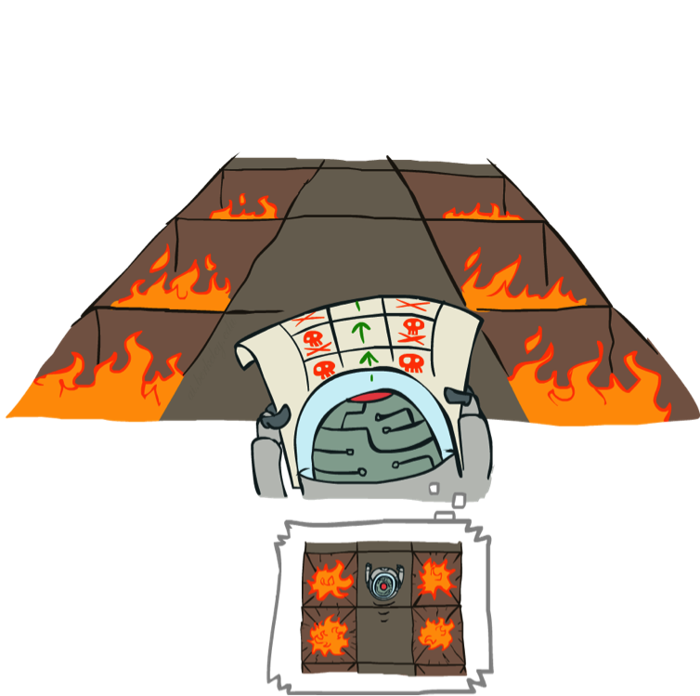
Example: Policy Evaluation
Always Go Right
Always Go Forward

Slide 50
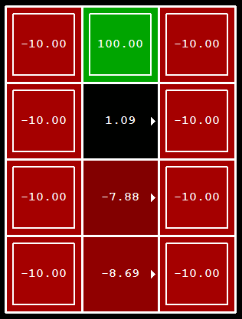
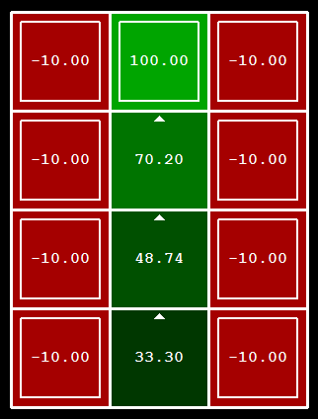
Example: Policy Evaluation
Always Go Right
Always Go Forward

Slide 51

Iterative Policy Evaluation Algorithm
s
How do we calculate the V’s for a fixed policy π?
Idea 1: Turn recursive Bellman equations into updates
(like value iteration)
Efficiency: O(S²) per iteration
  Often converges in much smaller number of iterations compared to VI
π(s)
s, π(s)
s, π(s),s’
s’

Slide 52
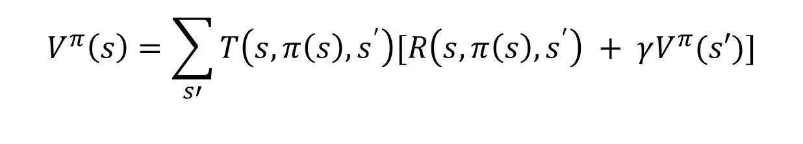
Linear Policy Evaluation Algorithm
How do we calculate the V’s for a fixed policy π?
Idea 2: Without the maxes, the Bellman equations are just a linear system of equations
Solve with Matlab (or your favorite linear system solver)
  S equations, S unknowns = O(S³) and EXACT!
  In large spaces, still too expensive
s
π(s)
s, π(s)
$$V^{π}\left(s\right)=\sum_{s′}{T\left(s,π\left(s\right),s^{′}\right)[R\left(s,π\left(s\right),s^{′}\right) + γV^{π}(s′)]}$$
s, π(s),s’
s’

Slide 53
Part 2 - Policy Iteration

Slide 54
Policy Iteration
Initialize π(s) to random actions
Repeat
  Step 1: Policy evaluation: calculate utilities of π at each s using a nested loop
  Step 2: Policy improvement: update policy using one-step look-ahead
  “For each s, what’s the best action I could execute, assuming I then follow π?
  Let π’(s) = this best action.
  π = π’
Until policy doesn’t change

Slide 55
Policy Iteration Details
Let i =0
Initialize π_{i}(s) to random actions
Repeat
  Step 1: Policy evaluation:
    Initialize k=0; Forall s, V₀^{π} (s) = 0
    Repeat until V^{π} converges
      For each state s,
      Let k += 1
  Step 2: Policy improvement:
    For each state, s,
    If π_{i} == π_{i+1} then it’s optimal; return it.
    Else let i += 1

Slide 56
Example
Initialize π₀ to “always go right”
Perform policy evaluation
Perform policy improvement
Iterate through states
?
Has policy changed?
?
Yes! i += 1
?

Slide 57
Example
π₁ says “always go up”
Perform policy evaluation
Perform policy improvement
Iterate through states
?
Has policy changed?
?
No! We have the optimal policy
?

Slide 58
Example: Policy Evaluation
Always Go Right
Always Go Forward

Slide 59
Policy Iteration Properties
Policy iteration finds the optimal policy, guaranteed (assuming exact evaluation)!
Often converges (much) faster

Slide 60
Comparison
Both value iteration and policy iteration compute the same thing (all optimal values)
In value iteration:
  Every iteration updates both the values and (implicitly) the policy
  We don’t track the policy, but taking the max over actions implicitly recomputes it
  What is the space being searched?
In policy iteration:
  We do fewer iterations
  Each one is slower (must update all V^{π} and then choose new best π)
  What is the space being searched?
Both are dynamic programs for planning in MDPs

Slide 61
What’s next? Reinforcement Learning!
So far we’ve assumed you know T(s,a,s’) and R(s,a,s’)
  Sometimes you don’t know them, must interact to learn them!
    Very tough problem
  P3 (after midterm) will cover this

Slide 62
Summary So Far: MDP Algorithms
So you want to….
  Compute optimal values: use value iteration or policy iteration
  Compute values for a particular policy: use policy evaluation
  Turn your values into a policy: use policy extraction (one-step lookahead)
These all look the same!
  They all use variations of Bellman updates
  They all use one-step lookahead expectimax fragments
  They differ
    whether we plug in a fixed policy or max over actions
    Whether we search finite (policy) space or infinite (R valued value function) space

Slide 63
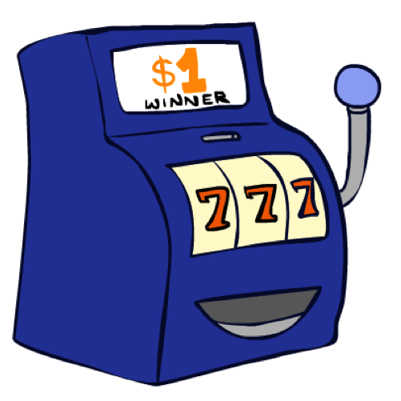
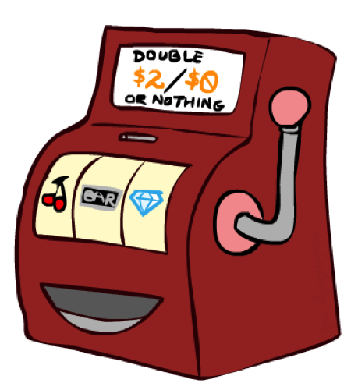

Double Bandits

Slide 64
Double-Bandit MDP
Actions: Blue, Red
States: Win, Lose
No discount
100 time steps
Both states have the same value
0.25 $0
0.75
$2
W
L
0.25
$0
$1
1.0
$1
1.0
0.75 $2

Slide 65
Offline Planning
Solving MDPs is offline planning
  You determine all quantities through computation
  You need to know the details of the MDP
  You do not actually play the game!
No discount
100 time steps
Both states have the same value
0.25 $0
Value
0.75
$2
W
0.25
$0
Play Red
150
L
$1
1.0
$1
1.0
0.75 $2
Play Blue
100

Slide 66
Let’s Play!
$2
$2
$0
$2
$2
$2
$2
$0
$0
$0

Slide 67
Online Planning
Rules changed! Red’s win chance is different.
?? $0
??
$2
W
L
??
$0
$1
1.0
$1
1.0
?? $2

Slide 68
Let’s Play!
$0
$0
$0
$2
$0
$2
$0
$0
$0
$0

Slide 69
Policy Evaluation
s
How do we calculate the V’s for a fixed policy π?
Idea 1: Turn recursive Bellman equations into updates
(like value iteration)
Efficiency: O(S²) per iteration
Idea 2: Without the maxes, the Bellman equations are just a linear system
  Solve with Matlab (or your favorite linear system solver)
π(s)
s, π(s)
s, π(s),s’
s’

Slide 70
What Just Happened?
That wasn’t planning, it was learning!
  Specifically, reinforcement learning
  There was an MDP, but you couldn’t solve it with just computation
  You needed to actually act to figure it out
Important ideas in reinforcement learning that came up
  Exploration: you have to try unknown actions to get information
  Exploitation: eventually, you have to use what you know
  Regret: even if you learn intelligently, you make mistakes
  Sampling: because of chance, you have to try things repeatedly
  Difficulty: learning can be much harder than solving a known MDP

Slide 71
Next Time: Reinforcement Learning!

Slide 72

Asynchronous Value Iteration*
In value iteration, we update every state in each iteration
  Actually, any sequences of Bellman updates will converge if every state is visited infinitely often
In fact, we can update the policy as seldom or often as we like, and we will still converge
Idea: Update states whose value we expect to change:
If is large then update predecessors of s

Slide 73
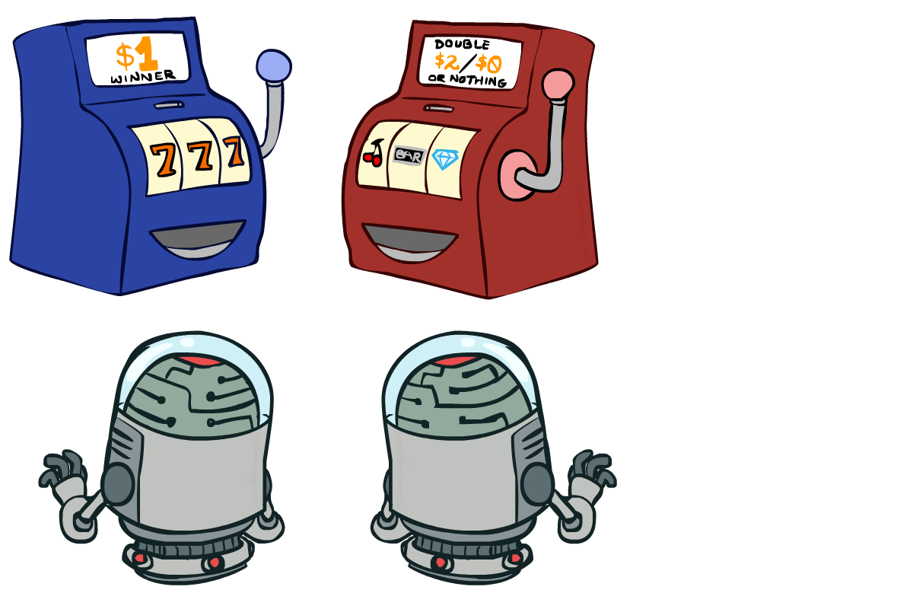
Interlude

