Slide 1

CS 573: Artificial Intelligence
Markov Decision Processes
Dan Weld
University of Washington
Slides by Dan Klein & Pieter Abbeel / UC Berkeley. (http://ai.berkeley.edu) and by Mausam & Andrey Kolobov
Notes:
Please retain proper attribution, including the reference to ai.berkeley.edu. Thanks!

Slide 2
Logistics
PS 2 due today
Midterm in one week
  Covers all material through value iteration (wed / fri)
  Closed book
  You may bring one 8.5 x 11” double-sided sheet of paper

Slide 3
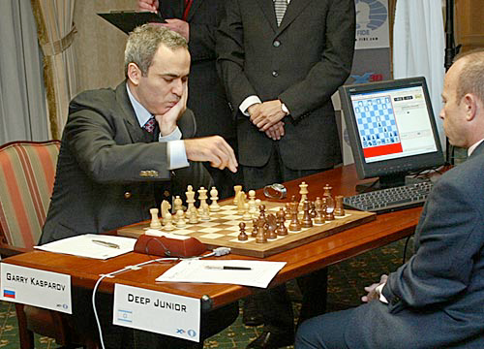
Outline
Adversarial Games
  Minimax search
  α-β search
  Evaluation functions
  Multi-player, non-0-sum
Stochastic Games
  Expectimax
  Markov Decision Processes
  Reinforcement Learning

Slide 4
Agent vs. Environment
An agent is an entity that perceives and acts.
A rational agent selects actions that maximize its utility function.
Agent
Sensors
Percepts
?
Environment
Actuators
Actions
Deterministic vs. stochastic
Fully observable vs. partially observable
Notes:
agent is really just a program
environment - inputs and outputs to the program
utility function - indirect specification of the what the program should do
goal: design an algorithm that can find actions for any utility function

Slide 5

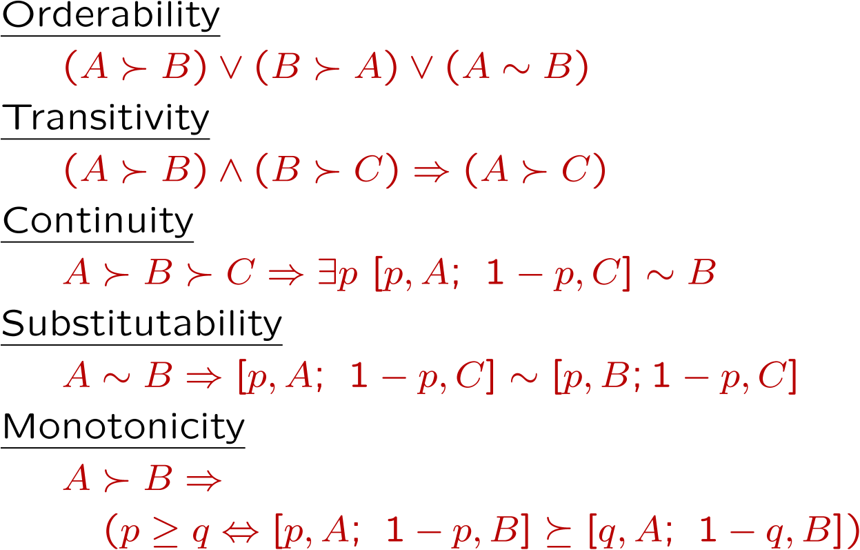
Rational Preferences
The Axioms of Rationality
Theorem: Rational preferences imply behavior describable as maximization of expected utility

Slide 6
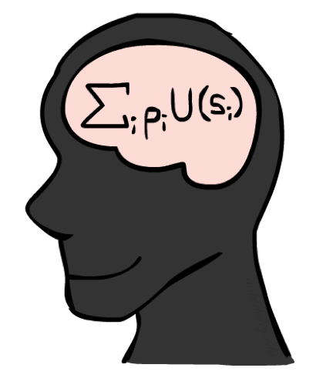
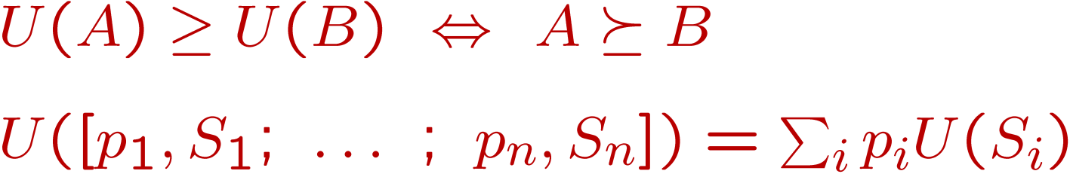
MEU Principle
Theorem [Ramsey, 1931; von Neumann & Morgenstern, 1944]
  Given any preferences satisfying these constraints, there exists a real-valued
  function U such that:
  I.e. values assigned by U preserve preferences of both prizes and lotteries!
Maximum expected utility (MEU) principle:
  Choose the action that maximizes expected utility
  Note: an agent can be entirely rational (consistent with MEU) without ever representing or manipulating utilities and probabilities
  E.g., a lookup table for perfect tic-tac-toe, a reflex vacuum cleaner

Slide 7
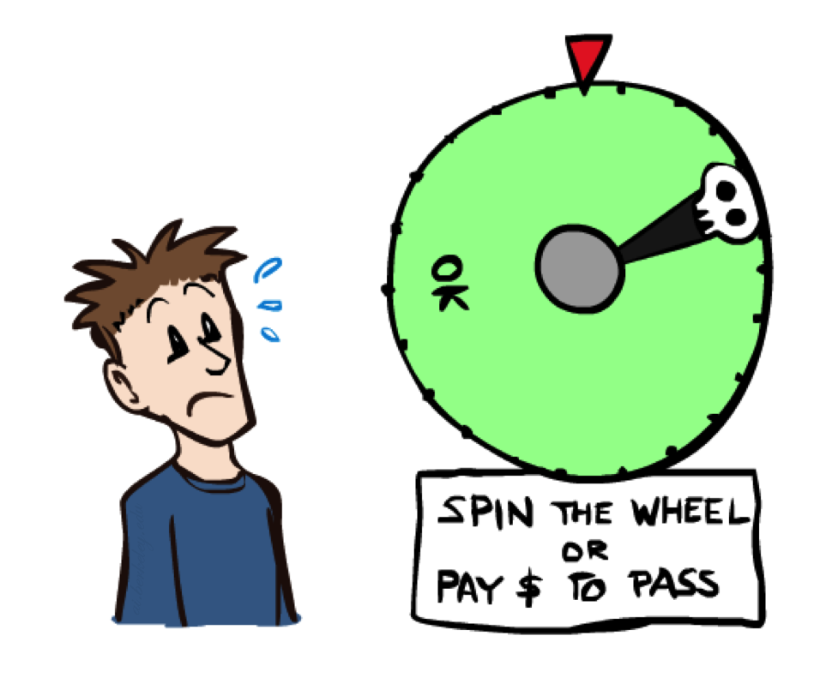
Human Utilities

Slide 8

Utility Scales
Normalized utilities: u₊ = 1.0, u₋ = 0.0
Micromorts: one-millionth chance of death, useful for paying to reduce product risks, etc.
QALYs: quality-adjusted life years, useful for medical decisions involving substantial risk
Note: behavior is invariant under positive linear transformation
With deterministic prizes only (no lottery choices), only ordinal utility can be determined, i.e., total order on prizes

Slide 9


Human Utilities
Utilities map states to real numbers. Which numbers?
Standard approach to assessment (elicitation) of human utilities:
  Compare a prize A to a standard lottery L_{p} between
    “best possible prize” u₊ with probability p
    “worst possible catastrophe” u₋ with probability 1-p
  Adjust lottery probability p until indifference: A ~ L_{p}
  Resulting p is a utility in [0,1]
Pay $30
0.999999 0.000001
No change
Instant death

Slide 10
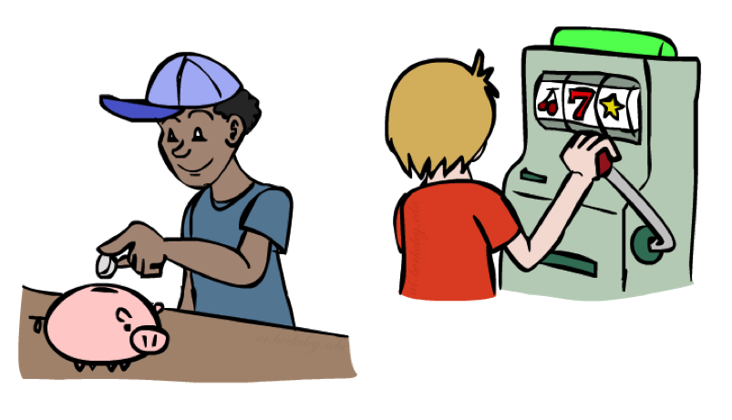
Money
Money does not behave as a utility function, but we can talk about the utility of having money (or being in debt)
Given a lottery L = [p, $X; (1-p), $Y]
  The expected monetary value EMV(L) is p*X + (1-p)*Y
  U(L) = p*U($X) + (1-p)*U($Y)
  Typically, U(L) < U( EMV(L) )
  In this sense, people are risk-averse
  When deep in debt, people are risk-prone
Notes:
Draw Jensen’s for utility curve

Slide 11
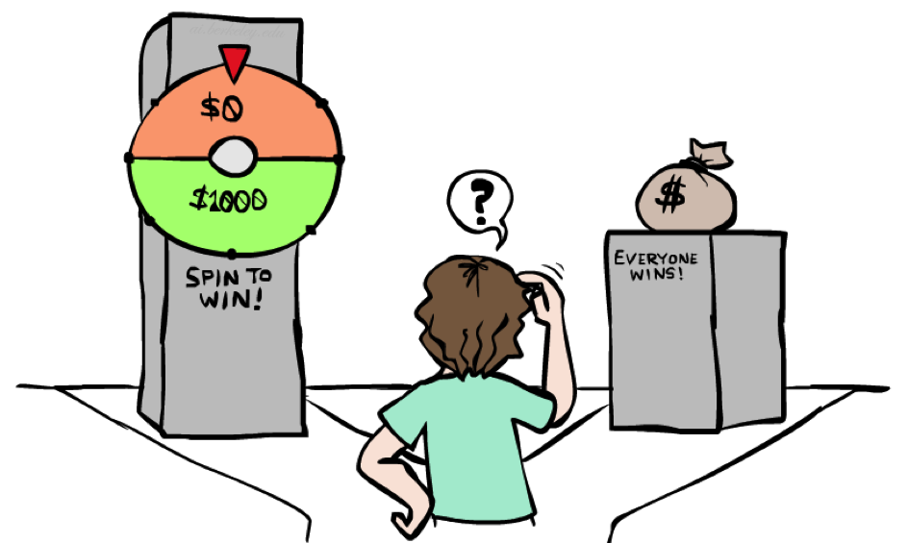
Example: Insurance
Consider the lottery [0.5, $1000; 0.5, $0]
  What is its expected monetary value? ($500)
  What is its certainty equivalent?
    Monetary value acceptable in lieu of lottery
    $400 for most people
  Difference of $100 is the insurance premium
    There’s an insurance industry because people will pay to reduce their risk
    If everyone were risk-neutral, no insurance needed!
  It’s win-win: you’d rather have the $400 and the insurance company would rather have the lottery (their utility curve is flat and they have many lotteries)

Slide 12

Example: Human Rationality?
Famous example of Allais (1953)
  A: [0.8, $4k; 0.2, $0]
  B: [1.0, $3k; 0.0, $0]
  C: [0.2, $4k; 0.8, $0]
  D: [0.25, $3k; 0.75, $0]
Most people prefer B > A, C > D
But if U($0) = 0, then
  B > A ⇒ U($3k) > 0.8 U($4k)
  C > D ⇒ 0.8 U($4k) > U($3k)

Slide 13

Non-Deterministic Search

Slide 14





Example: Grid World
A maze-like problem
  The agent lives in a grid
  Walls block the agent’s path
Noisy movement: actions do not always go as planned
  80% of the time, the action North takes the agent North
  (if there is no wall there)
  10% of the time, North takes the agent West; 10% East
  If there is a wall in the direction the agent would have been taken, the agent stays put
The agent receives rewards each time step
  Small “living” reward each step (can be negative)
  Big rewards come at the end (good or bad)
Goal: maximize sum of rewards
Notes:
[cut demo of moving around in grid world program]

Slide 15



Grid World Actions
Deterministic Grid World
Stochastic Grid World

Slide 16
Markov Decision Processes
An MDP is defined by:
  A set of states s ∈ S
  A set of actions a ∈ A
  A transition function T(s, a, s’)
    Probability that a from s leads to s’, i.e., P(s’| s, a)
    Also called the model or the dynamics
T(s₁₁, E, …
…
T(s₃₁, N, s₁₁) = 0
…
T is a Big Table!
X 4 x 11 = 484 entries
For now, we give this as input to the agent
T(s₃₁, N, s₃₂) = 0.8
T(s₃₁, N, s₂₁) = 0.1
T(s₃₁, N, s₄₁) = 0.1
…
Notes:
In search problems: did not talk about actions, but about successor functions --- now the information inside the successor function is unpacked into actions, transitions and reward
Write out S, A, example entry in T, entry in R
Reward function different from the book : R(s,a,s’)
In book simpler for equations, but not useful for the projects.
Need to modify expectimax a tiny little bit to account for rewards along the way, but that’s something you should be able to do, and so you can already solve MDP’s (not in most efficient way)

Slide 17
Markov Decision Processes
An MDP is defined by:
  A set of states s ∈ S
  A set of actions a ∈ A
  A transition function T(s, a, s’)
    Probability that a from s leads to s’, i.e., P(s’| s, a)
    Also called the model or the dynamics
  A reward function R(s, a, s’)
…
R(s₃₂, N, s₃₃) = -0.01
Cost of breathing
R is also a Big Table!
For now, we also give this to the agent
…
R(s₃₂, N, s₄₂) = -1.01
…
R(s₃₃, E, s₄₃) = 0.99
Notes:
In search problems: did not talk about actions, but about successor functions --- now the information inside the successor function is unpacked into actions, transitions and reward
Write out S, A, example entry in T, entry in R
Reward function different from the book : R(s,a,s’)
In book simpler for equations, but not useful for the projects.
Need to modify expectimax a tiny little bit to account for rewards along the way, but that’s something you should be able to do, and so you can already solve MDP’s (not in most efficient way)

Slide 18
Markov Decision Processes
An MDP is defined by:
  A set of states s ∈ S
  A set of actions a ∈ A
  A transition function T(s, a, s’)
    Probability that a from s leads to s’, i.e., P(s’| s, a)
    Also called the model or the dynamics
  A reward function R(s, a, s’)
    Sometimes just R(s) or R(s’)
…
R(s₃₃) = -0.01
R(s₄₂) = -1.01
R(s₄₃) = 0.99
Notes:
In search problems: did not talk about actions, but about successor functions --- now the information inside the successor function is unpacked into actions, transitions and reward
Write out S, A, example entry in T, entry in R
Reward function different from the book : R(s,a,s’)
In book simpler for equations, but not useful for the projects.
Need to modify expectimax a tiny little bit to account for rewards along the way, but that’s something you should be able to do, and so you can already solve MDP’s (not in most efficient way)

Slide 19
Markov Decision Processes
An MDP is defined by:
  A set of states s ∈ S
  A set of actions a ∈ A
  A transition function T(s, a, s’)
    Probability that a from s leads to s’, i.e., P(s’| s, a)
    Also called the model or the dynamics
  A reward function R(s, a, s’)
    Sometimes just R(s) or R(s’), e.g. in R&N
  A start state
  Maybe a terminal state
MDPs are non-deterministic search problems
  One way to solve them is with expectimax search
  We’ll have a new tool soon
Notes:
In search problems: did not talk about actions, but about successor functions --- now the information inside the successor function is unpacked into actions, transitions and reward
Write out S, A, example entry in T, entry in R
Reward function different from the book : R(s,a,s’)
In book simpler for equations, but not useful for the projects.
Need to modify expectimax a tiny little bit to account for rewards along the way, but that’s something you should be able to do, and so you can already solve MDP’s (not in most efficient way)

Slide 20


What is Markov about MDPs?
“Markov” generally means that given the present state, the future and the past are independent
For Markov decision processes, “Markov” means action outcomes depend only on the current state
This is just like search, where the successor function can only depend on the current state (not the history)
Andrey Markov (1856-1922)
Notes:
Like search: successor function only depended on current state
Can make this happen by stuffing more into the state;
Very similar to search problems: when solving a maze with food pellets, we stored which food pellets were eaten

Slide 21

Policies
In deterministic single-agent search problems, we wanted an optimal plan, or sequence of actions, from start to a goal
For MDPs, we want an optimal policy π*: S → A
  A policy π gives an action for each state
  An optimal policy is one that maximizes expected utility if followed
  An explicit policy defines a reflex agent
Expectimax didn’t output an entire policy
  It computed the action for a single state only
Optimal policy when R(s, a, s’) = -0.03 for all non-terminals s
Notes:
Dan has a DEMO for this.

Slide 22
Optimal Policies
R(s) = -0.01
R(s) = -0.03
Cost of breathing
R(s) = -0.4
R(s) = -2.0
Notes:
R(s) = the “living reward”

Slide 23
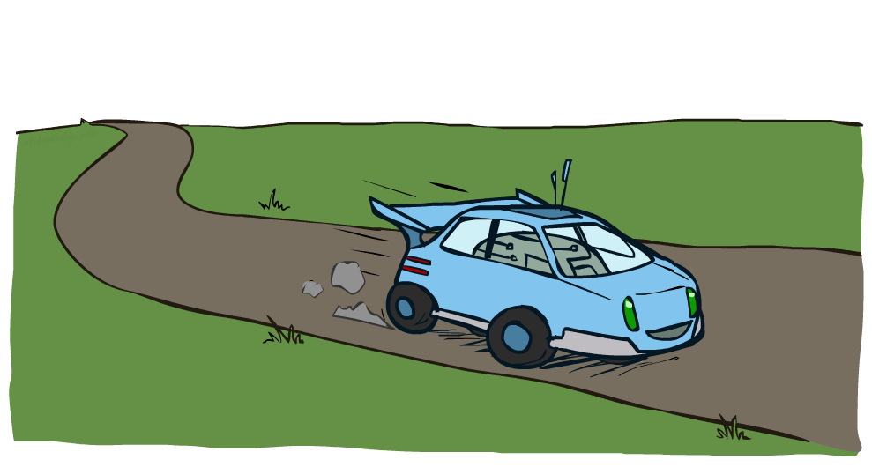
Example: Racing

Slide 24



Example: Racing
A robot car wants to travel far, quickly
Three states: Cool, Warm, Overheated
Two actions: Slow, Fast
Going faster gets double reward
  Except…
0.5
+1
1.0
Fast
Slow
-10
+1
0.5
Warm
Slow
Fast
0.5
+2
Cool
0.5
Overheated
+1
1.0
+2

Slide 25




Racing: Search Tree
Might be generated with ExpectiMax, but …?
Notes:
Two differences
Lots of repeated states
Reward comes incrementally at every action

Slide 26


MDP Search Trees
Each MDP state projects an expectimax-like search tree
s
s is a state
a
(s, a) is a q-state
s, a
(s,a,s’) called a transition
T(s,a,s’) = P(s’|s,a)
R(s,a,s’)
s,a,s’
s’
Notes:
In MDP chance node represents uncertainty about what might happen based on (s,a) [as opposed to being a random adversary]
Q-state (s,a) is when you were in a state and took an action

Slide 27

Utilities of Sequences

Slide 28
Utilities of Sequences
What preferences should an agent have over reward sequences?
More or less?
Now or later?
[1, 2, 2]
or
[2, 3, 4]
[0, 0, 1]
or
[1, 0, 0]

Slide 29




Discounting
It’s reasonable to maximize the sum of rewards
It’s also reasonable to prefer rewards now to rewards later
One solution: values of rewards decay exponentially
Worth Now
Worth Next Step
Worth In Two Steps

Slide 30

Discounting
How to discount?
  Each time we descend a level, we multiply by the discount
Why discount?
  Sooner rewards probably do have higher utility than later rewards
  Also helps our algorithms converge
Example: discount of 0.5
  U([1,2,3]) = 1*1 + 0.5*2 + 0.25*3
  U([1,2,3]) < U([3,2,1])
Notes:
Rewards in the future (deeper in the tree) matter less
Interesting: running expectimax, if having to truncate the search, then not losing much; e.g., less then \gamma^d / (1-\gamma)

Slide 31

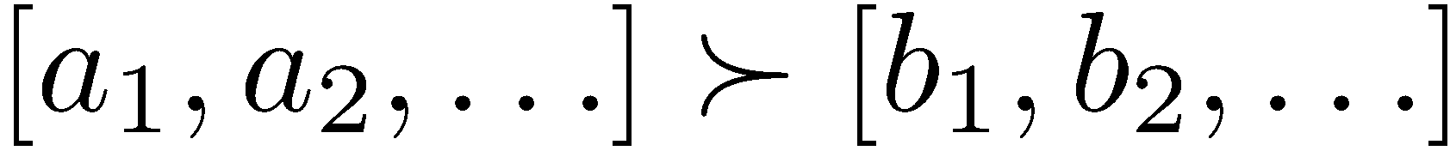
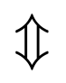
Stationary Preferences
Theorem: if we assume stationary preferences:
Then: there are only two ways to define utilities
  Additive utility:
  Discounted utility:

Slide 32


Quiz: Discounting
Given:
  Actions: East, West, and Exit (only available in exit states a, e)
  Transitions: deterministic
Quiz 1: For γ = 1, what is the optimal policy?
Quiz 2: For γ = 0.1, what is the optimal policy?
Quiz 3: For which γ are West and East equally good when in state d?

Slide 33

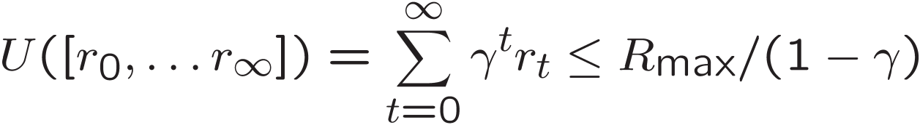
Infinite Utilities?!
Problem: What if the game lasts forever? Do we get infinite rewards?
Solutions:
  Finite horizon: (similar to depth-limited search)
    Terminate episodes after a fixed T steps (e.g. life)
    Gives nonstationary policies (π depends on time left)
  Discounting: use 0 < γ < 1
    Smaller γ means smaller “horizon” – shorter term focus
  Absorbing state: guarantee that for every policy, a terminal state will eventually be reached (like “overheated” for racing)
Notes:
Except no guarantee to reach overheating

Slide 34
Recap: Defining MDPs
Markov decision processes:
  Set of states S
  Start state s₀
  Set of actions A
  Transitions P(s’|s,a) (or T(s,a,s’))
  Rewards R(s,a,s’) (and discount γ)
MDP quantities so far:
  Policy = Choice of action for each state
  Utility = sum of (discounted) rewards
s
a
s, a
s,a,s’
s’

Slide 35
Solving MDPs
Value Iteration
  Asynchronous VI
Policy Iteration
Reinforcement Learning

Slide 36
V* = Optimal Value Function
The value (utility) of a state s:
V*(s)
“expected utility starting in s & acting optimally forever”

Slide 37
Q*
The value (utility) of the q-state (s,a):
Q*(s,a)
“expected utility of 1) starting in state s
2) taking action a
3) acting optimally forever after that”
Q*(s,a) = reward from executing a in s then ending in s’
plus… discounted value of V*(s’)

Slide 38
π* Specifies The Optimal Policy
  π*(s) = optimal action from state s
Notes:
[Note: this demo doesn’t show anything in action, just pops up V and Q values.]

Slide 39

The Bellman Equations
How to be optimal:
Step 1: Take correct first action
Step 2: Keep being optimal

Slide 40
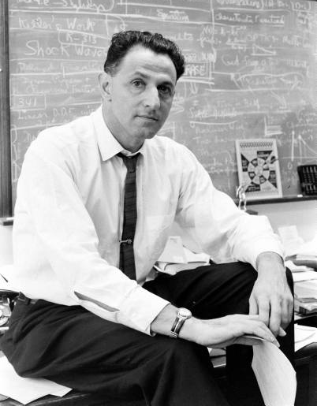


The Bellman Equations
Definition of “optimal utility” via expectimax recurrence gives a simple one-step lookahead relationship amongst optimal utility values
These are the Bellman equations, and they characterize optimal values in a way we’ll use over and over
(1920-1984)
s
a
s, a
s,a,s’
s’
Notes:
Let’s start by equations that characterize these quantities through mutual recursions. [step through this by writing on slide, one step at a time]
Recursive characterization of V* in terms of V*; not necessarily helpful; but it is a characterization.
Note: this is a set of equations that needs to be satisfied; but it could have multiple solutions (it does not, but at this stage of our knowledge it could).

Slide 41
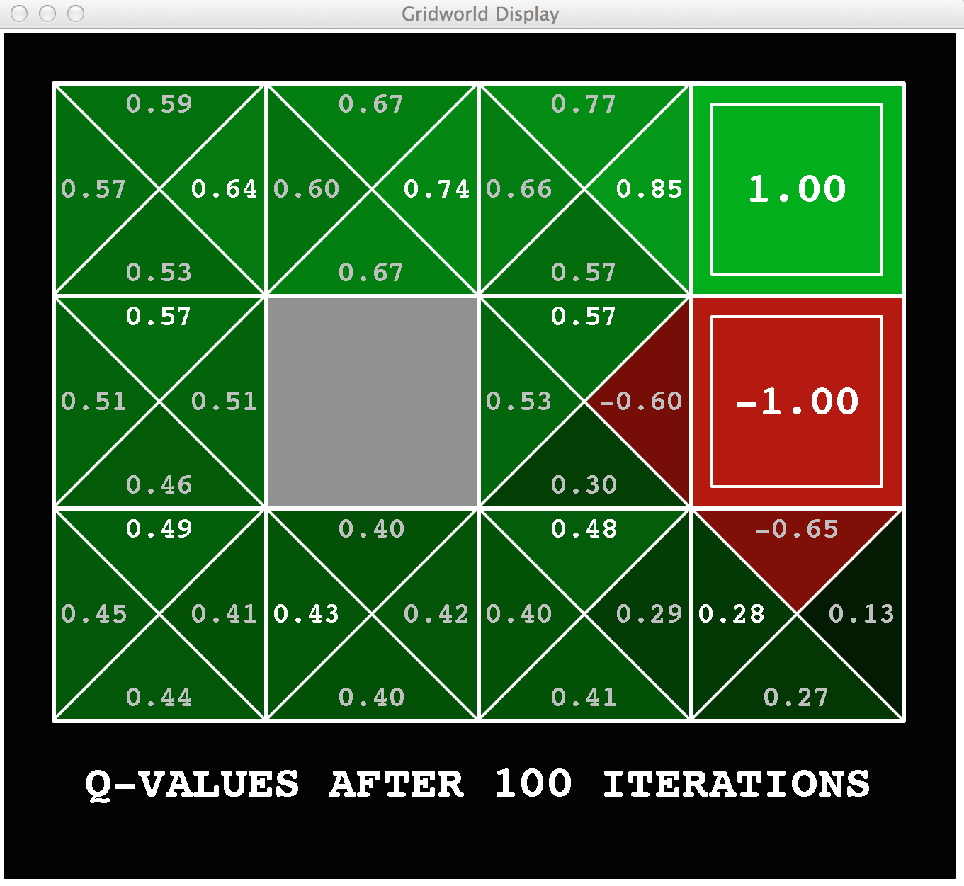
Gridworld: Q*

Slide 42
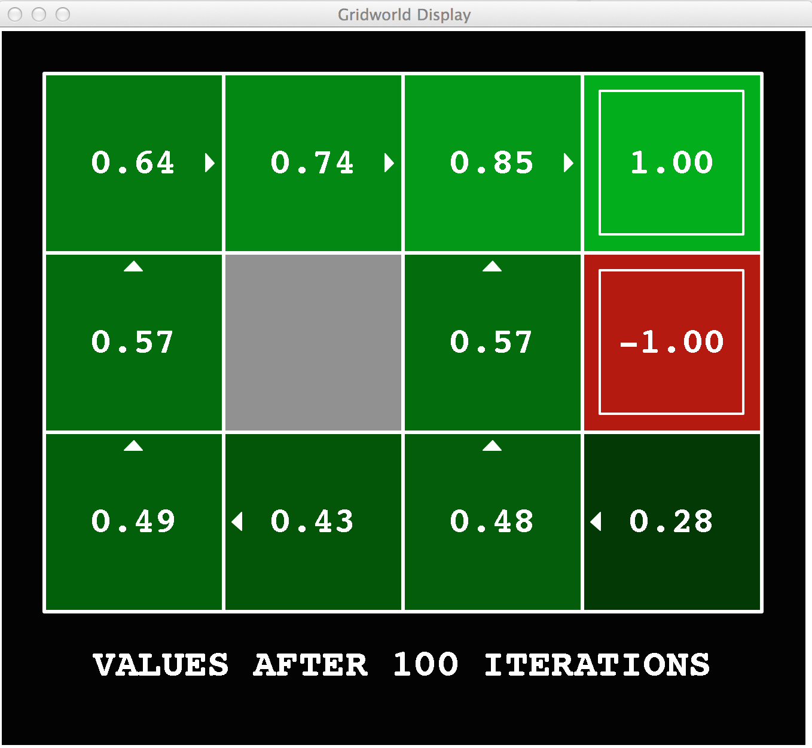
Gridworld Values V*

Slide 43

Values of States
Fundamental operation: compute the (expectimax) value of a state
  Expected utility under optimal action
  Average sum of (discounted) rewards
  This is just what expectimax computed!
Recursive definition of value:
s
a
s, a
s,a,s’
s’

Slide 44
Racing Search Tree

Slide 45




No End in Sight…
We’re doing way too much work with expectimax!
Problem 1: States are repeated
  Idea: Only compute needed quantities once
  Like graph search (vs. tree search)
Problem 2: Tree goes on forever
  Rewards @ each step → V changes
  Idea: Do a depth-limited computation, but with increasing depths until change is small
  Note: deep parts of the tree eventually don’t matter if γ < 1

Slide 46





Time-Limited Values
Key idea: time-limited values
Define V_{k}(s) to be the optimal value of s if the game ends in k more time steps
  Equivalently, it’s what a depth-k expectimax would give from s
[Demo – time-limited values (L8D6)]
Notes:
This demo generates the time-limited values for gridworld as snapshotted onto the next slides.

Slide 47





Time-Limited Values: Avoiding Redundant Computation

Slide 48

Value Iteration

Slide 49
Value Iteration
Called a
“Bellman Backup”
Forall s, Initialize V₀(s) = 0 no time steps left means an expected reward of zero
Repeat do Bellman backups
  K += 1
Repeat until |V_{k+1}(s) – V_{k}(s) | < ε, forall s “convergence”
}
V_{k+1}(s)
Q_{k+1}(s, a) = Σ_{s’} T(s, a, s’) [ R(s, a, s’) + γ V_{k}(s’)]
V_{k+1}(s) = Max _{a} Q_{k+1} (s, a)
a
} do ∀s, a
s, a
s,a,s’
V_{k}(s’)
Successive approximation; dynamic programming
Notes:
Discuss computational complexity: S * A * S times number of iterations
Note: updates not in place [if in place, it means something else and not even clear what it means]

Slide 50
Example: Bellman Backup
Assume γ ~ 1
s₁
Q₁(s,a₁) = 2 + γ 0
~ 2
Q₁(s,a₂) = 5 + γ 0.9~ 1
+ γ 0.1~ 2
~ 6.1
Q₁(s,a₃) = 4.5 + γ 2
~ 6.5
2
a₁
V₁= 0
V₂(s) = 6.5
s
5
a₂
4.5
s₂
0.9
V₁= 1
a₃
0.1
a_{greedy} = a₃
s₃
V₁= 2
max

Slide 51
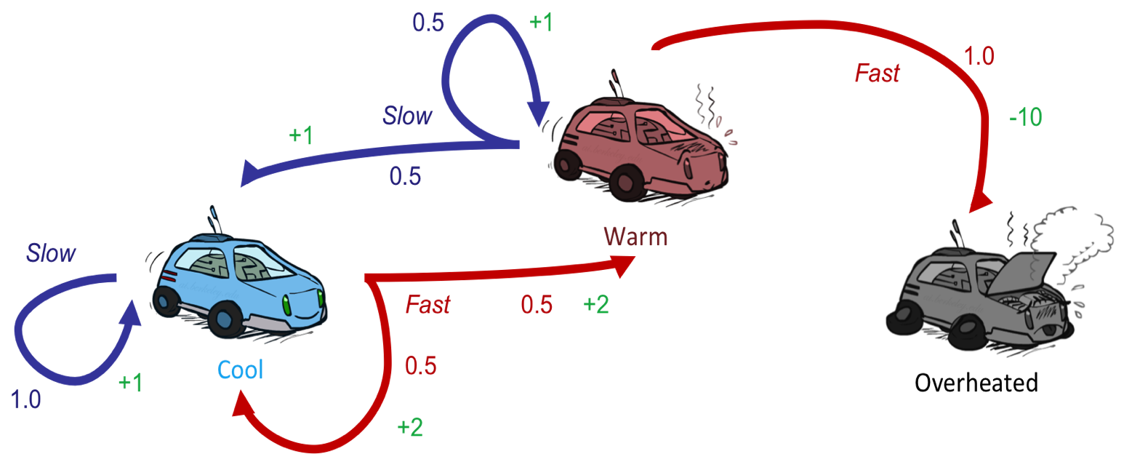
Example: Value Iteration
Assume no discount (gamma=1) to keep math simple!
Q_{k+1}(s, a) = Σ_{s’} T(s, a, s’) [ R(s, a, s’) + γ V_{k}(s’)]
V_{k+1}(s) = Max _{a} Q_{k+1} (s, a)

Slide 52






Example: Value Iteration
Assume no discount (gamma=1) to keep math simple!
0 0 0
Q_{k+1}(s, a) = Σ_{s’} T(s, a, s’) [ R(s, a, s’) + γ V_{k}(s’)]
V_{k+1}(s) = Max _{a} Q_{k+1} (s, a)

Slide 53
Example: Value Iteration
Q( , ,fast) =
Assume no discount (gamma=1) to keep math simple!
Q( , ,slow) =
0 0 0
Q₁(s,a)=
0
0
Q_{k+1}(s, a) = Σ_{s’} T(s, a, s’) [ R(s, a, s’) + γ V_{k}(s’)]
V_{k+1}(s) = Max _{a} Q_{k+1} (s, a)

Slide 54
Example: Value Iteration
Q( , ,fast) = -10 + 0
Assume no discount (gamma=1) to keep math simple!
Q( , ,slow) =
Q( , ,slow) = ½(1 + 0) + ½(1+0)
0 0 0
Q₁(s,a)=
1,
-10
0
1
0
Q_{k+1}(s, a) = Σ_{s’} T(s, a, s’) [ R(s, a, s’) + γ V_{k}(s’)]
V_{k+1}(s) = Max _{a} Q_{k+1} (s, a)

Slide 55
Example: Value Iteration
Q( , fast) =
Q( , fast) = ½(2 + 0) + ½(2 + 0)
Assume no discount (gamma=1) to keep math simple!
Q( , slow) = 1*(1 + 0)
Q( , slow) =
0 0 0
2
1,-10
0
Q₁(s,a)=
1,
2
1 0
Q_{k+1}(s, a) = Σ_{s’} T(s, a, s’) [ R(s, a, s’) + γ V_{k}(s’)]
V_{k+1}(s) = Max _{a} Q_{k+1} (s, a)

Slide 56
Example: Value Iteration
Assume no discount (gamma=1) to keep math simple!
0 0 0
Q₁(s,a)=
1, 2 1,-10 0
2 1 0
Q₂(s,a)=
3,3.5 2.5,-10 0
Q_{k+1}(s, a) = Σ_{s’} T(s, a, s’) [ R(s, a, s’) + γ V_{k}(s’)]
V_{k+1}(s) = Max _{a} Q_{k+1} (s, a)
3.5 2.5 0
Notes:
Q2(cold,slow) = 1 + 2 = 3
Q2(cold, fast) = .5*(2+2) + .5*(2+1) = 3.5
Q2(warm,slow) = .5*(1+2) + .5*(2+1) = 2.5
Q2(warm,fast) = -10

Slide 57

k=0
Noise = 0.2
Discount = 0.9
Living reward = 0
Notes:
Assuming zero living reward

Slide 58
k=1
If agent is in 4,3, it only has one legal action: get jewel. It gets a reward and the game is over.
If agent is in the pit, it has only one legal action, die. It gets a penalty and the game is over.
Agent does NOT get a reward for moving INTO 4,3.
Noise = 0.2
Discount = 0.9
Living reward = 0
Notes:
Assuming zero living reward

Slide 59

k=2
Noise = 0.2
Discount = 0.9
Living reward = 0
Notes:
Assuming zero living reward

Slide 60

k=3
Noise = 0.2
Discount = 0.9
Living reward = 0
Notes:
Assuming zero living reward

Slide 61

k=4
Noise = 0.2
Discount = 0.9
Living reward = 0
Notes:
Assuming zero living reward

Slide 62

k=5
Noise = 0.2
Discount = 0.9
Living reward = 0
Notes:
Assuming zero living reward

Slide 63

k=6
Noise = 0.2
Discount = 0.9
Living reward = 0
Notes:
Assuming zero living reward

Slide 64

k=7
Noise = 0.2
Discount = 0.9
Living reward = 0
Notes:
Assuming zero living reward

Slide 65

k=8
Noise = 0.2
Discount = 0.9
Living reward = 0
Notes:
Assuming zero living reward

Slide 66

k=9
Noise = 0.2
Discount = 0.9
Living reward = 0
Notes:
Assuming zero living reward

Slide 67

k=10
Noise = 0.2
Discount = 0.9
Living reward = 0
Notes:
Assuming zero living reward

Slide 68

k=11
Noise = 0.2
Discount = 0.9
Living reward = 0
Notes:
Assuming zero living reward

Slide 69

k=12
Noise = 0.2
Discount = 0.9
Living reward = 0
Notes:
Assuming zero living reward

Slide 70

k=100
Noise = 0.2
Discount = 0.9
Living reward = 0
Notes:
Assuming zero living reward

Slide 71
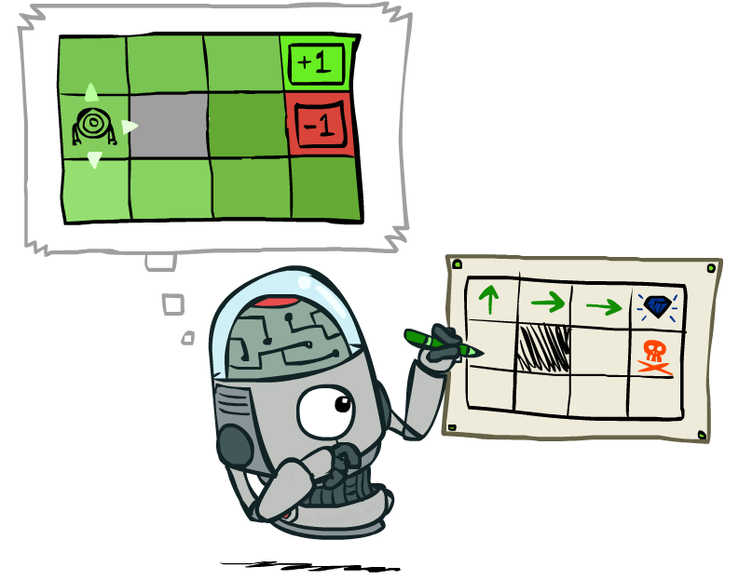
VI: Policy Extraction

Slide 72
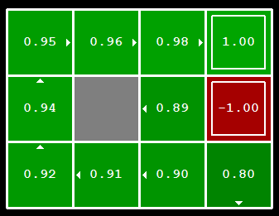


Computing Actions from Values
Let’s imagine we have the optimal values V*(s)
How should we act?
  In general, it’s not obvious!
We need to do a mini-expectimax (one step)
This is called policy extraction, since it gets the policy implied by the values

Slide 73
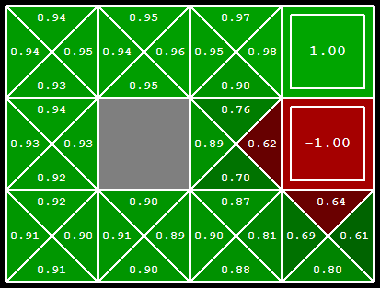
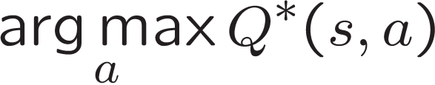
Computing Actions from Q-Values
Let’s imagine we have the optimal q-values:
How should we act?
  Completely trivial to decide!
Important lesson: actions are easier to select from q-values than values!

Slide 74
Value Iteration - Recap
Forall s, Initialize V₀(s) = 0 no time steps left means an expected reward of zero
Repeat do Bellman backups
  K += 1
  Repeat for all states, s, and all actions, a:
Until |V_{k+1}(s) – V_{k}(s) | < ε, forall s “convergence”
Theorem: will converge to unique optimal values
V_{k+1}(s)
a
Q_{k+1}(s, a) = Σ_{s’} T(s, a, s’) [ R(s, a, s’) + γ V_{k}(s’)]
V_{k+1}(s) = Max _{a} Q_{k+1} (s, a)
s, a
s,a,s’
V_{k}(s’)
Notes:
Discuss computational complexity: S * A * S times number of iterations
Note: updates not in place [if in place, it means something else and not even clear what it means]

Slide 75


Convergence*
How do we know the V_{k} vectors will converge?
Case 1: If the tree has maximum depth M, then V_{M} holds the actual untruncated values
Case 2: If the discount is less than 1
  Sketch: For any state V_{k} and V_{k+1} can be viewed as depth k+1 expectimax results in nearly identical search trees
  The max difference happens if big reward at k+1 level
  That last layer is at best all R_{MAX}
  But everything is discounted by γ^{k} that far out
  So V_{k} and V_{k+1} are at most γ^{k} max|R| different
  So as k increases, the values converge
Notes:
Theorem: will converge to unique optimal values
Basic idea: approximations get refined towards optimal values
Policy may converge long before values do

Slide 76
Value Iteration - Recap
Forall s, Initialize V₀(s) = 0 no time steps left means an expected reward of zero
Repeat do Bellman backups
  K += 1
  Repeat for all states, s, and all actions, a:
Until |V_{k+1}(s) – V_{k}(s) | < ε, forall s “convergence”
Complexity of each iteration?
V_{k+1}(s)
a
Q_{k+1}(s, a) = Σ_{s’} T(s, a, s’) [ R(s, a, s’) + γ V_{k}(s’)]
V_{k+1}(s) = Max _{a} Q_{k+1} (s, a)
s, a
s,a,s’
V_{k}(s’)
Notes:
Discuss computational complexity: S * A * S times number of iterations
Note: updates not in place [if in place, it means something else and not even clear what it means]

Slide 77
Value Iteration - Recap
Forall s, Initialize V₀(s) = 0 no time steps left means an expected reward of zero
Repeat do Bellman backups
  K += 1
  Repeat for all states, s, and all actions, a:
Until |V_{k+1}(s) – V_{k}(s) | < ε, forall s “convergence”
Complexity of each iteration: O(S²A)
  Number of iterations: poly(|S|, |A|, 1/(1-γ))
V_{k+1}(s)
a
Q_{k+1}(s, a) = Σ_{s’} T(s, a, s’) [ R(s, a, s’) + γ V_{k}(s’)]
V_{k+1}(s) = Max _{a} Q_{k+1} (s, a)
s, a
s,a,s’
V_{k}(s’)
Notes:
Discuss computational complexity: S * A * S times number of iterations
Note: updates not in place [if in place, it means something else and not even clear what it means]

Slide 78
Value Iteration as Successive Approximation
Bellman equations characterize the optimal values:
Value iteration computes them:
Value iteration is just a fixed-point solution method
  Computed using dynamic programming
  … though the V_{k} vectors are also interpretable as time-limited values
V(s)
a
s, a
s,a,s’
V(s’)
Q_{k+1}(s, a) = Σ_{s’} T(s, a, s’) [ R(s, a, s’) + γ V_{k}(s’)]
V_{k+1}(s) = Max _{a} Q_{k+1} (s, a)
Notes:
Discuss computational complexity: S * A * S times number of iterations
Note: updates not in place [if in place, it means something else and not even clear what it means]

Slide 79
Problems with Value Iteration
Value iteration repeats the Bellman updates:
Problem 1: It’s slow – O(S²A) per iteration
Problem 2: The “max” at each state rarely changes
Problem 3: The policy often converges long before the values
s
Q_{k+1}(s, a) = Σ_{s’} T(s, a, s’) [ R(s, a, s’) + γ V_{k}(s’)]
V_{k+1}(s) = Max _{a} Q_{k+1} (s, a)
a
s, a
s,a,s’
s’
[Demo: value iteration (L9D2)]
Notes:
Demo steps through value iteration; snapshots of values shown on next slides.

Slide 80
VI → Asynchronous VI
Is it essential to back up all states in each iteration?
  No!
States may be backed up
  many times or not at all
  in any order
As long as no state gets starved…
  convergence properties still hold!!

Slide 81
Prioritization of Bellman Backups
Are all backups equally important?
Can we avoid some backups?
Can we schedule the backups more appropriately?

Slide 82
k=1
Noise = 0.2
Discount = 0.9
Living reward = 0
Notes:
Assuming zero living reward

Slide 83
k=2
Noise = 0.2
Discount = 0.9
Living reward = 0
Notes:
Assuming zero living reward

Slide 84
k=3
Noise = 0.2
Discount = 0.9
Living reward = 0
Notes:
Assuming zero living reward

Slide 85
Asynch VI: Prioritized Sweeping
Why backup a state if values of successors unchanged?
Prefer backing a state
  whose successors had most change
Priority Queue of (state, expected change in value)
Backup in the order of priority
After backing up state s’, update priority queue
  for all predecessors (ie all states where an action can reach s’)

Slide 86
Residual wrt Value Function V (Res^{V})
Residual at s with respect to V
  magnitude(¢V(s)) after one Bellman backup at s
Residual wrt respect to V
  max residual
  Res^{V} = max_{s} (Res^{V}(s))
Res^{V} <²
(²-consistency)

Slide 87
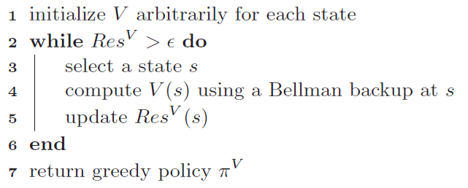
(General) Asynchronous VI

Slide 88
Asynchronous VI
Pros?
Cons?
Notes:
Pro: fewer backups!
Cons: n log(n) overhead of priority queue
Net: depends on domain structure. If branching factor is high, each backup may require updating many priorities

Slide 89
Async VI: Real Time Dynamic Programming
[Barto, Bradtke, Singh’95]
Trial: simulate greedy policy starting from start state;
perform Bellman backup just on visited states
RTDP:
  Repeat Trials until value function converges

Slide 90
RTDP Trial
Q_{n+1}(s₀,a)
V_{n}
a_{greedy} = a₂
Max
V_{n}
?
a₁
V_{n}
Goal
a₂
V_{n+1}(s₀)
s₀
?
V_{n}
a₃
?
V_{n}
V_{n}
V_{n}
Notes:
Finding lowest cost policy to reach goal

Slide 91

Solving MDPs
Value Iteration
Policy Iteration
Reinforcement Learning

Slide 92

Policy Methods
Policy Iteration =
Policy Evaluation
Policy Improvement

Slide 93

Part 1 - Policy Evaluation

Slide 94
Fixed Policies
Do the optimal action
Do what π says to do
s
s
a
π(s)
s, a
s, π(s)
s,a,s’
s, π(s),s’
s’
s’
Expectimax trees max over all actions to compute the optimal values
If we fixed some policy π(s), then the tree would be simpler – only one action per state
  … though the tree’s value would depend on which policy we fixed

Slide 95
Computing Utilities for a Fixed Policy
A new basic operation: compute the utility of a state s under a fixed (generally non-optimal) policy
Define the utility of a state s, under a fixed policy π:
  V^{π}(s) = expected total discounted rewards starting in s and following π
Recursive relation (variation of Bellman equation):
s
π(s)
s, π(s)
s, π(s),s’
s’

Slide 96
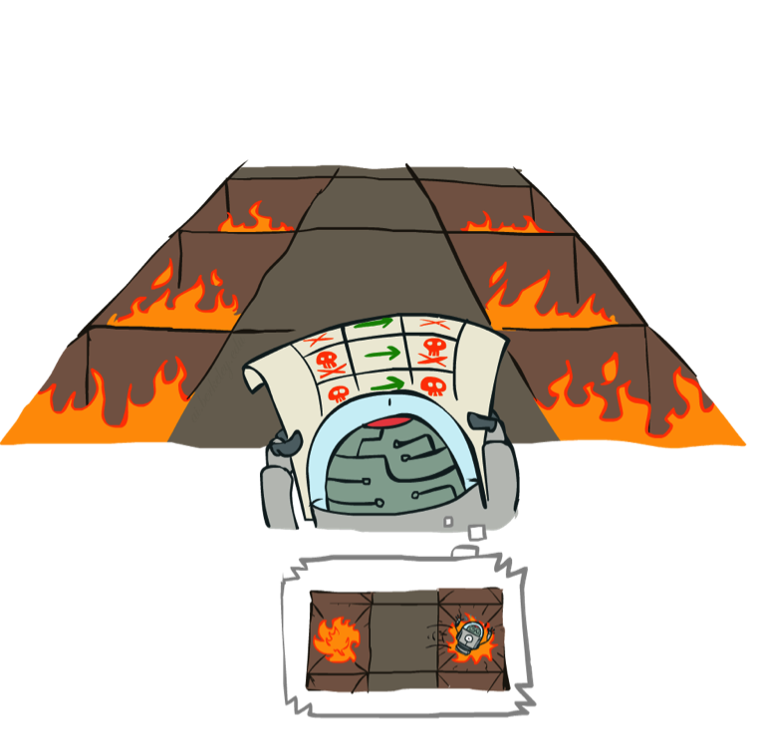
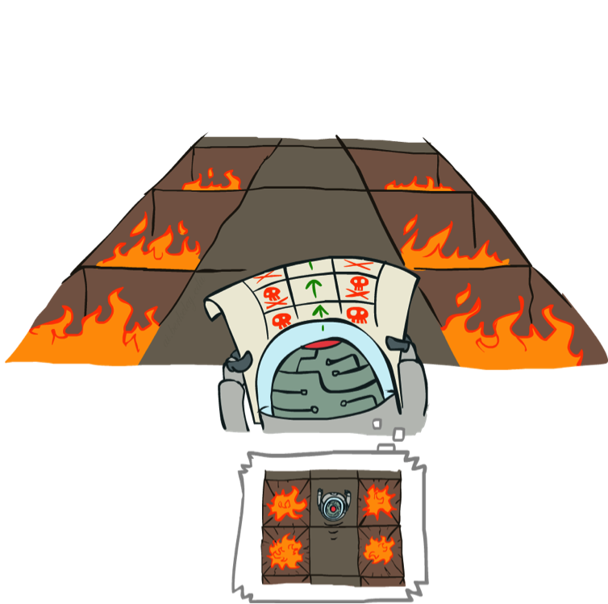
Example: Policy Evaluation
Always Go Right
Always Go Forward

Slide 97
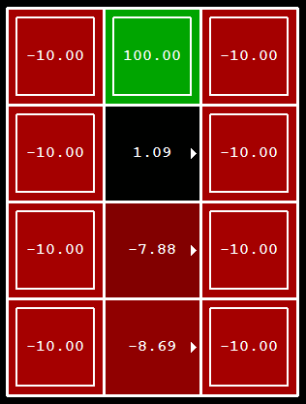
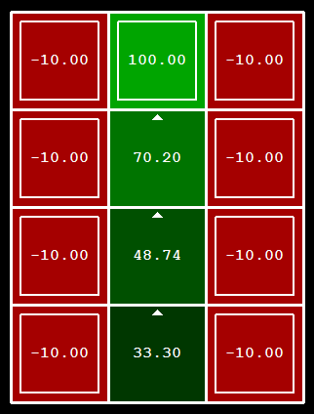
Example: Policy Evaluation
Always Go Right
Always Go Forward

Slide 98

Policy Evaluation Algorithm
s
How do we calculate the V’s for a fixed policy π?
Idea 1: Turn recursive Bellman equations into updates
(like value iteration)
Efficiency: O(S²) per iteration
Idea 2: Without the maxes, the Bellman equations are just a linear system
  Solve with Matlab (or your favorite linear system solver)
π(s)
s, π(s)
s, π(s),s’
s’

Slide 99
Part 2 - Policy Iteration

Slide 100
Policy Iteration
Initialize π(s) to random actions
Repeat
  Step 1: Policy evaluation: calculate utilities of π at each s using a nested loop
  Step 2: Policy improvement: update policy using one-step look-ahead
  “For each s, what’s the best action I could execute, assuming I then follow π?
  Let π’(s) = this best action.
  π = π’
Until policy doesn’t change

Slide 101
Policy Iteration Details
Let i =0
Initialize π_{i}(s) to random actions
Repeat
  Step 1: Policy evaluation:
    Initialize k=0; Forall s, V₀^{π} (s) = 0
    Repeat until V^{π} converges
      For each state s,
      Let k += 1
  Step 2: Policy improvement:
    For each state, s,
    If π_{i} == π_{i+1} then it’s optimal; return it.
    Else let i += 1

Slide 102
Example
Initialize π₀ to “always go right”
Perform policy evaluation
Perform policy improvement
Iterate through states
?
Has policy changed?
?
Yes! i += 1
?

Slide 103
Example
π₁ says “always go up”
Perform policy evaluation
Perform policy improvement
Iterate through states
?
Has policy changed?
?
No! We have the optimal policy
?

Slide 104
Example: Policy Evaluation
Always Go Right
Always Go Forward

Slide 105
Policy Iteration Properties
Policy iteration finds the optimal policy, guaranteed!
Often converges (much) faster

Slide 106
Comparison
Both value iteration and policy iteration compute the same thing (all optimal values)
In value iteration:
  Every iteration updates both the values and (implicitly) the policy
  We don’t track the policy, but taking the max over actions implicitly recomputes it
  What is the space being searched?
In policy iteration:
  We do fewer iterations
  Each one is slower (must update all V^{π} and then choose new best π)
  What is the space being searched?
Both are dynamic programs for solving MDPs

Slide 107
Summary So Far: MDP Algorithms
So you want to….
  Compute optimal values: use value iteration or policy iteration
  Compute values for a particular policy: use policy evaluation
  Turn your values into a policy: use policy extraction (one-step lookahead)
These all look the same!
  They all use variations of Bellman updates
  They all use one-step lookahead expectimax fragments
  They differ
    whether we plug in a fixed policy or max over actions
    Whether we search finite (policy) space or infinite (R valued value function) space

Slide 108
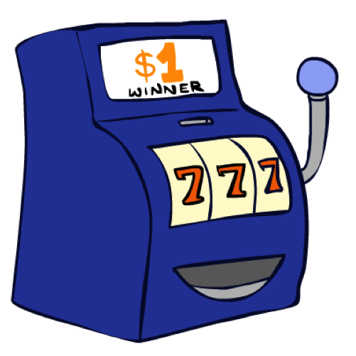
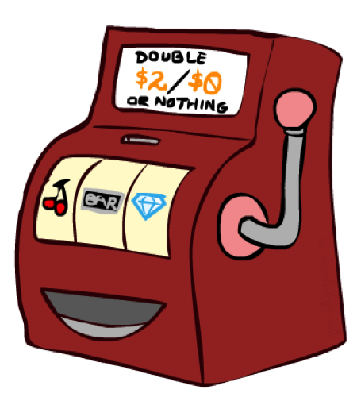

Double Bandits

Slide 109
Double-Bandit MDP
Actions: Blue, Red
States: Win, Lose
No discount
100 time steps
Both states have the same value
0.25 $0
0.75
$2
W
L
0.25
$0
$1
1.0
$1
1.0
0.75 $2

Slide 110
Offline Planning
Solving MDPs is offline planning
  You determine all quantities through computation
  You need to know the details of the MDP
  You do not actually play the game!
No discount
100 time steps
Both states have the same value
0.25 $0
Value
0.75
$2
W
0.25
$0
Play Red
150
L
$1
1.0
$1
1.0
0.75 $2
Play Blue
100

Slide 111
Let’s Play!
$2
$2
$0
$2
$2
$2
$2
$0
$0
$0

Slide 112
Online Planning
Rules changed! Red’s win chance is different.
?? $0
??
$2
W
L
??
$0
$1
1.0
$1
1.0
?? $2

Slide 113
Let’s Play!
$0
$0
$0
$2
$0
$2
$0
$0
$0
$0

Slide 114
Policy Evaluation
s
How do we calculate the V’s for a fixed policy π?
Idea 1: Turn recursive Bellman equations into updates
(like value iteration)
Efficiency: O(S²) per iteration
Idea 2: Without the maxes, the Bellman equations are just a linear system
  Solve with Matlab (or your favorite linear system solver)
π(s)
s, π(s)
s, π(s),s’
s’

Slide 115
What Just Happened?
That wasn’t planning, it was learning!
  Specifically, reinforcement learning
  There was an MDP, but you couldn’t solve it with just computation
  You needed to actually act to figure it out
Important ideas in reinforcement learning that came up
  Exploration: you have to try unknown actions to get information
  Exploitation: eventually, you have to use what you know
  Regret: even if you learn intelligently, you make mistakes
  Sampling: because of chance, you have to try things repeatedly
  Difficulty: learning can be much harder than solving a known MDP

Slide 116
Next Time: Reinforcement Learning!

Slide 117

Asynchronous Value Iteration*
In value iteration, we update every state in each iteration
  Actually, any sequences of Bellman updates will converge if every state is visited infinitely often
In fact, we can update the policy as seldom or often as we like, and we will still converge
Idea: Update states whose value we expect to change:
If is large then update predecessors of s

Slide 118
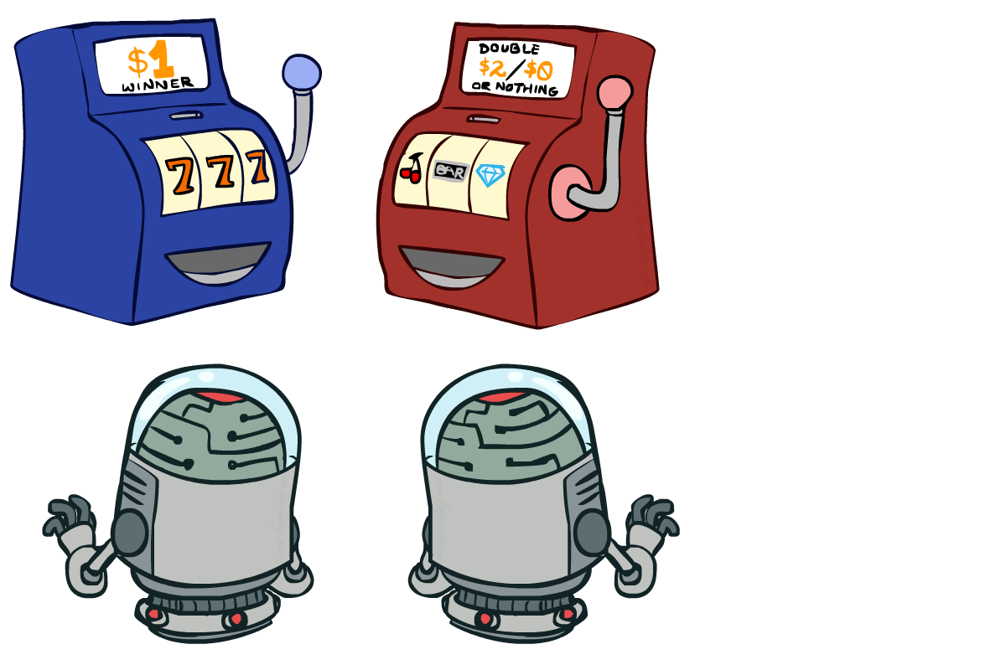
Interlude

