Slide 1
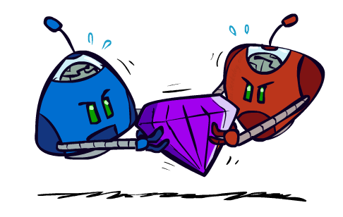
CSE 473: Artificial Intelligence
Expecti-Max Search for Stochastic Games
Dan Weld
Based on slides from
Mausam, Andrey Kolobov, Dan Klein, Stuart Russell, Pieter Abbeel,
(best illustrations from ai.berkeley.edu)
1

Slide 2
todo
See todo down below
Lecture is poor at end
Should shrink utility / preference stuff

Slide 3
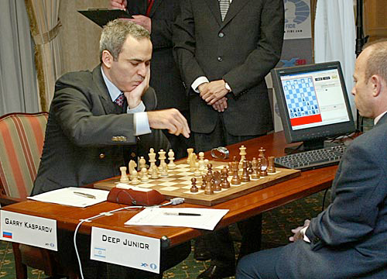
Outline
Adversarial Games
  Minimax search
  α-β search
  Evaluation functions
  Multi-player, non-0-sum
Stochastic Games
  Expectimax
  Markov Decision Processes
  Reinforcement Learning

Slide 4

Utilities
Utility function describes an agent’s preferences
Function from outcomes (states of the world) to
  (so we can take an expectation)
In a game, may be simple (+1/-1)
In general, we hard-wire an agent’s utilities
  let its actions emerge

Slide 5
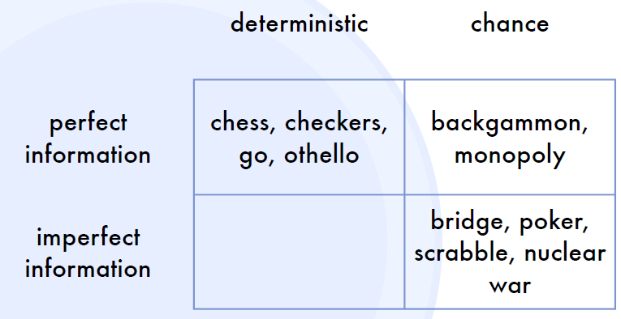
Types of “Games”
stratego
Number of Players? 1, 2, …?

Slide 6
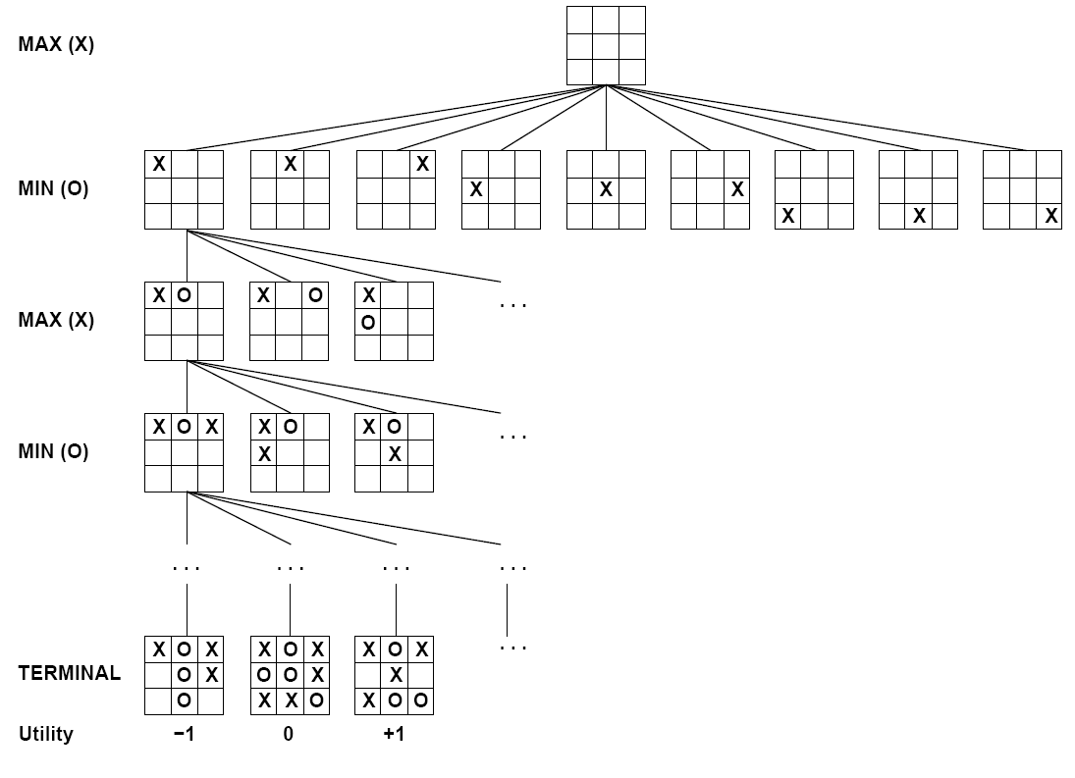
Tic-tac-toe Game Tree
Determine optimal play
Assuming opponent is playing optimally

Slide 7
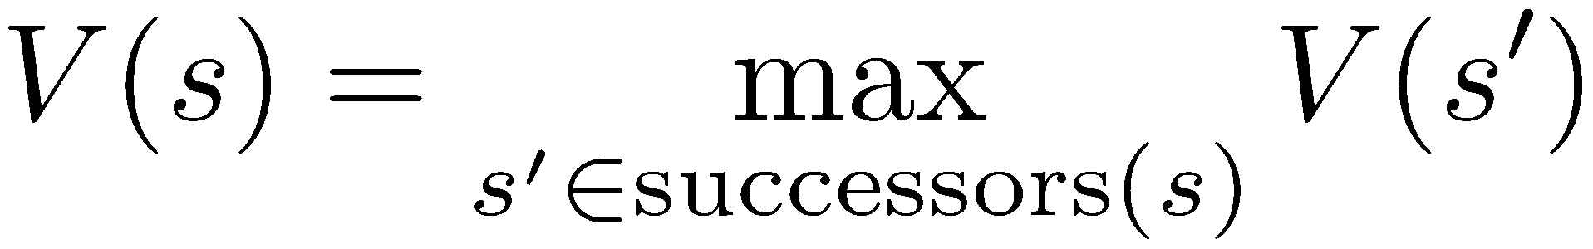
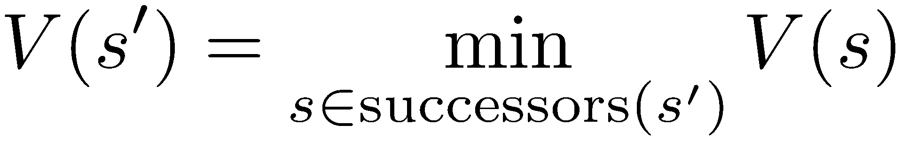
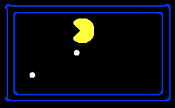

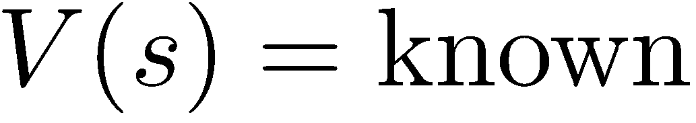
Minimax Values
States Under Agent’s Control:
States Under Opponent’s Control:
-8
-8
-10
-8
-5
-10
+8
Terminal States:
Slide from Dan Klein & Pieter Abbeel - ai.berkeley.edu

Slide 8
Minimax Implementation
def max-value(state):
  if leaf?(state), return U(state)
  initialize v = -∞
  for each c in children(state)
    v = max(v, min-value(c))
  return v
def min-value(state):
  if leaf?(state), return U(state)
  initialize v = +∞
  for each c in children(state)
    v = min(v, max-value(c))
  return v
Slide from Dan Klein & Pieter Abbeel - ai.berkeley.edu

Slide 9
Min-Max Implementation
def max-val(state ):
  if leaf?(state), return U(state)
  initialize v = -∞
  for each c in children(state):
    v = max(v, min-val(c ))
  return v
def min-val(state ):
  if leaf?(state), return U(state)
  initialize v = +∞
  for each c in children(state):
    v = min(v, max-val(c ))
  return v
Slide adapted from Dan Klein & Pieter Abbeel - ai.berkeley.edu
Notes:
Pick an order for two reasons: sequential processor and pruning

Slide 10
Alpha-Beta Implementation
  α: MAX’s best option on path to root
  β: MIN’s best option on path to root
def max-val(state, α, β):
  if leaf?(state), return U(state)
  initialize v = -∞
  for each c in children(state):
    v = max(v, min-val(c, α, β))
    if v ≥ β return v
    α = max(α, v)
  return v
def min-val(state, α, β):
  if leaf?(state), return U(state)
  initialize v = +∞
  for each c in children(state):
    v = min(v, max-val(c, α, β))
    if v ≤ α return v
    β = min(β, v)
  return v
Slide adapted from Dan Klein & Pieter Abbeel - ai.berkeley.edu
Notes:
Pick an order for two reasons: sequential processor and pruning

Slide 11
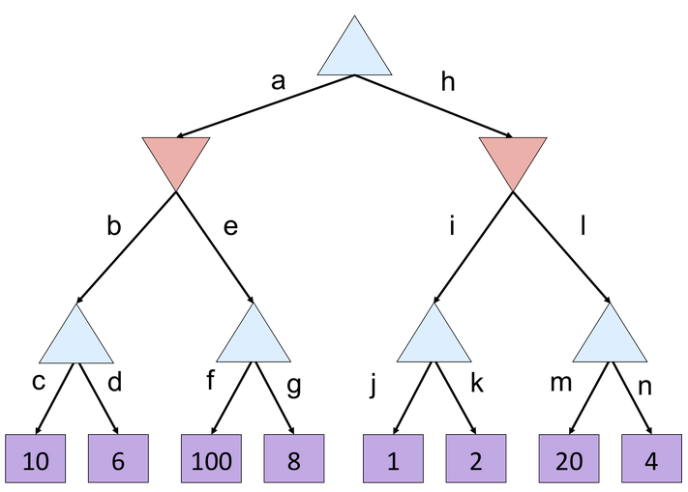
Alpha-Beta Example
Slide from Dan Klein & Pieter Abbeel - ai.berkeley.edu

Slide 12
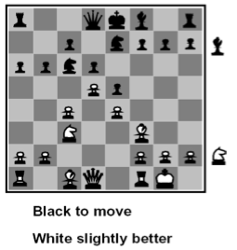
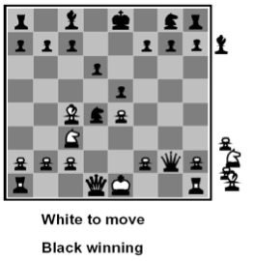
When can’t search to terminal states, use Heuristic Evaluation Function
Function which scores non-terminals
Ideal function: returns the true utility of the position
In practice: typically weighted linear sum of features:
  e.g. f₁(s) = (num white queens – num black queens), etc.

Slide 13





Evaluation for Pacman
What features would be good for Pacman?

Slide 14
Which algorithm?
α-β, depth 4, simple eval fun

Slide 15
Which algorithm?
α-β, depth 4, better eval fun

Slide 16
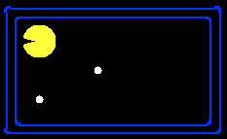
Why Pacman Starves
He knows his score will go up by eating the dot now
He knows his score will go up just as much by eating the dot later on
There are no point-scoring opportunities after eating the dot
Therefore, waiting seems just as good as eating

Slide 17
Zero-Sum Games
Non-
Zero-Sum games
  My gain is your loss
  Utility(me) - Utility(you) = 0
General Case
  “Non-zero sum”
  We each maximize our own utilities
me
max
opp.
min
2,-2
3,-3
1,-1
4,-4
me
max green
opp.
max blue
2,6
3,-2
1,2
4,-1

Slide 18
Multi-player Non-Zero-Sum Games
Again, similar to minimax:
  Utilities are now tuples
  Each player maximizes their own entry at each node
  Propagate (or back up) nodes from children
  Can give rise to cooperation and competition dynamically…
1,2,6
4,3,2
6,1,2
7,4,1
5,1,1
1,5,2
7,7,1
5,4,5

Slide 19
Stochastic Games
Much more useful model than “games”

Slide 20
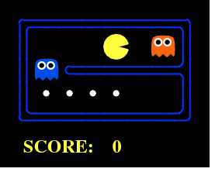
Alpha-Beta
3 ply look ahead, ghosts move randomly
Notes:
Out.mov

Slide 21
Expectimax Search Trees
What if we don’t know what the result of an action will be? E.g.,
  In solitaire, next card is unknown
  In minesweeper, mine locations
  In pacman, the ghosts act randomly
max
Can do expectimax search
  Chance nodes, like min nodes, except the outcome is uncertain
  Calculate expected utilities
  Max nodes as in minimax search
  Chance nodes take average (expectation) of value of children
chance
p (1-p)
q (1-q)
10
4
5
7
Soon, we’ll learn how to formalize this underlying problem as a Markov Decision Process

Slide 22

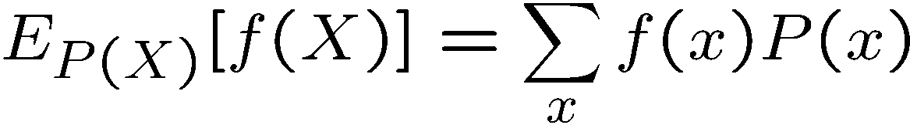

Review: Expectations
Real valued functions of random variables:
Expectation of a function of a random variable
Example: Expected value of a fair die roll
X | P | f
1 | 1/6 | 1
2 | 1/6 | 2
3 | 1/6 | 3
4 | 1/6 | 4
5 | 1/6 | 5
6 | 1/6 | 6

Slide 23
Expectimax Pseudocode
def value(s)
if s is a max node return maxValue(s)
if s is an exp node return expValue(s)
if s is a terminal node return evaluation(s)
def maxValue(s)
values = [value(s’) for s’ in successors(s)]
return max(values)
def expValue(s)
values = [value(s’) for s’ in successors(s)]
weights = [probability(s, s’) for s’ in successors(s)]
return expectation(values, weights)
8
4
5
6

Slide 24
Expectimax: wins some of the time
3 ply look ahead, ghosts move randomly

Slide 25

Modeling Assumptions

Slide 26
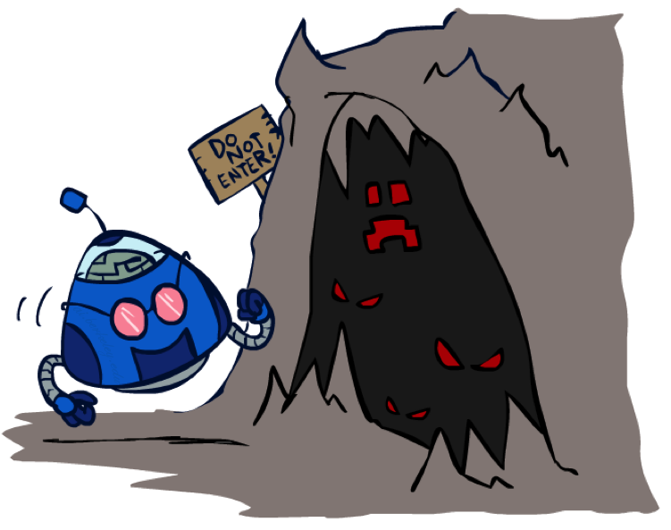
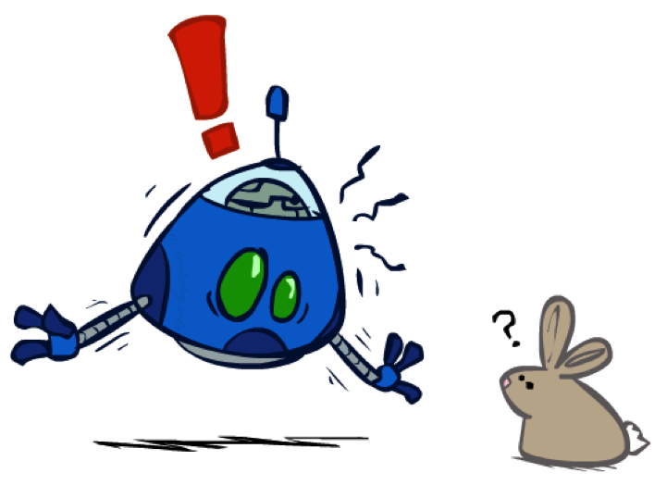
The Dangers of Optimism and Pessimism
Dangerous Optimism
Assuming chance when the world is adversarial
Dangerous Pessimism
Assuming the worst case when it’s not likely

Slide 27
Expectimax Search
In expectimax search, we have a probabilistic model of how the opponent (or environment) will behave in any state
  Model could be a simple uniform distribution (roll a die)
  Model could be sophisticated and require a great deal of computation
  We have a node for every outcome out of our control: opponent or environment
  The model might say that adversarial actions are likely!
For now, assume for any state we magically have a distribution to assign probabilities to opponent actions / environment outcomes

Slide 28
Expectimax for Pacman
Notice that we’ve gotten away from thinking that the ghosts are trying to minimize pacman’s score
  Instead, they are now a part of the environment
  Pacman has a belief (distribution) over how they will act
Quiz: Is minimax a special case of expectimax?
Quiz: What would pacman’s computation look like if we assumed that the ghosts were doing 1-ply minimax and taking the result 80% of the time, otherwise moving randomly?

Slide 29
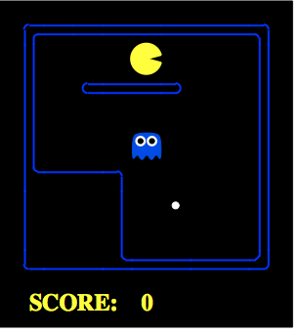
Expectimax for Pacman
Results from playing 5 games
 | Minimizing Ghost | Random Ghost
Minimax Pacman
Expectimax Pacman
Won 5/5
Avg. Score:
493
Won 5/5
Avg. Score:
483
Won 1/5
Avg. Score:
-303
Won 5/5
Avg. Score:
503
Pacman does depth 4 search with an eval function that avoids trouble
Minimizing ghost does depth 2 search with an eval function that seeks Pacman
Notes:
python pacman.py -g SmartGhost -l trapped2 -p ExpectimaxAgent -a depth=4,evalFn=better
animation is in order of who performs best (gets the dot quickiest)

Slide 30
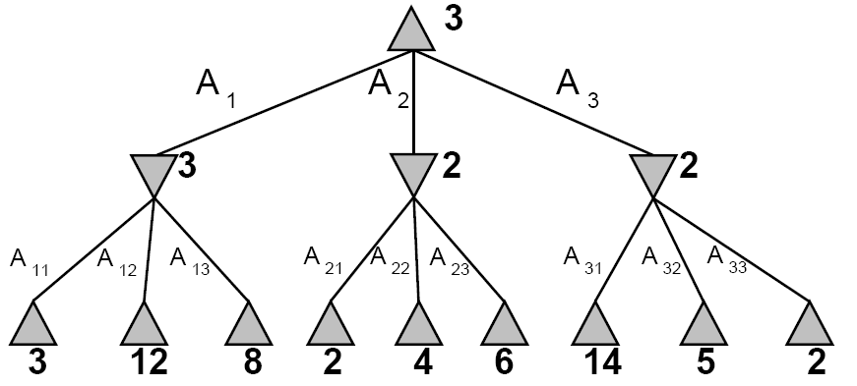
Expectimax Pruning?
Not easy
  exact: need bounds on possible values
  approximate: sample high-probability branches

Slide 31
Expectimax Evaluation
Evaluation functions quickly return an estimate for a node’s true value (which value, expectimax or minimax?)
For minimax, evaluation function scale doesn’t matter
  We just want better states to have higher evaluations (get the ordering right)
  We call this insensitivity to monotonic transformations
For expectimax, we need magnitudes to be meaningful
20
25
800
650
0
40
20
30
x²
0
1600
400
900

Slide 32
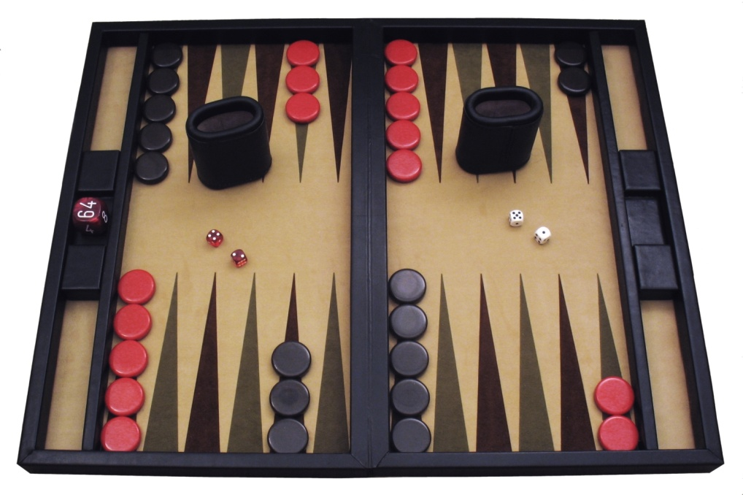
Example: Backgammon
Image: Wikipedia

Slide 33

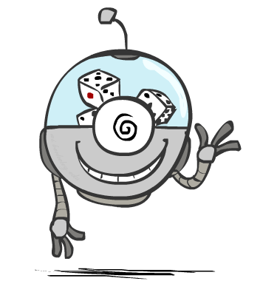


Mixed Layer Types
E.g. Backgammon
Expectiminimax
  Environment is an extra “random agent” player that moves after each min/max agent
  Each node computes the appropriate combination of its children
Notes:
If it’s terminal or we reached our depth limit, return utility

Slide 34
Example: Backgammon
Dice rolls increase b: 21 possible rolls with 2 dice
  Backgammon ≈ 20 legal moves
  Depth 2 = 20 x (21 x 20)³ = 1.2 x 10⁹
As depth increases, probability of reaching a given search node shrinks
  So usefulness of search is diminished
  So limiting depth is less damaging
  But pruning is trickier…
Historic AI (1992): TDGammon uses depth-2 search + very good evaluation function + reinforcement learning:
world-champion level play
1st AI world champion in any game!
Image: Wikipedia

Slide 35
Different Types of Ghosts

Slide 36
todo
Got here with 10 min left
Next slides are duplicative and flowed poorly
Did not get to human utilities, which would have been the payoff

Slide 37
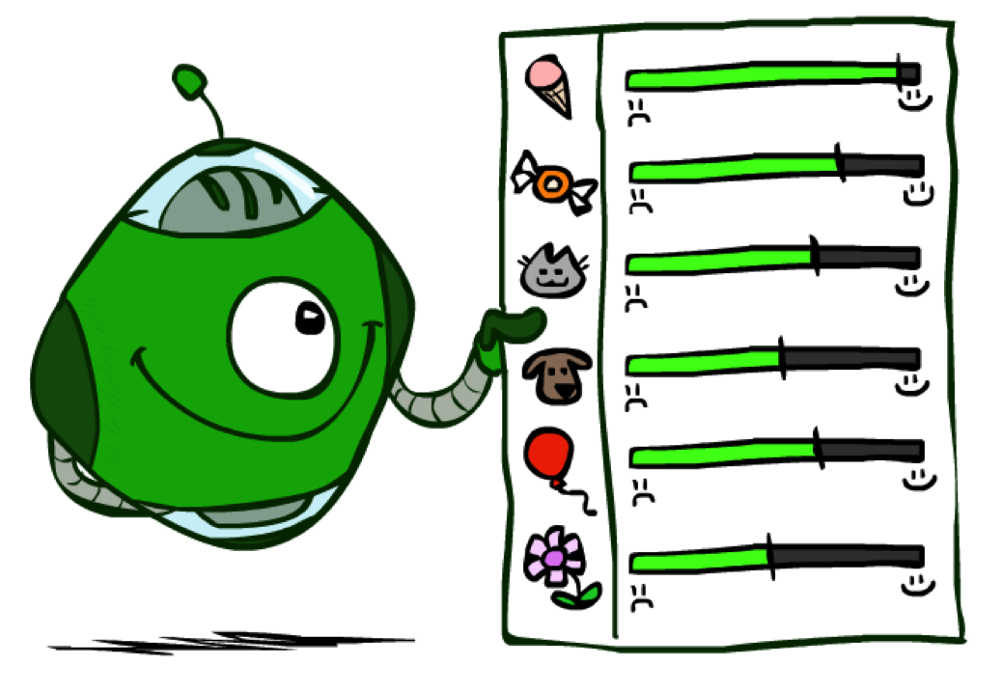
Utilities

Slide 38

Maximum Expected Utility
Why should we average utilities?
Principle of maximum expected utility:
  A rational agent should chose the action that maximizes its expected utility, given its knowledge
Questions:
  Where do utilities come from?
  How do we know such utilities even exist?
  How do we know that averaging even makes sense?
  What if our behavior (preferences) can’t be described by utilities?

Slide 39
What Utilities to Use?
0
40
20
30
x²
0
1600
400
900
For worst-case minimax reasoning, terminal function scale doesn’t matter
  We just want better states to have higher evaluations (get the ordering right)
  We call this insensitivity to monotonic transformations
For average-case expectimax reasoning, we need magnitudes to be meaningful

Slide 40

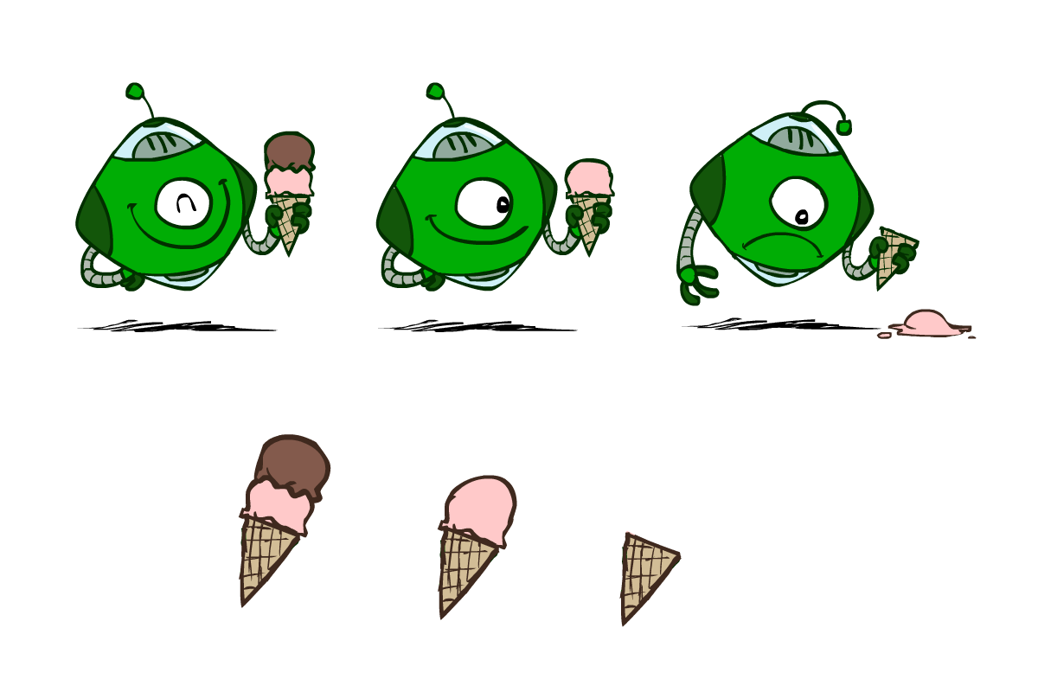
Utilities
Utilities are functions from outcomes (states of the world) to real numbers that describe an agent’s preferences
Where do utilities come from?
  In a game, may be simple (+1/-1)
  Utilities summarize the agent’s goals
  Theorem: any “rational” preferences can be summarized as a utility function
We hard-wire utilities and let behaviors emerge
  Why don’t we let agents pick utilities?
  Why don’t we prescribe behaviors?

Slide 41
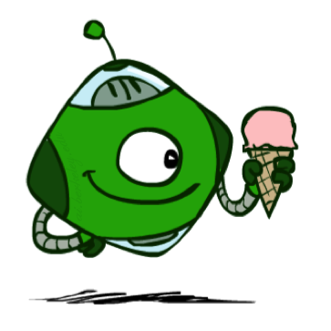
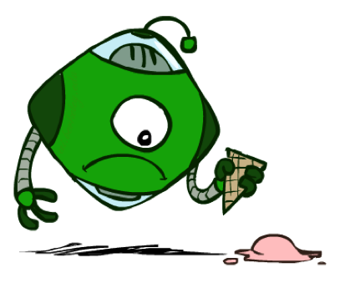
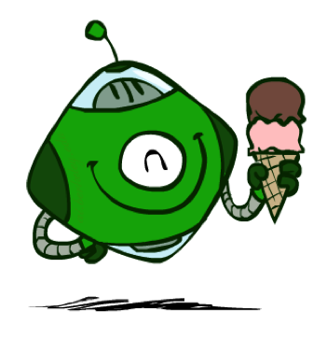
Utilities: Uncertain Outcomes
Getting ice cream
Get Single
Get Double
Oops
Whew!

Slide 42
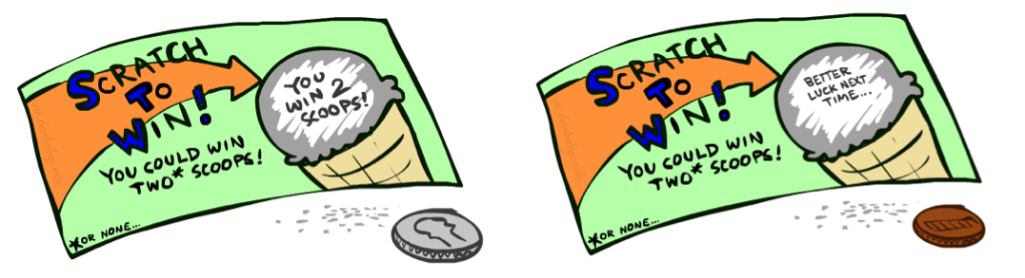
Preferences
An agent must have preferences among:
  Prizes: A, B, etc.
  Lotteries: situations with uncertain prizes
Notation:
  Preference:
  Indifference:
A Prize
A Lottery
A
p 1-p
A B

Slide 43
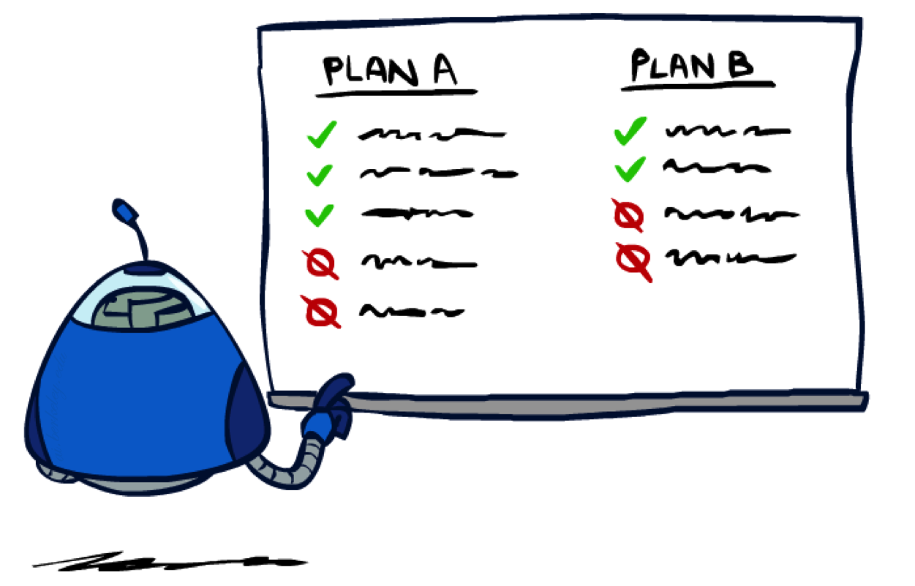
Rationality

Slide 44
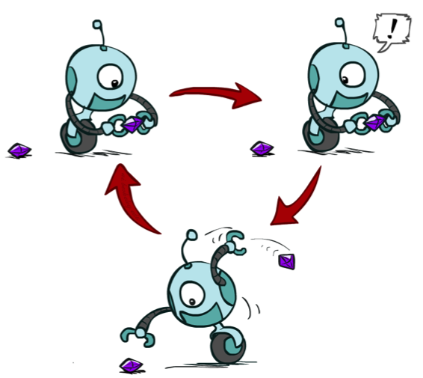
Rational Preferences
We want some constraints on preferences before we call them rational, such as:
For example: an agent with intransitive preferences can
be induced to give away all of its money
  If B > C, then an agent with C would pay (say) 1 cent to get B
  If A > B, then an agent with B would pay (say) 1 cent to get A
  If C > A, then an agent with A would pay (say) 1 cent to get C
Axiom of Transitivity:
Notes:
Apple, banana, carrot

Slide 45

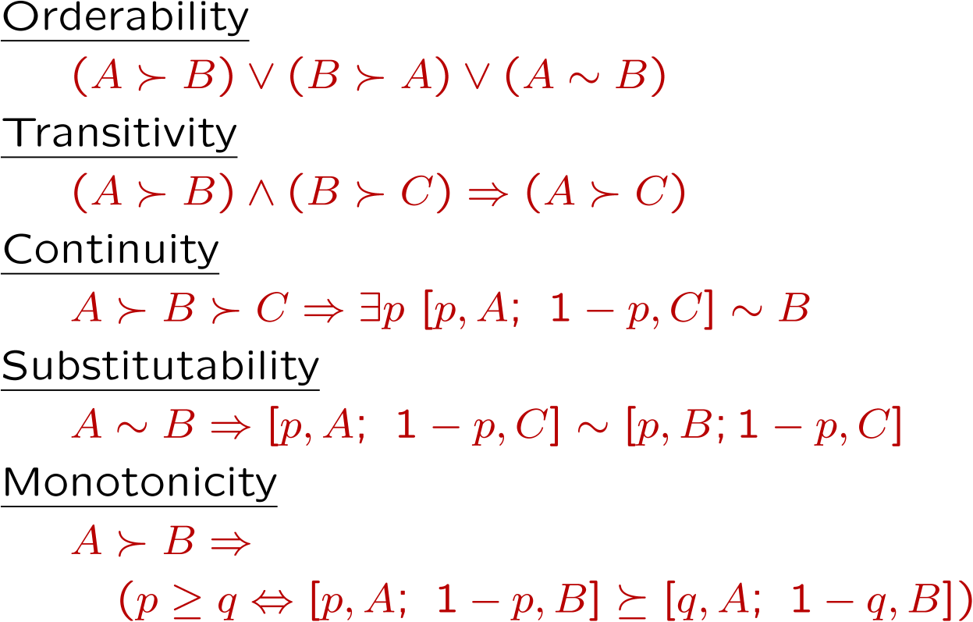
Rational Preferences
The Axioms of Rationality
Theorem: Rational preferences imply behavior describable as maximization of expected utility

Slide 46
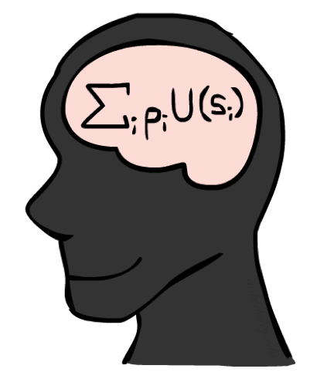
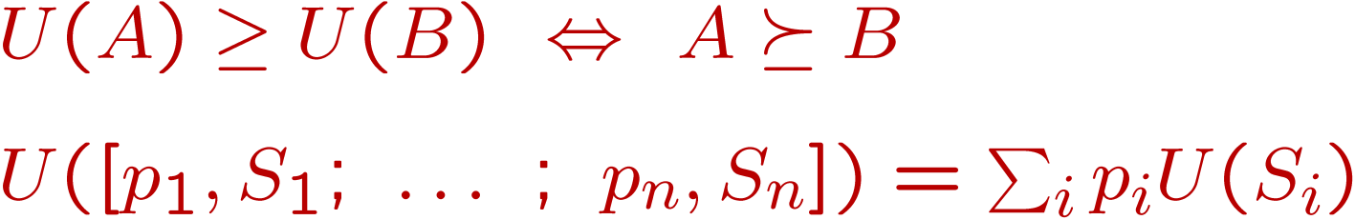
MEU Principle
Theorem [Ramsey, 1931; von Neumann & Morgenstern, 1944]
  Given any preferences satisfying these constraints, there exists a real-valued
  function U such that:
  I.e. values assigned by U preserve preferences of both prizes and lotteries!
Maximum expected utility (MEU) principle:
  Choose the action that maximizes expected utility
  Note: an agent can be entirely rational (consistent with MEU) without ever representing or manipulating utilities and probabilities
  E.g., a lookup table for perfect tic-tac-toe, a reflex vacuum cleaner

Slide 47
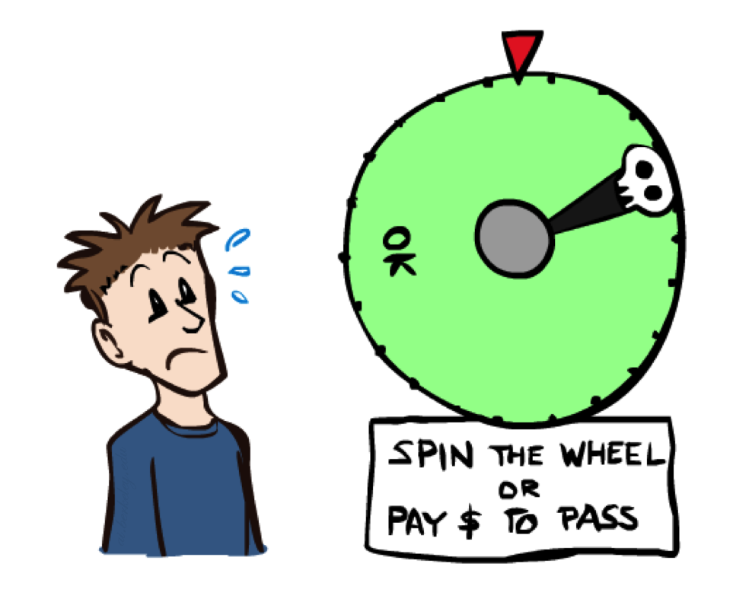
Human Utilities

Slide 48

Utility Scales
Normalized utilities: u₊ = 1.0, u₋ = 0.0
Micromorts: one-millionth chance of death, useful for paying to reduce product risks, etc.
QALYs: quality-adjusted life years, useful for medical decisions involving substantial risk
Note: behavior is invariant under positive linear transformation
With deterministic prizes only (no lottery choices), only ordinal utility can be determined, i.e., total order on prizes

Slide 49


Human Utilities
Utilities map states to real numbers. Which numbers?
Standard approach to assessment (elicitation) of human utilities:
  Compare a prize A to a standard lottery L_{p} between
    “best possible prize” u₊ with probability p
    “worst possible catastrophe” u₋ with probability 1-p
  Adjust lottery probability p until indifference: A ~ L_{p}
  Resulting p is a utility in [0,1]
Pay $30
0.999999 0.000001
No change
Instant death

Slide 50
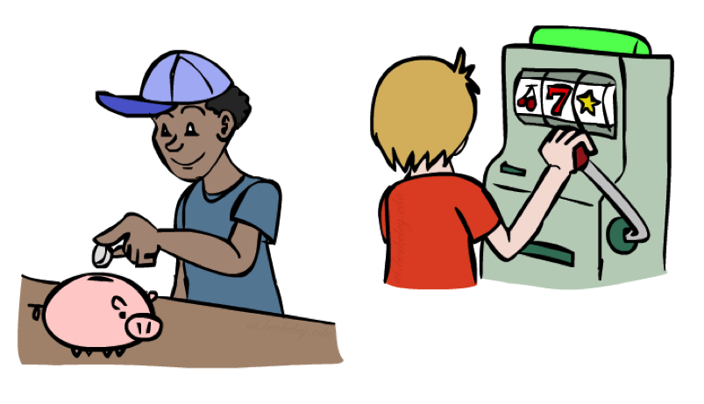
Money
Money does not behave as a utility function, but we can talk about the utility of having money (or being in debt)
Given a lottery L = [p, $X; (1-p), $Y]
  The expected monetary value EMV(L) is p*X + (1-p)*Y
  U(L) = p*U($X) + (1-p)*U($Y)
  Typically, U(L) < U( EMV(L) )
  In this sense, people are risk-averse
  When deep in debt, people are risk-prone
Notes:
Draw Jensen’s for utility curve

Slide 51
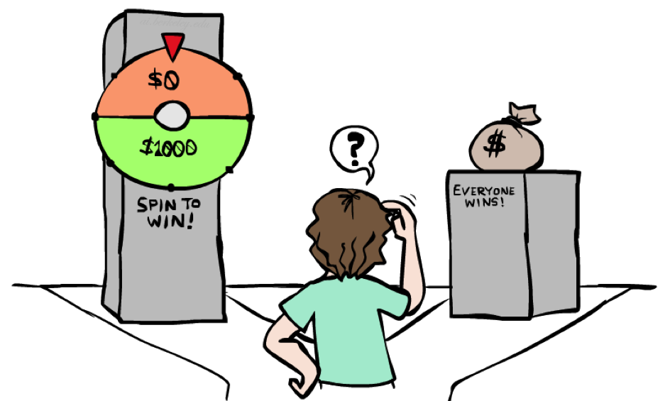
Example: Insurance
Consider the lottery [0.5, $1000; 0.5, $0]
  What is its expected monetary value? ($500)
  What is its certainty equivalent?
    Monetary value acceptable in lieu of lottery
    $400 for most people
  Difference of $100 is the insurance premium
    There’s an insurance industry because people will pay to reduce their risk
    If everyone were risk-neutral, no insurance needed!
  It’s win-win: you’d rather have the $400 and the insurance company would rather have the lottery (their utility curve is flat and they have many lotteries)

Slide 52

Example: Human Rationality?
Famous example of Allais (1953)
  A: [0.8, $4k; 0.2, $0]
  B: [1.0, $3k; 0.0, $0]
  C: [0.2, $4k; 0.8, $0]
  D: [0.25, $3k; 0.75, $0]
Most people prefer B > A, C > D
But if U($0) = 0, then
  B > A ⇒ U($3k) > 0.8 U($4k)
  C > D ⇒ 0.8 U($4k) > U($3k)

