Slide 1
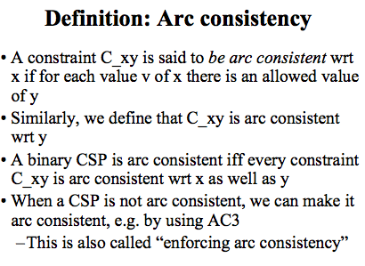
Clearer Definition
X is the tail

Slide 2
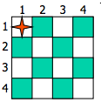
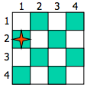
Chess as a CSP
Let’s define the 4-queens problem as a CSP with the variable Xi denoting the position (row) of the queen on column i.
X1 = 1
X1 = 2
Remember the constraints: two queens attack each other when the are in the same row, the same column or on the same diagonal. We want to place n=4 queens on the board so no queen is attacking another.

Slide 3
CSP Challenge Question 1
Suppose we set X1 = 1
Show the effect of forward checking on the domains of the remaining variables
(I suggest crossing off values in the lists below:)
X1 = 1
Domain X2 = {1, 2, 3, 4}
Domain X3 = {1, 2, 3, 4}
Domain X4 = {1, 2, 3, 4}

Slide 4
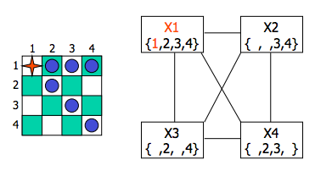
Answer 1
Forward checking will delete values from the domains of all other variables, as shown

Slide 5
Question 2
Is this CSP now arc consistent?
(for the purposes of this question – assume that there is one constraint between each pair of queens that rules out all attacks)

Slide 6
Answer 2
No, the constraint between X2 and X3 is not consistent with respect to X2
There exists a value in the domain of X2 (specifically X2=3) such that NO value for X3 will work.
Furthermore, the constraint between X4 and X3 is not consistent with respect to X4, because X4=3 also leaves X3 with no legal values

Slide 7
Question 3
Simulate the behavior of AC3 to make the CSP arc consistent
First subquestion, what goes on the queue?

Slide 8
Answer 4
For each pair of variables, you need to put a directed constraint.
I’ll write X2→X3 to mean the constraint wrt X2 (ie X2 is the tail)
For this example, let’s ignore constraints with X1 because those constraints are consistent (as a result of forward checking) and can’t become inconsistent because we’ve chose a single value for X1.
So the queue might be
<X2→X3, X2→X4, X3→X2, X3→X4, X4→X2, X4→X3>
We’ve already established that X2→X3 is inconsistent.
What does AC-3 do to fix this?

Slide 9
Answer 5
AC-3 deletes from the domain of … X2..
So now Domain(X2) = {4}
AC-3 also adds some more constraints onto the queue, X3→X2 and X4→X2, but since they are already there there is no change. So the queue is
<X2→X4, X3→X2, X3→X4, X4→X2, X4→X3>
Is X2→X4 consistent?

Slide 10
Answer 6
Yep. Now the queue is
<X3→X2, X3→X4, X4→X2, X4→X3>
Is X3→X2 consistent?

Slide 11
Answer 7
Nope. We need to delete X3=4.
That means we need to add some stuff to the queue.
So what’s the queue become?

Slide 12
Answer 8
We add X2→X3 and X4→X3 but the latter was already there so we get
<X3→X4, X4→X2, X4→X3, X2→X3>
Now what happens when we process the next constraint?

Slide 13
Answer 9
X3→X4 is inconsistent so we need to remove X3=2, but now X3’s domain is empty, which means that the CSP is unsolvable. So the very first decision to
Assign X1=1 was a mistake.
In fact, following the pseudocode, AC3 will keep running and remove some more stuff – a bit pointless. But I’ll stop here.

Slide 14
Part II – Tree structured CSPs
A
E
B
D
C
F
Let’s color this!

Slide 15
Tree-Structured CSPs
Algorithm for tree-structured CSPs:
Order: Choose a root variable, order variables so that parents precede children
Remove backward: For i = n : 2, apply RemoveInconsistent(Parent(X_{i}),X_{i})
Assign forward: For i = 1 : n, assign X_{i} consistently with Parent(X_{i})

Slide 16
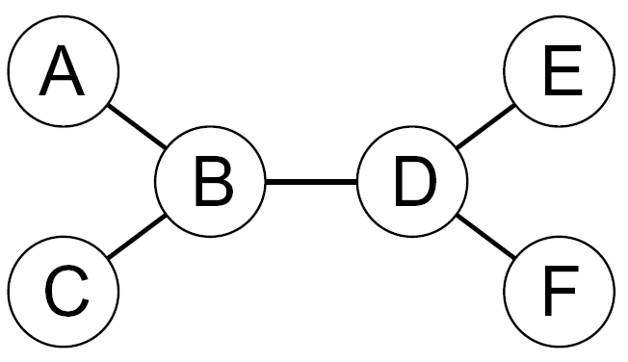
Tree-Structured CSPs
Algorithm for tree-structured CSPs:
Order: Choose a root variable, order variables so that parents precede children
My choice to start with A as the root is arbitrary – could have started with anything else.
It also doesn’t matter if B comes before C in the ordering etc.

Slide 17
Question 10
Algorithm for tree-structured CSPs:
Order: Choose a root variable, order variables so that parents precede children
Remove backward: For i = n : 2, apply RemoveInconsistent(Parent(X_{i}),X_{i})
Suppose that the initial legal colors are as I show above
Simulate step 2 of the algorithm (I suggest cross off colors in the diagram above)

Slide 18
Answer 10
Algorithm for tree-structured CSPs:
Order: Choose a root variable, order variables so that parents precede children
Remove backward: For i = n : 2, apply RemoveInconsistent(Parent(X_{i}),X_{i})
When processing D→F, we need to remove blue from the domain of D
What about when we process D→E?

Slide 19
Answer 11
Algorithm for tree-structured CSPs:
Order: Choose a root variable, order variables so that parents precede children
Remove backward: For i = n : 2, apply RemoveInconsistent(Parent(X_{i}),X_{i})
When processing D→E, we don’t do anything.
We would only remove something from the parent, D, but red is consistent, because we can make E green. So we just leave it as is.
What about B→D?

Slide 20
Answer 12
Algorithm for tree-structured CSPs:
Order: Choose a root variable, order variables so that parents precede children
Remove backward: For i = n : 2, apply RemoveInconsistent(Parent(X_{i}),X_{i})
When processing B→C, we don’t do anything.
What about A→B?

Slide 21
Answer 13
Algorithm for tree-structured CSPs:
Order: Choose a root variable, order variables so that parents precede children
Remove backward: For i = n : 2, apply RemoveInconsistent(Parent(X_{i}),X_{i})
Assign forward: For i = 1 : n, assign X_{i} consistently with Parent(X_{i})
Right, we delete blue from A.
Now simulate step 3.
Any choice for A is ok. B will be blue. C can be red or green. D is red, E will be green… It all works!!

