Slide 1


CSE 473: Artificial Intelligence
Constraint Satisfaction Problems III
Factored (aka Structured) Search
[With many slides by Dan Klein and Pieter Abbeel (UC Berkeley) available at http://ai.berkeley.edu.]
Notes:
Please retain proper attribution, including the reference to ai.berkeley.edu. Thanks!

Slide 2


What is Search For?
Planning: sequences of actions
  The path to the goal is the important thing
  Paths have various costs, depths
  Assume little about problem structure
Identification: assignments to variables
  The goal itself is important, not the path
  All paths at the same depth (for some formulations)

Slide 3


Constraint Satisfaction Problems
Standard search problems:
  State is a “black box”: arbitrary data structure
  Goal test can be any function over states
  Successor function can also be anything
Constraint satisfaction problems (CSPs):
  A special subset of search problems
  State is defined by variables X_{i} with values from a domain D (sometimes D depends on i)
  Goal test is a set of constraints specifying allowable combinations of values for subsets of variables
Making use of CSP formulation allows for optimized algorithms
  Typical example of trading generality for utility (in this case, speed)
Notes:
Goal test has structure, it ‘s more like a manual describing a set of constraints that have to hold true

Slide 4


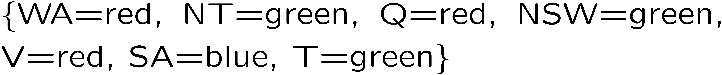
CSP Example: Map Coloring
Variables:
Domains:
Constraints: adjacent regions must have different colors
Solutions are assignments satisfying all constraints, e.g.:
Implicit:
Explicit:

Slide 5
Systematic Search to Solve CSP
States – partial assignments to variables
Operators – assign another variable
Initial State – no variables assigned
Goal State – all vars assigned & constraints satisfied
We’ll improve this basic method to exploit structure

Slide 6

Backtracking Search
Backtracking search is the basic uninformed algorithm for solving CSPs
Start with Depth First Search
  “backtracking search” IS a Kind of depth first search with these 2 details:
Idea 1: One variable at a time
  Variable assignments are commutative, so fix ordering
  I.e., [WA = red then NT = green] same as [NT = green then WA = red]
  Only need to consider assignments to a single variable at each step
Idea 2: Check constraints as you go
  I.e. consider only values which do not conflict previous assignments
  Might have to do some computation to check the constraints
  “Incremental goal test”
Can solve n-queens for n ≈ 25

Slide 7
Backtracking Example
…

Slide 8
Backtracking Search
What are the choice points?
[Demo: coloring -- backtracking]
Notes:
Demo:
CS188 javascript demos -> source -> exercises -> csps -> CSPs demos -> CSPs demos.html
Settings:
Graph = Simple
Algorithm = Backtracking
Ordering = None
Filtering = None

Slide 9
Backtracking Search
Kind of depth first search
Is it complete?

Slide 10

Video of Demo Coloring – Backtracking

Slide 11

Improving Backtracking
General-purpose ideas give huge gains in speed
Ordering:
  Which variable should be assigned next?
  In what order should its values be tried?
Filtering: Can we detect inevitable failure early?
Structure: Can we exploit the problem structure?

Slide 12

Filtering

Slide 13
Filtering: Forward Checking
Filtering: Keep track of domains for unassigned variables and cross off bad options
Forward checking: Cross off values that violate a constraint when added to the existing assignment
WA
NT
Q
SA
NSW
V
[Demo: coloring -- forward checking]
Notes:
Demo:
CS188 javascript demos -> source -> exercises -> csps -> CSPs demos -> CSPs demos.html
Settings:
Graph = Simple
Algorithm = Backtracking
Ordering = None
Filtering = Forward Checking

Slide 14
Video of Demo Coloring – Backtracking with Forward Checking

Slide 15
Filtering: Constraint Propagation
Forward checking only propagates information from assigned to unassigned
It doesn't catch when two unassigned variables have no consistent assignment:
NT and SA cannot both be blue!
Why didn’t we detect this yet?
Constraint propagation: reason from constraint to constraint
NT
Q
WA
SA
NSW
V

Slide 16

Consistency of a Single Arc
An arc X → Y is consistent iff for every x in the tail there is some y in the head which could be assigned without violating a constraint
Forward checking: Enforcing consistency of arcs pointing to each new assignment
NT
Q
WA
SA
NSW
V
Delete from the tail!

Slide 17
Arc Consistency of an Entire CSP
A simple form of propagation makes sure all arcs are consistent:
Important: If X loses a value, neighbors of X need to be rechecked!
Arc consistency detects failure earlier than forward checking
Can be run as a preprocessor or after each assignment
What’s the downside of enforcing arc consistency?
NT
Q
WA
SA
NSW
V
Remember: Delete from the tail!

Slide 18
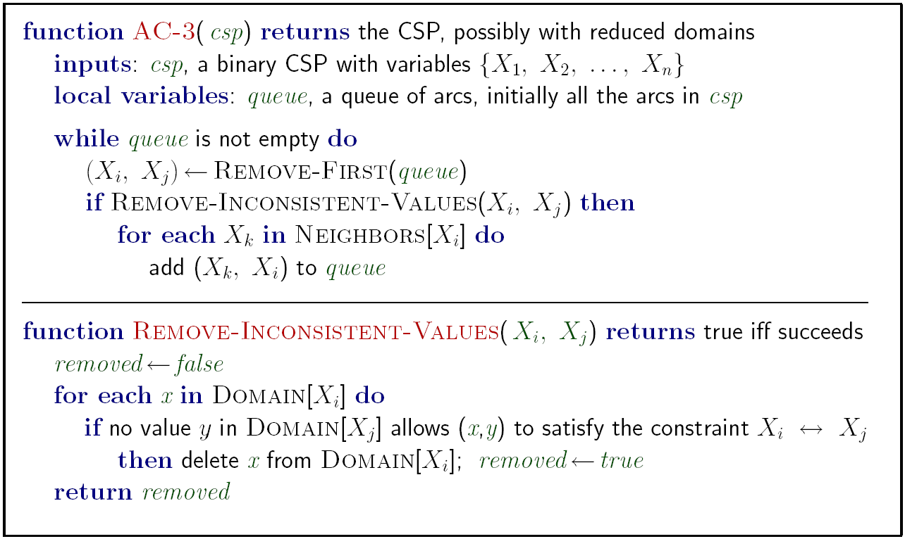
AC-3 algorithm for Arc Consistency
Runtime: O(n²d³), can be reduced to O(n²d²)
… but detecting all possible future problems is NP-hard – why?
[Demo: CSP applet (made available by aispace.org) -- n-queens]
Notes:
Auto-consistency (note initially nothing gets deleted/pruned since there are consistent options for all constraints for initial variable domains)
Flashes whenever something needs to be re-checked

Slide 19
Limitations of Arc Consistency
After enforcing arc consistency:
  Can have one solution left
  Can have multiple solutions left
  Can have no solutions left (and not know it)
Even with Arc Consistency you still need backtracking search!
  Could run at even step of that search
  Usually better to run it once, before search
What went wrong here?
[Demo: coloring -- forward checking]
[Demo: coloring -- arc consistency]
Notes:
Demo:
CS188 javascript demos -> source -> exercises -> csps -> CSPs demos -> CSPs demos.html
Settings:
Graph = Complex
Algorithm = Backtracking
Ordering = None
Filtering = Forward Checking (first) / Arc Consistency (second)

Slide 20
Video of Demo Arc Consistency – CSP Applet – n Queens

Slide 21
Video of Demo Coloring – Backtracking with Forward Checking – Complex Graph

Slide 22
Video of Demo Coloring – Backtracking with Arc Consistency – Complex Graph

Slide 23
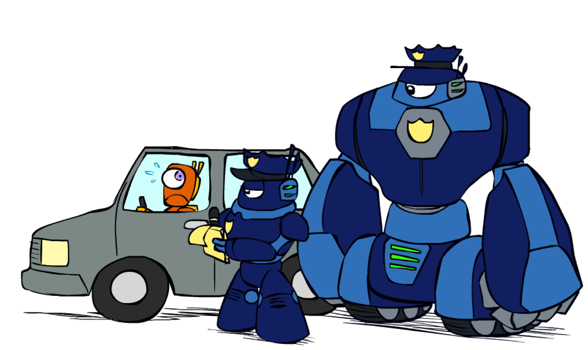
K-Consistency

Slide 24
K-Consistency
Increasing degrees of consistency
  1-Consistency (Node Consistency): Each single variable’s domain has a value which meets that variables unary constraints
  2-Consistency (Arc Consistency): For each pair of variables, any consistent assignment to one can be extended to the other
  3-Consistency (Path Consistency): For every set of 3 vars, any consistent assignment to 2 of the variables can be extended to the third var
  K-Consistency: For each k nodes, any consistent assignment to k-1 can be extended to the k^{th} node.
Higher k more expensive to compute
(You need to know the algorithm for k=2 case: arc consistency)

Slide 25
Strong K-Consistency
Strong k-consistency: also k-1, k-2, … 1 consistent
Claim: strong n-consistency means we can solve without backtracking!
Why?
  Choose any assignment to any variable
  Choose a new variable
  By 2-consistency, there is a choice consistent with the first
  Choose a new variable
  By 3-consistency, there is a choice consistent with the first 2
  …

Slide 26

Ordering

Slide 27
Backtracking Search
Notes:
Demo:
CS188 javascript demos -> source -> exercises -> csps -> CSPs demos -> CSPs demos.html
Settings:
Graph = Simple
Algorithm = Backtracking
Ordering = None
Filtering = None

Slide 28
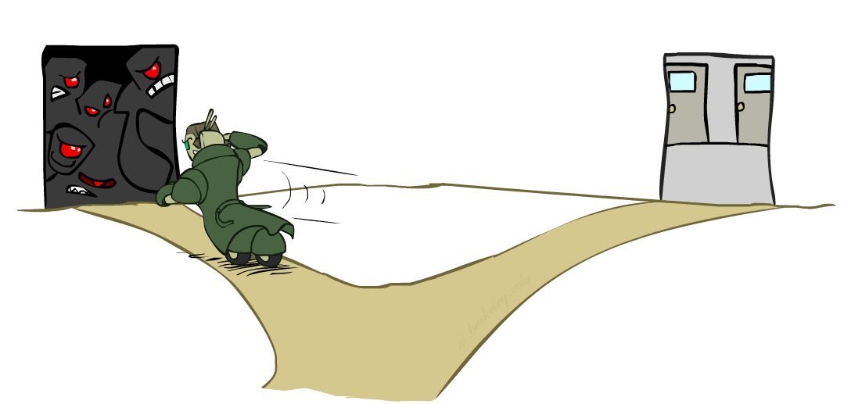
Ordering: Minimum Remaining Values
Variable Ordering: Minimum remaining values (MRV):
  Choose the variable with the fewest legal left values in its domain
Why min rather than max?
Also called “most constrained variable”
“Fail-fast” ordering

Slide 29

Ordering: Maximum Degree
Tie-breaker among MRV variables
  What is the very first state to color? (All have 3 values remaining.)
Maximum degree heuristic:
  Choose the variable participating in the most constraints on remaining variables
Why most rather than fewest constraints?

Slide 30
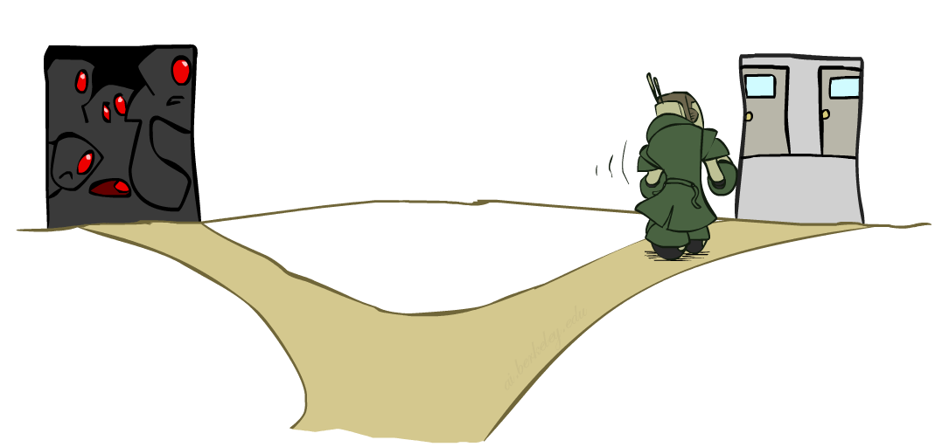
Ordering: Least Constraining Value
Value Ordering: Least Constraining Value
  Given a choice of variable, choose the least constraining value
  I.e., the one that rules out the fewest values in the remaining variables
  Note that it may take some computation to determine this! (E.g., rerunning filtering)
Why least rather than most?
Combining these ordering ideas makes
1000 queens feasible

Slide 31
Rationale for MRV, MD, LCV
We want to enter the most promising branch, but we also want to detect failure quickly
MRV+MD:
  Choose the variable that is most likely to cause failure
  It must be assigned at some point, so if it is doomed to fail, better to find out soon
LCV:
  We hope our early value choices do not doom us to failure
  Choose the value that is most likely to succeed

Slide 32
Demo: Coloring -- Backtracking + Forward Checking + Ordering
Notes:
Demo:
CS188 javascript demos -> source -> exercises -> csps -> CSPs demos -> CSPs demos.html
Settings:
Graph = Complex
Algorithm = Backtracking
Ordering = MRV
Filtering = Forward Checking
Solves already without any need for backtracking
Note: need a bigger problem to illustrate relevance of backtracking+AC+MRV+MCV

Slide 33
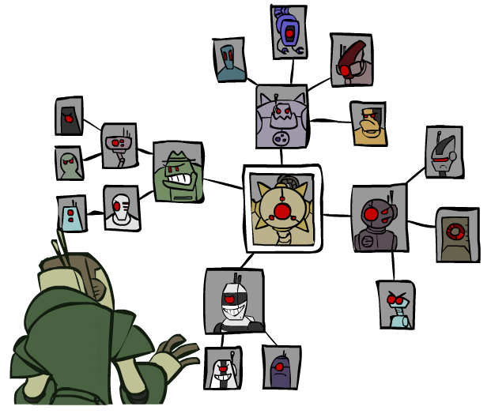
Structure

Slide 34
Problem Structure
Extreme case: independent subproblems
  Example: Tasmania and mainland do not interact
Independent subproblems are identifiable as connected components of constraint graph
Suppose a graph of n variables can be broken into subproblems of only c variables:
  Worst-case solution cost is O((n/c)(d^{c})), linear in n
  E.g., n = 80, d = 2, c =20
  2⁸⁰ = 4 billion years at 10 million nodes/sec
  (4)(2²⁰) = 0.4 seconds at 10 million nodes/sec

Slide 35
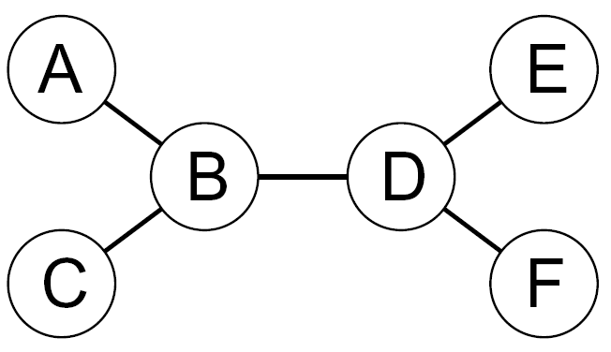
Tree-Structured CSPs
Theorem: if the constraint graph has no loops, the CSP can be solved in O(n d²) time
  Compare to general CSPs, where worst-case time is O(d^{n})
This property also applies to probabilistic reasoning (later): an example of the relation between syntactic restrictions and the complexity of reasoning

Slide 36
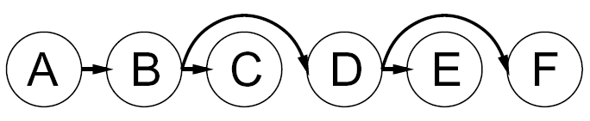


Tree-Structured CSPs
Algorithm for tree-structured CSPs:
  Order: Choose a root variable, order variables so that parents precede children
  Remove backward: For i = n : 2, apply RemoveInconsistent(Parent(X_{i}),X_{i})
  Assign forward: For i = 1 : n, assign X_{i} consistently with Parent(X_{i})
Runtime: O(n d²) (why?)

Slide 37
Tree-Structured CSPs
Algorithm for tree-structured CSPs:
  Order: Choose a root variable, order variables so that parents precede children
  Remove backward: For i = n : 2, apply RemoveInconsistent(Parent(X_{i}),X_{i})
  Assign forward: For i = 1 : n, assign X_{i} consistently with Parent(X_{i})
Runtime: O(n d²) (why?)

Slide 38
Tree-Structured CSPs
Claim 1: After backward pass, all root-to-leaf arcs are consistent
Proof: Each X→Y was made consistent at one point and Y’s domain could not have been reduced thereafter (because Y’s children were processed before Y)
Claim 2: If root-to-leaf arcs are consistent, forward assignment will not backtrack
Proof: Induction on position
Why doesn’t this algorithm work with cycles in the constraint graph?
Note: we’ll see this basic idea again with Bayes’ nets

Slide 39
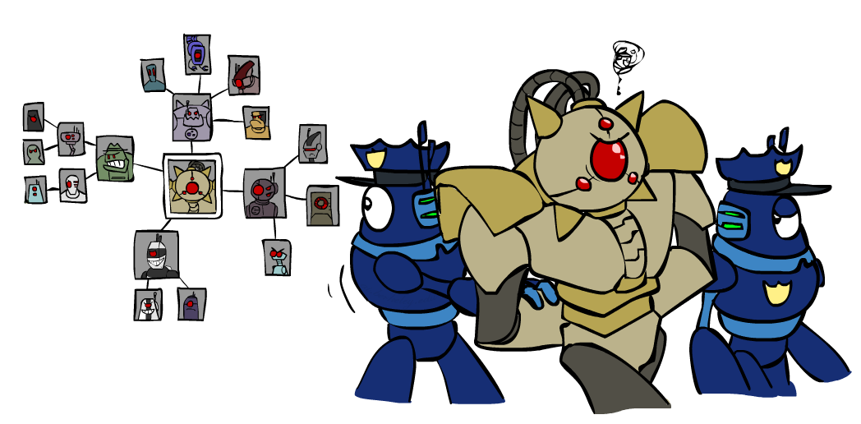
Improving Structure

Slide 40
Nearly Tree-Structured CSPs
Conditioning: instantiate a variable, prune its neighbors' domains
Cutset conditioning: instantiate (in all ways) a set of variables such that the remaining constraint graph is a tree
Cutset size c gives runtime O( (d^{c}) (n-c) d² ), very fast for small c

Slide 41
Cutset Conditioning
Choose a cutset
SA
Instantiate the cutset (all possible ways)
SA
SA
SA
Compute residual CSP for each assignment
Solve the residual CSPs (tree structured)

Slide 42
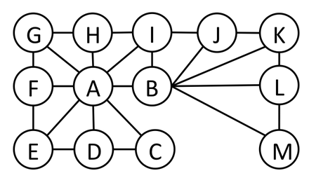
Cutset Quiz
Find the smallest cutset for the graph below.

Slide 43
Tree Decomposition*
Idea: create a tree-structured graph of mega-variables
Each mega-variable encodes part of the original CSP
Subproblems overlap to ensure consistent solutions
M1
M2
M3
M4
WA
≠
NT
NT
≠
Q
Q
≠
NSW
NSW
≠
V
≠
≠
≠
≠
≠
≠
≠
≠
SA
SA
SA
SA
Agree on shared vars
Agree on shared vars
Agree on shared vars
{(WA=r,SA=g,NT=b),
(WA=b,SA=r,NT=g),
…}
{(NT=r,SA=g,Q=b),
(NT=b,SA=g,Q=r),
…}
Agree: (M1,M2) ∈
{((WA=g,SA=g,NT=g), (NT=g,SA=g,Q=g)), …}

Slide 44

Local Search for CSPs

Slide 45
Iterative Algorithms for CSPs
Local search methods typically work with “complete” states, i.e., all variables assigned
To apply to CSPs:
  Take an assignment with unsatisfied constraints
  Operators reassign variable values
  No fringe! Live on the edge.
Algorithm: While not solved,
  Variable selection: randomly select any conflicted variable
  Value selection: min-conflicts heuristic:
    Choose a value that violates the fewest constraints
    I.e., hill climb with h(n) = total number of violated constraints

Slide 46
Example: 4-Queens
States: 4 queens in 4 columns (4⁴ = 256 states)
Operators: move queen in column
Goal test: no attacks
Evaluation: c(n) = number of attacks
  [Demo: n-queens – iterative improvement (L5D1)]
  [Demo: coloring – iterative improvement]
Notes:
L5D1 – python demos
Coloring – javascript demos

Slide 47
Video of Demo Iterative Improvement – n Queens

Slide 48
Video of Demo Iterative Improvement – Coloring

Slide 49
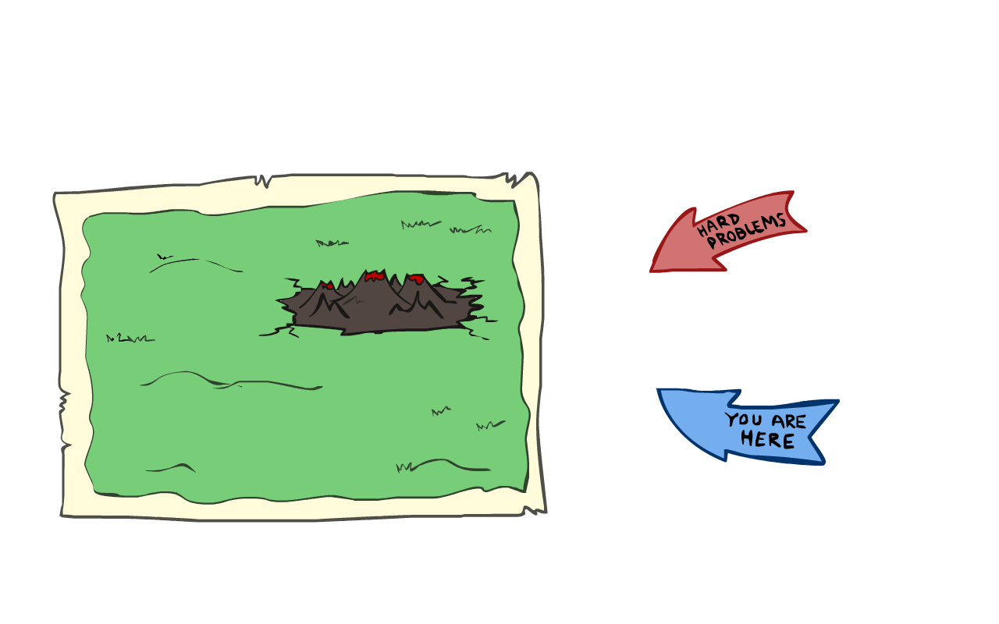
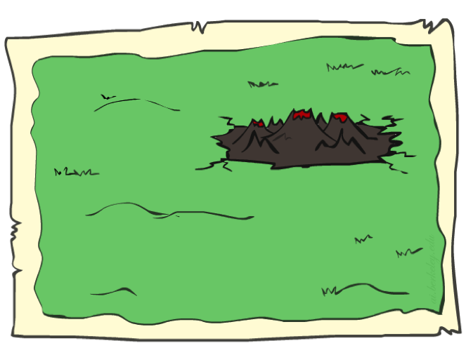
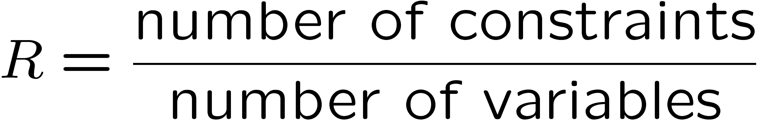
Performance of Min-Conflicts
Given random initial state, can solve n-queens in almost constant time for arbitrary n with high probability (e.g., n = 10,000,000)!
The same appears to be true for any randomly-generated CSP except in a narrow range of the ratio

Slide 50
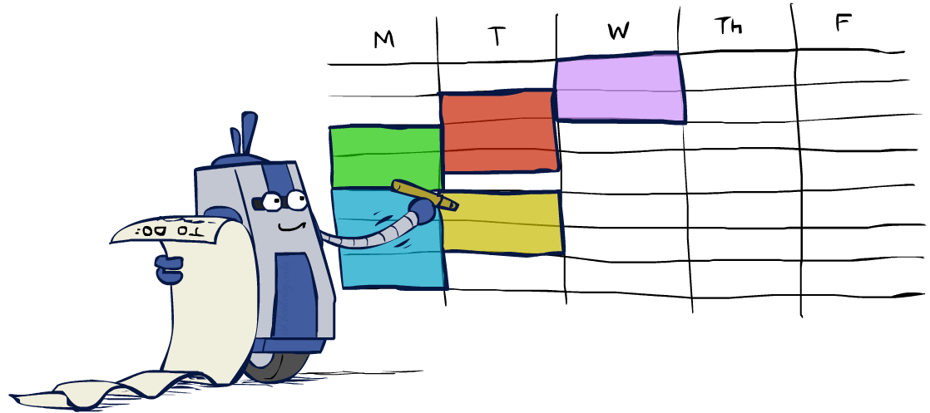
Summary: CSPs
CSPs are a special kind of search problem:
  States are partial assignments
  Goal test defined by constraints
Basic solution: backtracking search
Speed-ups:
  Ordering
  Filtering
  Structure (cutset conditioning)
Iterative min-conflicts is often effective in practice

