Slide 1
CSE 473: Artificial Intelligence
Autumn 2016
Local Search
Dan Weld
With slides from
Dan Klein, Stuart Russell, Andrew Moore, Luke Zettlemoyer
Notes:
Good to hit DFS and BFS quickly, since they’ve seen it before.

Slide 2
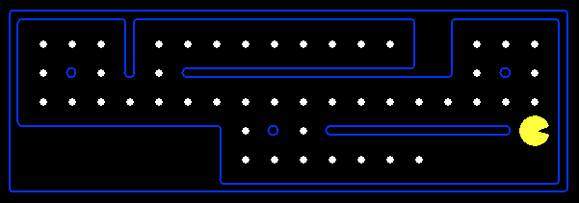
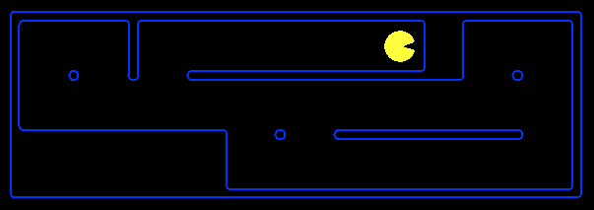
Goal Based Agents
Plan ahead
Ask “what if”
Decisions based on (hypothesized) consequences of actions
Must have a model of how the world evolves in response to actions
Act on how the world WOULD BE

Slide 3
Types of Environments
Fully observable vs. partially observable
Single agent vs. multiagent
Deterministic vs. stochastic
Episodic vs. sequential
Discrete vs. continuous

Slide 4
Search thru a
Problem Space (aka State Space)
Input:
  Set of states
  Operators [and costs]
  Start state
  Goal state [or test]
Functions: States → States
Aka Actions & “Successor Function”
Output:
  Path: start ⇒ a state satisfying goal test
  [May require shortest path]
  [Sometimes just need a state that passes test]
Notes:
State Space Search is basically a GRAPH SEARCH PROBLEM
STATES are whatever you like!
OPERATORS are a compact DESCRIPTION of possible STATE TRANSITIONS – the EDGES of the GRAPH
May have different COSTS or all be UNIT cost
OUTPUT may be specified either as ANY PATH (REACHABILITY), or a SHORTEST PATH

Slide 5
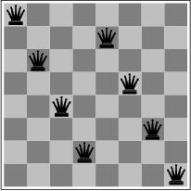
N Queens Problem
Place N queens so they don’t attack each other (same row, same col, same diagonal)
States
Operators
Initial
Goal
Chess board with 0 or more queens
Add a queen
No queens
N queens

Slide 6
Search thru State Space

Slide 7
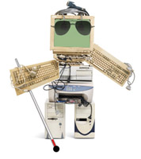
What if Robot is Blind?
Moving into wall → noop
?
?
?
?
?
?
?
?
?
“Conformant Planning”
[Has a talking compass – knows which way is N]

Slide 8
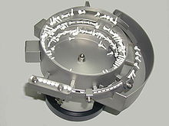

Conformant Planning
Sterilizing surgical gear
Bowl feeder

Slide 9
Search thru State Space
States
Operators
  Move actions
Initial State
Goal State
− SETS of states
− “Belief state”
?
?
?
?
?
?
− Set of all states
?
?
?
− Set of just goal state(s)

Slide 10
Soln: R, D, D, R, R, U, U
States
Operators
  Move actions
Initial State
Goal State
− SETS of states
− “Belief state”
?
?
?
?
?
?
− Set of all states
?
?
?
− Set of just goal states

Slide 11
Move Right
States
Operators
  Move actions
Initial State
Goal State
− SETS of states
− “Belief state”
?
?
?
?
?
− Set of all states
?
?
− Set of just goal states

Slide 12
Move Down
States
Operators
  Move actions
Initial State
Goal State
− SETS of states
− “Belief state”
?
?
− Set of all states
?
?
?
− Set of just goal states

Slide 13
Move Down
States
Operators
  Move actions
Initial State
Goal State
− SETS of states
− “Belief state”
− Set of all states
?
?
?
− Set of just goal states

Slide 14
Move Right
States
Operators
  Move actions
Initial State
Goal State
− SETS of states
− “Belief state”
− Set of all states
?
?
− Set of just goal states

Slide 15
Move Right
States
Operators
  Move actions
Initial State
Goal State
− SETS of states
− “Belief state”
− Set of all states
?
− Set of just goal states

Slide 16
Move Up
States
Operators
  Move actions
Initial State
Goal State
− SETS of states
− “Belief state”
?
− Set of all states
− Set of just goal states

Slide 17
Move Up
States
Operators
  Move actions
Initial State
Goal State
− SETS of states
− “Belief state”
Yay!
− Set of all states
− Set of just goal states

Slide 18
Heuristics?
States
Goal State
− SETS of states
− “Belief state”
?
?
?
?
− Set of just goal state(s)
Relaxed Problem?
− What if it weren’t blind?
− Max # moves from any state in belief state
Also… (admissable?)
− Number of states in belief state

Slide 19
Previous Search Methods
Systematic
Local (Randomized)
Constraint Satisfaction (Factored)
Blind Search
  Depth first search
  Breadth first search
  Iterative deepening search
  Uniform cost search
Informed Search
  Best First
  A*
  Beam Search
  Hill Climbing
Heuristic =
Estimate of solution cost

Slide 20
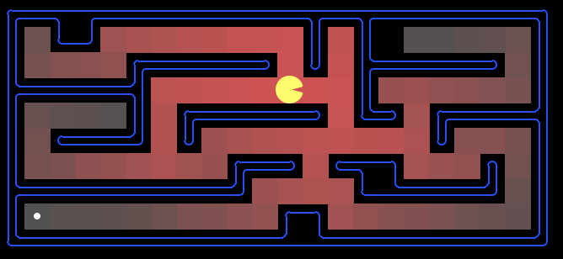
Which Algorithm?
Uniform cost search (UCS):
20

Slide 21
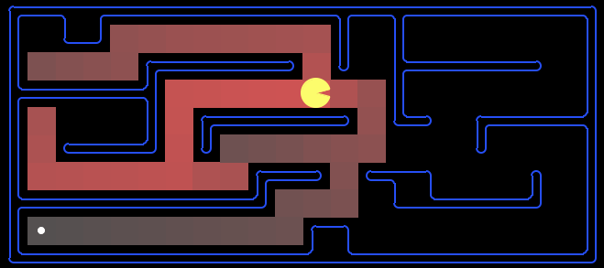
Which Algorithm?
A*, Manhattan Heuristic:

Slide 22
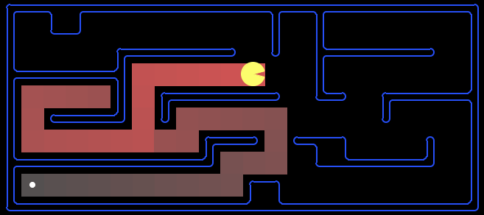
Which Algorithm?
Best First / Greedy, Manhattan Heuristic:

Slide 23
Demo
http://qiao.github.io/PathFinding.js/visual/
SUGGESTED BY Fernando Centurion

Slide 24
Goal State vs Path
  Previously: Search to find best path to goal
    Systematic exploration of search space.
Today: a state is solution to problem
  for some problems path is irrelevant.
  E.g., 8-queens
Different algorithms can be used
  Systematic Search
  Local Search
  Constraint Satisfaction

Slide 25
Local search algorithms
State space = set of "complete" configurations
Find configuration satisfying constraints,
  e.g., all n-queens on board, no attacks
In such cases, we can use local search algorithms
keep a single "current" state, try to improve it.
Very memory efficient
  duh - only remember current state

Slide 26
Goal Satisfaction
Optimization
Constraint satisfaction
reach the goal node
guided by heuristic fn
Constraint Optimization
optimize(objective fn)
You can go back and forth between the two problems
Typically in the same complexity class
© Mausam

Slide 27
Local Search and Optimization
Local search
  Keep track of single current state
  Move only to “neighboring” state
    Defined by operators
  Ignore previous states, path taken
Advantages:
  Use very little memory
  Can often find reasonable solutions in large or infinite (continuous) state spaces.
“Pure optimization” problems
  All states have an objective function
  Goal is to find state with max (or min) objective value
  Does not quite fit into path-cost/goal-state formulation
  Local search can do quite well on these problems.

Slide 28
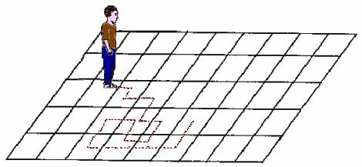
Trivial Algorithms
Random Sampling
  Generate a state randomly
Random Walk
  Randomly pick a neighbor of the current state
Why even mention these?
  Both algorithms asymptotically complete.
  http://projecteuclid.org/download/pdf_1/euclid.aop/1176996718 for Random Walk
© Mausam

Slide 29
Hill-climbing (Greedy Local Search) review from last time
(minimum)
function HILL-CLIMBING( problem) return a state that is a local maximum
input: problem, a problem
local variables: current, a node.
neighbor, a node.
current ← MAKE-NODE(INITIAL-STATE[problem])
loop do
neighbor ← a highest valued successor of current
if VALUE [neighbor] ≤ VALUE[current] then return STATE[current]
current ← neighbor
(lowest)
≥

Slide 30
Hill-climbing search
“a loop that continuously moves towards increasing value”
  terminates when a peak is reached
  Aka greedy local search
Value can be either
  Objective function value
  Heuristic function value (minimized)
Hill climbing does not look ahead of the immediate neighbors
Can randomly choose among the set of best successors
  if multiple have the best value
“climbing Mount Everest in a thick fog with amnesia”

Slide 31
To do
Next slides disorganized and repetitious
Move plateeau local max sooner

Slide 32
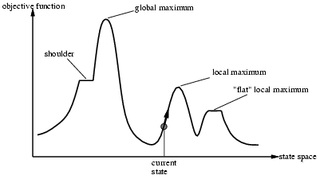
“Landscape” of search
Hill Climbing gets stuck in local maxima

Slide 33

Example: n-queens
Put n queens on an n x n board with no two queens on the same row, column, or diagonal
  Note different search space… all states have N queens
Is it a satisfaction problem or optimization?

Slide 34
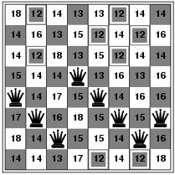
Hill-climbing search: 8-queens problem
Need heuristic function
  Convert to an optimization problem
h = number of pairs of queens attacking each other
h = 17 for the above state

Slide 35
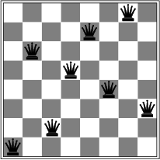
Hill-climbing search: 8-queens
Oooops
A local minimum with h = 1

Slide 36
Search Space Recap
State
  All N queens on the board in some configuration
Successor function
  Move single queen to another square in same column.
Example of a heuristic function h(n):
  the # of queens-pairs that are attacking each other
  (we want to minimize this)

Slide 37
Hill-climbing search: 8-queens problem
Is this a solution?
What is h?
Is any successor better?

Slide 38
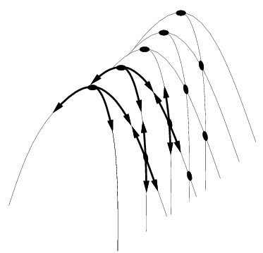
Hill Climbing Drawbacks
  Local maxima
  Plateaus
  Diagonal ridges

Slide 39
Hill Climbing Properties
  Not Complete
  Worst Case Exponential Time
  Simple, O(1) Space & Often Very Fast!

Slide 40
Hill-climbing on 8-queens
Randomly generated 8-queens starting states…
14% the time it solves the problem
86% of the time it get stuck at a local minimum
However…
  Takes only 4 steps on average when it succeeds
  And 3 on average when it gets stuck
  (for a state space with 8^8 =~17 million states)

Slide 41
Escaping Shoulders: Sideways Move
If no downhill (uphill) moves, allow sideways moves in hope that algorithm can escape
  Must limit the number of possible sideways moves to avoid infinite loops
For 8-queens
  Allow sideways moves with limit of 100
  Raises percentage of problems solved from 14 to 94%
  However….
    21 steps for every successful solution
    64 for each failure

Slide 42
Tabu Search
Prevent returning quickly to the same state
Keep fixed length queue (“tabu list”)
Add most recent state to queue; drop oldest
Never move to a tabu state
Properties:
  As the size of the tabu list grows, hill-climbing will asymptotically become “non-redundant” (won’t look at the same state twice)
  In practice, a reasonable sized tabu list (say 100 or so) improves the performance of hill climbing in many problems

Slide 43
Escaping Local Optima - Enforced Hill Climbing
Perform breadth first search from a local optima
  to find the next state with better h function
Typically,
  prolonged periods of exhaustive search
  bridged by relatively quick periods of hill-climbing
Middle ground b/w local and systematic search
© Mausam

Slide 44
Hill Climbing: stochastic variations
When the state-space landscape has local minima, any search that moves only in the greedy direction cannot be complete
Random walk, on the other hand, is
asymptotically complete
Idea: Combine random walk & greedy hill-climbing

Slide 45
Hill-climbing: stochastic variations
Stochastic hill-climbing
  Random selection among moves.
  Selection probability varies with move steepness
  Alternatively
    With probability p, choose best move
    Else choose move at random

Slide 46

Hill-climbing with random restarts
If at first you don’t succeed, try, try again!
Different variations
  For each restart: run until termination vs. run for a fixed time
  Run a fixed number of restarts or run indefinitely
Analysis
  Say each search has probability p of success
    E.g., for 8-queens, p = 0.14 with no sideways moves
  Expected number of restarts?
  Expected number of steps taken?
Use this algorithm!
Restarts | 0 | 2 | 4 | 8 | 16 | 32 | 64
Success? | 14% | 36% | 53% | 74% | 92% | 99% | 99.994%

Slide 47
Hill-climbing with random walk
At each step do one of the two
  Greedy: With prob p move to the neighbor with largest value
  Random: With prob 1-p move to a random neighbor
Hill-climbing with both
At each step do one of the three
  Greedy: move to the neighbor with largest value
  Random Walk: move to a random neighbor
  Random Restart: Start over from a new, random state
© Mausam

Slide 48
Simulated Annealing
Simulated Annealing = physics inspired twist on random walk
Basic ideas:
  like hill-climbing, identify the quality of the local improvements
  instead of picking the best move, pick one randomly
  say the change in objective function is δ
  if δ is positive, then move to that state
  otherwise:
    move to this state with probability proportional to δ
    thus: worse moves (very large negative δ) are executed less often
  always a chance of escaping from local maxima
  over time, make it less likely to accept locally bad moves
  (Can also make the size of the move random as well, i.e., allow “large” steps in state space)

Slide 49
Physical Interpretation of Simulated Annealing
Minimization (not max)
A Physical Analogy:
    Imagine letting a ball roll downhill on the function surface
    Now shake the surface, while the ball rolls,
    Gradually reducing the amount of shaking

Slide 50
Physical Interpretation of Simulated Annealing
A Physical Analogy:
    Imagine letting a ball roll downhill on the function surface
    Now shake the surface, while the ball rolls,
    Gradually reducing the amount of shaking

Slide 51
Physical Interpretation of Simulated Annealing
A Physical Analogy:
    Imagine letting a ball roll downhill on the function surface
    Now shake the surface, while the ball rolls,
    Gradually reducing the amount of shaking

Slide 52
Physical Interpretation of Simulated Annealing
A Physical Analogy:
    Imagine letting a ball roll downhill on the function surface
    Now shake the surface, while the ball rolls,
    Gradually reducing the amount of shaking

Slide 53
Physical Interpretation of Simulated Annealing
A Physical Analogy:
    Imagine letting a ball roll downhill on the function surface
    Now shake the surface, while the ball rolls,
    Gradually reducing the amount of shaking
Annealing = physical process of cooling a liquid → frozen
    simulated annealing:
      free variables are like particles
      seek “low energy” (high quality) configuration
      slowly reducing temp. T with particles moving around randomly

Slide 54
Temperature T
high T: probability of “locally bad” move is higher
low T: probability of “locally bad” move is lower
typically, T is decreased as the algorithm runs longer
i.e., there is a “temperature schedule”

Slide 55
Simulated annealing
function SIMULATED-ANNEALING( problem, schedule) return a solution state
input: problem, a problem
schedule, a mapping from time to temperature
local variables: current, a node.
next, a node.
T, a “temperature” controlling the prob. of downward steps
current ← MAKE-NODE(INITIAL-STATE[problem])
for t ← 1 to ∞ do
T ← schedule[t]
if T = 0 then return current
next ← a randomly selected successor of current
∆E ← VALUE[next] - VALUE[current]
if ∆E > 0 then current ← next
else current ← next only with probability e^{∆E /T}

Slide 56
Simulated Annealing in Practice
  method proposed in 1983 by IBM researchers for solving VLSI layout problems (Kirkpatrick et al, Science, 220:671-680, 1983).
    theoretically will always find the global optimum
  Other applications: Traveling salesman, Graph partitioning, Graph coloring, Scheduling, Facility Layout, Image Processing, …
  useful for some problems, but can be very slow
    slowness comes about because T must be decreased very gradually to retain optimality

Slide 57
Local beam search
Idea: Keeping only one node in memory is an extreme reaction to memory problems.
Keep track of k states instead of one
  Initially: k randomly selected states
  Next: determine all successors of k states
  If any of successors is goal → finished
  Else select k best from successors and repeat

Slide 58
Local Beam Search (contd)
Not the same as k random-start searches run in parallel!
Searches that find good states recruit other searches to join them
Problem: quite often, all k states end up on same local hill
Idea: Stochastic beam search
  Choose k successors randomly, biased towards good ones
Observe the close analogy to natural selection!

Slide 59

Hey! Perhaps sex can improve search?

Slide 60
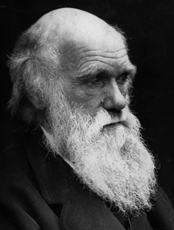
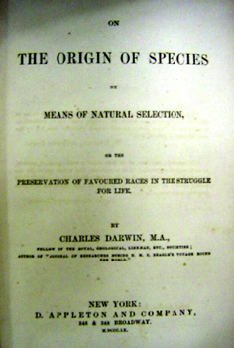
Sure! Check out ye book.

Slide 61
Genetic algorithms
Local beam search, but…
  A successor state is generated by combining two parent states
Start with k randomly generated states (population)
A state is represented as a string over a finite alphabet (often a string of 0s and 1s)
Evaluation function (fitness function). Higher = better
Produce the next generation of states by selection, crossover, and mutation

Slide 62
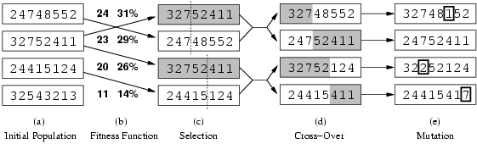
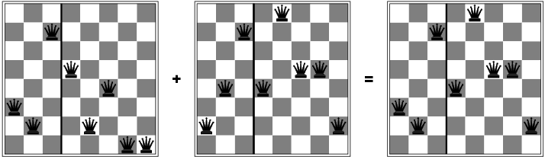
fitness:
#non-attacking queens
probability of being
regenerated
in next generation
Fitness function: number of non-attacking pairs of queens (min = 0, max = 8 × 7/2 = 28)
24/(24+23+20+11) = 31%
23/(24+23+20+11) = 29% etc

Slide 63
Genetic algorithms
Has the effect of “jumping” to a completely different new
part of the search space (quite non-local)

Slide 64
Comments on Genetic Algorithms
Genetic algorithm is a variant of “stochastic beam search”
Positive points
  Random exploration can find solutions that local search can’t
    (via crossover primarily)
  Appealing connection to human evolution
    “neural” networks, and “genetic” algorithms are metaphors!
Negative points
  Large number of “tunable” parameters
    Difficult to replicate performance from one problem to another
  Lack of good empirical studies comparing to simpler methods
  Useful on some (small?) set of problems but no convincing evidence that GAs are better than hill-climbing w/random restarts in general

Slide 65
Optimization of Continuous Functions
Discretization
  use hill-climbing
Gradient descent
  make a move in the direction of the gradient
    gradients: closed form or empirical

Slide 66
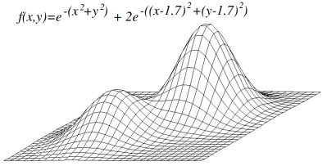

Slide 67
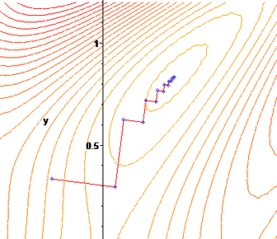
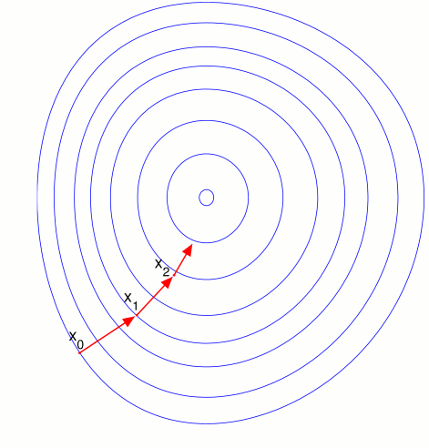
Gradient Descent
Assume we have a continuous function: f(x₁,x₂,…,x_{N})
and we want minimize over continuous variables X1,X2,..,Xn
1. Compute the gradients for all i: ∂f(x₁,x₂,…,x_{N}) /∂x_{i}
2. Take a small step downhill in the direction of the gradient:
x_{i} ← x_{i} - λ∂f(x₁,x₂,…,x_{N}) /∂x_{i}
3. Repeat.
How to select λ
  Line search: successively double
    until f starts to increase again

Slide 68
Newton-Raphson applied to function minimization
Newton-Raphson method: roots of a polynomial
  To find roots of g(x), start with x and iterate
    x ← x – g(x)/g’(x)
  To minimize a function f(x), we need to find the roots of the equation f’(x)=0
    x ← x – f’(x)/f’’(x)
    If x is a vector then
      x ← x – f’(x)/f’’(x)
Equivalent to fitting a quadratic function for f in the local neighborhood of x.
Hessian is costly to compute
(n² double derivative entries
for an n-dimensional vector)
➔ approximations
Δ
f(x)
H_{f}(x)

