Slide 1
CSE 473: Artificial Intelligence Autumn 2016
Search: Heuristics and Pattern DBs
Travis Mandel
(subbing for Dan Weld)
With slides from
Dan Weld, Dan Klein, Stuart Russell, Andrew Moore, Luke Zettlemoyer
Luke Zettlemoyer
Lecture adapted from Dan Klein’s slides
Multiple slides from Stuart Russell, Andrew Moore

Slide 2
Announcements
P0: You’re good unless you saw an email from us
Now in More 220!
Project 1: “Search” - due Friday 10/14
Should have started by now!
Dan will be back Friday!
Start!

Slide 3
Search thru a
Problem Space / State Space
Input:
Set of states
Operators [and costs]
Start state
Goal state [test]
Output:
Path: start ⇒ a state satisfying goal test
[May require shortest path]
[Sometimes just need state passing test]
Notes:
State Space Search is basically a GRAPH SEARCH PROBLEM
STATES are whatever you like!
OPERATORS are a compact DESCRIPTION of possible STATE TRANSITIONS – the EDGES of the GRAPH
May have different COSTS or all be UNIT cost
OUTPUT may be specified either as ANY PATH (REACHABILITY), or a SHORTEST PATH

Slide 4
Tree vs Graph search
In BFS, for example, we shouldn’t bother expanding the circled nodes (why?)
S
d
e
p
b
c
e
h
r
q
a
a
h
r
p
q
f
p
q
f
q
c
G
q
c
G
a
a

Slide 5
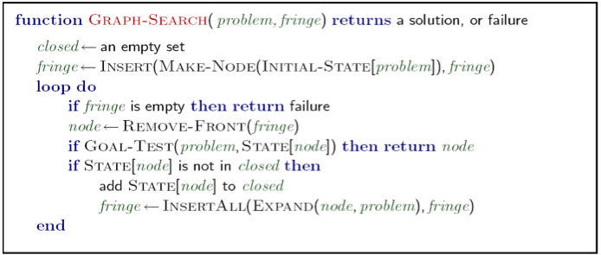
Graph Search
Very simple fix: never expand a state type twice
Can this wreck completeness? Why or why not?
How about optimality? Why or why not?

Slide 6
Graph Search
Very simple fix: never expand a state type twice

Slide 7
Some Hints
Graph search is almost always better than tree search
Implement your closed list as a dict or set!
Space huge concern!

Slide 8
A* Search
Hart, Nilsson & Rafael 1968
Best first search with f(n) = g(n) + h(n)
g(n) = sum of costs from start to n
h(n) = estimate of lowest cost path n → goal
h(goal) = 0
If h(n) is admissible and monotonic
then A* is optimal
{
}
Underestimates (≤) cost
of reaching goal from node
f values never decrease
From node to descendants
(triangle inequality)

Slide 9
Euclidean Distance
Admissible?
Monotonic?
S
G

Slide 10
Search with Heuristics
S
G

Slide 11
A* Search
Hart, Nilsson & Rafael 1968
Best first search with f(n) = g(n) + h(n)
g(n) = sum of costs from start to n
h(n) = estimate of lowest cost path n → goal
h(goal) = 0

Slide 12
A* Search
Hart, Nilsson & Rafael 1968
Best first search with f(n) = g(n) + h(n)
g(n) = sum of costs from start to n
h(n) = estimate of lowest cost path n → goal
h(goal) = 0
Can view as cross-breed:
g(n) ~ uniform cost search
h(n) ~ greedy search
Best of both worlds…

Slide 13
Admissible Heuristics
Admissible
Not Admissible
Value
State (x)
State (x)
True (optimal) cost remaining
Heuristic-estimated cost remaining
Slide credit: Travis Mandel

Slide 14
Monotonic/Consistent Heuristics
Monotonic
Not Monotonic (but admissible)
Value
State (x)
State (x)
True (optimal) cost remaining
h(x) Heuristic-estimated cost remaining
14
Slide credit: Travis Mandel

Slide 15
Monotonic/Consistent Heuristics
Monotonic
Not Monotonic (but admissible)
Value
State (x)
State (x)
True (optimal) cost remaining
h(x) Heuristic-estimated cost remaining
15
f(x) Heuristic + cost so far
Slide credit: Travis Mandel

Slide 16
Optimality of A* (tree search)

Slide 17
Optimality Continued

Slide 18
A* Example

Slide 19
A* Example

Slide 20
A* Example

Slide 21
A* Example

Slide 22
A* Example

Slide 23
A* Example

Slide 24
European Example
start
1
3
2
4
5
end

Slide 25
A* Summary
Pros
Cons
Produces optimal cost solution!
Does so quite quickly (focused)
Maintains priority queue…
Which can get exponentially big ☹

Slide 26
Iterative-Deepening A*
Like iterative-deepening depth-first, but...
Depth bound modified to be an f-limit
Start with f-limit = h(start)
Prune any node if f(node) > f-limit
Next f-limit = min-cost of any node pruned
e
FL=21
FL=15
a
d
f
b
c

Slide 27
IDA* Analysis
Complete & Optimal (ala A*)
Space usage ∝ depth of solution
Each iteration is DFS - no priority queue!
# nodes expanded relative to A*
Depends on # unique values of heuristic function
In 8 puzzle: few values ⇒ close to # A* expands
In traveling salesman: each f value is unique
⇒ 1+2+…+n = O(n²) where n=nodes A* expands
if n is too big for main memory, n² is too long to wait!
Generates duplicate nodes in cyclic graphs

Slide 28
IDA* Analysis
Complete & Optimal (ala A*)
Space usage ∝ depth of solution
Each iteration is DFS - no priority queue!
# nodes expanded relative to A*
Depends on # unique values of heuristic function
In 8 puzzle: few values ⇒ close to # A* expands
In traveling salesman: each f value is unique
⇒ 1+2+…+n = O(n²) where n=nodes A* expands
if n is too big for main memory, n² is too long to wait!

Slide 29
Forgetfulness
A* used exponential memory
How much does IDA* use?
During a run?
In between runs?
SMA*

Slide 30
SMA*
Use all available memory
Start like A*
When memory is full…
Erase node with highest f-value
First, backup parent with this f-value
So… parent knows cost-bound on best child

Slide 31
To Do:
Look at the course website:
http://www.cs.washington.edu/cse473/12sp
Do the readings (Ch 3)
Start PS1,

Slide 32
Extra Work?
Failure to detect repeated states can cause exponentially more work (why?)

Slide 33
Best First Greedy Search
Algorithm | Complete | Optimal | Time | Space
Greedy Best-First Search
Y*
N
O(b^{m})
O(b^{m})
b
…
m
What do we need to do to make it complete?
Can we make it optimal? Next class!

Slide 34
Heuristics
It’s what makes search actually work

Slide 35
Dominance
If h₂(n) ≥ h₁(n) for all n (both admissible)
then h₂ dominates h₁
h₂ is better - guaranteed never to expand more nodes.
h(x)
State (x)
True (optimal) cost remaining
Heuristic-estimated cost remaining

Slide 36
Admissable Heuristics
f(x) = g(x) + h(x)
g: cost so far
h: underestimate of remaining costs
Where do heuristics come from?

Slide 37
Relaxed Problems
Derive admissible heuristic from exact cost of a solution to a relaxed version of problem
For blocks world, distance = # move operations
heuristic = number of misplaced blocks
What is relaxed problem?
# out of place = 2, true distance to goal = 3
Cost of optimal soln to relaxed problem ≤ cost of optimal soln for real problem

Slide 38
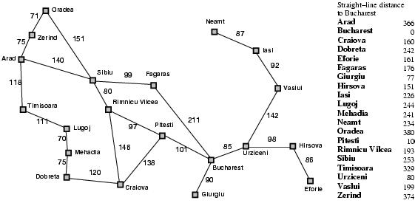
What’s being relaxed?
Heuristic = Euclidean distance

Slide 39
Example: Pancake Problem
Action: Flip over the
top n pancakes
Cost: Number of pancakes flipped
Notes:
Gates, W. and Papadimitriou, C., "Bounds for Sorting by Prefix Reversal.", Discrete Mathematics. 27, 47-57, 1979.

Slide 40
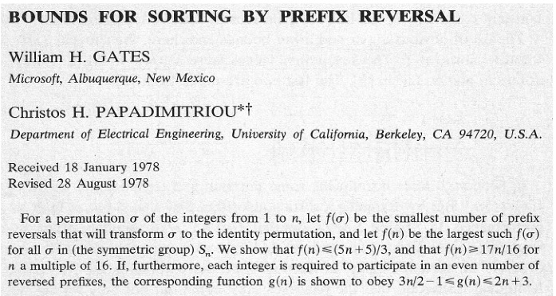
Example: Pancake Problem
Notes:
Gates, W. and Papadimitriou, C., "Bounds for Sorting by Prefix Reversal.", Discrete Mathematics. 27, 47-57, 1979.

Slide 41
Example: Pancake Problem
State space graph with costs as weights
4
2
3
2
3
4
3
4
2
3
2
2
4
3
3
Notes:
A* expanded 8100 ; Path cost = 33
UCS expanded 25263 . Path cost = 33
Greedy expanded 10 . Path cost = 41
[0, 7, 5, 3, 2, 1, 4, 6]
(7, 0, 5, 3, 2, 1, 4, 6)
(6, 4, 1, 2, 3, 5, 0, 7)
(3, 2, 1, 4, 6, 5, 0, 7)
(1, 2, 3, 4, 6, 5, 0, 7)
(5, 6, 4, 3, 2, 1, 0, 7)
(6, 5, 4, 3, 2, 1, 0, 7)
(0, 1, 2, 3, 4, 5, 6, 7)

Slide 42
Pancake Heuristic?
Heuristic: the largest pancake that is still out of place
3
h(x)
4
3
4
3
0
4
4
3
4
4
2
3
Notes:
A* expanded 8100 ; Path cost = 33
UCS expanded 25263 . Path cost = 33
Greedy expanded 10 . Path cost = 41
[0, 7, 5, 3, 2, 1, 4, 6]
(7, 0, 5, 3, 2, 1, 4, 6)
(6, 4, 1, 2, 3, 5, 0, 7)
(3, 2, 1, 4, 6, 5, 0, 7)
(1, 2, 3, 4, 6, 5, 0, 7)
(5, 6, 4, 3, 2, 1, 0, 7)
(6, 5, 4, 3, 2, 1, 0, 7)
(0, 1, 2, 3, 4, 5, 6, 7)

Slide 43
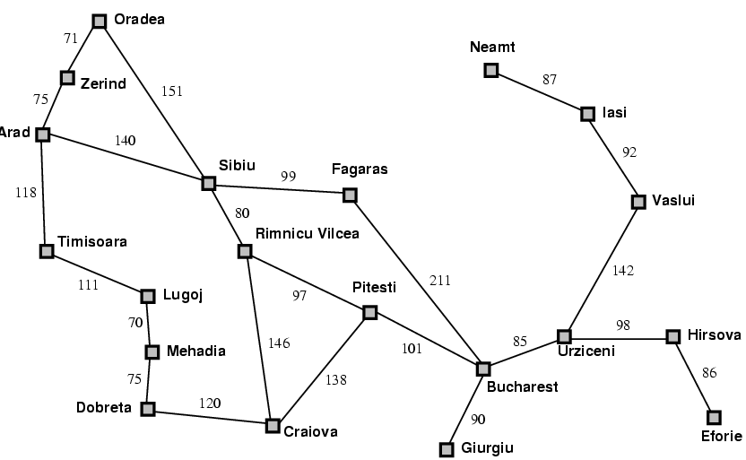
Traveling Salesman Problem
Objective: shortest path visiting every city
What can be
Relaxed?
Groundedness.
If can fly to previously seen city → minimum spanning tree

Slide 44
Heuristics for eight puzzle
7 2 3
1 2 3
5 1 6
4 5 6
→
8 3
7 8
start
goal
What can we relax?
h1 = number of tiles in wrong place
h2 = Σ distances of tiles from correct loc

Slide 45
Importance of Heuristics
7 2 3
4 1 6
h1 = number of tiles in wrong place
8 5
D IDS A*(h1) A*(h2)
2 10 6 6
4 112 13 12
6 680 20 18
8 6384 39 25
10 47127 93 39
12 364404 227 73
14 3473941 539 113
18 3056 363
24 39135 1641

Slide 46
Importance of Heuristics
7 2 3
4 1 6
h1 = number of tiles in wrong place
h2 = Σ distances of tiles from correct loc
8 5
D IDS A*(h1) A*(h2)
2 10 6 6
4 112 13 12
6 680 20 18
8 6384 39 25
10 47127 93 39
12 364404 227 73
14 3473941 539 113
18 3056 363
24 39135 1641
Decrease effective branching factor

Slide 47
Need More Power!
Performance of Manhattan Distance Heuristic
8 Puzzle < 1 second
15 Puzzle 1 minute
24 Puzzle 65000 years
Need even better heuristics!
Adapted from Richard Korf presentation

Slide 48
Subgoal Interactions
Manhattan distance assumes
Each tile can be moved independently of others
Underestimates because
Doesn’t consider interactions between tiles
1 2 3
4 6 5
7 8
Adapted from Richard Korf presentation

Slide 49
Pattern Databases
[Culberson & Schaeffer 1996]
1 2 3 4
Pick any subset of tiles
E.g., 3, 7, 11, 12, 13, 14, 15
(or as drawn)
Precompute a table
Optimal cost of solving just these tiles
For all possible configurations
57 Million in this case
Use A* or IDA*
State = position of just these tiles (& blank)
5 6 7 8
9 10 11 12
13 14 15
Adapted from Richard Korf presentation

Slide 50
Using a Pattern Database
As each state is generated
Use position of chosen tiles as index into DB
Use lookup value as heuristic, h(n)
Admissible?
Adapted from Richard Korf presentation

Slide 51
Combining Multiple Databases
1 2 3 4
Can choose another set of tiles
Precompute multiple tables
How combine table values?
E.g. Optimal solutions to Rubik’s cube
First found w/ IDA* using pattern DB heuristics
Multiple DBs were used (dif cubie subsets )
Most problems solved optimally in 1 day
Compare with 574,000 years for IDDFS
5 6 7 8
9 10 11 12
13 14 15
Adapted from Richard Korf presentation

Slide 52
Drawbacks of Standard Pattern DBs
Since we can only take max
Diminishing returns on additional DBs
Would like to be able to add values
Adapted from Richard Korf presentation

Slide 53
Disjoint Pattern DBs
1 2 3 4
5 6 7 8
Partition tiles into disjoint sets
For each set, precompute table
E.g. 8 tile DB has 519 million entries
And 7 tile DB has 58 million
During search
Look up heuristic values for each set
Can add values without overestimating!
Manhattan distance is a special case of this idea where each set is a single tile
9 10 11 12
13 14 15
Adapted from Richard Korf presentation

Slide 54
Performance
15 Puzzle: 2000x speedup vs Manhattan dist
IDA* with the two DBs shown previously solves 15 Puzzles optimally in 30 milliseconds
24 Puzzle: 12 million x speedup vs Manhattan
IDA* can solve random instances in 2 days.
Requires 4 DBs as shown
Each DB has 128 million entries
Without PDBs: 65,000 years
Adapted from Richard Korf presentation

Slide 55
Alternative Approach…
Optimality is nice to have, but…
Sometimes space is too vast! Find suboptimal solution using local search.

Slide 56
Depth-First Branch & Bound
Single DF search
→ uses linear space
Keep track of best solution so far
If f(n) = g(n)+h(n) ≥ cost(best-soln)
Then prune n
Requires
Finite search tree, or
Good upper bound on solution cost
Generates duplicate nodes in cyclic graphs
Tradeoff:
Prune space, but…
Must apply test to each node
Adapted from Richard Korf presentation

Slide 57
Beam Search
Idea
Best first but only keep N best items on priority queue
Evaluation
Complete?
Time Complexity?
Space Complexity?
No
O(b^d)
O(b + N)

Slide 58
Hill Climbing
“Gradient ascent”
Idea
Always choose best child; no backtracking
Beam search with |queue| = 1
Problems?
Local maxima
Plateaus
Diagonal ridges

Slide 59
Randomizing Hill Climbing
Randomly disobeying heuristic
Random restarts

Slide 60
Simulated Annealing
Objective: avoid local minima
Technique:
Choose random neighbor
If improves (lower cost/higher score) move with probability 1
Otherwise, let Δ be the decrease in quality
Move to neighbor with probability e ^{-Δ/T}
Reduce “temperature” (T) over time
Pros & cons
Optimal?
If T decreased slowly enough, will reach optimal state
Widely used
See also WalkSAT
temp

