Slide 1
CSE 473: Artificial Intelligence Autumn2016
Problem Spaces & Search
Dan Weld
With slides from
Dan Klein, Stuart Russell, Andrew Moore, Luke Zettlemoyer
Notes:
Good to hit DFS and BFS quickly, since they’ve seen it before.

Slide 2
Logistics
Read Ch 3
Do PS0 by Monday (should be easy)
Start PS1 (harder!)

Slide 3
Outline
Search Problems
Uninformed Search Methods
Depth-First Search
Breadth-First Search
Uniform-Cost Search
Heuristic Search Methods
Best First / Greedy Search

Slide 4
Agent vs. Environment
An agent is an entity that perceives and acts.
A rational agent selects actions that maximize its utility function.
Characteristics of the percepts, environment, and action space dictate techniques for selecting rational actions.
Agent
Sensors
Percepts
?
Environment
Actuators
Actions
Notes:
agent is really just a program
environment - inputs and outputs to the program
utility function - indirect specification of the what the program should do
goal: design an algorithm that can find actions for any utility function

Slide 5
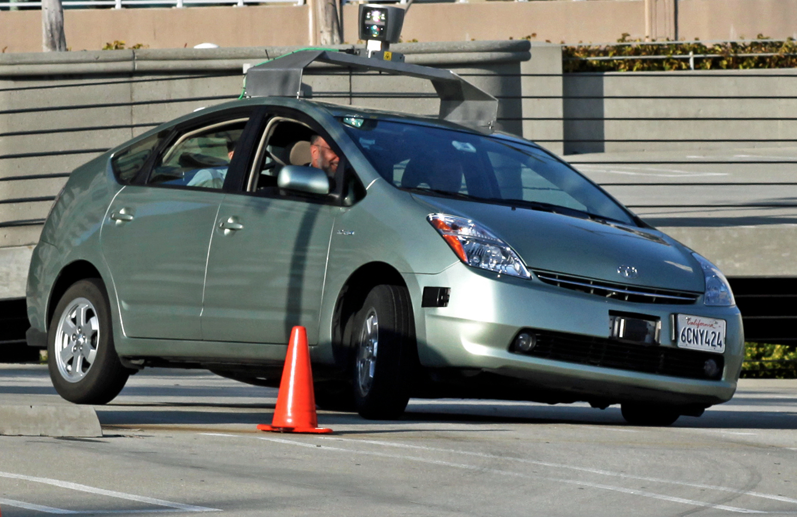
Actions? Percepts?

Slide 6
Actions? Percepts?
Recommender System

Slide 7
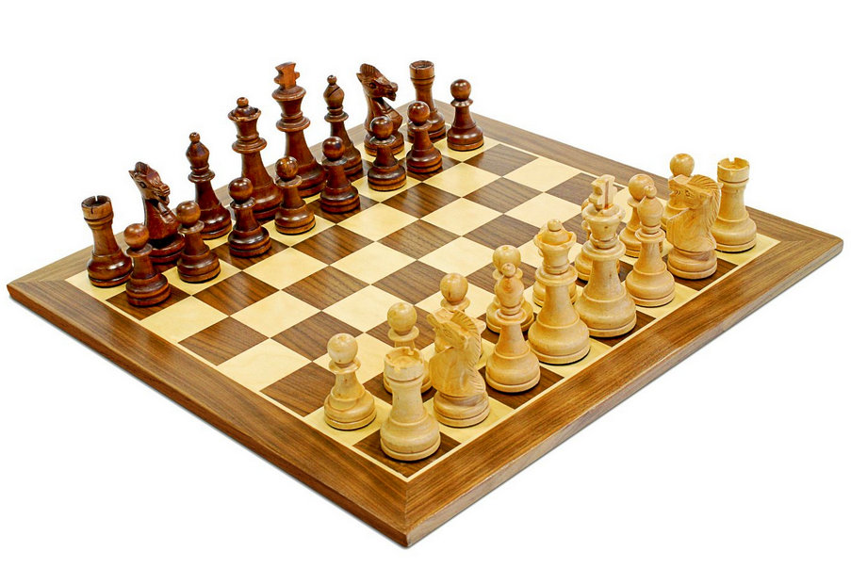
Types of Agents
Reflex
Goal oriented
Utility-based

Slide 8
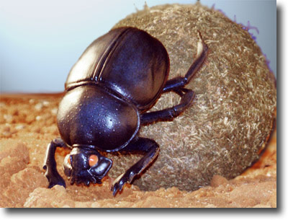
Famous Reflex Agents

Slide 9
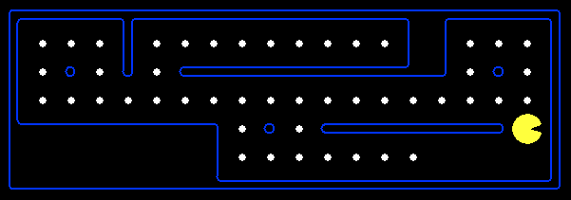
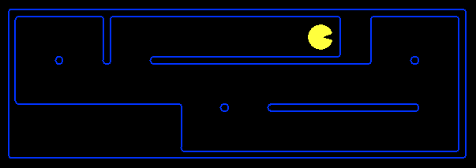
Goal Based Agents
Plan ahead
Ask “what if”
Decisions based on (hypothesized) consequences of actions
Must have a model of how the world evolves in response to actions
Act on how the world WOULD BE

Slide 10
Types of Environments
Fully observable vs. partially observable
Single agent vs. multiagent
Deterministic vs. stochastic
Episodic vs. sequential
Discrete vs. continuous

Slide 11
Search thru a
Problem Space (aka State Space)
Input:
Functions: States → States
Aka “Successor Function”
Set of states
Operators [and costs]
Start state
Goal state [or test]
Output:
Path: start ⇒ a state satisfying goal test
[May require shortest path]
[Sometimes just need a state that passes test]
Notes:
State Space Search is basically a GRAPH SEARCH PROBLEM
STATES are whatever you like!
OPERATORS are a compact DESCRIPTION of possible STATE TRANSITIONS – the EDGES of the GRAPH
May have different COSTS or all be UNIT cost
OUTPUT may be specified either as ANY PATH (REACHABILITY), or a SHORTEST PATH

Slide 12
Example: Simplified Pac-Man
Input:
A state space
Successor function
A start state
A goal test
Output:
“N”, 1.0
“E”, 1.0

Slide 13
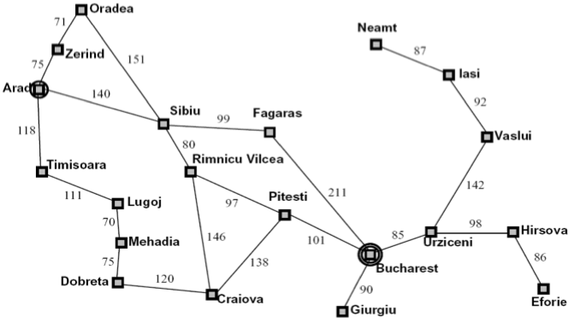
Ex: Route Planning: Arad → Bucharest
Input:
Set of states
Operators [and costs]
Start state
Goal state (test)
Output:
Different operators may be applicable in different states
Notes:
States = cities
Start state = starting city
Goal state test = is state the destination city?
Operators = move to an adjacent city; cost = distance
Output: a shortest path from start state to goal state
SUPPOSE WE REVERSE START AND GOAL STATES?

Slide 14
Example: N Queens
Q
Input:
Set of states
Operators [and costs]
Start state
Goal state (test)
Output
Q
Q
Q

Slide 15
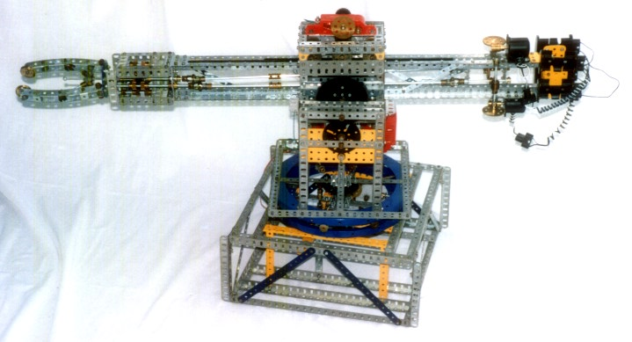
Ex: Blocks World
Input:
Set of states
Operators [and costs]
Start state
Goal state (test)
Output:
Partially specified plans
Plan modification operators
The null plan (no actions)
A plan which provably achieves
The desired world configuration
Notes:
State = configuration of blocks: ON(A,B), ON(B, TABLE), ON(C, TABLE)
Start state = starting configuration
Goal state test = does state satisfy some test, e.g. “ON(A,B)”?
Operators: MOVE x FROM y TO z
or PICKUP(x,y) and PUTDOWN(x,y)
Output: Sequence of actions that transform start state into goal.
HOW HARD if don’t care about number of actions used? POLYNOMIAL
HOW HARD to find smallest number of actions? NP-COMPLETE
Suppose we want to search BACKWARDS from GOAL?
Simple if goal COMPLETELY specified
NEED to have a DIFFERENT notion of STATE if goals are PARTIALLY SPECIFIED

Slide 16
Plan Space
Need less abstract / better motivated example
At-home
Drive
LINK
Uber
At-SEATAC
At-SEATAC
At-SEATAC

Slide 17
Plan Space
Visit FEZ
Visit FEZ
Camel Ride
<
Visit FEZ
Camel Ride
Add
Action
Add
Action
Constrain
Ordering

Slide 18
Multiple Problem Spaces
Real World
States of the world (e.g. block configurations)
Actions (take one world-state to another)
Robot’s Head
Problem Space 1
PS states =
models of world states
Operators =
models of actions
Problem Space 2
PS states =
partially spec. plan
Operators =
plan modificat’n ops
Notes:
State = configuration of blocks: ON(A,B), ON(B, TABLE), ON(C, TABLE)
Start state = starting configuration
Goal state test = does state satisfy some test, e.g. “ON(A,B)”?
Operators: MOVE x FROM y TO z
or PICKUP(x,y) and PUTDOWN(x,y)
Output: Sequence of actions that transform start state into goal.
HOW HARD if don’t care about number of actions used? POLYNOMIAL
HOW HARD to find smallest number of actions? NP-COMPLETE
Suppose we want to search BACKWARDS from GOAL?
Simple if goal COMPLETELY specified
NEED to have a DIFFERENT notion of STATE if goals are PARTIALLY SPECIFIED

Slide 19
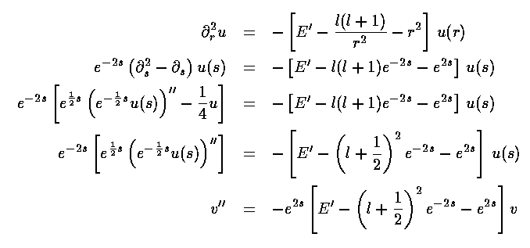
Algebraic Simplification
Input:
Set of states
Operators [and costs]
Start state
Goal state (test)
Output:

Slide 20
State Space Graphs
State space graph:
Each node is a state
The operators are represented by arcs
Edges may be labeled with costs
We can rarely build this graph in memory (so we don’t)
a
G
b
c
e
d
f
S
h
p
q
r
Ridiculously tiny search graph for a tiny search problem

Slide 21
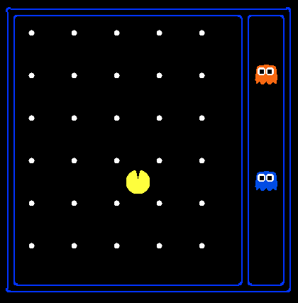
State Space Sizes?
Search Problem: Eat all of the food
Pacman positions: 10 x 12 = 120
Pacman facing: up, down, left, right
Food configurations: 2³⁰
Ghost1 positions: 12
Ghost 2 positions: 11
10 x 12 = 120
up, down, left, right
2³⁰
12
11
120 x 4 x 2³⁰ x 12 x 11 = 6.8 x 10¹³
Notes:
90 * (2^30-1) + 30 * 2^29 = 145 billion
2^29 = 536 870 912

Slide 22
Search Methods
Blind Search
Local Search
Informed Search
Constraint Satisfaction
Adversary Search
Depth first search
Breadth first search
Iterative deepening search
Uniform cost search

Slide 23
Search Trees
“N”, 1.0
“E”, 1.0
A search tree:
Start state at the root node
Children correspond to successors
Nodes contain states, correspond to PLANS to those states
Edges are labeled with actions and costs
For most problems, we can never actually build the whole tree

Slide 24
Example: Tree Search
State graph:
a
G
b
c
e
d
f
S
h
p
q
r
What is the search tree?

Slide 25
State Graphs vs. Search Trees
a
G
Each NODE in in the search tree denotes an entire PATH in the problem graph.
b
c
d
e
f
S
h
p
q
r
S
d
e
p
We construct both on demand – and we construct as little as possible.
b
c
e
h
r
q
a
a
h
r
p
q
f
p
q
f
q
c
G
q
c
G
a
a

Slide 26
States vs. Nodes
Vertices in state space graphs are problem states
Represent an abstracted state of the world
Have successors, can be goal / non-goal, have multiple predecessors
Vertices in search trees (“Nodes”) are plans
Contain a problem state and one parent, a path length, a depth & a cost
Represent a plan (sequence of actions) which results in the node’s state
The same problem state may be achieved by multiple search tree nodes
Search Tree Nodes
Problem States
Parent
Depth 5
Action
Node
Depth 6

Slide 27
Building Search Trees
Search:
Expand out possible nodes (plans) in the tree
Maintain a fringe of unexpanded nodes
Try to expand as few nodes as possible

Slide 28
General Tree Search
Important ideas:
Fringe (leaves of tree)
Expansion (adding successors of a leaf)
Exploration strategy
which fringe node to expand next?
Detailed pseudocode is in the book!

Slide 29
Review: Depth First Search
a
G
b
c
e
d
f
S
h
Strategy: expand deepest node first
Implementation: Fringe is a stack - LIFO
p
q
r

Slide 30
Review: Depth First Search
a
G
a
Expansion ordering:
(d,b,a,c,a,e,h,p,q,q,r,f,c,a,G)
c
b
c
b
e
d
e
d
f
f
S
h
h
p
p
r
q
r
q
S
d
e
p
b
c
e
h
r
q
a
a
h
r
p
q
f
p
q
f
q
c
G
q
c
G
a
a

Slide 31
Review: Breadth First Search
a
G
b
c
Strategy: expand shallowest node first
Implementation: Fringe is a queue - FIFO
e
d
f
S
h
p
q
r

Slide 32
Review: Breadth First Search
a
G
Expansion order:
(S,d,e,p,b,c,e,h,r,q,a,a,h,r,p,q,f,p,q,f,q,c,G)
b
c
d
e
f
S
h
p
q
r
S
d
e
p
Search
Tiers
b
c
e
h
r
q
a
a
h
r
p
q
f
p
q
f
q
c
G
q
c
G
a
a

Slide 33
Search Algorithm Properties
Complete? Guaranteed to find a solution if one exists?
Optimal? Guaranteed to find the least cost path?
Time complexity?
Space complexity?
Variables:
n | Number of states in the problem
b | The maximum branching factor B (the maximum number of successors for a state)
C* | Cost of least cost solution
d | Depth of the shallowest solution
m | Max depth of the search tree

Slide 34
DFS
Algorithm |  | Complete | Optimal | Time | Space
DFS | Depth First Search | N | N | O(B^{LMAX}) | O(LMAX)
No
No
Infinite
Infinite
START
Infinite paths make DFS incomplete…
How can we fix this?
Check new nodes against path from S
Infinite search spaces still a problem
a
GOAL
b

Slide 35
DFS
1 node
b
…
b nodes
b² nodes
m tiers
b^{m} nodes
Algorithm |  | Complete | Optimal | Time | Space
DFS | w/ Path Checking
Y if finite
N
O(b^{m})
O(bm)
* Or graph search – next lecture.

Slide 36
BFS
Algorithm |  | Complete | Optimal | Time | Space
DFS | w/ Path Checking
BFS
N unless
finite
N
O(b^{m})
O(bm)
Y
Y
O(b^{d})
O(b^{d})
When is BFS optimal?
1 node
b
…
b nodes
d tiers
b² nodes
b^{d} nodes
b^{m} nodes

Slide 37
Memory a Limitation?
Suppose:
4 GHz CPU
32 GB main memory
100 instructions / expansion
5 bytes / node
40 M expansions / sec
Memory filled in … 3 min

Slide 38
Comparisons
When will BFS outperform DFS?
When will DFS outperform BFS?
Notes:
Made it to this slide in 50 minute class. Made students pair up to draw search tree and do depth first search. Didn’t have them to breadth first...

Slide 39
Iterative Deepening
Iterative deepening uses DFS as a subroutine:
Do a DFS which only searches for paths of length 1 or less.
If “1” failed, do a DFS which only searches paths of length 2 or less.
If “2” failed, do a DFS which only searches paths of length 3 or less.
….and so on.
b
…
Algorithm |  | Complete | Optimal | Time | Space
DFS | w/ Path Checking
BFS
ID
Y
N
O(b^{m})
O(bm)
Y
Y
O(b^{d})
O(b^{d})
Y
Y
O(b^{d})
O(bd)

Slide 40
Conclusions…
Iterative Deepening is great!
But what about all the repeated work??!?

Slide 41
Cost of Iterative Deepening
b | ratio ID to DFS
2 | 3
3 | 2
5 | 1.5
10 | 1.2
25 | 1.08
100 | 1.02

Slide 42
Speed
Assuming 10M nodes/sec & sufficient memory
BFS
Nodes Time
Iter. Deep.
Nodes Time
8 Puzzle
2x2x2 Rubik’s
15 Puzzle
3x3x3 Rubik’s
24 Puzzle
10⁵ .01 sec
10⁶ .2 sec
10¹³ 6 days
10¹⁹ 68k yrs
10²⁵ 12B yrs
10⁵ .01 sec
10⁶ .2 sec
10¹⁷ 20k yrs
10²⁰ 574k yrs
10³⁷ 10²³ yrs
1Mx
8x
Why the difference?
Rubik has higher branching factor 15 puzzle has greater depth
→ # of duplicates
Slide adapted from Richard Korf presentation

Slide 43
When to Use Iterative Deepening
N Queens?
Define as search problem
States?
Operators?
Start state?
Goal test?
Q
Q
Q
Q

Slide 44
Costs on Actions
2
a
GOAL
2
b
c
3
2
1
8
2
e
3
d
f
9
8
2
START
h
1
4
1
p
4
r
15
q
Notice that BFS finds the shortest path in terms of number of transitions. It does not find the least-cost path.

Slide 45
Uniform Cost Search
aka Dijkstra’s Algorithm
Expand cheapest node first:
Fringe is a priority queue
2
a
GOAL
2
b
c
3
2
1
8
2
e
3
d
f
9
8
2
START
h
1
4
1
p
4
r
15
q

Slide 46
Uniform Cost Search
2
G
a
Expansion order:
(S,p,d,b,e,a,r,f,e,G)
b
1
8
c
2
2
3
d
e
f
9
8
1
S
h
1
1
p
q
r
15
0
S
d
3
e
9
p
1
b
4
e
5
h
17
r
11
q
16
c
11
Cost contours
a
6
a
h
13
r
7
p
q
f
p
q
f
8
q
c
G
q
c
a
11
G
10
a

Slide 47
Priority Queue Refresher
A priority queue is a data structure in which you can insert and retrieve (key, value) pairs with the following operations:
pq.push(key, value) | inserts (key, value) into the queue.
pq.pop() | returns the key with the lowest value, and removes it from the queue.
You can decrease a key’s priority by pushing it again
Unlike a regular queue, insertions aren’t constant time, usually O(log n)
We’ll need priority queues for cost-sensitive search methods

Slide 48
Uniform Cost Search
Algorithm |  | Complete | Optimal | Time | Space
DFS | w/ Path Checking
BFS
UCS
Y
N
O(b^{m})
O(bm)
Y
Y
O(b^{d})
O(b^{d})
Y*
Y*
O(b^{C*/ε})
O(b^{C*/ε})
C* = cost of best soln
ε = cost of cheapest operator
b
…
Worst case depth:
C*/ε tiers
* Important: ε > 0
Notes:
Optimal if the cost of actions at each step exceeds some bound, epsilon

Slide 49
Uniform Cost Issues
Remember: explores increasing cost contours
The good: UCS is complete and optimal (if ε>0)!
The bad:
Explores options in every “direction”
Will explore short & unhelpful options before longer but useful ones
No information about goal location
c ≤ 1
…
c ≤ 2
c ≤ 3
Start
Goal
Notes:
python pacman.py -l contoursMaze -p SearchAgent -a fn=ucs --frameTime -1
python pacman.py -p SearchAgent -a fn=ucs -l smallMaze --frameTime -1

Slide 50
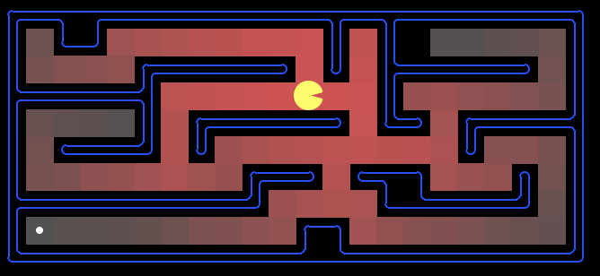
Uniform Cost: Pac-Man
Cost of 1 for each action
Explores all of the states, but one

Slide 51
Outline
Search Problems
Uninformed Search Methods
Depth-First Search
Breadth-First Search
Uniform-Cost Search
Heuristic Search Methods
Best First / Greedy Search

Slide 52
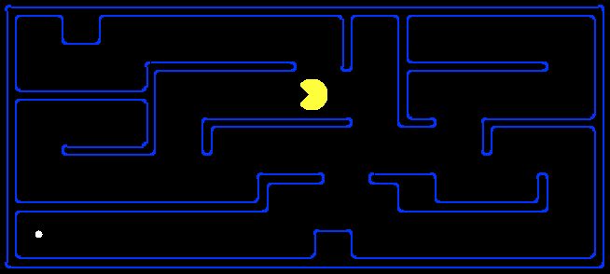
Search Heuristics
Any estimate of how close a state is to a goal
Designed for a particular search problem
10
5
11.2
Examples: Manhattan distance, Euclidean distance

Slide 53
What is a Heuristic?
An estimate of how close a state is to a goal
Designed for a particular search problem
10
5
10
5
Actual distance to goal: 2+4+2+1+8=

Slide 54
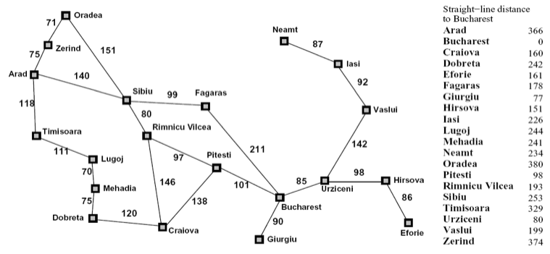
Heuristics

Slide 55
Best First (aka Greedy) Search
Expand closest node first: Fringe is a priority queue

Slide 56
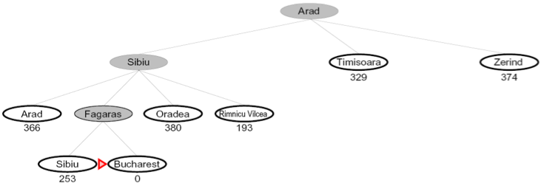
Best First / Greedy Search
Expand the node that seems closest…
What can go wrong?

Slide 57
Greedy Search
Expand the node that seems closest…
What can go wrong?
A
start
B
goal

Slide 58
Best First / Greedy Search
A common case:
Best-first takes you straight to the goal (but with non-optimal path)
Worst-case: like a badly-guided DFS in the worst case
Can explore everything
Can get stuck in loops if no cycle checking
Like DFS in completeness (finite states w/ cycle checking)
b
…
b
…

Slide 59
Extra Work?
Failure to detect repeated states can cause exponentially more work (why?)

Slide 60
Graph Search
In BFS, for example, we shouldn’t bother expanding the circled nodes (why?)
S
d
e
p
b
c
e
h
r
q
a
a
h
r
p
q
f
p
q
f
q
c
G
q
c
G
a
a

Slide 61
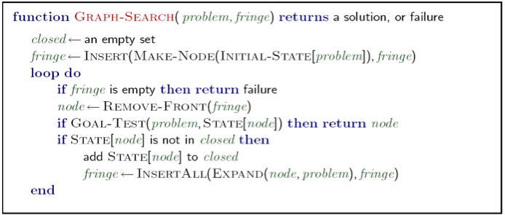
Graph Search
Very simple fix: never expand a state type twice
Can this wreck completeness? Why or why not?
How about optimality? Why or why not?

Slide 62
Some Hints
Graph search is almost always better than tree search (when not?)
In Python, implement your closed list as a dict or set!
Nodes are conceptually paths, but better to represent with a state, cost, last action, and reference to the parent node

Slide 63
Best First Greedy Search
Algorithm | Complete | Optimal | Time | Space
Greedy Best-First Search
N
N
O(b^{m})
O(b^{m})
b
…
m
What do we need to do to make it complete?
Can we make it optimal? Next topic!

Slide 64
Graduation?
Getting a PhD in CSE as a search problem? (don’t think too hard)
Space of States
Operators
Initial State
Goal State

Slide 65
Concept Learning
Labeled Training Examples
<p1,blond,32,mc,ok>
<p2,red,47,visa,ok>
<p3,blond,23,cash,ter>
<p4,…
Output: f: <pn…> → {ok, ter}
Input:
Set of states
Operators [and costs]
Start state
Goal state (test)
Output:

Slide 66
A* Search
Hart, Nilsson & Rafael 1968
Best first search with f(n) = g(n) + h(n)
g(n) = sum of costs from start to n
h(n) = estimate of lowest cost path n → goal
h(goal) = 0
Can view as cross-breed:
g(n) ~ uniform cost search
h(n) ~ greedy search
Best of both worlds…

Slide 67
A* Search
Hart, Nilsson & Rafael 1968
Best first search with f(n) = g(n) + h(n)
g(n) = sum of costs from start to n
h(n) = estimate of lowest cost path n → goal
h(goal) = 0
If h(n) is admissible and monotonic
then A* is optimal
{
}
Underestimates cost
of reaching goal from node
f values increase from
node to descendants
(triangle inequality)

Slide 68
Monotonicity
f(n) = g(n) + h(n)
g(n) = sum of costs from start to n
h(n) = estimate of lowest cost path n → goal
start
G(A)
A
“F-values always increase”
x
h(A)
F(B) ≥ F(A)
G(B)+H(B) ≥ G(A)+H(A)
G(A)+x+ H(B) ≥ G(A)+H(A)
x+ H(B) ≥ H(A)
B
h(B)
G(B) = G(A)+x
G

Slide 69
Is Manhattan distance admissible?
Underestimate?
S
G

Slide 70
Is Manhattan distance monotonic?
f values increase from node to children
(triangle inequality)
S
G

Slide 71
Euclidean Distance
Admissible?
Monotonic?
S
G

Slide 72
A* Example

Slide 73
A* Example

Slide 74
A* Example

Slide 75
A* Example

Slide 76
A* Example

Slide 77
A* Example

Slide 78
European Example
start
1
3
2
4
5
end

Slide 79
Optimality of A*

Slide 80
Optimality Continued

Slide 81
A* Summary
Pros
Cons
Produces optimal cost solution!
Does so quite quickly (focused)
Maintains priority queue…
Which can get exponentially big ☹

Slide 82
Iterative-Deepening A*
Like iterative-deepening depth-first, but...
Depth bound modified to be an f-limit
Start with f-limit = h(start)
Prune any node if f(node) > f-limit
Next f-limit = min-cost of any node pruned
e
FL=21
FL=15
a
d
f
b
c

Slide 83
IDA* Analysis
Complete & Optimal (ala A*)
Space usage ∝ depth of solution
Each iteration is DFS - no priority queue!
# nodes expanded relative to A*
Depends on # unique values of heuristic function
In 8 puzzle: few values ⇒ close to # A* expands
In traveling salesman: each f value is unique
⇒ 1+2+…+n = O(n²) where n=nodes A* expands
if n is too big for main memory, n² is too long to wait!
Generates duplicate nodes in cyclic graphs

Slide 84
Forgetfulness
A* used exponential memory
How much does IDA* use?
During a run?
In between runs?

Slide 85
SMA*
Use all available memory
Start like A*
When memory is full…
Erase node with highest f-value
First, backup parent with this f-value
So… parent knows cost-bound on best child

Slide 86
Alternative Approach to Finite Memory…
Optimality is nice to have, but…

Slide 87
Depth-First Branch & Bound
Single DF search
→ uses linear space
Keep track of best solution so far
If f(n) = g(n)+h(n) ≥ cost(best-soln)
Then prune n
Requires
Finite search tree, or
Good upper bound on solution cost
Generates duplicate nodes in cyclic graphs
Tradeoff:
Prune space, but…
Must apply test to each node
Adapted from Richard Korf presentation

Slide 88
Beam Search
Idea
Best first but only keep N best items on priority queue
Evaluation
Complete?
Time Complexity?
Space Complexity?
No
O(b^d)
O(b + N)

Slide 89
Hill Climbing
“Gradient ascent”
Idea
Always choose best child; no backtracking
Beam search with |queue| = 1
Problems?
Local maxima
Plateaus
Diagonal ridges

Slide 90
Randomizing Hill Climbing
Randomly disobeying heuristic
Random restarts
( heavy tailed distributions )
→ Local Search

