Slide 1
CSE 473: Artificial Intelligence
Spring 2014
Hanna Hajishirzi
Problem Spaces and Search
slides from
Dan Klein, Stuart Russell, Andrew Moore, Dan Weld, Pieter Abbeel, Luke Zettelmoyer

Slide 2
Outline
Agents that Plan Ahead
Search Problems
Uninformed Search Methods (part review for some)
  Depth-First Search
  Breadth-First Search
  Uniform-Cost Search
Heuristic Search Methods (new for all)
  Best First / Greedy Search

Slide 3
Review: Agents
An agent:
Perceives and acts
Selects actions that maximize its utility function
Has a goal
Environment:
Input and output to the agent
Agent
Sensors
Percepts
?
Environment
Actuators
Actions
Search -- the environment is:
fully observable, single agent, deterministic, static, discrete
Notes:
agent is really just a program
environment - inputs and outputs to the program
utility function - indirect specification of the what the program should do
goal: design an algorithm that can find actions for any utility function

Slide 4

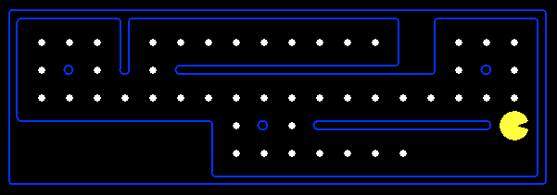
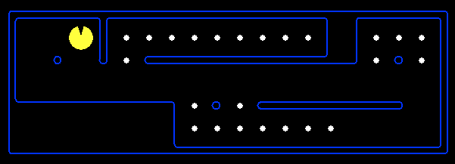
Reflex Agents
Reflex agents:
  Choose action based on current percept (and maybe memory)
  Do not consider the future consequences of their actions
  Act on how the world IS
Can a reflex agent achieve goals?

Slide 5
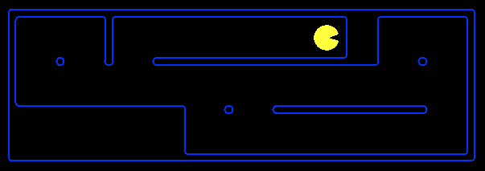
Goal Based Agents
Goal-based agents:
  Plan ahead
  Ask “what if”
  Decisions based on (hypothesized) consequences of actions
  Must have a model of how the world evolves in response to actions
  Act on how the world WOULD BE

Slide 6
Search thru a
Problem Space / State Space
Input:
  Set of states
  Successor Function [and costs - default to 1.0]
  Start state
  Goal state [test]
Output:
  Path: start ⇒ a state satisfying goal test
  [May require shortest path]
  [Sometimes just need state passing test]
Notes:
State Space Search is basically a GRAPH SEARCH PROBLEM
STATES are whatever you like!
OPERATORS are a compact DESCRIPTION of possible STATE TRANSITIONS – the EDGES of the GRAPH
May have different COSTS or all be UNIT cost
OUTPUT may be specified either as ANY PATH (REACHABILITY), or a SHORTEST PATH
----- Meeting Notes (4/1/14 17:32) -----
One way of getting to the goal is to search the state space where every state is the representation of every details in the environment.
The states are changing according to the successor funcion. The problem is modeled using the start staet and the end state.

Slide 7







Example: Simplified Pac-Man
Input:
  A state space
  A successor function
  A start state
  A goal test
Output:
“N”, 1.0
“E”, 1.0

Slide 8
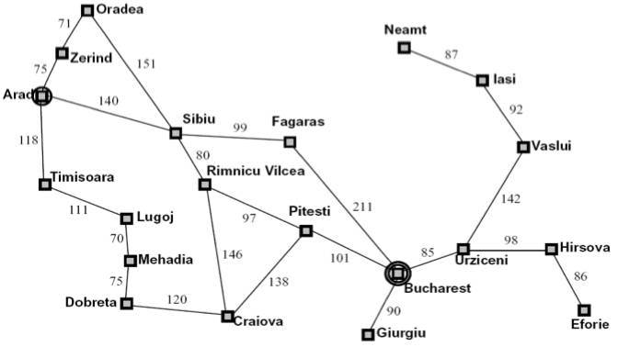
Ex: Route Planning: Romania → Bucharest
Input:
  Set of states
  Operators [and costs]
  Start state
  Goal state (test)
Output:
Notes:
States = cities
Start state = starting city
Goal state test = is state the destination city?
Operators = move to an adjacent city; cost = distance
Output: a shortest path from start state to goal state
SUPPOSE WE REVERSE START AND GOAL STATES?

Slide 9
Example: N Queens
Q
Input:
  Set of states
  Operators [and costs]
  Start state
  Goal state (test)
Output
Q
Q
Q
Notes:
----- Meeting Notes (4/1/14 17:32) -----
such that no queen can attack the other queen

Slide 10
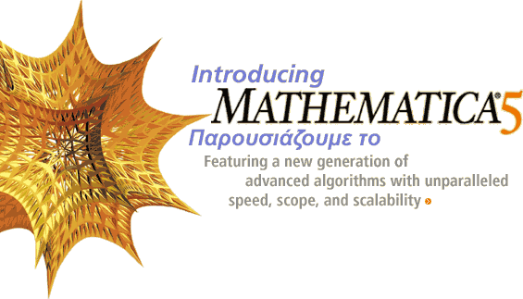
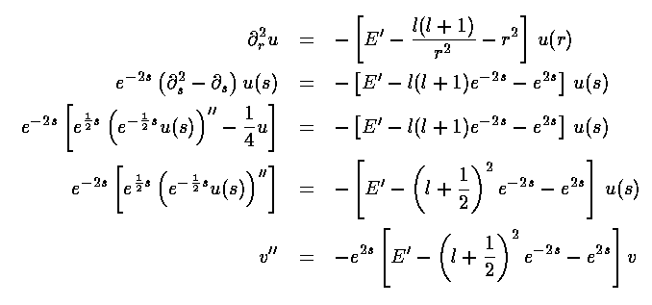
Algebraic Simplification
Input:
  Set of states
  Operators [and costs]
  Start state
  Goal state (test)
Output:

Slide 11
What is in State Space?
A world state includes every details of the environment
A search state includes only details needed for planning
Problem: Pathing
Problem: Eat-all-dots
States: {x,y} locations
Actions: NSEW moves
Successor: update location
Goal: is (x,y) End?
States: {(x,y), dot booleans}
Actions: NSEW moves
Successor: update location and dot boolean
Goal: dots all false?
Notes:
----- Meeting Notes (4/1/14 17:32) -----
There is a subtle distinction between a world state and a search state (state space).

Slide 12
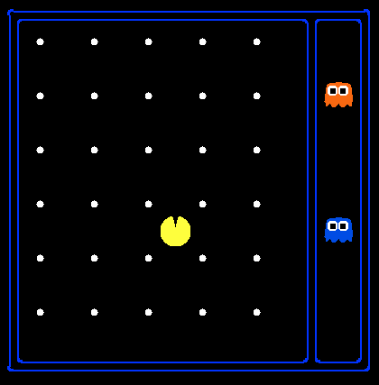
State Space Sizes?
World states:
Pacman positions:
10 x 12 = 120
Pacman facing:
up, down, left, right
Food Count: 30
Ghost positions: 12
Notes:
90 * (2^30-1) + 30 * 2^29 = 145 billion
2^29 = 536 870 912

Slide 13
State Space Sizes?
How many?
World State:
States for Pathing:
States for eat-all-dots:
120*(2³⁰)*(12²)*4
120
120*(2³⁰)
Notes:
90 * (2^30-1) + 30 * 2^29 = 145 billion
2^29 = 536 870 912

Slide 15
State Space Graphs
State space graph:
  Each node is a state
  The successor function is represented by arcs
  Edges may be labeled with costs
We can rarely build this graph in memory (so we don’t)

Slide 16
Search Trees
“N”, 1.0
“E”, 1.0
A search tree:
  Start state at the root node
  Children correspond to successors
  Nodes contain states, correspond to PLANS to those states
  Edges are labeled with actions and costs
  For most problems, we can never actually build the whole tree
Notes:
----- Meeting Notes (4/1/14 17:32) -----
A search tree is the way we traverse the state space graph according to some strategy frmo the start state to the goal state.

Slide 17
Example: Tree Search
State Graph:
a
G
b
c
e
d
f
S
h
p
q
r
Ridiculously tiny search graph for a tiny search problem
What is the search tree?

Slide 18
State Graphs vs. Search Trees
a
G
Each NODE in in the search tree is an entire PATH in the problem graph.
b
c
d
e
f
S
h
p
q
r
S
d
e
p
We construct both on demand – and we construct as little as possible.
b
c
e
h
r
q
a
a
h
r
p
q
f
p
q
f
q
c
G
q
c
G
a
a

Slide 19

States vs. Nodes
Nodes in state space graphs are problem states
  Represent an abstracted state of the world
  Have successors, can be goal / non-goal, have multiple predecessors
Nodes in search trees are plans
  Represent a plan (sequence of actions) which results in the node’s state
  Have a problem state and one parent, a path length, a depth & a cost
  The same problem state may be achieved by multiple search tree nodes
Search Nodes
Problem States
Parent
Depth 5
Action
Node
Depth 6

Slide 21
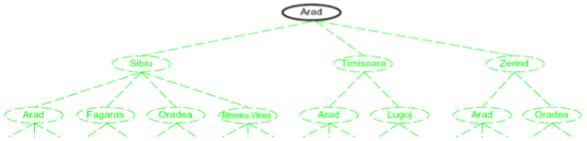
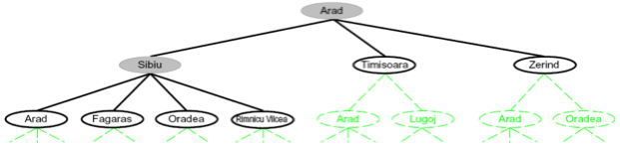
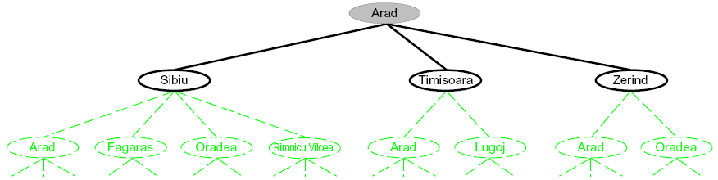
Building Search Trees
Search:
  Expand out possible plans
  Maintain a fringe of unexpanded plans
  Try to expand as few tree nodes as possible

Slide 22
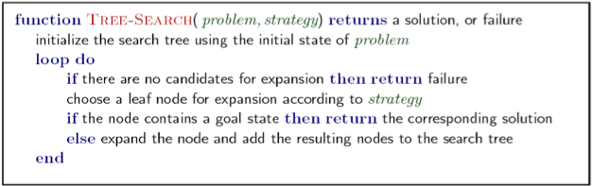
General Tree Search
Important ideas:
  Fringe
  Expansion
  Exploration strategy
Main question: which fringe nodes to explore?
Detailed pseudocode is in the book!

