Slide 1
CSE 473: Artificial Intelligence
Fall 2014
Bayesian Networks - Learning
Dan Weld
Slides adapted from Jack Breese, Dan Klein, Daphne Koller, Stuart Russell, Andrew Moore & Luke Zettlemoyer
1

Slide 2
todo
Must cut coin stuff – way, way to slow
Beta distribution – cut. No need for it given that it ends up with laplacian smoothing
Probably also cut taxonomy of ML
Terrible lecture

Slide 3
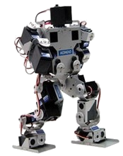
Static vs. Dynamic
Environment
Fully
vs.
Partially
Observable
Deterministic
vs.
Stochastic
What action next?
Perfect
vs.
Noisy
Instantaneous
vs.
Durative
Percepts
Actions

Slide 4
Algorithms
Blind search
Heuristic search
Mini-max & Expectimax
MDPs
Reinforcement learning
State estimation
Variable Elimination
What action next?

Slide 5
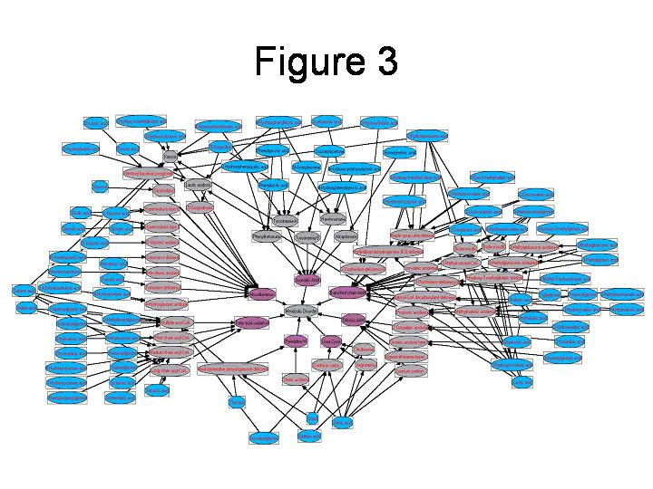
Knowledge Representation
Problem spaces
Constraint networks
HMMs
Bayesian networks
First-order logic
Markov logic networks
…

Slide 6
Example: Alarm Network
Only 10 params
E | P(E)
+e | 0.002
←e | 0.998
B | P(B)
+b | 0.001
←b | 0.999
Burglary
Earthqk
Alarm
B | E | A | P(A|B,E)
+b | +e | +a | 0.95
+b | +e | ←a | 0.05
+b | ←e | +a | 0.94
+b | ←e | ←a | 0.06
←b | +e | +a | 0.29
←b | +e | ←a | 0.71
←b | ←e | +a | 0.001
←b | ←e | ←a | 0.999
John calls
Mary calls
A | J | P(J|A)
+a | +j | 0.9
+a | ←j | 0.1
←a | +j | 0.05
←a | ←j | 0.95
A | M | P(M|A)
+a | +m | 0.7
+a | ←m | 0.3
←a | +m | 0.01
←a | ←m | 0.99

Slide 7
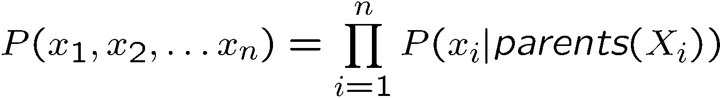
Probabilities in BNs
Bayes’ nets implicitly encode joint distributions
  As a product of local conditional distributions
  To see what probability a BN gives to a full assignment, multiply all the relevant conditionals together:
This lets us reconstruct any entry of the full joint
Not every BN can represent every joint distribution
  The topology enforces certain independence assumptions
  Compare to the exact decomposition according to the chain rule!

Slide 8

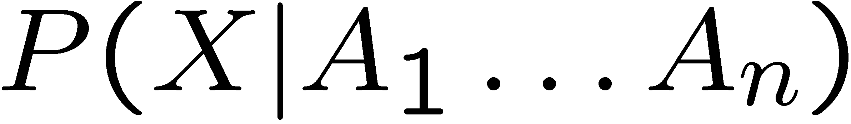
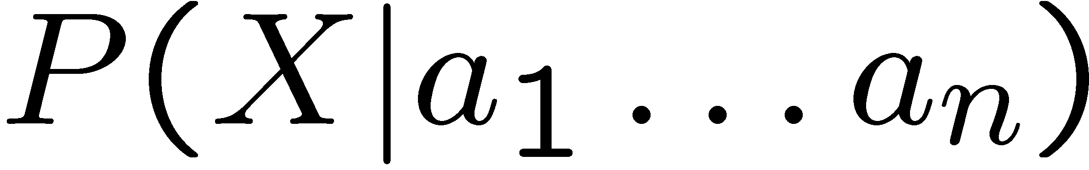
Bayes’ Net Semantics
Formally:
A set of nodes, one per variable X
A directed, acyclic graph
A CPT for each node
  CPT = “Conditional Probability Table”
  Collection of distributions over X, one for each combination of parents’ values
A₁
A_{n}
X
A Bayes net = Topology (graph) + Local Conditional Probabilities

Slide 9
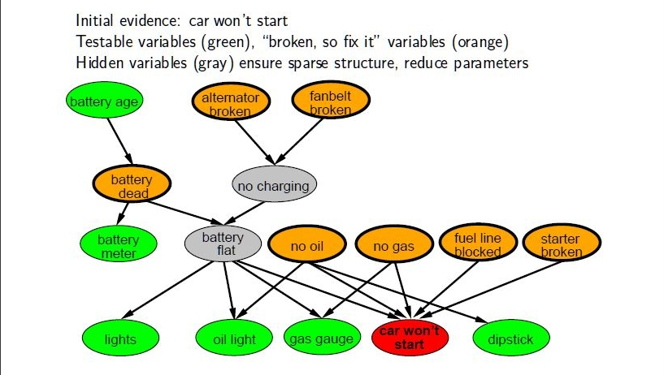
Example: Car Diagnosis

Slide 10
P(B | J=true, M=true)
Earthquake
Burglary
Alarm
JohnCalls
MaryCalls
P(b|j,m) = α Σ P(b,j,m,e,a)
e,a

Slide 11
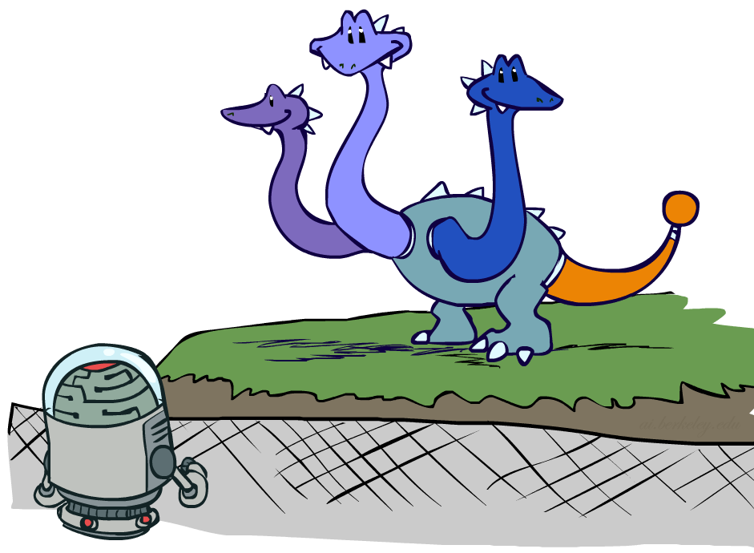
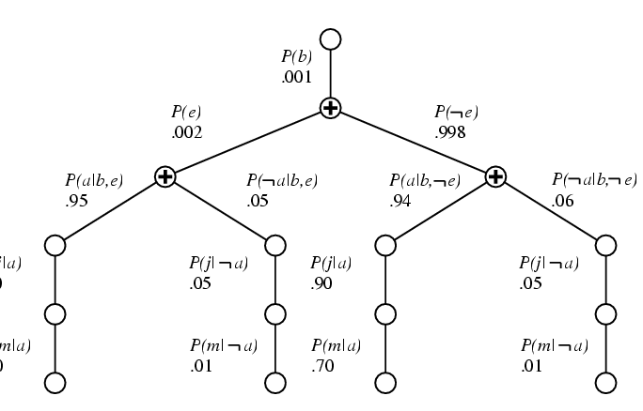

Variable Elimination
P(b|j,m) = αP(b) ΣP(e) ΣP(a|b,e)P(j|a)P(m,a)
e a
© UC Berkeley
Repeated computations ➔ Dynamic Programming

Slide 12
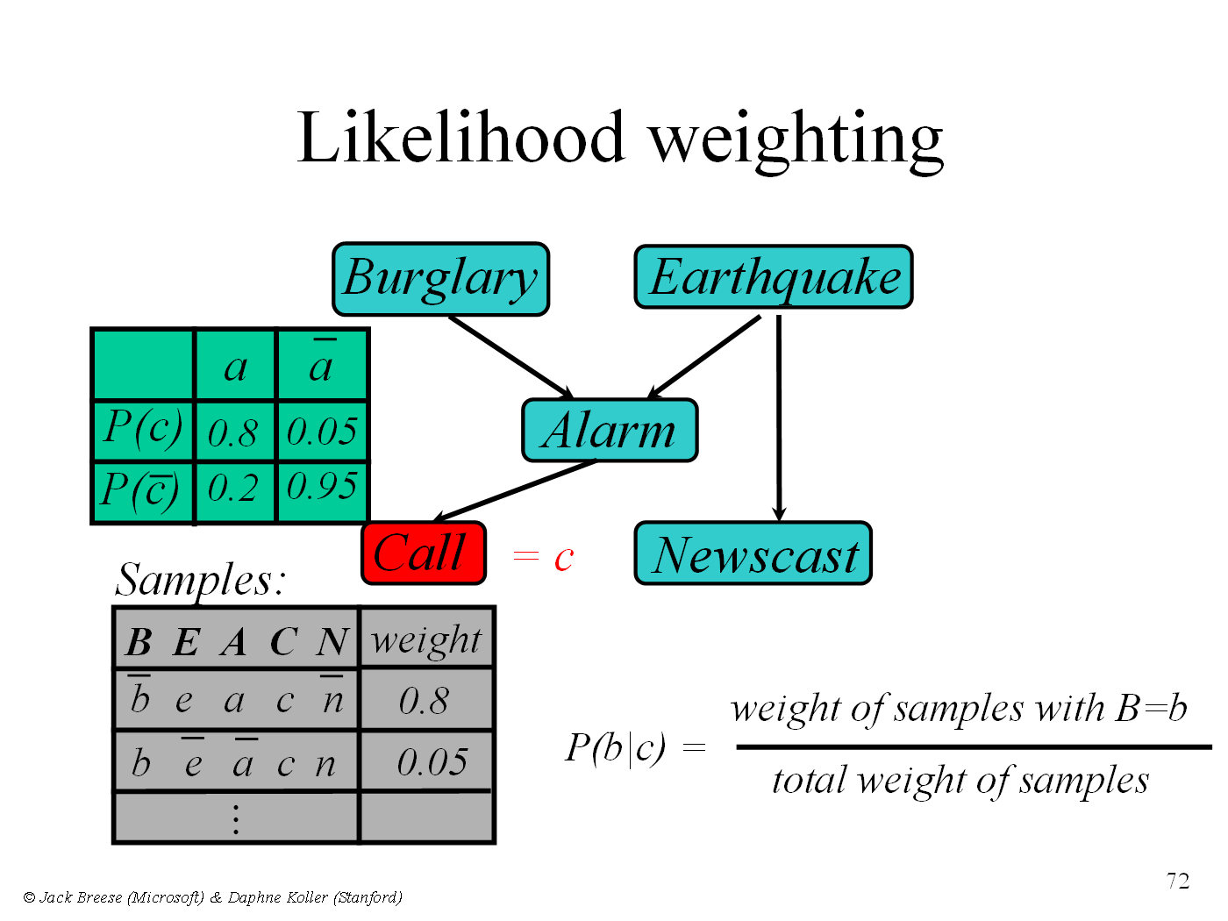
P(B|C)

Slide 13
MCMC with Gibbs Sampling
Fix the values of observed variables
Set the values of all non-observed variables randomly
Perform a random walk through the space of complete variable assignments. On each move:
  Pick a variable X
  Calculate Pr(X=true | Markov blanket)
  Set X to true with that probability
Repeat many times. Frequency with which any variable X is true is it’s posterior probability.
Converges to true posterior when frequencies stop changing significantly
  stable distribution, mixing

Slide 14

Learning
?

Slide 15
What is Machine Learning ?

Slide 16
Machine Learning
Study of algorithms that
improve their performance
at some task
with experience
Machine
Learning
Data
Understanding

Slide 17
Exponential Growth in Data
Machine
Learning
Data
Understanding

Slide 18
Supremacy of Machine Learning
Machine learning is preferred approach to
  Speech recognition, Natural language processing
  Web search – result ranking
  Computer vision
  Medical outcomes analysis
  Robot control
  Computational biology
  Sensor networks
  …
This trend is accelerating
  Improved machine learning algorithms
  Improved data capture, networking, faster computers
  Software too complex to write by hand
  New sensors / IO devices
  Demand for self-customization to user, environment

Slide 19
Space of ML Problems
Type of Supervision
(eg, Experience, Feedback)
 | Labeled Examples | Reward | Nothing
Discrete Function | Classification |  | Clustering
Continuous Function | Regression
Policy | Apprenticeship Learning | Reinforcement Learning
What is Being Learned?

Slide 20
The Origin of Bayes Nets
Pr(B=t) Pr(B=f)
0.05 0.95
Earthquake
Burglary
Pr(A|E,B)
e,b 0.9 (0.1)
e,b 0.2 (0.8)
e,b 0.85 (0.15)
e,b 0.01 (0.99)
Radio
Alarm
Nbr1Calls
Nbr2Calls
© Daniel S. Weld
20

Slide 21
Learning Topics
Learning Parameters for a Bayesian Network
  Fully observable
    Maximum Likelihood (ML)
    Maximum A Posteriori (MAP)
    Bayesian
  Hidden variables (EM algorithm)
Learning Structure of Bayesian Networks

Slide 22
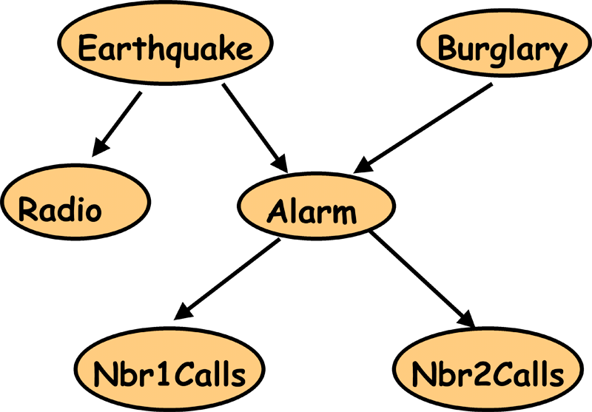
Parameter Estimation and Bayesian Networks
E | B | R | A | J | M
T | F | T | T | F | T
F | F | F | F | F | T
F | T | F | T | T | T
F | F | F | T | T | T
F | T | F | F | F | F
...
We have:
- Bayes Net structure and observations
- We need: Bayes Net parameters

Slide 23
Parameter Estimation and Bayesian Networks
E | B | R | A | J | M
T | F | T | T | F | T
F | F | F | F | F | T
F | T | F | T | T | T
F | F | F | T | T | T
F | T | F | F | F | F
...
P(B) = ?
P(¬B) = 1- P(B)
= 0.4
= 0.6

Slide 24
Parameter Estimation and Bayesian Networks
E | B | R | A | J | M
T | F | T | T | F | T
F | F | F | F | F | T
F | T | F | T | T | T
F | F | F | T | T | T
F | T | F | F | F | F
...
P(A|E,B) = ?
P(A|E,¬B) = ?
P(A|¬E,B) = ?
P(A|¬E,¬B) = ?

Slide 25
Parameter Estimation and Bayesian Networks
E | B | R | A | J | M
T | F | T | T | F | T
F | F | F | F | F | T
F | T | F | T | T | T
F | F | F | T | T | T
F | T | F | F | F | F
...
P(A|E,B) = ?
P(A|E,¬B) = ?
P(A|¬E,B) = ?
P(A|¬E,¬B) = 0.5

Slide 26
Parameter Estimation and Bayesian Networks
Coin

Slide 27

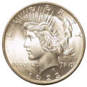
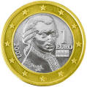
Coin Flip
C₁
C₂
C₃
P(H|C₁) = 0.1
P(H|C₂) = 0.5
P(H|C₃) = 0.9
Which coin will I use?
P(C₁) = 1/3
P(C₂) = 1/3
P(C₃) = 1/3
Prior: Probability of a hypothesis
before we make any observations

Slide 28
Coin Flip
C₁
C₂
C₃
P(H|C₁) = 0.1
P(H|C₂) = 0.5
P(H|C₃) = 0.9
Which coin will I use?
P(C₁) = 1/3
P(C₂) = 1/3
P(C₃) = 1/3
Uniform Prior: All hypothesis are equally likely
before we make any observations

Slide 29

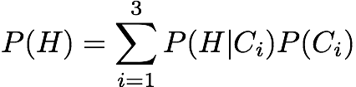
Experiment 1: Heads
Which coin did I use?
P(C₁|H) = ?
P(C₂|H) = ?
P(C₃|H) = ?
C₁
C₂
C₃
P(H|C₁)=0.1
P(H|C₂) = 0.5
P(H|C₃) = 0.9
P(C₁)=1/3
P(C₂) = 1/3
P(C₃) = 1/3

Slide 30
Experiment 1: Heads
Which coin did I use?
P(C₁|H) = 0.066
P(C₂|H) = 0.333
P(C₃|H) = 0.6
Posterior: Probability of a hypothesis given data
C₁
C₂
C₃
P(H|C₁) = 0.1
P(H|C₂) = 0.5
P(H|C₃) = 0.9
P(C₁) = 1/3
P(C₂) = 1/3
P(C₃) = 1/3

Slide 31
Terminology
Prior:
  Probability of a hypothesis before we see any data
Uniform Prior:
  A prior that makes all hypothesis equally likely
Posterior:
  Probability of a hypothesis after we saw some data
Likelihood:
  Probability of data given hypothesis

Slide 32
Experiment 2: Tails
Now, Which coin did I use?
P(C₁|HT) = ?
P(C₂|HT) = ?
P(C₃|HT) = ?
C₁
C₂
C₃
P(H|C₁) = 0.1
P(H|C₂) = 0.5
P(H|C₃) = 0.9
P(C₁) = 1/3
P(C₂) = 1/3
P(C₃) = 1/3

Slide 33
Experiment 2: Tails
Now, Which coin did I use?
P(C₁|HT) = 0.21
P(C₂|HT) = 0.58
P(C₃|HT) = 0.21
C₁
C₂
C₃
P(H|C₁) = 0.1
P(H|C₂) = 0.5
P(H|C₃) = 0.9
P(C₁) = 1/3
P(C₂) = 1/3
P(C₃) = 1/3

Slide 34
Experiment 2: Tails
Which coin did I use?
P(C₁|HT) = 0.21
P(C₂|HT) = 0.58
P(C₃|HT) = 0.21
C₁
C₂
C₃
P(H|C₁) = 0.1
P(H|C₂) = 0.5
P(H|C₃) = 0.9
P(C₁) = 1/3
P(C₂) = 1/3
P(C₃) = 1/3

Slide 35
Your Estimate?
What is the probability of heads after two experiments?
Most likely coin:
Best estimate for P(H)
C₂
P(H|C₂) = 0.5
C₁
C₂
C₃
P(H|C₁) = 0.1
P(H|C₂) = 0.5
P(H|C₃) = 0.9
P(C₁) = 1/3
P(C₂) = 1/3
P(C₃) = 1/3

Slide 36
Your Estimate?
Maximum Likelihood Estimate: The best hypothesis
that fits observed data assuming uniform prior
Most likely coin:
Best estimate for P(H)
C₂
P(H|C₂) = 0.5
C₂
P(H|C₂) = 0.5
P(C₂) = 1/3

Slide 37
Using Prior Knowledge
Should we always use a Uniform Prior ?
Background knowledge:
  Heads => we have to buy Dan chocolate
  Dan likes chocolate…
  => Dan is more likely to use a coin biased in his favor
C₁
C₂
C₃
P(H|C₁) = 0.1
P(H|C₂) = 0.5
P(H|C₃) = 0.9

Slide 38
Using Prior Knowledge
We can encode it in the prior:
P(C₁) = 0.05
P(C₂) = 0.25
P(C₃) = 0.70
C₁
C₂
C₃
P(H|C₁) = 0.1
P(H|C₂) = 0.5
P(H|C₃) = 0.9

Slide 39
Experiment 1: Heads
Which coin did I use?
P(C₁|H) = ?
P(C₂|H) = ?
P(C₃|H) = ?
C₁
C₂
C₃
P(H|C₁) = 0.1
P(H|C₂) = 0.5
P(H|C₃) = 0.9
P(C₁) = 0.05
P(C₂) = 0.25
P(C₃) = 0.70

Slide 40
Experiment 1: Heads
Which coin did I use?
P(C₁|H) = 0.006
P(C₂|H) = 0.165
P(C₃|H) = 0.829
Compare with ML posterior after Exp 1:
P(C₁|H) = 0.066
P(C₂|H) = 0.333
P(C₃|H) = 0.600
C₁
C₂
C₃
P(H|C₁) = 0.1
P(H|C₂) = 0.5
P(H|C₃) = 0.9
P(C₁) = 0.05
P(C₂) = 0.25
P(C₃) = 0.70

Slide 41
Experiment 2: Tails
Which coin did I use?
P(C₁|HT) = ?
P(C₂|HT) = ?
P(C₃|HT) = ?
C₁
C₂
C₃
P(H|C₁) = 0.1
P(H|C₂) = 0.5
P(H|C₃) = 0.9
P(C₁) = 0.05
P(C₂) = 0.25
P(C₃) = 0.70

Slide 42
Experiment 2: Tails
Which coin did I use?
P(C₁|HT) = 0.035
P(C₂|HT) = 0.481
P(C₃|HT) = 0.485
C₁
C₂
C₃
P(H|C₁) = 0.1
P(H|C₂) = 0.5
P(H|C₃) = 0.9
P(C₁) = 0.05
P(C₂) = 0.25
P(C₃) = 0.70

Slide 43
Experiment 2: Tails
Which coin did I use?
P(C₁|HT) = 0.035
P(C₂|HT)=0.481
P(C₃|HT) = 0.485
C₁
C₂
C₃
P(H|C₁) = 0.1
P(H|C₂) = 0.5
P(H|C₃) = 0.9
P(C₁) = 0.05
P(C₂) = 0.25
P(C₃) = 0.70

Slide 44
Your Estimate?
What is the probability of heads after two experiments?
Most likely coin:
Best estimate for P(H)
C₃
P(H|C₃) = 0.9
C₁
C₂
C₃
P(H|C₁) = 0.1
P(H|C₂) = 0.5
P(H|C₃) = 0.9
P(C₁) = 0.05
P(C₂) = 0.25
P(C₃) = 0.70

Slide 45
Your Estimate?
Maximum A Posteriori (MAP) Estimate:
The best hypothesis that fits observed data
assuming a non-uniform prior
Most likely coin:
Best estimate for P(H)
C₃
P(H|C₃) = 0.9
C₃
P(H|C₃) = 0.9
P(C₃) = 0.70

Slide 46
Did We Do The Right Thing?
P(C₁|HT)=0.035
P(C₂|HT)=0.481
P(C₃|HT)=0.485
C₁
C₂
C₃
P(H|C₁) = 0.1
P(H|C₂) = 0.5
P(H|C₃) = 0.9

Slide 47

Did We Do The Right Thing?
P(C₁|HT) =0.035
P(C₂|HT)=0.481
P(C₃|HT)=0.485
C₂ and C₃ are almost
equally likely
C₁
C₂
C₃
P(H|C₁) = 0.1
P(H|C₂) = 0.5
P(H|C₃) = 0.9

Slide 48
A Better Estimate
Recall:
= 0.680
P(C₁|HT)=0.035
P(C₂|HT)=0.481
P(C₃|HT)=0.485
C₁
C₂
C₃
P(H|C₁) = 0.1
P(H|C₂) = 0.5
P(H|C₃) = 0.9

Slide 49
Bayesian Estimate
Bayesian Estimate: Minimizes prediction error,
given data assuming an arbitrary prior
= 0.680
P(C₁|HT)=0.035
P(C₂|HT)=0.481
P(C₃|HT)=0.485
C₁
C₂
C₃
P(H|C₁) = 0.1
P(H|C₂) = 0.5
P(H|C₃) = 0.9

Slide 50
Comparison
After more experiments: HTHHHHHHHHH
ML (Maximum Likelihood):
P(H) = 0.5
after 10 experiments: P(H) = 0.9
MAP (Maximum A Posteriori):
P(H) = 0.9
after 10 experiments: P(H) = 0.9
Bayesian:
P(H) = 0.68
after 10 experiments: P(H) = 0.9

Slide 51
Summary
Easy to compute
 | Prior | Hypothesis
Maximum Likelihood Estimate
Maximum A Posteriori Estimate
Bayesian Estimate
Uniform | The most likely
Any | The most likely
Any | Weighted combination
Still easy to compute
Incorporates prior knowledge
Minimizes error
Great when data is scarce
Potentially much harder to compute

Slide 52
Bayesian Learning
Prior
Data Likelihood
Use Bayes rule:
P(Y | X) = P(X |Y) P(Y)
P(X)
Posterior
Normalization
Or equivalently: P(Y | X) ∝ P(X | Y) P(Y)

Slide 53
Parameter Estimation and Bayesian Networks
E | B | R | A | J | M
T | F | T | T | F | T
F | F | F | F | F | T
F | T | F | T | T | T
F | F | F | T | T | T
F | T | F | F | F | F
...
Prior
Now compute
either MAP or
Bayesian estimate
P(B) = ?
+ data =

Slide 54
What Prior to Use?
Prev, you knew: it was one of only three coins
  Now more complicated…
The following are two common priors
Binary variable Beta
  Posterior distribution is binomial
  Easy to compute posterior
Discrete variable Dirichlet
  Posterior distribution is multinomial
  Easy to compute posterior

Slide 55
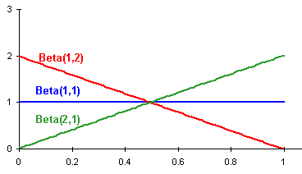
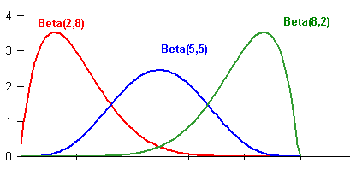
Beta Distribution

Slide 56
Beta Distribution
Example: Flip coin with Beta distribution as prior over p [prob(heads)]
  Parameterized by two positive numbers: a, b
  Mode of distribution (E[p]) is a/(a+b)
  Specify our prior belief for p = a/(a+b)
  Specify confidence in this belief with high initial values for a and b
Updating our prior belief based on data
  incrementing a for every heads outcome
  incrementing b for every tails outcome
So after h heads out of n flips, our posterior distribution says P(head)=(a+h)/(a+b+n)

Slide 57

One Prior: Beta Distribution
a,b
For any positive integer y, Γ(y) = (y-1)!

Slide 58
Parameter Estimation and Bayesian Networks
E | B | R | A | J | M
T | F | T | T | F | T
F | F | F | F | F | T
F | T | F | T | T | T
F | F | F | T | T | T
F | T | F | F | F | F
...
Prior
B
¬B
P(B|data) = ?
Beta(1,4)
“+ data” =
(3,7)
.3
.7
Prior P(B)= 1/(1+4) = 20% with equivalent sample size 5

Slide 59
Parameter Estimation and Bayesian Networks
E | B | R | A | J | M
T | F | T | T | F | T
F | F | F | F | F | T
F | T | F | T | T | T
F | F | F | T | T | T
F | T | F | F | F | F
...
P(A|E,B) = ?
P(A|E,¬B) = ?
P(A|¬E,B) = ?
P(A|¬E,¬B) = ?

Slide 60
Parameter Estimation and Bayesian Networks
E | B | R | A | J | M
T | F | T | T | F | T
F | F | F | F | F | T
F | T | F | T | T | T
F | F | F | T | T | T
F | T | F | F | F | F
...
P(A|E,B) = ?
P(A|E,¬B) = ?
P(A|¬E,B) = ?
P(A|¬E,¬B) = ?
Prior
Beta(2,3)

Slide 61
Parameter Estimation and Bayesian Networks
E | B | R | A | J | M
T | F | T | T | F | T
F | F | F | F | F | T
F | T | F | T | T | T
F | F | F | T | T | T
F | T | F | F | F | F
...
P(A|E,B) = ?
P(A|E,¬B) = ?
P(A|¬E,B) = ?
P(A|¬E,¬B) = ?
Prior
Beta(2,3)
+ data=
(3,4)

Slide 62
Bayesian Learning
Prior
Data Likelihood
Use Bayes rule:
P(Y | X) = P(X |Y) P(Y)
P(X)
Posterior
Normalization
Or equivalently: P(Y | X) ∝ P(X | Y) P(Y)

Slide 63

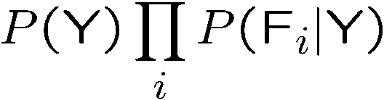
Naïve Bayes
Y
Class
Value
…
F 1
F 2
F 3
F _{N}
Assume that features are conditionally independent given class variable
Works well in practice
But forces probabilities towards 0 and 1

Slide 64

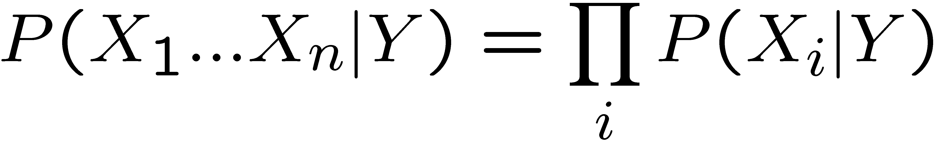
Naïve Bayes
Naïve Bayes assumption:
  Features are independent given class:
  More generally:
How many parameters now?
    Suppose X is composed of n binary features

Slide 65
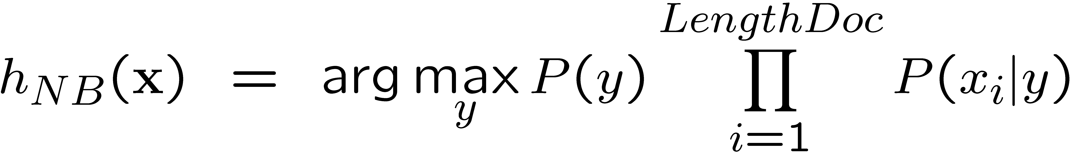
NB with Bag of Words for text classification
Learning phase:
  Prior P(Y)
    Count how many documents from each topic (prior)
  P(X_{i}|Y)
    For each of m topics, count how many times you saw word X_{i} in documents of this topic (+ k for prior)
    Divide by number of times you saw the word (+ k×m)
Test phase:
  For each document
    Use naïve Bayes decision rule

Slide 66
Probabilities: Important Detail!
P(spam | X₁ … X_{n}) = Π P(spam | X_{i})
i
Any more potential problems here?
We are multiplying lots of small numbers Danger of underflow!
  0.5⁵⁷ = 7 E -18
Solution? Use logs and add!
  p₁ * p₂ = e ^{log(p1)+log(p2)}
  Always keep in log form

Slide 67
What if we don’t know structure?

Slide 68
Learning The Structure of Bayesian Networks
Search thru the space…
  of possible network structures!
  (for now, assume we observe all variables)
For each structure, learn parameters
Pick the one that fits observed data best
  Caveat – won’t we end up fully connected????
Problem !?!?
When scoring, add a penalty
  ∝ model complexity

Slide 69
Learning The Structure of Bayesian Networks
Search thru the space
For each structure, learn parameters
Pick the one that fits observed data best
  Penalize complex models
Problem?
  Exponential number of networks!
  And we need to learn parameters for each!
  Exhaustive search out of the question!
So what now?

Slide 70
Structure Learning as Search
Local Search
  Start with some network structure
  Try to make a change
  (add or delete or reverse edge)
  See if the new network is any better
What should the initial state be?
  Uniform prior over random networks?
  Based on prior knowledge?
  Empty network?
How do we evaluate networks?

Slide 71
A
A
B
C
B
C
D
E
A
D
E
A
B
B
C
C
A
E
D
E
D
B
C
D
E

Slide 72
Score Functions
Bayesian Information Criteion (BIC)
  P(D | BN) – penalty
  Penalty = ½ (# parameters) Log (# data points)
MAP score
  P(BN | D) = P(D | BN) P(BN)
  P(BN) must decay exponentially with # of parameters for this to work well

Slide 74
Important Concepts
Data: labeled instances, e.g. emails marked spam/ham
  Training set
  Held out set
  Test set
Features: attribute-value pairs which characterize each x
Experimentation cycle
  Learn parameters (e.g. model probabilities) on training set
  (Tune hyperparameters on held-out set)
  Very important: never “peek” at the test set!
Evaluation
  Compute accuracy of test set
  Accuracy: fraction of instances predicted correctly
Overfitting and generalization
  Want a classifier which does well on test data
  Overfitting: fitting the training data very closely, but not generalizing well
Training
Data
Held-Out
Data
Test
Data

Slide 75
Bayes Nets for Classification
One method of classification:
  Use a probabilistic model!
  Features are observed random variables F_{i}
  Y is the query variable
  Use probabilistic inference to compute most likely Y
You already know how to do this inference

Slide 76




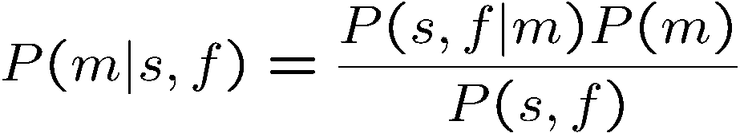
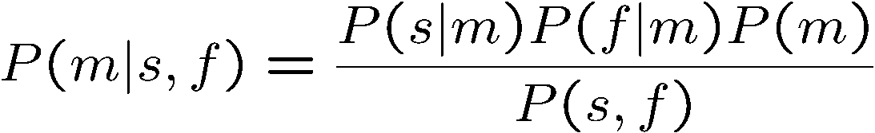
Simple Classification
M
Simple example: two binary features
S
F
direct estimate
Bayes estimate (no assumptions)
Conditional independence
+

Slide 77
Naïve Bayes
Y
Class
Value
…
F 1
F 2
F 3
F _{N}
Assume that features are conditionally independent given class variable
Works well in practice
But forces probabilities towards 0 and 1

Slide 78
General Naïve Bayes
What do we need in order to use naïve Bayes?
  Inference (you know this part)
    Start with a bunch of conditionals, P(Y) and the P(F_{i}|Y) tables
    Use standard inference to compute P(Y|F₁…F_{n})
    Nothing new here
  Estimates of local conditional probability tables
    P(Y), the prior over labels
    P(F_{i}|Y) for each feature (evidence variable)
    These probabilities are collectively called the parameters of the model and denoted by θ
    Up until now, we assumed these appeared by magic, but…
    …they typically come from training data: we’ll look at this now

Slide 79






A Digit Recognizer
Input: pixel grids
Output: a digit 0-9

Slide 80


Naïve Bayes for Digits
Simple version:
  One feature F_{ij} for each grid position <i,j>
  Possible feature values are on / off, based on whether intensity is more or less than 0.5 in underlying image
  Each input maps to a feature vector, e.g.
  Here: lots of features, each is binary valued
Naïve Bayes model:
What do we need to learn?

Slide 81



Examples: CPTs
1 | 0.1
2 | 0.1
3 | 0.1
4 | 0.1
5 | 0.1
6 | 0.1
7 | 0.1
8 | 0.1
9 | 0.1
0 | 0.1
1 | 0.01
2 | 0.05
3 | 0.05
4 | 0.30
5 | 0.80
6 | 0.90
7 | 0.05
8 | 0.60
9 | 0.50
0 | 0.80
1 | 0.05
2 | 0.01
3 | 0.90
4 | 0.80
5 | 0.90
6 | 0.90
7 | 0.25
8 | 0.85
9 | 0.60
0 | 0.80

Slide 82
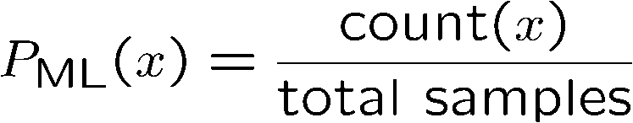

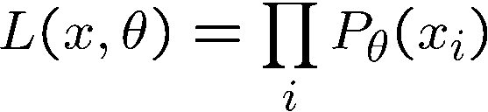
Parameter Estimation
Estimating distribution of random variables like X or X | Y
Elicitation: ask a human!
  Usually need domain experts, and sophisticated ways of eliciting probabilities (e.g. betting games)
  Trouble calibrating
Empirically: use training data
  For each outcome x, look at the empirical rate of that value:
  This is the estimate that maximizes the likelihood of the data
r
g
g

Slide 83
A Spam Filter
Naïve Bayes spam filter
Data:
  Collection of emails, labeled spam or ham
  Note: someone has to hand label all this data!
  Split into training, held-out, test sets
Classifiers
  Learn on the training set
  (Tune it on a held-out set)
  Test it on new emails
Dear Sir.
First, I must solicit your confidence in this transaction, this is by virture of its nature as being utterly confidencial and top secret. …
TO BE REMOVED FROM FUTURE MAILINGS, SIMPLY REPLY TO THIS MESSAGE AND PUT "REMOVE" IN THE SUBJECT.
99 MILLION EMAIL ADDRESSES
FOR ONLY $99
Ok, Iknow this is blatantly OT but I'm beginning to go insane. Had an old Dell Dimension XPS sitting in the corner and decided to put it to use, I know it was working pre being stuck in the corner, but when I plugged it in, hit the power nothing happened.

Slide 84
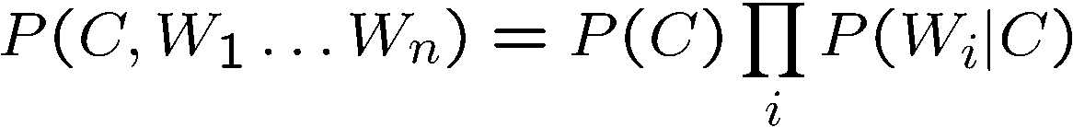
Naïve Bayes for Text
Bag-of-Words Naïve Bayes:
  Predict unknown class label (spam vs. ham)
  Assume evidence features (e.g. the words) are independent
  Warning: subtly different assumptions than before!
Generative model
Tied distributions and bag-of-words
  Usually, each variable gets its own conditional probability distribution P(F|Y)
  In a bag-of-words model
    Each position is identically distributed
    All positions share the same conditional probs P(W|C)
    Why make this assumption?
Word at position i, not i^{th} word in the dictionary!

Slide 85




Example: Spam Filtering
Model:
What are the parameters?
ham : 0.66
spam: 0.33
the : 0.0156
to : 0.0153
and : 0.0115
of : 0.0095
you : 0.0093
a : 0.0086
with: 0.0080
from: 0.0075
...
the : 0.0210
to : 0.0133
of : 0.0119
2002: 0.0110
with: 0.0108
from: 0.0107
and : 0.0105
a : 0.0100
...
Where do these come from?

Slide 86
Spam Example
Word | P(w|spam) | P(w|ham) | Tot Spam | Tot Ham
(prior) | 0.33333 | 0.66666 | -1.1 | -0.4
Gary | 0.00002 | 0.00021 | -11.8 | -8.9
would | 0.00069 | 0.00084 | -19.1 | -16.0
you | 0.00881 | 0.00304 | -23.8 | -21.8
like | 0.00086 | 0.00083 | -30.9 | -28.9
to | 0.01517 | 0.01339 | -35.1 | -33.2
lose | 0.00008 | 0.00002 | -44.5 | -44.0
weight | 0.00016 | 0.00002 | -53.3 | -55.0
while | 0.00027 | 0.00027 | -61.5 | -63.2
you | 0.00881 | 0.00304 | -66.2 | -69.0
sleep | 0.00006 | 0.00001 | -76.0 | -80.5
P(spam | w) = 98.9

Slide 87












Example: Overfitting
2 wins!!

Slide 88
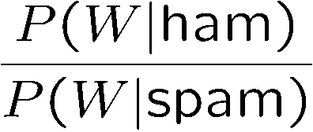
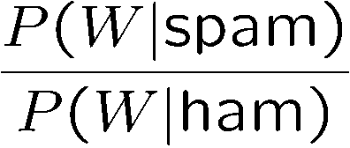
Example: Overfitting
Posteriors determined by relative probabilities (odds ratios):
south-west : inf
nation : inf
morally : inf
nicely : inf
extent : inf
seriously : inf
...
screens : inf
minute : inf
guaranteed : inf
$205.00 : inf
delivery : inf
signature : inf
...
What went wrong here?

Slide 89
Generalization and Overfitting
Relative frequency parameters will overfit the training data!
  Just because we never saw a 3 with pixel (15,15) on during training doesn’t mean we won’t see it at test time
  Unlikely that every occurrence of “minute” is 100% spam
  Unlikely that every occurrence of “seriously” is 100% ham
  What about all the words that don’t occur in the training set at all?
  In general, we can’t go around giving unseen events zero probability
As an extreme case, imagine using the entire email as the only feature
  Would get the training data perfect (if deterministic labeling)
  Wouldn’t generalize at all
  Just making the bag-of-words assumption gives us some generalization, but isn’t enough
To generalize better: we need to smooth or regularize the estimates

Slide 90
Estimation: Smoothing
Problems with maximum likelihood estimates:
  If I flip a coin once, and it’s heads, what’s the estimate for P(heads)?
  What if I flip 10 times with 8 heads?
  What if I flip 10M times with 8M heads?
Basic idea:
  We have some prior expectation about parameters (here, the probability of heads)
  Given little evidence, we should skew towards our prior
  Given a lot of evidence, we should listen to the data

Slide 91
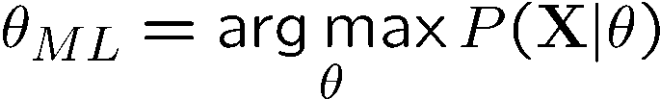
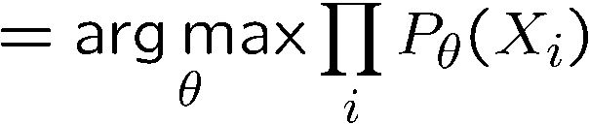
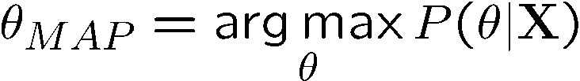
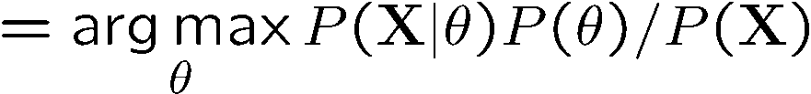
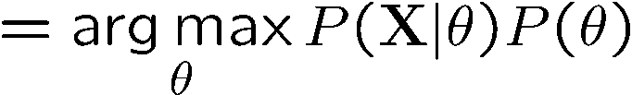
Estimation: Smoothing
Relative frequencies are the maximum likelihood estimates
In Bayesian statistics, we think of the parameters as just another random variable, with its own distribution
????

Slide 92
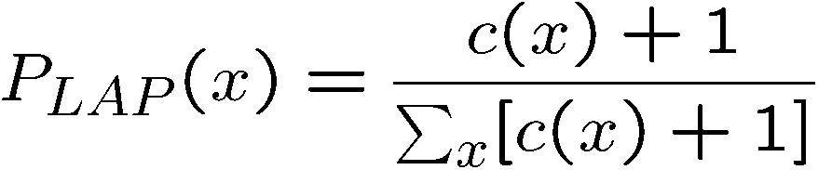
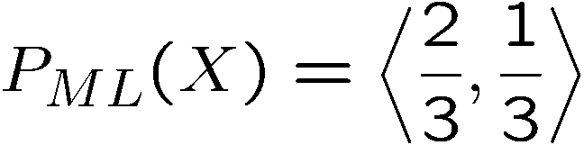
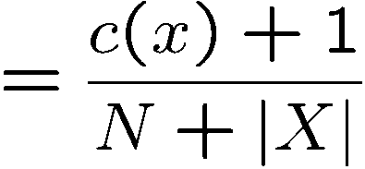
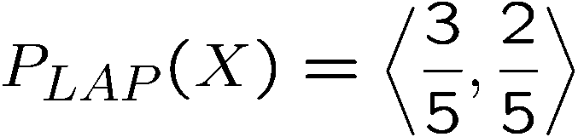
Estimation: Laplace Smoothing
Laplace’s estimate:
  Pretend you saw every outcome once more than you actually did
  Can derive this as a MAP estimate with Dirichlet priors (Bayesian justfication)
H
H
T

Slide 93
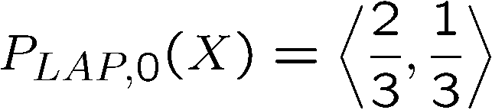
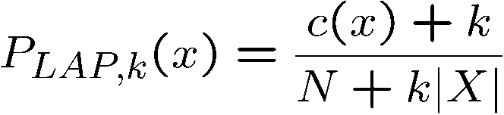
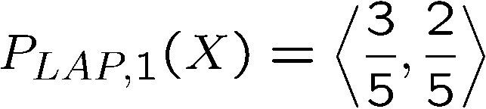
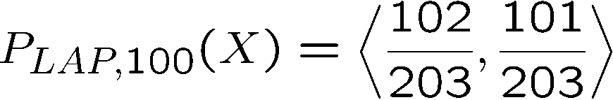
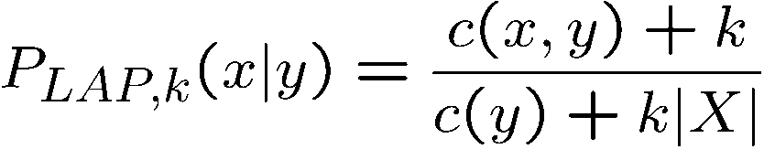
Estimation: Laplace Smoothing
Laplace’s estimate (extended):
  Pretend you saw every outcome k extra times
  What’s Laplace with k = 0?
  k is the strength of the prior
H
H
T
Laplace for conditionals:
  Smooth each condition independently:

Slide 94
Estimation: Linear Interpolation
In practice, Laplace often performs poorly for P(X|Y):
  When |X| is very large
  When |Y| is very large
Another option: linear interpolation
  Also get P(X) from the data
  Make sure the estimate of P(X|Y) isn’t too different from P(X)
  What if α is 0? 1?

Slide 95
Real NB: Smoothing
For real classification problems, smoothing is critical
New odds ratios:
helvetica : 11.4
seems : 10.8
group : 10.2
ago : 8.4
areas : 8.3
...
verdana : 28.8
Credit : 28.4
ORDER : 27.2
<FONT> : 26.9
money : 26.5
...
Do these make more sense?

Slide 96





Tuning on Held-Out Data
Now we’ve got two kinds of unknowns
  Parameters: the probabilities P(Y|X), P(Y)
  Hyperparameters, like the amount of smoothing to do: k, α
Where to learn?
  Learn parameters from training data
  Must tune hyperparameters on different data
    Why?
  For each value of the hyperparameters, train and test on the held-out data
  Choose the best value and do a final test on the test data

Slide 97
Baselines
First step: get a baseline
  Baselines are very simple “straw man” procedures
  Help determine how hard the task is
  Help know what a “good” accuracy is
Weak baseline: most frequent label classifier
  Gives all test instances whatever label was most common in the training set
  E.g. for spam filtering, might label everything as ham
  Accuracy might be very high if the problem is skewed
  E.g. calling everything “ham” gets 66%, so a classifier that gets 70% isn’t very good…
For real research, usually use previous work as a (strong) baseline

Slide 98


Confidences from a Classifier
The confidence of a probabilistic classifier:
  Posterior over the top label
  Represents how sure the classifier is of the classification
  Any probabilistic model will have confidences
  No guarantee confidence is correct
Calibration
  Weak calibration: higher confidences mean higher accuracy
  Strong calibration: confidence predicts accuracy rate
  What’s the value of calibration?

Slide 99
Precision vs. Recall
Let’s say we want to classify web pages as
homepages or not
  In a test set of 1K pages, there are 3 homepages
  Our classifier says they are all non-homepages
  99.7 accuracy!
  Need new measures for rare positive events
Precision: fraction of guessed positives which were actually positive
Recall: fraction of actual positives which were guessed as positive
Say we detect 5 spam emails, of which 2 were actually spam, and we missed one
  Precision: 2 correct / 5 guessed = 0.4
  Recall: 2 correct / 3 true = 0.67
Which is more important in customer support email automation?
Which is more important in airport face recognition?
-
actual +
guessed +

Slide 100



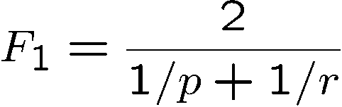
Precision vs. Recall
Precision/recall tradeoff
  Often, you can trade off precision and recall
  Only works well with weakly calibrated classifiers
To summarize the tradeoff:
  Break-even point: precision value when p = r
  F-measure: harmonic mean of p and r:

Slide 101
Errors, and What to Do
Examples of errors
Dear GlobalSCAPE Customer,
GlobalSCAPE has partnered with ScanSoft to offer you the latest version of OmniPage Pro, for just $99.99* - the regular list price is $499! The most common question we've received about this offer is - Is this genuine? We would like to assure you that this offer is authorized by ScanSoft, is genuine and valid. You can get the . . .
. . . To receive your $30 Amazon.com promotional certificate, click through to
http://www.amazon.com/apparel
and see the prominent link for the $30 offer. All details are there. We hope you enjoyed receiving this message. However, if you'd rather not receive future e-mails announcing new store launches, please click . . .

Slide 102
What to Do About Errors?
Need more features– words aren’t enough!
  Have you emailed the sender before?
  Have 1K other people just gotten the same email?
  Is the sending information consistent?
  Is the email in ALL CAPS?
  Do inline URLs point where they say they point?
  Does the email address you by (your) name?
Can add these information sources as new variables in the NB model
Next class we’ll talk about classifiers which let you easily add arbitrary features more easily

Slide 103
Summary
Bayes rule lets us do diagnostic queries with causal probabilities
The naïve Bayes assumption takes all features to be independent given the class label
We can build classifiers out of a naïve Bayes model using training data
Smoothing estimates is important in real systems
Classifier confidences are useful, when you can get them

Slide 104
Errors, and What to Do
Examples of errors
Dear GlobalSCAPE Customer,
GlobalSCAPE has partnered with ScanSoft to offer you the latest version of OmniPage Pro, for just $99.99* - the regular list price is $499! The most common question we've received about this offer is - Is this genuine? We would like to assure you that this offer is authorized by ScanSoft, is genuine and valid. You can get the . . .
. . . To receive your $30 Amazon.com promotional certificate, click through to
http://www.amazon.com/apparel
and see the prominent link for the $30 offer. All details are there. We hope you enjoyed receiving this message. However, if you'd rather not receive future e-mails announcing new store launches, please click . . .

Slide 105
What to Do About Errors?
Need more features– words aren’t enough!
  Have you emailed the sender before?
  Have 1K other people just gotten the same email?
  Is the sending information consistent?
  Is the email in ALL CAPS?
  Do inline URLs point where they say they point?
  Does the email address you by (your) name?
Can add these information sources as new variables in the NB model
Next class we’ll talk about classifiers which let you easily add arbitrary features more easily

Slide 106
Summary
Bayes rule lets us do diagnostic queries with causal probabilities
The naïve Bayes assumption takes all features to be independent given the class label
We can build classifiers out of a naïve Bayes model using training data
Smoothing estimates is important in real systems
Classifier confidences are useful, when you can get them

