Slide 1
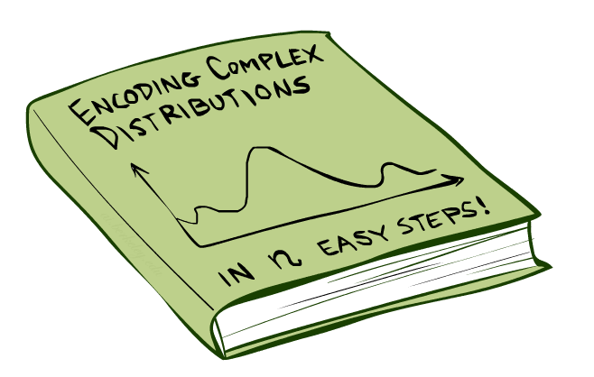
CSE 473: Artificial Intelligence
Bayes’ Nets
Daniel Weld
[Most slides were created by Dan Klein and Pieter Abbeel for CS188 Intro to AI at UC Berkeley. All CS188 materials are available at http://ai.berkeley.edu.]
Notes:
Please retain proper attribution, including the reference to ai.berkeley.edu. Thanks!

Slide 2


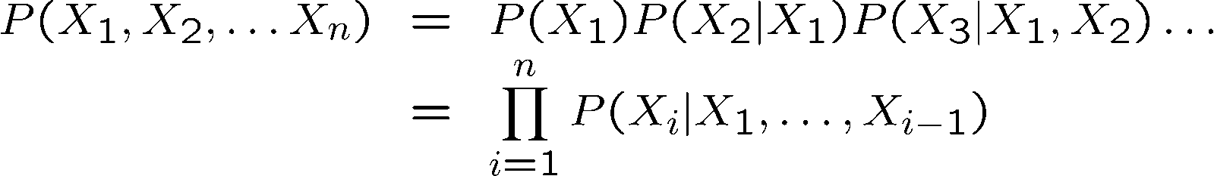
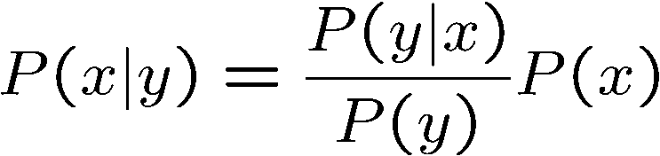

Probability Recap
Conditional probability
Product rule
Chain rule
Bayes rule
X, Y independent if and only if:
X and Y are conditionally independent given Z: if and only if:

Slide 3

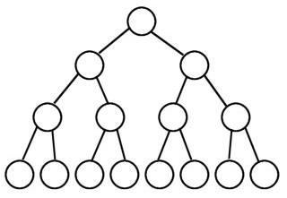
Joint Distribution for Snapshot of World
It gets big…
P
T
F
Q
T
F
T
F
R
T
F
T
F
T
F
T
F
http://img4.wikia.nocookie.net/__cb20090430175407/monster/images/9/92/Basilisk.jpg
0.1
0.05
0.2
0.07
0.03
0.05
0.1
0.3

Slide 4

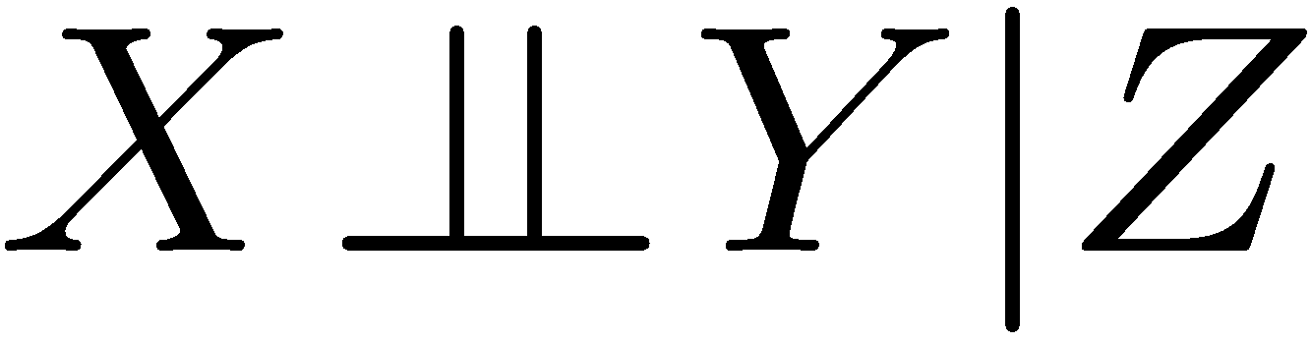
The Sword of Conditional Independence!
I am a BIG joint distribution!
Slay
the
Basilisk!
harrypotter.wikia.com/
Means:
Or, equivalently:

Slide 5
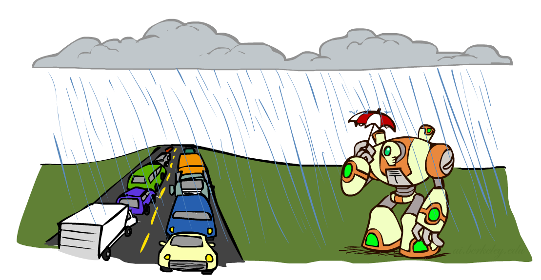
Conditional Independence and the Chain Rule
Chain rule:
Trivial decomposition:
With assumption of conditional independence:
Bayes’nets / graphical models help us express conditional independence assumptions

Slide 6
Bayes’Nets: Big Picture

Slide 7


Bayes’ Nets: Big Picture
Two problems with using full joint distribution tables as our probabilistic models:
  Unless there are only a few variables, the joint is WAY too big to represent explicitly
  Hard to learn (estimate) anything empirically about more than a few variables at a time
Bayes’ nets: a technique for describing complex joint distributions (models) using simple, local distributions (conditional probabilities)
  More properly called graphical models
  We describe how variables locally interact
  Local interactions chain together to give global, indirect interactions
  For about 10 min, we’ll be vague about how these interactions are specified

Slide 8
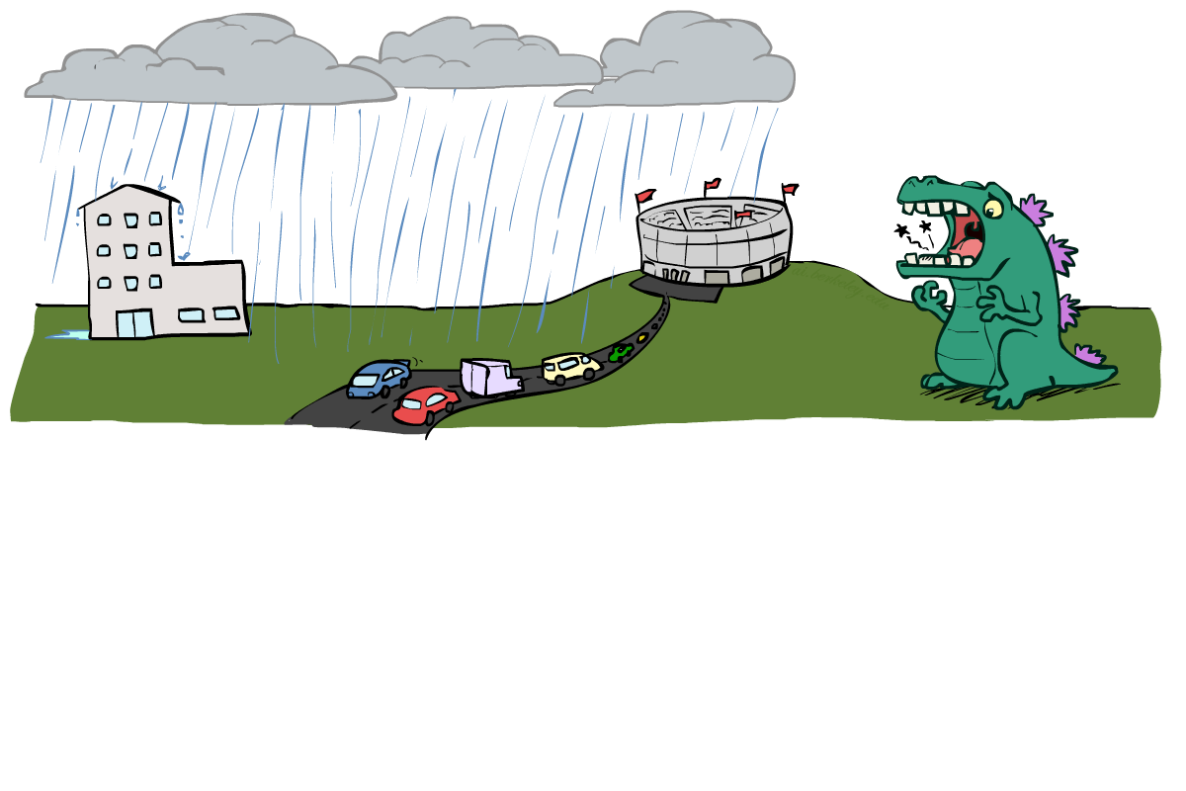
Example: Traffic II
Let’s build a causal graphical model!
Variables
  T: Traffic
  R: It rains
  L: Low pressure
  D: Roof drips
  B: Ballgame
  C: Cavity
L
B
R
C
D
T

Slide 9
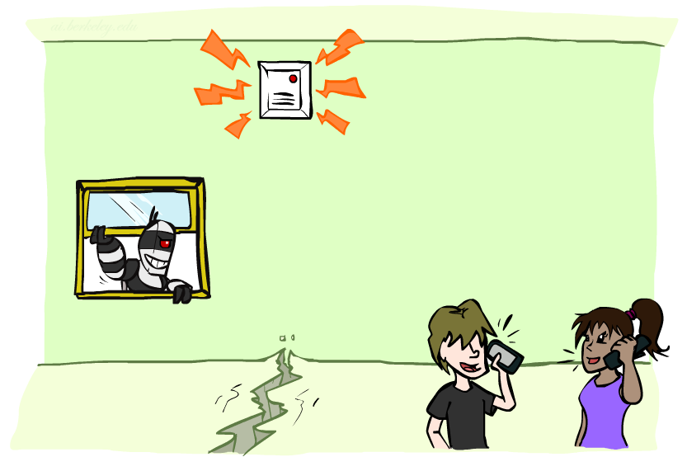
Example: Alarm Network
Variables
  B: Burglary
  A: Alarm goes off
  M: Mary calls
  J: John calls
  E: Earthquake!
B
E
A
M
J

Slide 10
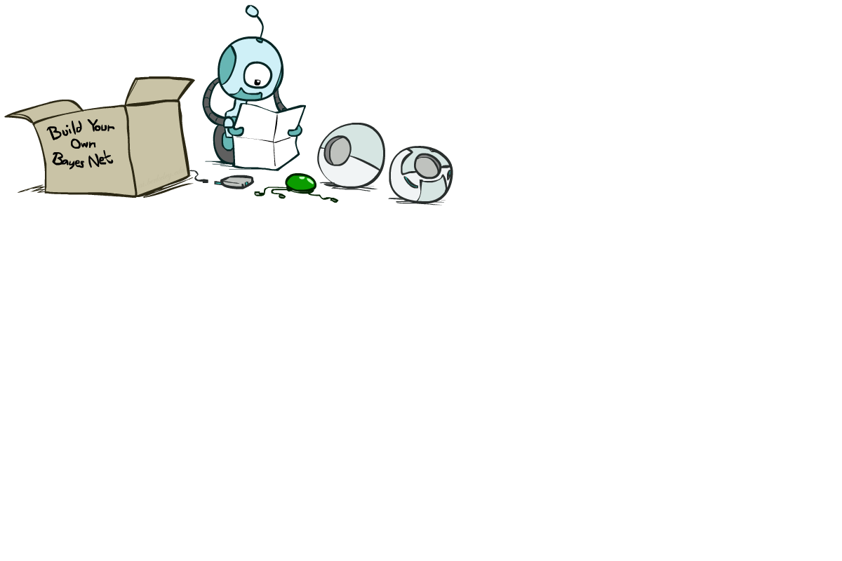
Bayes’ Net Semantics

Slide 11
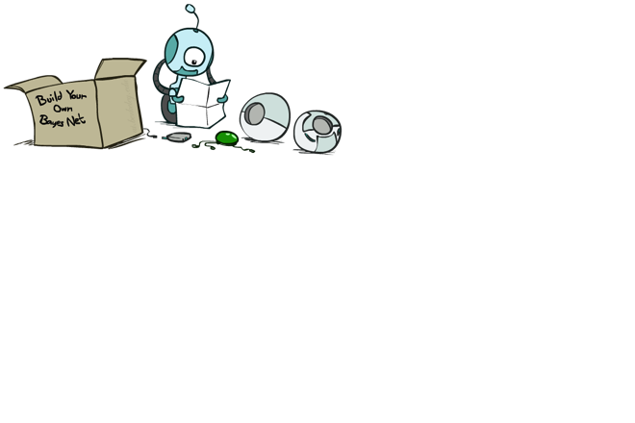
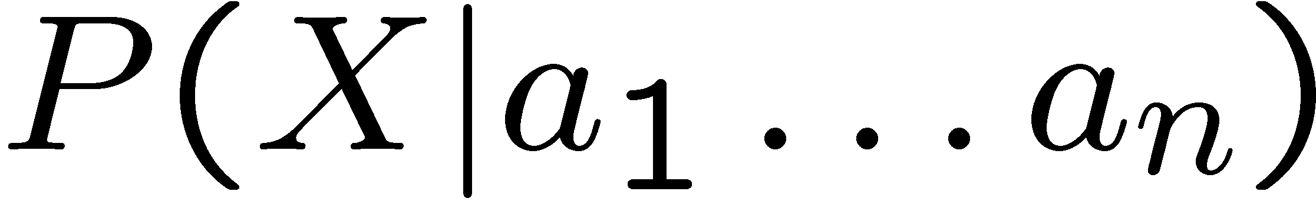
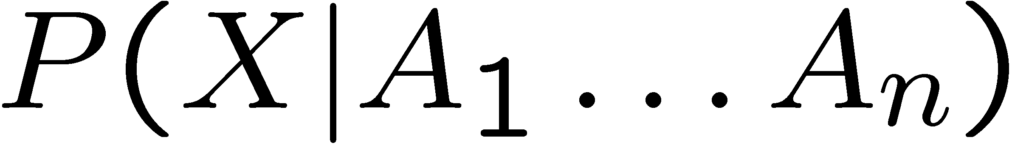
Bayes’ Net Semantics
A set of nodes, one per random variable X
A directed, acyclic graph
A conditional distribution for each node
  A collection of distributions over X, one for each combination of parents’ values
  CPT: conditional probability table
  Description of a noisy “causal” process
If a node has no parents, CPT = prior
P(A₁ ) …. P(A_{n} )
A₁
A_{n}
X
A Bayes net = Topology (graph) + Local Conditional Probabilities

Slide 12
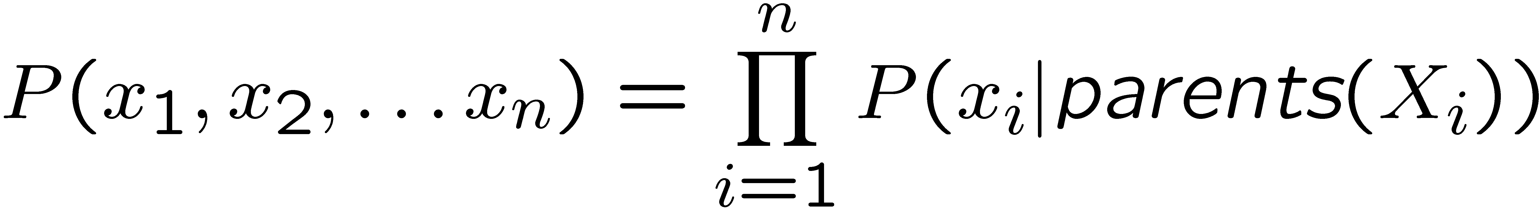
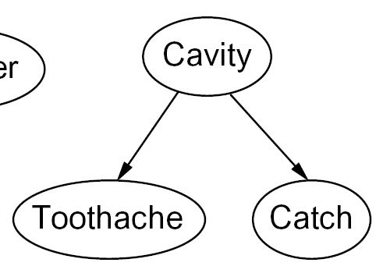

Probabilities in BNs
Bayes’ nets implicitly encode joint distributions
  As a product of local conditional distributions
  To see what probability a BN gives to a full assignment, multiply all the relevant conditionals together:
  Example:

Slide 13
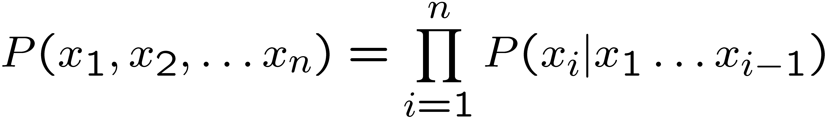
Probabilities in BNs
Why are we guaranteed that setting
results in a proper joint distribution?
Chain rule (valid for all distributions):
Assume conditional independences:
→ Consequence:
Every BN represents a joint distribution, but
Not every distribution can be represented by a specific BN
  The topology enforces certain conditional independencies

Slide 14

Example: Coin Flips
X₁
X₂
X_{n}
h | 0.5
t | 0.5
h | 0.5
t | 0.5
h | 0.5
t | 0.5
Only distributions whose variables are absolutely independent can be represented by a Bayes’ net with no arcs.
Notes:
demo

Slide 15

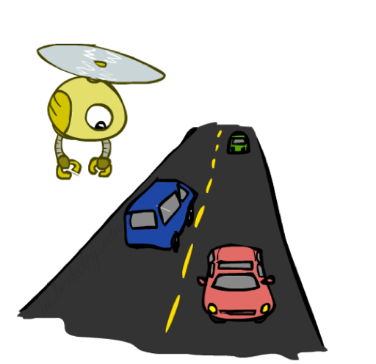

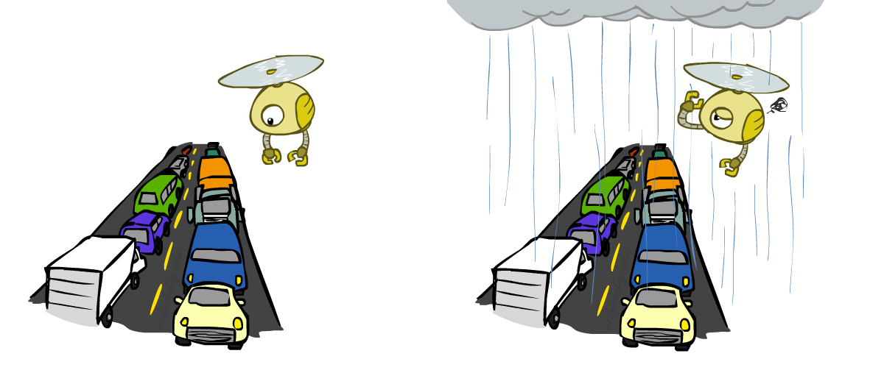
Example: Traffic
+r | 1/4
-r | 3/4
¼ * ¼ = 1/16
R
+r | +t | 3/4
 | -t | 1/4
T
-r | +t | 1/2
 | -t | 1/2
Notes:
demo

Slide 16

Example: Alarm Network
B | P(B)
+b | 0.001
-b | 0.999
E | P(E)
+e | 0.002
-e | 0.998
Burglary
Earthqk
Alarm
B | E | A | P(A|B,E)
+b | +e | +a | 0.95
+b | +e | -a | 0.05
+b | -e | +a | 0.94
+b | -e | -a | 0.06
-b | +e | +a | 0.29
-b | +e | -a | 0.71
-b | -e | +a | 0.001
-b | -e | -a | 0.999
John calls
Mary calls
A | J | P(J|A)
+a | +j | 0.9
+a | -j | 0.1
-a | +j | 0.05
-a | -j | 0.95
A | M | P(M|A)
+a | +m | 0.7
+a | -m | 0.3
-a | +m | 0.01
-a | -m | 0.99
Notes:
demo

Slide 17
Example: Alarm Network
B | P(B)
+b | 0.001
-b | 0.999
B
E
E | P(E)
+e | 0.002
-e | 0.998
A
A | J | P(J|A)
+a | +j | 0.9
+a | -j | 0.1
-a | +j | 0.05
-a | -j | 0.95
A | M | P(M|A)
+a | +m | 0.7
+a | -m | 0.3
-a | +m | 0.01
-a | -m | 0.99
B | E | A | P(A|B,E)
+b | +e | +a | 0.95
+b | +e | -a | 0.05
+b | -e | +a | 0.94
+b | -e | -a | 0.06
-b | +e | +a | 0.29
-b | +e | -a | 0.71
-b | -e | +a | 0.001
-b | -e | -a | 0.999
J
M
Notes:
demo

Slide 18
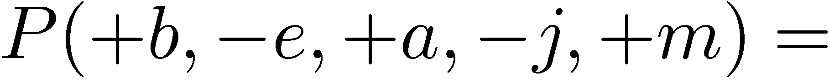
Example: Alarm Network
B | P(B)
+b | 0.001
-b | 0.999
B
E
E | P(E)
+e | 0.002
-e | 0.998
A
A | J | P(J|A)
+a | +j | 0.9
+a | -j | 0.1
-a | +j | 0.05
-a | -j | 0.95
A | M | P(M|A)
+a | +m | 0.7
+a | -m | 0.3
-a | +m | 0.01
-a | -m | 0.99
B | E | A | P(A|B,E)
+b | +e | +a | 0.95
+b | +e | -a | 0.05
+b | -e | +a | 0.94
+b | -e | -a | 0.06
-b | +e | +a | 0.29
-b | +e | -a | 0.71
-b | -e | +a | 0.001
-b | -e | -a | 0.999
J
M
Notes:
demo

Slide 19

Example: Alarm Network
B | P(B)
+b | 0.001
-b | 0.999
B
E
E | P(E)
+e | 0.002
-e | 0.998
A
A | J | P(J|A)
+a | +j | 0.9
+a | -j | 0.1
-a | +j | 0.05
-a | -j | 0.95
A | M | P(M|A)
+a | +m | 0.7
+a | -m | 0.3
-a | +m | 0.01
-a | -m | 0.99
B | E | A | P(A|B,E)
+b | +e | +a | 0.95
+b | +e | -a | 0.05
+b | -e | +a | 0.94
+b | -e | -a | 0.06
-b | +e | +a | 0.29
-b | +e | -a | 0.71
-b | -e | +a | 0.001
-b | -e | -a | 0.999
J
M
Notes:
demo

Slide 20
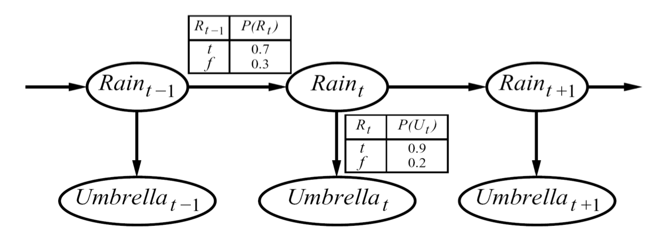
Example: Hidden Markov Models
X₁
X₂
X₃
X₄
X_{N}
X₅
E₁
E₂
E₃
E₄
E_{N}
E₅
…
P(R₀) = 0.4
R₀
R₁
R₂
U₀
U₁
U₂

Slide 21

Example: Traffic
Causal direction
R
+r | 1/4
-r | 3/4
+r | +t | 3/16
+r | -t | 1/16
-r | +t | 6/16
-r | -t | 6/16
+r | +t | 3/4
 | -t | 1/4
T
-r | +t | 1/2
 | -t | 1/2

Slide 22
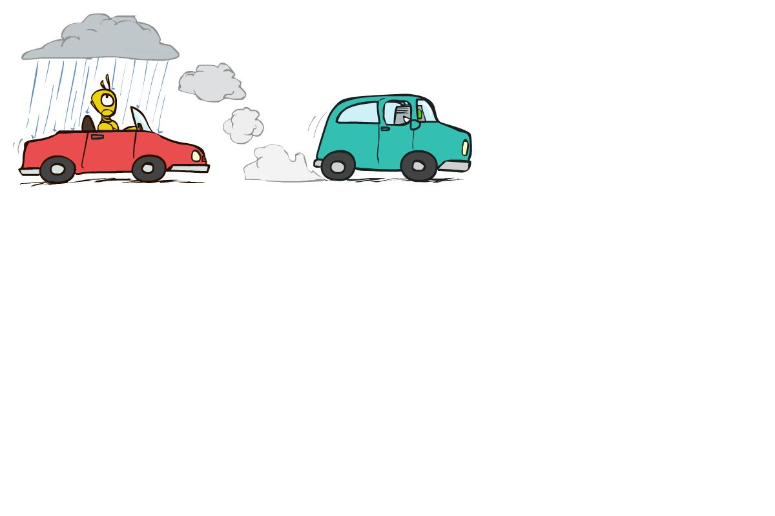

Example: Reverse Traffic
Reverse causality?
T
+t | 9/16
-t | 7/16
+r | +t | 3/16
+r | -t | 1/16
-r | +t | 6/16
-r | -t | 6/16
+t | +r | 1/3
 | -r | 2/3
R
-t | +r | 1/7
 | -r | 6/7

Slide 23
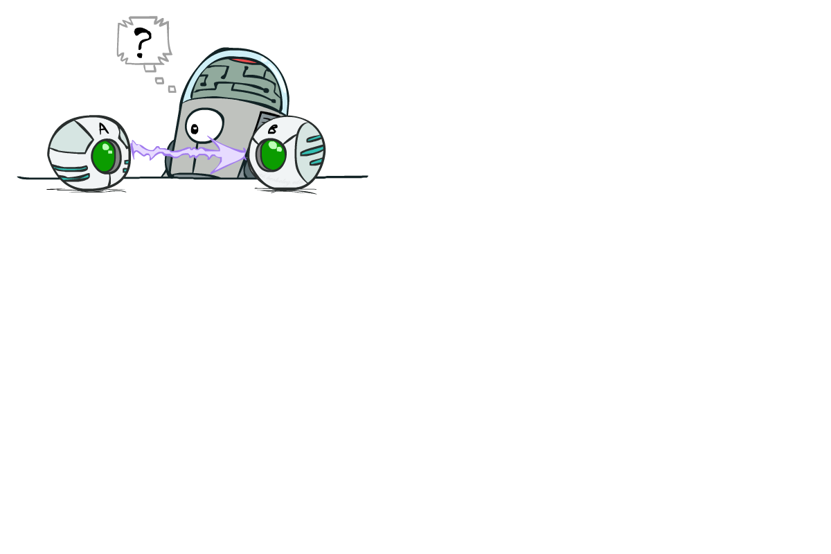
Causality?
When Bayes’ nets reflect the true causal patterns:
  Often simpler (nodes have fewer parents)
  Often easier to think about
  Often easier to elicit from experts
BNs need not actually be causal
  Sometimes no causal net exists over the domain (especially if variables are missing)
  E.g. consider the variables Traffic and Drips
  End up with arrows that reflect correlation, not causation
What do the arrows really mean?
  Topology may happen to encode causal structure
  Topology really encodes conditional independence

Slide 24

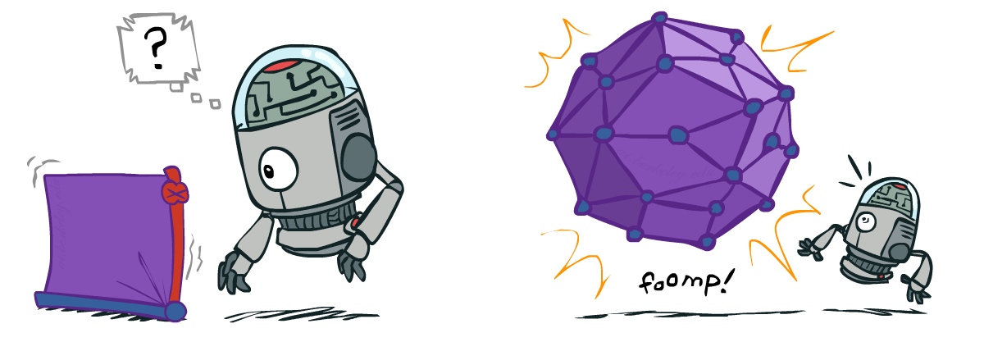
Size of a Bayes’ Net
How big is a joint distribution over N Boolean variables?
  2^{N}
How big is an N-node net if nodes have up to k parents?
  O(N * 2^{k+1})
Both give you the power to calculate
BNs: Huge space savings!
Also easier to elicit local CPTs
Also faster to answer queries (coming)

Slide 25

Bayes’ Nets
So far: how a Bayes’ net encodes a joint distribution
Next: how to answer queries about that distribution
  answer queries about conditional independence and influence
After that: how to answer numerical queries (inference)

Slide 26
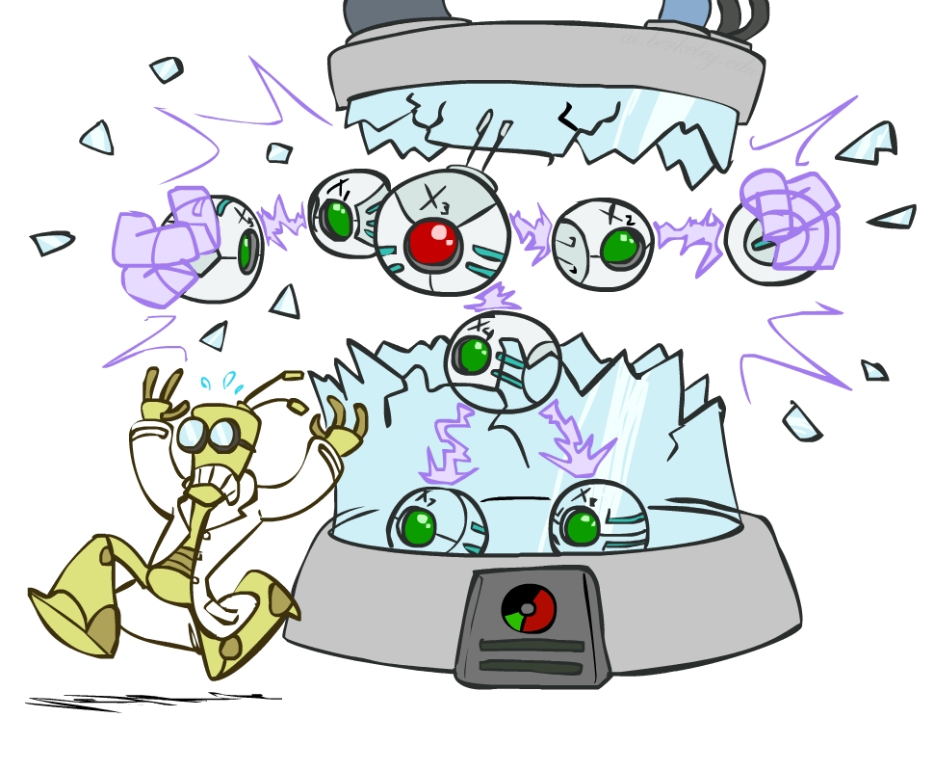
CS 188: Artificial Intelligence
Bayes’ Nets: Independence
Instructors: Dan Klein and Pieter Abbeel --- University of California, Berkeley
[These slides were created by Dan Klein and Pieter Abbeel for CS188 Intro to AI at UC Berkeley. All CS188 materials are available at http://ai.berkeley.edu.]
Notes:
Please retain proper attribution, including the reference to ai.berkeley.edu. Thanks!

Slide 27
Probability Recap
Conditional probability
Product rule
Chain rule
X, Y independent if and only if:
X and Y are conditionally independent given Z if and only if:

Slide 28
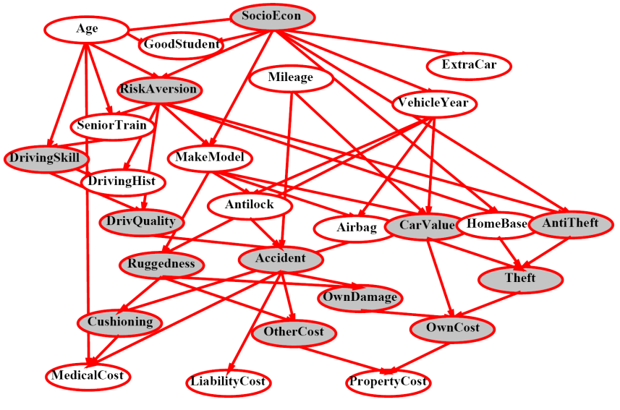
Recap: Bayes’ Nets
A Bayes’ net is an
efficient encoding
of a probabilistic
model of a domain
Questions we can ask:
  Inference: given a fixed BN, what is P(X | e)?
  Representation: given a BN graph, what kinds of distributions can it encode?
  Modeling: what BN is most appropriate for a given domain?

Slide 29

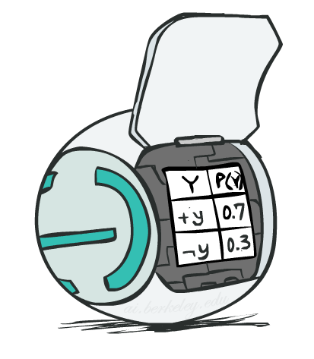
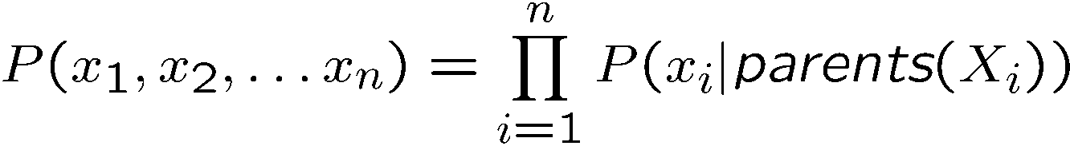
Bayes’ Net Semantics
A directed, acyclic graph, one node per random variable
A conditional probability table (CPT) for each node
  A collection of distributions over X, one for each combination of parents’ values
Bayes’ nets implicitly encode joint distributions
  As a product of local conditional distributions
  To see what probability a BN gives to a full assignment, multiply all the relevant conditionals together:

Slide 30

Bayes’ Nets
Representation
Conditional Independences
Probabilistic Inference
Learning Bayes’ Nets from Data

Slide 31

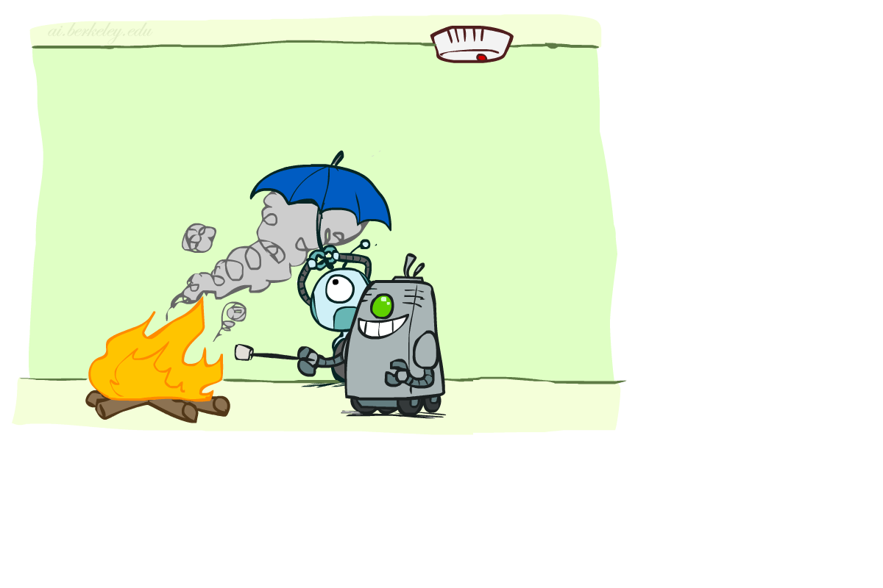

Conditional Independence
X and Y are independent if
X and Y are conditionally independent given Z
(Conditional) independence is a property of a distribution
Example:

Slide 32
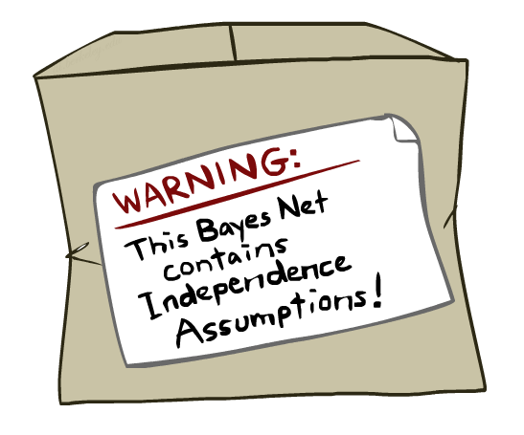
Bayes Nets: Assumptions
Assumptions we are required to make to define the Bayes net when given the graph:
Beyond above “chain rule → Bayes net” conditional independence assumptions
  Often additional conditional independences
  They can be read off the graph
Important for modeling: understand assumptions made when choosing a Bayes net graph
Notes:
Important for modeling: understanding which assumptions you are making!

Slide 33
Example
X
Y
Z
W
Conditional independence assumptions directly from simplifications in chain rule:
Additional implied conditional independence assumptions?

Slide 34
Independence in a BN
Important question about a BN:
  Are two nodes independent given certain evidence?
  If yes, can prove using algebra (tedious in general)
  If no, can prove with a counter example
  Example:
  Question: are X and Z necessarily independent?
    Answer: no. Example: low pressure causes rain, which causes traffic.
    X can influence Z, Z can influence X (via Y)
    Addendum: they could be independent: how?
X
Y
Z

Slide 35
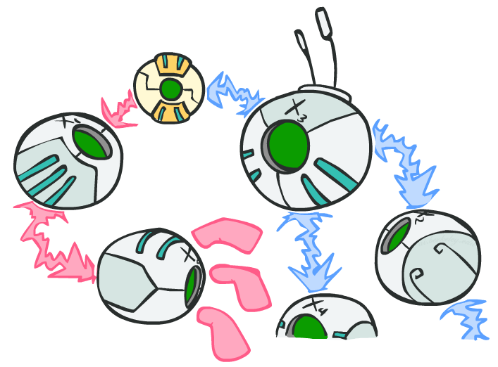
D-separation: Outline

Slide 36
D-separation: Outline
Study independence properties for triples
Analyze complex cases in terms of member triples
D-separation: a condition / algorithm for answering such queries

Slide 37
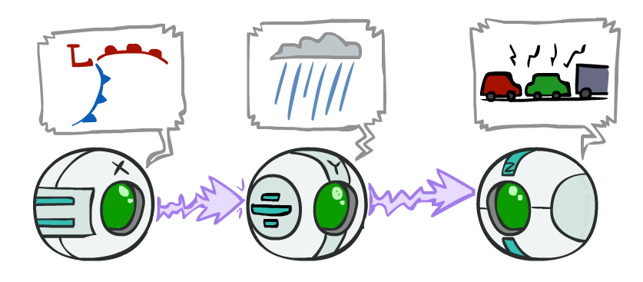
Causal Chains
This configuration is a “causal chain”
Guaranteed X independent of Z ? No!
  One example set of CPTs for which X is not independent of Z is sufficient to show this independence is not guaranteed.
  Example:
    Low pressure causes rain causes traffic,
    high pressure causes no rain causes no
    traffic
    In numbers:
    P( +y | +x ) = 1, P( -y | - x ) = 1,
    P( +z | +y ) = 1, P( -z | -y ) = 1
X: Low pressure Y: Rain Z: Traffic

Slide 38
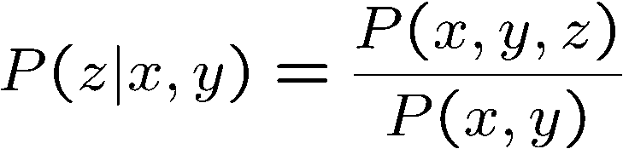
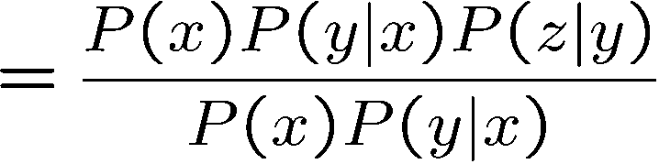

Causal Chains
This configuration is a “causal chain”
Guaranteed X independent of Z given Y?
  Evidence along the chain “blocks” the influence
X: Low pressure Y: Rain Z: Traffic
Yes!

Slide 39
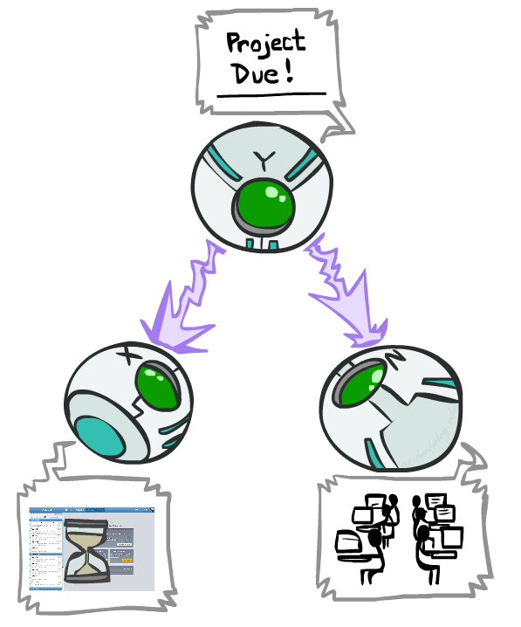
Common Cause
This configuration is a “common cause”
Guaranteed X independent of Z ? No!
  One example set of CPTs for which X is not independent of Z is sufficient to show this independence is not guaranteed.
  Example:
    Project due causes both forums busy
    and lab full
    In numbers:
    P( +x | +y ) = 1, P( -x | -y ) = 1,
    P( +z | +y ) = 1, P( -z | -y ) = 1
Y: Project due
X: Forums busy
Z: Lab full

Slide 40
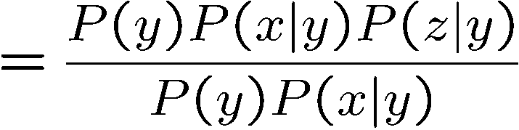
Common Cause
This configuration is a “common cause”
Guaranteed X and Z independent given Y?
  Observing the cause blocks influence between effects.
Y: Project due
X: Forums busy
Z: Lab full
Yes!

Slide 41
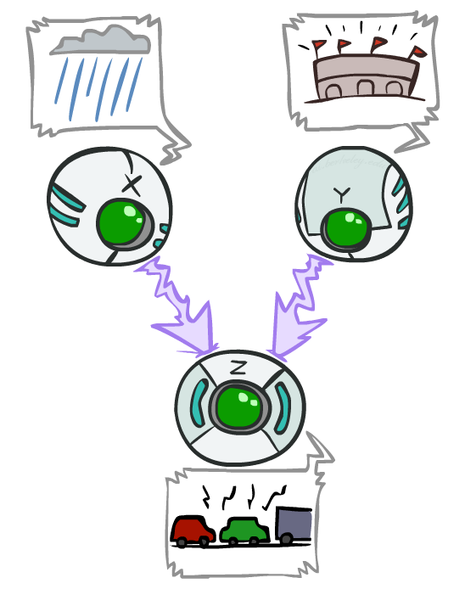
Common Effect
Last configuration: two causes of one effect (v-structures)
Are X and Y independent?
  Yes: the ballgame and the rain cause traffic, but they are not correlated
  Still need to prove they must be (try it!)
Are X and Y independent given Z?
  No: seeing traffic puts the rain and the ballgame in competition as explanation.
This is backwards from the other cases
  Observing an effect activates influence between possible causes.
X: Raining
Y: Ballgame
Z: Traffic

Slide 42
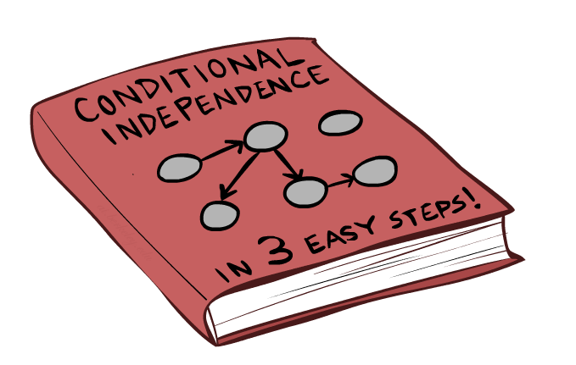
The General Case

Slide 43
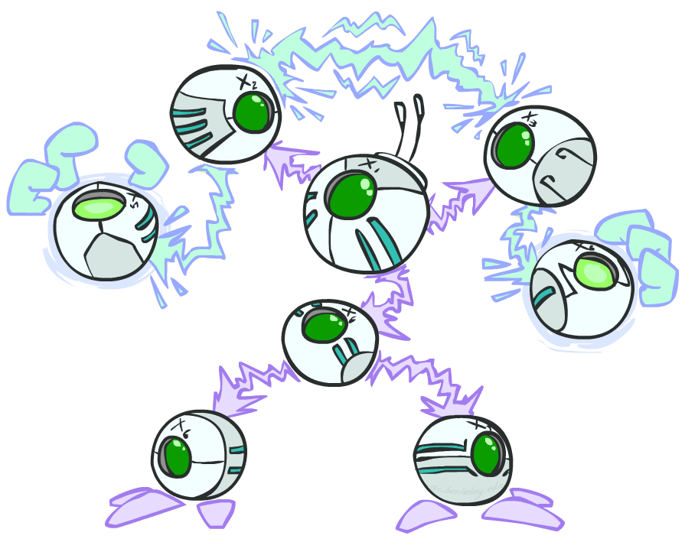
The General Case
General question: in a given BN, are two variables independent (given evidence)?
Solution: analyze the graph
Any complex example can be broken
into repetitions of the three canonical cases

Slide 44

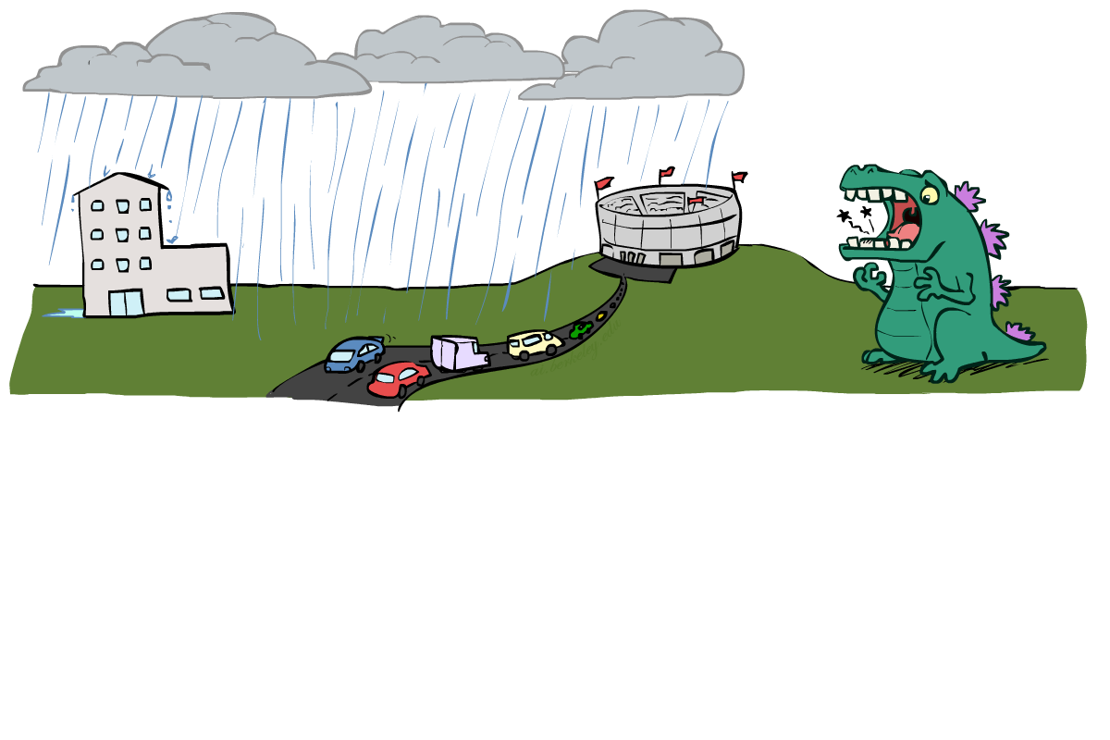
Reachability
L
Recipe: shade evidence nodes, look for paths in the resulting graph
Attempt 1: if two nodes are connected by an undirected path not blocked by a shaded node, they are conditionally independent
Almost works, but not quite
  Where does it break?
  Answer: the v-structure at T doesn’t count as a link in a path unless “active”
R
B
D
T

Slide 45
Active / Inactive Paths
Question: Are X and Y conditionally independent given evidence variables {Z}?
  Yes, if X and Y “d-separated” by Z
  Consider all (undirected) paths from X to Y
  No active paths = independence!
A path is active if each triple is active:
  Causal chain A → B → C where B is unobserved (either direction)
  Common cause A ← B → C where B is unobserved
  Common effect (aka v-structure)
  A → B ← C where B or one of its descendents is observed
All it takes to block a path is a single inactive segment
Active Triples
Inactive Triples

Slide 46
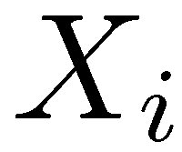
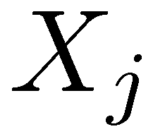

D-Separation
?
Query:
Check all (undirected!) paths between and
  If one or more active, then independence not guaranteed
  Otherwise (i.e. if all paths are inactive),
  then independence is guaranteed

Slide 47


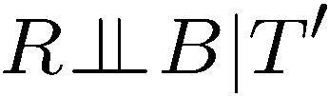
Example
Yes
R
B
T
T’
Notes:
T’: traffic report

Slide 48
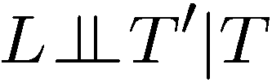


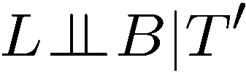

Example
L
Yes
R
B
Yes
D
T
Yes
T’

Slide 49



Example
Variables:
  R: Raining
  T: Traffic
  D: Roof drips
  S: I’m sad
Questions:
R
T
D
S
Yes

Slide 50

Structure Implications
Given a Bayes net structure, can run d-separation algorithm to build a complete list of conditional independences that are necessarily true of the form
This list determines the set of probability distributions that can be represented

Slide 51

Computing All Independences
Y
X
Z
Y
X
Z
X
Z
Y
Y
X
Z

Slide 52
Topology Limits Distributions
Given some graph topology G, only certain joint distributions can be encoded
The graph structure guarantees certain (conditional) independences
(There might be more independence)
Adding arcs increases the set of distributions, but has several costs
Full conditioning can encode any distribution
Y
Y
X
Z
X
Z
Y
X
Z
Y
X
Z
Y
Y
Y
X
Z
X
Z
X
Z
Y
Y
Y
X
Z
X
Z
X
Z

Slide 53
Bayes Nets Representation Summary
Bayes nets compactly encode joint distributions
Guaranteed independencies of distributions can be deduced from BN graph structure
D-separation gives precise conditional independence guarantees from graph alone
A Bayes’ net’s joint distribution may have further (conditional) independence that is not detectable until you inspect its specific distribution

Slide 54
Bayes’ Nets
Representation
Conditional Independences
Probabilistic Inference
  Enumeration (exact, exponential complexity)
  Variable elimination (exact, worst-case
  exponential complexity, often better)
  Probabilistic inference is NP-complete
  Sampling (approximate)
Learning Bayes’ Nets from Data

