Slide 1

CSE 473: Artificial Intelligence
Markov Models - II
Daniel S. Weld --- University of Washington
[Most slides were created by Dan Klein and Pieter Abbeel for CS188 Intro to AI at UC Berkeley. All CS188 materials are available at http://ai.berkeley.edu.]
Notes:
Please retain proper attribution, including the reference to ai.berkeley.edu. Thanks!
Note: pretty short lecture, good one to present mini-contest results or anything else not exactly lecture.

Slide 2


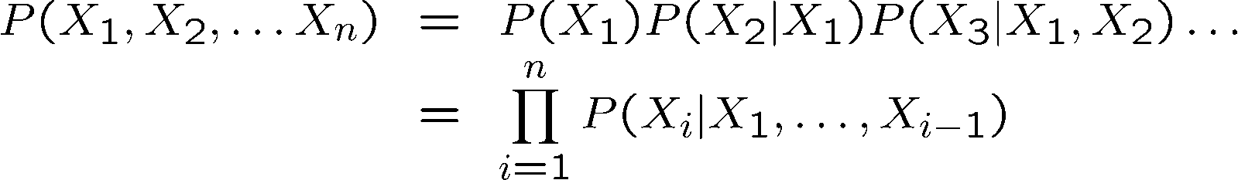
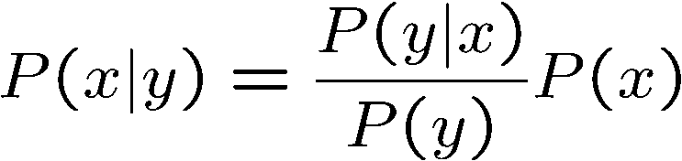

Probability Recap
Conditional probability
Product rule
Chain rule
Bayes rule
X, Y independent if and only if:
X and Y are conditionally independent given Z: if and only if:

Slide 3
Reasoning over Time or Space
Often, we want to reason about a sequence of observations
  Speech recognition
  Robot localization
  User attention
  Medical monitoring
Need to introduce time (or space) into our models

Slide 4
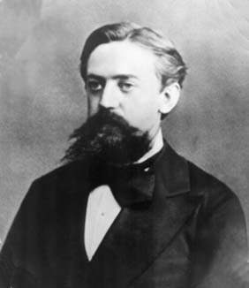
Markov Models Recap
Explicit assumption for all t :
Consequence, joint distribution can be written as:
Additional explicit assumption: is the same for all t
T-1
T
is the same for all t

Slide 5
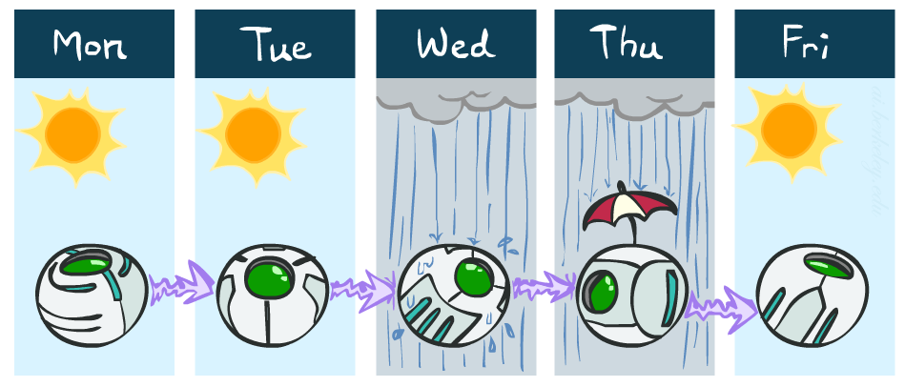
Example Markov Chain: Weather
States: X = {rain, sun}
Initial distribution: 1.0 sun
CPT P(X_{t} | X_{t-1}):
Two new ways of representing the same CPT
X_{t-1} | X_{t} | P(X_{t}|X_{t-1})
sun | sun | 0.9
sun | rain | 0.1
rain | sun | 0.3
rain | rain | 0.7
0.9
0.3
0.9
rain
sun
sun
sun
0.1
0.3
rain
rain
0.7
0.7
0.1

Slide 6
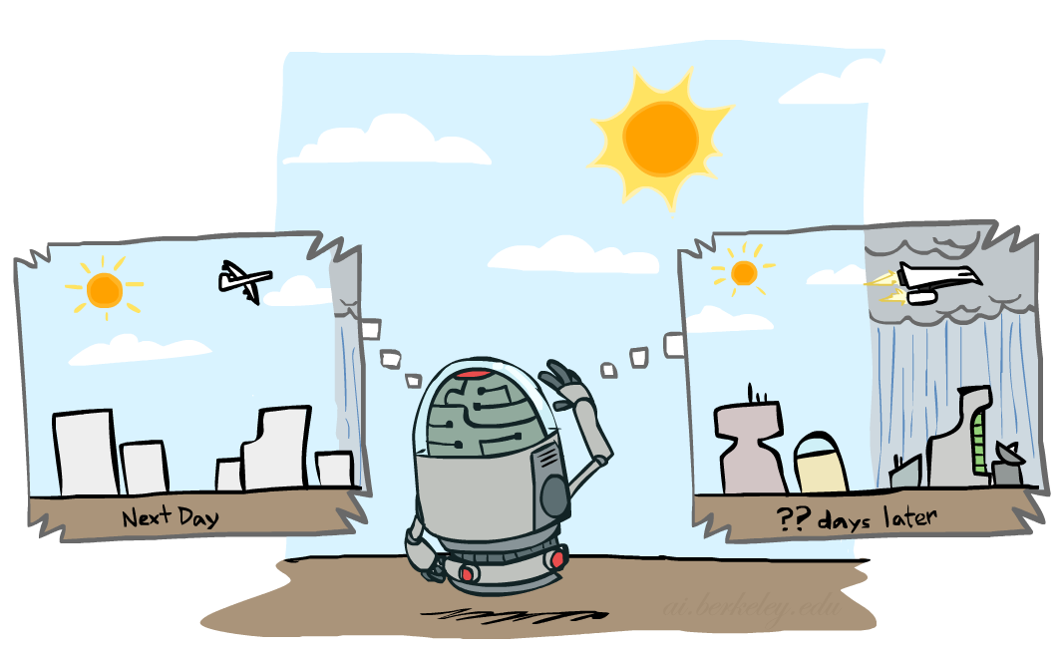

Mini-Forward Algorithm
Question: What’s P(X) on some day t?
X₁
X₂
X₃
X₄
Forward simulation

Slide 7
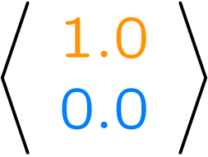
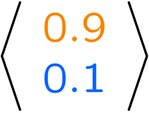
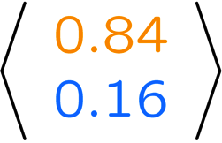
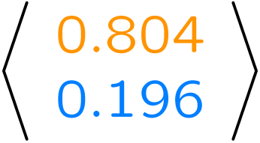
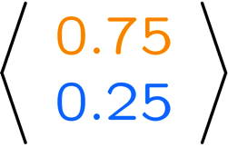
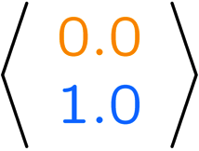
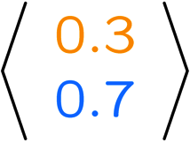
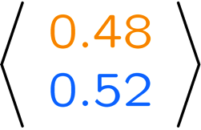
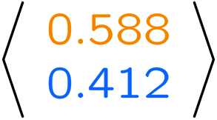
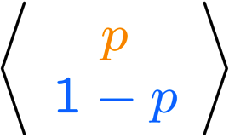
Example Run of Mini-Forward Algorithm
From initial observation of sun
From initial observation of rain
From yet another initial distribution P(X₁):
P(X₁)
P(X₂)
P(X₃)
P(X₄)
P(X∞)
“?”
P(X₁)
P(X₂)
P(X₃)
P(X₄)
P(X∞)
…
P(X₁)
P(X∞)
[Demo: L13D1,2,3]

Slide 8

Hidden Markov Models

Slide 9
Hidden Markov Models
Markov chains not so useful for most agents
  Eventually you don’t know anything anymore
  Need observations to update your beliefs
Hidden Markov models (HMMs)
  Underlying Markov chain over states S
  You observe outputs (effects) at each time step
  As a Bayes’ net:
X₁
X₂
X₃
X₄
X_{N}
X₅
E₁
E₂
E₃
E₄
E_{N}
E₅

Slide 10
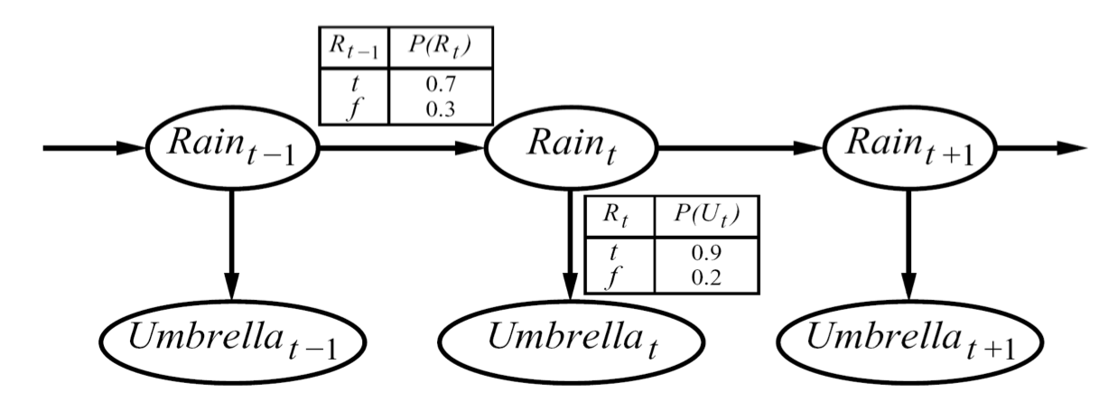



Example
An HMM is defined by:
  Initial distribution:
  Transitions:
  Emissions:

Slide 11



Hidden Markov Models
X₁
X₂
X₃
X₄
X_{N}
X₅
E₁
E₂
E₃
E₄
E_{N}
E₅
Defines a joint probability distribution:

Slide 12
Conditional Independence
HMMs have two important independence properties:
  Markov hidden process, future depends on past via the present
?
?
X₁
X₂
X₃
X₄
E₁
E₁
E₃
E₄

Slide 13
Conditional Independence
HMMs have two important independence properties:
  Markov hidden process, future depends on past via the present
  Current observation independent of all else given current state
?
X₁
X₂
X₃
X₄
E₁
E₁
E₃
E₄
?

Slide 14
Conditional Independence
HMMs have two important independence properties:
  Markov hidden process, future depends on past via the present
  Current observation independent of all else given current state
Quiz: does this mean that observations are independent given no evidence?
  [No, correlated by the hidden state]
X₁
X₂
X₃
X₄
E₁
E₁
E₃
E₄
?
?

Slide 15
HMM Computations
Given
  parameters
  evidence E_{1:n} =e_{1:n}
Inference problems include:
  Filtering, find P(X_{t}|e_{1:t}) for all t
  Smoothing, find P(X_{t}|e_{1:n}) for all t
  Most probable explanation, find
      x*_{1:n} = argmaxx_{1:n} P(x_{1:n}|e_{1:n})

Slide 16
Filtering (aka Monitoring)
The task of tracking the agent’s belief state, B(x), over time
  B(x) is a distribution over world states – repr agent knowledge
  We start with B(X) in an initial setting, usually uniform
  As time passes, or we get observations, we update B(X)
Many algorithms for this:
  Exact probabilistic inference
  Particle filter approximation
  Kalman filter (one method – Real valued values)
    invented in the 60’for Apollo Program – real-valued state, Gaussian noise

Slide 17
HMM Examples
Robot tracking:
  Observations are range readings (continuous)
  States are positions on a map (continuous)
X₁
X₂
X₃
X₄
E₁
E₁
E₃
E₄

Slide 18
Example: Robot Localization
Example from Michael Pfeiffer
Prob
0
1
t=0
Sensor model: never more than 1 mistake
Motion model: may not execute action with small prob.

Slide 19
Example: Robot Localization
Prob
0
1
t=1

Slide 20
Example: Robot Localization
Prob
0
1
t=2

Slide 21
Example: Robot Localization
Prob
0
1
t=3

Slide 22
Example: Robot Localization
Prob
0
1
t=4

Slide 23
Example: Robot Localization
Prob
0
1
t=5

Slide 24
Other Real HMM Examples
Speech recognition HMMs:
  Observations are acoustic signals (continuous valued)
  States are specific positions in specific words (so, tens of thousands)
X₁
X₂
X₃
X₄
E₁
E₁
E₃
E₄

Slide 25
Other Real HMM Examples
Machine translation HMMs:
  Observations are words (tens of thousands)
  States are translation options
X₁
X₂
X₃
X₄
E₁
E₁
E₃
E₄

Slide 26


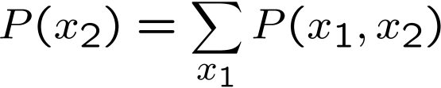

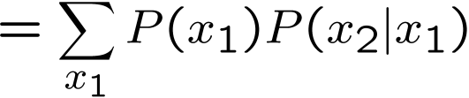

Inference Preview
X₁
X₁
X₂
E₁

Slide 27
Online Belief Updates
Every time step, we start with current P(X | evidence)
We update for time:
We update for evidence:
The forward algorithm does both at once (and doesn’t normalize)
Problem: space is |X| and time is |X|² per time step
X₁
X₂
X₂
E₂

Slide 28

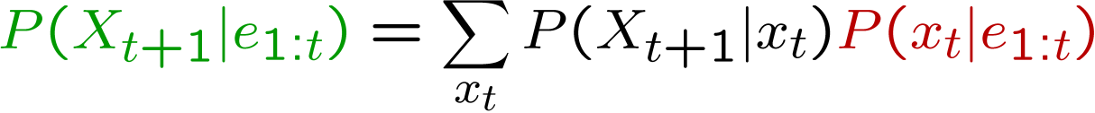
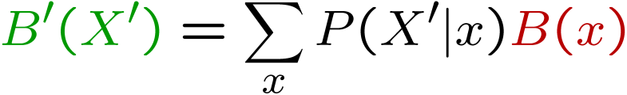
Passage of Time
Assume we have current belief P(X | evidence to date)
Then, after one time step passes:
Or, compactly:
Basic idea: beliefs get “pushed” through the transitions
  With the “B” notation, we have to be careful about what time step t the belief is about, and what evidence it includes
X₁
X₂

Slide 29
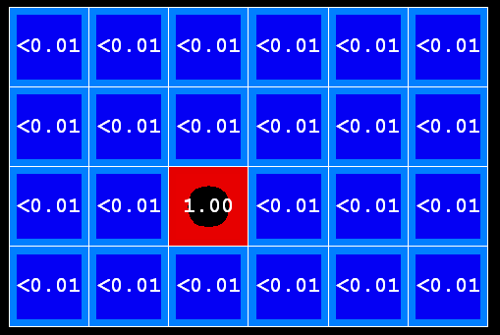

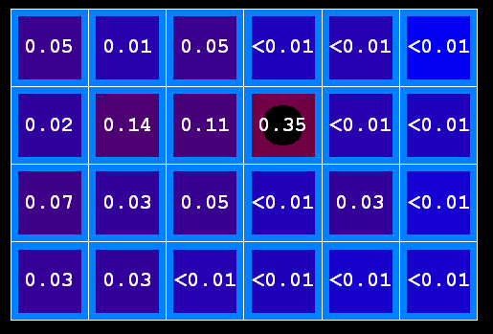
Example: Passage of Time
As time passes, uncertainty “accumulates”
T = 1
T = 2
T = 5
Transition model: ghosts usually go clockwise

Slide 30

Observation
Assume we have current belief P(X | previous evidence):
Then:
Or:
Basic idea: beliefs reweighted by likelihood of evidence
Unlike passage of time, we have to renormalize
X₁
E₁

Slide 31
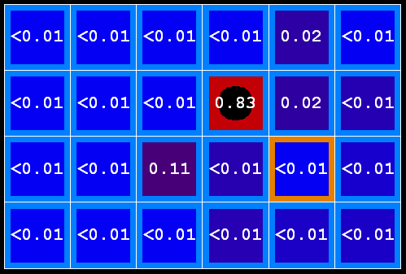

Example: Observation
As we get observations, beliefs get reweighted, uncertainty “decreases”
Before observation
After observation

Slide 32

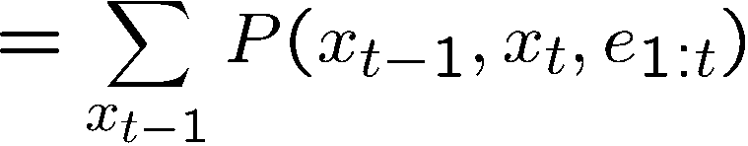
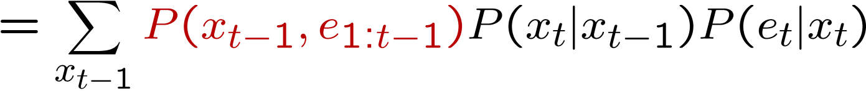
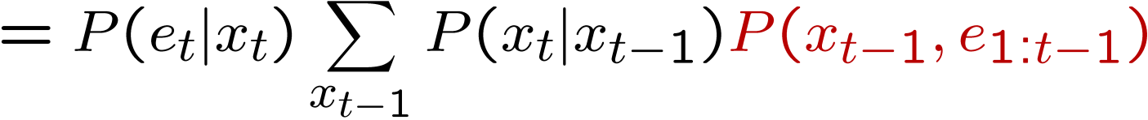
The Forward Algorithm
We want to know:
We can derive the following updates
To get , compute each entry and normalize

Slide 33
Example: Run the Filter
An HMM is defined by:
  Initial distribution:
  Transitions:
  Emissions:

Slide 34
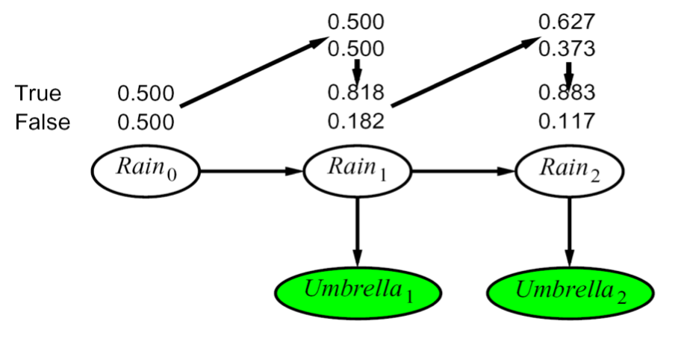
Example HMM

Slide 35
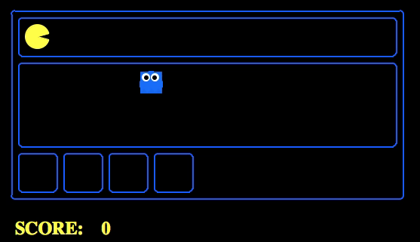
Example Pac-man

Slide 36
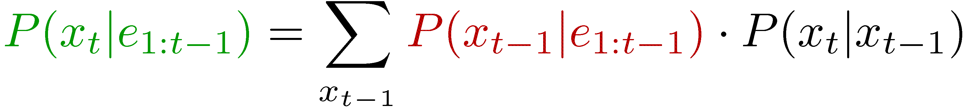
Summary: Filtering
Filtering is the inference process of finding a distribution over X_{T} given e₁ through e_{T} : P( X_{T} | e_{1:t} )
We first compute P( X₁ | e₁ ):
For each t from 2 to T, we have P( X_{t-1} | e_{1:t-1} )
Elapse time: compute P( X_{t} | e_{1:t-1} )
Observe: compute P(X_{t} | e_{1:t-1} , e_{t}) = P( X_{t} | e_{1:t} )

Slide 37


Recap: Reasoning Over Time
Stationary Markov models
0.3
0.7
rain
sun
X₁
X₂
X₃
X₄
0.7
0.3
Hidden Markov models
X | E | P
rain | umbrella | 0.9
rain | no umbrella | 0.1
sun | umbrella | 0.2
sun | no umbrella | 0.8
X₁
X₂
X₃
X₄
X₅
E₁
E₂
E₃
E₄
E₅

Slide 38



Recap: Filtering
Elapse time: compute P( X_{t} | e_{1:t-1} )
Observe: compute P( X_{t} | e_{1:t} )
Belief: <P(rain), P(sun)>
X₁
X₂
<0.5, 0.5>
Prior on X₁
<0.82, 0.18>
Observe
E₁
E₂
<0.63, 0.37>
Elapse time
<0.88, 0.12>
Observe

Slide 39
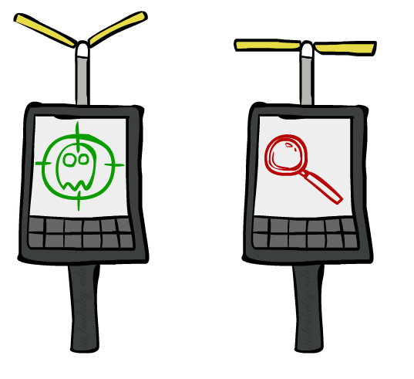

Inference: Base Cases
“Observation”
“Passage of Time”
X₁
X₁
X₂
E₁

Slide 40
Passage of Time
Assume we have current belief P(X | evidence to date)
Then, after one time step passes:
Basic idea: beliefs get “pushed” through the transitions
  With the “B” notation, we have to be careful about what time step t the belief is about, and what evidence it includes
X₁
X₂
Or compactly:
Notes:
TODO: intermediate step in derivation!

Slide 41

Example: Passage of Time
As time passes, uncertainty “accumulates”
(Transition model: ghosts usually go clockwise)
T = 1
T = 2
T = 5

Slide 42
Observation
X₁
Assume we have current belief P(X | previous evidence):
Then, after evidence comes in:
Or, compactly:
E₁
Basic idea: beliefs “reweighted” by likelihood of evidence
Unlike passage of time, we have to renormalize
Notes:
Basic idea: beliefs “reweighted” by likelihood of evidence
Unlike passage of time, we have to renormalize

Slide 43


Example: Observation
As we get observations, beliefs get reweighted, uncertainty “decreases”
Before observation
After observation

Slide 44

Example: Weather HMM
B’(+r) = 0.5
B’(-r) = 0.5
B’(+r) = 0.627
B’(-r) = 0.373
B(+r) = 0.5
B(-r) = 0.5
B(+r) = 0.818
B(-r) = 0.182
B(+r) = 0.883
B(-r) = 0.117
Rain₀
Rain₁
Rain₂
R_{t} | R_{t+1} | P(R_{t+1}|R_{t})
+r | +r | 0.7
+r | -r | 0.3
-r | +r | 0.3
-r | -r | 0.7
R_{t} | U_{t} | P(U_{t}|R_{t})
+r | +u | 0.9
+r | -u | 0.1
-r | +u | 0.2
-r | -u | 0.8
Umbrella₁
Umbrella₂
Notes:
demo

Slide 45
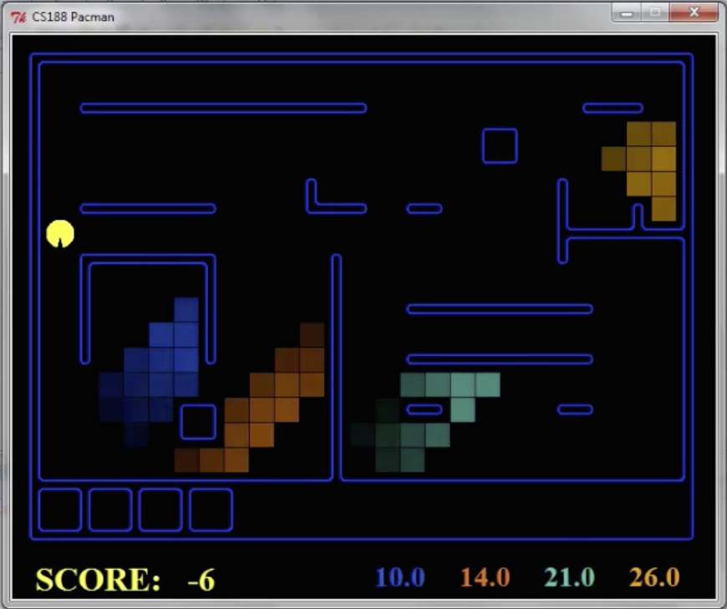
Pacman – Sonar (P4)
[Demo: Pacman – Sonar – No Beliefs(L14D1)]

Slide 46

Video of Demo Pacman – Sonar (with beliefs)

Slide 47
Summary: Online Belief Updates
Every time step, we start with current P(X | evidence)
We update for time:
We update for evidence:
The forward algorithm does both at once (and doesn’t normalize)
X₁
X₂
X₂
E₂

Slide 48
The Forward Algorithm
We are given evidence at each time and want to know
We use the single (time-passage+observation) updates:
We can normalize as we go if we want to have P(x|e) at each time step, or just once at the end…
Complexity?
O(|X|²) time & O(X) space
Notes:
TODO: explain propto and it’s X_t, not X

Slide 49
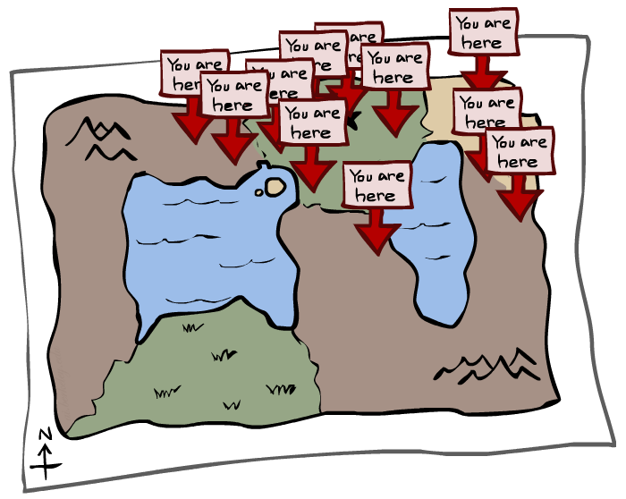
Particle Filtering

Slide 50
Particle Filtering
Filtering: approximate solution
Sometimes |X| is too big to use exact inference
  |X| may be too big to even store B(X)
  E.g. X is continuous
Solution: approximate inference
  Track samples of X, not all values
  Samples are called particles
  Time per step is linear in the number of samples
  But: number needed may be large
  In memory: list of particles, not states
This is how robot localization works in practice
Particle is just new name for sample
0.0
0.1
0.0
0.0
0.0
0.2
0.0
0.2
0.5

Slide 51
Representation: Particles
Our representation of P(X) is now a list of N particles (samples)
  Generally, N << |X|
  Storing map from X to counts would defeat the point
P(x) approximated by number of particles with value x
  So, many x may have P(x) = 0!
  More particles, more accuracy
For now, all particles have a weight of 1
Particles:
(3,3)
(2,3)
(3,3)
(3,2)
(3,3)
(3,2)
(1,2)
(3,3)
(3,3)
(2,3)

Slide 52

Particle Filtering: Elapse Time
Each particle is moved by sampling its next position from the transition model
  This is like prior sampling – samples’ frequencies reflect the transition probabilities
  Here, most samples move clockwise, but some move in another direction or stay in place
This captures the passage of time
  If enough samples, close to exact values before and after (consistent)
Particles:
(3,3)
(2,3)
(3,3)
(3,2)
(3,3)
(3,2)
(1,2)
(3,3)
(3,3)
(2,3)
Particles:
(3,2)
(2,3)
(3,2)
(3,1)
(3,3)
(3,2)
(1,3)
(2,3)
(3,2)
(2,2)

Slide 53


Particle Filtering: Observe
Particles:
(3,2)
(2,3)
(3,2)
(3,1)
(3,3)
(3,2)
(1,3)
(2,3)
(3,2)
(2,2)
Slightly trickier:
  Don’t sample observation, fix it
  Similar to likelihood weighting, downweight samples based on the evidence
  As before, the probabilities don’t sum to one, since all have been downweighted (in fact they now sum to (N times) an approximation of P(e))
Particles:
(3,2) w=.9
(2,3) w=.2
(3,2) w=.9
(3,1) w=.4
(3,3) w=.4
(3,2) w=.9
(1,3) w=.1
(2,3) w=.2
(3,2) w=.9
(2,2) w=.4

Slide 54
Particle Filtering: Resample
Rather than tracking weighted samples, we resample
N times, we choose from our weighted sample distribution (i.e. draw with replacement)
This is equivalent to renormalizing the distribution
Now the update is complete for this time step, continue with the next one
Particles:
(3,2) w=.9
(2,3) w=.2
(3,2) w=.9
(3,1) w=.4
(3,3) w=.4
(3,2) w=.9
(1,3) w=.1
(2,3) w=.2
(3,2) w=.9
(2,2) w=.4
(New) Particles:
(3,2)
(2,2)
(3,2)
(2,3)
(3,3)
(3,2)
(1,3)
(2,3)
(3,2)
(3,2)

Slide 55
Recap: Particle Filtering
Particles: track samples of states rather than an explicit distribution
Elapse
Weight
Resample
Particles:
(3,3)
(2,3)
(3,3)
(3,2)
(3,3)
(3,2)
(1,2)
(3,3)
(3,3)
(2,3)
Particles:
(3,2)
(2,3)
(3,2)
(3,1)
(3,3)
(3,2)
(1,3)
(2,3)
(3,2)
(2,2)
Particles:
(3,2) w=.9
(2,3) w=.2
(3,2) w=.9
(3,1) w=.4
(3,3) w=.4
(3,2) w=.9
(1,3) w=.1
(2,3) w=.2
(3,2) w=.9
(2,2) w=.4
(New) Particles:
(3,2)
(2,2)
(3,2)
(2,3)
(3,3)
(3,2)
(1,3)
(2,3)
(3,2)
(3,2)
[Demos: ghostbusters particle filtering (L15D3,4,5)]

Slide 56
Video of Demo – Moderate Number of Particles

Slide 57
Video of Demo – One Particle

Slide 58
Video of Demo – Huge Number of Particles

Slide 59
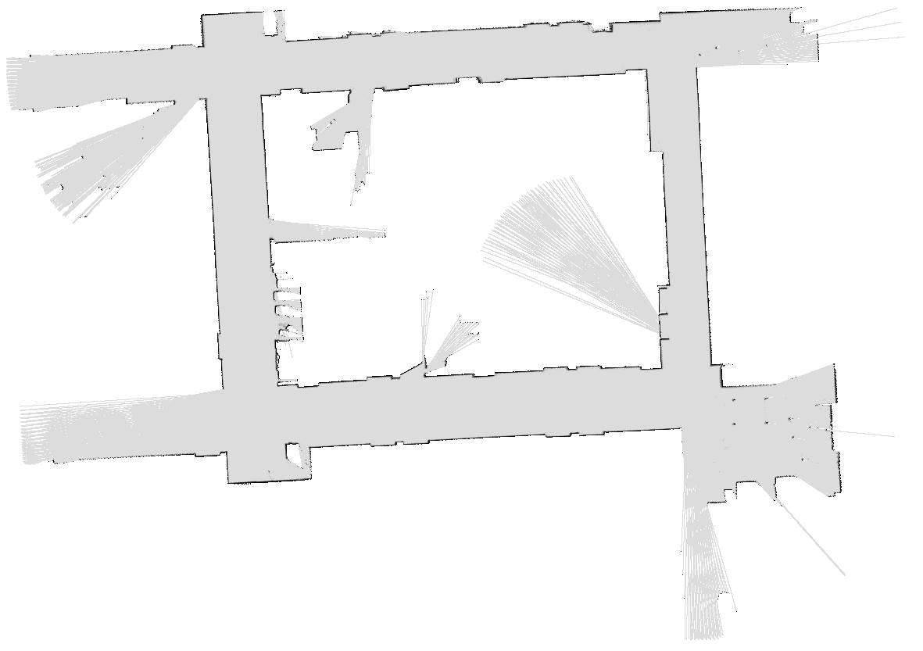

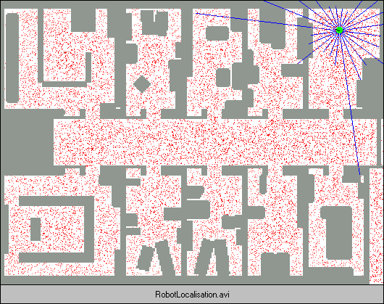
Demo Bonanza!

Slide 60
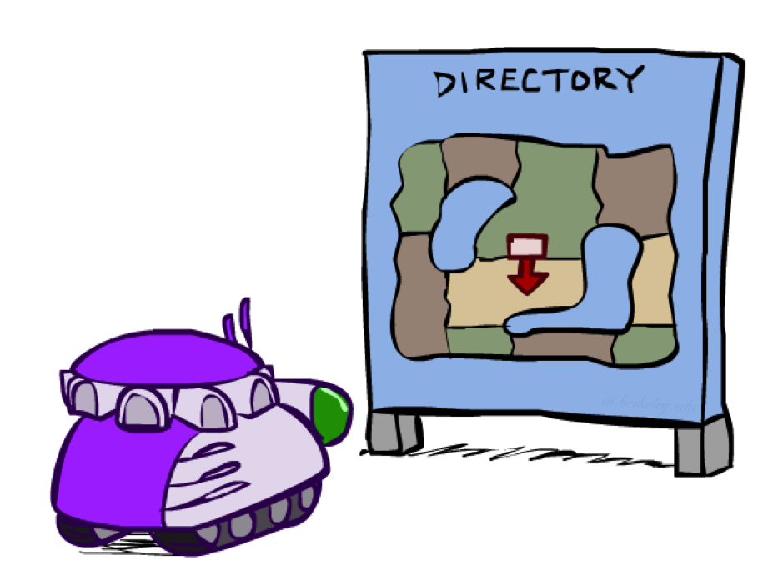
Robot Localization
In robot localization:
  We know the map, but not the robot’s position
  Observations may be vectors of range finder readings
  State space and readings are typically continuous (works basically like a very fine grid) and so we cannot store B(X)
  Particle filtering is a main technique

Slide 61

Particle Filter Localization (Sonar)
[Video: global-sonar-uw-annotated.avi]

Slide 62
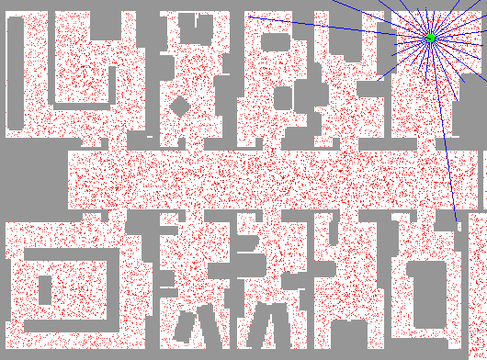
Particle Filter Localization (Laser)
[Video: global-floor.gif]

Slide 63

Robot Mapping
SLAM: Simultaneous Localization And Mapping
  We do not know the map or our location
  State consists of position AND map!
  Main techniques: Kalman filtering (Gaussian HMMs) and particle methods
DP-SLAM, Ron Parr
[Demo: PARTICLES-SLAM-mapping1-new.avi]

Slide 64

Particle Filter SLAM – Video 1
[Demo: PARTICLES-SLAM-mapping1-new.avi]

Slide 65

Particle Filter SLAM – Video 2
[Demo: PARTICLES-SLAM-fastslam.avi]

