Slide 1

CSE 473: Artificial Intelligence
Markov Models
Daniel S. Weld --- University of Washington
[Most slides were created by Dan Klein and Pieter Abbeel for CS188 Intro to AI at UC Berkeley. All CS188 materials are available at http://ai.berkeley.edu.]
Notes:
Please retain proper attribution, including the reference to ai.berkeley.edu. Thanks!
Note: pretty short lecture, good one to present mini-contest results or anything else not exactly lecture.

Slide 2
Announcements
No class on Wed…

Slide 3

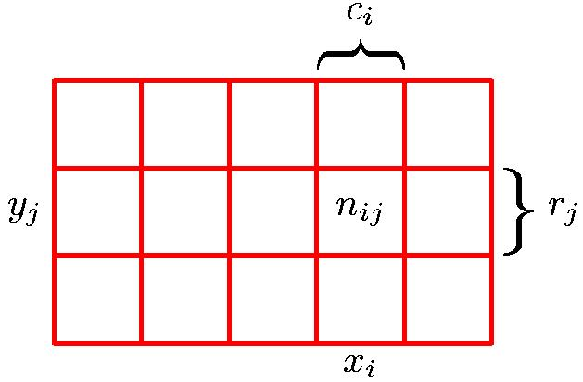
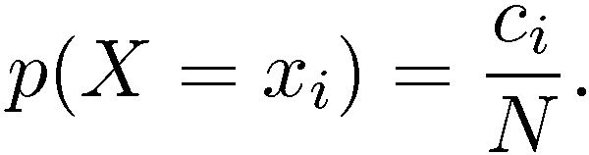
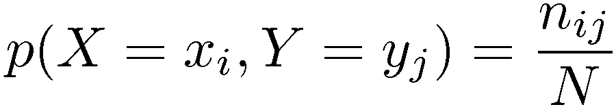
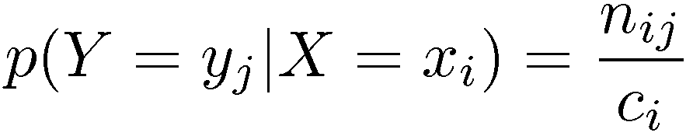
Terminology
Marginal Probability
Conditional Probability
Joint Probability
X value is given

Slide 4

Don’t be Fooled
It may look cute…
https://fc08.deviantart.net/fs71/i/2010/258/4/4/baby_dragon__charles_by_imsorrybuti-d2yti11.png

Slide 5
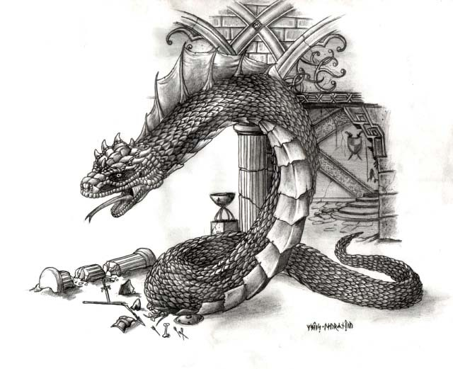
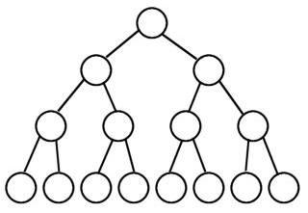
Don’t be Fooled
It gets big…
P
T
F
Q
T
F
T
F
R
T
F
T
F
T
F
T
F
http://img4.wikia.nocookie.net/__cb20090430175407/monster/images/9/92/Basilisk.jpg
0.1
0.05
0.2
0.07
0.03
0.05
0.1
0.3

Slide 6


The Sword of Conditional Independence!
I am a BIG joint distribution!
Slay
the
Basilisk!
harrypotter.wikia.com/
Means:
Or, equivalently:

Slide 7


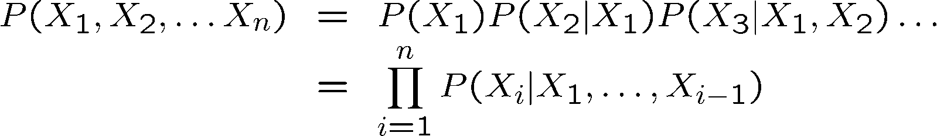
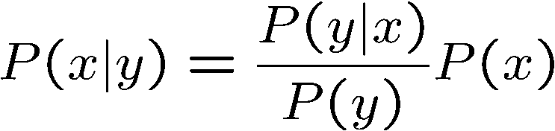

Probability Recap
Conditional probability
Product rule
Chain rule
Bayes rule
X, Y independent if and only if:
X and Y are conditionally independent given Z: if and only if:

Slide 8
Reasoning over Time or Space
Often, we want to reason about a sequence of observations
  Speech recognition
  Robot localization
  User attention
  Medical monitoring
Need to introduce time (or space) into our models

Slide 9
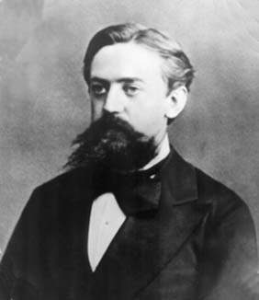
Markov Models Recap
Explicit assumption for all t :
Consequence, joint distribution can be written as:
Additional explicit assumption: is the same for all t
T-1
T
is the same for all t

Slide 10
Conditional Independence
Basic conditional independence:
  Past and future independent of the present
  Each time step only depends on the previous
  This is called the (first order) Markov property
Note that the chain is just a (growable) BN
  We can always use generic BN reasoning on it if we truncate the chain at a fixed length

Slide 11
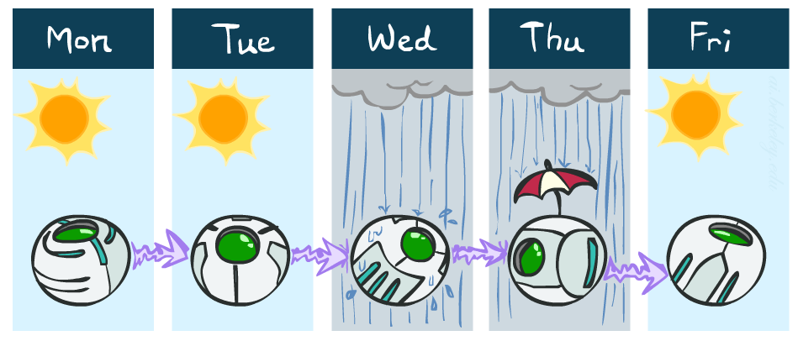
Example Markov Chain: Weather
States: X = {rain, sun}
Initial distribution: 1.0 sun
CPT P(X_{t} | X_{t-1}):
Two new ways of representing the same CPT
X_{t-1} | X_{t} | P(X_{t}|X_{t-1})
sun | sun | 0.9
sun | rain | 0.1
rain | sun | 0.3
rain | rain | 0.7
0.9
0.3
0.9
rain
sun
sun
sun
0.1
0.3
rain
rain
0.7
0.7
0.1

Slide 12
Example Markov Chain: Weather
0.9
Initial distribution: 1.0 sun
What is the probability distribution after one step?
0.3
rain
sun
0.7
0.1

Slide 13
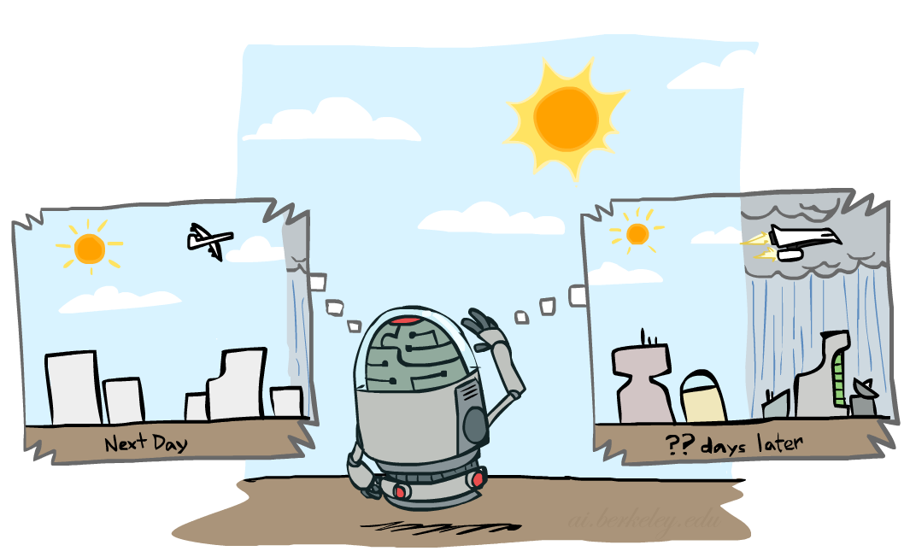

Mini-Forward Algorithm
Question: What’s P(X) on some day t?
X₁
X₂
X₃
X₄
Forward simulation

Slide 14
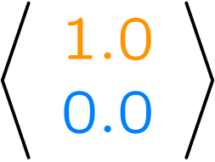
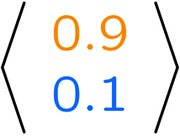
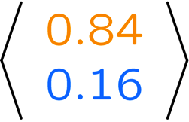
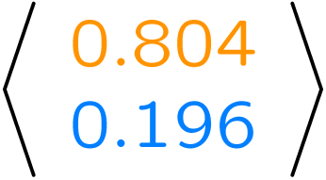
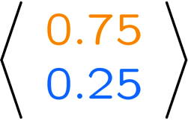
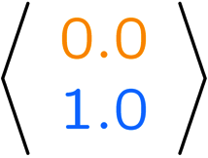
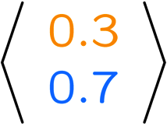
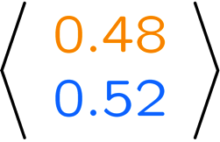
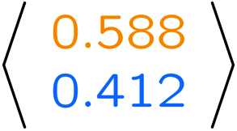
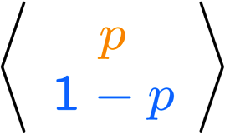
Example Run of Mini-Forward Algorithm
From initial observation of sun
From initial observation of rain
From yet another initial distribution P(X₁):
P(X₁)
P(X₂)
P(X₃)
P(X₄)
P(X∞)
P(X₁)
P(X₂)
P(X₃)
P(X₄)
P(X∞)
…
P(X₁)
P(X∞)
[Demo: L13D1,2,3]

Slide 15

Video of Demo Ghostbusters Basic Dynamics
Notes:
At T=1.03 he advances time – skip until then

Slide 16
Video of Demo Ghostbusters Circular Dynamics
Notes:
Time advances at T=18. Ask” what will happen with circular dynamics?

Slide 17
Video of Demo Ghostbusters Whirlpool Dynamics
Notes:
Start at T=15 – ask what will happen with belief?
Afterwards – second simulation starting from uniform

Slide 18

Stationary Distributions
For most chains:
  Influence of the initial distribution gets less and less over time.
  The distribution we end up in is independent of the initial distribution
Stationary distribution:
  The distribution we end up with is called the stationary distribution of the chain
  It satisfies

Slide 19
Example: Stationary Distributions
Question: What’s P(X) at time t = infinity?
X₁
X₂
X₃
X₄
X_{t-1} | X_{t} | P(X_{t}|X_{t-1})
sun | sun | 0.9
sun | rain | 0.1
rain | sun | 0.3
rain | rain | 0.7
Also:

Slide 20

Application of Stationary Distribution: Web Link Analysis
PageRank over a web graph
  Each web page is a state
  Initial distribution: uniform over pages
  Transitions:
    With prob. c, uniform jump to a
    random page (dotted lines, not all shown)
    With prob. 1-c, follow a random
    outlink (solid lines)
Stationary distribution
  Will spend more time on highly reachable pages
  E.g. many ways to get to the Acrobat Reader download page
  Somewhat robust to link spam
  Google 1.0 returned the set of pages containing all your keywords in decreasing rank, now all search engines use link analysis along with many other factors (rank actually getting less important over time)
Notes:
Before: most search engines were merely based on how well a page matches your search words.
Note: currently dominated by clickstreams

Slide 21

Application of Stationary Distributions: Gibbs Sampling*
Each joint instantiation over all hidden and query variables is a state: {X₁, …, X_{n}} = H U Q
Transitions:
  With probability 1/n resample variable X_{j} according to
  P(X_{j} | x₁, x₂, …, x_{j-1,} x_{j+1}, …, x_{n,} e_{1,} …, e_{m})
Stationary distribution:
  Conditional distribution P(X₁, X₂ , … , X_{n}|e_{1,} …, e_{m})
  Means that when running Gibbs sampling long enough we get a sample from the desired distribution
  Requires some proof to show this is true!
Notes:
With re-ordering of topics, can’t cover this here yet, need to wait till after sampling.

Slide 22
Hidden Markov Models
Markov chains not so useful for most agents
  Eventually you don’t know anything anymore
  Need observations to update your beliefs
Hidden Markov models (HMMs)
  Underlying Markov chain over states S
  You observe outputs (effects) at each time step
  As a Bayes’ net:
X₁
X₂
X₃
X₄
X_{N}
X₅
E₁
E₂
E₃
E₄
E_{N}
E₅

Slide 23
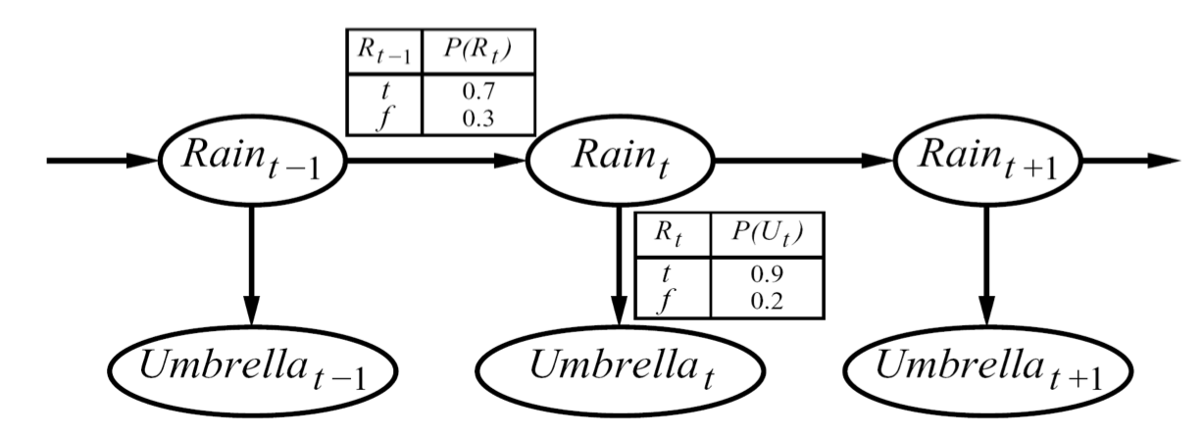



Example
An HMM is defined by:
  Initial distribution:
  Transitions:
  Emissions:

Slide 24



Hidden Markov Models
X₁
X₂
X₃
X₄
X_{N}
X₅
E₁
E₂
E₃
E₄
E_{N}
E₅
Defines a joint probability distribution:

Slide 25
Ghostbusters HMM
P(X₁) = uniform
P(X’|X) = ghosts usually move clockwise, but sometimes move in a random direction or stay put
P(E|X) = same sensor model as before:
red means close, green means far away.
1/9
1/9
1/9
1/9
1/9
1/9
1/9
1/9
1/9
P(X₁)
X₁
X₂
X₃
X₄
1/6
1/6
1/2
0
1/6
0
Etc…
E₁
E₁
E₃
E₄
0
0
0
P(X’|X=<1,2>)
P(red | 3) | P(orange | 3) | P(yellow | 3) | P(green | 3)
0.05 | 0.15 | 0.5 | 0.3
P(E|X)
E₅
Etc… (must specify for other distances)

Slide 26
HMM Computations
Given
  parameters
  evidence E_{1:n} =e_{1:n}
Inference problems include:
  Filtering, find P(X_{t}|e_{1:t}) for all t
  Smoothing, find P(X_{t}|e_{1:n}) for all t
  Most probable explanation, find
      x*_{1:n} = argmaxx_{1:n} P(x_{1:n}|e_{1:n})

Slide 27
Real HMM Examples
Speech recognition HMMs:
  Observations are acoustic signals (continuous valued)
  States are specific positions in specific words (so, tens of thousands)
X₁
X₂
X₃
X₄
E₁
E₁
E₃
E₄

Slide 28
Real HMM Examples
Machine translation HMMs:
  Observations are words (tens of thousands)
  States are translation options
X₁
X₂
X₃
X₄
E₁
E₁
E₃
E₄

Slide 29
Real HMM Examples
Robot tracking:
  Observations are range readings (continuous)
  States are positions on a map (continuous)
X₁
X₂
X₃
X₄
E₁
E₁
E₃
E₄

Slide 30
Conditional Independence
HMMs have two important independence properties:
  Markov hidden process, future depends on past via the present
?
?
X₁
X₂
X₃
X₄
E₁
E₁
E₃
E₄

Slide 31
Conditional Independence
HMMs have two important independence properties:
  Markov hidden process, future depends on past via the present
  Current observation independent of all else given current state
?
X₁
X₂
X₃
X₄
E₁
E₁
E₃
E₄
?

Slide 32
Conditional Independence
HMMs have two important independence properties:
  Markov hidden process, future depends on past via the present
  Current observation independent of all else given current state
Quiz: does this mean that observations are independent given no evidence?
  [No, correlated by the hidden state]
X₁
X₂
X₃
X₄
E₁
E₁
E₃
E₄
?
?

Slide 33
Filtering / Monitoring
Filtering, or monitoring, is the task of tracking the distribution B(X) (the belief state) over time
We start with B(X) in an initial setting, usually uniform
As time passes, or we get observations, we update B(X)
The Kalman filter (one method – Real valued values)
  invented in the 60’s as a method of trajectory estimation for the Apollo program

Slide 34
Example: Robot Localization
Example from Michael Pfeiffer
Prob
0
1
t=0
Sensor model: never more than 1 mistake
Motion model: may not execute action with small prob.

Slide 35
Example: Robot Localization
Prob
0
1
t=1

Slide 36
Example: Robot Localization
Prob
0
1
t=2

Slide 37
Example: Robot Localization
Prob
0
1
t=3

Slide 38
Example: Robot Localization
Prob
0
1
t=4

Slide 39
Example: Robot Localization
Prob
0
1
t=5

Slide 40


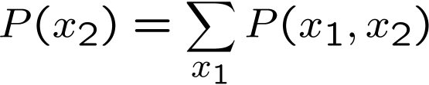

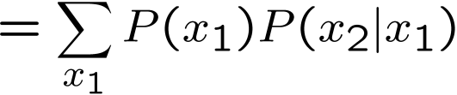

Inference Recap: Simple Cases
X₁
X₁
X₂
E₁

Slide 41
Online Belief Updates
Every time step, we start with current P(X | evidence)
We update for time:
We update for evidence:
The forward algorithm does both at once (and doesn’t normalize)
Problem: space is |X| and time is |X|² per time step
X₁
X₂
X₂
E₂

Slide 42

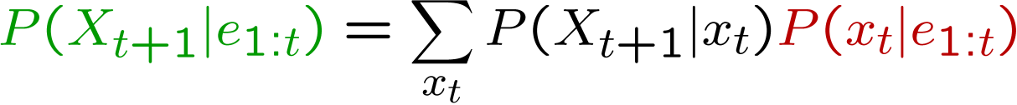
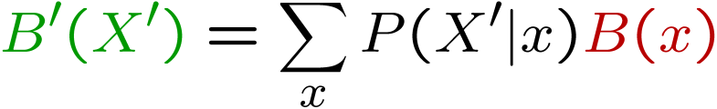
Passage of Time
Assume we have current belief P(X | evidence to date)
Then, after one time step passes:
Or, compactly:
Basic idea: beliefs get “pushed” through the transitions
  With the “B” notation, we have to be careful about what time step t the belief is about, and what evidence it includes
X₁
X₂

Slide 43
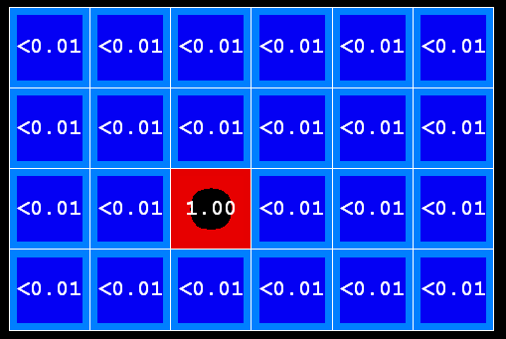

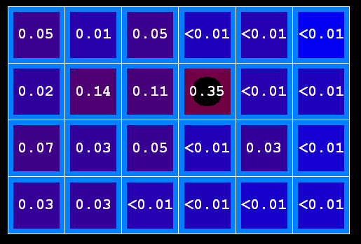
Example: Passage of Time
As time passes, uncertainty “accumulates”
T = 1
T = 2
T = 5
Transition model: ghosts usually go clockwise

Slide 44

Observation
Assume we have current belief P(X | previous evidence):
Then:
Or:
Basic idea: beliefs reweighted by likelihood of evidence
Unlike passage of time, we have to renormalize
X₁
E₁

Slide 45
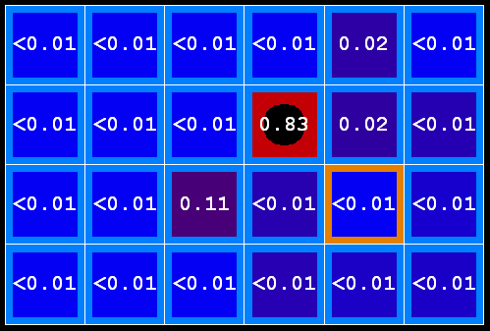

Example: Observation
As we get observations, beliefs get reweighted, uncertainty “decreases”
Before observation
After observation

Slide 46

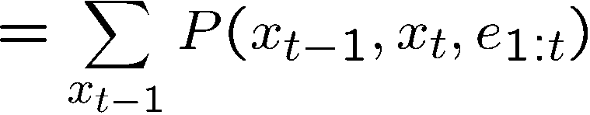
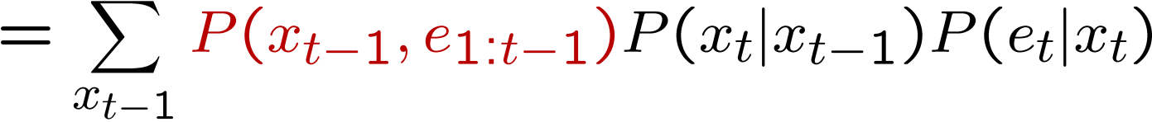
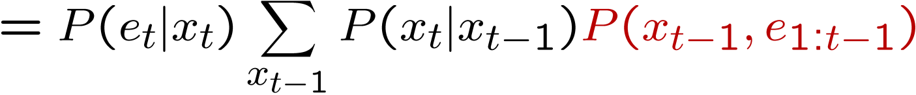
The Forward Algorithm
We want to know:
We can derive the following updates
To get , compute each entry and normalize

Slide 47
Example: Run the Filter
An HMM is defined by:
  Initial distribution:
  Transitions:
  Emissions:

Slide 48
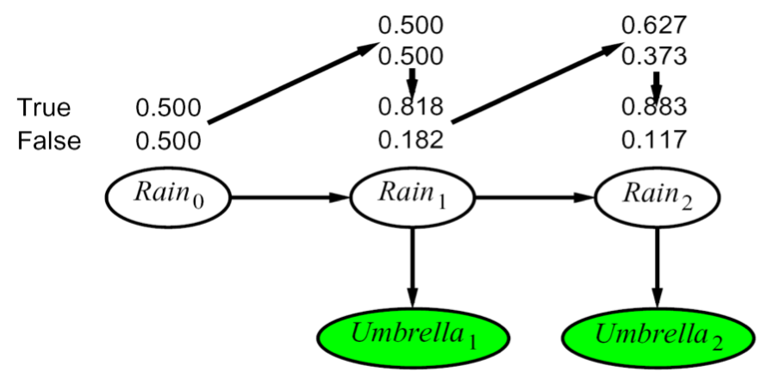
Example HMM

Slide 49
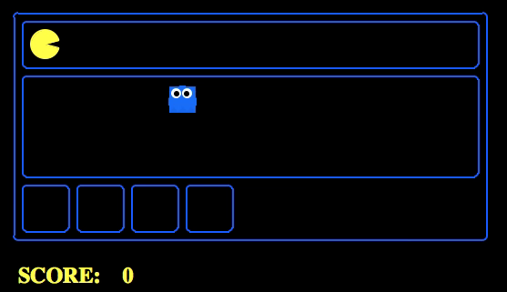
Example Pac-man

Slide 50
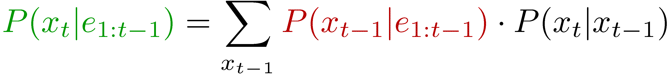
Summary: Filtering
Filtering is the inference process of finding a distribution over X_{T} given e₁ through e_{T} : P( X_{T} | e_{1:t} )
We first compute P( X₁ | e₁ ):
For each t from 2 to T, we have P( X_{t-1} | e_{1:t-1} )
Elapse time: compute P( X_{t} | e_{1:t-1} )
Observe: compute P(X_{t} | e_{1:t-1} , e_{t}) = P( X_{t} | e_{1:t} )

Slide 51


Recap: Reasoning Over Time
Stationary Markov models
0.3
0.7
rain
sun
X₁
X₂
X₃
X₄
0.7
0.3
Hidden Markov models
X | E | P
rain | umbrella | 0.9
rain | no umbrella | 0.1
sun | umbrella | 0.2
sun | no umbrella | 0.8
X₁
X₂
X₃
X₄
X₅
E₁
E₂
E₃
E₄
E₅

Slide 52



Recap: Filtering
Elapse time: compute P( X_{t} | e_{1:t-1} )
Observe: compute P( X_{t} | e_{1:t} )
Belief: <P(rain), P(sun)>
X₁
X₂
<0.5, 0.5>
Prior on X₁
<0.82, 0.18>
Observe
E₁
E₂
<0.63, 0.37>
Elapse time
<0.88, 0.12>
Observe

Slide 53
Particle Filtering
Sometimes |X| is too big to use exact inference
  |X| may be too big to even store B(X)
  E.g. X is continuous
  |X|² may be too big to do updates
Solution: approximate inference
  Track samples of X, not all values
  Samples are called particles
  Time per step is linear in the number of samples
  But: number needed may be large
  In memory: list of particles, not states
This is how robot localization works in practice
0.0
0.1
0.0
0.0
0.0
0.2
0.0
0.2
0.5

Slide 54
Representation: Particles
Our representation of P(X) is now a list of N particles (samples)
  Generally, N << |X|
  Storing map from X to counts would defeat the point
P(x) approximated by number of particles with value x
  So, many x will have P(x) = 0!
  More particles, more accuracy
For now, all particles have a weight of 1
Particles:
(3,3)
(2,3)
(3,3)
(3,2)
(3,3)
(3,2)
(2,1)
(3,3)
(3,3)
(2,1)

Slide 55

Particle Filtering: Elapse Time
Each particle is moved by sampling its next position from the transition model
  This is like prior sampling – samples’ frequencies reflect the transition probs
  Here, most samples move clockwise, but some move in another direction or stay in place
This captures the passage of time
  If we have enough samples, close to the exact values before and after (consistent)

Slide 56


Particle Filtering: Observe
Slightly trickier:
  Don’t do rejection sampling (why not?)
  We don’t sample the observation, we fix it
  This is similar to likelihood weighting, so we downweight our samples based on the evidence
  Note that, as before, the probabilities don’t sum to one, since most have been downweighted (in fact they sum to an approximation of P(e))

Slide 57
Particle Filtering: Resample
Old Particles:
(3,3) w=0.1
(2,1) w=0.9
(2,1) w=0.9
(3,1) w=0.4
(3,2) w=0.3
(2,2) w=0.4
(1,1) w=0.4
(3,1) w=0.4
(2,1) w=0.9
(3,2) w=0.3
Rather than tracking weighted samples, we resample
N times, we choose from our weighted sample distribution (i.e. draw with replacement)
This is equivalent to renormalizing the distribution
Now the update is complete for this time step, continue with the next one
New Particles:
(2,1) w=1
(2,1) w=1
(2,1) w=1
(3,2) w=1
(2,2) w=1
(2,1) w=1
(1,1) w=1
(3,1) w=1
(2,1) w=1
(1,1) w=1

Slide 58
Recap: Particle Filtering
At each time step t, we have a set of N particles / samples
Initialization: Sample from prior, reweight and resample
Three step procedure, to move to time t+1:
  Sample transitions: for each each particle x, sample next state
  Reweight: for each particle, compute its weight given the actual observation e
  Resample: normalize the weights, and sample N new particles from the resulting distribution over states

Slide 59

Particle Filtering Summary
Represent current belief P(X | evidence to date) as set of n samples (actual assignments X=x)
For each new observation e:
  Sample transition, once for each current particle x
  For each new sample x’, compute importance weights for the new evidence e:
  Finally, normalize the importance weights and resample N new particles

Slide 60
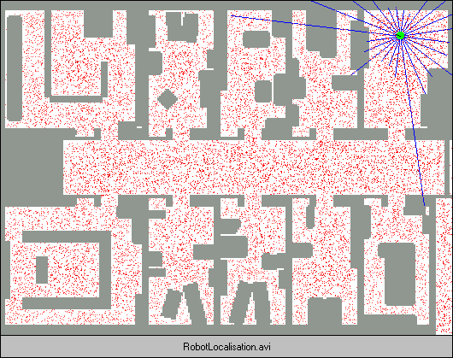
Robot Localization
In robot localization:
  We know the map, but not the robot’s position
  Observations may be vectors of range finder readings
  State space and readings are typically continuous (works basically like a very fine grid) and so we cannot store B(X)
  Particle filtering is a main technique

Slide 61
Robot Localization

Slide 62
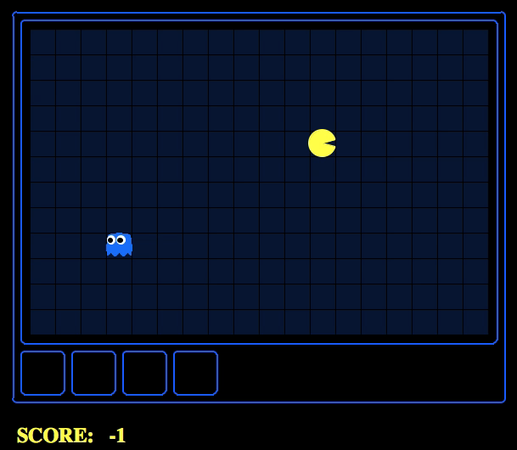
Which Algorithm?
Exact filter, uniform initial beliefs

Slide 63
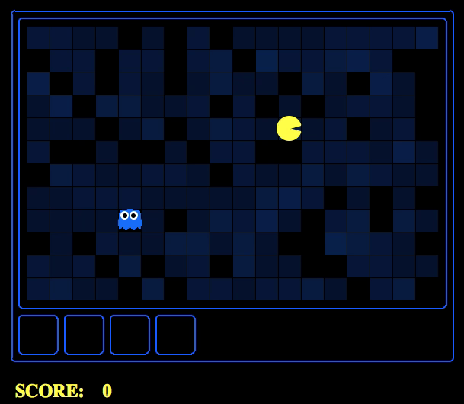
Which Algorithm?
Particle filter, uniform initial beliefs, 300 particles

Slide 64
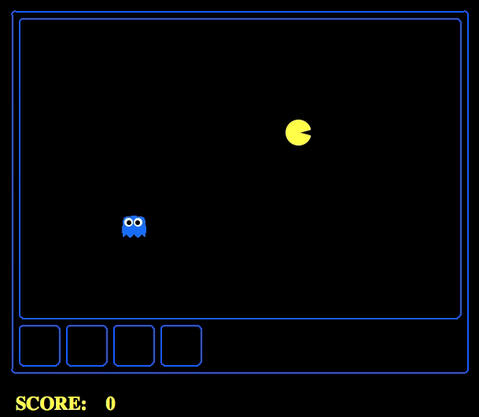
Which Algorithm?
Particle filter, uniform initial beliefs, 25 particles

Slide 65
P4: Ghostbusters
Noisy distance prob
True distance = 8
Plot: Pacman's grandfather, Grandpac, learned to hunt ghosts for sport.
He was blinded by his power, but could hear the ghosts’ banging and clanging.
Transition Model: All ghosts move randomly, but are sometimes biased
Emission Model: Pacman knows a “noisy” distance to each ghost

Slide 66
Dynamic Bayes Nets (DBNs)
We want to track multiple variables over time, using multiple sources of evidence
Idea: Repeat a fixed Bayes net structure at each time
Variables from time t can condition on those from t-1
Discrete valued dynamic Bayes nets are also HMMs
t =1
t =2
t =3
G₁ª
G₂ª
G₃ª
G₁^{b}
G₂^{b}
G₃^{b}
E₁ª
E₁^{b}
E₂ª
E₂^{b}
E₃ª
E₃^{b}

Slide 67
Exact Inference in DBNs
Variable elimination applies to dynamic Bayes nets
Procedure: “unroll” the network for T time steps, then eliminate variables until P(X_{T}|e_{1:T}) is computed
Online belief updates: Eliminate all variables from the previous time step; store factors for current time only
t =1
t =2
t =3
G₁ª
G₂ª
G₃ª
G₃^{b}
G₁^{b}
G₂^{b}
G₃^{b}
E₁ª
E₁^{b}
E₂ª
E₂^{b}
E₃ª
E₃^{b}

Slide 68
DBN Particle Filters
A particle is a complete sample for a time step
Initialize: Generate prior samples for the t=1 Bayes net
  Example particle: G₁ª = (3,3) G₁^{b} = (5,3)
Elapse time: Sample a successor for each particle
  Example successor: G₂ª = (2,3) G₂^{b} = (6,3)
Observe: Weight each entire sample by the likelihood of the evidence conditioned on the sample
  Likelihood: P(E₁ª |G₁ª ) * P(E₁^{b} |G₁^{b} )
Resample: Select prior samples (tuples of values) in proportion to their likelihood

Slide 69
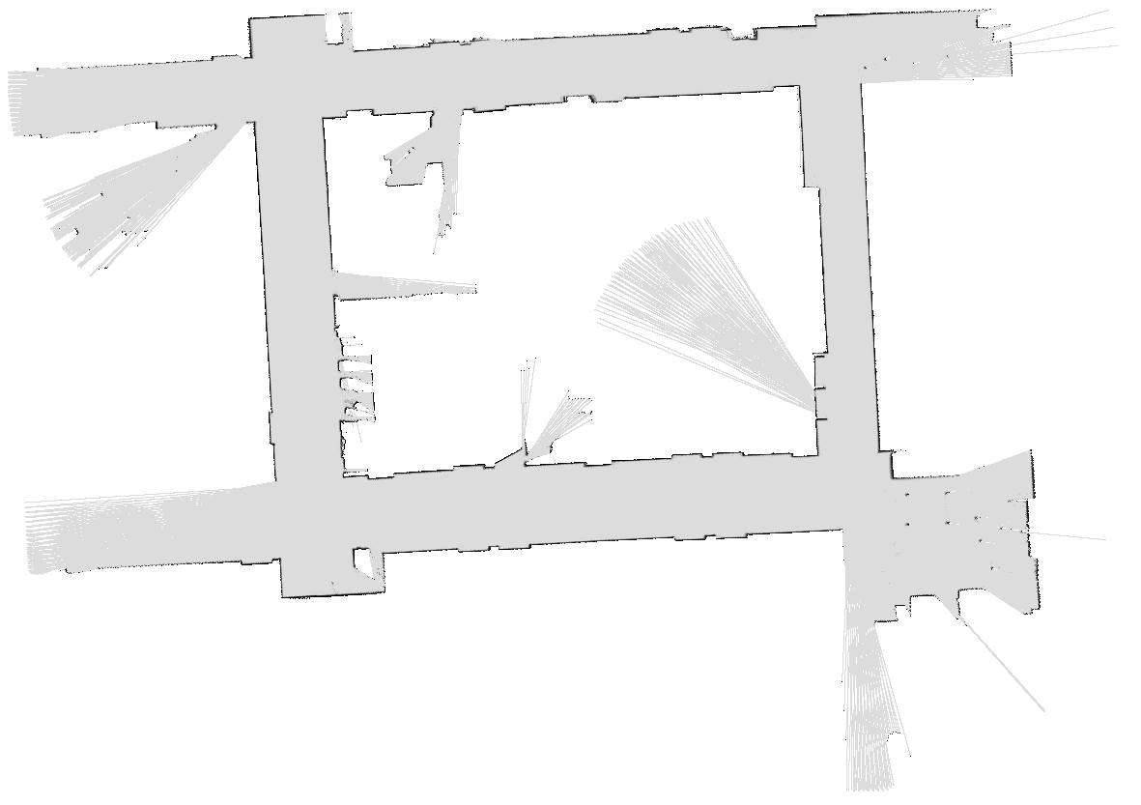
SLAM
SLAM = Simultaneous Localization And Mapping
  We do not know the map or our location
  Our belief state is over maps and positions!
  Main techniques: Kalman filtering (Gaussian HMMs) and particle methods
[DEMOS]
DP-SLAM, Ron Parr

Slide 70
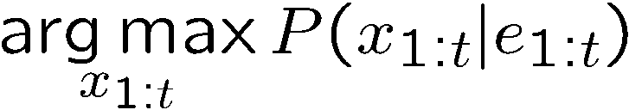
Best Explanation Queries
X₁
X₂
X₃
X₄
X₅
E₁
E₂
E₃
E₄
E₅
Query: most likely seq:

Slide 71





State Path Trellis
State trellis: graph of states and transitions over time
Each arc represents some transition
Each arc has weight
Each path is a sequence of states
The product of weights on a path is the seq’s probability
Can think of the Forward (and now Viterbi) algorithms as computing sums of all paths (best paths) in this graph
sun
sun
sun
sun
rain
rain
rain
rain

Slide 72
Viterbi Algorithm
sun
sun
sun
sun
rain
rain
rain
rain
22

Slide 73
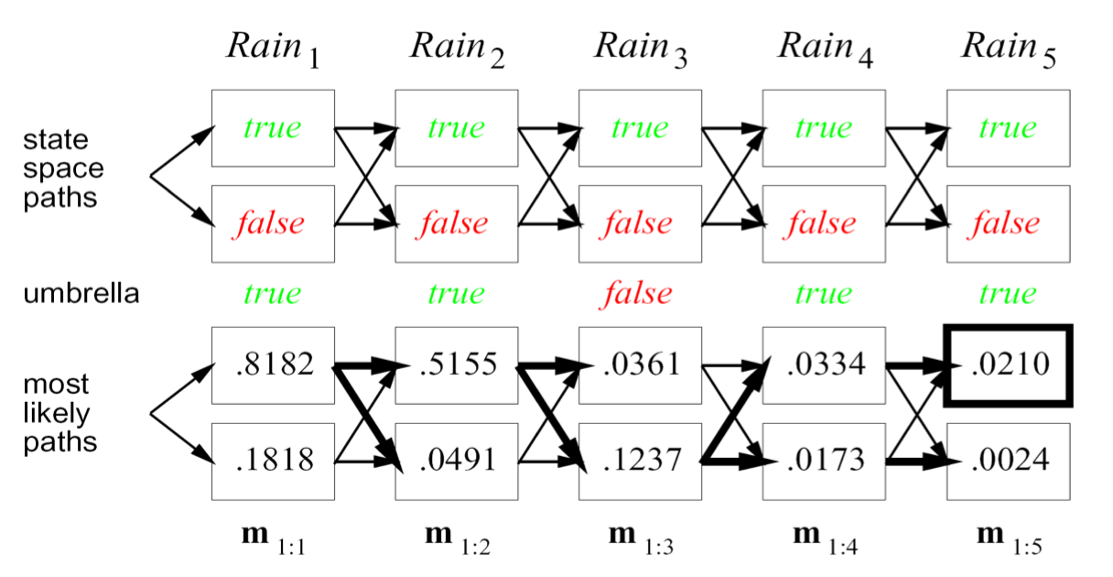
Example
23

