Slide 1
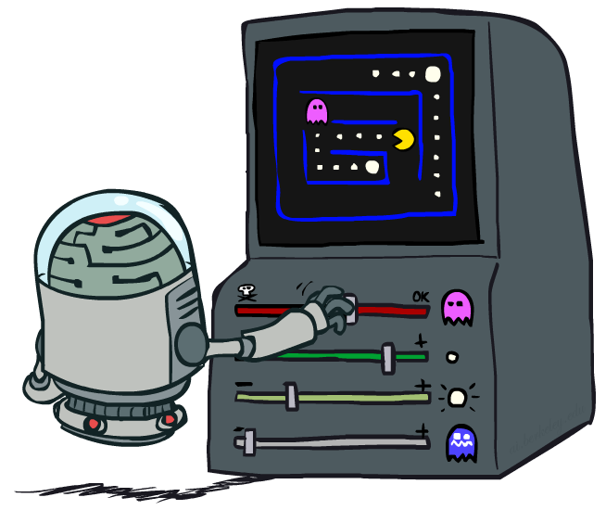
CS 473: Artificial Intelligence
Reinforcement Learning III
Travis Mandel (filling in for Dan) / University of Washington
[Most slides were taken from Dan Klein and Pieter Abbeel / CS188 Intro to AI at UC Berkeley. All CS188 materials are available at http://ai.berkeley.edu.]
Notes:
Please retain proper attribution and the reference to ai.berkeley.edu. Thanks!

Slide 2
Logistics
PS3 – due 11/12

Slide 3
Two main reinforcement learning approaches
Model-based approaches:
  explore environment & learn model, T=P(s’|s,a) and R(s,a), (almost) everywhere
  use model to plan policy, MDP-style
  approach leads to strongest theoretical results
  often works well when state-space is manageable
Model-free approach:
  don’t learn a model; learn value function or policy directly
  weaker theoretical results
  often works better when state space is large

Slide 4
Reinforcement Learning Recap
Model-based approach
Model-free approaches
  TD-learning
  Tabular Q-Learning
  Epsilon-Greedy, Exploration Functions
  TODAY: Approximate Linear Q-Learning

Slide 5
Approximate Q-Learning

Slide 6
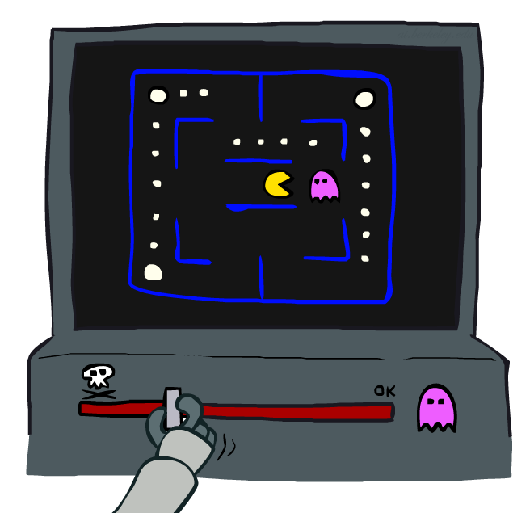
Approximate Q-Learning

Slide 7
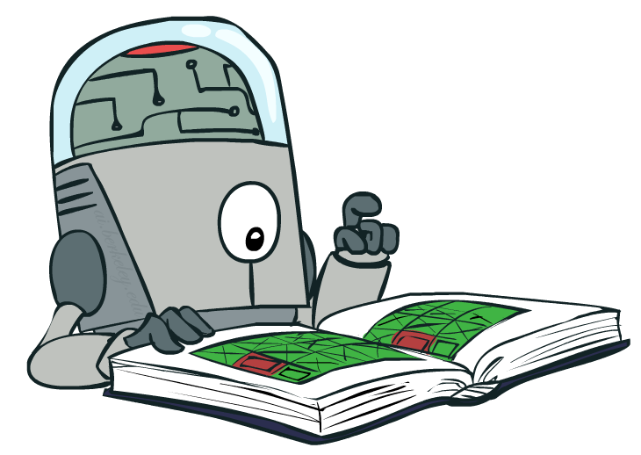
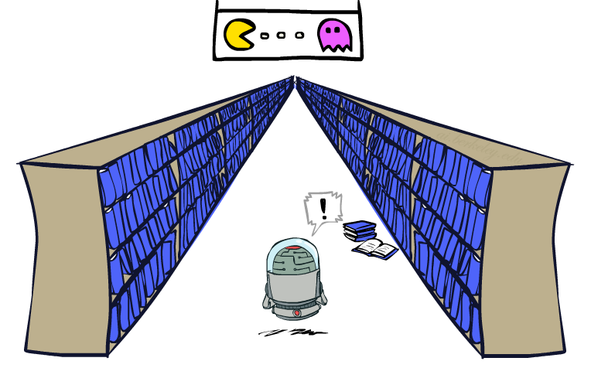
Generalizing Across States
Basic Q-Learning keeps a table of all q-values
In realistic situations, we cannot possibly learn about every single state!
  Too many states to visit them all in training
  Too many states to hold the q-tables in memory
Instead, we want to generalize:
  Learn about some small number of training states from experience
  Generalize that experience to new, similar situations
  This is a fundamental idea in machine learning, and we’ll see it over and over again
[demo – RL pacman]

Slide 8




Example: Pacman
Let’s say we discover through experience that this state is bad:
In naïve q-learning, we know nothing about this state:
Or even this one!
[Demo: Q-learning – pacman – tiny – watch all (L11D5)]
[Demo: Q-learning – pacman – tiny – silent train (L11D6)]
[Demo: Q-learning – pacman – tricky – watch all (L11D7)]

Slide 9
Feature-Based Representations
Solution: describe a state using a vector of features (aka “properties”)
  Features are functions from states to real numbers (often 0/1) that capture important properties of the state
  Example features:
    Distance to closest ghost
    Distance to closest dot
    Number of ghosts
    1 / (dist to dot)²
    Is Pacman in a tunnel? (0/1)
    …… etc.
    Is it the exact state on this slide?
  Can also describe a q-state (s, a) with features (e.g. action moves closer to food)

Slide 10

How to use features?
Using a feature representation, we can write a q function (or value function) for any state
$$V\left(s\right)=g(f_{1}\left(s\right), f_{2}\left(s\right),…,f_{n}\left(s\right))$$
$$Q\left(s,a\right)=g(f_{1}\left(s\right), f_{2}\left(s\right),…,f_{n}\left(s\right))$$
Notes:
General form!

Slide 11
How to use features?
Using a feature representation, we can write a q function (or value function) for any state using a few weights:
Advantage: our experience is summed up in a few powerful numbers
Disadvantage: states may share features but actually be very different in value!

Slide 12

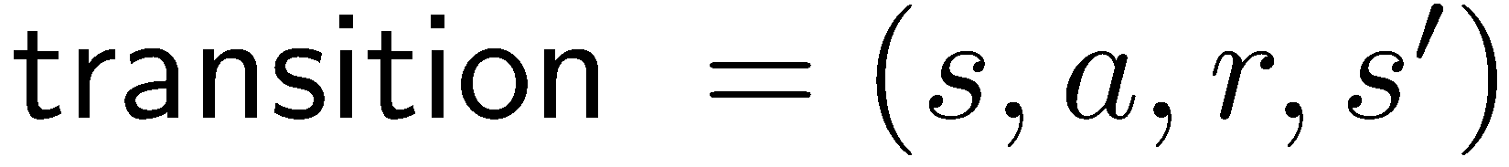
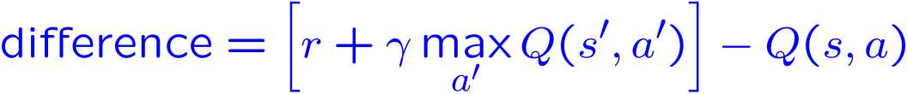
Approximate Q-Learning
Q-learning with linear Q-functions:
Intuitive interpretation:
  Adjust weights of active features
  E.g., if something unexpectedly bad happens, blame the features that were on: disprefer all states with that state’s features
Formal justification: in a few slides!
Exact Q’s
Approximate Q’s

Slide 13



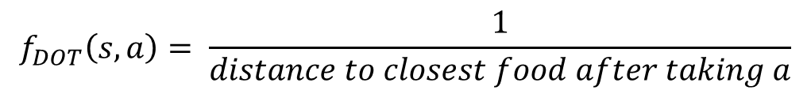
Example: Pacman Features
$$Q\left(s,a\right)= w_{1}f_{DOT}\left(s, a\right)+w_{2}f_{GST}(s,a)$$
$$f_{DOT}\left(s,a\right)= \frac{1}{distance to closest food after taking a}$$
$$f_{DOT}\left(s,NORTH\right)=0.5$$
$$f_{GST}\left(s,a\right)=distance to closest ghost after taking a$$
$$f_{GST}\left(s,NORTH\right)= 1.0$$

Slide 14
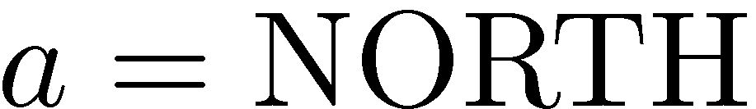
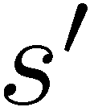



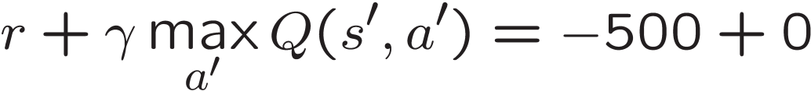
Example: Q-Pacman
[Demo: approximate Q-learning pacman (L11D10)]

Slide 15

Video of Demo Approximate Q-Learning -- Pacman

Slide 16
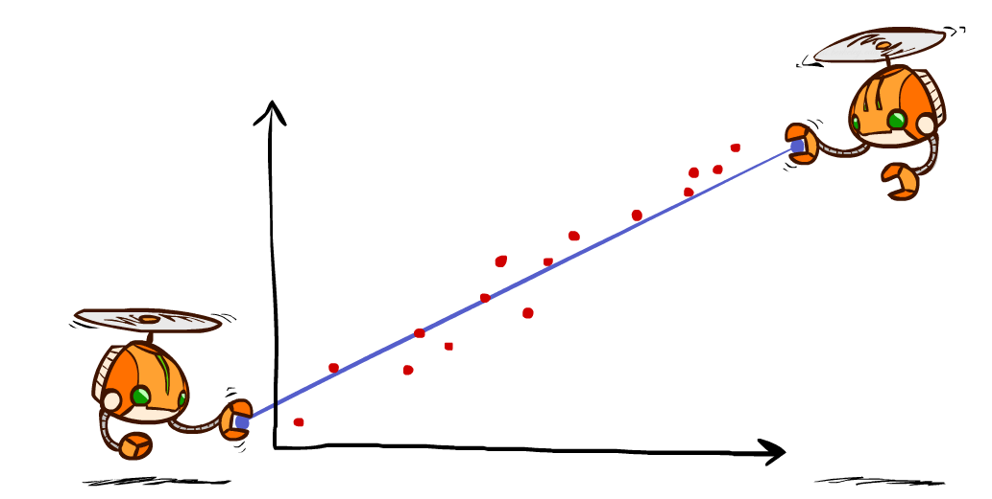
Sidebar: Q-Learning and Least Squares

Slide 17

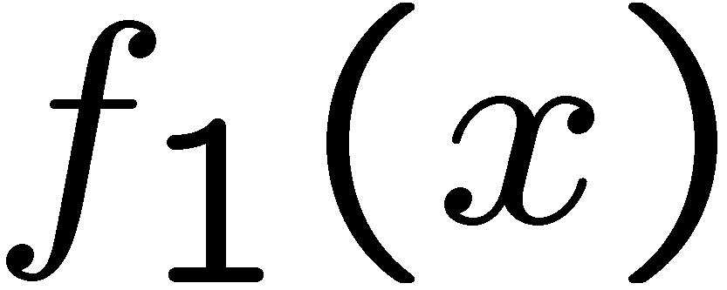
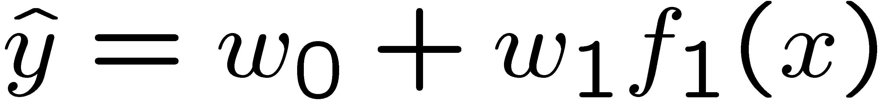
Linear Approximation: Regression
40
26
24
20
22
20
30
20
40
0
0
20
30
10
20
0
10
0
Prediction:
Prediction:
Notes:
Figure 1: scatter(1:20,10+(1:20)+2*randn(1,20),'k','filled'); a=axis; a(3)=0; axis(a);

Slide 18
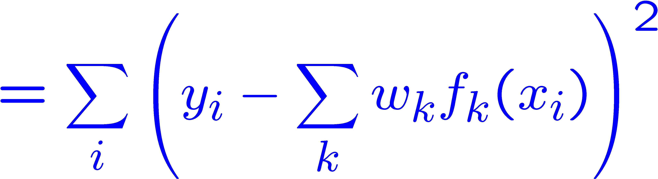
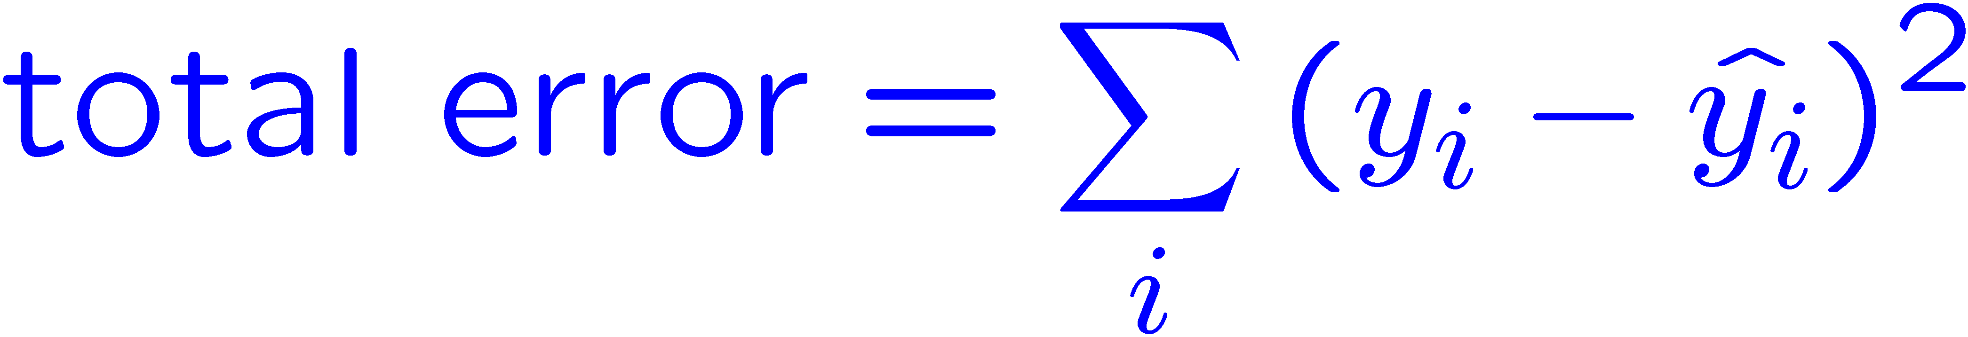



Optimization: Least Squares
Error or “residual”
Observation
Prediction
0
0
20
Notes:
Figure 1: scatter(1:20,10+(1:20)+2*randn(1,20),'k','filled'); a=axis; a(3)=0; axis(a);

Slide 19
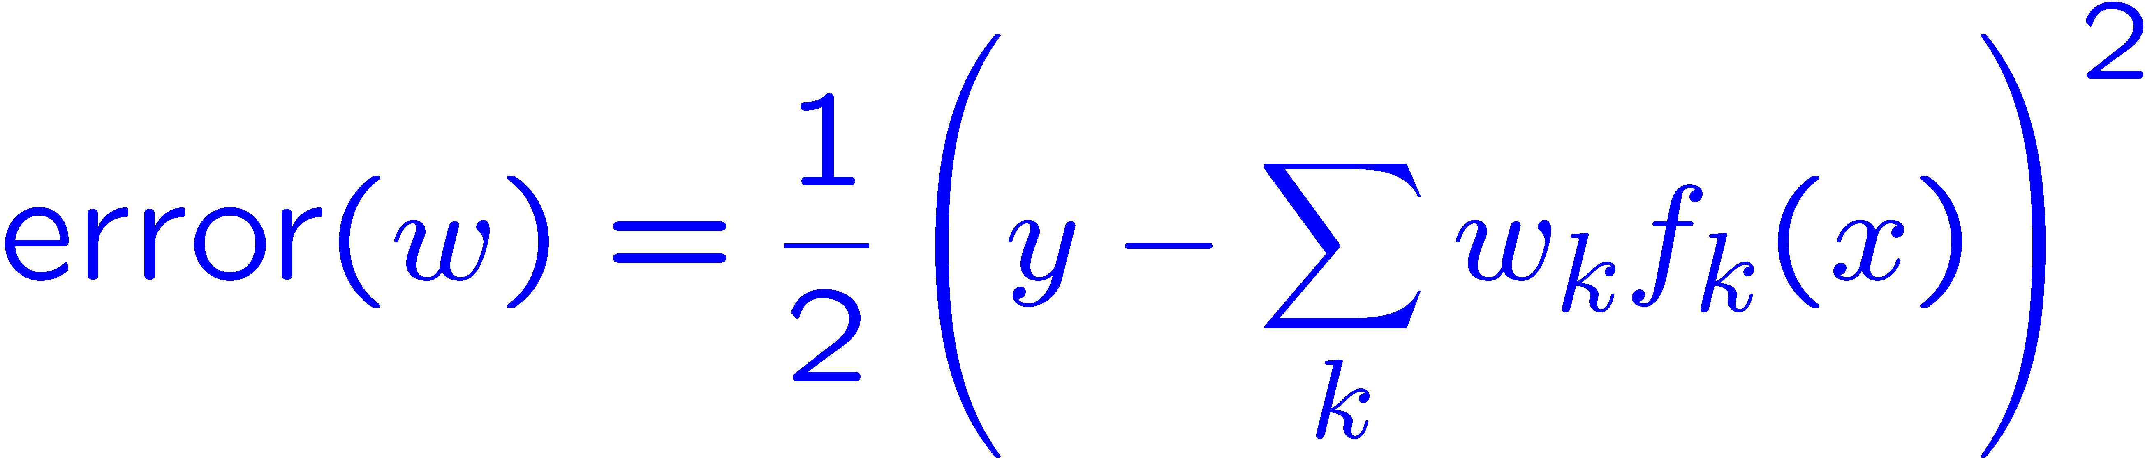
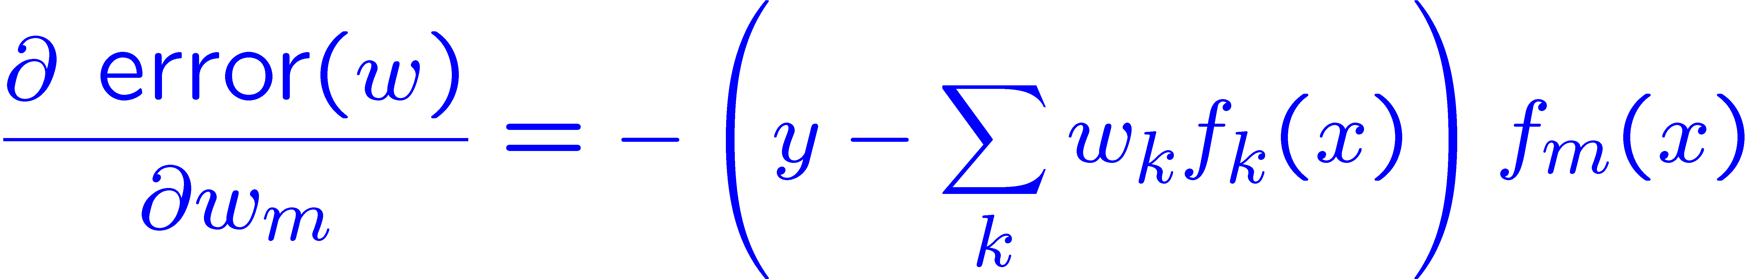
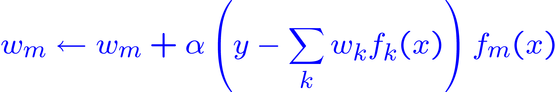
Minimizing Error
Imagine we had only one point x, with features f(x), target value y, and weights w:
Approximate q update explained:
“target”
“prediction”

Slide 20
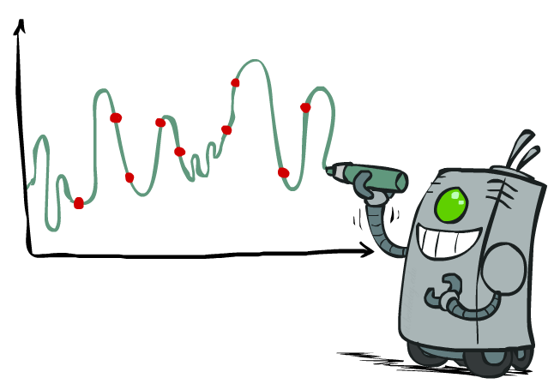
Overfitting: Why Limiting Capacity Can Help
30
25
20
Degree 15 polynomial
15
10
5
0
-5
-10
-15
0
2
4
6
8
10
12
14
16
18
20

Slide 21
Simple Problem
Given: Features of current state
Predict: Will Pacman die on the next step?

Slide 22
Just one feature. See a pattern?
Ghost one step away, pacman dies
Ghost one step away, pacman dies
Ghost one step away, pacman dies
Ghost one step away, pacman dies
Ghost one step away, pacman lives
Ghost more than one step away, pacman lives
Ghost more than one step away, pacman lives
Ghost more than one step away, pacman lives
Ghost more than one step away, pacman lives
Ghost more than one step away, pacman lives
Ghost more than one step away, pacman lives
Learn: Ghost one step away → pacman dies!

Slide 23
See a pattern?
Ghost one step away, pacman dies
Ghost one step away, pacman dies
Ghost one step away, pacman dies
Ghost one step away, pacman dies
Ghost one step away, pacman lives
Ghost more than one step away, pacman lives
Ghost more than one step away, pacman lives
Ghost more than one step away, pacman lives
Ghost more than one step away, pacman lives
Ghost more than one step away, pacman lives
Ghost more than one step away, pacman lives
Learn: Ghost one step away → pacman dies!

Slide 24
What if we add more features?
Ghost one step away, score 211, pacman dies
Ghost one step away, score 341, pacman dies
Ghost one step away, score 231, pacman dies
Ghost one step away, score 121, pacman dies
Ghost one step away, score 301, pacman lives
Ghost more than one step away, score 205, pacman lives
Ghost more than one step away, score 441, pacman lives
Ghost more than one step away, score 219, pacman lives
Ghost more than one step away, score 199, pacman lives
Ghost more than one step away, score 331, pacman lives
Ghost more than one step away, score 251, pacman lives
Learn: Ghost one step away AND score is NOT 301 → pacman dies!

Slide 25
What if we add more features?
Ghost one step away, score 211, pacman dies
Ghost one step away, score 341, pacman dies
Ghost one step away, score 231, pacman dies
Ghost one step away, score 121, pacman dies
Ghost one step away, score 301, pacman lives
Ghost more than one step away, score 205, pacman lives
Ghost more than one step away, score 441, pacman lives
Ghost more than one step away, score 219, pacman lives
Ghost more than one step away, score 199, pacman lives
Ghost more than one step away, score 331, pacman lives
Ghost more than one step away, score 251, pacman lives
Learn: Ghost one step away AND score is NOT 301 → pacman dies!

Slide 26

Normal Programming now resuming…

Slide 27
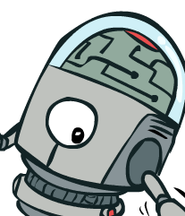
Policy Search

Slide 28
Policy Search
Problem: often the feature-based policies that work well (win games, maximize utilities) aren’t the ones that approximate V / Q best
  E.g. your value functions from project 2 were probably horrible estimates of future rewards, but they still produced good decisions
  Q-learning’s priority: get Q-values close (modeling)
  Action selection priority: get ordering of Q-values right (prediction)
  We’ll see this distinction between modeling and prediction again later in the course
Solution: learn policies that maximize rewards, not the values that predict them
Policy search: start with an ok solution (e.g. Q-learning) then fine-tune by hill climbing on feature weights

Slide 29
Policy Search
Simplest policy search:
  Start with an initial linear value function or Q-function
  Nudge each feature weight up and down and see if your policy is better than before
Problems:
  How do we tell the policy got better?
  Need to run many sample episodes!
  If there are a lot of features, this can be impractical
Better methods exploit lookahead structure, sample wisely, change multiple parameters…

Slide 30
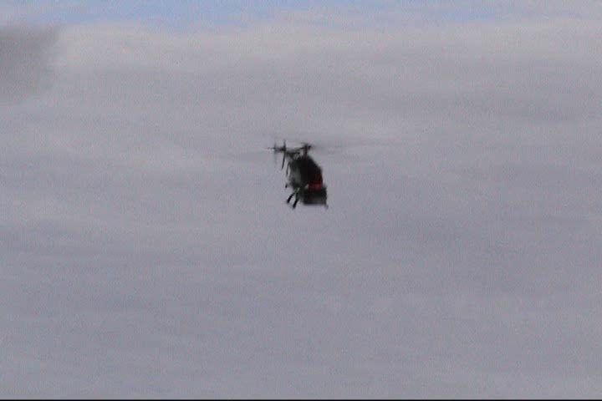
Policy Search
[Andrew Ng]
[Video: HELICOPTER]

Slide 31
That’s all for Reinforcement Learning!
Data (experiences with environment)
Reinforcement Learning Agent
Very tough problem: How to perform any task well in an unknown, noisy environment!
Traditionally used mostly for robotics, but becoming more widely used
Lots of open research areas:
  How to best balance exploration and exploitation?
  How to deal with cases where we don’t know a good state/feature representation?
Policy (how to act in the future)

Slide 32
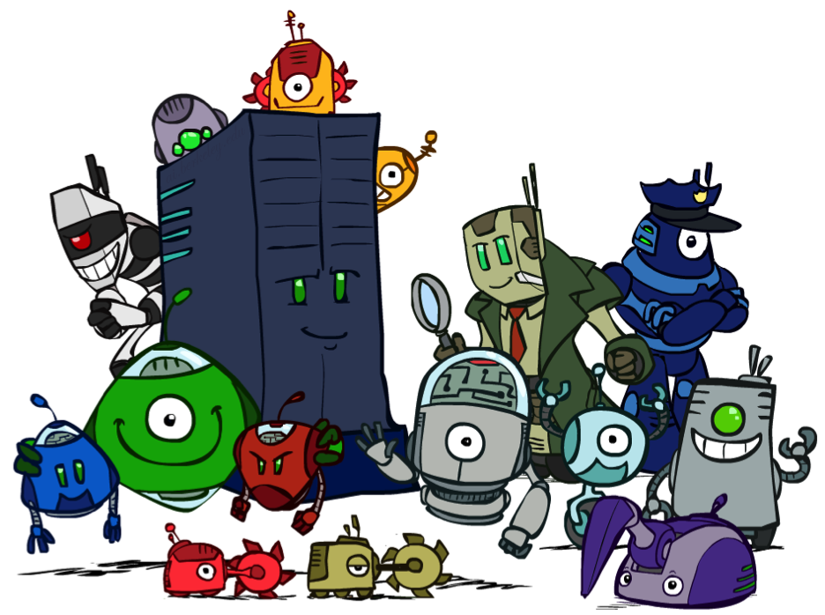
Conclusion
We’re done with Part I: Search and Planning!
We’ve seen how AI methods can solve problems in:
  Search
  Constraint Satisfaction Problems
  Games
  Markov Decision Problems
  Reinforcement Learning
Next up: Part II: Uncertainty and Learning!

Slide 33
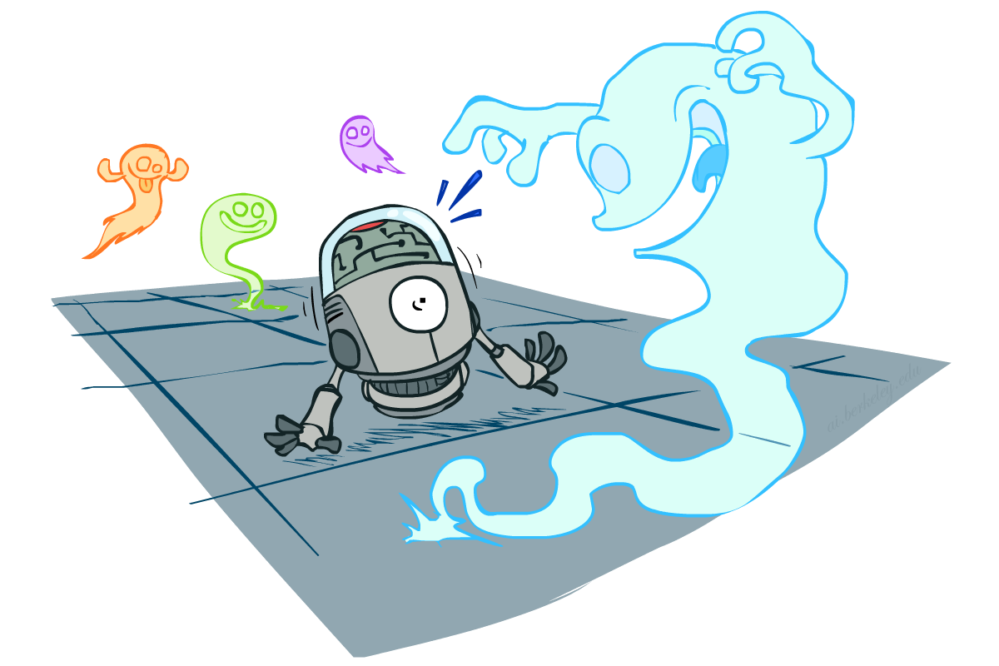
CS 473: Artificial Intelligence
Probability
Instructor: Travis Mandel --- University of Washingtion
[These slides were created by Dan Klein and Pieter Abbeel for CS188 Intro to AI at UC Berkeley. All CS188 materials are available at http://ai.berkeley.edu.]
Notes:
Please retain proper attribution, including the reference to ai.berkeley.edu. Thanks!

Slide 34
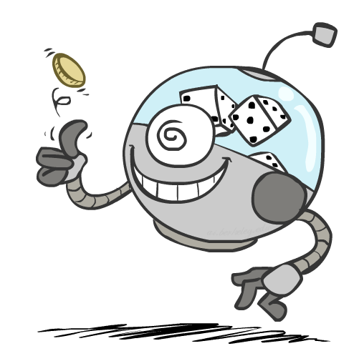
Next
Probability
  Random Variables
  Joint and Marginal Distributions
  Conditional Distribution
  Product Rule, Chain Rule, Bayes’ Rule
  Inference
  Independence
You’ll need all this stuff A LOT for the next few weeks, so make sure you go over it now!
Notes:
Like “sort this list” or “add these two numbers”

Slide 35
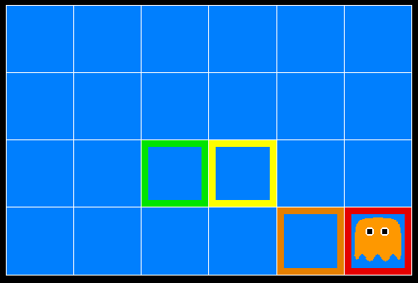
Inference in Ghostbusters
A ghost is in the grid somewhere
Sensor readings tell how close a square is to the ghost
  On the ghost: red
  1 or 2 away: orange
  3 or 4 away: yellow
  5+ away: green
Sensors are noisy, but we know P(Color | Distance)
P(red | 3) | P(orange | 3) | P(yellow | 3) | P(green | 3)
0.05 | 0.15 | 0.5 | 0.3
[Demo: Ghostbuster – no probability (L12D1) ]

Slide 36
Video of Demo Ghostbuster – No probability

Slide 37
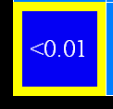
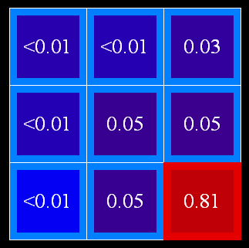
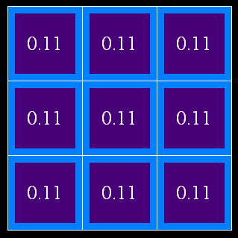
Uncertainty
General situation:
  Observed variables (evidence): Agent knows certain things about the state of the world (e.g., sensor readings or symptoms)
  Unobserved variables: Agent needs to reason about other aspects (e.g. where an object is or what disease is present)
  Model: Agent knows something about how the known variables relate to the unknown variables
Probabilistic reasoning gives us a framework for managing our beliefs and knowledge

Slide 38
Random Variables
A random variable is some aspect of the world about which we (may) have uncertainty
  R = Is it raining?
  T = Is it hot or cold?
  D = How long will it take to drive to work?
  L = Where is the ghost?
We denote random variables with capital letters
Like variables in a CSP, random variables have domains
  R in {true, false} (often write as {+r, -r})
  T in {hot, cold}
  D in [0, ∞)
  L in possible locations, maybe {(0,0), (0,1), …}

Slide 39
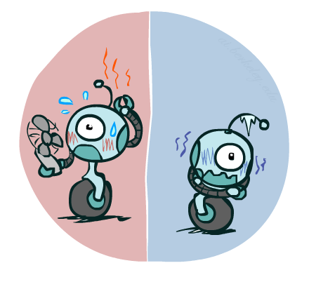

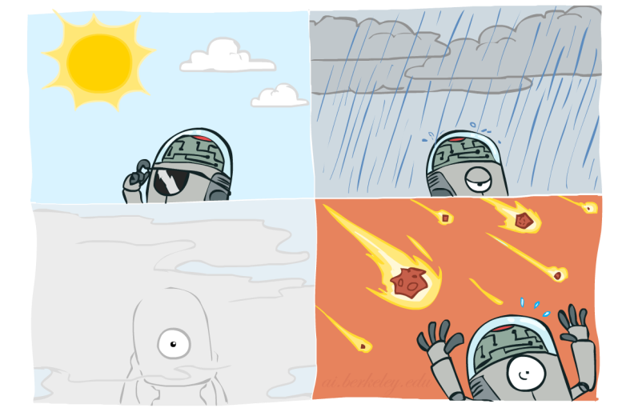

Probability Distributions
Associate a probability with each value
  Temperature:
  Weather:
W | P
sun | 0.6
rain | 0.1
fog | 0.3
meteor | 0.0
T | P
hot | 0.5
cold | 0.5

Slide 40


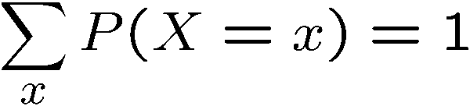
Probability Distributions
Unobserved random variables have distributions
A distribution is a TABLE of probabilities of values
A probability (lower case value) is a single number
Must have: and
Shorthand notation:
OK if all domain entries are unique
T | P
hot | 0.5
cold | 0.5
W | P
sun | 0.6
rain | 0.1
fog | 0.3
meteor | 0.0

Slide 41




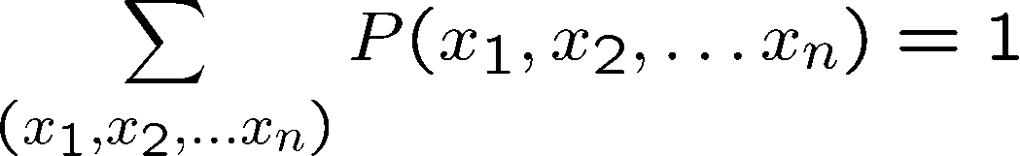
Joint Distributions
A joint distribution over a set of random variables:
specifies a real number for each assignment (or outcome):
  Must obey:
Size of distribution if n variables with domain sizes d?
  For all but the smallest distributions, impractical to write out!
T | W | P
hot | sun | 0.4
hot | rain | 0.1
cold | sun | 0.2
cold | rain | 0.3

Slide 42
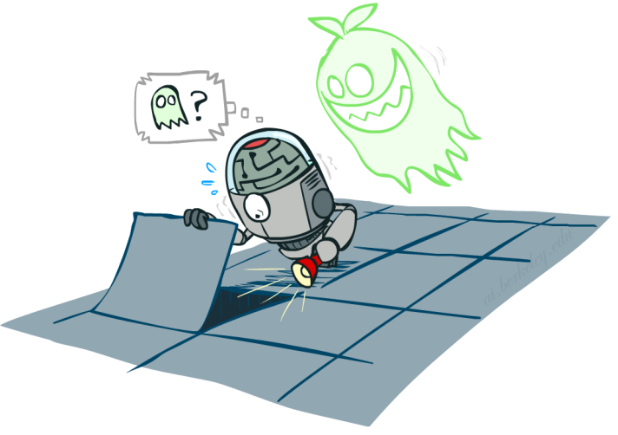

Probabilistic Models
Distribution over T,W
A probabilistic model is a joint distribution over a set of random variables
Probabilistic models:
  (Random) variables with domains
  Assignments are called outcomes
  Joint distributions: say whether assignments (outcomes) are likely
  Normalized: sum to 1.0
  Ideally: only certain variables directly interact
Constraint satisfaction problems:
  Variables with domains
  Constraints: state whether assignments are possible
  Ideally: only certain variables directly interact
T | W | P
hot | sun | 0.4
hot | rain | 0.1
cold | sun | 0.2
cold | rain | 0.3
Constraint over T,W
T | W | P
hot | sun | T
hot | rain | F
cold | sun | F
cold | rain | T

