Slide 1
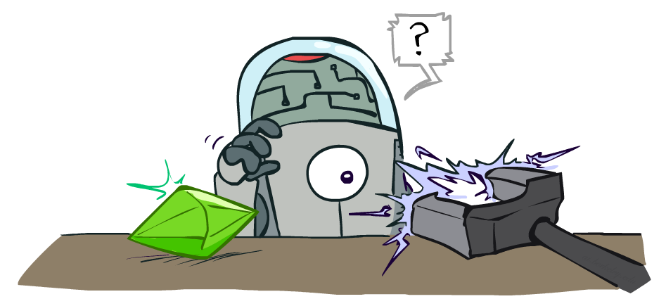
CSE 473: Artificial Intelligence
Reinforcement Learning
Dan Weld
University of Washington
[Most of these slides were created by Dan Klein and Pieter Abbeel for CS188 Intro to AI at UC Berkeley. All CS188 materials are available at http://ai.berkeley.edu.]
Notes:
Please retain proper attribution, including the reference to ai.berkeley.edu. Thanks!

Slide 2
Midterm Postmortem
It was long, hard… ☹
Max 41
Min 13
Mean & Median 27
Final
Will include some of the midterm problems

Slide 3
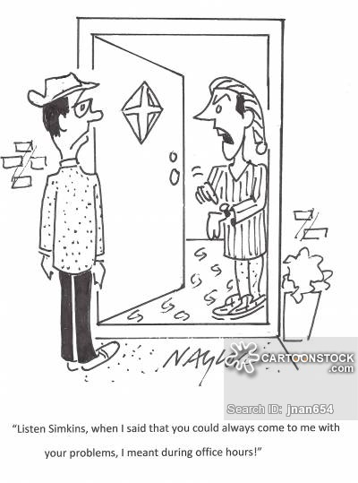
Office Hour Change (this week)
Thurs 10-11am
CSE 588
(Not Fri)
“Listen Simkins, when I said that you could always come to me with your problems, I meant during office hours!”

Slide 4
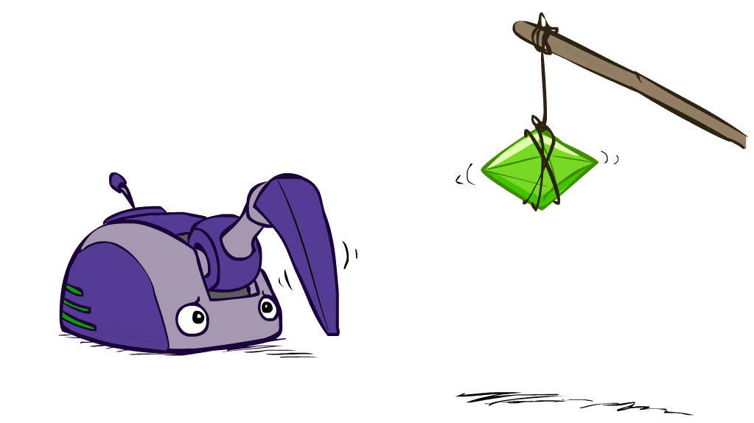
Reinforcement Learning

Slide 5
Two Key Ideas
Credit assignment problem
Exploration-exploitation tradeoff

Slide 6
Reinforcement Learning
Agent
State: s
Reward: r
Actions: a
Environment
Basic idea:
Receive feedback in the form of rewards
Agent’s utility is defined by the reward function
Must (learn to) act so as to maximize expected rewards
All learning is based on observed samples of outcomes!
Notes:
Show robot-soccer learning to walk videos (UT Austin):
? Show snake robot:

Slide 7
The “Credit Assignment” Problem
I’m in state 43, | reward = 0, | action = 2

Slide 8
The “Credit Assignment” Problem
I’m in state 43, | reward = 0, | action = 2
“ “ “ 39, | “ = 0, | “ = 4

Slide 9
The “Credit Assignment” Problem
I’m in state 43, | reward = 0, | action = 2
“ “ “ 39, | “ = 0, | “ = 4
“ “ “ 22, | “ = 0, | “ = 1

Slide 10
The “Credit Assignment” Problem
I’m in state 43, | reward = 0, | action = 2
“ “ “ 39, | “ = 0, | “ = 4
“ “ “ 22, | “ = 0, | “ = 1
“ “ “ 21, | “ = 0, | “ = 1

Slide 11
The “Credit Assignment” Problem
I’m in state 43, | reward = 0, | action = 2
“ “ “ 39, | “ = 0, | “ = 4
“ “ “ 22, | “ = 0, | “ = 1
“ “ “ 21, | “ = 0, | “ = 1
“ “ “ 21, | “ = 0, | “ = 1

Slide 12
The “Credit Assignment” Problem
I’m in state 43, | reward = 0, | action = 2
“ “ “ 39, | “ = 0, | “ = 4
“ “ “ 22, | “ = 0, | “ = 1
“ “ “ 21, | “ = 0, | “ = 1
“ “ “ 21, | “ = 0, | “ = 1
“ “ “ 13, | “ = 0, | “ = 2

Slide 13
The “Credit Assignment” Problem
I’m in state 43, | reward = 0, | action = 2
“ “ “ 39, | “ = 0, | “ = 4
“ “ “ 22, | “ = 0, | “ = 1
“ “ “ 21, | “ = 0, | “ = 1
“ “ “ 21, | “ = 0, | “ = 1
“ “ “ 13, | “ = 0, | “ = 2
“ “ “ 54, | “ = 0, | “ = 2

Slide 14
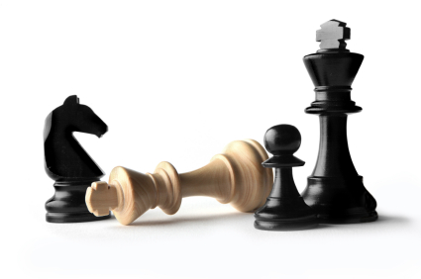
The “Credit Assignment” Problem
I’m in state 43, | reward = 0, | action = 2
“ “ “ 39, | “ = 0, | “ = 4
“ “ “ 22, | “ = 0, | “ = 1
“ “ “ 21, | “ = 0, | “ = 1
“ “ “ 21, | “ = 0, | “ = 1
“ “ “ 13, | “ = 0, | “ = 2
“ “ “ 54, | “ = 0, | “ = 2
“ “ “ 26, | “ = 100,
Yippee! I got to a state with a big reward!
But which of my actions along the way
actually helped me get there??
This is the Credit Assignment problem.

Slide 15
Exploration-Exploitation tradeoff
You have visited part of the state space and found a reward of 100
is this the best you can hope for???
Exploitation: should I stick with what I know and find a good policy w.r.t. this knowledge?
at risk of missing out on a better reward somewhere
Exploration: should I look for states w/ more reward?
at risk of wasting time & getting some negative reward

Slide 16
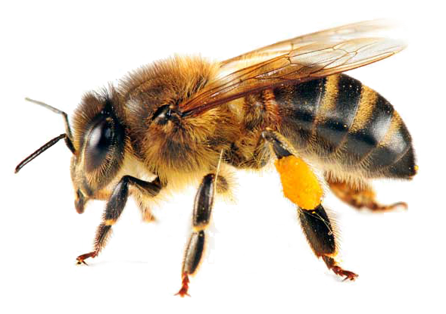
Example: Animal Learning
RL studied experimentally for more than 60 years in psychology
Example: foraging
Rewards: food, pain, hunger, drugs, etc.
Mechanisms and sophistication debated
Bees learn near-optimal foraging plan in field of artificial flowers with controlled nectar supplies
Bees have a direct neural connection from nectar intake measurement to motor planning area

Slide 17
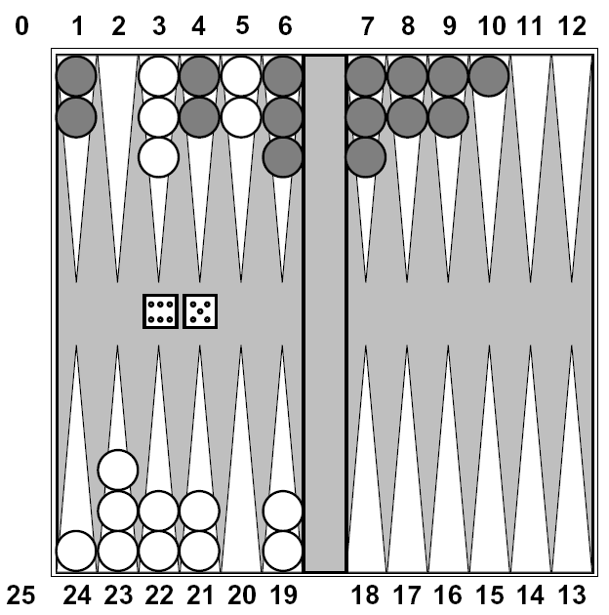
Example: Backgammon
Reward only for win / loss in terminal states, zero otherwise
TD-Gammon learns a function approximation to V(s) using a neural network
Combined with depth 3 search, one of the top 3 players in the world
You could imagine training Pacman this way…
… but it’s tricky! (It’s also P3)

Slide 18
Demos
http://inst.eecs.berkeley.edu/~ee128/fa11/videos.html

Slide 19
Extreme Driving
http://www.youtube.com/watch?v=gzI54rm9m1Q

Slide 20
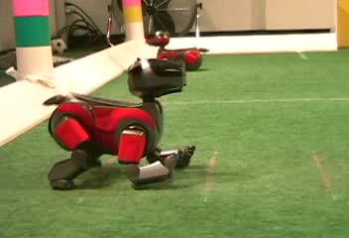
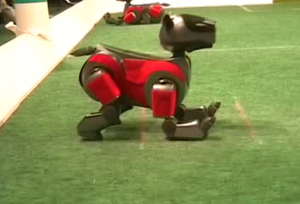
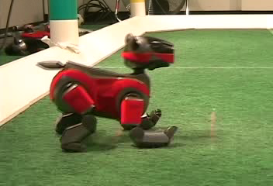
Example: Learning to Walk
Initial
A Learning Trial
After Learning [1K Trials]
[Kohl and Stone, ICRA 2004]

Slide 21
Example: Learning to Walk
Initial
[Kohl and Stone, ICRA 2004]
[Video: AIBO WALK – initial]

Slide 22
Example: Learning to Walk
Training
[Kohl and Stone, ICRA 2004]
[Video: AIBO WALK – training]

Slide 23
Example: Learning to Walk
Finished
[Kohl and Stone, ICRA 2004]
[Video: AIBO WALK – finished]

Slide 24
Example: Sidewinding
[Andrew Ng]
[Video: SNAKE – climbStep+sidewinding]

Slide 25
Example: Toddler Robot
[Tedrake, Zhang and Seung, 2005]
[Video: TODDLER – 40s]

Slide 26
The Crawler!
[Demo: Crawler Bot (L10D1)] [You, in Project 3]
Notes:
At times no reward accumulated at all, just sitting still

Slide 27
Video of Demo Crawler Bot

Slide 28
Other Applications
Robotic control
helicopter maneuvering, autonomous vehicles
Mars rover - path planning, oversubscription planning
elevator planning
Game playing - backgammon, tetris, checkers
Neuroscience
Computational Finance, Sequential Auctions
Assisting elderly in simple tasks
Spoken dialog management
Communication Networks – switching, routing, flow control
War planning, evacuation planning

Slide 29
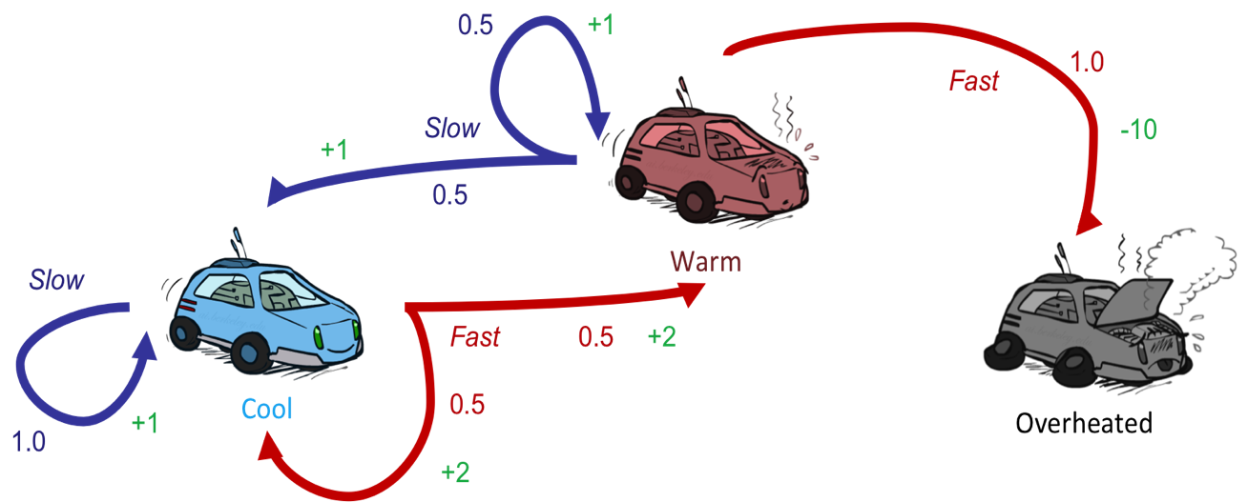
Reinforcement Learning
Still assume a Markov decision process (MDP):
A set of states s ∈ S
A set of actions (per state) A
A model T(s,a,s’)
A reward function R(s,a,s’) & discount γ
Still looking for a policy π(s)
New twist: don’t know T or R
I.e. we don’t know which states are good or what the actions do
Must actually try actions and states out to learn

Slide 30
Overview
Offline Planning (MDPs)
Value iteration, policy iteration
Online: Reinforcement Learning
Model-Based
Model-Free
Passive
Active

Slide 31
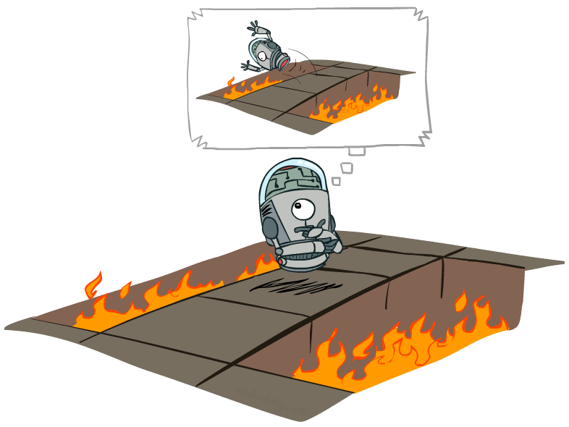
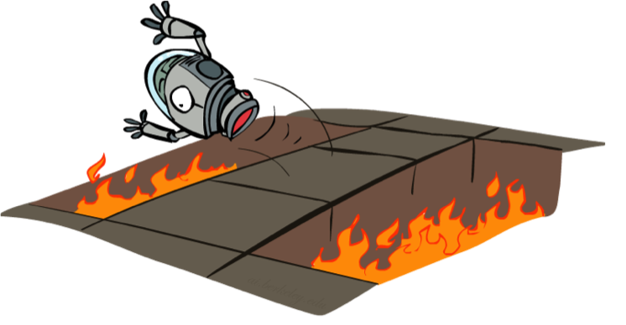
Offline (MDPs) vs. Online (RL)
Offline Solution
Online Learning

Slide 32
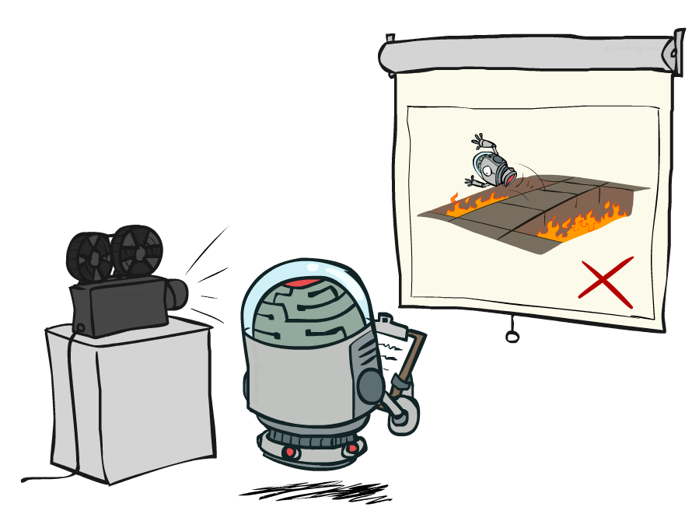
Passive Reinforcement Learning

Slide 33
Passive Reinforcement Learning
Simplified task: policy evaluation
Input: a fixed policy π(s)
You don’t know the transitions T(s,a,s’)
You don’t know the rewards R(s,a,s’)
Goal: learn the state values
In this case:
Learner is “along for the ride”
No choice about what actions to take
Just execute the policy and learn from experience
This is NOT offline planning! You actually take actions in the world.

Slide 34
Model-Based Learning

Slide 35
Model-Based Learning
Model-Based Idea:
Learn an approximate model based on experiences
Solve for values as if the learned model were correct
Step 1: Learn empirical MDP model
Count outcomes s’ for each s, a
Normalize to give an estimate of
Discover each when we experience (s, a, s’)
Step 2: Solve the learned MDP
For example, use value iteration, as before

Slide 36
Example: Model-Based Learning
Passive
Input Policy π
Observed Episodes (Training)
Learned Model
Episode 1
Episode 2
T(s,a,s’).
T(B, east, C) = 1.00
T(C, east, D) = 0.75
T(C, east, A) = 0.25
…
R(s,a,s’).
R(B, east, C) = -1
R(C, east, D) = -1
R(D, exit, x) = +10
…
 | A
B | C | D
 | E
B, east, C, -1
C, east, D, -1
D, exit, x, +10
B, east, C, -1
C, east, D, -1
D, exit, x, +10
Episode 3
Episode 4
E, north, C, -1
C, east, D, -1
D, exit, x, +10
E, north, C, -1
C, east, A, -1
A, exit, x, -10
Assume: γ = 1

Slide 37
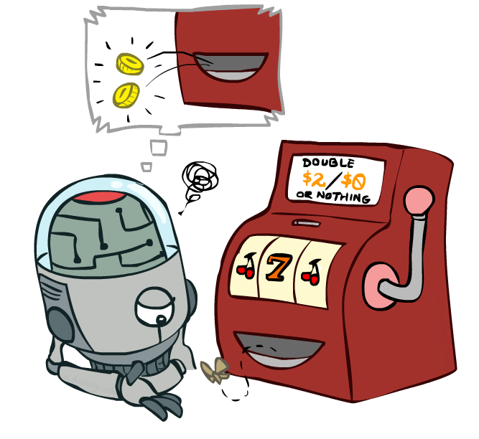
Model-Free Learning

Slide 38
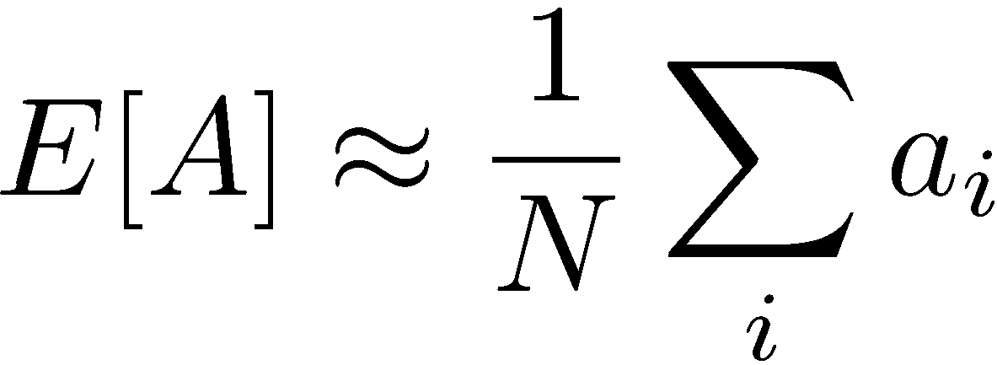
Simple Example: Expected Age
Goal: Compute expected age of CSE 473 students
Known P(A)
Without P(A), instead collect samples [a₁, a₂, … a_{N}]
Unknown P(A): “Model Based”
Unknown P(A): “Model Free”
Why does this work? Because eventually you learn the right model.
Why does this work? Because samples appear with the right frequencies.

Slide 39
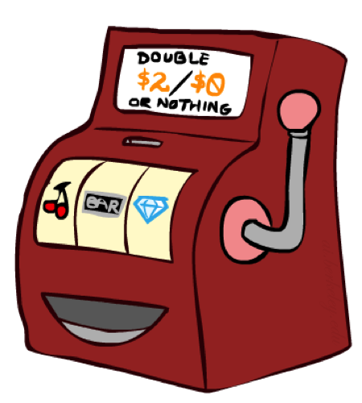
Direct Evaluation
Goal: Compute values for each state under π
Idea: Average together observed sample values
Act according to π
Every time you visit a state, write down what the sum of discounted rewards turned out to be
Average those samples
This is called direct evaluation

Slide 40
Example: Direct Evaluation
Input Policy π
Observed Episodes (Training)
Output Values
Episode 1
Episode 2
-10
 | A
B | C | D
 | E
B, east, C, -1
C, east, D, -1
D, exit, x, +10
B, east, C, -1
C, east, D, -1
D, exit, x, +10
 | A
B | C | D
 | E
+8
+4
+10
Episode 3
Episode 4
-2
E, north, C, -1
C, east, D, -1
D, exit, x, +10
E, north, C, -1
C, east, A, -1
A, exit, x, -10
Assume: γ = 1

Slide 41
Problems with Direct Evaluation
What’s good about direct evaluation?
It’s easy to understand
It doesn’t require any knowledge of T, R
It eventually computes the correct average values, using just sample transitions
What bad about it?
It wastes information about state connections
Ignores Bellman equations
Each state must be learned separately
So, it takes a long time to learn
Output Values
-10
 | A
B | C | D
 | E
+8
+4
+10
-2
If B and E both go to C under this policy, how can their values be different?

Slide 42
Why Not Use Policy Evaluation?
s
Simplified Bellman updates calculate V for a fixed policy:
Each round, replace V with a one-step-look-ahead layer over V
This approach fully exploited the connections between the states
Unfortunately, we need T and R to do it!
Key question: how can we do this update to V without knowing T and R?
In other words, how to we take a weighted average without knowing the weights?
π(s)
s, π(s)
s, π(s),s’
s’

Slide 43
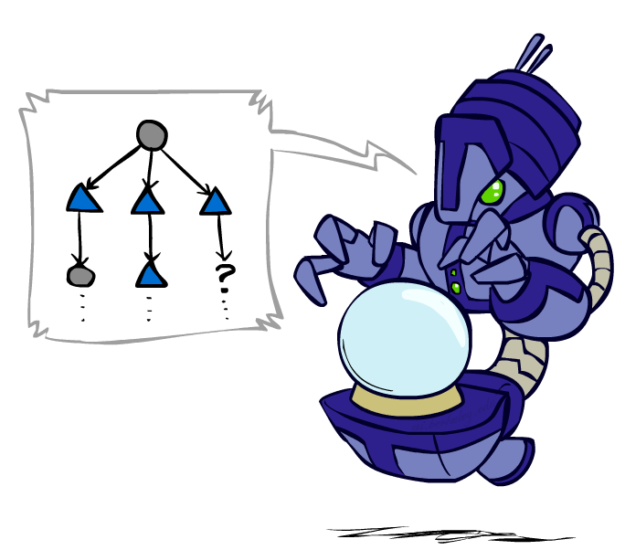
Sample-Based Policy Evaluation?
We want to improve our estimate of V by computing these averages:
Idea: Take samples of outcomes s’ (by doing the action!) and average
s
π(s)
s, π(s)
s, π(s),s’
s₁'
s₂'
s'
s₃'
Almost! But we can’t rewind time to get sample after sample from state s.

Slide 44
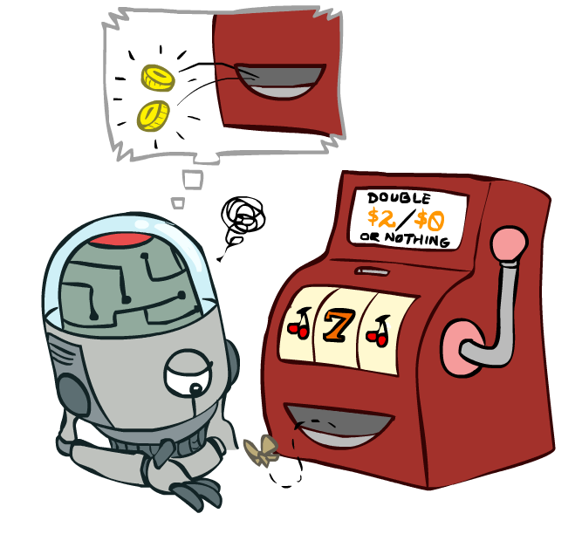
Temporal Difference Learning

Slide 45
Temporal Difference Learning
Big idea: learn from every experience!
Update V(s) each time we experience a transition (s, a, s’, r)
Likely outcomes s’ will contribute updates more often
Temporal difference learning of values
Policy still fixed, still doing evaluation!
Move values toward value of whatever successor occurs: running average
s
π(s)
s, π(s)
s’
Sample of V(s):
Update to V(s):
Same update:

Slide 46
Exponential Moving Average
Exponential moving average
The running interpolation update:
Makes recent samples more important:
Forgets about the past (distant past values were wrong anyway)
Decreasing learning rate (alpha) can give converging averages

Slide 47
Example: Temporal Difference Learning
States
Observed Transitions
B, east, C, -2
C, east, D, -2
 | A
B | C | D
 | E
 | 0
0 | 0 | 8
 | 0
 | 0
-1 | 0 | 8
 | 0
 | 0
-1 | 3 | 8
 | 0
Assume: γ = 1, α = 1/2

Slide 48
Problems with TD Value Learning
TD value leaning is a model-free way to do policy evaluation, mimicking Bellman updates with running sample averages
However, if we want to turn values into a (new) policy, we’re sunk:
Idea: learn Q-values, not values
Makes action selection model-free too!
s
a
s, a
s,a,s’
s’

Slide 49
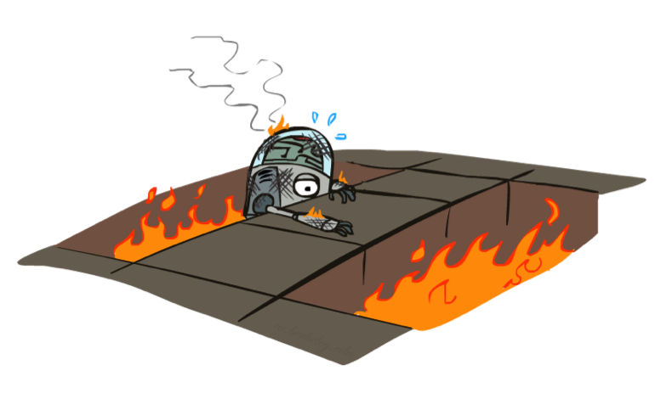
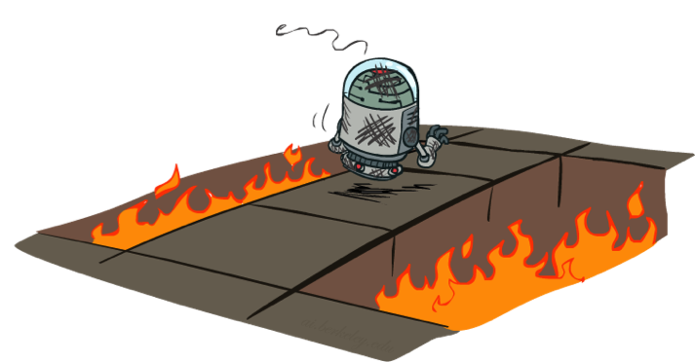
Active Reinforcement Learning

Slide 50
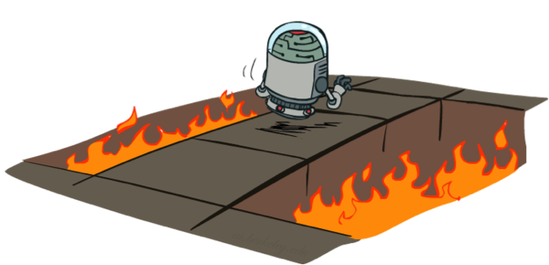
Active Reinforcement Learning
Full reinforcement learning: optimal policies (like value iteration)
You don’t know the transitions T(s,a,s’)
You don’t know the rewards R(s,a,s’)
You choose the actions now
Goal: learn the optimal policy / values
In this case:
Learner makes choices!
Fundamental tradeoff: exploration vs. exploitation
This is NOT offline planning! You actually take actions in the world and find out what happens…

Slide 51
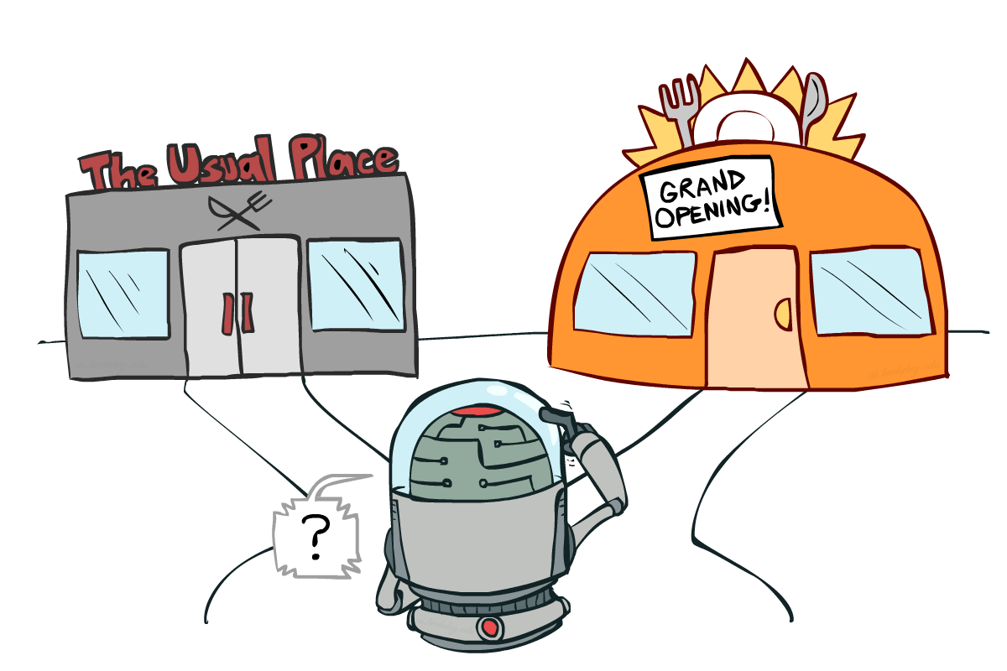
Exploration vs. Exploitation

Slide 52
How to Explore?
Several schemes for forcing exploration
Simplest: random actions (ε-greedy)
Every time step, flip a coin
With (small) probability ε, act randomly
With (large) probability 1-ε, act on current policy
Problems with random actions?
You do eventually explore the space, but keep thrashing around once learning is done
One solution: lower ε over time
Another solution: exploration functions
[Demo: Q-learning – manual exploration – bridge grid (L11D2)] [Demo: Q-learning – epsilon-greedy -- crawler (L11D3)]

Slide 53
Reminder: Q-Value Iteration
Forall s, Initialize V₀(s) = 0 no time steps left means an expected reward of zero
Repeat do Bellman backups
K += 1
Until convergence
V_{k+1}(s)
Q_{k+1}(s, a) = Σ_{s’} T(s, a, s’) [ R(s, a, s’) + γ Max _{a} Q_{k} (s, a) ]
a
s, a
s,a,s’
V_{k}(s’)
Notes:
Discuss computational complexity: S * A * S times number of iterations
Note: updates not in place [if in place, it means something else and not even clear what it means]

Slide 54
Detour: Q-Value Iteration
Value iteration: find successive (depth-limited) values
Start with V₀(s) = 0, which we know is right
Given V_{k}, calculate the depth k+1 values for all states:
But Q-values are more useful, so compute them instead
Start with Q₀(s,a) = 0, which we know is right
Given Q_{k}, calculate the depth k+1 q-values for all q-states:

Slide 55
Q-Learning
Q-Learning: sample-based Q-value iteration
Learn Q(s,a) values as you go
Receive a sample (s,a,s’,r)
Consider your old estimate:
Consider your new sample estimate:
Incorporate the new estimate into a running average:
[Demo: Q-learning – gridworld (L10D2)]
[Demo: Q-learning – crawler (L10D3)]

Slide 56
Video of Demo Q-Learning -- Gridworld

Slide 57
Video of Demo Q-Learning -- Crawler

Slide 58
Q-Learning Properties
Amazing result: Q-learning converges to optimal policy -- even if you’re acting suboptimally!
This is called off-policy learning
Caveats:
You have to explore enough
You have to eventually make the learning rate
small enough
… but not decrease it too quickly
Basically, in the limit, it doesn’t matter how you select actions (!)

Slide 59
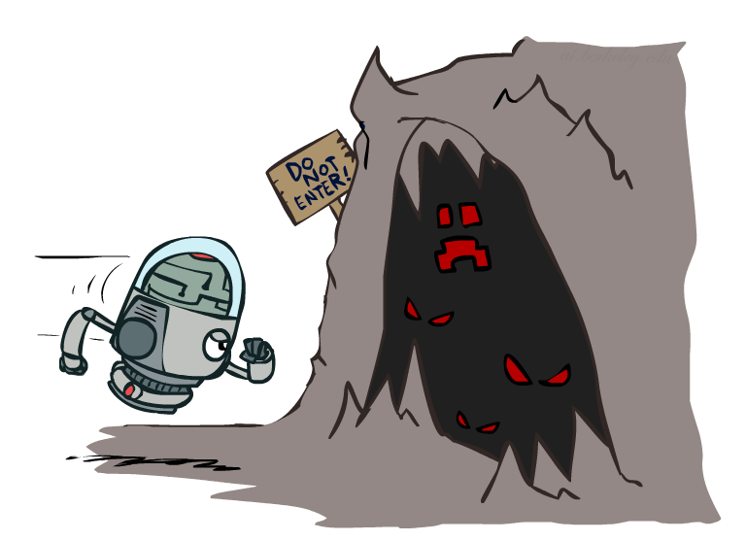
Exploration Functions
When to explore?
Random actions: explore a fixed amount
Better idea: explore areas whose badness is not
(yet) established, eventually stop exploring
Exploration function
Takes a value estimate u and a visit count n, and
returns an optimistic utility, e.g.
Note: this propagates the “bonus” back to states that lead to unknown states as well!
Regular Q-Update:
Modified Q-Update:
[Demo: exploration – Q-learning – crawler – exploration function (L11D4)]

Slide 60
Video of Demo Q-learning – Exploration Function – Crawler

Slide 61
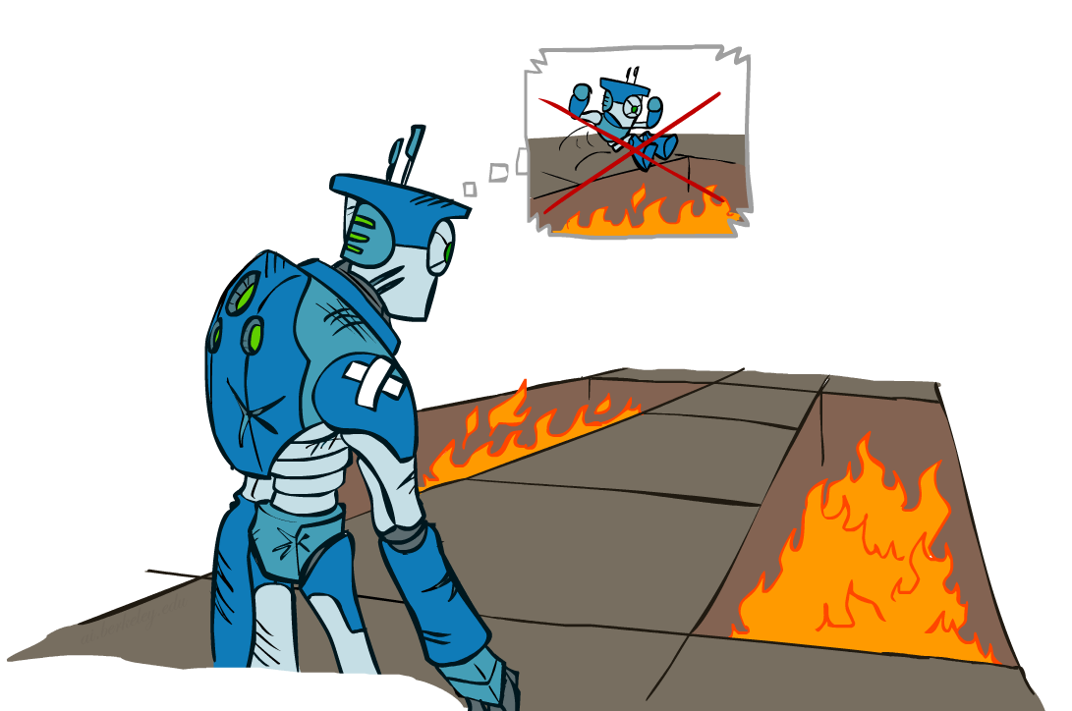
Regret
Even if you learn the optimal policy, you still make mistakes along the way!
Regret is a measure of your total mistake cost: the difference between your (expected) rewards, including youthful suboptimality, and optimal (expected) rewards
Minimizing regret goes beyond learning to be optimal – it requires optimally learning to be optimal
Example: random exploration and exploration functions both end up optimal, but random exploration has higher regret

