Slide 1
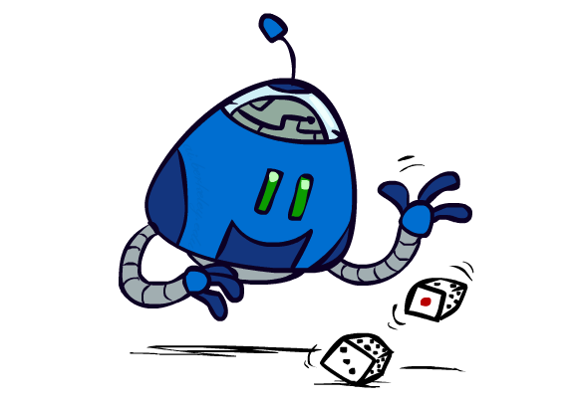
CSE 473: Artificial Intelligence
Uncertainty and Utilities
Dan Weld
[These slides were created by Dan Klein and Pieter Abbeel for CS188 Intro to AI at UC Berkeley.
All CS188 materials are available at http://ai.berkeley.edu.]
Notes:
Please retain proper attribution, including the reference to ai.berkeley.edu. Thanks!

Slide 2
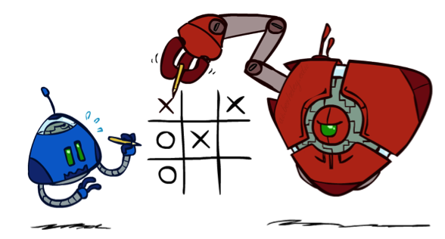
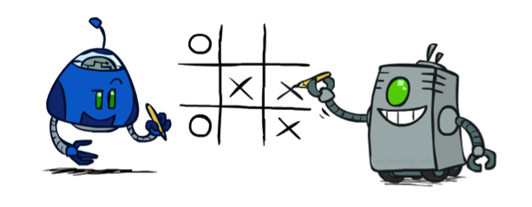
Worst-Case vs. Average Case
max
min
10
10
9
100
Notes:
At least 10, or otherwise just rather dead; or just 100, or otherwise rather dead; that’s yet something different than minimax or expectimax

Slide 3

Worst-Case vs. Average Case
max
New type of node!
chance
10
10
9
100
Idea: Uncertain outcomes controlled by chance, not an adversary!
Notes:
At least 10, or otherwise just rather dead; or just 100, or otherwise rather dead; that’s yet something different than minimax or expectimax

Slide 4
Randomness?
max
A₁
A₂
chance
Why wouldn’t we know the results of an action?
  Explicit randomness: rolling dice
  Unpredictable opponents: the ghosts respond erratically
  Actions can fail: when robot moves, its wheels might slip
10
10
4
10
5
9
7
100

Slide 5
Expectimax Search
Values now reflect average-case (expected) outcomes, not worst-case (minimum) outcomes
Expectimax search:
Compute average score under optimal play
  Max nodes as in minimax search
  Chance nodes are like min nodes but the outcome is uncertain. Calculate their expected utilities
    I.e. take weighted average (expectation) of children
Later, we’ll formalize as Markov Decision Processes
max
chance
10
10
4
10
5
9
7
100
[Demo: min vs exp (L7D1,2)]

Slide 6
Which Algorithm?
Minimax: no point in trying
3 ply look ahead, ghosts move randomly

Slide 7
Which Algorithm?
Expectimax: wins some of the time
3 ply look ahead, ghosts move randomly

Slide 8
Expectimax Pseudocode
def value(state):
  if the state is a terminal state: return the state’s utility
  if the next agent is MAX: return max-value(state)
  if the next agent is EXP: return exp-value(state)
def max-value(state):
  initialize v = -∞
  for each successor of state:
    v = max(v, value(successor))
  return v
def exp-value(state):
  initialize v = 0
  for each successor of state:
  p = probability(successor)
    v += p * value(successor)
  return v
Notes:
Pick an order for two reasons: sequential processor and pruning

Slide 9
Expectimax Pseudocode
10
1/2
1/6
1/3
5
8
7
24
-12
def exp-value(state):
  initialize v = 0
  for each successor of state:
  p = probability(successor)
    v += p * value(successor)
  return v
10
v = (1/2) (8) + (1/3) (24) + (1/6) (-12) =

Slide 10
Expectimax Example
3
12
9
2
4
6
15
6
0

Slide 11
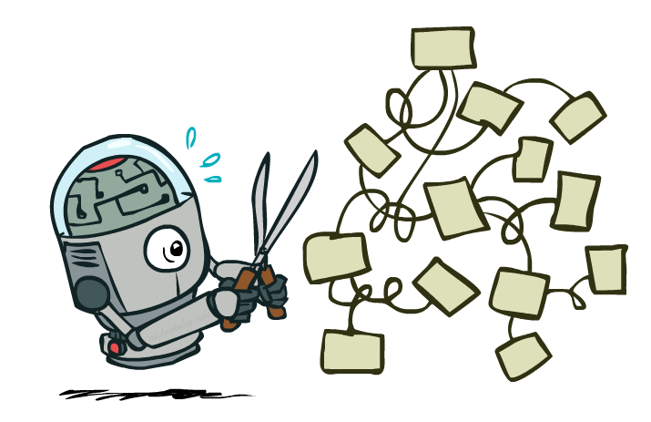
Expectimax Pruning?
10
8
24
-12
2

Slide 12



Depth-Limited Expectimax
Estimate of true expectimax value (which would require a lot of work to compute)
400
300
…
…
492
362
…

Slide 13
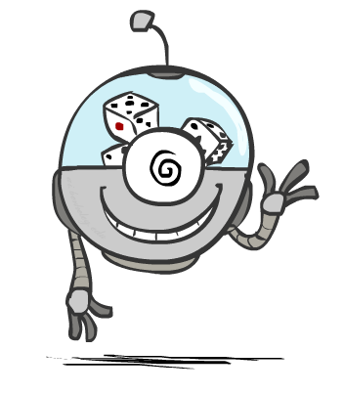
Probabilities

Slide 14
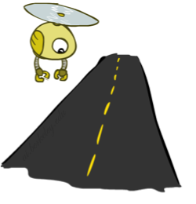
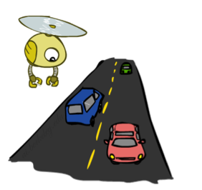
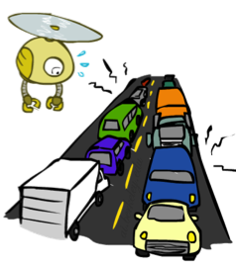
Reminder: Probabilities
A random variable represents an event whose outcome is unknown
A probability distribution is an assignment of weights to outcomes
Example: Traffic on freeway
  Random variable: T = whether there’s traffic
  Outcomes: T in {none, light, heavy}
  Distribution: P(T=none) = 0.25, P(T=light) = 0.50, P(T=heavy) = 0.25
Some laws of probability (more later):
  Probabilities are always non-negative
  Probabilities over all possible outcomes sum to one
As we get more evidence, probabilities may change:
  P(T=heavy) = 0.25,
  P(T=heavy | Hour=8am) = 0.60
  We’ll talk about methods for reasoning and updating probabilities later
0.25
0.50
0.25

Slide 15
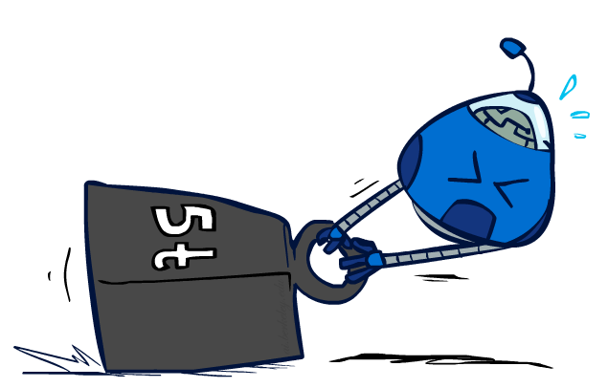
Reminder: Expectations
The expected value of a function of a random variable is the average, weighted by the probability distribution over outcomes
Example: How long to get to the airport?
Time:
20 min
30 min
60 min
+
+
35 min
x
x
x
Probability:
0.25
0.50
0.25

Slide 16

What Probabilities to Use?
In expectimax search, we have a probabilistic model of how the opponent (or environment) will behave in any state
  Model could be a simple uniform distribution (roll a die)
  Model could be sophisticated and require a great deal of computation
  We have a chance node for any outcome out of our control: opponent or environment
  The model might say that adversarial actions are likely!
For now, assume each chance node magically comes along with probabilities that specify the distribution over its outcomes

Slide 17
Quiz: Informed Probabilities
Let’s say you know that your opponent is sometimes lazy. 20% of the time, she moves randomly, but usually (80%) she runs a depth 2 minimax to decide her move
Question: What tree search should you use?
Answer: Expectimax!
  To figure out EACH chance node’s probabilities, you have to run a simulation of your opponent
  This kind of thing gets very slow very quickly
  Even worse if you have to simulate your opponent simulating you…
  … except for minimax, which has the nice property that it all collapses into one game tree
0.1 0.9

Slide 18

Modeling Assumptions

Slide 19
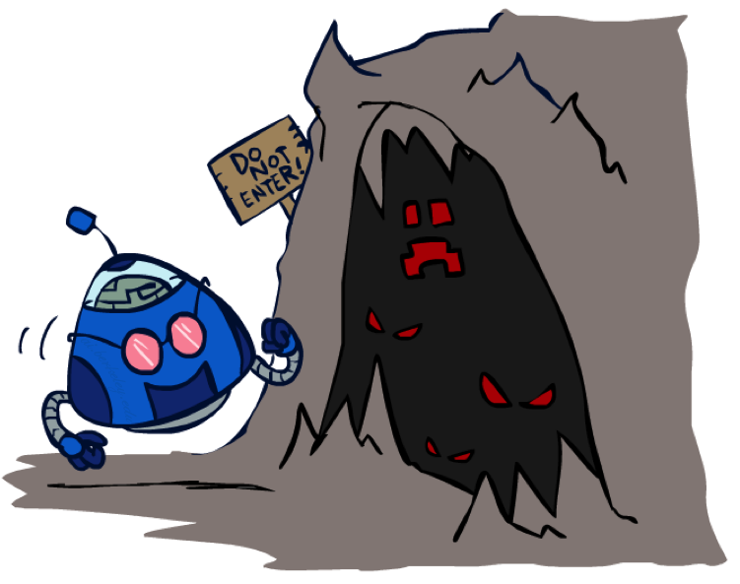
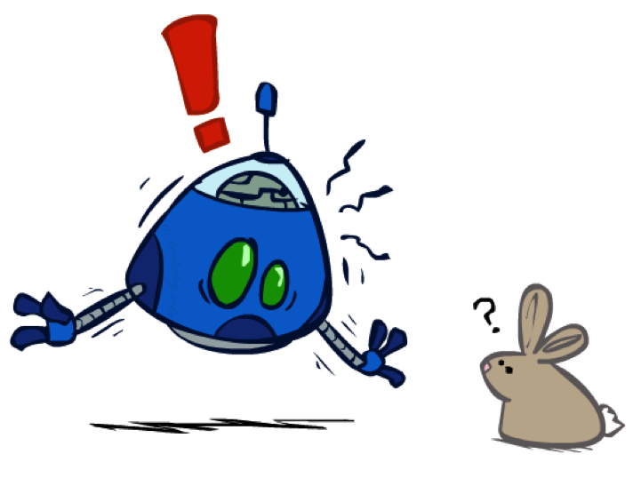
The Dangers of Optimism and Pessimism
Dangerous Optimism
Assuming chance when the world is adversarial
Dangerous Pessimism
Assuming the worst case when it’s not likely

Slide 20

Video of Demo World Assumptions
Random Ghost – Expectimax Pacman

Slide 21
Video of Demo World Assumptions
Adversarial Ghost – Minimax Pacman

Slide 22
Video of Demo World Assumptions
Adversarial Ghost – Expectimax Pacman

Slide 23
Video of Demo World Assumptions
Random Ghost – Minimax Pacman

Slide 24
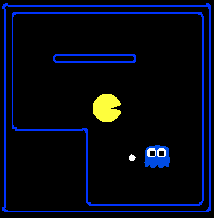
Assumptions vs. Reality
 | Adversarial Ghost | Random Ghost
Minimax Pacman | Won 5/5 Avg. Score: 483 | Won 5/5 Avg. Score: 493
Expectimax Pacman | Won 1/5 Avg. Score: -303 | Won 5/5 Avg. Score: 503
Results from playing 5 games
Pacman used depth 4 search with an eval function that avoids trouble
Ghost used depth 2 search with an eval function that seeks Pacman
[Demos: world assumptions (L7D3,4,5,6)]
Notes:
python pacman.py -g SmartGhost -l trapped2 -p ExpectimaxAgent -a depth=4,evalFn=better

Slide 25
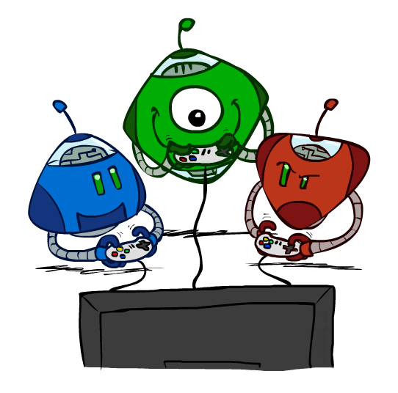
Other Game Types

Slide 26
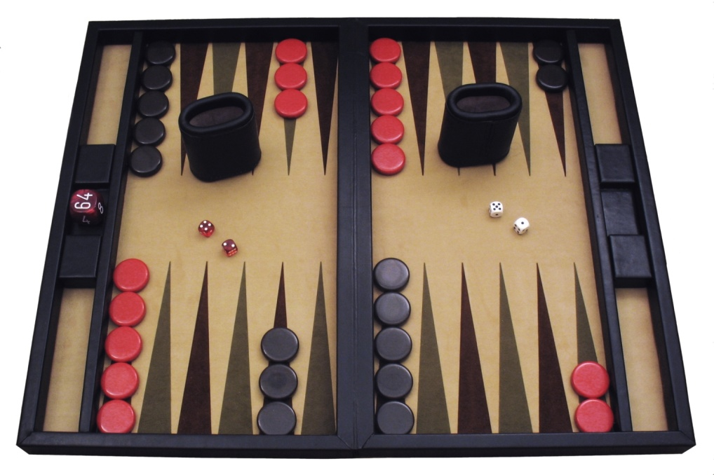
Example: Backgammon
Image: Wikipedia

Slide 27



Mixed Layer Types
E.g. Backgammon
Expectiminimax
  Environment is an extra “random agent” player that moves after each min/max agent
  Each node computes the appropriate combination of its children
Notes:
If it’s terminal or we reached our depth limit, return utility

Slide 28
Example: Backgammon
Dice rolls increase b: 21 possible rolls with 2 dice
  Backgammon ≈ 20 legal moves
  Depth 2 = 20 x (21 x 20)³ = 1.2 x 10⁹
As depth increases, probability of reaching a given search node shrinks
  So usefulness of search is diminished
  So limiting depth is less damaging
  But pruning is trickier…
Historic AI (1992): TDGammon uses depth-2 search + very good evaluation function + reinforcement learning:
world-champion level play
1st AI world champion in any game!
Image: Wikipedia

Slide 29
Different Types of Ghosts?
Stupid
Devilish Smart

Slide 30
Zero Sum Games
X
O
X
Terminal nodes:
Utilities sum to zero
X
O
O
X

Slide 31
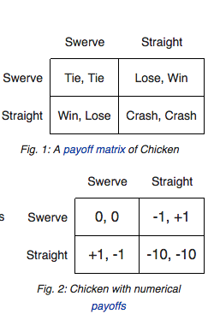
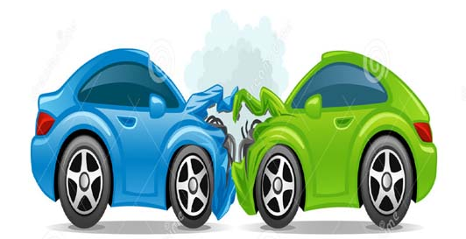
Zero Sum Games
Non-
Chicken
X
O
X
X
O
O
X

Slide 32
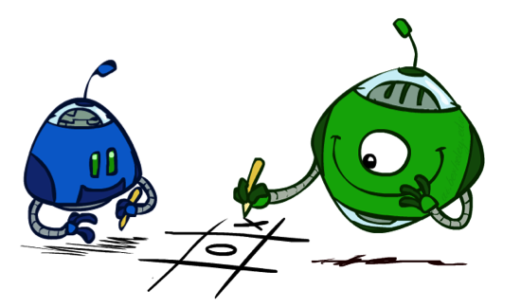
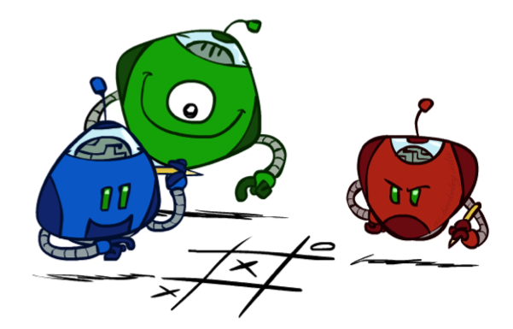
Multi-Agent Utilities
What if the game is not zero-sum, or has multiple players?
Generalization of minimax:
  Terminals have utility tuples
  Node values are also utility tuples
  Each player maximizes its own component
  Can give rise to cooperation and
  competition dynamically…
1,6,6
7,1,2
6,1,2
7,2,1
5,1,7
1,5,2
7,7,1
5,2,5

Slide 33
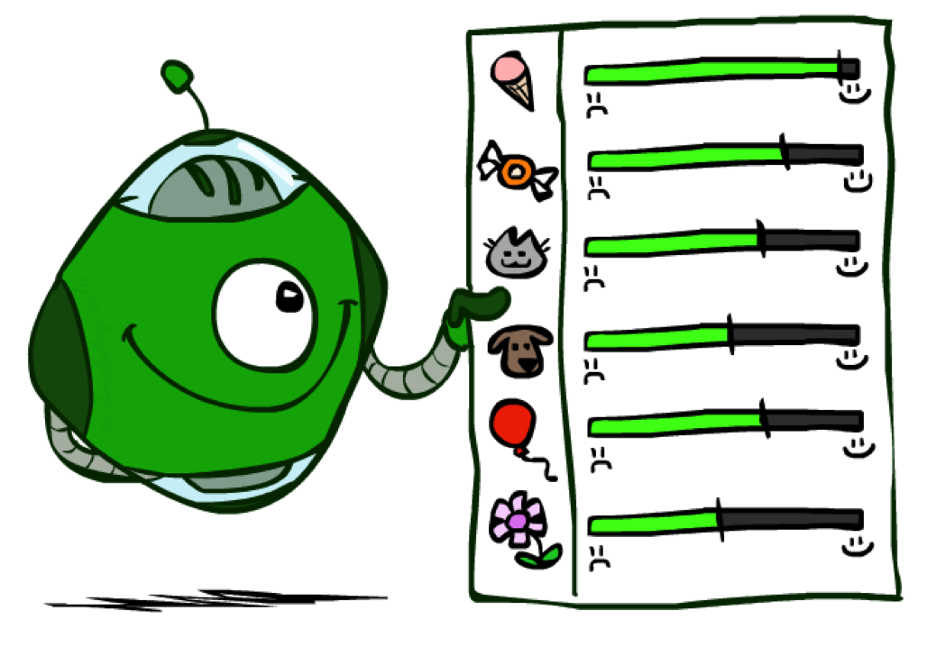
Utilities

Slide 34
Announcements
Project 2: Multi-Agent Pacman
  Has been released, due Friday 10/24 at 11:59pm.
In class midterm
  Monday, 10/27
  Closed book, no electronics, one 8 ½ x 11 piece of paper allowed

Slide 35

Maximum Expected Utility
Why should we average utilities?
Principle of maximum expected utility:
  A rational agent should chose the action that maximizes its expected utility, given its knowledge
Questions:
  Where do utilities come from?
  How do we know such utilities even exist?
  How do we know that averaging even makes sense?
  What if our behavior (preferences) can’t be described by utilities?

Slide 36
What Utilities to Use?
0
40
20
30
x²
0
1600
400
900
For worst-case minimax reasoning, terminal function scale doesn’t matter
  We just want better states to have higher evaluations (get the ordering right)
  We call this insensitivity to monotonic transformations
For average-case expectimax reasoning, we need magnitudes to be meaningful

Slide 37

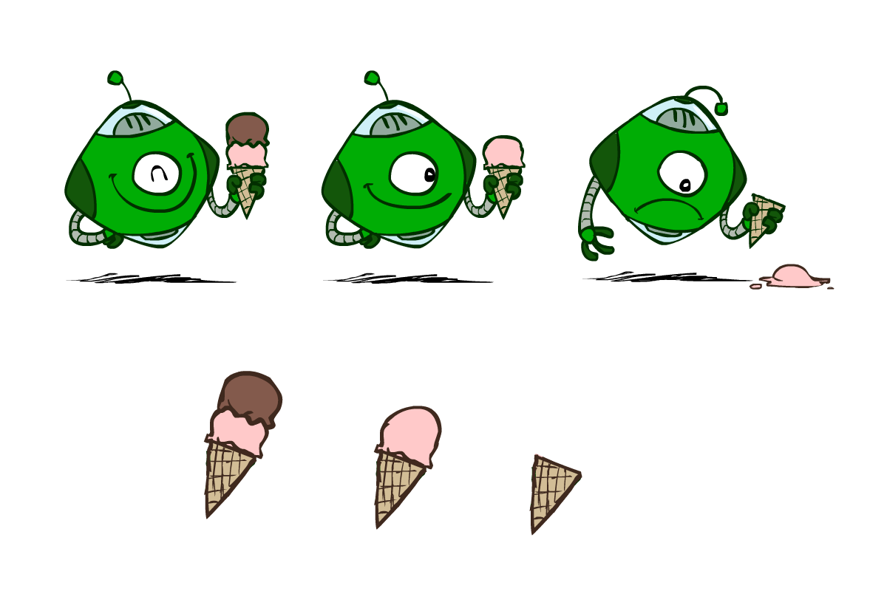
Utilities
Utilities are functions from outcomes (states of the world) to real numbers that describe an agent’s preferences
Where do utilities come from?
  In a game, may be simple (+1/-1)
  Utilities summarize the agent’s goals
  Theorem: any “rational” preferences can be summarized as a utility function
We hard-wire utilities and let behaviors emerge
  Why don’t we let agents pick utilities?
  Why don’t we prescribe behaviors?

Slide 38
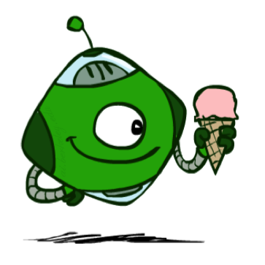
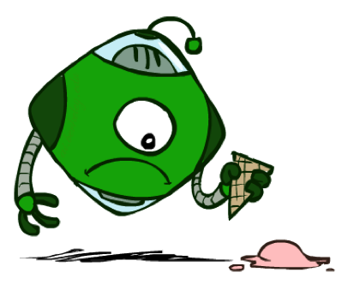
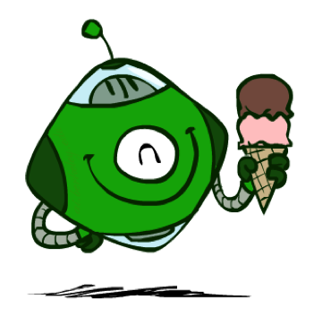
Utilities: Uncertain Outcomes
Getting ice cream
Get Single
Get Double
Oops
Whew!

Slide 39
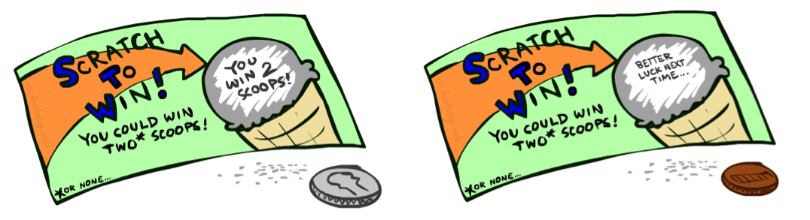
Preferences
A Prize
A Lottery
An agent must have preferences among:
  Prizes: A, B, etc.
  Lotteries: situations with uncertain prizes
Notation:
  Preference:
  Indifference:
A
p 1-p
A B

Slide 40
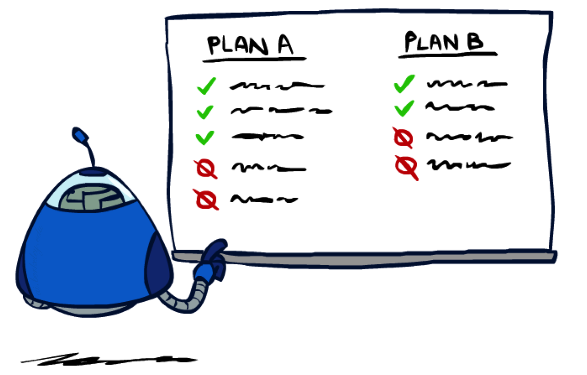
Rationality

Slide 41
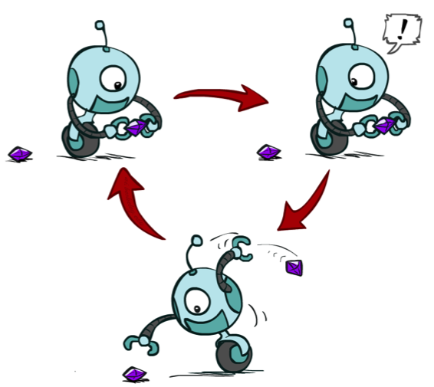
Rational Preferences
We want some constraints on preferences before we call them rational, such as:
For example: an agent with intransitive preferences can
be induced to give away all of its money
  If B > C, then an agent with C would pay (say) 1 cent to get B
  If A > B, then an agent with B would pay (say) 1 cent to get A
  If C > A, then an agent with A would pay (say) 1 cent to get C
Axiom of Transitivity:
Notes:
Apple, banana, carrot

Slide 42

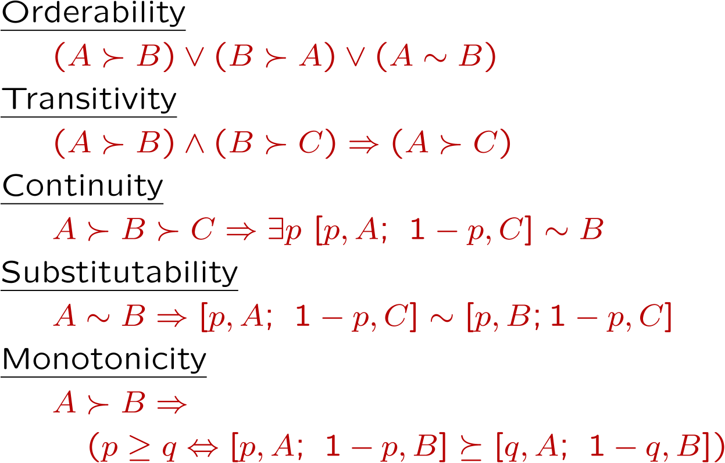
Rational Preferences
The Axioms of Rationality
Theorem: Rational preferences imply behavior describable as maximization of expected utility

Slide 43
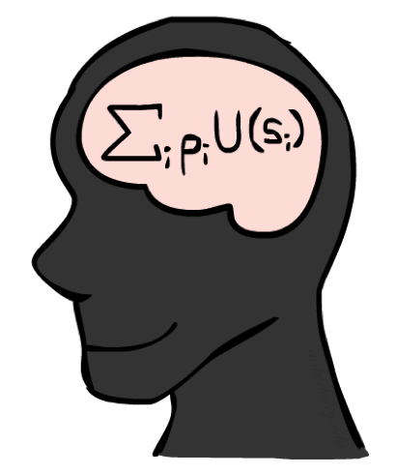
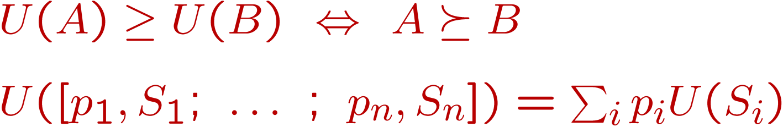
MEU Principle
Theorem [Ramsey, 1931; von Neumann & Morgenstern, 1944]
  Given any preferences satisfying these constraints, there exists a real-valued
  function U such that:
  I.e. values assigned by U preserve preferences of both prizes and lotteries!
Maximum expected utility (MEU) principle:
  Choose the action that maximizes expected utility
  Note: an agent can be entirely rational (consistent with MEU) without ever representing or manipulating utilities and probabilities
  E.g., a lookup table for perfect tic-tac-toe, a reflex vacuum cleaner

Slide 44
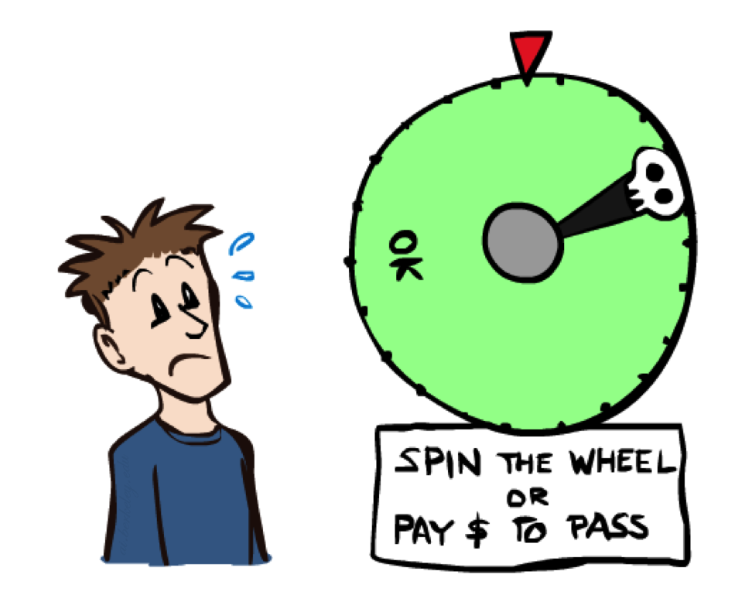
Human Utilities

Slide 45

Utility Scales
Normalized utilities: u₊ = 1.0, u₋ = 0.0
Micromorts: one-millionth chance of death, useful for paying to reduce product risks, etc.
QALYs: quality-adjusted life years, useful for medical decisions involving substantial risk
Note: behavior is invariant under positive linear transformation
With deterministic prizes only (no lottery choices), only ordinal utility can be determined, i.e., total order on prizes

Slide 46


Human Utilities
Utilities map states to real numbers. Which numbers?
Standard approach to assessment (elicitation) of human utilities:
  Compare a prize A to a standard lottery L_{p} between
    “best possible prize” u₊ with probability p
    “worst possible catastrophe” u₋ with probability 1-p
  Adjust lottery probability p until indifference: A ~ L_{p}
  Resulting p is a utility in [0,1]
Pay $30
0.999999 0.000001
No change
Instant death

Slide 47
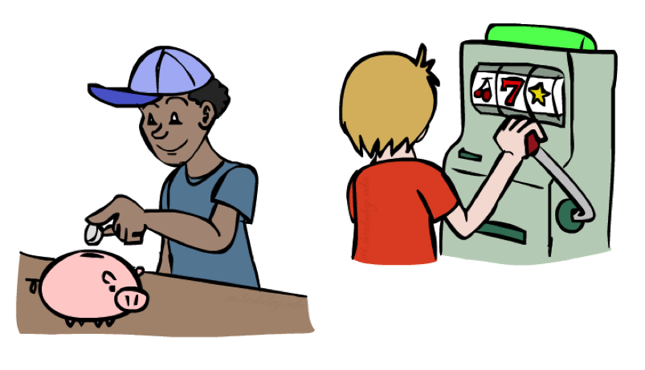
Money
Money does not behave as a utility function, but we can talk about the utility of having money (or being in debt)
Given a lottery L = [p, $X; (1-p), $Y]
  The expected monetary value EMV(L) is p*X + (1-p)*Y
  U(L) = p*U($X) + (1-p)*U($Y)
  Typically, U(L) < U( EMV(L) )
  In this sense, people are risk-averse
  When deep in debt, people are risk-prone
Notes:
Draw Jensen’s for utility curve

Slide 48
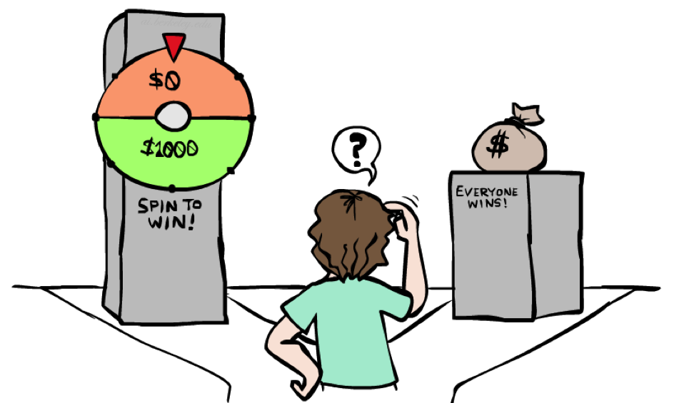
Example: Insurance
Consider the lottery [0.5, $1000; 0.5, $0]
  What is its expected monetary value? ($500)
  What is its certainty equivalent?
    Monetary value acceptable in lieu of lottery
    $400 for most people
  Difference of $100 is the insurance premium
    There’s an insurance industry because people will pay to reduce their risk
    If everyone were risk-neutral, no insurance needed!
  It’s win-win: you’d rather have the $400 and the insurance company would rather have the lottery (their utility curve is flat and they have many lotteries)

Slide 49

Example: Human Rationality?
Famous example of Allais (1953)
  A: [0.8, $4k; 0.2, $0]
  B: [1.0, $3k; 0.0, $0]
  C: [0.2, $4k; 0.8, $0]
  D: [0.25, $3k; 0.75, $0]
Most people prefer B > A, C > D
But if U($0) = 0, then
  B > A ⇒ U($3k) > 0.8 U($4k)
  C > D ⇒ 0.8 U($4k) > U($3k)

Slide 50
Kahneman & Tversky
Choose between
Option A
33% $2500
66% $2400
01% 0
Option B
100% $2400
[18] [82]*

Slide 51
Kahneman & Tversky
Choose between
Option C
33% $2500
67% 0
Option D
34% $2400
66% 0
[83]* [17]

Slide 52
Kahneman & Tversky
Choose between
Option A
33% $2500
66% $2400
01% 0
Option B
100% $2400
-66% chance of $2400 from both options
[18] [82]*
Option C
33% $2500
67% 0
Option D
34% $2400
66% 0
[83]* [17]

Slide 53
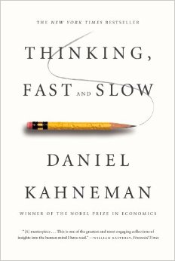
Recommended
Risks vs gains
Probability estimates
Cognitive architecture
Much more

Slide 54
Next Time: MDPs!

Slide 55
What are Probabilities?
Objectivist / frequentist answer:
  Averages over repeated experiments
  E.g. empirically estimating P(rain) from historical observation
  Assertion about how future experiments will go (in the limit)
  New evidence changes the reference class
  Makes one think of inherently random events, like rolling dice
Subjectivist / Bayesian answer:
  Degrees of belief about unobserved variables
  E.g. an agent’s belief that it’s raining, given the temperature
  E.g. pacman’s belief that the ghost will turn left, given the state
  Often learn probabilities from past experiences (more later)
  New evidence updates beliefs (more later)

Slide 56
Uncertainty Everywhere
Not just for games of chance!
  I’m sick: will I sneeze this minute?
  Email contains “FREE!”: is it spam?
  Tooth hurts: have cavity?
  60 min enough to get to the airport?
  Robot rotated wheel three times, how far did it advance?
  Safe to cross street? (Look both ways!)
Sources of uncertainty in random variables:
  Inherently random process (dice, etc)
  Insufficient or weak evidence
  Ignorance of underlying processes
  Unmodeled variables
  The world’s just noisy – it doesn’t behave according to plan!
Compare to fuzzy logic, which has degrees of truth, rather than just degrees of belief

