Slide 1
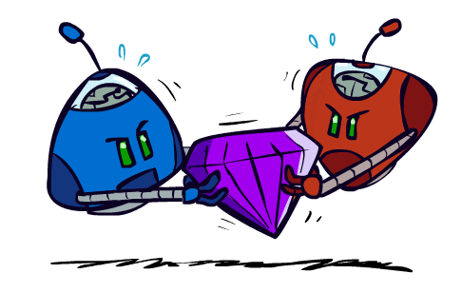
CSE 473: Artificial Intelligence Fall 2014
Adversarial Search
Dan Weld
Based on slides from
Dan Klein, Stuart Russell, Pieter Abbeel, Andrew Moore and Luke Zettlemoyer
(best illustrations from ai.berkeley.edu)
1

Slide 2
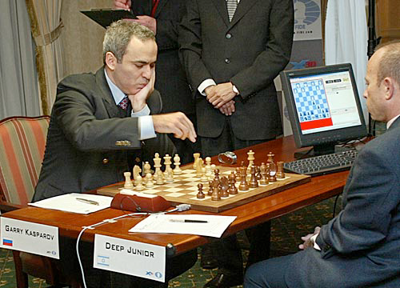
Outline
Adversarial Search
Minimax search
α-β search
Evaluation functions
Expectimax
Reminder:
Project 1 due Today

Slide 3
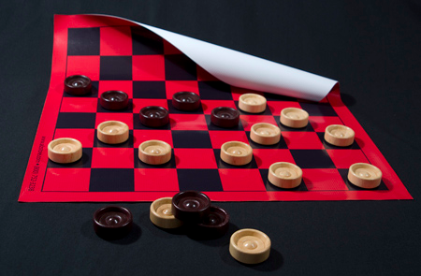
Game Playing State-of-the-Art
Checkers: Chinook ended 40-year-reign of human world champion Marion Tinsley in 1994. Used an endgame database defining perfect play for all positions involving 8 or fewer pieces on the board, a total of 443,748,401,247 positions. Checkers is now solved!

Slide 4
Game Playing State-of-the-Art
Chess: Deep Blue defeated human world champion Gary Kasparov in a six-game match in 1997. Deep Blue examined 200 million positions per second, used very sophisticated evaluation and undisclosed methods for extending some lines of search up to 40 ply. Current programs are even better, if less historic.

Slide 5
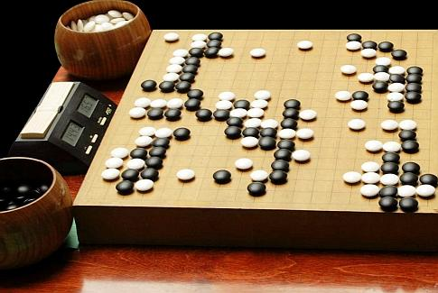
Game Playing State-of-the-Art
Othello: Human champions refuse to compete against computers, which are too good.
Go: Human champions are beginning to be challenged by machines, though the best humans still beat the best machines on the full board. In go, b > 300, so need pattern knowledge bases and monte carlo search (UCT)
Pacman: unknown

Slide 6
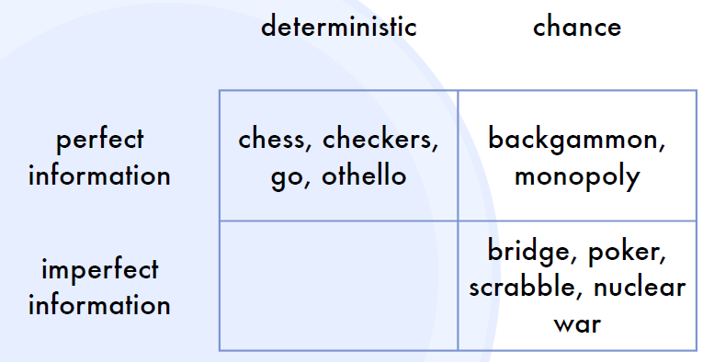
Types of Games
stratego
Number of Players? 1, 2, …?

Slide 7
Deterministic Games
Many possible formalizations, one is:
States: S (start at s₀)
Players: P={1...N} (usually take turns)
Actions: A (may depend on player / state)
Transition Function: S x A → S
Terminal Test: S → {t,f}
Terminal Utilities: S x P→ R
Solution for a player is a policy: S → A
Notes:
Work tic-tac-toe example?

Slide 8
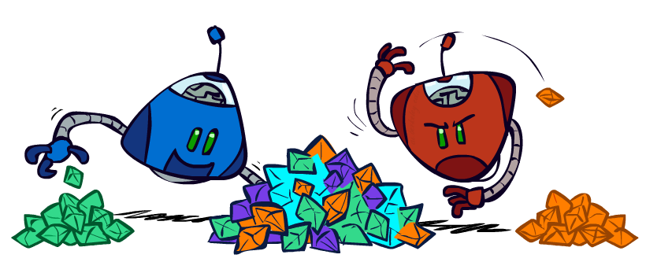
Zero-Sum Games
Zero-Sum Games
Agents have opposite utilities (values on outcomes)
Lets us think of a single value that one maximizes and the other minimizes
Adversarial, pure competition
General Games
Agents have independent utilities (values on outcomes)
Cooperation, indifference, competition, & more are possible
More later on non-zero-sum games

Slide 9
Deterministic Single-Player
Deterministic, single player, perfect information:
Know the rules, action effects, winning states
E.g. Freecell, 8-Puzzle, Rubik’s cube
… it’s just search!
Slight reinterpretation:
Each node stores a value: the best outcome it can reach
This is the maximal outcome of its children (the max value)
Note that we don’t have path sums as before (utilities at end)
After search, can pick move that leads to best node
lose
win
lose

Slide 10
Deterministic Two-Player
E.g. tic-tac-toe, chess, checkers
Zero-sum games
One player maximizes result
The other minimizes result

Slide 11
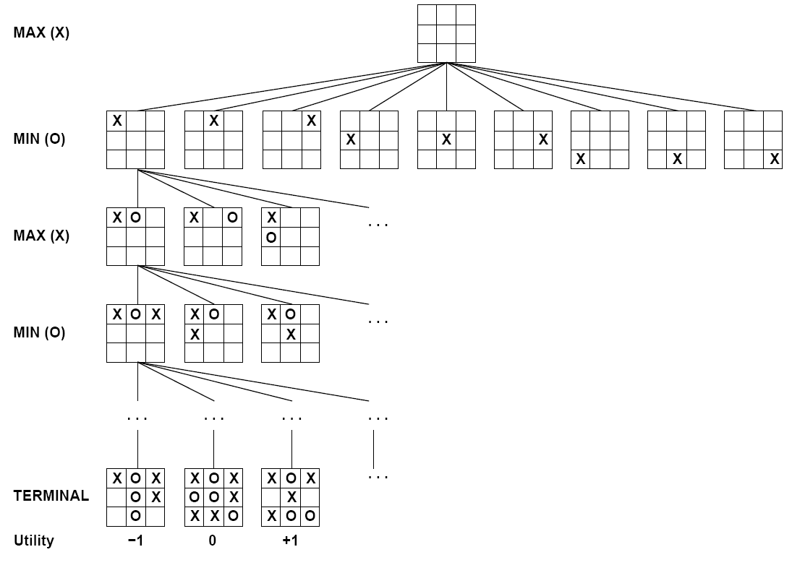
Tic-tac-toe Game Tree
You choose
Opponent
You choose
Opponent
You choose

Slide 12
Deterministic Two-Player
E.g. tic-tac-toe, chess, checkers
Zero-sum games
One player maximizes result
The other minimizes result
max
min
Minimax search
A state-space search tree
Players alternate
Choose move to position with highest minimax value = best achievable utility against best play
8
2
5
6

Slide 13
Tic-tac-toe Game Tree

Slide 14
Previously: Single-Agent Trees
8
2
0
…
2
6
…
4
6
Slide from Dan Klein & Pieter Abbeel - ai.berkeley.edu

Slide 15
Previously: Value of a State
Value of a state: The best achievable outcome (utility) from that state
Non-Terminal States:
8
2
0
…
2
6
…
4
6
Terminal States:
Slide from Dan Klein & Pieter Abbeel - ai.berkeley.edu

Slide 16
Adversarial Game Trees
-20
-8
…
-18
-5
…
-10
+4
-20
+8
Slide from Dan Klein & Pieter Abbeel - ai.berkeley.edu

Slide 17
Minimax Values
States Under Agent’s Control:
States Under Opponent’s Control:
-8
-5
-10
+8
Terminal States:
Slide from Dan Klein & Pieter Abbeel - ai.berkeley.edu

Slide 18
Adversarial Search (Minimax)
Deterministic, zero-sum games:
Tic-tac-toe, chess, checkers
One player maximizes result
The other minimizes result
Minimax search:
A state-space search tree
Players alternate turns
Compute each node’s minimax value: the best achievable utility against a rational (optimal) adversary
Minimax values: computed recursively
5
max
2
5
min
8
2
5
6
Terminal values: part of the game
Slide from Dan Klein & Pieter Abbeel - ai.berkeley.edu

Slide 19
Minimax Implementation
def max-value(state):
initialize v = -∞
for each successor of state:
v = max(v, min-value(successor))
return v
def min-value(state):
initialize v = +∞
for each successor of state:
v = min(v, max-value(successor))
return v
Slide from Dan Klein & Pieter Abbeel - ai.berkeley.edu

Slide 20
Minimax Implementation (Dispatch)
def value(state):
if the state is a terminal state: return the state’s utility
if the next agent is MAX: return max-value(state)
if the next agent is MIN: return min-value(state)
def max-value(state):
initialize v = -∞
for each successor of state:
v = max(v, value(successor))
return v
def min-value(state):
initialize v = +∞
for each successor of state:
v = min(v, value(successor))
return v
Slide from Dan Klein & Pieter Abbeel - ai.berkeley.edu
Notes:
Pick an order for two reasons: sequential processor and pruning

Slide 21
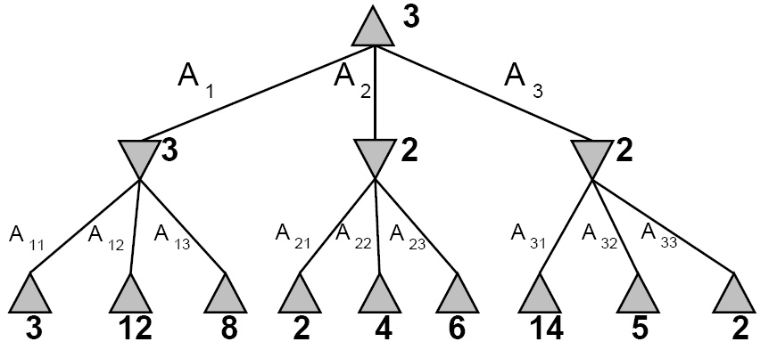
Concrete Minimax Example
max
min
Notes:
what if we had more than two players?

Slide 22
Minimax Example
max
A₁
min
Notes:
what if we had more than two players?

Slide 23
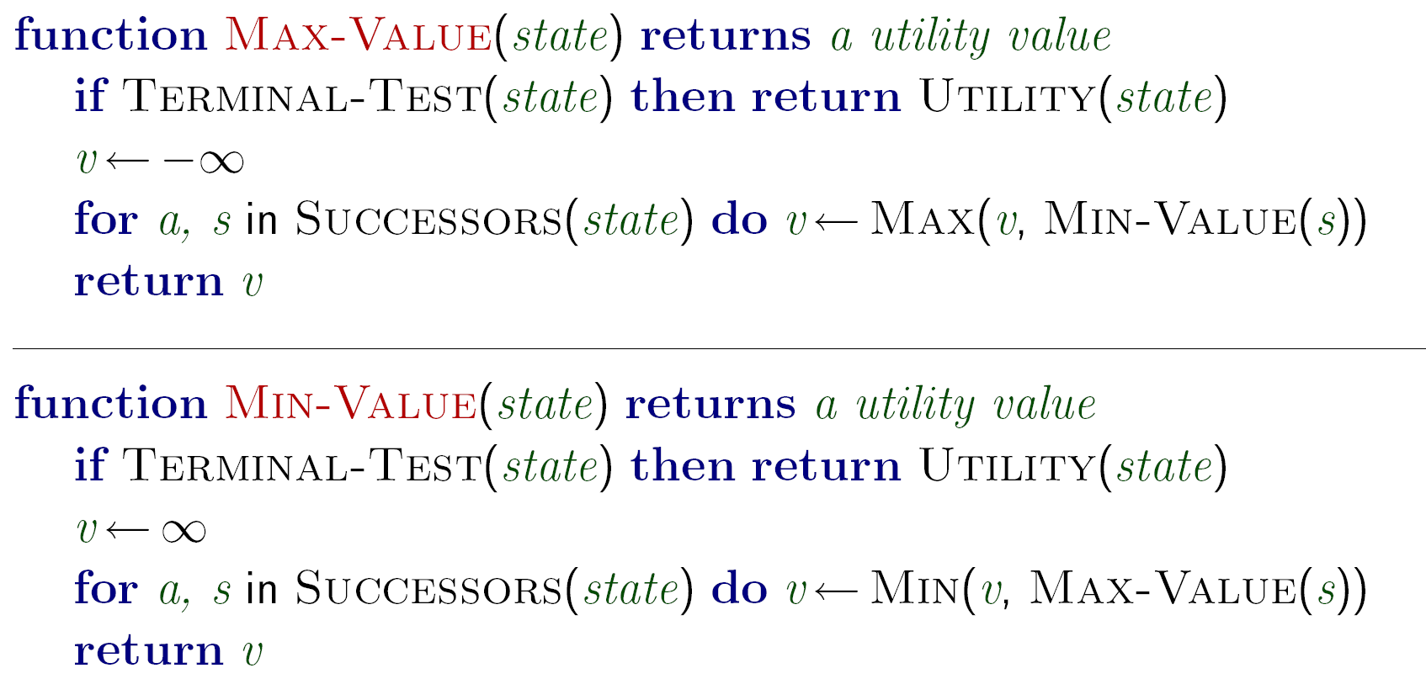
Minimax Search
Notes:
depth first search! why? because there are no intermediate utilities / costs

Slide 24
Minimax Properties
Optimal?
Yes, against perfect player. Otherwise?
max
Time complexity?
Space complexity?
O(b^{m})
min
O(bm)
10
10
9
100
For chess, b ∼ 35, m ∼ 100
Exact solution is completely infeasible
But, do we need to explore the whole tree?

Slide 25
Do We Need to Evaluate Every Node?
Notes:
\alpha - value of the best (highest value) choice along the current path for MAX
\beta - value of the vest (lowest value) choice along the current path for MIN
this figure will show bounds on the actual values

Slide 26
α-β Pruning Example
≥3
3
≤2
?
Progress of search…
Notes:
\alpha - value of the best (highest value) choice along the current path for MAX
\beta - value of the vest (lowest value) choice along the current path for MIN
this figure

Slide 27
α-β Pruning
General configuration
α is MAX’s best choice on path to root
If n becomes worse than α, MAX will avoid it, so can stop considering n’s other children
Define β similarly for MIN
Player
Opponent
α
Player
Opponent
n

Slide 28
Alpha-Beta Pseudocode
inputs: state, current game state
α, value of best alternative for MAX on path to state
β, value of best alternative for MIN on path to state
returns: a utility value
function MAX-VALUE(state,α,β)
if TERMINAL-TEST(state) then
return UTILITY(state)
v ← −∞
for a, s in SUCCESSORS(state) do
v ← MAX(v, MIN-VALUE(s,α,β))
if v ≥ β then return v
α ← MAX(α,v)
return v
function MIN-VALUE(state,α,β)
if TERMINAL-TEST(state) then
return UTILITY(state)
v ← +∞
for a, s in SUCCESSORS(state) do
v ← MIN(v, MAX-VALUE(s,α,β))
if v ≤ α then return v
β ← MIN(β,v)
return v
At max node:
Prune if v≥β;
Update α≤
At min node:
Prune if α≤v;
Update β

Slide 29
Alpha-Beta Implementation
α: MAX’s best option on path to root
β: MIN’s best option on path to root
def max-val(state, α, β):
initialize v = -∞
for each c in children(state):
v = max(v, min-val(c, α, β))
if v ≥ β return v
α = max(α, v)
return v
def min-val(state , α, β):
initialize v = +∞
for each c in children(state):
v = min(v, max-val(child, α, β))
if v ≤ α return v
β = min(β, v)
return v
Slide adapted from Dan Klein & Pieter Abbeel - ai.berkeley.edu
Notes:
Pick an order for two reasons: sequential processor and pruning

Slide 30
Alpha-Beta Pruning Example
At max node:
Prune if v≥β;
Update α
α=-∞
β=+∞
At min node:
Prune if v≤α;
Update β
3
α=-∞
β=+∞
α=3
β=+∞
α=3
β=+∞
α=3
β=+∞
3
≤2
≤1
α=-∞
β=+ ∞
α=-∞
β=3
α=3
β=2
α=3
β=+∞
α=3
β=1
α=-∞
β=3
α=-∞
β=3
α=3
β=+∞
α=3
β=14
α=3
β=5
3
12
2
14
5
1
≥8
α=-∞
β=3
α=8
β=3
α is MAX’s best alternative here or above
β is MIN’s best alternative here or above
8

Slide 31
Alpha-Beta Pruning Example
0
7
4
2
1
5
6
2
3
5
9
α is MAX’s best alternative here or above
β is MIN’s best alternative here or above

Slide 32
Alpha-Beta Pruning Example
0
2
1
2
3
5
α is MAX’s best alternative here or above
β is MIN’s best alternative here or above

Slide 33
Alpha-Beta Pruning Properties
This pruning has no effect on final result at the root
Values of intermediate nodes might be wrong!
but, they are bounds
Good child ordering improves effectiveness of pruning
With “perfect ordering”:
Time complexity drops to O(b^{m/2})
Doubles solvable depth!
Full search of, e.g. chess, is still hopeless…

Slide 34
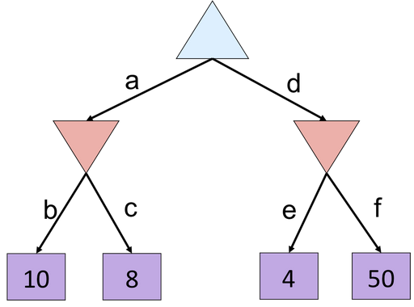
Alpha-Beta Quiz
Slide from Dan Klein & Pieter Abbeel - ai.berkeley.edu

Slide 35
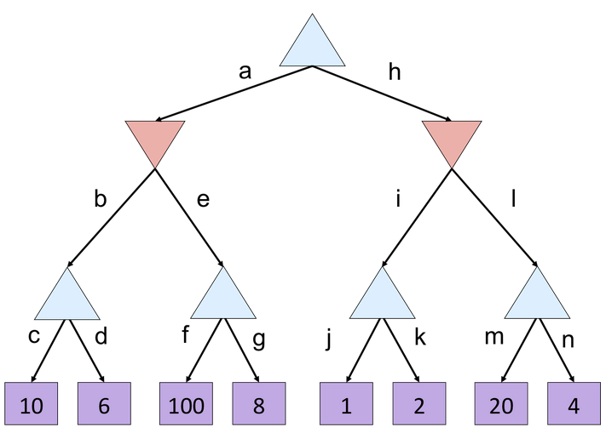
Alpha-Beta Quiz 2
Slide from Dan Klein & Pieter Abbeel - ai.berkeley.edu

Slide 36
Resource Limits
Cannot search to leaves
Depth-limited search
Instead, search a limited depth of tree
Replace terminal utilities with heuristic eval function for non-terminal positions
Guarantee of optimal play is gone
Example:
Suppose we have 100 seconds, can explore 10K nodes / sec
So can check 1M nodes per move
α−β reaches about depth 8 decent chess program
max
4
-2
min
4
min
-1
-2
4
9
?
?
?
?

Slide 37
Resource Limits
Problem: In realistic games, cannot search to leaves!
Solution: Depth-limited search
Instead, search only to a limited depth in the tree
Replace terminal utilities with an evaluation function for non-terminal positions
Example:
Suppose we have 100 seconds, can explore 10K nodes / sec
So can check 1M nodes per move
α-β reaches about depth 8 – decent chess program
Guarantee of optimal play is gone
More plies makes a BIG difference
Use iterative deepening for an anytime algorithm
4
max
-2
4
min
-1
-2
4
9
?
?
?
?

Slide 38
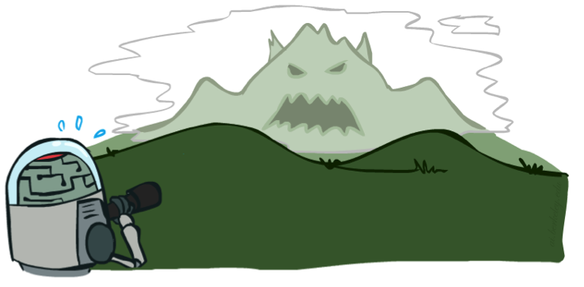
Depth Matters
Evaluation functions are always imperfect
The deeper in the tree the evaluation function is buried, the less the quality of the evaluation function matters
An important example of the tradeoff between complexity of features and complexity of computation
[Demo: depth limited (L6D4, L6D5)]

Slide 39
Iterative Deepening
Iterative deepening uses DFS as a subroutine:
Do a DFS which only searches for paths of length 1 or less. (DFS gives up on any path of length 2)
If “1” failed, do a DFS which only searches paths of length 2 or less.
If “2” failed, do a DFS which only searches paths of length 3 or less.
….and so on.
Why do we want to do this for multiplayer games?
b
…

Slide 40
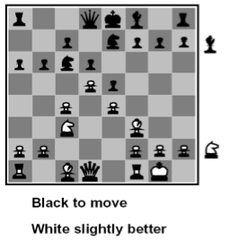
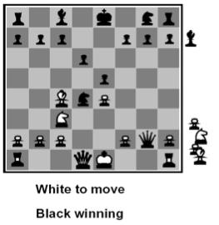
Heuristic Evaluation Function
Function which scores non-terminals
Ideal function: returns the utility of the position
In practice: typically weighted linear sum of features:
e.g. f₁(s) = (num white queens – num black queens), etc.

Slide 41
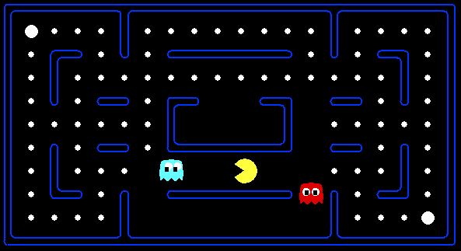
Evaluation for Pacman
What features would be good for Pacman?

Slide 42
Which algorithm?
α-β, depth 4, simple eval fun

Slide 43
Which algorithm?
α-β, depth 4, better eval fun

Slide 44
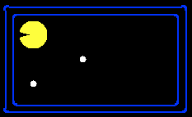
Why Pacman Starves
He knows his score will go up by eating the dot now
He knows his score will go up just as much by eating the dot later on
There are no point-scoring opportunities after eating the dot
Therefore, waiting seems just as good as eating

Slide 45
Stochastic Single-Player
What if we don’t know what the result of an action will be? E.g.,
In solitaire, shuffle is unknown
In minesweeper, mine locations
max
average
Can do expectimax search
Chance nodes, like actions except the environment controls the action chosen
Max nodes as before
Chance nodes take average (expectation) of value of children
10
4
5
7

Slide 46
Which Algorithms?
Expectimax
Minimax
3 ply look ahead, ghosts move randomly

Slide 47
Maximum Expected Utility
Why should we average utilities? Why not minimax?
Principle of maximum expected utility: an agent should chose the action which maximizes its expected utility, given its knowledge
General principle for decision making
Often taken as the definition of rationality
We’ll see this idea over and over in this course!
Let’s decompress this definition…

Slide 48
Reminder: Probabilities
A random variable represents an event whose outcome is unknown
A probability distribution is an assignment of weights to outcomes
Example: traffic on freeway?
Random variable: T = whether there’s traffic
Outcomes: T in {none, light, heavy}
Distribution: P(T=none) = 0.25, P(T=light) = 0.55, P(T=heavy) = 0.20
Some laws of probability (more later):
Probabilities are always non-negative
Probabilities over all possible outcomes sum to one
As we get more evidence, probabilities may change:
P(T=heavy) = 0.20, P(T=heavy | Hour=8am) = 0.60
We’ll talk about methods for reasoning and updating probabilities later

Slide 49
What are Probabilities?
Objectivist / frequentist answer:
Averages over repeated experiments
E.g. empirically estimating P(rain) from historical observation
E.g. pacman’s estimate of what the ghost will do, given what it has done in the past
Assertion about how future experiments will go (in the limit)
Makes one think of inherently random events, like rolling dice
Subjectivist / Bayesian answer:
Degrees of belief about unobserved variables
E.g. an agent’s belief that it’s raining, given the temperature
E.g. pacman’s belief that the ghost will turn left, given the state
Often learn probabilities from past experiences (more later)
New evidence updates beliefs (more later)

Slide 50
Uncertainty Everywhere
Not just for games of chance!
I’m sick: will I sneeze this minute?
Email contains “FREE!”: is it spam?
Tooth hurts: have cavity?
60 min enough to get to the airport?
Robot rotated wheel three times, how far did it advance?
Safe to cross street? (Look both ways!)
Sources of uncertainty in random variables:
Inherently random process (dice, etc)
Insufficient or weak evidence
Ignorance of underlying processes
Unmodeled variables
The world’s just noisy – it doesn’t behave according to plan!

Slide 51
Reminder: Expectations
We can define function f(X) of a random variable X
The expected value of a function is its average value, weighted by the probability distribution over inputs
Example: How long to get to the airport?
Length of driving time as a function of traffic:
L(none) = 20, L(light) = 30, L(heavy) = 60
What is my expected driving time?
Notation: EP(T)[ L(T) ]
Remember, P(T) = {none: 0.25, light: 0.5, heavy: 0.25}
E[ L(T) ] = L(none) * P(none) + L(light) * P(light) + L(heavy) * P(heavy)
E[ L(T) ] = (20 * 0.25) + (30 * 0.5) + (60 * 0.25) = 35

Slide 52
Review: Expectations
Real valued functions of random variables:
Expectation of a function of a random variable
Example: Expected value of a fair die roll
X | P | f
1 | 1/6 | 1
2 | 1/6 | 2
3 | 1/6 | 3
4 | 1/6 | 4
5 | 1/6 | 5
6 | 1/6 | 6

Slide 53
Utilities
Utilities are functions from outcomes (states of the world) to real numbers that describe an agent’s preferences
Where do utilities come from?
In a game, may be simple (+1/-1)
Utilities summarize the agent’s goals
Theorem: any set of preferences between outcomes can be summarized as a utility function (provided the preferences meet certain conditions)
In general, we hard-wire utilities and let actions emerge (why don’t we let agents decide their own utilities?)
More on utilities soon…

Slide 54
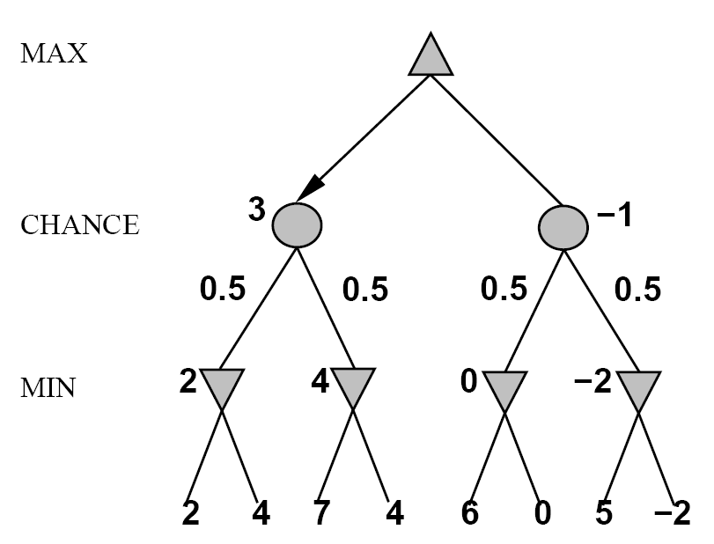
Stochastic Two-Player
E.g. backgammon
Expectiminimax (!)
Environment is an extra player that moves after each agent
Chance nodes take expectations, otherwise like minimax

Slide 55
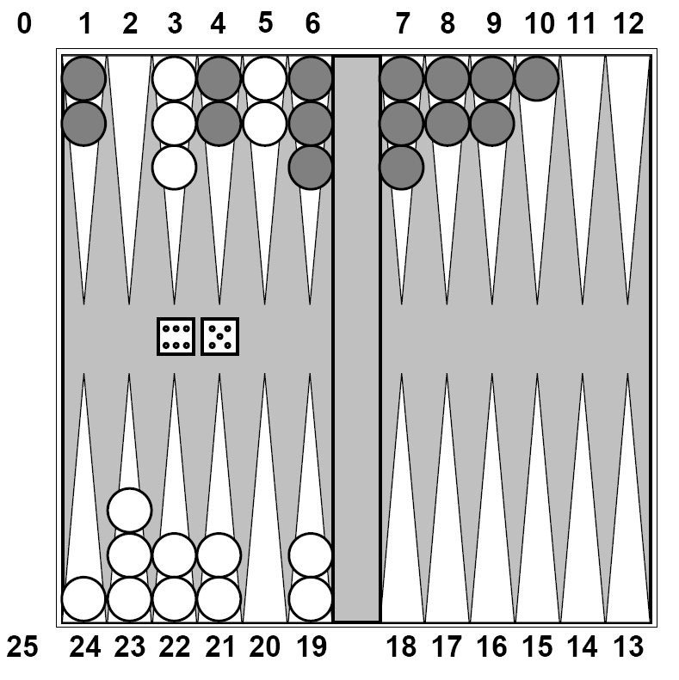
Stochastic Two-Player
Dice rolls increase b: 21 possible rolls with 2 dice
Backgammon ≈ 20 legal moves
Depth 4 = 20 x (21 x 20)³ = 1.2 x 10⁹
As depth increases, probability of reaching a given node shrinks
So value of lookahead is diminished
So limiting depth is less damaging
But pruning is less possible…
TDGammon uses depth-2 search + very good eval function + reinforcement learning: world-champion level play

Slide 56
Expectimax Search Trees
What if we don’t know what the result of an action will be? E.g.,
In solitaire, next card is unknown
In minesweeper, mine locations
In pacman, the ghosts act randomly
max
Can do expectimax search
Chance nodes, like min nodes, except the outcome is uncertain
Calculate expected utilities
Max nodes as in minimax search
Chance nodes take average (expectation) of value of children
chance
10
4
5
7
Later, we’ll learn how to formalize the underlying problem as a Markov Decision Process

Slide 57
Which Algorithm?
Minimax: no point in trying
3 ply look ahead, ghosts move randomly

Slide 58
Which Algorithm?
Expectimax: wins some of the time
3 ply look ahead, ghosts move randomly

Slide 59
Expectimax Search
In expectimax search, we have a probabilistic model of how the opponent (or environment) will behave in any state
Model could be a simple uniform distribution (roll a die)
Model could be sophisticated and require a great deal of computation
We have a node for every outcome out of our control: opponent or environment
The model might say that adversarial actions are likely!
For now, assume for any state we magically have a distribution to assign probabilities to opponent actions / environment outcomes

Slide 60
Expectimax Pseudocode
def value(s)
if s is a max node return maxValue(s)
if s is an exp node return expValue(s)
if s is a terminal node return evaluation(s)
def maxValue(s)
values = [value(s’) for s’ in successors(s)]
return max(values)
def expValue(s)
values = [value(s’) for s’ in successors(s)]
weights = [probability(s, s’) for s’ in successors(s)]
return expectation(values, weights)
8
4
5
6

Slide 61
Expectimax for Pacman
Notice that we’ve gotten away from thinking that the ghosts are trying to minimize pacman’s score
Instead, they are now a part of the environment
Pacman has a belief (distribution) over how they will act
Quiz: Can we see minimax as a special case of expectimax?
Quiz: what would pacman’s computation look like if we assumed that the ghosts were doing 1-ply minimax and taking the result 80% of the time, otherwise moving randomly?

Slide 62
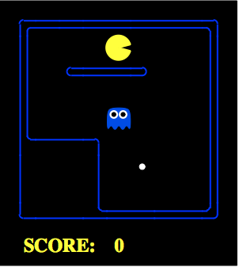
Expectimax for Pacman
Results from playing 5 games
 | Minimizing Ghost | Random Ghost
Minimax Pacman
Expectimax Pacman
Won 5/5
Avg. Score:
493
Won 5/5
Avg. Score:
483
Won 1/5
Avg. Score:
-303
Won 5/5
Avg. Score:
503
Pacman does depth 4 search with an eval function that avoids trouble Minimizing ghost does depth 2 search with an eval function that seeks Pacman
Notes:
python pacman.py -g SmartGhost -l trapped2 -p ExpectimaxAgent -a depth=4,evalFn=better
animation is in order of who performs best (gets the dot quickiest)

Slide 63
Expectimax Pruning?
Not easy
exact: need bounds on possible values
approximate: sample high-probability branches

Slide 64
Expectimax Evaluation
Evaluation functions quickly return an estimate for a node’s true value (which value, expectimax or minimax?)
For minimax, evaluation function scale doesn’t matter
We just want better states to have higher evaluations (get the ordering right)
We call this insensitivity to monotonic transformations
For expectimax, we need magnitudes to be meaningful
0
40
20
30
x²
0
1600
400
900

Slide 65
Mixed Layer Types
E.g. Backgammon
Expectiminimax
Environment is an extra player that moves after each agent
Chance nodes take expectations, otherwise like minimax

Slide 66
Stochastic Two-Player
Dice rolls increase b: 21 possible rolls with 2 dice
Backgammon ≈ 20 legal moves
Depth 4 = 20 x (21 x 20)³ 1.2 x 10⁹
As depth increases, probability of reaching a given node shrinks
So value of lookahead is diminished
So limiting depth is less damaging
But pruning is less possible…
TDGammon uses depth-2 search + very good eval function + reinforcement learning: world-champion level play

Slide 67
Multi-player Non-Zero-Sum Games
Similar to minimax:
Utilities are now tuples
Each player maximizes their own entry at each node
Propagate (or back up) nodes from children
Can give rise to cooperation and competition dynamically…
1,2,6
4,3,2
6,1,2
7,4,1
5,1,1
1,5,2
7,7,1
5,4,5

