Slide 1
CSE 473: Artificial Intelligence Autumn 2014
Heuristics & Pattern Databases for Search
Dan Weld
With many slides from
Dan Klein, Richard Korf, Stuart Russell, Andrew Moore, & UW Faculty

Slide 2
Todo
Spanning tree heuristic for TSP way too hard – cut or at least define search space (nodes and edges) first with illustration. Use illustration of TSP for partial solution.
Pattern databases too hard and abstract. Need concrete example and need to concretely show how the DB is –used-
People couldn’t grok using the DB to compute a solution. Maybe show manhattan distance as a big table next to pattern DB as a table. Also nice to know other examples where pattern DBs are used. (maybe tie into endgame DB)

Slide 3
Logistics
PS1 – due Monday 10/13
Office hours
Jeff today 10:30am CSE 021
Galen today 1-3pm CSE 218
See Website for all

Slide 4
Recap: Search Problem
States
configurations of the world
Successor function:
function from states to lists of (state, action, cost) triples
Start state
Goal test

Slide 5
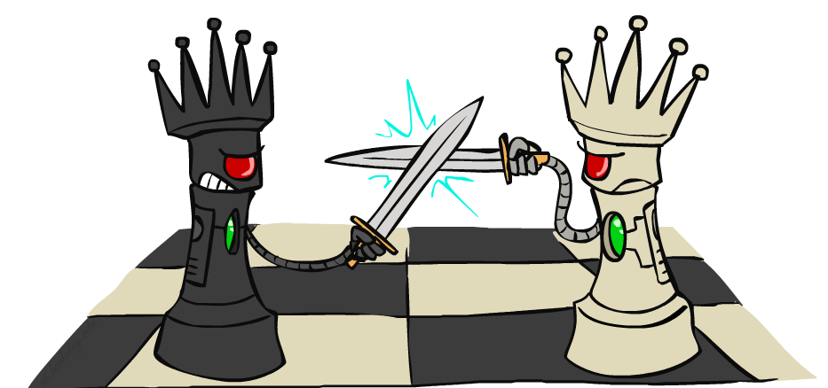
N-Queens as Search?
Given N x N chess board
Can you place N queens so they don’t fight?
Cool picture from Dan Klein & Pieter Abeel ai.berkeley.edu

Slide 6
States are Board Positions
Etc…

Slide 7
Search Methods
Depth first search (DFS)
Breadth first search (BFS)
Iterative deepening depth-first search (IDS)
Best first search
Uniform cost search (UCS)
Greedy search
A*
Iterative Deepening A* (IDA*)
Beam search, hill climbing
Stochastic Search
Constraint Satisfaction
Heuristic search

Slide 8
IDA* for N-Queens?
Given N x N chess board
Can you place N queens so they don’t fight?
Cool picture from Dan Klein & Pieter Abeel ai.berkeley.edu

Slide 9
Best-First Search
Generalization of breadth-first search
Fringe = Priority queue of nodes to be explored
Cost function f(n) applied to each node
Add initial state to priority queue
While queue not empty
Node = head(queue)
If goal?(node) then return node
Add children of node to queue
“expanding the node”

Slide 10
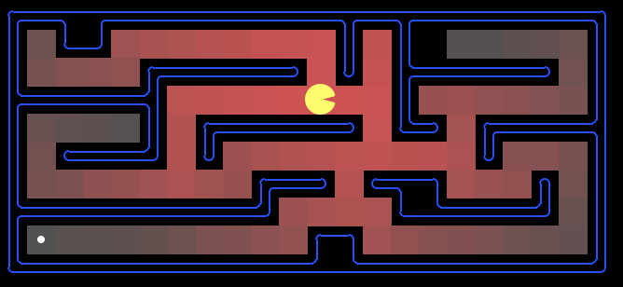
Which Algorithm?
Uniform cost search (UCS):
10

Slide 11
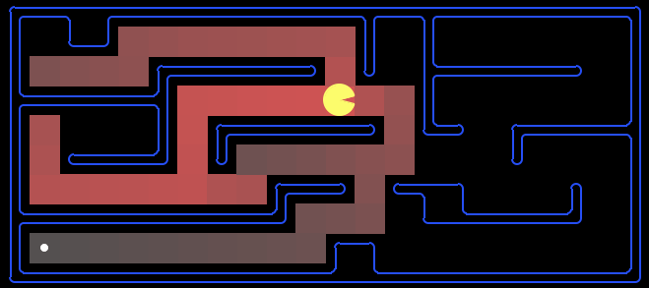
Which Algorithm?
A*, Manhattan Heuristic:

Slide 12
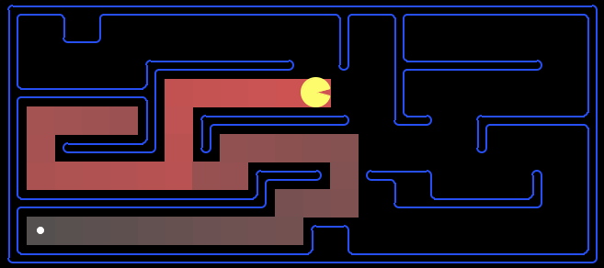
Which Algorithm?
Best First / Greedy, Manhattan Heuristic:

Slide 13
Iterative-Deepening A*
Like iterative-deepening depth-first, but...
Depth bound modified to be an f-limit
Start with f-limit = h(start)
Prune any node if f(node) > f-limit
Next f-limit = min-cost of any node pruned
e
FL=21
FL=15
a
d
f
b
c

Slide 14
IDA* Analysis
Complete & Optimal (ala A*)
Space usage ∝ depth of solution
Each iteration is DFS - no priority queue!
# nodes expanded relative to A*
Depends on # unique values of heuristic function
In 8 puzzle: few values ⇒ close to # A* expands
In eastern-europe travel: each f value is unique
⇒ 1+2+…+n = O(n²) where n=nodes A* expands
if n is too big for main memory, n² is too long to wait!
Generates duplicate nodes in cyclic graphs

Slide 15
Forgetfulness
A* used exponential memory
How much does IDA* use?
During a run?
In between runs?

Slide 16
SMA*
Use all available memory
Start like A*
When memory is full…
Erase node with highest f-value
First, backup parent with this f-value
So… parent knows cost-bound on best child

Slide 17
Alternative Approach to Finite Memory…
Optimality is nice to have, but…

Slide 18
Depth-First Branch & Bound
Single DF search
→ uses linear space
Keep track of best solution so far
If f(n) = g(n)+h(n) ≥ cost(best-soln)
Then prune n
Requires
Finite search tree, or
Good upper bound on solution cost
Generates duplicate nodes in cyclic graphs
Tradeoff:
Prune space, but…
Must apply test to each node
Adapted from Richard Korf presentation

Slide 19
Beam Search
Idea
Best first
But discard all but N best items on priority queue
Evaluation
Complete?
Time Complexity?
Space Complexity?
No
O(b^d)
O(b + N)

Slide 20
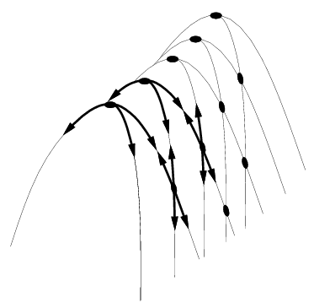
Hill Climbing
“Gradient ascent”
Idea
Always choose best child; no backtracking
Beam search with |queue| = 1
Problems?
Local maxima
Plateaus
Diagonal ridges

Slide 21
Randomizing Hill Climbing
Randomly disobeying heuristic
Random restarts
( heavy tailed distributions )
→ Local Search

Slide 22
Simulated Annealing
Objective: avoid local minima
Technique:
For the most part use hill climbing
When no improvement possible
Choose random neighbor
Let Δ be the decrease in quality
Move to neighbor with probability e ^{-Δ-/T}
Reduce “temperature” (T) over time
Pros & cons
Optimal?
If T decreased slowly enough, will reach optimal state
Widely used
See also WalkSAT
temp

Slide 23
Heuristics
It’s what makes search actually work

Slide 24
Admissable Heuristics
f(x) = g(x) + h(x)
g: cost so far
h: underestimate of remaining costs
Where do heuristics come from?

Slide 25
Relaxed Problems
Derive admissible heuristic from exact cost of a solution to a relaxed version of problem
For blocks world, distance = # move operations
heuristic = number of misplaced blocks
What is relaxed problem?
# out of place = 2, true distance to goal = 3
Cost of optimal soln to relaxed problem ≤ cost of optimal soln for real problem

Slide 26
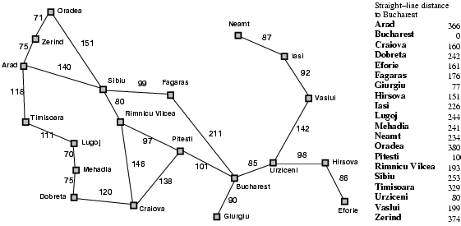
What’s being relaxed?
Heuristic = Euclidean distance

Slide 27
Example: Pancake Problem
Action: Flip over the
top n pancakes
Cost: Number of pancakes flipped
Notes:
Gates, W. and Papadimitriou, C., "Bounds for Sorting by Prefix Reversal.", Discrete Mathematics. 27, 47-57, 1979.

Slide 28
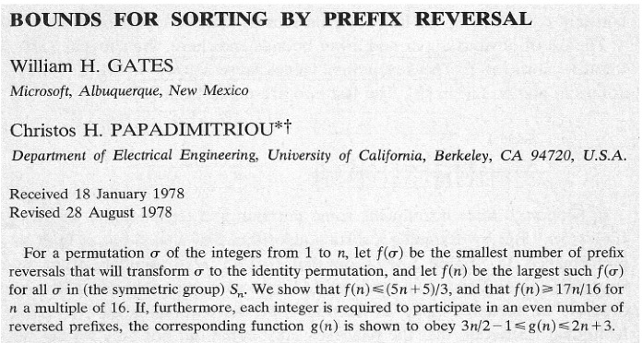
Example: Pancake Problem
Notes:
Gates, W. and Papadimitriou, C., "Bounds for Sorting by Prefix Reversal.", Discrete Mathematics. 27, 47-57, 1979.

Slide 29
Example: Pancake Problem
State space graph with costs as weights
4
2
3
2
3
4
3
4
2
3
2
2
4
3
3
Notes:
A* expanded 8100 ; Path cost = 33
UCS expanded 25263 . Path cost = 33
Greedy expanded 10 . Path cost = 41
[0, 7, 5, 3, 2, 1, 4, 6]
(7, 0, 5, 3, 2, 1, 4, 6)
(6, 4, 1, 2, 3, 5, 0, 7)
(3, 2, 1, 4, 6, 5, 0, 7)
(1, 2, 3, 4, 6, 5, 0, 7)
(5, 6, 4, 3, 2, 1, 0, 7)
(6, 5, 4, 3, 2, 1, 0, 7)
(0, 1, 2, 3, 4, 5, 6, 7)

Slide 30
Example: Heuristic Function
Heuristic: the largest pancake that is still out of place
3
h(x)
4
3
4
3
0
4
4
3
4
4
2
3
Notes:
A* expanded 8100 ; Path cost = 33
UCS expanded 25263 . Path cost = 33
Greedy expanded 10 . Path cost = 41
[0, 7, 5, 3, 2, 1, 4, 6]
(7, 0, 5, 3, 2, 1, 4, 6)
(6, 4, 1, 2, 3, 5, 0, 7)
(3, 2, 1, 4, 6, 5, 0, 7)
(1, 2, 3, 4, 6, 5, 0, 7)
(5, 6, 4, 3, 2, 1, 0, 7)
(6, 5, 4, 3, 2, 1, 0, 7)
(0, 1, 2, 3, 4, 5, 6, 7)

Slide 31
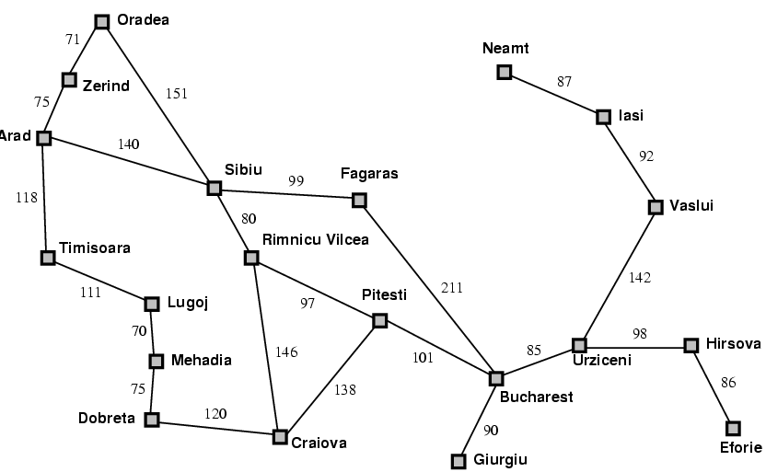
Traveling Salesman Problem
Objective: shortest path visiting every city
What can be
Relaxed?

Slide 32
Heuristics for eight puzzle
7 2 3
1 2 3
5 1 6
4 5 6
→
8 3
7 8
start
goal
What can we relax?
h1 = number of tiles in wrong place
h2 = Σ distances of tiles from correct loc

Slide 33
Importance of Heuristics
7 2 3
4 1 6
h1 = number of tiles in wrong place
8 5
D IDS A*(h1) A*(h2)
2 10 6 6
4 112 13 12
6 680 20 18
8 6384 39 25
10 47127 93 39
12 364404 227 73
14 3473941 539 113
18 3056 363
24 39135 1641

Slide 34
Importance of Heuristics
7 2 3
4 1 6
h1 = number of tiles in wrong place
h2 = Σ distances of tiles from correct loc
8 5
D IDS A*(h1) A*(h2)
2 10 6 6
4 112 13 12
6 680 20 18
8 6384 39 25
10 47127 93 39
12 364404 227 73
14 3473941 539 113
18 3056 363
24 39135 1641
Decrease effective branching factor

Slide 35
Need More Power!
Performance of Manhattan Distance Heuristic
8 Puzzle < 1 second
15 Puzzle 1 minute
24 Puzzle 65000 years
Need even better heuristics!
Adapted from Richard Korf presentation

Slide 36
Subgoal Interactions
Manhattan distance assumes
Each tile can be moved independently of others
Underestimates because
Doesn’t consider interactions between tiles
1 2 3
4 6 5
7 8
Adapted from Richard Korf presentation

Slide 37
Pattern Databases
[Culberson & Schaeffer 1996]
1 2 3 4
Pick any subset of tiles
E.g., 3, 7, 11, 12, 13, 14, 15
(or as drawn)
Precompute a table
Optimal cost of solving just these tiles
For all possible configurations
57 Million in this case
Use A* or IDA*
State = position of just these tiles (& blank)
5 6 7 8
9 10 11 12
13 14 15
Adapted from Richard Korf presentation

Slide 38
Using a Pattern Database
As each state is generated
Use position of chosen tiles as index into DB
Use lookup value as heuristic, h(n)
Admissible?
Adapted from Richard Korf presentation

Slide 39
Combining Multiple Databases
1 2 3 4
Can choose another set of tiles
Precompute multiple tables
How combine table values?
E.g. Optimal solutions to Rubik’s cube
First found w/ IDA* using pattern DB heuristics
Multiple DBs were used (dif cubie subsets )
Most problems solved optimally in 1 day
Compare with 574,000 years for IDDFS
5 6 7 8
9 10 11 12
13 14 15
Adapted from Richard Korf presentation

Slide 40
Drawbacks of Standard Pattern DBs
Since we can only take max
Diminishing returns on additional DBs
Would like to be able to add values
Adapted from Richard Korf presentation

Slide 41
Disjoint Pattern DBs
1 2 3 4
5 6 7 8
Partition tiles into disjoint sets
For each set, precompute table
E.g. 8 tile DB has 519 million entries
And 7 tile DB has 58 million
During search
Look up heuristic values for each set
Can add values without overestimating!
Manhattan distance is a special case of this idea where each set is a single tile
9 10 11 12
13 14 15
Adapted from Richard Korf presentation

Slide 42
Performance
15 Puzzle: 2000x speedup vs Manhattan dist
IDA* with the two DBs shown previously solves 15 Puzzles optimally in 30 milliseconds
24 Puzzle: 12 million x speedup vs Manhattan
IDA* can solve random instances in 2 days.
Requires 4 DBs as shown
Each DB has 128 million entries
Without PDBs: 65,000 years
Adapted from Richard Korf presentation

