Slide 1
CSE 473: Artificial Intelligence Autumn 2014
Search: Cost & Heuristics
Dan Weld
With slides from
Dan Klein, Stuart Russell, Andrew Moore, Luke Zettlemoyer
Luke Zettlemoyer
Lecture adapted from Dan Klein’s slides
Multiple slides from Stuart Russell, Andrew Moore

Slide 2
Announcements
Piazza?
Project 1: Search
online tomorrow
due Monday 10/13
ue Wed 4/11
Start!

Slide 3
Search thru a
Problem Space / State Space
Input:
Set of states
Operators [and costs]
Start state
Goal state [test]
Output:
Path: start ⇒ a state satisfying goal test
[May require shortest path]
[Sometimes just need state passing test]
Notes:
State Space Search is basically a GRAPH SEARCH PROBLEM
STATES are whatever you like!
OPERATORS are a compact DESCRIPTION of possible STATE TRANSITIONS – the EDGES of the GRAPH
May have different COSTS or all be UNIT cost
OUTPUT may be specified either as ANY PATH (REACHABILITY), or a SHORTEST PATH

Slide 4
Graduation?
Getting a BS in CSE as a search problem? (don’t think too hard)
Space of States
Operators
Initial State
Goal State

Slide 5
Concept Learning
Labeled Training Examples
<p1,blond,32,mc,ok>
<p2,red,47,visa,ok>
<p3,blond,23,cash,ter>
<p4,…
Output: f: <pn…> → {ok, ter}
Input:
Set of states
Operators [and costs]
Start state
Goal state (test)
Output:

Slide 6
Search Methods
Depth first search (DFS)
Breadth first search (BFS)
Iterative deepening depth-first search (IDS)
Blind search

Slide 7
Search Methods
Depth first search (DFS)
Breadth first search (BFS)
Iterative deepening depth-first search (IDS)
Best first search
Uniform cost search (UCS)
Greedy search
A*
Iterative Deepening A* (IDA*)
Beam search
Hill climbing
Heuristic search

Slide 8
Depth First Search
Maintain stack of nodes to visit
Check path to root to prune duplicates
Evaluation
Complete?
Time Complexity?
Space Complexity?
Not for infinite spaces
a
O(b^{m})
b
e
m
c
d
f
g
h
O(bm)

Slide 9
Breadth First Search
Maintain queue of nodes to visit
Evaluation
Complete?
Time Complexity?
Space Complexity?
Yes
a
d
O(b^{d})
b
c
d
e
f
g
h
O(b^{d})

Slide 10
Memory a Limitation?
Suppose:
4 GHz CPU
16 GB main memory
100 instructions / expansion
10 bytes / node
400,000 expansions / sec
Memory filled in 400 sec … < 7 min

Slide 11
Iterative Deepening Search
DFS with limit; incrementally grow limit
Evaluation
Complete?
Time Complexity?
Space Complexity?
a

Slide 12
Iterative Deepening Search
DFS with limit; incrementally grow limit
Evaluation
Complete?
Time Complexity?
Space Complexity?
a b
c
d

Slide 13
Iterative Deepening Search
DFS with limit; incrementally grow limit
Evaluation
Complete?
Time Complexity?
Space Complexity?
a b e
c f
d i
g
h
j
k
l

Slide 14
Iterative Deepening Search
DFS with limit; incrementally grow limit
Evaluation
Complete?
Time Complexity?
Space Complexity?
a b e
Yes
d
c
d
O(b^{d})
O(b^{d})

Slide 15
Cost of Iterative Deepening
b | ratio ID to DFS
2 | 3
3 | 2
5 | 1.5
10 | 1.2
25 | 1.08
100 | 1.02

Slide 16
Speed
Assuming 10M nodes/sec & sufficient memory
BFS
Nodes Time
Iter. Deep.
Nodes Time
8 Puzzle
2x2x2 Rubik’s
15 Puzzle
3x3x3 Rubik’s
24 Puzzle
10⁵ .01 sec
10⁶ .2 sec
10¹³ 6 days
10¹⁹ 68k yrs
10²⁵ 12B yrs
10⁵ .01 sec
10⁶ .2 sec
10¹⁷ 20k yrs
10²⁰ 574k yrs
10³⁷ 10²³ yrs
1Mx
8x
Why the difference?
Rubik has higher branch factor 15 puzzle has greater depth
# of duplicates
Slide adapted from Richard Korf presentation

Slide 17
Costs on Actions
a
2
GOAL
2
b
c
3
2
1
8
2
e
3
d
f
9
8
2
START
h
1
4
1
p
4
r
15
q
Objective: Path with smallest overall cost

Slide 18
Costs on Actions
a
2
GOAL
2
b
c
3
2
1
8
2
e
3
d
f
9
8
2
START
h
1
4
1
p
4
r
15
q
What will BFS return?
… finds the shortest path in terms of number of transitions.
It does not find the least-cost path.

Slide 19
Best-First Search
Generalization of breadth-first search
Fringe = Priority queue of nodes to be explored
Cost function f(n) applied to each node

Slide 20
Priority Queue Refresher
A priority queue is a data structure in which you can insert and retrieve (key, value) pairs with the following operations:
pq.push(key, value) | inserts (key, value) into the queue.
pq.pop() | returns the key with the lowest value, and removes it from the queue.
You can decrease a key’s priority by pushing it again
Unlike a regular queue, insertions aren’t constant time, usually O(log n)
We’ll need priority queues for cost-sensitive search methods

Slide 21
Best-First Search
Generalization of breadth-first search
Fringe = Priority queue of nodes to be explored
Cost function f(n) applied to each node
Add initial state to priority queue
While queue not empty
Node = head(queue)
If goal?(node) then return node
Add children of node to queue
“expanding the node”

Slide 22
Old Friends
Breadth First =
Best First
with f(n) = depth(n)
Dijkstra’s Algorithm (Uniform cost) =
Best First
with f(n) = the sum of edge costs from start to n

Slide 23
Uniform Cost Search
Best first, where
f(n) = “cost from start to n”
2
a
GOAL
2
b
c
3
2
1
8
2
e
3
d
f
9
8
2
START
h
1
4
1
p
4
r
15
q
aka “Dijkstra’s Algorithm”

Slide 24
Uniform Cost Search
2
G
a
Expansion order:
S, p, d, b, e, a, r, f, e, G
b
1
8
c
2
2
3
d
e
f
9
1
S
h
8
1
1
p
q
r
15
0
S
d
3
e
9
p
1
b
4
e
5
h
17
r
11
q
16
c
11
Cost
contours
(not all shown)
a
6
a
h
13
r
7
p
q
f
p
q
f
8
q
c
G
q
c
a
11
G
10
a

Slide 25
Uniform Cost Search
Algorithm |  | Complete | Optimal | Time | Space
DFS | w/ Path Checking
BFS
UCS
Y if finite
N
O(b^{m})
O(bm)
Y
Y*
O(b^{d})
O(b^{d})
Y*
Y
O(b^{C*/ε})
O(b^{C*/ε})
b
…
C*/ε tiers
C* = Optimal cost
ε = Minimum cost of an action

Slide 26
Uniform Cost Issues
Remember: explores increasing cost contours
The good: UCS is complete and optimal!
The bad:
Explores options in every “direction”
No information about goal location
c ≤ 1
…
c ≤ 2
c ≤ 3
Start
Goal
Notes:
python pacman.py -l contoursMaze -p SearchAgent -a fn=ucs --frameTime -1
python pacman.py -p SearchAgent -a fn=ucs -l smallMaze --frameTime -1

Slide 27
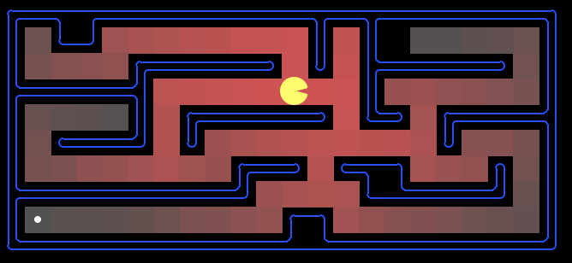
Uniform Cost: Pac-Man
Cost of 1 for each action
Explores all of the states, but one

Slide 28
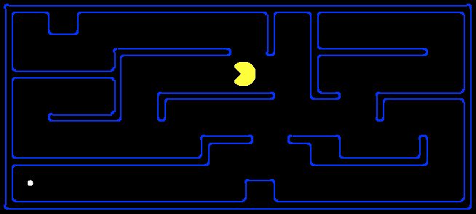
What is a Heuristic?
An estimate of how close a state is to a goal
Designed for a particular search problem
10
5
11.2
Examples: Manhattan distance: 10+5 = 15
Euclidean distance: 11.2

Slide 29
What is a Heuristic?
An estimate of how close a state is to a goal
Designed for a particular search problem
10
5
10
5
Actual distance to goal: 2+4+2+1+8=

Slide 30
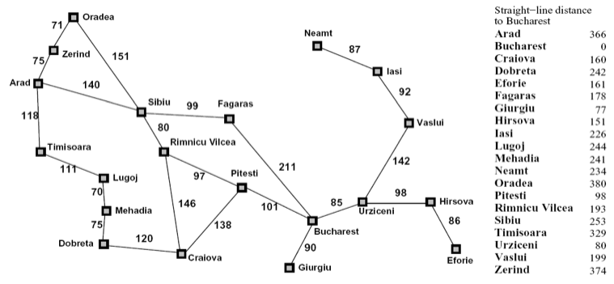
Heuristics
?
?

Slide 31
Greedy Search
Best first with f(n) = heuristic estimate of distance to goal

Slide 32
Greedy Search
Expand the node that seems closest…
What can go wrong?
A
start
B
goal

Slide 33
Greedy Search
A common case:
Best-first takes you straight to a (suboptimal) goal
Worst-case: like a badly-guided DFS in the worst case
Can explore everything
Can get stuck in loops if no cycle checking
Like DFS in completeness (if finite # states w/ cycle checking)
b
…
b
…

Slide 34
A* Search
Hart, Nilsson & Rafael 1968
Best first search with f(n) = g(n) + h(n)
g(n) = sum of costs from start to n
h(n) = estimate of lowest cost path n → goal
h(goal) = 0
If h(n) is admissible and monotonic
then A* is optimal
{
}
Underestimates cost
of reaching goal from node
f values increase from
node to descendants
(triangle inequality)

Slide 35
A* Search
Hart, Nilsson & Rafael 1968
Best first search with f(n) = g(n) + h(n)
g(n) = sum of costs from start to n
h(n) = estimate of lowest cost path n → goal
h(goal) = 0
Can view as cross-breed:
g(n) ~ uniform cost search
h(n) ~ greedy search
Best of both worlds…

Slide 36
Is Manhattan distance admissible?
Underestimate?
S
G

Slide 37
Is Manhattan distance monotonic?
f values increase from node to children
(triangle inequality)
S
G

Slide 38
Euclidean Distance
Admissible?
Monotonic?
S
G

Slide 39
A* Example

Slide 40
A* Example

Slide 41
A* Example

Slide 42
A* Example

Slide 43
A* Example

Slide 44
A* Example

Slide 45
European Example
start
1
3
2
4
5
end

Slide 46
Optimality of A*

Slide 47
Optimality Continued

Slide 48
A* Summary
Pros
Cons
Produces optimal cost solution!
Does so quite quickly (focused)
Maintains priority queue…
Which can get exponentially big ☹

Slide 49
Reached this point

Slide 50
Iterative-Deepening A*
Like iterative-deepening depth-first, but...
Depth bound modified to be an f-limit
Start with f-limit = h(start)
Prune any node if f(node) > f-limit
Next f-limit = min-cost of any node pruned
e
FL=21
FL=15
a
d
f
b
c

Slide 51
IDA* Analysis
Complete & Optimal (ala A*)
Space usage ∝ depth of solution
Each iteration is DFS - no priority queue!
# nodes expanded relative to A*
Depends on # unique values of heuristic function
In 8 puzzle: few values ⇒ close to # A* expands
In traveling salesman: each f value is unique
⇒ 1+2+…+n = O(n²) where n=nodes A* expands
if n is too big for main memory, n² is too long to wait!
Generates duplicate nodes in cyclic graphs

Slide 52
Forgetfulness
A* used exponential memory
How much does IDA* use?
During a run?
In between runs?

Slide 53
SMA*
Use all available memory
Start like A*
When memory is full…
Erase node with highest f-value
First, backup parent with this f-value
So… parent knows cost-bound on best child

Slide 54
Alternative Approach to Finite Memory…
Optimality is nice to have, but…

Slide 55
Depth-First Branch & Bound
Single DF search
→ uses linear space
Keep track of best solution so far
If f(n) = g(n)+h(n) ≥ cost(best-soln)
Then prune n
Requires
Finite search tree, or
Good upper bound on solution cost
Generates duplicate nodes in cyclic graphs
Tradeoff:
Prune space, but…
Must apply test to each node
Adapted from Richard Korf presentation

Slide 56
Beam Search
Idea
Best first but only keep N best items on priority queue
Evaluation
Complete?
Time Complexity?
Space Complexity?
No
O(b^d)
O(b + N)

Slide 57
Hill Climbing
“Gradient ascent”
Idea
Always choose best child; no backtracking
Beam search with |queue| = 1
Problems?
Local maxima
Plateaus
Diagonal ridges

Slide 58
Randomizing Hill Climbing
Randomly disobeying heuristic
Random restarts
( heavy tailed distributions )
→ Local Search

Slide 59
Simulated Annealing
Objective: avoid local minima
Technique:
For the most part use hill climbing
When no improvement possible
Choose random neighbor
Let Δ be the decrease in quality
Move to neighbor with probability e ^{-Δ-/T}
Reduce “temperature” (T) over time
Pros & cons
Optimal?
If T decreased slowly enough, will reach optimal state
Widely used
See also WalkSAT
temp

Slide 60
To Do:
Look at the course website:
http://www.cs.washington.edu/cse473/12sp
Do the readings (Ch 3)
Start PS1,

Slide 61
Extra Work?
Failure to detect repeated states can cause exponentially more work (why?)

Slide 62
Graph Search
In BFS, for example, we shouldn’t bother expanding the circled nodes (why?)
S
d
e
p
b
c
e
h
r
q
a
a
h
r
p
q
f
p
q
f
q
c
G
q
c
G
a
a

Slide 63
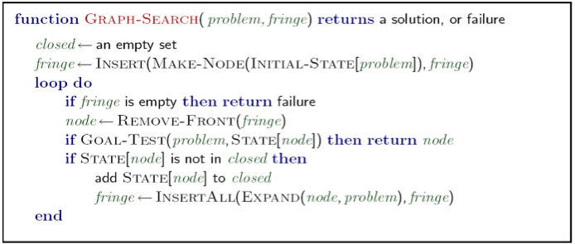
Graph Search
Very simple fix: never expand a state type twice
Can this wreck completeness? Why or why not?
How about optimality? Why or why not?

Slide 64
Some Hints
Graph search is almost always better than tree search (when not?)
Implement your closed list as a dict or set!
Nodes are conceptually paths, but better to represent with a state, cost, last action, and reference to the parent node

Slide 65
Best First Greedy Search
Algorithm | Complete | Optimal | Time | Space
Greedy Best-First Search
Y*
N
O(b^{m})
O(b^{m})
b
…
m
What do we need to do to make it complete?
Can we make it optimal? Next class!

