Slide 1
CSE 473: Artificial Intelligence Autumn 2014
Problem Spaces & Search
Dan Weld
With slides from
Dan Klein, Stuart Russell, Andrew Moore, Luke Zettlemoyer
Notes:
Good to hit DFS and BFS quickly, since they’ve seen it before.

Slide 2
Logistics
Piazza
PS0 Due for optional grading end of Wed 10/1

Slide 3
Outline
Search Problems
Uninformed Search Methods
Depth-First Search
Breadth-First Search
Uniform-Cost Search
Heuristic Search Methods
Best First / Greedy Search

Slide 4
Agent vs. Environment
An agent is an entity that perceives and acts.
A rational agent selects actions that maximize its utility function.
Characteristics of the percepts, environment, and action space dictate techniques for selecting rational actions.
Agent
Sensors
Percepts
?
Environment
Actuators
Actions
Notes:
agent is really just a program
environment - inputs and outputs to the program
utility function - indirect specification of the what the program should do
goal: design an algorithm that can find actions for any utility function

Slide 5
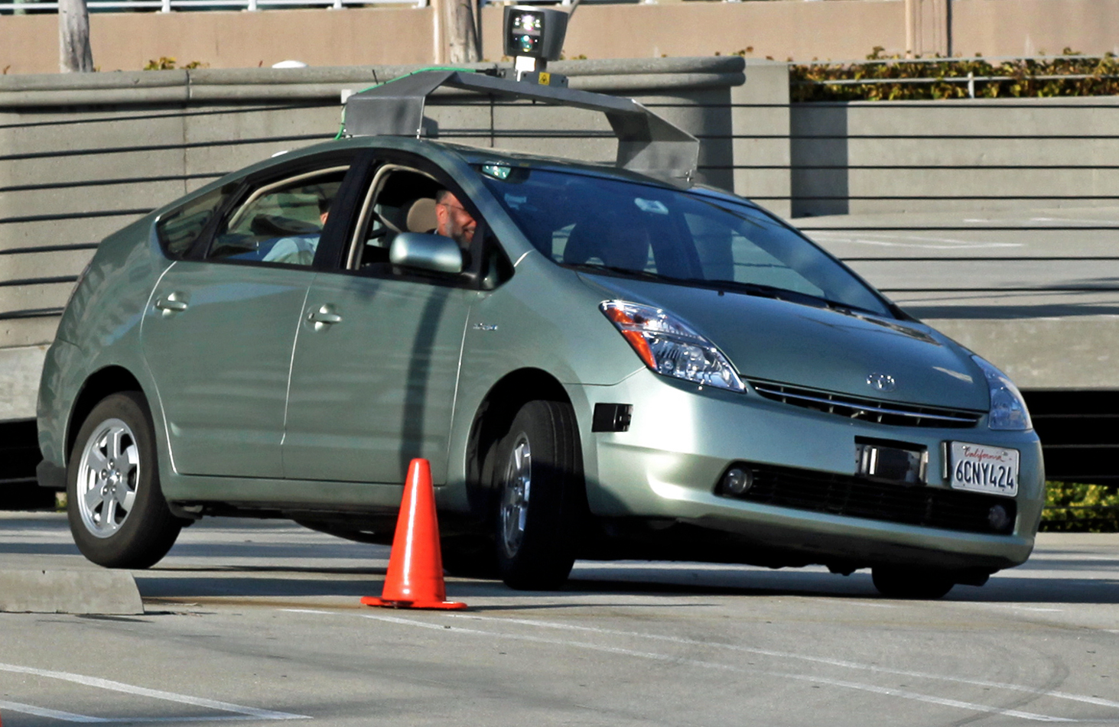
Actions? Percepts?

Slide 6
Actions? Percepts?
Recommender System

Slide 7
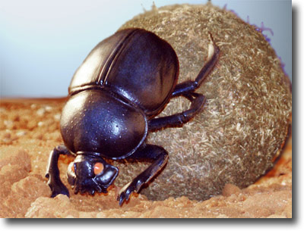
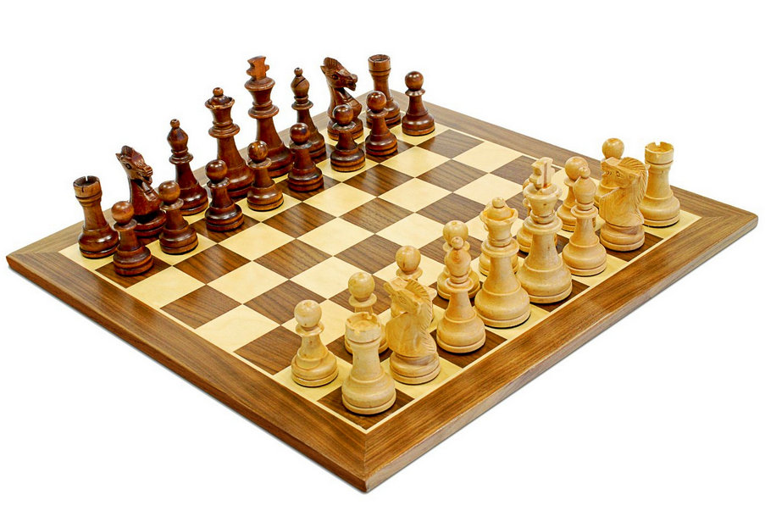
Types of Agents
Reflex
Goal oriented
Utility-based

Slide 8
Famous Reflex Agents

Slide 9
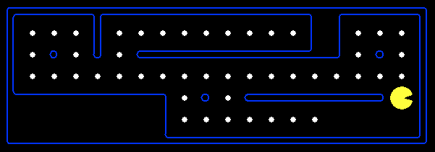
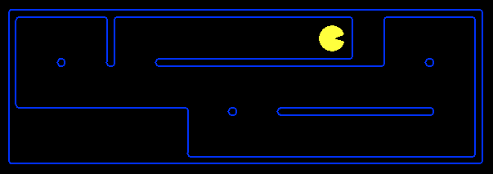
Goal Based Agents
Plan ahead
Ask “what if”
Decisions based on (hypothesized) consequences of actions
Must have a model of how the world evolves in response to actions
Act on how the world WOULD BE

Slide 10
Search thru a
Problem Space (aka State Space)
Input:
Set of states
Operators [and costs]
Start state
Goal state [test]
Output:
Path: start ⇒ a state satisfying goal test
[May require shortest path]
[Sometimes just need a state that passes test]
Notes:
State Space Search is basically a GRAPH SEARCH PROBLEM
STATES are whatever you like!
OPERATORS are a compact DESCRIPTION of possible STATE TRANSITIONS – the EDGES of the GRAPH
May have different COSTS or all be UNIT cost
OUTPUT may be specified either as ANY PATH (REACHABILITY), or a SHORTEST PATH

Slide 11
Example: Simplified Pac-Man
Input:
A state space
A successor function
A start state
A goal test
Output:
“N”, 1.0
“E”, 1.0

Slide 12
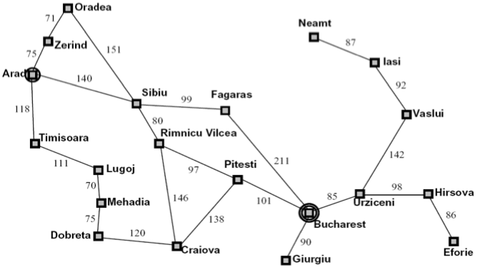
Ex: Route Planning: Arad → Bucharest
Input:
Set of states
Operators [and costs]
Start state
Goal state (test)
Output:
Notes:
States = cities
Start state = starting city
Goal state test = is state the destination city?
Operators = move to an adjacent city; cost = distance
Output: a shortest path from start state to goal state
SUPPOSE WE REVERSE START AND GOAL STATES?

Slide 13
Example: N Queens
Q
Input:
Set of states
Operators [and costs]
Start state
Goal state (test)
Output
Q
Q
Q

Slide 14
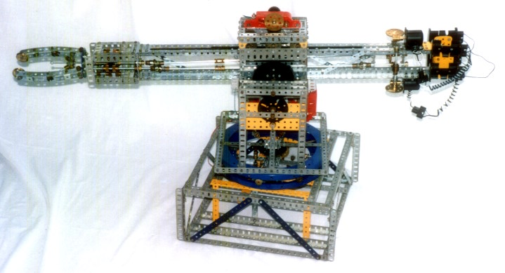
Ex: Blocks World
Input:
Set of states
Operators [and costs]
Start state
Goal state (test)
Output:
Partially specified plans
Plan modification operators
The null plan (no actions)
A plan which provably achieves
The desired world configuration
Notes:
State = configuration of blocks: ON(A,B), ON(B, TABLE), ON(C, TABLE)
Start state = starting configuration
Goal state test = does state satisfy some test, e.g. “ON(A,B)”?
Operators: MOVE x FROM y TO z
or PICKUP(x,y) and PUTDOWN(x,y)
Output: Sequence of actions that transform start state into goal.
HOW HARD if don’t care about number of actions used? POLYNOMIAL
HOW HARD to find smallest number of actions? NP-COMPLETE
Suppose we want to search BACKWARDS from GOAL?
Simple if goal COMPLETELY specified
NEED to have a DIFFERENT notion of STATE if goals are PARTIALLY SPECIFIED

Slide 15
Multiple Problem Spaces
Real World
States of the world (e.g. block configurations)
Actions (take one world-state to another)
Robot’s Head
Problem Space 1
PS states =
models of world states
Operators =
models of actions
Problem Space 2
PS states =
partially spec. plan
Operators =
plan modificat’n ops
Notes:
State = configuration of blocks: ON(A,B), ON(B, TABLE), ON(C, TABLE)
Start state = starting configuration
Goal state test = does state satisfy some test, e.g. “ON(A,B)”?
Operators: MOVE x FROM y TO z
or PICKUP(x,y) and PUTDOWN(x,y)
Output: Sequence of actions that transform start state into goal.
HOW HARD if don’t care about number of actions used? POLYNOMIAL
HOW HARD to find smallest number of actions? NP-COMPLETE
Suppose we want to search BACKWARDS from GOAL?
Simple if goal COMPLETELY specified
NEED to have a DIFFERENT notion of STATE if goals are PARTIALLY SPECIFIED

Slide 16
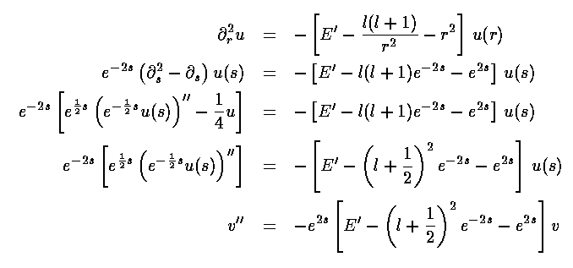
Algebraic Simplification
Input:
Set of states
Operators [and costs]
Start state
Goal state (test)
Output:

Slide 17
State Space Graphs
State space graph:
Each node is a state
The successor function is represented by arcs
Edges may be labeled with costs
We can rarely build this graph in memory (so we don’t)
a
G
b
c
e
d
f
S
h
p
q
r
Ridiculously tiny search graph for a tiny search problem

Slide 18
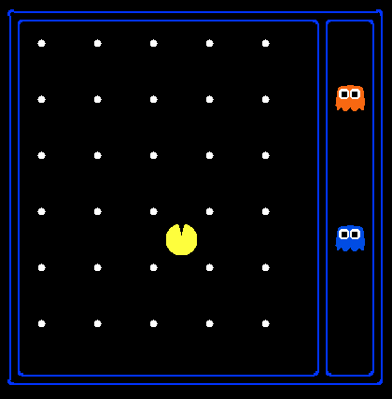
State Space Sizes?
Search Problem: Eat all of the food
Pacman positions: 10 x 12 = 120
Pacman facing: up, down, left, right
Food configurations: 2³⁰
Ghost1 positions: 12
Ghost 2 positions: 11
10 x 12 = 120
up, down, left, right
2³⁰
12
11
120 x 4 x 2³⁰ x 12 x 11 = 6.8 x 10¹³
Notes:
90 * (2^30-1) + 30 * 2^29 = 145 billion
2^29 = 536 870 912

Slide 19
Search Methods
Blind Search
Local Search
Informed Search
Constraint Satisfaction
Adversary Search
Depth first search
Breadth first search
Iterative deepening search
Uniform cost search

Slide 20
Search Trees
“N”, 1.0
“E”, 1.0
A search tree:
Start state at the root node
Children correspond to successors
Nodes contain states, correspond to PLANS to those states
Edges are labeled with actions and costs
For most problems, we can never actually build the whole tree

Slide 21
Example: Tree Search
State Graph:
a
G
b
c
e
d
f
S
h
p
q
r
What is the search tree?

Slide 22
State Graphs vs. Search Trees
a
G
Each NODE in in the search tree denotes an entire PATH in the problem graph.
b
c
d
e
f
S
h
p
q
r
S
d
e
p
We construct both on demand – and we construct as little as possible.
b
c
e
h
r
q
a
a
h
r
p
q
f
p
q
f
q
c
G
q
c
G
a
a

Slide 23
States vs. Nodes
Nodes in state space graphs are problem states
Represent an abstracted state of the world
Have successors, can be goal / non-goal, have multiple predecessors
Nodes in search trees are plans
Represent a plan (sequence of actions) which results in the node’s state
Have a problem state and one parent, a path length, a depth & a cost
The same problem state may be achieved by multiple search tree nodes
Search Tree Nodes
Problem States
Parent
Depth 5
Action
Node
Depth 6

Slide 24
Building Search Trees
Search:
Expand out possible plans
Maintain a fringe of unexpanded plans
Try to expand as few tree nodes as possible

Slide 25
General Tree Search
Important ideas:
Fringe
Expansion
Exploration strategy
which fringe node to expand next?
Detailed pseudocode is in the book!

Slide 26
Review? Depth First Search
Strategy: expand deepest node first
Implementation: Fringe is a LIFO queue (a stack)
a
G
b
c
e
d
f
S
h
p
q
r

Slide 27
Review? Depth First Search
a
G
a
Expansion ordering:
(d,b,a,c,a,e,h,p,q,q,r,f,c,a,G)
c
b
c
b
e
d
e
d
f
f
S
h
h
p
p
r
q
r
q
S
d
e
p
b
c
e
h
r
q
a
a
h
r
p
q
f
p
q
f
q
c
G
q
c
G
a
a

Slide 28
Review? Breadth First Search
Strategy: expand shallowest node first
Implementation: Fringe is a FIFO queue
a
G
b
c
e
d
f
S
h
p
q
r

Slide 29
Review? Breadth First Search
a
G
Expansion order:
(S,d,e,p,b,c,e,h,r,q,a,a,h,r,p,q,f,p,q,f,q,c,G)
b
c
d
e
f
S
h
p
q
r
S
d
e
p
Search
Tiers
b
c
e
h
r
q
a
a
h
r
p
q
f
p
q
f
q
c
G
q
c
G
a
a

Slide 30
Search Algorithm Properties
Complete? Guaranteed to find a solution if one exists?
Optimal? Guaranteed to find the least cost path?
Time complexity?
Space complexity?
Variables:
n | Number of states in the problem
b | The maximum branching factor B (the maximum number of successors for a state)
C* | Cost of least cost solution
d | Depth of the shallowest solution
m | Max depth of the search tree

Slide 31
DFS
Algorithm |  | Complete | Optimal | Time | Space
DFS | Depth First Search | N | N | O(B^{LMAX}) | O(LMAX)
No
No
Infinite
Infinite
START
Infinite paths make DFS incomplete…
How can we fix this?
Check new nodes against path from S
Infinite search spaces still a problem
a
GOAL
b

Slide 32
DFS
1 node
b
…
b nodes
b² nodes
m tiers
b^{m} nodes
Algorithm |  | Complete | Optimal | Time | Space
DFS | w/ Path Checking
Y if finite
N
O(b^{m})
O(bm)
* Or graph search – next lecture.

Slide 33
BFS
Algorithm |  | Complete | Optimal | Time | Space
DFS | w/ Path Checking
BFS
N unless
finite
N
O(b^{m})
O(bm)
Y
Y
O(b^{d})
O(b^{d})
When is BFS optimal?
1 node
b
…
b nodes
d tiers
b² nodes
b^{d} nodes
b^{m} nodes

Slide 34
Memory a Limitation?
Suppose:
4 GHz CPU
32 GB main memory
100 instructions / expansion
5 bytes / node
40 M expansions / sec
Memory filled in 160 sec … 3 min

Slide 35
Comparisons
When will BFS outperform DFS?
When will DFS outperform BFS?
Notes:
Made it to this slide in 50 minute class. Made students pair up to draw search tree and do depth first search. Didn’t have them to breadth first...

Slide 36
Iterative Deepening
Iterative deepening uses DFS as a subroutine:
Do a DFS which only searches for paths of length 1 or less.
If “1” failed, do a DFS which only searches paths of length 2 or less.
If “2” failed, do a DFS which only searches paths of length 3 or less.
….and so on.
b
…
Algorithm |  | Complete | Optimal | Time | Space
DFS | w/ Path Checking
BFS
ID
Y
N
O(b^{m})
O(bm)
Y
Y
O(b^{d})
O(b^{d})
Y
Y
O(b^{d})
O(bd)

Slide 37
Cost of Iterative Deepening
b | ratio ID to DFS
2 | 3
3 | 2
5 | 1.5
10 | 1.2
25 | 1.08
100 | 1.02

Slide 38
Speed
Assuming 10M nodes/sec & sufficient memory
BFS
Nodes Time
Iter. Deep.
Nodes Time
8 Puzzle
2x2x2 Rubik’s
15 Puzzle
3x3x3 Rubik’s
24 Puzzle
10⁵ .01 sec
10⁶ .2 sec
10¹³ 6 days
10¹⁹ 68k yrs
10²⁵ 12B yrs
10⁵ .01 sec
10⁶ .2 sec
10¹⁷ 20k yrs
10²⁰ 574k yrs
10³⁷ 10²³ yrs
1Mx
8x
Why the difference?
Rubik has higher branching factor 15 puzzle has greater depth
# of duplicates
Slide adapted from Richard Korf presentation

Slide 39
When to Use Iterative Deepening
N Queens?
Define as search problem
States?
Operators?
Start state?
Goal test?
Q
Q
Q
Q

Slide 40
Costs on Actions
2
a
GOAL
2
b
c
3
2
1
8
2
e
3
d
f
9
8
2
START
h
1
4
1
p
4
r
15
q
Notice that BFS finds the shortest path in terms of number of transitions. It does not find the least-cost path.

Slide 41
Uniform Cost Search
Expand cheapest node first:
Fringe is a priority queue
2
a
GOAL
2
b
c
3
2
1
8
2
e
3
d
f
9
8
2
START
h
1
4
1
p
4
r
15
q

Slide 42
Uniform Cost Search
2
G
a
Expansion order:
(S,p,d,b,e,a,r,f,e,G)
b
1
8
c
2
2
3
d
e
f
9
8
1
S
h
1
1
p
q
r
15
0
S
d
3
e
9
p
1
b
4
e
5
h
17
r
11
q
16
c
11
Cost contours
a
6
a
h
13
r
7
p
q
f
p
q
f
8
q
c
G
q
c
a
11
G
10
a

Slide 43
Priority Queue Refresher
A priority queue is a data structure in which you can insert and retrieve (key, value) pairs with the following operations:
pq.push(key, value) | inserts (key, value) into the queue.
pq.pop() | returns the key with the lowest value, and removes it from the queue.
You can decrease a key’s priority by pushing it again
Unlike a regular queue, insertions aren’t constant time, usually O(log n)
We’ll need priority queues for cost-sensitive search methods

Slide 44
Uniform Cost Search
Algorithm |  | Complete | Optimal | Time | Space
DFS | w/ Path Checking
BFS
UCS
Y
N
O(b^{m})
O(bm)
Y
Y
O(b^{d})
O(b^{d})
Y*
Y
O(b^{C*/ε})
O(b^{C*/ε})
b
…
C*/ε tiers
Notes:
Optimal if the cost of actions at each step exceeds some bound, epsilon

Slide 45
Uniform Cost Issues
Remember: explores increasing cost contours
The good: UCS is complete and optimal!
The bad:
Explores options in every “direction”
No information about goal location
c ≤ 1
…
c ≤ 2
c ≤ 3
Start
Goal
Notes:
python pacman.py -l contoursMaze -p SearchAgent -a fn=ucs --frameTime -1
python pacman.py -p SearchAgent -a fn=ucs -l smallMaze --frameTime -1

Slide 46
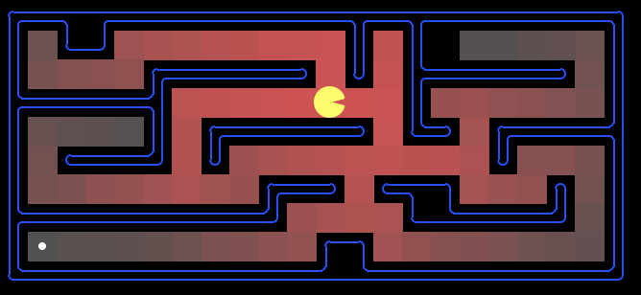
Uniform Cost: Pac-Man
Cost of 1 for each action
Explores all of the states, but one

Slide 47
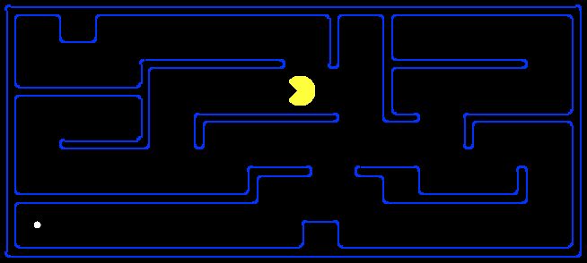
Search Heuristics
Any estimate of how close a state is to a goal
Designed for a particular search problem
10
5
11.2
Examples: Manhattan distance, Euclidean distance

Slide 48
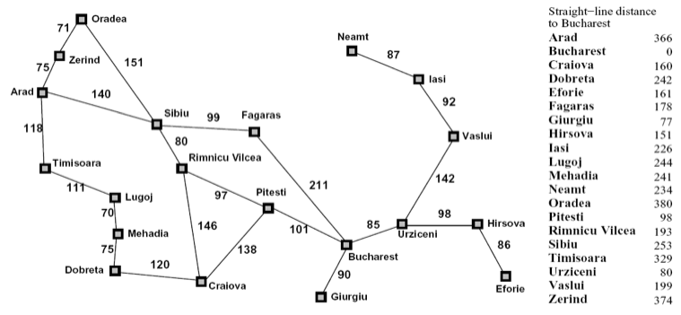
Heuristics

Slide 49
Best First / Greedy Search
Expand closest node first: Fringe is a priority queue

Slide 50
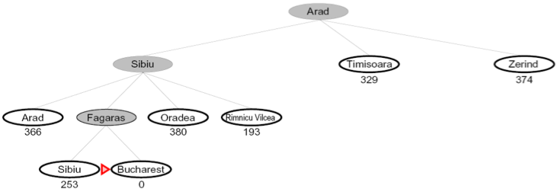
Best First / Greedy Search
Expand the node that seems closest…
What can go wrong?

Slide 51
Best First / Greedy Search
A common case:
Best-first takes you straight to the goal (but with non-optimal path)
Worst-case: like a badly-guided DFS in the worst case
Can explore everything
Can get stuck in loops if no cycle checking
Like DFS in completeness (finite states w/ cycle checking)
b
…
b
…

Slide 52
To Do:
Look at the course website:
http://www.cs.washington.edu/cse473/14au
Do the readings (Ch 3)
Do PS0 if new to Python
Start PS1, when it is posted

Slide 53
Extra Work?
Failure to detect repeated states can cause exponentially more work (why?)

Slide 54
Graph Search
In BFS, for example, we shouldn’t bother expanding the circled nodes (why?)
S
d
e
p
b
c
e
h
r
q
a
a
h
r
p
q
f
p
q
f
q
c
G
q
c
G
a
a

Slide 55
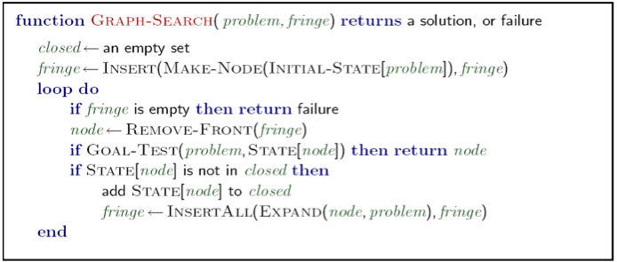
Graph Search
Very simple fix: never expand a state type twice
Can this wreck completeness? Why or why not?
How about optimality? Why or why not?

Slide 56
Some Hints
Graph search is almost always better than tree search (when not?)
Implement your closed list as a dict or set!
Nodes are conceptually paths, but better to represent with a state, cost, last action, and reference to the parent node

Slide 57
Best First Greedy Search
Algorithm | Complete | Optimal | Time | Space
Greedy Best-First Search
Y*
N
O(b^{m})
O(b^{m})
b
…
m
What do we need to do to make it complete?
Can we make it optimal? Next class!

Slide 58
Uniform Cost Search
What will UCS do for this graph?
What does this mean for completeness?
0
b
1
0
START
a
1
GOAL

Slide 59
Best First / Greedy Search
Strategy: expand the closest node to the goal
a
G
2
2
h=8
c
h=0
b
2
h=4
5
1
8
h=5
h=11
2
e
e
3
d
f
h=8
9
1
9
S
h
h=4
4
h=6
5
1
h=12
4
3
p
15
r
q
h=11
h=6
h=9
[demo: greedy]
Notes:
python pacman.py -p SearchAgent -a fn=greedySearch,heuristic=manhattanHeuristic -l smallMaze --frameTime -1
python pacman.py -p SearchAgent -a fn=greedySearch,heuristic=euclideanHeuristic -l contoursMaze --frameTime -1

Slide 61
Example: Tree Search
a
G
b
c
e
d
f
S
h
p
r
q
Notes:
Use class participation expansion strategy, but organize alphabetically

Slide 62
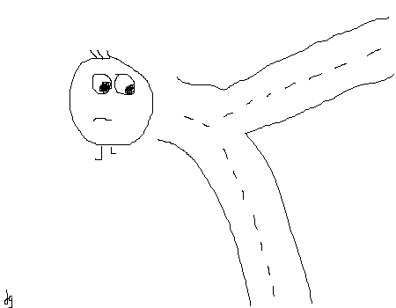
5 Minute Break
A Dan Gillick original

