Slide 1
Artificial Intelligence
Recap & Expectation Maximization
CSE 473
Dan Weld

Slide 2
Exam Topics
Search
  BFS, DFS, UCS, A* (tree and graph)
  Completeness and Optimality
  Heuristics: admissibility and consistency
CSPs
  Constraint graphs, backtracking search
  Forward checking, AC3 constraint propagation, ordering heuristics
Games
  Minimax, Alpha-beta pruning, Expectimax, Evaluation Functions
MDPs
  Bellman equations
  Value iteration
Reinforcement Learning
  Exploration vs Exploitation
  Model-based vs. model-free
  Q-learning
  Linear value function approx.
Hidden Markov Models
  Markov chains
  Forward algorithm
  Particle Filter
Bayesian Networks
  Basic definition, independence
  Variable elimination
  Sampling (rejection, importance)
Learning
  BN parameters with complete data
  Search thru space of BN structures
  Expectation maximization

Slide 3
What is intelligence?
(bounded) Rationality
  We have a performance measure to optimize
  Given our state of knowledge
  Choose optimal action
  Given limited computational resources
Human-like intelligence/behavior

Slide 4
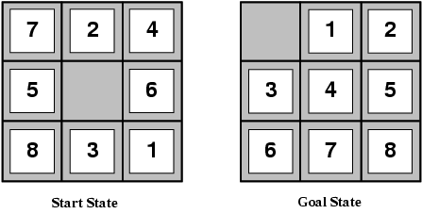
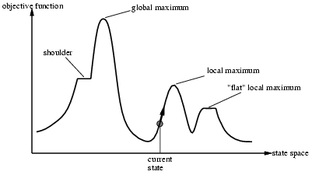
Search in Discrete State Spaces
Every discrete problem can be cast as a search problem.
  states, actions, transitions, cost, goal-test
Types
  uninformed systematic: often slow
    DFS, BFS, uniform-cost, iterative deepening
  Heuristic-guided: better
    Greedy best first, A*
    relaxation leads to heuristics
  Local: fast, fewer guarantees; often local optimal
    Hill climbing and variations
    Simulated Annealing: global optimal
  (Local) Beam Search

Slide 5
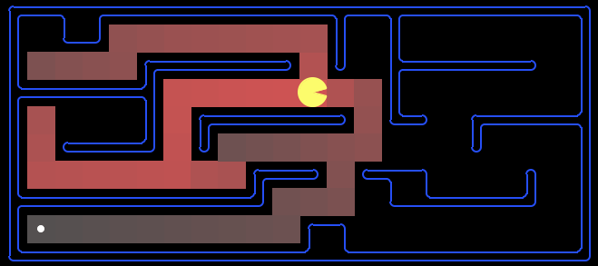
Which Algorithm?
A*, Manhattan Heuristic:

Slide 6
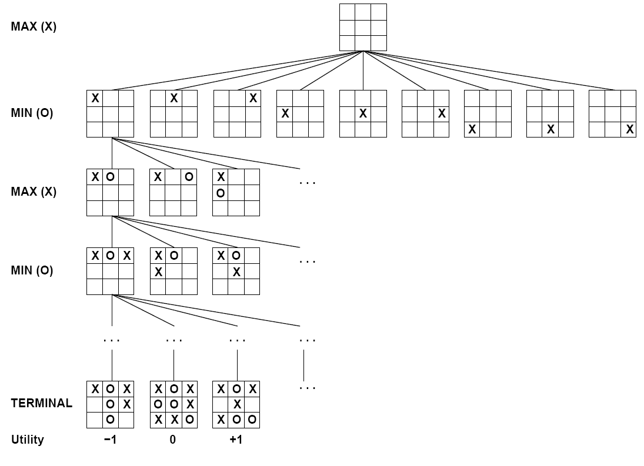
Adversarial Search

Slide 7
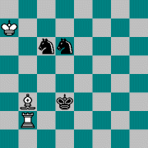
Adversarial Search
AND/OR search space (max, min)
minimax objective function
minimax algorithm (~dfs)
  alpha-beta pruning
Utility function for partial search
  Learning utility functions by playing with itself
Openings/Endgame databases

Slide 8
Knowledge Representation and Reasoning
Representing: what I know
Reasoning: what I can infer
Uncertainty
Prop Logic
Constraint Sat
Bayesian
Networks
Quantification
First-Order
Logic
?

Slide 9
KR&R Example: Propositional Logic
Representation: Propositional Logic Formula
  CNF, Horn Clause,…
Reasoning: Deduction
  Forward Chaining
  Resolution
Model Finding
  Enumeration
  SAT Solving

Slide 10
Search+KR&R Example: SAT Solving
Representation: CNF Formula
Reasoning
  pure literals; unit clauses; unit propagation
Search
  DPLL (~ backtracking search)
    MOM’s heuristic
  Local: GSAT, WalkSAT
Phase Transitions in SAT problems
a
b
b
c
c

Slide 11
Expressivity
Propositional Logic vs Bayesian network?
(X ∧ Y) ∨ (¬X ∧ ¬Y)

Slide 12
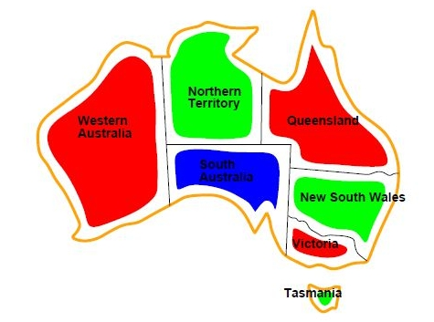
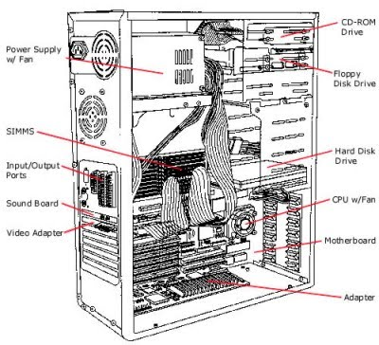
Search+KR&R Example: CSP
Representation
  Variables, Domains, Constraints
Reasoning: Constraint Propagation
  Node consistency, Arc Consistency, k-Consistency
Search
  Backtracking search: partial var assignments
    Heuristics: min remaining values, min conflicts
  Local search: complete var assignments

Slide 13
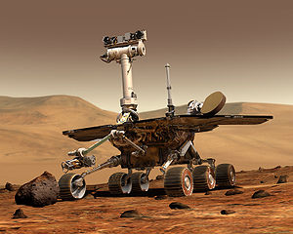
Search+KR&R Example: Planning
Representation: STRIPS
Reasoning: Planning Graph
  Polynomial data structure
  reasons about constraints on plans (mutual exclusion)
Search
  Forward: state space search
    planning graph based heuristic
  Backward: subgoal space search
Planning as SAT: SATPlan
C
A
B

Slide 14
KR&R: Markov Decision Process
Representation
  states, actions, probabilistic outcomes, rewards
  ~AND/OR Graph (sum, max)
  Generalization of expectimax
Reasoning: V*(s)
  Value Iteration: search thru value space
Reinforcement Learning:
  Exploration / exploitation
  Learn model or learn Q-function?
max
a₁
s₁
V₁= 6.5
(γ∼1)
2
s₀
5
a₂
4.5
0.9
s₂
a₃
0.1
s₃

Slide 15

KR&R: Probability
Representation: Bayesian Networks
  encode probability distributions compactly
    by exploiting conditional independences
Reasoning
  Exact inference: var elimination
  Approx inference: sampling based methods
    rejection sampling, likelihood weighting, MCMC/Gibbs
Earthquake
Burglary
Alarm
JohnCalls
MaryCalls

Slide 16









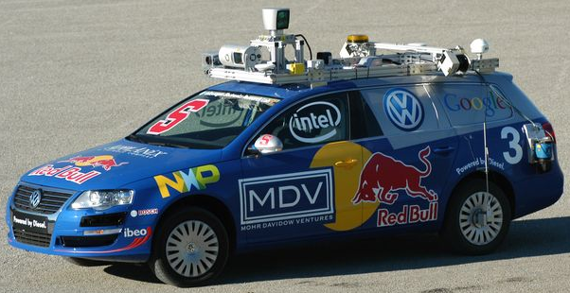

KR&R: Hidden Markov Models
Representation
  Spl form of BN
  Sequence model
  One hidden state, one observation
Reasoning/Search
  most likely state sequence: Viterbi algorithm
  marginal prob of one state: forward-backward

Slide 17
Learning Bayes Networks
Learning Structure of Bayesian Networks
  Search thru space of BN structures
Learning Parameters for a Bayesian Network
  Fully observable variables
    Maximum Likelihood (ML), MAP & Bayesian estimation
    Example: Naïve Bayes for text classification
  Hidden variables
    Expectation Maximization (EM)

Slide 18
Bayesian Learning
Prior
Data Likelihood
Use Bayes rule:
P(Y | X) = P(X |Y) P(Y)
P(X)
Posterior
Normalization
Or equivalently: P(Y | X) ∝ P(X | Y) P(Y)

Slide 19
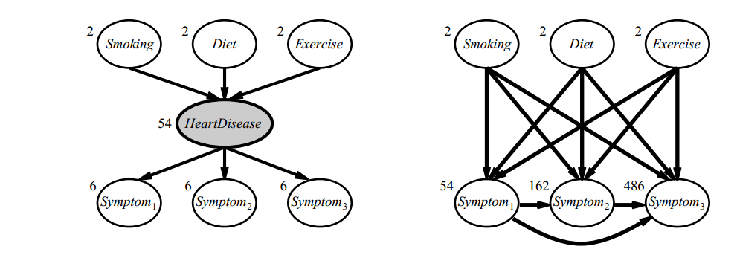
Why Learn Hidden Variables?

Slide 20
Chicken & Egg Problem
If we knew whether patient had disease
  It would be easy to learn CPTs
  But we can’t observe states, so we don’t!
If we knew CPTs
  It would be easy to predict if patient had disease
  But we don’t, so we can’t!
Slide by Daniel S. Weld
20
Notes:
20

Slide 21
Continuous Variables
Pr(A=t) Pr(A=f)
0.01 0.99
hidden
Aliens
Pr(E|A)
a μ = 6
σ = 2
a μ = 1
σ = 3
Earthquake
© Daniel S. Weld

Slide 22
Simplest Version
Mixture of two distributions
Know: form of distribution & variance,
% =5
Just need mean of each distribution
.01 .03 .05 .07 .09
22
Slide by Daniel S. Weld
Notes:
22

Slide 23
Input Looks Like
.01 .03 .05 .07 .09
23
Slide by Daniel S. Weld
Notes:
23

Slide 24
We Want to Predict
?
.01 .03 .05 .07 .09
24
Slide by Daniel S. Weld
Notes:
24

Slide 25
Chicken & Egg
Note that coloring instances would be easy
if we knew Gausians….
.01 .03 .05 .07 .09
25
Slide by Daniel S. Weld
Notes:
25

Slide 26
Chicken & Egg
And finding the Gausians would be easy
If we knew the coloring
.01 .03 .05 .07 .09
26
Slide by Daniel S. Weld
Notes:
26

Slide 27
Expectation Maximization (EM)
Pretend we do know the parameters
  Initialize randomly: set θ₁=?; θ₂=?
.01 .03 .05 .07 .09
27
Slide by Daniel S. Weld
Notes:
27

Slide 28
Expectation Maximization (EM)
Pretend we do know the parameters
  Initialize randomly
[E step] Compute probability of instance having each possible value of the hidden variable
.01 .03 .05 .07 .09
28
Slide by Daniel S. Weld
Notes:
28

Slide 29
Expectation Maximization (EM)
Pretend we do know the parameters
  Initialize randomly
[E step] Compute probability of instance having each possible value of the hidden variable
.01 .03 .05 .07 .09
29
Slide by Daniel S. Weld
Notes:
29

Slide 30
Expectation Maximization (EM)
Pretend we do know the parameters
  Initialize randomly
[E step] Compute probability of instance having each possible value of the hidden variable
[M step] Treating each instance as fractionally having both values compute the new parameter values
.01 .03 .05 .07 .09
30
Slide by Daniel S. Weld
Notes:
30

Slide 31
ML Mean of Single Gaussian
U_{ml} = argmin_{u} Σ_{i}(x_{i} – u)²
.01 .03 .05 .07 .09
31
Slide by Daniel S. Weld
Notes:
31

Slide 32
Expectation Maximization (EM)
[E step] Compute probability of instance having each possible value of the hidden variable
[M step] Treating each instance as fractionally having both values compute the new parameter values
.01 .03 .05 .07 .09
32
Slide by Daniel S. Weld
Notes:
32

Slide 33
Expectation Maximization (EM)
[E step] Compute probability of instance having each possible value of the hidden variable
.01 .03 .05 .07 .09
33
Slide by Daniel S. Weld
Notes:
33

Slide 34
Expectation Maximization (EM)
[E step] Compute probability of instance having each possible value of the hidden variable
[M step] Treating each instance as fractionally having both values compute the new parameter values
.01 .03 .05 .07 .09
34
Slide by Daniel S. Weld
Notes:
34

Slide 35
Expectation Maximization (EM)
[E step] Compute probability of instance having each possible value of the hidden variable
[M step] Treating each instance as fractionally having both values compute the new parameter values
.01 .03 .05 .07 .09
35
Slide by Daniel S. Weld
Notes:
35

Slide 36
Applications of AI
Mars rover: planning
Jeopardy: NLP, info retrieval, machine learning
Puzzles: search, CSP, logic
Chess: search
Web search: IR
Text categorization: machine learning
Self-driving cars: robotics, prob. reasoning, ML…

Slide 37
Ethics of Artificial Intelligence
Robots
  Robot Rights
  Three Laws of Robotics
AI replacing people jobs
  Any different from industrial revolution?
Ethical use of technology
  Dynamite vs. Speech understanding
Privacy concerns
  Humans/Machines reading freely available data on Web
  Gmail reading our news
AI for developing countries/improving humanity

Slide 38

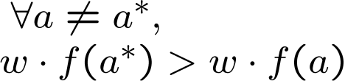

Pacman Apprenticeship!
Examples are states s
Candidates are pairs (s,a)
“Correct” actions: those taken by expert
Features defined over (s,a) pairs: f(s,a)
Score of a q-state (s,a) given by:
How is this VERY different from reinforcement learning?
“correct” action a*

Slide 39
Exam Topics
Search
  BFS, DFS, UCS, A* (tree and graph)
  Completeness and Optimality
  Heuristics: admissibility and consistency
CSPs
  Constraint graphs, backtracking search
  Forward checking, AC3 constraint propagation, ordering heuristics
Games
  Minimax, Alpha-beta pruning, Expectimax, Evaluation Functions
MDPs
  Bellman equations
  Value iteration
Reinforcement Learning
  Exploration vs Exploitation
  Model-based vs. model-free
  Q-learning
  Linear value function approx.
Hidden Markov Models
  Markov chains
  Forward algorithm
  Particle Filter
Bayesian Networks
  Basic definition, independence
  Variable elimination
  Sampling (rejection, importance)
Learning
  BN parameters with complete data
  Search thru space of BN structures
  Expectation maximization

