Slide 1
CSE 473: Artificial Intelligence
Spring 2012
Bayesian Networks - Learning
Dan Weld
Slides adapted from Jack Breese, Dan Klein, Daphne Koller, Stuart Russell, Andrew Moore & Luke Zettlemoyer
1

Slide 2

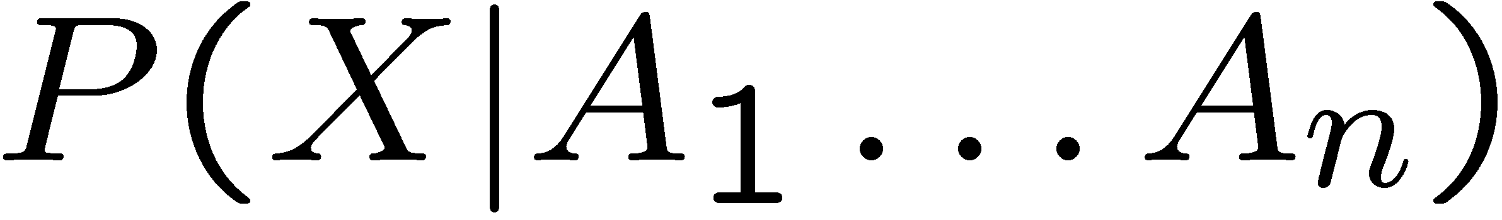
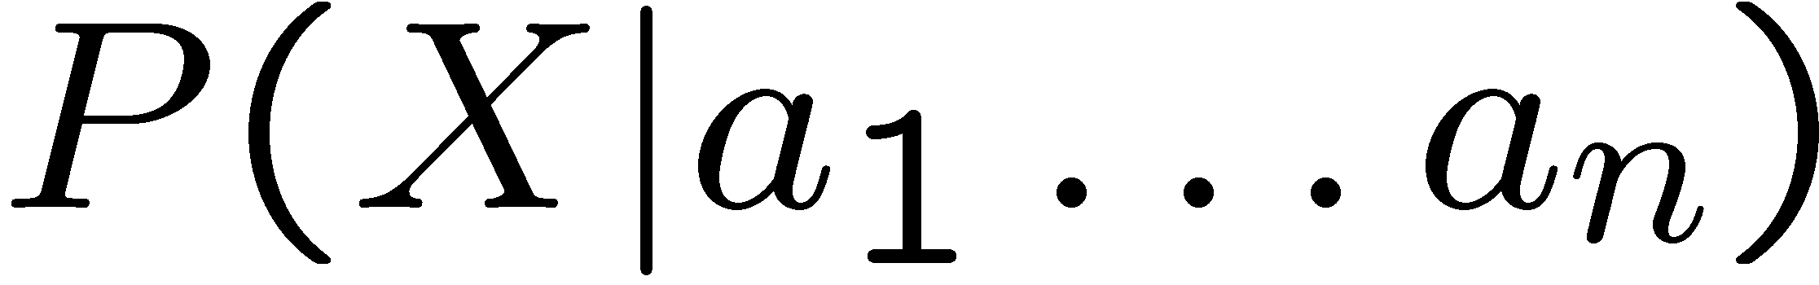
Bayes’ Net Semantics
Formally:
A set of nodes, one per variable X
A directed, acyclic graph
A CPT for each node
  CPT = “Conditional Probability Table”
  Collection of distributions over X, one for each combination of parents’ values
A₁
A_{n}
X
A Bayes net = Topology (graph) + Local Conditional Probabilities

Slide 3
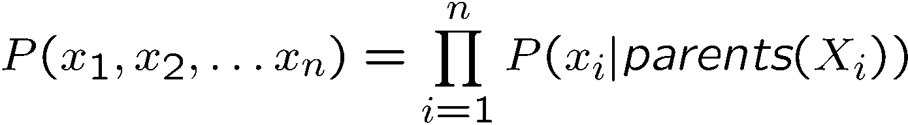
Probabilities in BNs
Bayes’ nets implicitly encode joint distributions
  As a product of local conditional distributions
  To see what probability a BN gives to a full assignment, multiply all the relevant conditionals together:
This lets us reconstruct any entry of the full joint
Not every BN can represent every joint distribution
  The topology enforces certain independence assumptions
  Compare to the exact decomposition according to the chain rule!

Slide 4
Example: Alarm Network
Only 10 params
E | P(E)
+e | 0.002
←e | 0.998
B | P(B)
+b | 0.001
←b | 0.999
Burglary
Earthqk
Alarm
B | E | A | P(A|B,E)
+b | +e | +a | 0.95
+b | +e | ←a | 0.05
+b | ←e | +a | 0.94
+b | ←e | ←a | 0.06
←b | +e | +a | 0.29
←b | +e | ←a | 0.71
←b | ←e | +a | 0.001
←b | ←e | ←a | 0.999
John calls
Mary calls
A | J | P(J|A)
+a | +j | 0.9
+a | ←j | 0.1
←a | +j | 0.05
←a | ←j | 0.95
A | M | P(M|A)
+a | +m | 0.7
+a | ←m | 0.3
←a | +m | 0.01
←a | ←m | 0.99

Slide 5
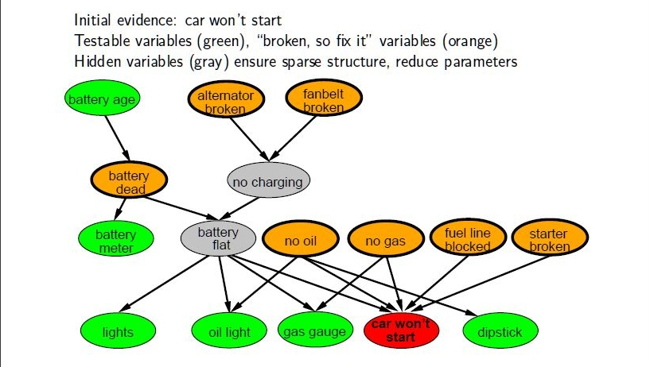
Example: Car Diagnosis

Slide 6
P(B | J=true, M=true)
Earthquake
Burglary
Alarm
JohnCalls
MaryCalls
P(b|j,m) = α Σ P(b,j,m,e,a)
e,a

Slide 7
Variable Elimination
P(b|j,m) = αP(b) ΣP(e) ΣP(a|b,e)P(j|a)P(m,a)
e a
Repeated computations ➔ Dynamic Programming

Slide 8
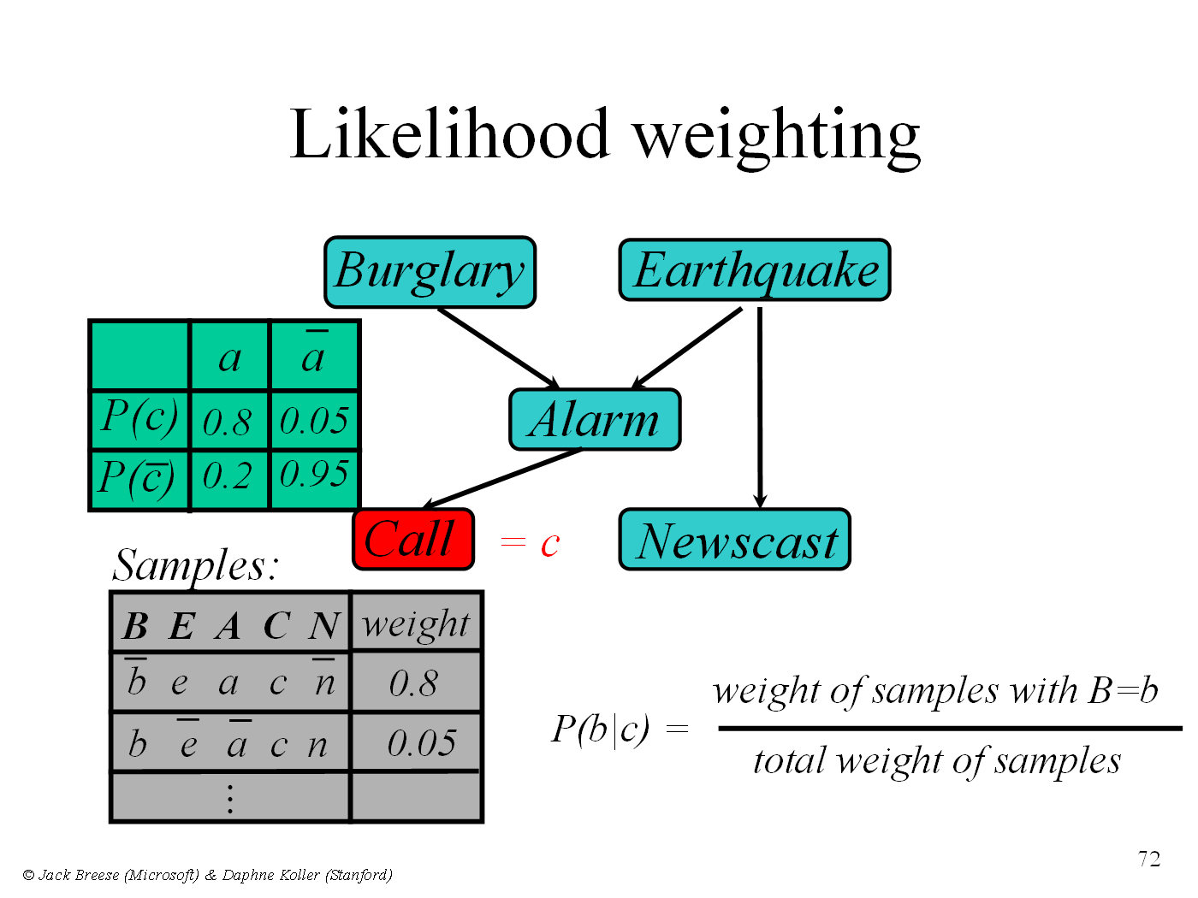
P(B|C)

Slide 9
MCMC with Gibbs Sampling
Fix the values of observed variables
Set the values of all non-observed variables randomly
Perform a random walk through the space of complete variable assignments. On each move:
  Pick a variable X
  Calculate Pr(X=true | Markov blanket)
  Set X to true with that probability
Repeat many times. Frequency with which any variable X is true is it’s posterior probability.
Converges to true posterior when frequencies stop changing significantly
  stable distribution, mixing

Slide 10
The Origin of Bayes Nets
Pr(B=t) Pr(B=f)
0.05 0.95
Earthquake
Burglary
Pr(A|E,B)
e,b 0.9 (0.1)
e,b 0.2 (0.8)
e,b 0.85 (0.15)
e,b 0.01 (0.99)
Radio
Alarm
Nbr1Calls
Nbr2Calls
© Daniel S. Weld
10

Slide 11
Learning Topics
Learning Parameters for a Bayesian Network
  Fully observable
    Maximum Likelihood (ML)
    Maximum A Posteriori (MAP)
    Bayesian
  Hidden variables (EM algorithm)
Learning Structure of Bayesian Networks

Slide 12
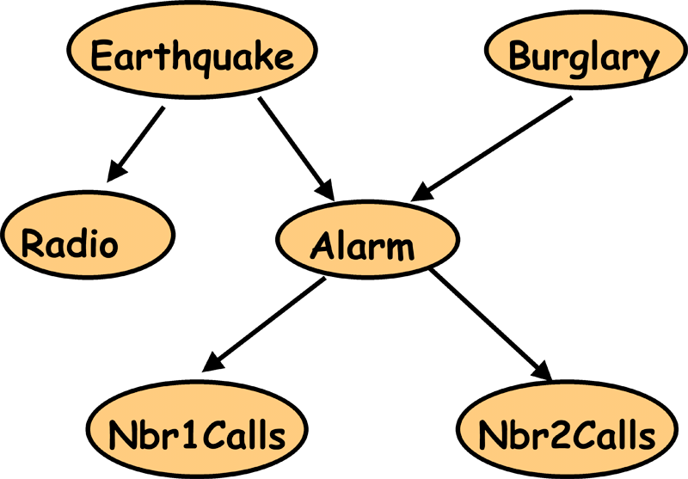
Parameter Estimation and Bayesian Networks
E | B | R | A | J | M
T | F | T | T | F | T
F | F | F | F | F | T
F | T | F | T | T | T
F | F | F | T | T | T
F | T | F | F | F | F
...
We have:
- Bayes Net structure and observations
- We need: Bayes Net parameters

Slide 13
Parameter Estimation and Bayesian Networks
E | B | R | A | J | M
T | F | T | T | F | T
F | F | F | F | F | T
F | T | F | T | T | T
F | F | F | T | T | T
F | T | F | F | F | F
...
P(B) = ?
P(¬B) = 1- P(B)
= 0.4
= 0.6

Slide 14
Parameter Estimation and Bayesian Networks
E | B | R | A | J | M
T | F | T | T | F | T
F | F | F | F | F | T
F | T | F | T | T | T
F | F | F | T | T | T
F | T | F | F | F | F
...
P(A|E,B) = ?
P(A|E,¬B) = ?
P(A|¬E,B) = ?
P(A|¬E,¬B) = ?

Slide 15
Parameter Estimation and Bayesian Networks
Coin

Slide 16

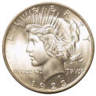

Coin Flip
C₁
C₂
C₃
P(H|C₁) = 0.1
P(H|C₂) = 0.5
P(H|C₃) = 0.9
Which coin will I use?
P(C₁) = 1/3
P(C₂) = 1/3
P(C₃) = 1/3
Prior: Probability of a hypothesis
before we make any observations

Slide 17
Coin Flip
C₁
C₂
C₃
P(H|C₁) = 0.1
P(H|C₂) = 0.5
P(H|C₃) = 0.9
Which coin will I use?
P(C₁) = 1/3
P(C₂) = 1/3
P(C₃) = 1/3
Uniform Prior: All hypothesis are equally likely
before we make any observations

Slide 18

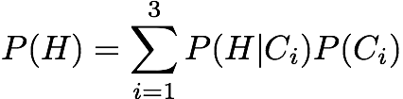
Experiment 1: Heads
Which coin did I use?
P(C₁|H) = ?
P(C₂|H) = ?
P(C₃|H) = ?
C₁
C₂
C₃
P(H|C₁)=0.1
P(H|C₂) = 0.5
P(H|C₃) = 0.9
P(C₁)=1/3
P(C₂) = 1/3
P(C₃) = 1/3

Slide 19
Experiment 1: Heads
Which coin did I use?
P(C₁|H) = 0.066
P(C₂|H) = 0.333
P(C₃|H) = 0.6
Posterior: Probability of a hypothesis given data
C₁
C₂
C₃
P(H|C₁) = 0.1
P(H|C₂) = 0.5
P(H|C₃) = 0.9
P(C₁) = 1/3
P(C₂) = 1/3
P(C₃) = 1/3

Slide 20
Terminology
Prior:
  Probability of a hypothesis before we see any data
Uniform Prior:
  A prior that makes all hypothesis equally likely
Posterior:
  Probability of a hypothesis after we saw some data
Likelihood:
  Probability of data given hypothesis

Slide 21
Experiment 2: Tails
Now, Which coin did I use?
P(C₁|HT) = ?
P(C₂|HT) = ?
P(C₃|HT) = ?
C₁
C₂
C₃
P(H|C₁) = 0.1
P(H|C₂) = 0.5
P(H|C₃) = 0.9
P(C₁) = 1/3
P(C₂) = 1/3
P(C₃) = 1/3

Slide 22
Experiment 2: Tails
Now, Which coin did I use?
P(C₁|HT) = 0.21
P(C₂|HT) = 0.58
P(C₃|HT) = 0.21
C₁
C₂
C₃
P(H|C₁) = 0.1
P(H|C₂) = 0.5
P(H|C₃) = 0.9
P(C₁) = 1/3
P(C₂) = 1/3
P(C₃) = 1/3

Slide 23
Experiment 2: Tails
Which coin did I use?
P(C₁|HT) = 0.21
P(C₂|HT) = 0.58
P(C₃|HT) = 0.21
C₁
C₂
C₃
P(H|C₁) = 0.1
P(H|C₂) = 0.5
P(H|C₃) = 0.9
P(C₁) = 1/3
P(C₂) = 1/3
P(C₃) = 1/3

Slide 24
Your Estimate?
What is the probability of heads after two experiments?
Most likely coin:
Best estimate for P(H)
C₂
P(H|C₂) = 0.5
C₁
C₂
C₃
P(H|C₁) = 0.1
P(H|C₂) = 0.5
P(H|C₃) = 0.9
P(C₁) = 1/3
P(C₂) = 1/3
P(C₃) = 1/3

Slide 25
Your Estimate?
Maximum Likelihood Estimate: The best hypothesis
that fits observed data assuming uniform prior
Most likely coin:
Best estimate for P(H)
C₂
P(H|C₂) = 0.5
C₂
P(H|C₂) = 0.5
P(C₂) = 1/3

Slide 26
Using Prior Knowledge
Should we always use a Uniform Prior ?
Background knowledge:
  Heads => we have to buy Dan chocolate
  Dan likes chocolate…
  => Dan is more likely to use a coin biased in his favor
C₁
C₂
C₃
P(H|C₁) = 0.1
P(H|C₂) = 0.5
P(H|C₃) = 0.9

Slide 27
Using Prior Knowledge
We can encode it in the prior:
P(C₁) = 0.05
P(C₂) = 0.25
P(C₃) = 0.70
C₁
C₂
C₃
P(H|C₁) = 0.1
P(H|C₂) = 0.5
P(H|C₃) = 0.9

Slide 28
Experiment 1: Heads
Which coin did I use?
P(C₁|H) = ?
P(C₂|H) = ?
P(C₃|H) = ?
C₁
C₂
C₃
P(H|C₁) = 0.1
P(H|C₂) = 0.5
P(H|C₃) = 0.9
P(C₁) = 0.05
P(C₂) = 0.25
P(C₃) = 0.70

Slide 29
Experiment 1: Heads
Which coin did I use?
P(C₁|H) = 0.006
P(C₂|H) = 0.165
P(C₃|H) = 0.829
Compare with ML posterior after Exp 1:
P(C₁|H) = 0.066
P(C₂|H) = 0.333
P(C₃|H) = 0.600
C₁
C₂
C₃
P(H|C₁) = 0.1
P(H|C₂) = 0.5
P(H|C₃) = 0.9
P(C₁) = 0.05
P(C₂) = 0.25
P(C₃) = 0.70

Slide 30
Experiment 2: Tails
Which coin did I use?
P(C₁|HT) = ?
P(C₂|HT) = ?
P(C₃|HT) = ?
C₁
C₂
C₃
P(H|C₁) = 0.1
P(H|C₂) = 0.5
P(H|C₃) = 0.9
P(C₁) = 0.05
P(C₂) = 0.25
P(C₃) = 0.70

Slide 31
Experiment 2: Tails
Which coin did I use?
P(C₁|HT) = 0.035
P(C₂|HT) = 0.481
P(C₃|HT) = 0.485
C₁
C₂
C₃
P(H|C₁) = 0.1
P(H|C₂) = 0.5
P(H|C₃) = 0.9
P(C₁) = 0.05
P(C₂) = 0.25
P(C₃) = 0.70

Slide 32
Experiment 2: Tails
Which coin did I use?
P(C₁|HT) = 0.035
P(C₂|HT)=0.481
P(C₃|HT) = 0.485
C₁
C₂
C₃
P(H|C₁) = 0.1
P(H|C₂) = 0.5
P(H|C₃) = 0.9
P(C₁) = 0.05
P(C₂) = 0.25
P(C₃) = 0.70

Slide 33
Your Estimate?
What is the probability of heads after two experiments?
Most likely coin:
Best estimate for P(H)
C₃
P(H|C₃) = 0.9
C₁
C₂
C₃
P(H|C₁) = 0.1
P(H|C₂) = 0.5
P(H|C₃) = 0.9
P(C₁) = 0.05
P(C₂) = 0.25
P(C₃) = 0.70

Slide 34
Your Estimate?
Maximum A Posteriori (MAP) Estimate:
The best hypothesis that fits observed data
assuming a non-uniform prior
Most likely coin:
Best estimate for P(H)
C₃
P(H|C₃) = 0.9
C₃
P(H|C₃) = 0.9
P(C₃) = 0.70

Slide 35
Did We Do The Right Thing?
P(C₁|HT)=0.035
P(C₂|HT)=0.481
P(C₃|HT)=0.485
C₁
C₂
C₃
P(H|C₁) = 0.1
P(H|C₂) = 0.5
P(H|C₃) = 0.9

Slide 36

Did We Do The Right Thing?
P(C₁|HT) =0.035
P(C₂|HT)=0.481
P(C₃|HT)=0.485
C₂ and C₃ are almost
equally likely
C₁
C₂
C₃
P(H|C₁) = 0.1
P(H|C₂) = 0.5
P(H|C₃) = 0.9

Slide 37
A Better Estimate
Recall:
= 0.680
P(C₁|HT)=0.035
P(C₂|HT)=0.481
P(C₃|HT)=0.485
C₁
C₂
C₃
P(H|C₁) = 0.1
P(H|C₂) = 0.5
P(H|C₃) = 0.9

Slide 38
Bayesian Estimate
Bayesian Estimate: Minimizes prediction error,
given data assuming an arbitrary prior
= 0.680
P(C₁|HT)=0.035
P(C₂|HT)=0.481
P(C₃|HT)=0.485
C₁
C₂
C₃
P(H|C₁) = 0.1
P(H|C₂) = 0.5
P(H|C₃) = 0.9

Slide 39
Comparison
After more experiments: HTHHHHHHHHH
ML (Maximum Likelihood):
P(H) = 0.5
after 10 experiments: P(H) = 0.9
MAP (Maximum A Posteriori):
P(H) = 0.9
after 10 experiments: P(H) = 0.9
Bayesian:
P(H) = 0.68
after 10 experiments: P(H) = 0.9

Slide 40
Summary
Easy to compute
 | Prior | Hypothesis
Maximum Likelihood Estimate
Maximum A Posteriori Estimate
Bayesian Estimate
Uniform | The most likely
Any | The most likely
Any | Weighted combination
Still easy to compute
Incorporates prior knowledge
Minimizes error
Great when data is scarce
Potentially much harder to compute

Slide 41
Bayesian Learning
Prior
Data Likelihood
Use Bayes rule:
P(Y | X) = P(X |Y) P(Y)
P(X)
Posterior
Normalization
Or equivalently: P(Y | X) ∝ P(X | Y) P(Y)

Slide 42
Parameter Estimation and Bayesian Networks
E | B | R | A | J | M
T | F | T | T | F | T
F | F | F | F | F | T
F | T | F | T | T | T
F | F | F | T | T | T
F | T | F | F | F | F
...
Prior
Now compute
either MAP or
Bayesian estimate
P(B) = ?
+ data =

Slide 43
What Prior to Use?
Prev, you knew: it was one of only three coins
  Now more complicated…
The following are two common priors
Binary variable Beta
  Posterior distribution is binomial
  Easy to compute posterior
Discrete variable Dirichlet
  Posterior distribution is multinomial
  Easy to compute posterior

Slide 44
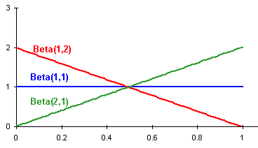
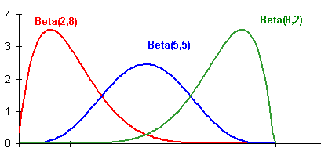
Beta Distribution

Slide 45
Beta Distribution
Example: Flip coin with Beta distribution as prior over p [prob(heads)]
  Parameterized by two positive numbers: a, b
  Mode of distribution (E[p]) is a/(a+b)
  Specify our prior belief for p = a/(a+b)
  Specify confidence in this belief with high initial values for a and b
Updating our prior belief based on data
  incrementing a for every heads outcome
  incrementing b for every tails outcome
So after h heads out of n flips, our posterior distribution says P(head)=(a+h)/(a+b+n)

Slide 46

One Prior: Beta Distribution
a,b
For any positive integer y, Γ(y) = (y-1)!

Slide 47
Parameter Estimation and Bayesian Networks
E | B | R | A | J | M
T | F | T | T | F | T
F | F | F | F | F | T
F | T | F | T | T | T
F | F | F | T | T | T
F | T | F | F | F | F
...
Prior
B
¬B
P(B|data) = ?
Beta(1,4)
“+ data” =
(3,7)
.3
.7
Prior P(B)= 1/(1+4) = 20% with equivalent sample size 5

Slide 48
Parameter Estimation and Bayesian Networks
E | B | R | A | J | M
T | F | T | T | F | T
F | F | F | F | F | T
F | T | F | T | T | T
F | F | F | T | T | T
F | T | F | F | F | F
...
P(A|E,B) = ?
P(A|E,¬B) = ?
P(A|¬E,B) = ?
P(A|¬E,¬B) = ?

Slide 49
Parameter Estimation and Bayesian Networks
E | B | R | A | J | M
T | F | T | T | F | T
F | F | F | F | F | T
F | T | F | T | T | T
F | F | F | T | T | T
F | T | F | F | F | F
...
P(A|E,B) = ?
P(A|E,¬B) = ?
P(A|¬E,B) = ?
P(A|¬E,¬B) = ?
Prior
Beta(2,3)

Slide 50
Parameter Estimation and Bayesian Networks
E | B | R | A | J | M
T | F | T | T | F | T
F | F | F | F | F | T
F | T | F | T | T | T
F | F | F | T | T | T
F | T | F | F | F | F
...
P(A|E,B) = ?
P(A|E,¬B) = ?
P(A|¬E,B) = ?
P(A|¬E,¬B) = ?
Prior
Beta(2,3)
+ data=
(3,4)

Slide 51
Bayesian Learning
Prior
Data Likelihood
Use Bayes rule:
P(Y | X) = P(X |Y) P(Y)
P(X)
Posterior
Normalization
Or equivalently: P(Y | X) ∝ P(X | Y) P(Y)

Slide 52

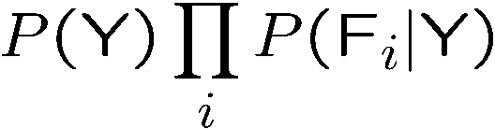
Naïve Bayes
Y
Class
Value
…
F 1
F 2
F 3
F _{N}
Assume that features are conditionally independent given class variable
Works well in practice
But forces probabilities towards 0 and 1

Slide 53
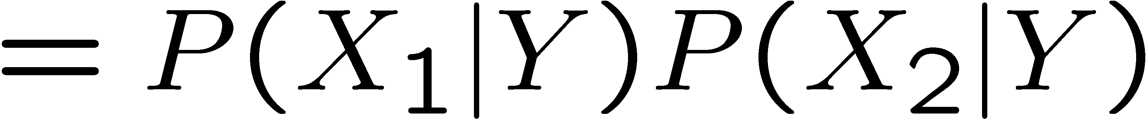
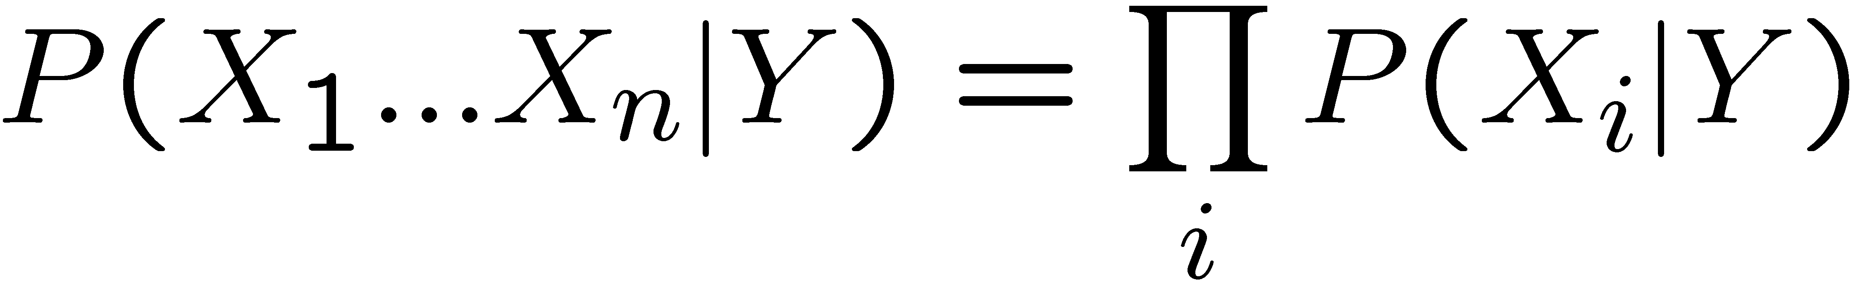
Naïve Bayes
Naïve Bayes assumption:
  Features are independent given class:
  More generally:
How many parameters now?
    Suppose X is composed of n binary features

Slide 54
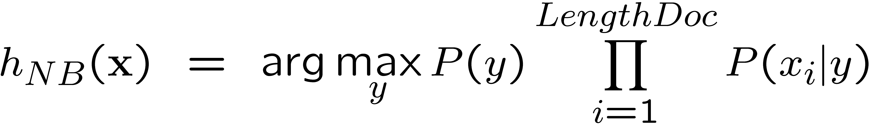
NB with Bag of Words for text classification
Learning phase:
  Prior P(Y)
    Count how many documents from each topic (prior)
  P(X_{i}|Y)
    For each of m topics, count how many times you saw word X_{i} in documents of this topic (+ k for prior)
    Divide by number of times you saw the word (+ k×m)
Test phase:
  For each document
    Use naïve Bayes decision rule

Slide 55
Probabilities: Important Detail!
P(spam | X₁ … X_{n}) = Π P(spam | X_{i})
i
Any more potential problems here?
We are multiplying lots of small numbers Danger of underflow!
  0.5⁵⁷ = 7 E -18
Solution? Use logs and add!
  p₁ * p₂ = e ^{log(p1)+log(p2)}
  Always keep in log form

Slide 56
What if we don’t know structure?

Slide 57
Learning The Structure of Bayesian Networks
Search thru the space…
  of possible network structures!
  (for now, assume we observe all variables)
For each structure, learn parameters
Pick the one that fits observed data best
  Caveat – won’t we end up fully connected????
Problem !?!?
When scoring, add a penalty
  ∝ model complexity

Slide 58
Learning The Structure of Bayesian Networks
Search thru the space
For each structure, learn parameters
Pick the one that fits observed data best
  Penalize complex models
Problem?
  Exponential number of networks!
  And we need to learn parameters for each!
  Exhaustive search out of the question!
So what now?

Slide 59
Structure Learning as Search
Local Search
  Start with some network structure
  Try to make a change
  (add or delete or reverse edge)
  See if the new network is any better
What should the initial state be?
  Uniform prior over random networks?
  Based on prior knowledge?
  Empty network?
How do we evaluate networks?

Slide 60
A
A
B
C
B
C
D
E
A
D
E
A
B
B
C
C
A
E
D
E
D
B
C
D
E

Slide 61
Score Functions
Bayesian Information Criteion (BIC)
  P(D | BN) – penalty
  Penalty = ½ (# parameters) Log (# data points)
MAP score
  P(BN | D) = P(D | BN) P(BN)
  P(BN) must decay exponentially with # of parameters for this to work well

Slide 63
Important Concepts
Data: labeled instances, e.g. emails marked spam/ham
  Training set
  Held out set
  Test set
Features: attribute-value pairs which characterize each x
Experimentation cycle
  Learn parameters (e.g. model probabilities) on training set
  (Tune hyperparameters on held-out set)
  Very important: never “peek” at the test set!
Evaluation
  Compute accuracy of test set
  Accuracy: fraction of instances predicted correctly
Overfitting and generalization
  Want a classifier which does well on test data
  Overfitting: fitting the training data very closely, but not generalizing well
Training
Data
Held-Out
Data
Test
Data

Slide 64
Bayes Nets for Classification
One method of classification:
  Use a probabilistic model!
  Features are observed random variables F_{i}
  Y is the query variable
  Use probabilistic inference to compute most likely Y
You already know how to do this inference

Slide 65




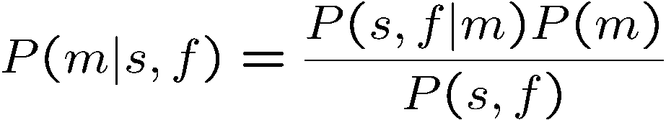
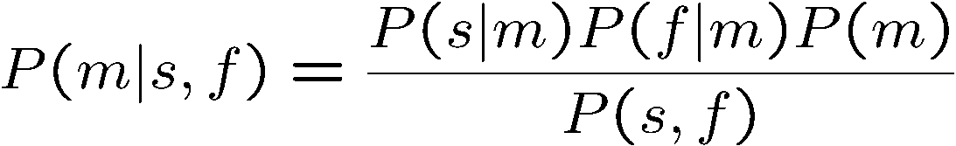
Simple Classification
M
Simple example: two binary features
S
F
direct estimate
Bayes estimate (no assumptions)
Conditional independence
+

Slide 66
Naïve Bayes
Y
Class
Value
…
F 1
F 2
F 3
F _{N}
Assume that features are conditionally independent given class variable
Works well in practice
But forces probabilities towards 0 and 1

Slide 67
General Naïve Bayes
What do we need in order to use naïve Bayes?
  Inference (you know this part)
    Start with a bunch of conditionals, P(Y) and the P(F_{i}|Y) tables
    Use standard inference to compute P(Y|F₁…F_{n})
    Nothing new here
  Estimates of local conditional probability tables
    P(Y), the prior over labels
    P(F_{i}|Y) for each feature (evidence variable)
    These probabilities are collectively called the parameters of the model and denoted by θ
    Up until now, we assumed these appeared by magic, but…
    …they typically come from training data: we’ll look at this now

Slide 68






A Digit Recognizer
Input: pixel grids
Output: a digit 0-9

Slide 69


Naïve Bayes for Digits
Simple version:
  One feature F_{ij} for each grid position <i,j>
  Possible feature values are on / off, based on whether intensity is more or less than 0.5 in underlying image
  Each input maps to a feature vector, e.g.
  Here: lots of features, each is binary valued
Naïve Bayes model:
What do we need to learn?

Slide 70



Examples: CPTs
1 | 0.1
2 | 0.1
3 | 0.1
4 | 0.1
5 | 0.1
6 | 0.1
7 | 0.1
8 | 0.1
9 | 0.1
0 | 0.1
1 | 0.01
2 | 0.05
3 | 0.05
4 | 0.30
5 | 0.80
6 | 0.90
7 | 0.05
8 | 0.60
9 | 0.50
0 | 0.80
1 | 0.05
2 | 0.01
3 | 0.90
4 | 0.80
5 | 0.90
6 | 0.90
7 | 0.25
8 | 0.85
9 | 0.60
0 | 0.80

Slide 71
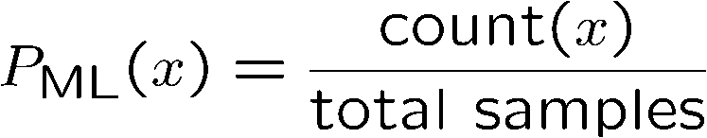

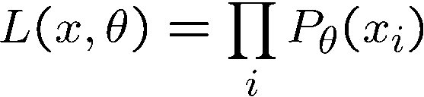
Parameter Estimation
Estimating distribution of random variables like X or X | Y
Elicitation: ask a human!
  Usually need domain experts, and sophisticated ways of eliciting probabilities (e.g. betting games)
  Trouble calibrating
Empirically: use training data
  For each outcome x, look at the empirical rate of that value:
  This is the estimate that maximizes the likelihood of the data
r
g
g

Slide 72
A Spam Filter
Naïve Bayes spam filter
Data:
  Collection of emails, labeled spam or ham
  Note: someone has to hand label all this data!
  Split into training, held-out, test sets
Classifiers
  Learn on the training set
  (Tune it on a held-out set)
  Test it on new emails
Dear Sir.
First, I must solicit your confidence in this transaction, this is by virture of its nature as being utterly confidencial and top secret. …
TO BE REMOVED FROM FUTURE MAILINGS, SIMPLY REPLY TO THIS MESSAGE AND PUT "REMOVE" IN THE SUBJECT.
99 MILLION EMAIL ADDRESSES
FOR ONLY $99
Ok, Iknow this is blatantly OT but I'm beginning to go insane. Had an old Dell Dimension XPS sitting in the corner and decided to put it to use, I know it was working pre being stuck in the corner, but when I plugged it in, hit the power nothing happened.

Slide 73
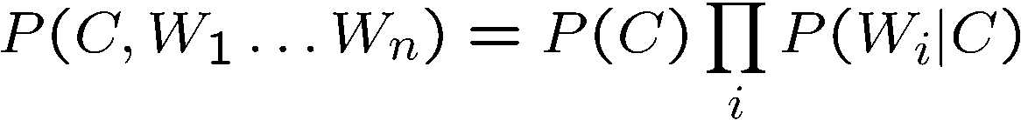
Naïve Bayes for Text
Bag-of-Words Naïve Bayes:
  Predict unknown class label (spam vs. ham)
  Assume evidence features (e.g. the words) are independent
  Warning: subtly different assumptions than before!
Generative model
Tied distributions and bag-of-words
  Usually, each variable gets its own conditional probability distribution P(F|Y)
  In a bag-of-words model
    Each position is identically distributed
    All positions share the same conditional probs P(W|C)
    Why make this assumption?
Word at position i, not i^{th} word in the dictionary!

Slide 74




Example: Spam Filtering
Model:
What are the parameters?
ham : 0.66
spam: 0.33
the : 0.0156
to : 0.0153
and : 0.0115
of : 0.0095
you : 0.0093
a : 0.0086
with: 0.0080
from: 0.0075
...
the : 0.0210
to : 0.0133
of : 0.0119
2002: 0.0110
with: 0.0108
from: 0.0107
and : 0.0105
a : 0.0100
...
Where do these come from?

Slide 75
Spam Example
Word | P(w|spam) | P(w|ham) | Tot Spam | Tot Ham
(prior) | 0.33333 | 0.66666 | -1.1 | -0.4
Gary | 0.00002 | 0.00021 | -11.8 | -8.9
would | 0.00069 | 0.00084 | -19.1 | -16.0
you | 0.00881 | 0.00304 | -23.8 | -21.8
like | 0.00086 | 0.00083 | -30.9 | -28.9
to | 0.01517 | 0.01339 | -35.1 | -33.2
lose | 0.00008 | 0.00002 | -44.5 | -44.0
weight | 0.00016 | 0.00002 | -53.3 | -55.0
while | 0.00027 | 0.00027 | -61.5 | -63.2
you | 0.00881 | 0.00304 | -66.2 | -69.0
sleep | 0.00006 | 0.00001 | -76.0 | -80.5
P(spam | w) = 98.9

Slide 76












Example: Overfitting
2 wins!!

Slide 77
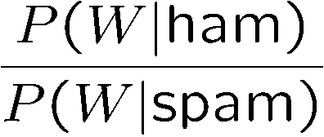
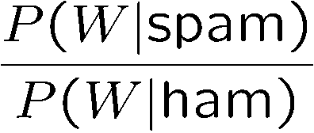
Example: Overfitting
Posteriors determined by relative probabilities (odds ratios):
south-west : inf
nation : inf
morally : inf
nicely : inf
extent : inf
seriously : inf
...
screens : inf
minute : inf
guaranteed : inf
$205.00 : inf
delivery : inf
signature : inf
...
What went wrong here?

Slide 78
Generalization and Overfitting
Relative frequency parameters will overfit the training data!
  Just because we never saw a 3 with pixel (15,15) on during training doesn’t mean we won’t see it at test time
  Unlikely that every occurrence of “minute” is 100% spam
  Unlikely that every occurrence of “seriously” is 100% ham
  What about all the words that don’t occur in the training set at all?
  In general, we can’t go around giving unseen events zero probability
As an extreme case, imagine using the entire email as the only feature
  Would get the training data perfect (if deterministic labeling)
  Wouldn’t generalize at all
  Just making the bag-of-words assumption gives us some generalization, but isn’t enough
To generalize better: we need to smooth or regularize the estimates

Slide 79
Estimation: Smoothing
Problems with maximum likelihood estimates:
  If I flip a coin once, and it’s heads, what’s the estimate for P(heads)?
  What if I flip 10 times with 8 heads?
  What if I flip 10M times with 8M heads?
Basic idea:
  We have some prior expectation about parameters (here, the probability of heads)
  Given little evidence, we should skew towards our prior
  Given a lot of evidence, we should listen to the data

Slide 80
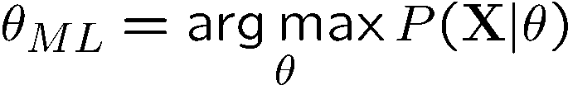
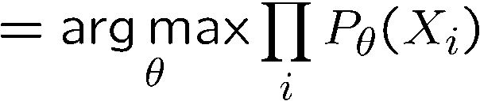
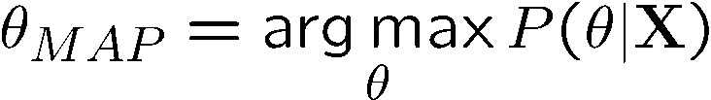
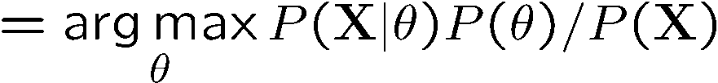
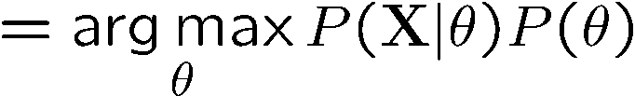
Estimation: Smoothing
Relative frequencies are the maximum likelihood estimates
In Bayesian statistics, we think of the parameters as just another random variable, with its own distribution
????

Slide 81
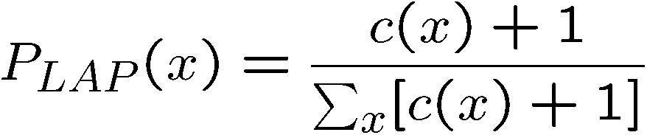
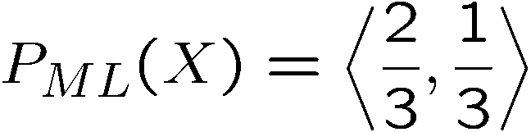
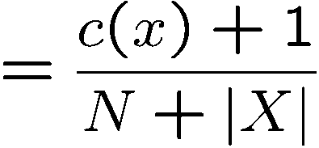
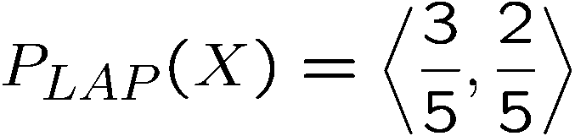
Estimation: Laplace Smoothing
Laplace’s estimate:
  Pretend you saw every outcome once more than you actually did
  Can derive this as a MAP estimate with Dirichlet priors (Bayesian justfication)
H
H
T

Slide 82
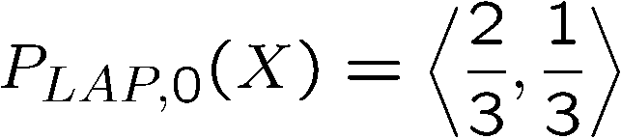
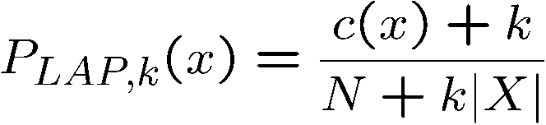
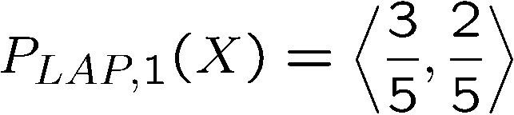
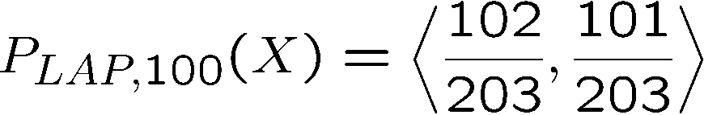
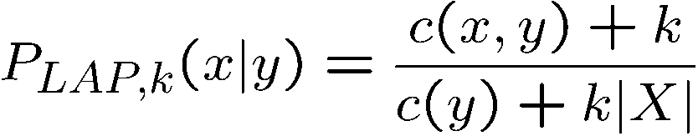
Estimation: Laplace Smoothing
Laplace’s estimate (extended):
  Pretend you saw every outcome k extra times
  What’s Laplace with k = 0?
  k is the strength of the prior
H
H
T
Laplace for conditionals:
  Smooth each condition independently:

Slide 83
Estimation: Linear Interpolation
In practice, Laplace often performs poorly for P(X|Y):
  When |X| is very large
  When |Y| is very large
Another option: linear interpolation
  Also get P(X) from the data
  Make sure the estimate of P(X|Y) isn’t too different from P(X)
  What if α is 0? 1?

Slide 84
Real NB: Smoothing
For real classification problems, smoothing is critical
New odds ratios:
helvetica : 11.4
seems : 10.8
group : 10.2
ago : 8.4
areas : 8.3
...
verdana : 28.8
Credit : 28.4
ORDER : 27.2
<FONT> : 26.9
money : 26.5
...
Do these make more sense?

Slide 85





Tuning on Held-Out Data
Now we’ve got two kinds of unknowns
  Parameters: the probabilities P(Y|X), P(Y)
  Hyperparameters, like the amount of smoothing to do: k, α
Where to learn?
  Learn parameters from training data
  Must tune hyperparameters on different data
    Why?
  For each value of the hyperparameters, train and test on the held-out data
  Choose the best value and do a final test on the test data

Slide 86
Baselines
First step: get a baseline
  Baselines are very simple “straw man” procedures
  Help determine how hard the task is
  Help know what a “good” accuracy is
Weak baseline: most frequent label classifier
  Gives all test instances whatever label was most common in the training set
  E.g. for spam filtering, might label everything as ham
  Accuracy might be very high if the problem is skewed
  E.g. calling everything “ham” gets 66%, so a classifier that gets 70% isn’t very good…
For real research, usually use previous work as a (strong) baseline

Slide 87


Confidences from a Classifier
The confidence of a probabilistic classifier:
  Posterior over the top label
  Represents how sure the classifier is of the classification
  Any probabilistic model will have confidences
  No guarantee confidence is correct
Calibration
  Weak calibration: higher confidences mean higher accuracy
  Strong calibration: confidence predicts accuracy rate
  What’s the value of calibration?

Slide 88
Precision vs. Recall
Let’s say we want to classify web pages as
homepages or not
  In a test set of 1K pages, there are 3 homepages
  Our classifier says they are all non-homepages
  99.7 accuracy!
  Need new measures for rare positive events
Precision: fraction of guessed positives which were actually positive
Recall: fraction of actual positives which were guessed as positive
Say we detect 5 spam emails, of which 2 were actually spam, and we missed one
  Precision: 2 correct / 5 guessed = 0.4
  Recall: 2 correct / 3 true = 0.67
Which is more important in customer support email automation?
Which is more important in airport face recognition?
-
actual +
guessed +

Slide 89



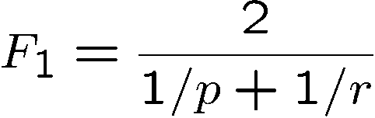
Precision vs. Recall
Precision/recall tradeoff
  Often, you can trade off precision and recall
  Only works well with weakly calibrated classifiers
To summarize the tradeoff:
  Break-even point: precision value when p = r
  F-measure: harmonic mean of p and r:

Slide 90
Errors, and What to Do
Examples of errors
Dear GlobalSCAPE Customer,
GlobalSCAPE has partnered with ScanSoft to offer you the latest version of OmniPage Pro, for just $99.99* - the regular list price is $499! The most common question we've received about this offer is - Is this genuine? We would like to assure you that this offer is authorized by ScanSoft, is genuine and valid. You can get the . . .
. . . To receive your $30 Amazon.com promotional certificate, click through to
http://www.amazon.com/apparel
and see the prominent link for the $30 offer. All details are there. We hope you enjoyed receiving this message. However, if you'd rather not receive future e-mails announcing new store launches, please click . . .

Slide 91
What to Do About Errors?
Need more features– words aren’t enough!
  Have you emailed the sender before?
  Have 1K other people just gotten the same email?
  Is the sending information consistent?
  Is the email in ALL CAPS?
  Do inline URLs point where they say they point?
  Does the email address you by (your) name?
Can add these information sources as new variables in the NB model
Next class we’ll talk about classifiers which let you easily add arbitrary features more easily

Slide 92
Summary
Bayes rule lets us do diagnostic queries with causal probabilities
The naïve Bayes assumption takes all features to be independent given the class label
We can build classifiers out of a naïve Bayes model using training data
Smoothing estimates is important in real systems
Classifier confidences are useful, when you can get them

Slide 93
Errors, and What to Do
Examples of errors
Dear GlobalSCAPE Customer,
GlobalSCAPE has partnered with ScanSoft to offer you the latest version of OmniPage Pro, for just $99.99* - the regular list price is $499! The most common question we've received about this offer is - Is this genuine? We would like to assure you that this offer is authorized by ScanSoft, is genuine and valid. You can get the . . .
. . . To receive your $30 Amazon.com promotional certificate, click through to
http://www.amazon.com/apparel
and see the prominent link for the $30 offer. All details are there. We hope you enjoyed receiving this message. However, if you'd rather not receive future e-mails announcing new store launches, please click . . .

Slide 94
What to Do About Errors?
Need more features– words aren’t enough!
  Have you emailed the sender before?
  Have 1K other people just gotten the same email?
  Is the sending information consistent?
  Is the email in ALL CAPS?
  Do inline URLs point where they say they point?
  Does the email address you by (your) name?
Can add these information sources as new variables in the NB model
Next class we’ll talk about classifiers which let you easily add arbitrary features more easily

Slide 95
Summary
Bayes rule lets us do diagnostic queries with causal probabilities
The naïve Bayes assumption takes all features to be independent given the class label
We can build classifiers out of a naïve Bayes model using training data
Smoothing estimates is important in real systems
Classifier confidences are useful, when you can get them

