Slide 1
CSE 473: Artificial Intelligence Spring 2012
Bayesian Networks - Inference
Dan Weld
Slides adapted from Jack Breese, Dan Klein, Daphne Koller, Stuart Russell, Andrew Moore & Luke Zettlemoyer
1

Slide 2
Probabilistic Models - Outline
Bayesian Networks (BNs)
Independence
Efficient Inference in BNs
Variable Elimination
Direct Sampling
Markov Chain Monte Carlo (MCMC)
Learning

Slide 3
Bayes’ Nets: Big Picture
Problems with using full joint distribution :
Unless very few variables, the joint is WAY too big
Unless very few variables, hard to learn (estimate empirically)
Bayesian networks: a technique for describing complex joint distributions (models) using simple, local distributions (conditional probabilities)
A kind of “graphical model”
We describe how random variables interact, locally
Local interactions chain together to give global distribution

Slide 4
Bayes’ Net Semantics
Formally:
A set of nodes, one per variable X
A directed, acyclic graph
A CPT for each node
CPT = “Conditional Probability Table”
Collection of distributions over X, one for each combination of parents’ values
A₁
A_{n}
X
A Bayes net = Topology (graph) + Local Conditional Probabilities

Slide 5
Example: Alarm Network
10 params vs 31
E | P(E)
+e | 0.002
←e | 0.998
B | P(B)
+b | 0.001
←b | 0.999
Burglary
Earthqk
Alarm
B | E | A | P(A|B,E)
+b | +e | +a | 0.95
+b | +e | ←a | 0.05
+b | ←e | +a | 0.94
+b | ←e | ←a | 0.06
←b | +e | +a | 0.29
←b | +e | ←a | 0.71
←b | ←e | +a | 0.001
←b | ←e | ←a | 0.999
John calls
Mary calls
A | J | P(J|A)
+a | +j | 0.9
+a | ←j | 0.1
←a | +j | 0.05
←a | ←j | 0.95
A | M | P(M|A)
+a | +m | 0.7
+a | ←m | 0.3
←a | +m | 0.01
←a | ←m | 0.99

Slide 6
Probabilities in BNs
Bayes’ nets implicitly encode joint distributions
As a product of local conditional distributions
To see what probability a BN gives to a full assignment, multiply all the relevant conditionals together:
This lets us reconstruct any entry of the full joint
Not every BN can represent every joint distribution
The topology enforces certain independence assumptions
Compare to the exact decomposition according to the chain rule!

Slide 7
Independence in a BN
Important question about a BN:
Are two nodes independent given certain evidence?
If yes, can prove using algebra (tedious in general)
If no, can prove with a counter example
Example:
X
Y
Z
Question: are X and Z independent?
Answer: no.
Example: low pressure causes rain, which causes traffic.
Knowledge about X may change belief in Z,
Knowledge about Z may change belief in X (via Y)
Addendum: they could be independent: how?

Slide 8
Reachability (D-Separation)
Question: Are X and Y conditionally independent given evidence vars {Z}?
Yes, if X and Y “separated” by Z
Look for active paths from X to Y
No active paths = independence!
A path is active if each triple is active:
Causal chain A ◊ B ◊ C where B is unobserved (either direction)
Common cause A ⇓ B ◊ C where B is unobserved
Common effect (aka v-structure)
A ◊ B ⇓ C where B or one of its descendents is observed
All it takes to block a path is a single inactive segment
Active Triples
Inactive Triples

Slide 9
Example
Active Triples
Variables:
R: Raining
W: Wet
P: Plants growing
T: Traffic bad
D: Roof drips
S: I’m sad
Questions:
W ⊥ D
R
W
D
T
P
S

Slide 10
Example
Active Triples
Variables:
R: Raining
W: Wet
P: Plants growing
T: Traffic bad
D: Roof drips
S: I’m sad
Questions:
W ⊥ D
P ⊥ D | R, S
R
W
D
T
P
No
S

Slide 11
Example
Active Triples
Variables:
R: Raining
W: Wet
P: Plants growing
T: Traffic bad
D: Roof drips
S: I’m sad
Questions:
W ⊥ D
P ⊥ D | R, S
P ⊥ D | R, T
R
W
D
T
P
No
S
No
Yes

Slide 12
Given Markov Blanket, X is Independent of All Other Nodes
MB(X) = Par(X) ∪ Childs(X) ∪ Par(Childs(X))

Slide 13
Given Markov Blanket, X is Independent of All Other Nodes
MB(X) = Par(X) ∪ Childs(X) ∪ Par(Childs(X))

Slide 14
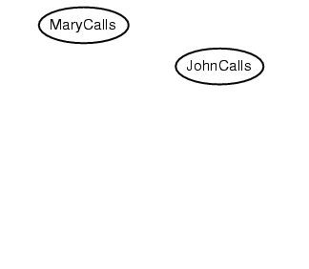
Bayes Net Construction Example
Suppose we choose the ordering M, J, A, B, E
P(J | M) = P(J)?

Slide 15
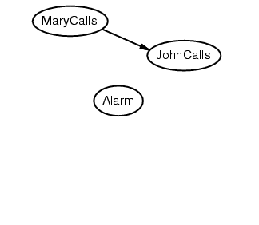
Example
Suppose we choose the ordering M, J, A, B, E
P(J | M) = P(J)? No
P(A | J, M) = P(A | J)? P(A | M)? P(A)?

Slide 16
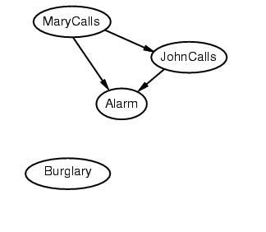
Example
Suppose we choose the ordering M, J, A, B, E
P(J | M) = P(J)? No
P(A | J, M) = P(A | J)? P(A | J, M) = P(A)? No
P(B | A, J, M) = P(B | A)?
P(B | A, J, M) = P(B)?

Slide 17
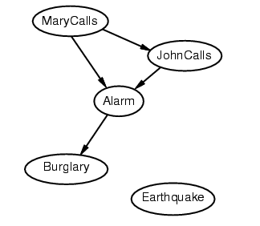
Example
Suppose we choose the ordering M, J, A, B, E
P(J | M) = P(J)? No
P(A | J, M) = P(A | J)? P(A | J, M) = P(A)? No
P(B | A, J, M) = P(B | A)? Yes
P(B | A, J, M) = P(B)? No
P(E | B, A ,J, M) = P(E | A)?
P(E | B, A, J, M) = P(E | A, B)?

Slide 18
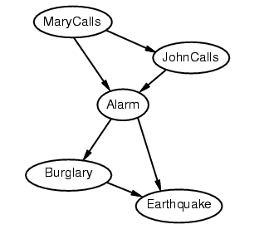
Example
Suppose we choose the ordering M, J, A, B, E
P(J | M) = P(J)? No
P(A | J, M) = P(A | J)? P(A | J, M) = P(A)? No
P(B | A, J, M) = P(B | A)? Yes
P(B | A, J, M) = P(B)? No
P(E | B, A ,J, M) = P(E | A)? No
P(E | B, A, J, M) = P(E | A, B)? Yes

Slide 19
Example contd.
Deciding conditional independence is hard in noncausal directions
(Causal models and conditional independence seem hardwired for humans!)
Network is less compact: 1 + 2 + 4 + 2 + 4 = 13 numbers needed

Slide 20
Example: Car Diagnosis

Slide 21
Example: Car Insurance

Slide 22
Other Applications
Medical Diagnosis
Computational Biology and Bioinformatics
Natural Language Processing
Document classification
Image processing
Decision support systems
Ecology & natural resource management
Robotics
Forensic science…

Slide 23
Compact Conditionals

Slide 24
Compact Conditionals

Slide 25
Hybrid (discrete+cont) Networks

Slide 26
#1: Continuous Child Variables

Slide 27
#2 Discrete child – cont. parents

Slide 28
Why probit?

Slide 29
Sigmoid Function

Slide 30
Inference in BNs
The graphical independence representation
yields efficient inference schemes
We generally want to compute
Marginal probability: Pr(Z),
Pr(Z|E) where E is (conjunctive) evidence
Z: query variable(s),
E: evidence variable(s)
everything else: hidden variable
Computations organized by network topology

Slide 31
P(B | J=true, M=true)
Earthquake
Burglary
Alarm
JohnCalls
MaryCalls
P(b|j,m) = α Σ P(b,j,m,e,a)
e,a

Slide 32
P(B | J=true, M=true)
Earthquake
Burglary
Alarm
JohnCalls
MaryCalls
P(b|j,m) = αP(b) ΣP(e) ΣP(a|b,e)P(j|a)P(m|a)
e a

Slide 33
Variable Elimination
P(b|j,m) = αP(b) ΣP(e) ΣP(a|b,e)P(j|a)P(m,a)
e a
Repeated computations ➔ Dynamic Programming

Slide 34
Variable Elimination
A factor is a function from some set of variables into a specific value: e.g., f(E,A,J)
CPTs are factors, e.g., P(A|E,B) function of A,E,B
VE works by eliminating all variables in turn until there is a factor with only query variable
To eliminate a variable:
join all factors containing that variable (like DB)
sum out the influence of the variable on new factor
exploits product form of joint distribution

Slide 35
Example of VE: P(J)
Earthqk
Burgl
P(J)
= Σ_{M,A,B,E} P(J,M,A,B,E)
= Σ_{M,A,B,E} P(J|A)P(M|A) P(B)P(A|B,E)P(E)
= Σ_{A}P(J|A) Σ_{M}P(M|A) Σ_{B}P(B) Σ_{E}P(A|B,E)P(E)
Alarm
J
M
must fix next slides – more complex exampe

Slide 36
Example of VE: P(J)
Earthqk
Burgl
P(J)
= Σ_{M,A,B,E} P(J,M,A,B,E)
= Σ_{M,A,B,E} P(J|A)P(M|A) P(B)P(A|B,E)P(E)
= Σ_{A}P(J|A) Σ_{M}P(M|A) Σ_{B}P(B) Σ_{E}P(A|B,E)P(E)
= Σ_{A}P(J|A) Σ_{M}P(M|A) Σ_{B}P(B) f1(A,B)
Alarm
J
M
B | E | A | P(A|B,E)
+b | +e | +a | 0.95
+b | +e | ←a | 0.05
+b | ←e | +a | 0.94
+b | ←e | ←a | 0.06
←b | +e | +a | 0.29
←b | +e | ←a | 0.71
←b | ←e | +a | 0.001
←b | ←e | ←a | 0.999
B | A | f1(A,B)
+b | +a | 0.95
+b | ←a | 0.05
←b | +a | 0.29
←b | ←a | 0.71

Slide 37
Example of VE: P(J)
Earthqk
Burgl
P(J)
= Σ_{M,A,B,E} P(J,M,A,B,E)
= Σ_{M,A,B,E} P(J|A)P(M|A) P(B)P(A|B,E)P(E)
= Σ_{A}P(J|A) Σ_{M}P(M|A) Σ_{B}P(B) Σ_{E}P(A|B,E)P(E)
= Σ_{A}P(J|A) Σ_{M}P(M|A) Σ_{B}P(B) f1(A,B)
= Σ_{A}P(J|A) Σ_{M}P(M|A) f2(A)
= Σ_{A}P(J|A) f3(A)
= f4(J)
Alarm
J
M

Slide 38
Notes on VE
Each operation:
Just multiply factor & sum out variable
Complexity ~ size of largest factor
in our example, 3 vars (not 5)
linear in number of vars,
exponential in largest factor elimination
ordering greatly impacts factor size
optimal elimination orderings: NP-hard
heuristics, special structure (e.g., polytrees)
Practically, inference is much more tractable using structure of this sort

Slide 39
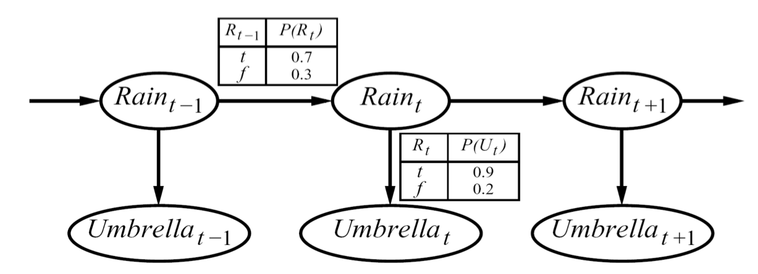
Hidden Markov Models
X₁
X₂
X₃
X₄
X_{N}
X₅
E₁
E₂
E₃
E₄
E_{N}
E₅
An HMM is defined by:
Initial distribution:
Transitions:
Emissions:

Slide 40
Irrelevant variables
Earthquake
Burglary
Alarm
P(J)
= Σ_{M,A,B,E} P(J,M,A,B,E)
= Σ_{M,A,B,E} P(J|A)P(B)P(A|B,E)P(E)P(M|A)
= Σ_{A}P(J|A) Σ_{B}P(B) Σ_{E}P(A|B,E)P(E) Σ_{M}P(M|A)
= Σ_{A}P(J|A) Σ_{B}P(B) Σ_{E}P(A|B,E)P(E)
= Σ_{A}P(J|A) Σ_{B}P(B) f1(A,B)
= Σ_{A}P(J|A) f2(A)
= f3(J)
JohnCalls
MaryCalls
M is irrelevant to the computation
Thm: Y is irrelevant unless Y ϵ Ancestors(Z U E)

Slide 41
Reducing 3-SAT to Bayes Nets

Slide 42
Complexity of Exact Inference
Exact inference is NP hard
3-SAT to Bayes Net Inference
It can count no. of assignments for 3-SAT: #P complete
Inference in tree-structured Bayesian network
Polynomial time
compare with inference in CSPs
Approximate Inference
Sampling based techniques

Slide 43
Summary
Bayes nets compactly encode joint distributions
Guaranteed independencies of distributions can be deduced from BN graph structure
D-separation gives precise conditional independence guarantees from graph alone
A Bayes’ net’s joint distribution may have further (conditional) independence that is not detectable until you inspect its specific distribution

Slide 44
Approximate Inference in Bayes Nets Sampling based methods
(Based on slides by Jack Breese and Daphne Koller)

Slide 45
Bayes Net is a generative model
We can easily generate samples from the distribution represented by the Bayes net
Generate one variable at a time in topological order
Use the samples to compute marginal probabilities, say P(c)

Slide 46
P(B|C)

Slide 47
P(B|C)

Slide 48
P(B|C)

Slide 49
P(B|C)

Slide 50
P(B|C)

Slide 51
P(B|C)

Slide 52
P(B|C)

Slide 53
P(B|C)

Slide 54
P(B|C)

Slide 55
P(B|C)

Slide 56
P(B|C)

Slide 57
P(B|C)

Slide 58
P(B|C)

Slide 59
P(B|C)

Slide 60
P(B|C)

Slide 61
P(B|C)

Slide 62
Rejection Sampling
Sample from the prior
reject if do not match the evidence
Returns consistent posterior estimates
Hopelessly expensive if P(e) is small
P(e) drops off exponentially with no. of evidence vars

Slide 63
Likelihood Weighting
Idea:
fix evidence variables
sample only non-evidence variables
weight each sample by the likelihood of evidence

Slide 64
P(B|C)

Slide 65
P(B|C)

Slide 66
P(B|C)

Slide 67
P(B|C)

Slide 68
P(B|C)

Slide 69
P(B|C)

Slide 70
P(B|C)

Slide 71
P(B|C)

Slide 72
P(B|C)

Slide 73
P(B|C)

Slide 74
Likelihood Weighting
Sampling probability: S(z,e) =
Neither prior nor posterior
Wt for a sample <z,e>:
Weighted Sampling probability S(z,e)w(z,e)
=
= P(z,e)
➔ returns consistent estimates
performance degrades w/ many evidence vars
but a few samples have nearly all the total weight
late occuring evidence vars do not guide sample generation

Slide 75
MCMC with Gibbs Sampling
Fix the values of observed variables
Set the values of all non-observed variables randomly
Perform a random walk through the space of complete variable assignments. On each move:
Pick a variable X
Calculate Pr(X=true | all other variables)
Set X to true with that probability
Repeat many times. Frequency with which any variable X is true is it’s posterior probability.
Converges to true posterior when frequencies stop changing significantly
stable distribution, mixing

Slide 76
Given Markov Blanket, X is Independent of All Other Nodes
MB(X) = Par(X) ∪ Childs(X) ∪ Par(Childs(X))

Slide 77
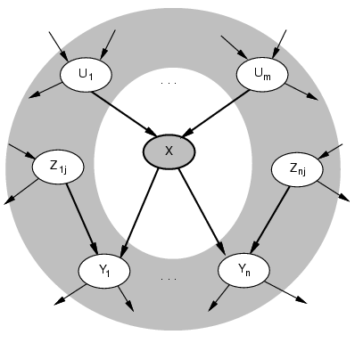
Markov Blanket Sampling
How to calculate Pr(X=true | all other variables) ?
Recall: a variable is independent of all others given it’s Markov Blanket
parents
children
other parents of children
So problem becomes calculating Pr(X=true | MB(X))
We solve this sub-problem exactly
Fortunately, it is easy to solve

Slide 78
Example
A
X
C
B

Slide 79
Example
P(s)
0.2
 | P(g)
s | 0.8
~s | 0.1
Smoking
 | P(h)
s | 0.6
~s | 0.1
Heart disease
Lung disease
Shortness of breath
H | G | P(b)
h | g | 0.9
h | ~g | 0.8
~h | g | 0.7
~h | ~g | 0.1

Slide 80
Example
P(s)
0.2
 | P(g)
s | 0.8
~s | 0.1
Smoking
 | P(h)
s | 0.6
~s | 0.1
Heart disease
Lung disease
Evidence: s, b
Shortness of breath
H | G | P(b)
h | g | 0.9
h | ~g | 0.8
~h | g | 0.7
~h | ~g | 0.1

Slide 81
Example
P(s)
0.2
 | P(g)
s | 0.8
~s | 0.1
Smoking
 | P(h)
s | 0.6
~s | 0.1
Heart disease
Lung disease
Evidence: s, b
Randomly set: h, b
Shortness of breath
H | G | P(b)
h | g | 0.9
h | ~g | 0.8
~h | g | 0.7
~h | ~g | 0.1

Slide 82
Example
P(s)
0.2
 | P(g)
s | 0.8
~s | 0.1
Smoking
 | P(h)
s | 0.6
~s | 0.1
Heart disease
Lung disease
Evidence: s, b
Randomly set: h, g
Sample H using P(H|s,g,b)
Shortness of breath
H | G | P(b)
h | g | 0.9
h | ~g | 0.8
~h | g | 0.7
~h | ~g | 0.1

Slide 83
Example
P(s)
0.2
 | P(g)
s | 0.8
~s | 0.1
Smoking
 | P(h)
s | 0.6
~s | 0.1
Heart disease
Lung disease
Evidence: s, b
Randomly set: ~h, g
Sample H using P(H|s,g,b)
⇒ Suppose result is ~h
Shortness of breath
H | G | P(b)
h | g | 0.9
h | ~g | 0.8
~h | g | 0.7
~h | ~g | 0.1

Slide 84
Example
P(s)
0.2
 | P(g)
s | 0.8
~s | 0.1
Smoking
 | P(h)
s | 0.6
~s | 0.1
Heart disease
Lung disease
Evidence: s, b
Randomly set: ~h, g
Sample H using P(H|s,g,b)
Suppose result is ~h
Sample G using P(G|s,~h,b)
Shortness of breath
H | G | P(b)
h | g | 0.9
h | ~g | 0.8
~h | g | 0.7
~h | ~g | 0.1

Slide 85
Example
P(s)
0.2
 | P(g)
s | 0.8
~s | 0.1
Smoking
 | P(h)
s | 0.6
~s | 0.1
Heart disease
Lung disease
Evidence: s, b
Randomly set: ~h, g
Sample H using P(H|s,g,b)
Suppose result is ~h
Sample G using P(G|s,~h,b)
⇒Suppose result is g
Shortness of breath
H | G | P(b)
h | g | 0.9
h | ~g | 0.8
~h | g | 0.7
~h | ~g | 0.1

Slide 86
Example
P(s)
0.2
 | P(g)
s | 0.8
~s | 0.1
Smoking
 | P(h)
s | 0.6
~s | 0.1
Heart disease
Lung disease
Evidence: s, b
Randomly set: ~h, g
Sample H using P(H|s,g,b)
Suppose result is ~h
Sample G using P(G|s,~h,b)
⇒Suppose result is g
Sample G using P(G|s,~h,b)
Shortness of breath
H | G | P(b)
h | g | 0.9
h | ~g | 0.8
~h | g | 0.7
~h | ~g | 0.1

Slide 87
Example
P(s)
0.2
 | P(g)
s | 0.8
~s | 0.1
Smoking
 | P(h)
s | 0.6
~s | 0.1
Heart disease
Lung disease
Evidence: s, b
Randomly set: ~h, g
Sample H using P(H|s,g,b)
Suppose result is ~h
Sample G using P(G|s,~h,b)
⇒Suppose result is g
Sample G using P(G|s,~h,b)
⇒Suppose result is ~g
Shortness of breath
H | G | P(b)
h | g | 0.9
h | ~g | 0.8
~h | g | 0.7
~h | ~g | 0.1

Slide 88
Gibbs MCMC Summary
number of samples with X=x
P(X|E) =
total number of samples
Advantages:
No samples are discarded
No problem with samples of low weight
Can be implemented very efficiently
10K samples @ second
Disadvantages:
Can get stuck if relationship between vars is deterministic
Many variations devised to make MCMC more robust

Slide 89
Other inference methods
Exact inference
Junction tree
Approximate inference
Belief Propagation
Variational Methods

