Slide 1
CSE 473: Artificial Intelligence Spring 2012
Bayesian Networks
Dan Weld
Many slides adapted from Dan Klein, Stuart Russell, Andrew Moore & Luke Zettlemoyer
1

Slide 2
Outline
Probabilistic models (and inference)
Bayesian Networks (BNs)
Independence in BNs
Efficient Inference in BNs
Learning

Slide 3
Bayes’ Nets: Big Picture
Two problems with using full joint distribution tables as our probabilistic models:
Unless there are only a few variables, the joint is WAY too big to represent explicitly
Hard to learn (estimate) anything empirically about more than a few variables at a time
Bayes’ nets: a technique for describing complex joint distributions (models) using simple, local distributions (conditional probabilities)
More properly called graphical models
We describe how variables locally interact
Local interactions chain together to give global, indirect interactions

Slide 4
Bayes’ Net Semantics
Formally:
A set of nodes, one per variable X
A directed, acyclic graph
A CPT for each node
CPT = “Conditional Probability Table”
Collection of distributions over X, one for each combination of parents’ values
A₁
A_{n}
X
A Bayes net = Topology (graph) + Local Conditional Probabilities

Slide 5
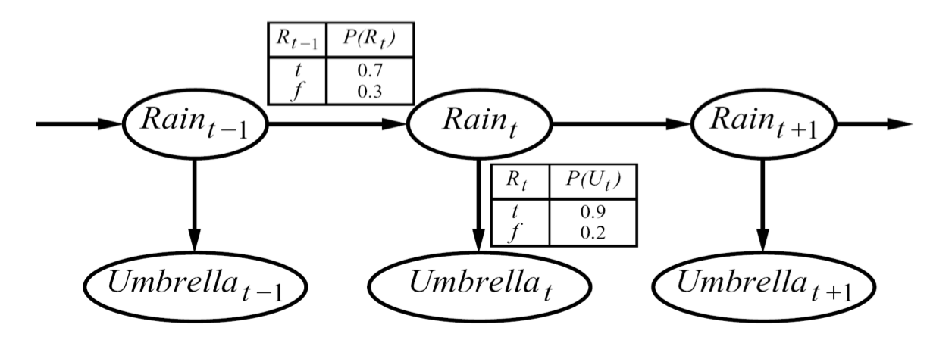
Hidden Markov Models
X₁
X₂
X₃
X₄
X_{N}
X₅
E₁
E₂
E₃
E₄
E_{N}
E₅
An HMM is defined by:
Initial distribution:
Transitions:
Emissions:

Slide 6
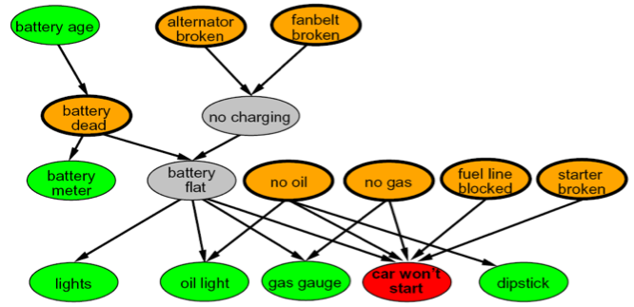
Example Bayes’ Net: Car

Slide 7
Probabilities in BNs
Bayes’ nets implicitly encode joint distributions
As a product of local conditional distributions
To see what probability a BN gives to a full assignment, multiply all the relevant conditionals together:
This lets us reconstruct any entry of the full joint
Not every BN can represent every joint distribution
The topology enforces certain independence assumptions
Compare to the exact decomposition according to the chain rule!

Slide 8
Example: Independence
N fair, independent coin flips:
h | 0.5
t | 0.5
h | 0.5
t | 0.5
h | 0.5
t | 0.5

Slide 9
Example: Coin Flips
N independent coin flips
No interactions between variables: absolute independence
X₁
X₂
X_{n}

Slide 10
Independence
A
A ∧ B
B
Two variables are independent if:
This says that their joint distribution factors into a product of two simpler distributions
Another form:
We write:
?

Slide 11
Independence
A
A ∧ B
B
Two variables are independent if:
This says that their joint distribution factors into a product of two simpler distributions
Another form:
We write:
?

Slide 12
Independence
A
A ∧ B
B
Two variables are independent if:
This says that their joint distribution factors into a product two simpler distributions
Another form:
We write:
Independence is a simplifying modeling assumption
Empirical joint distributions: at best “close” to independent
What could we assume for {Weather, Traffic, Cavity, Toothache}?

Slide 13
Example: Independence?
T | P
warm | 0.25
cold | 0.75
T | W | P
warm | sun | 0.4
warm | rain | 0.1
cold | sun | 0.2
cold | rain | 0.3
T | W
warm | sun | 0.15
warm | rain | 0.10
cold | sun | 0.45
cold | rain | 0.30
W | P
sun | 0.6
rain | 0.4

Slide 14
Conditional Independence
Unconditional (absolute) independence very rare (why?)
Conditional independence is our most basic and robust form of knowledge about uncertain environments:
What about fire, smoke, alarm?

Slide 15
Conditional Independence
Are A & B independent? P(A|B) ? P(A)
≤
A ∧ B
P(A)=(.25+.5)/2
= .375
P(B)= .75
P(A|B)=(.25+.25+.5)/3
=.3333
A
B
© Daniel S. Weld
15

Slide 16
A, B Conditionally Independent Given C
P(A|B,C) = P(A|C) C = spots
A∧C
P(A|C) =.25
C
© Daniel S. Weld
16

Slide 17
A, B Conditionally Independent Given C
P(A|B,C) = P(A|C) C = spots
A∧B∧C
P(A|C) =.25
P(A|B,C)=.25
B∧C
© Daniel S. Weld
17

Slide 18
A, B Conditionally Independent Given ¬C
P(A|B,C) = P(A|C) C = spots
P(A|C) =.25
P(A|B,C)=.25
A∧¬C
A∧B∧¬C
P(A|¬C) =.5
P(A|B,¬C)=.5
B∧¬C
© Daniel S. Weld
18

Slide 19
Conditional Independence
P(Toothache, Cavity, Catch)
If I have a cavity, the probability that the probe catches in it doesn't depend on whether I have a toothache:
P(+catch | +toothache, +cavity) = P(+catch | +cavity)
The same independence holds if I don’t have a cavity:
P(+catch | +toothache, ←cavity) = P(+catch| ←cavity)
Catch is conditionally independent of Toothache given Cavity:
P(Catch | Toothache, Cavity) = P(Catch | Cavity)
Equivalent statements:
P(Toothache | Catch , Cavity) = P(Toothache | Cavity)
P(Toothache, Catch | Cavity) = P(Toothache | Cavity) P(Catch | Cavity)
One can be derived from the other easily

Slide 20
Ghostbusters Chain Rule
2-position maze, each sensor indicates ghost location
T: Top square is red B: Bottom square is red G: Ghost is in the top
P(T,B,G) = P(G) P(T|G) P(B|G)
T | B | G | P(T,B,G)
+t | +b | +g | 0.16
+t | +b | ←g | 0.16
+t | ←b | +g | 0.24
+t | ←b | ←g | 0.04
←t | +b | +g | 0.04
←t | +b | ←g | 0.24
←t | ←b | +g | 0.06
←t | ←b | ←g | 0.06
That means, the two sensors are conditionally independent, given the ghost position
Can assume:
P( +g ) = 0.5
P( +t | +g ) = 0.8 P( +t | ←g ) = 0.4 P( +b | +g ) = 0.4 P( +b | ←g ) = 0.8

Slide 21
Example: Traffic
Variables:
R: It rains
T: There is traffic
Model 1: independence
Model 2: rain is conditioned on traffic
Why is an agent using model 2 better?
Model 3: traffic is conditioned on rain
Is this better than model 2?

Slide 22
Example: Alarm Network
Variables
B: Burglary
A: Alarm goes off
M: Mary calls
J: John calls
E: Earthquake!
How big is joint distribution?
2^{n}-1 = 31 parameters

Slide 23
Example: Alarm Network
Only 10 params
E | P(E)
+e | 0.002
←e | 0.998
B | P(B)
+b | 0.001
←b | 0.999
Burglary
Earthqk
Alarm
B | E | A | P(A|B,E)
+b | +e | +a | 0.95
+b | +e | ←a | 0.05
+b | ←e | +a | 0.94
+b | ←e | ←a | 0.06
←b | +e | +a | 0.29
←b | +e | ←a | 0.71
←b | ←e | +a | 0.001
←b | ←e | ←a | 0.999
John calls
Mary calls
A | J | P(J|A)
+a | +j | 0.9
+a | ←j | 0.1
←a | +j | 0.05
←a | ←j | 0.95
A | M | P(M|A)
+a | +m | 0.7
+a | ←m | 0.3
←a | +m | 0.01
←a | ←m | 0.99

Slide 24
Example: Traffic II
Let’s build a graphical model
Variables
T: Traffic
R: It rains
L: Low pressure
D: Roof drips
B: Ballgame
C: Cavity

Slide 25
Changing Bayes’ Net Structure
The same joint distribution can be encoded in many different Bayes’ nets
Analysis question: given some edges, what other edges do you need to add?
One answer: fully connect the graph
Better answer: don’t make any false conditional independence assumptions

Slide 26
Example: Independence
For this graph, you can fiddle with θ (the CPTs) all you want, but you won’t be able to represent any distribution in which the flips are dependent!
X₁
X₂
h | 0.5
t | 0.5
h | 0.5
t | 0.5
All distributions

Slide 27
Example: Coins
Extra arcs don’t prevent representing independence, just allow non-independence
X₁
X₂
X₁
X₂
h | 0.5
t | 0.5
h | 0.5
t | 0.5
h | 0.5
t | 0.5
h | h | 0.5
t | h | 0.5
Adding unneeded arcs isn’t wrong, it’s just inefficient
h | t | 0.5
t | t | 0.5

Slide 28
Topology Limits Distributions
Given some graph topology G, only certain joint distributions can be encoded
The graph structure guarantees certain (conditional) independences
(There might be more independence)
Adding arcs increases the set of distributions, but has several costs
Full conditioning can encode any distribution
Y
X
Z
Y
X
Z
Y
X
Z

Slide 29
Independence in a BN
Important question about a BN:
Are two nodes independent given certain evidence?
If yes, can prove using algebra (tedious in general)
If no, can prove with a counter example
Example:
X
Y
Z
Question: are X and Z independent?
Answer: no.
Example: low pressure causes rain, which causes traffic.
Knowledge about X may change belief in Z,
Knowledge about Z may change belief in X (via Y)
Addendum: they could be independent: how?

Slide 30
Causal Chains
This configuration is a “causal chain”
Is X independent of Z given Y?
X: Low pressure
Y: Rain
Z: Traffic
X
Y
Z
Yes!
Evidence along the chain “blocks” the influence

Slide 31
Common Parent
Another basic configuration: two effects of the same parent
Are X and Z independent?
Y
X
Z
Y: Project due
X: Forum busy
Z: Lab full

Slide 32
Common Parent
Another basic configuration: two effects of the same parent
Are X and Z independent?
Are X and Z independent given Y?
Y
X
Z
Y: Project due
X: Forum busy
Z: Lab full
Yes!
Observing the cause blocks influence between effects.

Slide 33
Common Effect
Last configuration: two causes of one effect (v-structures)
Are X and Z independent?
X
Z
Yes: the ballgame and the rain cause traffic, but they are not correlated
Still need to prove they must be (try it!)
Y
X: Raining
Z: Ballgame
Y: Traffic

Slide 34
Common Effect
Last configuration: two causes of one effect (v-structures)
Are X and Z independent?
X
Z
Yes: the ballgame and the rain cause traffic, but they are not correlated
Still need to prove they must be (try it!)
Y
Are X and Z independent given Y?
X: Raining
Z: Ballgame
Y: Traffic
No: seeing traffic puts the rain and the ballgame in competition as explanation!
This is backwards from the other cases
Observing an effect activates influence between possible causes.

Slide 35
The General Case
Any complex example can be analyzed using these three canonical cases
General question: in a given BN, are two variables independent (given evidence)?
Solution: analyze the graph

Slide 36
Reachability
Recipe: shade evidence nodes
Attempt 1: if two nodes are connected by an undirected path not blocked by a shaded node, they are conditionally independent
L
R
B
Almost works, but not quite
Where does it break?
Answer: the v-structure at T doesn’t count as a link in a path unless “active”
D
T

Slide 37
Reachability (D-Separation)
Question: Are X and Y conditionally independent given evidence vars {Z}?
Yes, if X and Y “separated” by Z
Look for active paths from X to Y
No active paths = independence!
A path is active if each triple is active:
Causal chain A ◊ B ◊ C where B is unobserved (either direction)
Common cause A ⇓ B ◊ C where B is unobserved
Common effect (aka v-structure)
A ◊ B ⇓ C where B or one of its descendents is observed
All it takes to block a path is a single inactive segment
Active Triples
Inactive Triples

Slide 38
Example: Independent?
Active Segments
Yes
R
B
T
T’

Slide 39
Example: Independent?
Active Segments
L
Yes
R
B
Yes
D
T
Yes
T’

Slide 40
Example
Active Segments
Variables:
R: Raining
T: Traffic
D: Roof drips
S: I’m sad
Questions:
R
T
D
S
Yes

Slide 41
Summary
Bayes nets compactly encode joint distributions
Guaranteed independencies of distributions can be deduced from BN graph structure
D-separation gives precise conditional independence guarantees from graph alone
A Bayes’ net’s joint distribution may have further (conditional) independence that is not detectable until you inspect its specific distribution

Slide 42
Bayes’ Nets
So far: how a Bayes’ net encodes a joint distribution
Next: how to answer queries about that distribution
Key idea: conditional independence
Last class: assembled BNs using an intuitive notion of conditional independence as causality
Today: formalize these ideas
Main goal: answer queries about conditional independence and influence
After that: how to answer numerical queries (inference)

