Slide 1
CSE 473: Artificial Intelligence
Spring 2012
Reasoning about Uncertainty
&
Hidden Markov Models
Daniel Weld
Many slides adapted from Dan Klein, Stuart Russell, Andrew Moore & Luke Zettlemoyer
1

Slide 2
Stop!
Use lecture 23 version instead

Slide 3
Outline
Probability review
  Random Variables and Events
  Joint / Marginal / Conditional Distributions
  Product Rule, Chain Rule, Bayes’ Rule
  Probabilistic Inference
Probabilistic sequence models (and inference)
  Markov Chains
  Hidden Markov Models
  Particle Filters

Slide 4
Probability Review
Probability
  Random Variables
  Joint and Marginal Distributions
  Conditional Distribution
  Product Rule, Chain Rule, Bayes’ Rule
  Inference
You’ll need all this stuff A LOT for the next few weeks, so make sure you go over it now!

Slide 5

Planning in Belief Space
  Pr(heat | s_{eb}) = 1.0
  Pr(heat | s_{wb}) = 0.2
Observe:
¬heat
sign
sign
100%
0%
S
sign
sign
50%
50%
heat
sign
sign
17%
83%

Slide 6
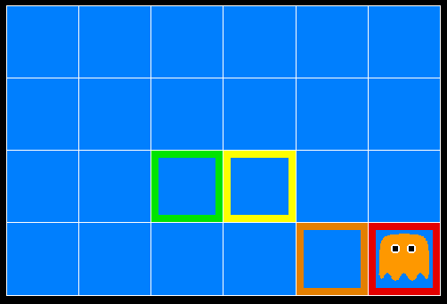
Inference in Ghostbusters
A ghost is in the grid somewhere
Sensor readings tell how close a square is to the ghost
  On the ghost: red
  1 or 2 away: orange
  3 or 4 away: yellow
  5+ away: green
Sensors are noisy, but we know P(Color | Distance)
P(red | 3) | P(orange | 3) | P(yellow | 3) | P(green | 3)
0.05 | 0.15 | 0.5 | 0.3

Slide 7
Random Variables
A random variable is some aspect of the world about which we (may) have uncertainty
  R = Is it raining?
  D = How long will it take to drive to work?
  L = Where am I?
We denote random variables with capital letters
Random variables have domains
  R in {true, false}
  D in [0, 1)
  L in possible locations, maybe {(0,0), (0,1), …}

Slide 8




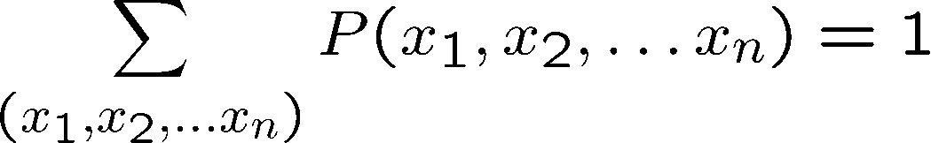
Joint Distributions
A joint distribution over a set of random variables:
specifies a real number for each outcome (ie each assignment):
  Size of distribution if n variables with domain sizes d?
T | W | P
hot | sun | 0.4
hot | rain | 0.1
cold | sun | 0.2
cold | rain | 0.3
  Must obey:
A probabilistic model is a joint distribution over variables of interest
For all but the smallest distributions, impractical to write out

Slide 9
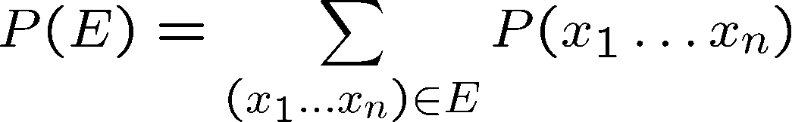
Events
An outcome is a joint assignment for all the variables
An event is a set E of outcomes
T | W | P
hot | sun | 0.4
hot | rain | 0.1
cold | sun | 0.2
cold | rain | 0.3
From a joint distribution, we can calculate the probability of any event
  Probability that it’s hot AND sunny?
  Probability that it’s hot?
  Probability that it’s hot OR sunny?

Slide 10
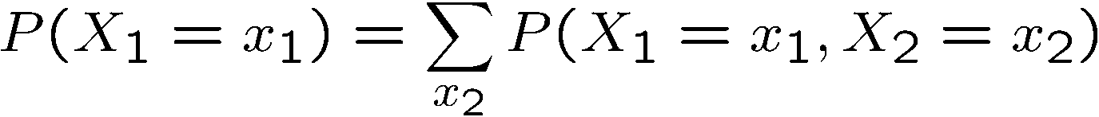




Marginal Distributions
Marginal distributions are sub-tables which eliminate variables
Marginalization (summing out): Combine collapsed rows by adding
T | P
hot | 0.5
cold | 0.5
T | W | P
hot | sun | 0.4
hot | rain | 0.1
cold | sun | 0.2
cold | rain | 0.3
W | P
sun | 0.6
rain | 0.4

Slide 11



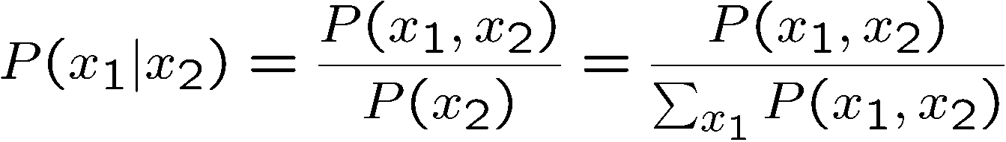
Conditional Distributions
Conditional distributions are probability distributions over some variables given fixed values of others
Conditional Distributions
Joint Distribution
W | P
sun | 0.8
rain | 0.2
T | W | P
hot | sun | 0.4
hot | rain | 0.1
cold | sun | 0.2
cold | rain | 0.3
W | P
sun | 0.4
rain | 0.6
Notes:
review normalization trick here

Slide 12


Normalization Trick
A trick to get a whole conditional distribution at once:
  Select the joint probabilities matching the evidence
  Normalize the selection (make it sum to one)
Select
Normalize
T | W | P
hot | sun | 0.4
hot | rain | 0.1
cold | sun | 0.2
cold | rain | 0.3
T | R | P
hot | rain | 0.1
cold | rain | 0.3
T | P
hot | 0.25
cold | 0.75
  Why does this work? Sum of selection is P(evidence)! (P(r), here)

Slide 13
Probabilistic Inference
Probabilistic inference: compute a desired probability from other known probabilities (e.g. conditional from joint)
We generally compute conditional probabilities
  P(on time | no reported accidents) = 0.90
  These represent the agent’s beliefs given the evidence
Probabilities change with new evidence:
  P(on time | no accidents, 5 a.m.) = 0.95
  P(on time | no accidents, 5 a.m., raining) = 0.80
  Observing new evidence causes beliefs to be updated

Slide 14
Inference by Enumeration
P(sun)?
S | T | W | P
summer | hot | sun | 0.30
summer | hot | rain | 0.05
summer | cold | sun | 0.10
summer | cold | rain | 0.05
winter | hot | sun | 0.10
winter | hot | rain | 0.05
winter | cold | sun | 0.15
winter | cold | rain | 0.20

Slide 15
Inference by Enumeration
P(sun)?
P(sun | winter)?
S | T | W | P
summer | hot | sun | 0.30
summer | hot | rain | 0.05
summer | cold | sun | 0.10
summer | cold | rain | 0.05
winter | hot | sun | 0.10
winter | hot | rain | 0.05
winter | cold | sun | 0.15
winter | cold | rain | 0.20

Slide 16
Inference by Enumeration
P(sun)?
P(sun | winter)?
P(sun | winter, hot)?
S | T | W | P
summer | hot | sun | 0.30
summer | hot | rain | 0.05
summer | cold | sun | 0.10
summer | cold | rain | 0.05
winter | hot | sun | 0.10
winter | hot | rain | 0.05
winter | cold | sun | 0.15
winter | cold | rain | 0.20

Slide 17





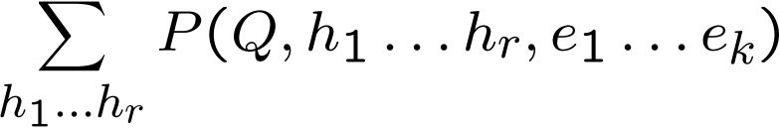

Inference by Enumeration
General case:
  Evidence variables:
  Query* variable:
  Hidden variables:
We want:
All variables
First, select the entries consistent with the evidence
Second, sum out H to get joint of Query and evidence:
Finally, normalize the remaining entries to conditionalize
Obvious problems:
  Worst-case time complexity O(d^{n})
  Space complexity O(d^{n}) to store the joint distribution

Slide 18
Supremacy of the Joint Distribution
P(sun)?
P(sun | winter)?
P(sun | winter, hot)?
S | T | W | P
summer | hot | sun | 0.30
summer | hot | rain | 0.05
summer | cold | sun | 0.10
summer | cold | rain | 0.05
winter | hot | sun | 0.10
winter | hot | rain | 0.05
winter | cold | sun | 0.15
winter | cold | rain | 0.20

Slide 19




The Product Rule
Sometimes have conditional distributions but want the joint
Example:
D | W | P
wet | sun | 0.08
dry | sun | 0.72
wet | rain | 0.14
dry | rain | 0.06
D | W | P
wet | sun | 0.1
dry | sun | 0.9
wet | rain | 0.7
dry | rain | 0.3
R | P
sun | 0.8
rain | 0.2

Slide 20
The Product Rule
Sometimes have conditional distributions but want the joint
Example:
W
D

Slide 21
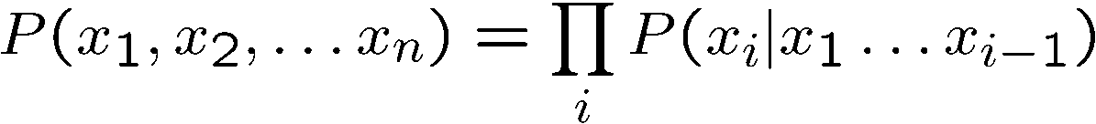
The Chain Rule
More generally, can always write any joint distribution as an incremental product of conditional distributions

Slide 22


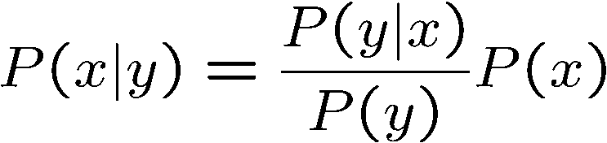
Bayes’ Rule
Two ways to factor a joint distribution over two variables:
Dividing, we get:
That’s my rule!
Why is this at all helpful?
  Lets us build a conditional from its reverse
  Often one conditional is tricky but the other one is simple
  Foundation of many systems we’ll see later
In the running for most important AI equation!

Slide 23
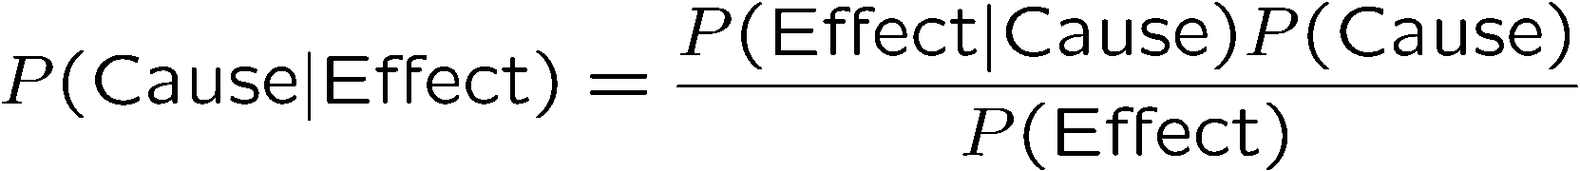



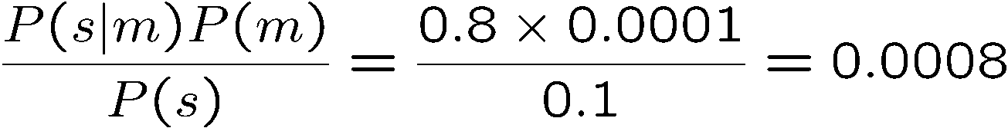

Inference with Bayes’ Rule
Example: Diagnostic probability from causal probability:
Example:
  m is meningitis, s is stiff neck
Example
givens
  Note: posterior probability of meningitis still very small
  Note: you should still get stiff necks checked out! Why?

Slide 24
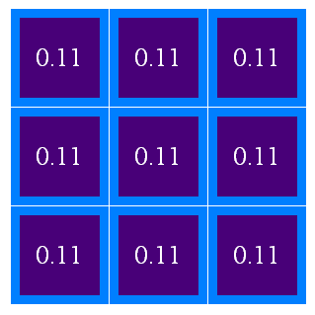
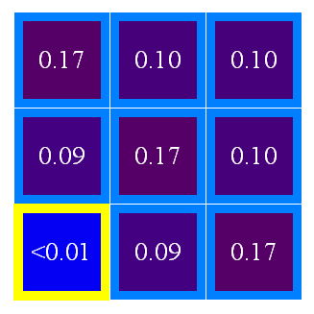

Ghostbusters, Revisited
Let’s say we have two distributions:
  Prior distribution over ghost location: P(G)
    Let’s say this is uniform
  Sensor reading model: P(R | G)
    Given: we know what our sensors do
    R = reading color measured at (1,1)
    E.g. P(R = yellow | G=(1,1)) = 0.1
We can calculate the posterior distribution P(G|r) over ghost locations given a reading using Bayes’ rule:

Slide 25


Markov Models (Markov Chains)
A Markov model is:
  a MDP with no actions (and no rewards)
  a chain-structured Bayesian Network (BN)
X₁
X₂
X₃
X₄
X_{N}
A Markov model includes:
    Random variables X_{t} for all time steps t (the state)
    Parameters: called transition probabilities or dynamics, specify how the state evolves over time (also, initial probs)
    and

Slide 26
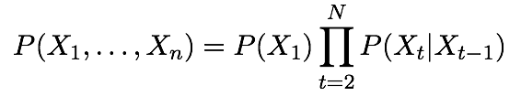
Markov Models (Markov Chains)
X₁
X₂
X₃
X₄
X_{N}
A Markov model defines
  a joint probability distribution:
One common inference problem:
  Compute marginals P(X_{t}) for all time steps t

Slide 27
Conditional Independence
X₁
X₂
X₃
X₄
Basic conditional independence:
  Past and future independent of the present
  Each time step only depends on the previous
  This is called the (first order) Markov property
Note that the chain is just a (growing) BN
  We can always use generic BN reasoning on it if we truncate the chain at a fixed length

Slide 28
Example: Markov Chain
Weather:
  States: X = {rain, sun}
  Transitions:
  Initial distribution: 1.0 sun
  What’s the probability distribution after one step?
0.9
0.1
rain
sun
0.1
0.9
This is a conditional distribution

Slide 29
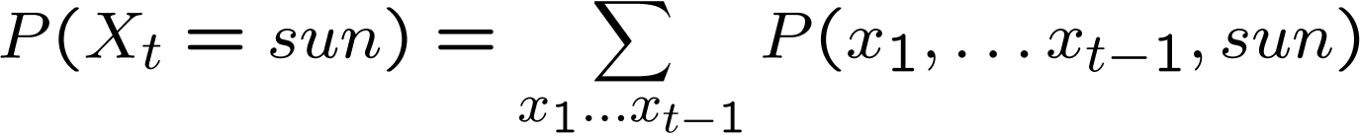
Markov Chain Inference
Question: probability of being in state x at time t?
Slow answer:
  Enumerate all sequences of length t which end in s
  Add up their probabilities
…

Slide 30
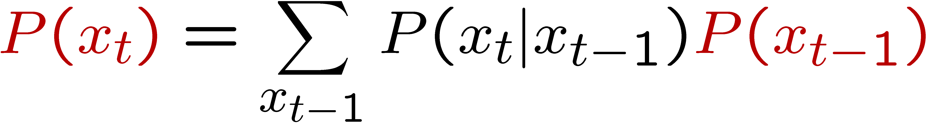

Mini-Forward Algorithm
Question: What’s P(X) on some day t?
  We don’t need to enumerate every sequence!
sun
sun
sun
sun
rain
rain
rain
rain
Forward simulation

Slide 31
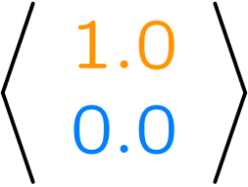
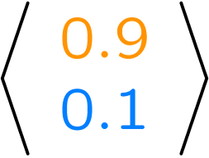
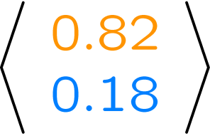
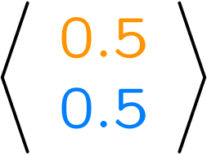
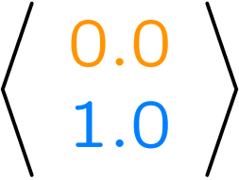
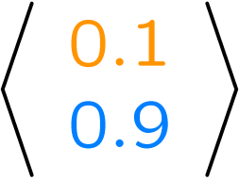
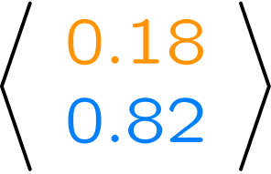
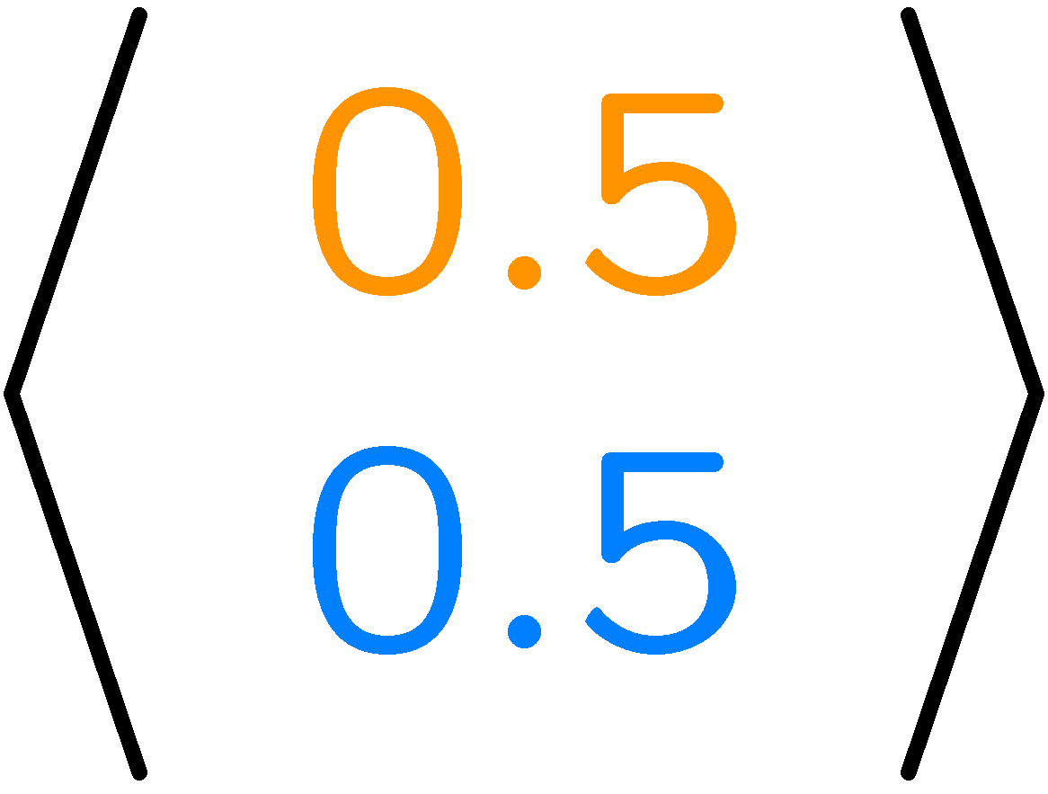
Example
From initial observation of sun
From initial observation of rain
P(X₁)
P(X₂)
P(X₃)
P(X∞)
P(X₁)
P(X₂)
P(X₃)
P(X∞)

Slide 32
Stationary Distributions
If we simulate the chain long enough:
  What happens?
  Uncertainty accumulates
  Eventually, we have no idea what the state is!
Stationary distributions:
  For most chains, the distribution we end up in is independent of the initial distribution
  Called the stationary distribution of the chain
  Usually, can only predict a short time out

Slide 33

Pac-man Markov Chain
Pac-man knows the ghost’s initial position, but gets no observations!

Slide 34
Web Link Analysis
PageRank over a web graph
  Each web page is a state
  Initial distribution: uniform over pages
  Transitions:
    With prob. c, uniform jump to a
    random page (dotted lines, not all shown)
    With prob. 1-c, follow a random
    outlink (solid lines)
Stationary distribution
  Will spend more time on highly reachable pages
  E.g. many ways to get to the Acrobat Reader download page
  Somewhat robust to link spam
  Google 1.0 returned the set of pages containing all your keywords in decreasing rank, now all search engines use link analysis along with many other factors (rank actually getting less important over time)

Slide 35
Hidden Markov Models
Markov chains not so useful for most agents
  Eventually you don’t know anything anymore
  Need observations to update your beliefs
Hidden Markov models (HMMs)
  Underlying Markov chain over states S
  You observe outputs (effects) at each time step
  POMDPs without actions (or rewards).
  As a Bayes’ net:
X₁
X₂
X₃
X₄
X_{N}
X₅
E₁
E₂
E₃
E₄
E_{N}
E₅

Slide 36
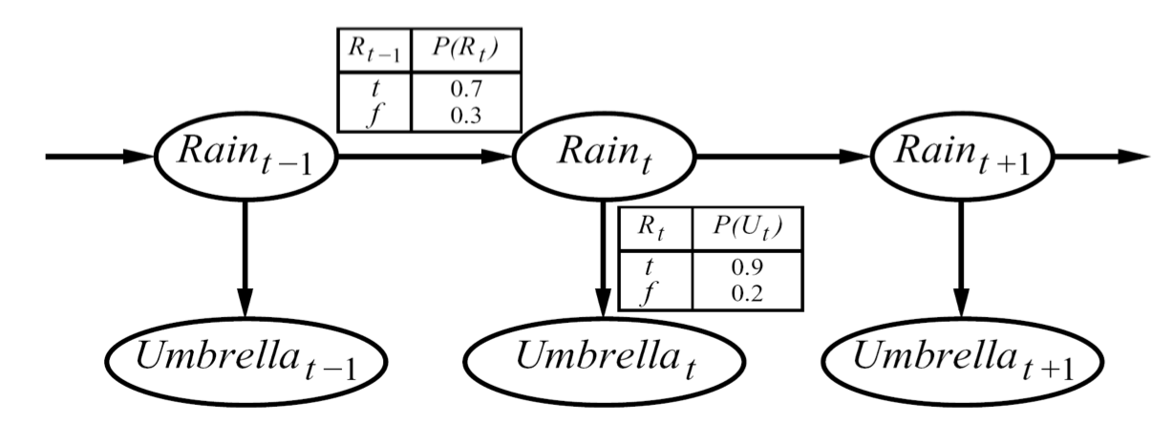


Example
An HMM is defined by:
  Initial distribution:
  Transitions:
  Emissions:

Slide 37



Hidden Markov Models
X₁
X₂
X₃
X₄
X_{N}
X₅
E₁
E₂
E₃
E₄
E_{N}
E₅
Defines a joint probability distribution:

Slide 38
Ghostbusters HMM
P(X₁) = uniform
P(X’|X) = usually move clockwise, but sometimes move in a random direction or stay in place
P(E|X) = same sensor model as before:
red means close, green means far away.
1/9
1/9
1/9
1/9
1/9
1/9
1/9
1/9
1/9
P(X₁)
1/6
1/6
1/2
X₁
X₂
X₃
X₄
0
1/6
0
X₅
0
0
0
E₁
E₁
E₃
E₄
P(X’|X=<1,2>)
E₅

Slide 39
HMM Computations
Given
  joint P(X_{1:n},E_{1:n})
  evidence E_{1:n} =e_{1:n}
Inference problems include:
  Filtering, find P(X_{t}|e_{1:t}) for all t
  Smoothing, find P(X_{t}|e_{1:n}) for all t
  Most probable explanation, find
      x*_{1:n} = argmaxx_{1:n} P(x_{1:n}|e_{1:n})

Slide 40
Conditional Independence
HMMs have two important independence properties:
  Markov hidden process, future depends on past via the present
  Current observation independent of all else given current state
Quiz: does this mean that observations are independent given no evidence?
  [No, correlated by the hidden state]
X₁
X₂
X₃
X₄
X₅
E₁
E₂
E₃
E₄
E₅

Slide 41
Real HMM Examples
Speech recognition HMMs:
  Observations are acoustic signals (continuous valued)
  States are specific positions in specific words (so, tens of thousands)
Machine translation HMMs:
  Observations are words (tens of thousands)
  States are translation options
Robot tracking:
  Observations are range readings (continuous)
  States are positions on a map (continuous)

Slide 42
Filtering / Monitoring
Filtering, or monitoring, is the task of tracking the distribution B(X) (the belief state) over time
We start with B(X) in an initial setting, usually uniform
As time passes, or we get observations, we update B(X)
The Kalman filter was invented in the 60’s and first implemented as a method of trajectory estimation for the Apollo program

Slide 43
Example: Robot Localization
Example from Michael Pfeiffer
Prob
0
1
t=0
Sensor model: never more than 1 mistake
Motion model: may not execute action with small prob.

Slide 44
Example: Robot Localization
Prob
0
1
t=1

Slide 45
Example: Robot Localization
Prob
0
1
t=2

Slide 46
Example: Robot Localization
Prob
0
1
t=3

Slide 47
Example: Robot Localization
Prob
0
1
t=4

Slide 48
Example: Robot Localization
Prob
0
1
t=5

Slide 49


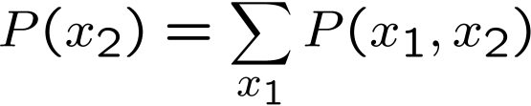

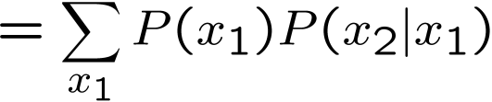

Inference Recap: Simple Cases
X₁
X₁
X₂
E₁

Slide 50
Online Belief Updates
Every time step, we start with current P(X | evidence)
We update for time:
We update for evidence:
The forward algorithm does both at once (and doesn’t normalize)
Problem: space is |X| and time is |X|² per time step
X₁
X₂
X₂
E₂

Slide 51

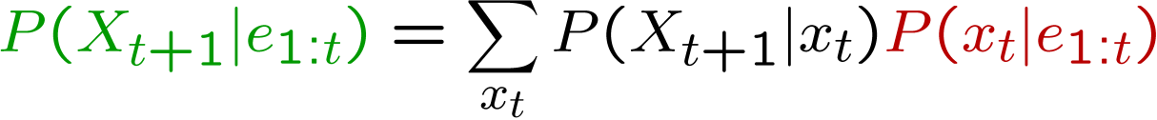
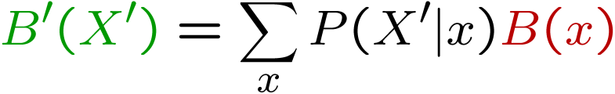
Passage of Time
Assume we have current belief P(X | evidence to date)
Then, after one time step passes:
Or, compactly:
Basic idea: beliefs get “pushed” through the transitions
  With the “B” notation, we have to be careful about what time step t the belief is about, and what evidence it includes
X₁
X₂

Slide 52
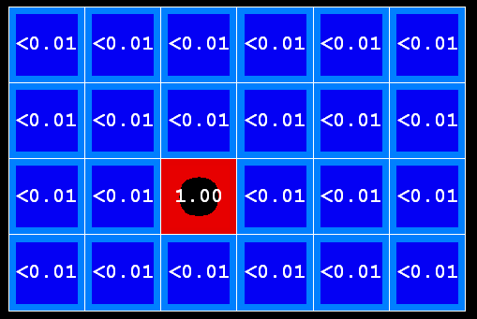

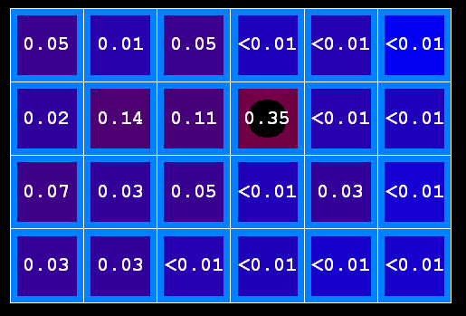
Example: Passage of Time
As time passes, uncertainty “accumulates”
T = 1
T = 2
T = 5
Transition model: ghosts usually go clockwise

Slide 53

Observation
Assume we have current belief P(X | previous evidence):
Then:
Or:
Basic idea: beliefs reweighted by likelihood of evidence
Unlike passage of time, we have to renormalize
X₁
E₁

Slide 54
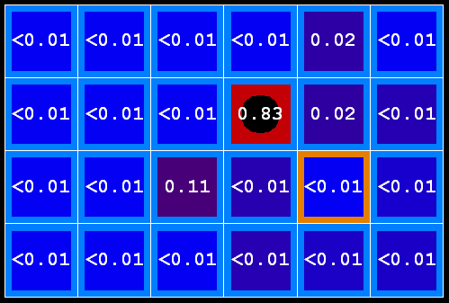

Example: Observation
As we get observations, beliefs get reweighted, uncertainty “decreases”
Before observation
After observation

Slide 55

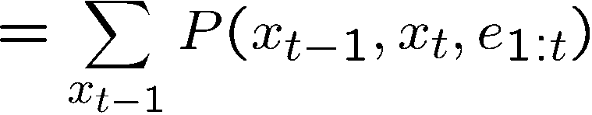
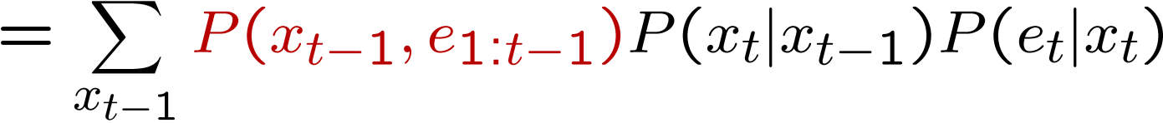
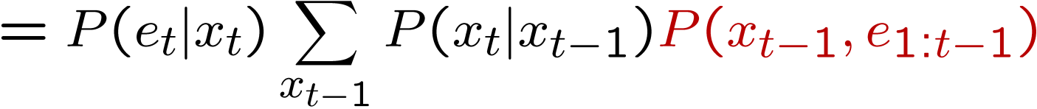
The Forward Algorithm
We to know:
We can derive the following updates
To get , compute each entry and normalize

Slide 56
Example: Run the Filter
An HMM is defined by:
  Initial distribution:
  Transitions:
  Emissions:

Slide 57
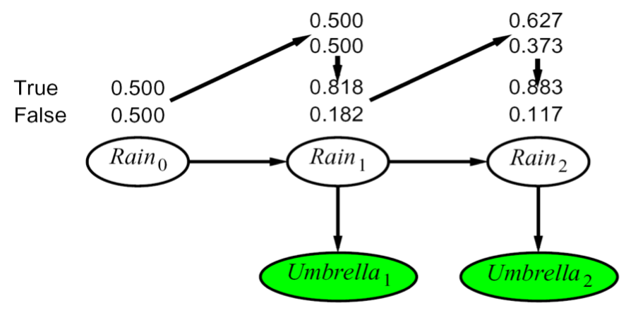
Example HMM

Slide 58
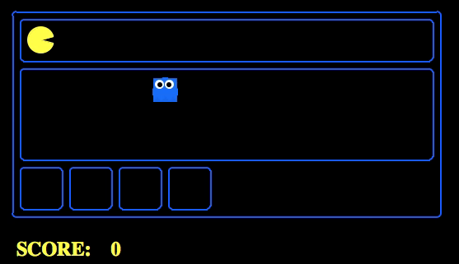
Example Pac-man

Slide 59
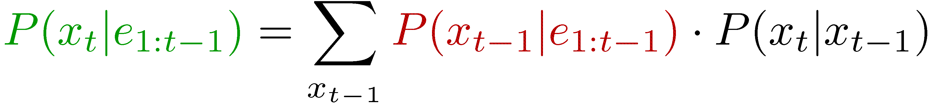
Summary: Filtering
Filtering is the inference process of finding a distribution over X_{T} given e₁ through e_{T} : P( X_{T} | e_{1:t} )
We first compute P( X₁ | e₁ ):
For each t from 2 to T, we have P( X_{t-1} | e_{1:t-1} )
Elapse time: compute P( X_{t} | e_{1:t-1} )
Observe: compute P(X_{t} | e_{1:t-1} , e_{t}) = P( X_{t} | e_{1:t} )

Slide 60


Recap: Reasoning Over Time
Stationary Markov models
0.3
0.7
rain
sun
X₁
X₂
X₃
X₄
0.7
0.3
Hidden Markov models
X | E | P
rain | umbrella | 0.9
rain | no umbrella | 0.1
sun | umbrella | 0.2
sun | no umbrella | 0.8
X₁
X₂
X₃
X₄
X₅
E₁
E₂
E₃
E₄
E₅

Slide 61

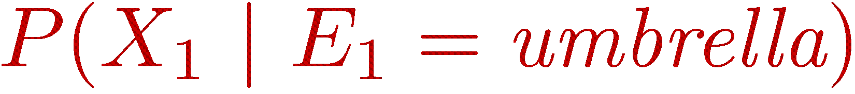
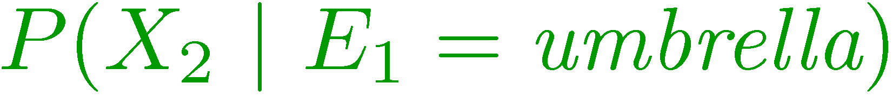
Recap: Filtering
Elapse time: compute P( X_{t} | e_{1:t-1} )
Observe: compute P( X_{t} | e_{1:t} )
Belief: <P(rain), P(sun)>
X₁
X₂
<0.5, 0.5>
Prior on X₁
<0.82, 0.18>
Observe
E₁
E₂
<0.63, 0.37>
Elapse time
<0.88, 0.12>
Observe

Slide 62
Particle Filtering
Sometimes |X| is too big to use exact inference
  |X| may be too big to even store B(X)
  E.g. X is continuous
  |X|² may be too big to do updates
Solution: approximate inference
  Track samples of X, not all values
  Samples are called particles
  Time per step is linear in the number of samples
  But: number needed may be large
  In memory: list of particles, not states
This is how robot localization works in practice
0.0
0.1
0.0
0.0
0.0
0.2
0.0
0.2
0.5

Slide 63
Representation: Particles
Our representation of P(X) is now a list of N particles (samples)
  Generally, N << |X|
  Storing map from X to counts would defeat the point
P(x) approximated by number of particles with value x
  So, many x will have P(x) = 0!
  More particles, more accuracy
For now, all particles have a weight of 1
Particles:
(3,3)
(2,3)
(3,3)
(3,2)
(3,3)
(3,2)
(2,1)
(3,3)
(3,3)
(2,1)

Slide 64

Particle Filtering: Elapse Time
Each particle is moved by sampling its next position from the transition model
  This is like prior sampling – samples’ frequencies reflect the transition probs
  Here, most samples move clockwise, but some move in another direction or stay in place
This captures the passage of time
  If we have enough samples, close to the exact values before and after (consistent)

Slide 65


Particle Filtering: Observe
Slightly trickier:
  Don’t do rejection sampling (why not?)
  We don’t sample the observation, we fix it
  This is similar to likelihood weighting, so we downweight our samples based on the evidence
  Note that, as before, the probabilities don’t sum to one, since most have been downweighted (in fact they sum to an approximation of P(e))

Slide 66
Particle Filtering: Resample
Old Particles:
(3,3) w=0.1
(2,1) w=0.9
(2,1) w=0.9
(3,1) w=0.4
(3,2) w=0.3
(2,2) w=0.4
(1,1) w=0.4
(3,1) w=0.4
(2,1) w=0.9
(3,2) w=0.3
Rather than tracking weighted samples, we resample
N times, we choose from our weighted sample distribution (i.e. draw with replacement)
This is equivalent to renormalizing the distribution
Now the update is complete for this time step, continue with the next one
New Particles:
(2,1) w=1
(2,1) w=1
(2,1) w=1
(3,2) w=1
(2,2) w=1
(2,1) w=1
(1,1) w=1
(3,1) w=1
(2,1) w=1
(1,1) w=1

Slide 67
Recap: Particle Filtering
At each time step t, we have a set of N particles / samples
Initialization: Sample from prior, reweight and resample
Three step procedure, to move to time t+1:
  Sample transitions: for each each particle x, sample next state
  Reweight: for each particle, compute its weight given the actual observation e
  Resample: normalize the weights, and sample N new particles from the resulting distribution over states

Slide 68

Particle Filtering Summary
Represent current belief P(X | evidence to date) as set of n samples (actual assignments X=x)
For each new observation e:
  Sample transition, once for each current particle x
  For each new sample x’, compute importance weights for the new evidence e:
  Finally, normalize the importance weights and resample N new particles

Slide 69
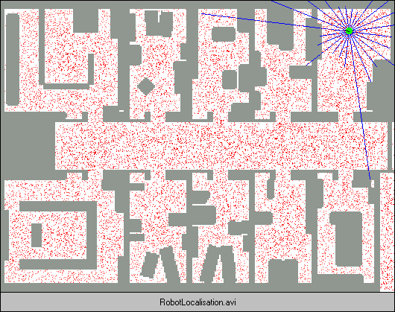
Robot Localization
In robot localization:
  We know the map, but not the robot’s position
  Observations may be vectors of range finder readings
  State space and readings are typically continuous (works basically like a very fine grid) and so we cannot store B(X)
  Particle filtering is a main technique

Slide 70
Robot Localization

Slide 71
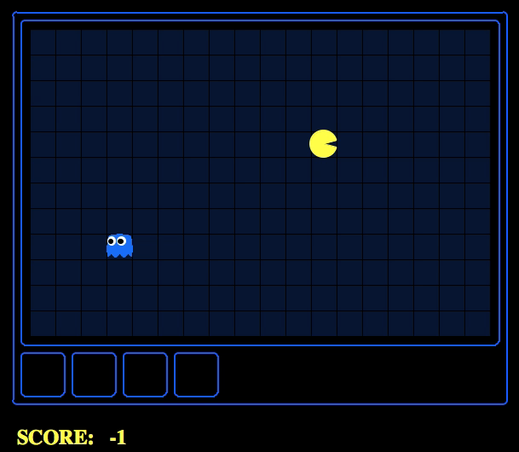
Which Algorithm?
Exact filter, uniform initial beliefs

Slide 72
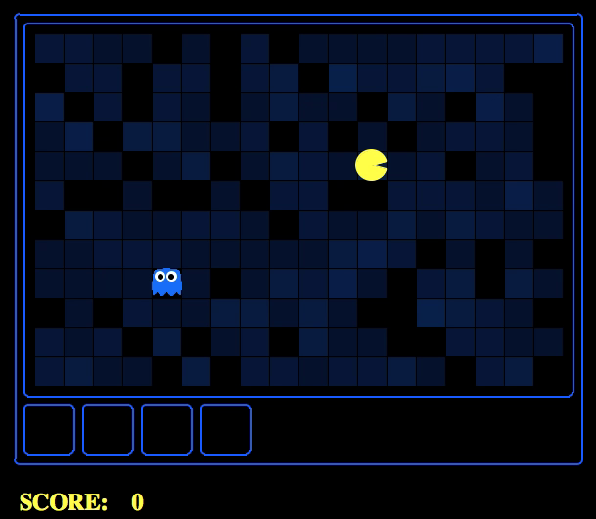
Which Algorithm?
Particle filter, uniform initial beliefs, 300 particles

Slide 73
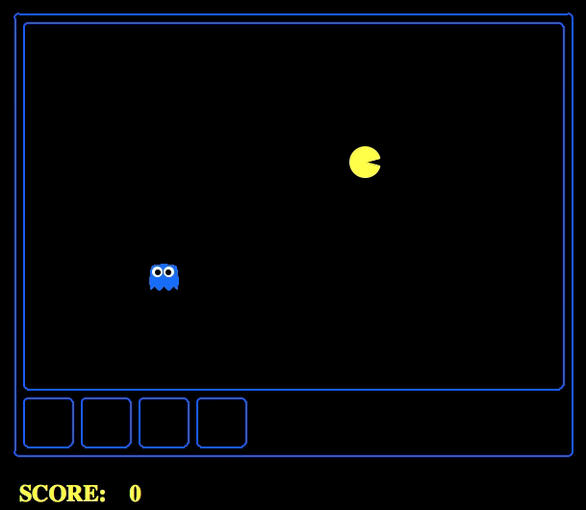
Which Algorithm?
Particle filter, uniform initial beliefs, 25 particles

Slide 74
P4: Ghostbusters
Noisy distance prob
True distance = 8
Plot: Pacman's grandfather, Grandpac, learned to hunt ghosts for sport.
He was blinded by his power, but could hear the ghosts’ banging and clanging.
Transition Model: All ghosts move randomly, but are sometimes biased
Emission Model: Pacman knows a “noisy” distance to each ghost

Slide 75
Dynamic Bayes Nets (DBNs)
We want to track multiple variables over time, using multiple sources of evidence
Idea: Repeat a fixed Bayes net structure at each time
Variables from time t can condition on those from t-1
Discrete valued dynamic Bayes nets are also HMMs
t =1
t =2
t =3
G₁ª
G₂ª
G₃ª
G₁^{b}
G₂^{b}
G₃^{b}
E₁ª
E₁^{b}
E₂ª
E₂^{b}
E₃ª
E₃^{b}

Slide 76
Exact Inference in DBNs
Variable elimination applies to dynamic Bayes nets
Procedure: “unroll” the network for T time steps, then eliminate variables until P(X_{T}|e_{1:T}) is computed
Online belief updates: Eliminate all variables from the previous time step; store factors for current time only
t =1
t =2
t =3
G₁ª
G₂ª
G₃ª
G₃^{b}
G₁^{b}
G₂^{b}
G₃^{b}
E₁ª
E₁^{b}
E₂ª
E₂^{b}
E₃ª
E₃^{b}

Slide 77
DBN Particle Filters
A particle is a complete sample for a time step
Initialize: Generate prior samples for the t=1 Bayes net
  Example particle: G₁ª = (3,3) G₁^{b} = (5,3)
Elapse time: Sample a successor for each particle
  Example successor: G₂ª = (2,3) G₂^{b} = (6,3)
Observe: Weight each entire sample by the likelihood of the evidence conditioned on the sample
  Likelihood: P(E₁ª |G₁ª ) * P(E₁^{b} |G₁^{b} )
Resample: Select prior samples (tuples of values) in proportion to their likelihood

Slide 78
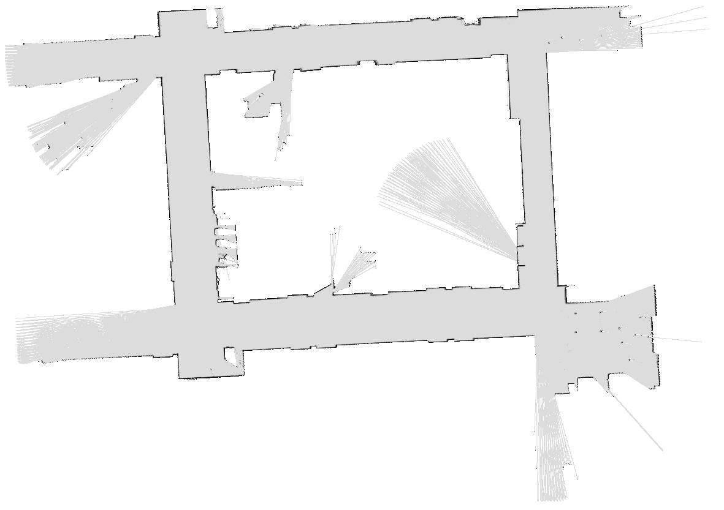
SLAM
SLAM = Simultaneous Localization And Mapping
  We do not know the map or our location
  Our belief state is over maps and positions!
  Main techniques: Kalman filtering (Gaussian HMMs) and particle methods
[DEMOS]
DP-SLAM, Ron Parr

Slide 79
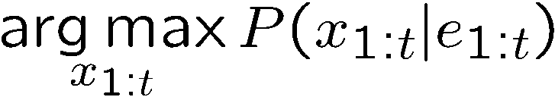
Best Explanation Queries
X₁
X₂
X₃
X₄
X₅
E₁
E₂
E₃
E₄
E₅
Query: most likely seq:

Slide 80





State Path Trellis
State trellis: graph of states and transitions over time
Each arc represents some transition
Each arc has weight
Each path is a sequence of states
The product of weights on a path is the seq’s probability
Can think of the Forward (and now Viterbi) algorithms as computing sums of all paths (best paths) in this graph
sun
sun
sun
sun
rain
rain
rain
rain

Slide 81
Viterbi Algorithm
sun
sun
sun
sun
rain
rain
rain
rain
22

Slide 82
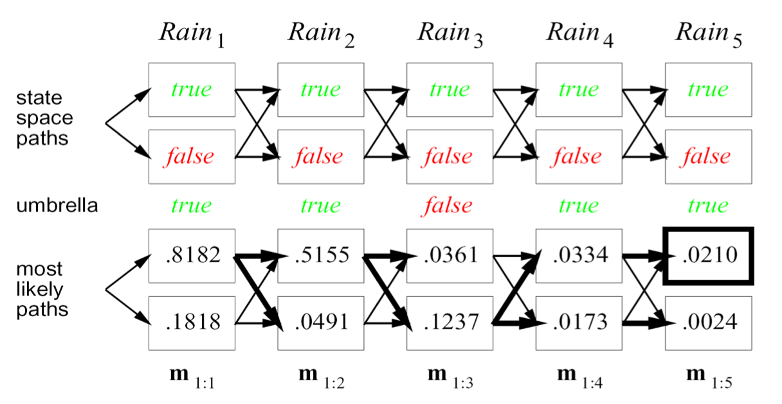
Example
23

