Slide 1
CSE 473 Markov Decision Processes
Dan Weld
Many slides from Chris Bishop, Mausam, Dan Klein,
Stuart Russell, Andrew Moore & Luke Zettlemoyer

Slide 2
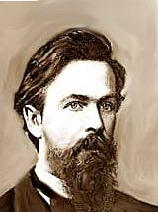
MDPs
Markov Decision Processes
Planning Under Uncertainty
Mathematical Framework
Bellman Equations
Value Iteration
Real-Time Dynamic Programming
Policy Iteration
Reinforcement Learning
Andrey Markov
(1856-1922)

Slide 3
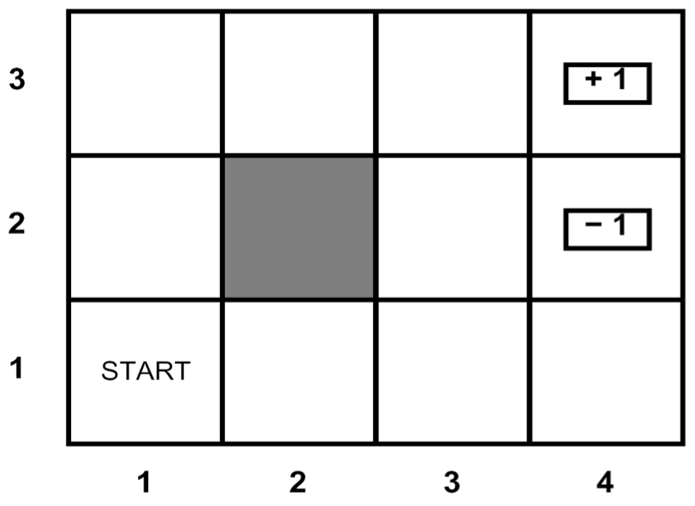
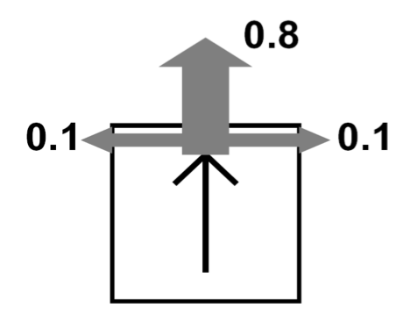
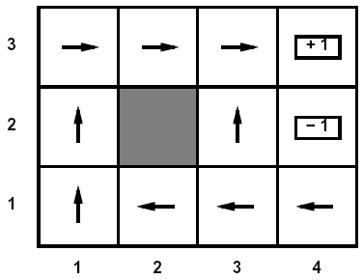
Recap: Defining MDPs
Markov decision process:
States S
Start state s₀
Actions A
Transitions P(s’|s, a)
aka T(s,a,s’)
Rewards R(s,a,s’) (and discount γ)
Compute the optimal policy, π*
π is a function that chooses an action for each state
We the policy which maximizes sum of discounted rewards

Slide 4
High-Low as an MDP
States:
2, 3, 4, done
Actions:
High, Low
Model: T(s, a, s’):
P(s’=4 | 4, Low) =
P(s’=3 | 4, Low) =
P(s’=2 | 4, Low) =
P(s’=done | 4, Low) = 0
P(s’=4 | 4, High) = 1/4
P(s’=3 | 4, High) = 0
P(s’=2 | 4, High) = 0
P(s’=done | 4, High) = 3/4
…
Rewards: R(s, a, s’):
Number shown on s’ if s’<s ∧ a=“high” …
0 otherwise
Start: 3
3
4
2
1/4
1/4
2
1/2
So, what’s a policy?
π : {2,3,4,D} → {hi,lo}

Slide 5
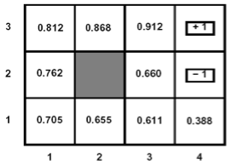
Bellman Equations for MDPs
<S, A, Pr, R, s_{0,} γ>
Define V*(s) {optimal value} as the maximum expected discounted reward from this state.
V* should satisfy the following equation:

Slide 6
Bellman Equations for MDPs
Q*(a, s)

Slide 7
Existence
If positive cycles, does v* exist?

Slide 8
Bellman Backup (MDP)
Given an estimate of V* function (say V_{n})
Backup V_{n} function at state s
calculate a new estimate (V_{n+1}) :
Q_{n+1}(s,a) : value/cost of the strategy:
execute action a in s, execute π_{n} subsequently
π_{n} = argmax_{a∈Ap(s)}Q_{n}(s,a)
R
V
γ
V
ax

Slide 9
Bellman Backup
Q₁(s,a₁) = 2 + γ 0
~ 2
Q₁(s,a₂) = 5 + γ 0.9~ 1
+ γ 0.1~ 2
~ 6.1
Q₁(s,a₃) = 4.5 + γ 2
~ 6.5
s₁
2
a₁
V₀= 0
V₁= 6.5
s₀
5
a₂
4.5
s₂
0.9
V₀= 1
a₃
0.1
a_{greedy} = a₃
s₃
V₀= 2
max

Slide 10
Value iteration [Bellman’57]
assign an arbitrary assignment of V₀ to each state.
repeat
for all states s
compute V_{n+1}(s) by Bellman backup at s.
until max_{s} |V_{n+1}(s) – V_{n}(s)| < ε
Iteration n+1
Residual(s)
Theorem: will converge to unique optimal values
Basic idea: approximations get refined towards optimal values
Policy may converge long before values do

Slide 11
Example: Value Iteration

Slide 12
Next slide confusing – out of order?
Need to define policy
We never stored Q* just value so where does this come from?

Slide 13
What about Policy?
Which action should we chose from state s:
Given optimal values Q?
Given optimal values V?
Lesson: actions are easier to select from Q’s!

Slide 14
Policy Computation
Theorem: optimal policy is
Stationary (time-independent)
Deterministic
for infinite / indefinite horizon problems
ax
ax
V
R
γ

Slide 15
Example: Value Iteration
Q₁(s_{3,},hi)=.25*(4+0) +
.25*(0+0) +
.5*0 = 1
hi
2
3
V₀(s₂)=0
V₀(s₃)=0
hi
hi
4
D
V₀(s₄)=0
V₀(s_{D})=0

Slide 16
Example: Value Iteration
Q₁(s_{3,},hi)=.25*(4+0) +
.25*(0+0) +
.5*0 = 1
Q₁(s_{3,},lo)=.5*(2+0) +
.25*(0+0) +
.25*0 = 1
V₁(s₃) = Max_{a} Q(s₃,a)
= Max (1, 1) = 1
lo
lo
2
3
V₀(s₂)=0
V₀(s₃)=0
lo
4
D
V₀(s₄)=0
V₀(s_{D})=0

Slide 17
Example: Value Iteration
2
3
V₀(s₂)=0
V₁(s₃)=1
4
D
V₀(s₄)=0
V₀(s_{D})=0

Slide 18
Example: Value Iteration
Q₁(s_{2,},hi)=.5*(0+0) +
.25*(3+0) +
.25*(4+0) = 1.75
hi
hi
2
3
V₀(s₂)=0
V₀(s₃)=0
hi
4
D
V₀(s₄)=0
V₀(s_{D})=0

Slide 19
Example: Value Iteration
Q₁(s_{2,},hi)=.5*(0+0) +
.25*(3+0) +
.25*(4+0) = 1.75
Q₁(s_{2,},lo)=.5*(0+0) +
.25*(0) +
.25*(0) = 0
V₁(s₂) = Max_{a} Q(s₂,a)
= Max (1, 0) = 1
lo
lo
2
3
V₀(s₂)=0
V₀(s₃)=0
lo
4
D
V₀(s₄)=0
V₀(s_{D})=0

Slide 20
Example: Value Iteration
2
3
V₁(s₂)=1.75
V₁(s₃)=1
4
D
V₁(s₄)=1.75
V₀(s_{D})=0

Slide 21
Next slides garbled

Slide 22
Round 2
Q₂(s_{3,},hi)=.25*(4+1) +
.25*(0+1) +
.5*0 = 1.5
hi
2
3
V₁(s₂)=1
V₁(s₃)=1
hi
hi
4
D
V₁(s₄)=1
V₁(s_{D})=0

Slide 23
Round 2
Q₁(s_{2,},hi)=.5*(0+0) +
.25*(3+0) +
.25*(4+0) = 1
Q₁(s_{2,},lo)=.5*(0+0) +
.25*(0) +
.25*(0) = 0
V₁(s₂) = Max_{a} Q(s₂,a)
= Max (1, 0) = 1
lo
lo
2
3
V₀(s₂)=0
V₀(s₃)=0
lo
4
D
V₀(s₄)=0
V₀(s_{D})=0

Slide 24
Example: Bellman Updates
Example: γ=0.9, living reward=0, noise=0.2
?
?
?
?
?
?
?
?
?
Notes:
first point: why all zeros and one ? (because you can find actions that guarentee you wont get the -1 and you are taking a max!)

Slide 25
Example: Value Iteration
V₁
V₂
Information propagates outward from terminal states and eventually all states have correct value estimates

Slide 26
Convergence
Define the max-norm:
Theorem: For any two approximations U and V
I.e. any distinct approximations must get closer to each other, so, in particular, any approximation must get closer to the true U and value iteration converges to a unique, stable, optimal solution
Theorem:
I.e. once the change in our approximation is small, it must also be close to correct

Slide 27
Value Iteration Complexity
Problem size:
|A| actions and |S| states
Each Iteration
Computation: O(|A|⋅|S|²)
Space: O(|S|)
Num of iterations
Can be exponential in the discount factor γ

Slide 28
Summary: Value Iteration
Idea:
Start with V₀*(s) = 0, which we know is right (why?)
Given V_{i}*, calculate the values for all states for depth i+1:
This is called a value update or Bellman update
Repeat until convergence
Theorem: will converge to unique optimal values
Basic idea: approximations get refined towards optimal values
Policy may converge long before values do

Slide 29
todo
Get sldies for labeled RTDP

Slide 30
Asynchronous Value Iteration
States may be backed up in any order
instead of an iteration by iteration
As long as all states backed up infinitely often
Asynchronous Value Iteration converges to optimal

Slide 31
Asynch VI: Prioritized Sweeping
Why backup a state if values of successors same?
Prefer backing a state
whose successors had most change
Priority Queue of (state, expected change in value)
Backup in the order of priority
After backing a state update priority queue
for all predecessors

Slide 32
Asynchonous Value Iteration Real Time Dynamic Programming [Barto, Bradtke, Singh’95]
Trial: simulate greedy policy starting from start state;
perform Bellman backup on visited states
RTDP: repeat Trials until value function converges

Slide 33
Why?
Why is next slide saying min

Slide 34
RTDP Trial
Q_{n+1}(s₀,a)
V_{n}
a_{greedy} = a₂
Min
V_{n}
?
a₁
V_{n}
Goal
a₂
V_{n+1}(s₀)
s₀
?
V_{n}
a₃
?
V_{n}
V_{n}
V_{n}

Slide 35
Comments
Properties
if all states are visited infinitely often then V_{n} → V*
Advantages
Anytime: more probable states explored quickly
Disadvantages
complete convergence can be slow!

